Slide 1
Last lesson REVISION
Insufficientia renalis chronica gr. IV.
Decubitus regionis ossis sacri et calcanei l. sin. gr. II.
St. p. amputationem pollicis et digiti III. manus l. dx. traumaticam
Gangraena digiti IV. et V. pedis l. sin.
St. p. fracturam vertebrae Th12 compressivam
St. p. fracturam costae l. sin. IV., V., VI. et VII. inveteratam
Pelvis renalis l. dx. et ureter l. dx duplex
Tumor lobi superioris pulmonis l. sin. triplex
Metastases hepatis multiplices susp.
Funiculus umbilicalis circum collum fetus 1x/2x/3x in grav. hebd. 40+4
Notes:
Abbreviations: gr. = gradus; l. sin/dx = lateris sinistri/dextri; Th
= vertebra thoracica duodecima; St.p. = status post; susp. = suspectae; in grav. hebd. = in graviditatis hebdomade

Slide 2
EXPLAIN THE MEANING OF DERIVED WORDS
digitatus
stimulus
DIGITUS
digitalis
STIMULARE
stimulans
digitiformis
stimulatio
capitulum
capitatus
CAPUT
cuticula
CUTIS
percutaneus
intercapitularis
mammarius
sterilisatio
MAMMA
mamilla
STERILIS
sterilitas
mamillaris
sterilisatus

Slide 3
TRANSLATE. EXPLAIN THE MEANING OF THE PREFIXES USED
Dolores in hypogastrio post operationem
Tu prostatae suspectus
Fibrillatio cordis chronica. Dyspnoe.
Haematoma periorbitale l. sin.
Infractio partis distalis ulnae susp.
Injectio antitetanica post vulnus morsum
Embolia arteriarum pulmonalium recidivans
St. p. resectionem ilei. St. p. excisionem tumoris pelvis minoris
Obstructio postinflammatoria auris l. dx.
Decubitus magni parasacrales

Slide 4
BASIC RULES OF COMPOUNDING
DERIVED WORDS BASIC ELEMENTS
Prefix
Root
Suffix
en- | -cephal- | -(on)
 | cephal- | -icus
en- | -cephal- | -itis
peri- -en- | -cephal- | -itis
peri- en- | -cephal- | -it- -icus

Slide 5
BASIC RULES OF COMPOUNDING
COMPOUND WORDS BASIC ELEMENTS
Prefix
Root
Connect-
ing vowel
Root
Suffix
en- | -cephal- | -o- | -spin- | -alis
cheil-o-gnath-o-palat-o-schis-is
ROOTS /Nouns, Verbal forms, Numerals
 | cerebr- | -o- | -spin- | -alis
en- | -cephal- | -o- | -graph- | -ia
 | cerebr- | -o- | cardi- | -acus
 | lact- | -i- | fer
 | prim- | -i- | -gravid- | (-a)

Slide 6
BASIC RULES OF COMPOUNDING
CONNECTING WOVELS (ELEMENTS)
Prefix(es)
Root 1
Connector
Root 2
Suffix(es)
en- | -cephal- | -o- | -graph- | -ia
 | falc- | -i- | -formis
 | bili- | -i- | -fer
 | secund- | -i- | -gravid- | (-a)
endo- | brachy- |  | -oesophag- | (-us)
 | cephal- |  | -alg- | -ia

Slide 7
FORM LATIN COMPOUND ADJECTIVES
Example: articulatio + (carpus+metacarpus) > articulatio carpometacarpalis
articulatio + (costa + vertebra)
articulatio + (metacarpus + phalanx)
articulatio + (sternum + costa)
ganglion + (cervix + thorax)
ganglion + (cranium + spina)
ganglion + (encephalon + spina)
ligamentum + (carpus + metacarpus)
ligamentum + (costa + clavicula)
ligamentum + (hepar + duodenum)
musculus + ( brachium + radius)
musculus + (cranium + spina)
musculus + (urethra + vagina)
costovertebralis
metacarpophalangea
sternocostalis
cervicothoracicum
craniospinale
encephalospinale
carpometacarpale
costoclaviculare
hepatoduodenale
brachioradialis
craniospinalis
urethrovaginalis

Slide 8
Anatomical structures and body liquids
Greek roots
see the list in Handout 4

Slide 9
NAME STRUCTURES ACCORDING TO DEFINITIONS,
TERMS SHOULD BE COMPOUND ADJECTIVES
The structure is the connection between the sacrum and coccyx; it is frequently a true joint, but often occurs as a synchondrosis, it is: ___________________ _______________________
articulatio sacrococcygea
Suture lateral to the nasal bone that connects the nasal portion of the frontal bone and the frontal process of the maxilla, is:
______________ _____________________
sutura frontomaxillaris
Epicanthus, is the skin fold of the upper eyelid covering the inner angle of the eye (i. e. on the side close to the nose), another Latin name for it is: ____________ ___________________
plica palpebronasalis
The pleural recess between the lateral wall of thorax (i. e. ribs) and the descending is sides of diaphragm and, is called:
____________ _______________________
recessus costodiaphragmaticus

Slide 10
NAME STRUCTURES ACCORDING TO DEFINITIONS,
TERMS SHOULD BE COMPOUND ADJECTIVES
Right or left opening between the atrium and ventricle is: ____________ ______________________
ostium atrioventriculare
The anterior part of the superficial fibers of the medial collateral ligament of the ankle joint, attached superiorly to the anterior surface of the medial malleolus of the tibia and inferiorly to the navicular bone is:
________ ____________________ __________________ ____________________
pars tibionavicularis ligamenti collateralis
The deep recess of the peritoneal cavity extending upward between the liver in front and the kidney behind is:
__________ ___________________
recessus hepatorenalis
One of facial lymph nodes situated near the junction of the superior labial and facial arteries, which drains the external nose and upper lip into the submandibular node is called: ____________ ____________________ ________________________
nodus lymphaticus nasolabialis

Slide 11

FILL IN MISSING COMPOUND WORDS
Each lung is enclosed within a sac (pleura), which has two layers. Normally there is no space within these two layers except for a thin film of lubricating fluid. In certain lung diseases, however, a space may be forced between these layers by the accumulation of fluid, called: _____________________, of blood, called: _____________________ or of air, called: _____________________;. Sometimes there is a combination of more factors, e.g. of air ad blood in pericardium : _____________________
fluidothorax
haemothorax
pneumothorax
haemopneumopericardium / pneumohaemopericardium
Abnormalities detected in the analysis of urine are common in clinical practice. Their evaluation can lead to detection of serious underlying diseases. Blood in urine, which is both frightening and well visible is called ___________________ . The presence of excess of serum proteins in urine is _________________, the presence of pus in urine is _____________________, and the excretion of glucose into urine is _____________________.
haematuria
proteinuria
pyuria
glycosuria
Notes:
Toto odpovídá task 5: ppt v hodině, task 5 za úkol doma (je to to samé naopak, ale i tak si nebudou pamatovat všechno)

Slide 12

On the contrary, if there is an excess of urea (one of te main components of urine: i.e. amino acid and protein metabolism products) in blood, we call the state _____________________ . Similarly, if there is alcohol in patient´s blood, the medical term is _____________________ ; if there are pus-forming bacteria in blood, the condition is called _____________________ . A condition of raised blood acidity (pH under 7.35) is then _____________________ ; if the blood volume is increased as a result of an increase in the water content of plasma, we call the state _____________________; and the pathological presence of copper in blood is then termed _____________________.
ur(a)emia
alcoholaemia
pyaemia
acidaemia
hydraemia
cupraemia

Slide 13
Expressing resemblance

Slide 14
FORM THE PHRASES AND MATCH THEM WITH SHAPES/LETTERS
os + cuboideus, a, um
musculus + deltoideus, a, um
articulatio + sphaeroideus, a, um
linea + trapezoideus, a, um
regio + ellipsoideus, a, um
ossa + sesamoideus, a, um
tuberculum + conoideus, a, um
musculus + rhomboideus, a, um
os + hyoideus, a, um
colon + sigmoideus, a, um
Δ
υ
Σ, C

Slide 15
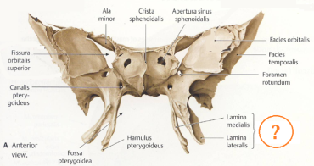
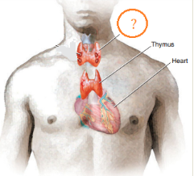
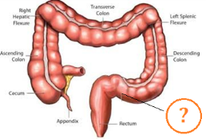
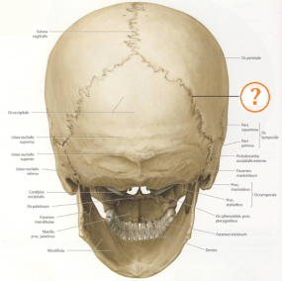
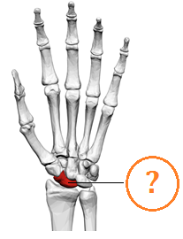
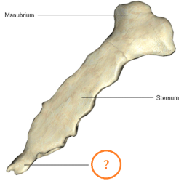
FIGURE OUT THE ANATOMICAL NAMES FOR THE FOLLOWING STRUCTURES BASED ON RESEMBLANCE
sigma (Greek letter Σ)
pteryx, gen. pterygos (wing):
thyros (shield)
colon sigmoideum
processus pterygoideus
glandula thyroidea
sutura lambdoidea
processus xiphoideus
os scaphoideum
lambda (Greek letter Λ):
skafe (boat):
xifos (sword):
Notes:
colon sigmoideum; processus pterygoideus; glandula thyroidea; sutura lambdoidea; os scaphoideum; processus xiphoideus

Slide 16
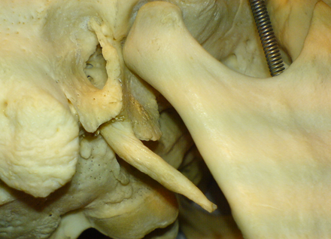
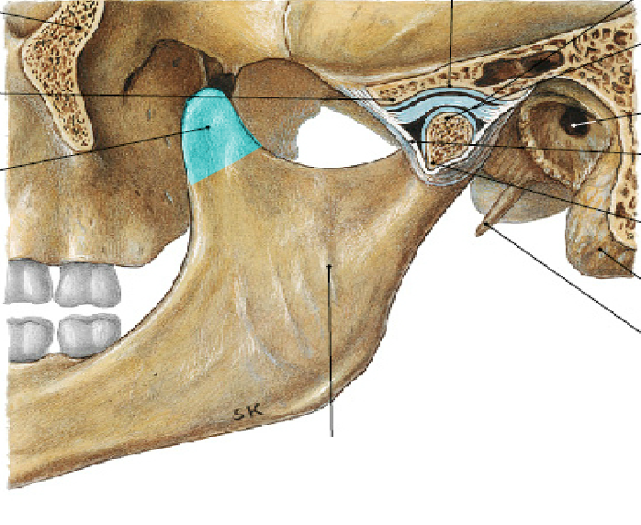
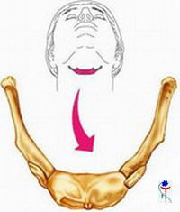
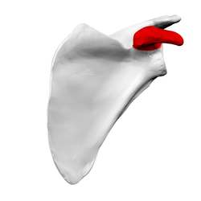
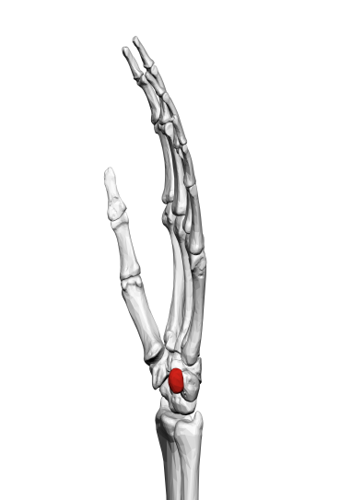
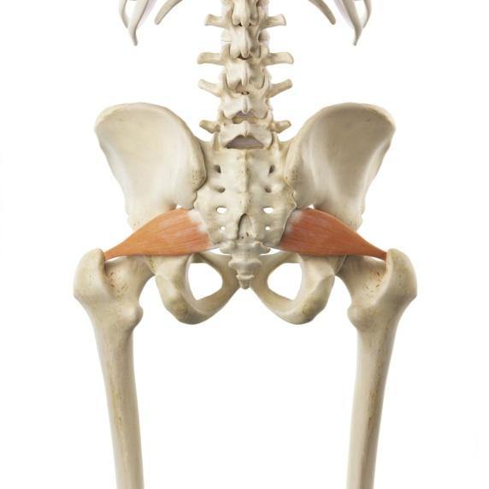
stylus (pen, writing tool)
corona (crown)
Greek letter υ
?
processus styloideus
processus coronoideus
os hyoideum
corax, gen. coracis (crow)
pisum, gen. pisi (pea)
pirum, gen. piri (pear)
processus coracoideus
os pisiforme
musculus piriformis
Notes:
Processus styloideus, processus coronoideus; os hyoideum; processus coracoideus; os pisiforme; musculus piriformis

Slide 17
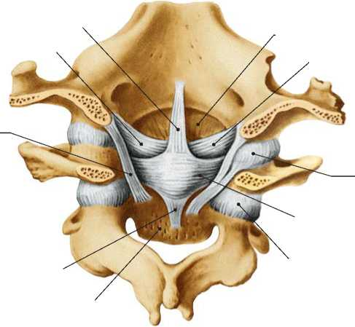
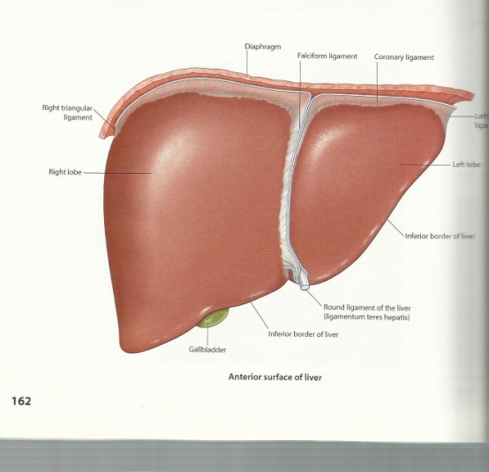
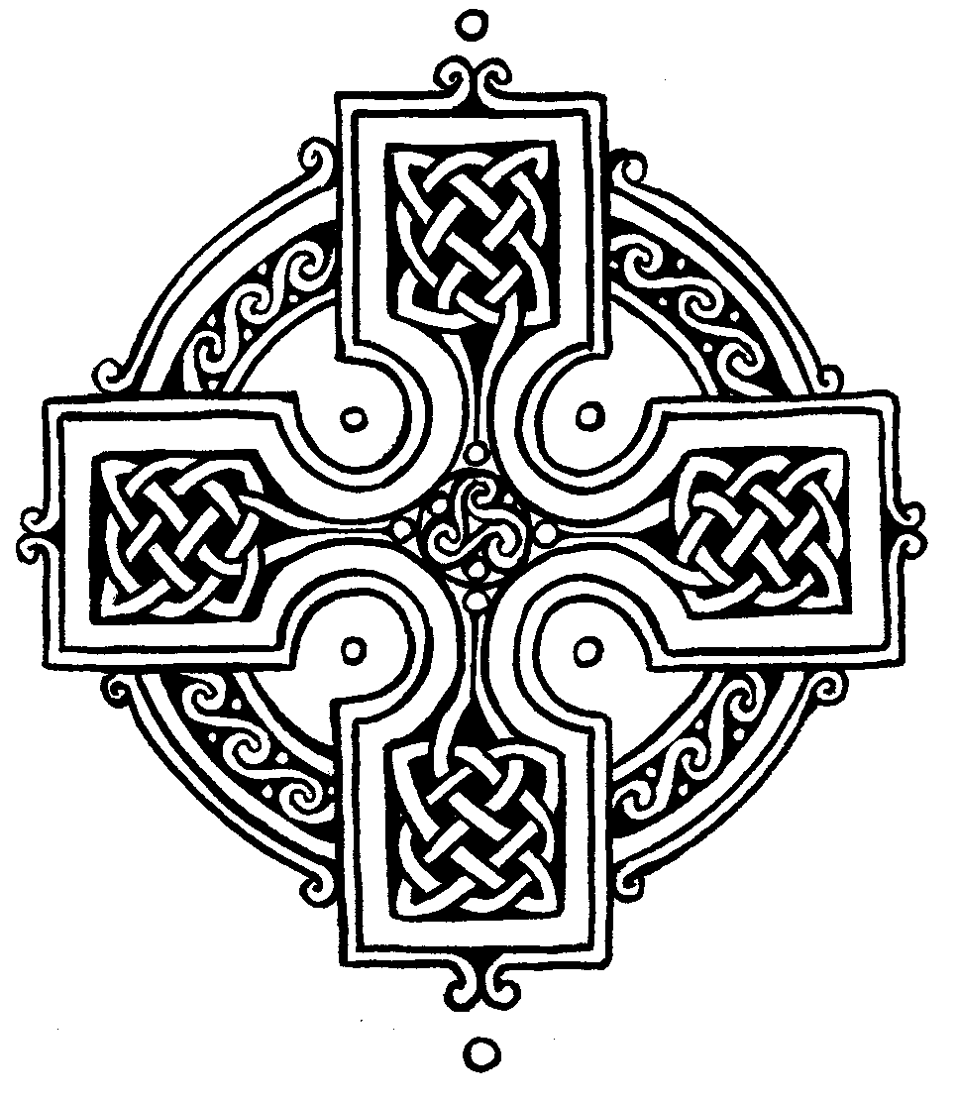
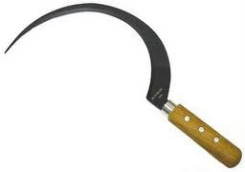
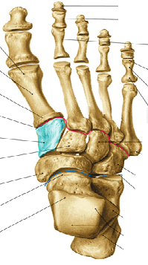
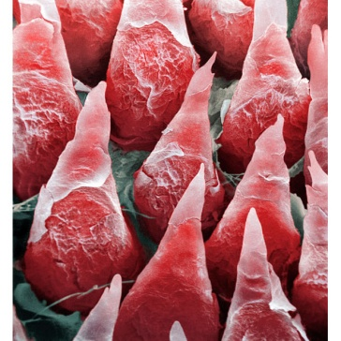
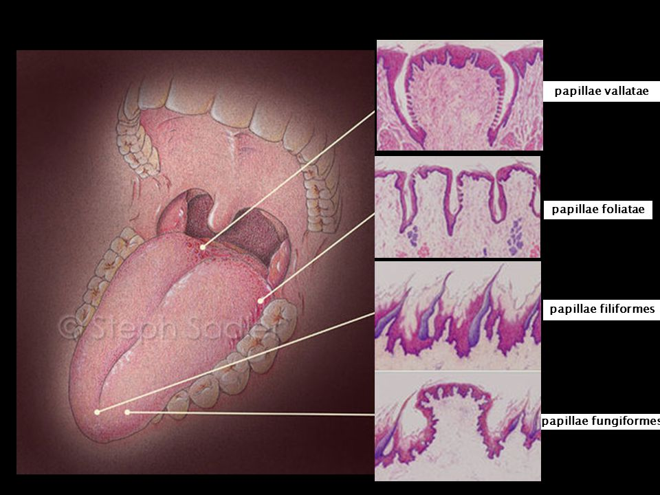
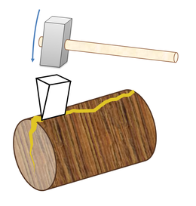
crux, gen. crucis (cross)
lig. ________________ atlantis
falx, gen. falcis (sickle)
lig. ______________ hepatis
cruciforme
falciforme
cuneus, gen. cunei (trig, wedge)
os___________________
filum, gen. fili (fibre)
papillae _________________ linguae
cuneiforme
filiformes

Slide 18
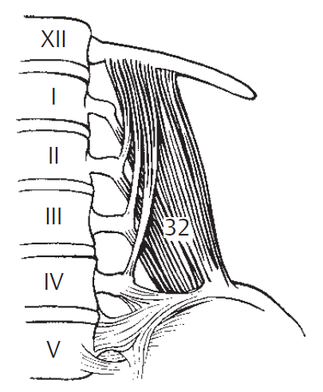
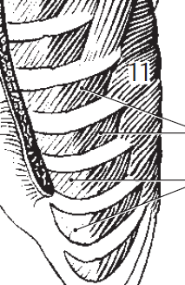
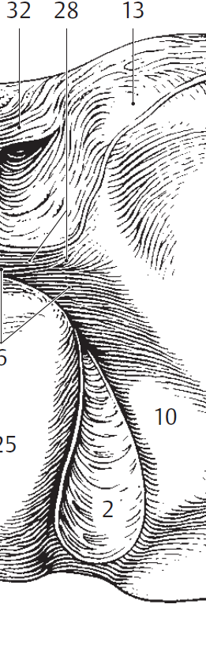
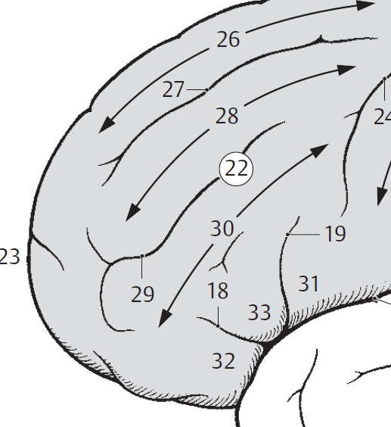
m. quadratus lumborum
m. serratus anterior
*serra, ae, f. = saw
pars triangularis
(gyri frontalis inferioris)
processus caudatus (hepatis)
* ≠ caudalis, e!!

Slide 19
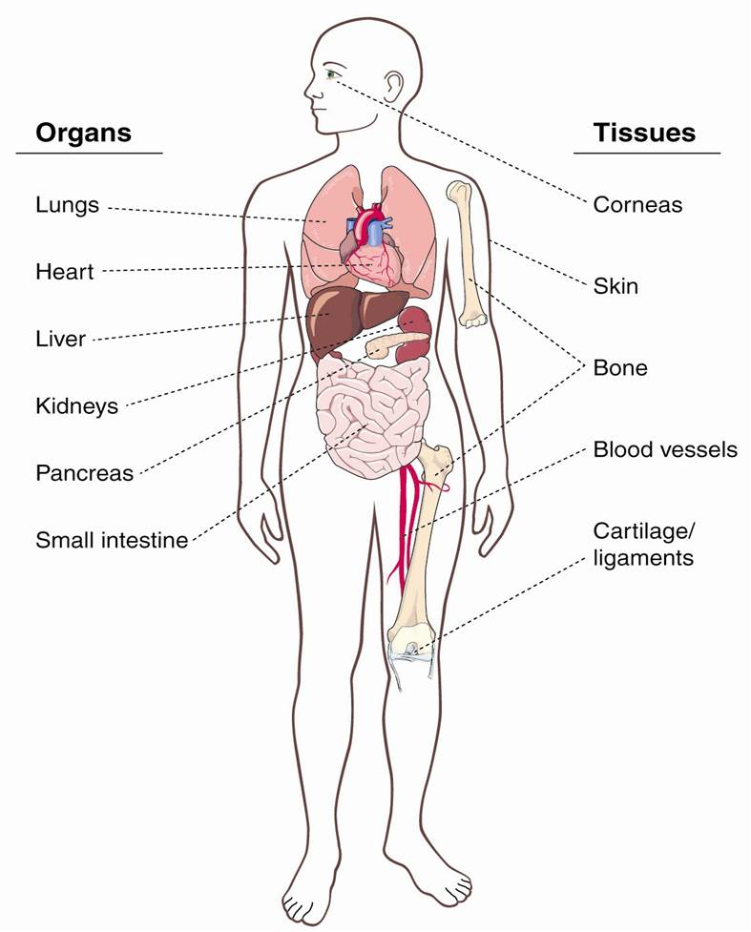
NAME GREEK ELEMENTS OF SELECTED BODY PARTS
DERIVE TERMS FOR INFLAMMATIONS
Pneum-(on)
Ophthalm-
Eye
Cardi-
Derm-(at)-
Hepat-
Ost-(e)-
Nephr-
Pancreat-
Angi-
Enter-
Chondr-

Slide 20
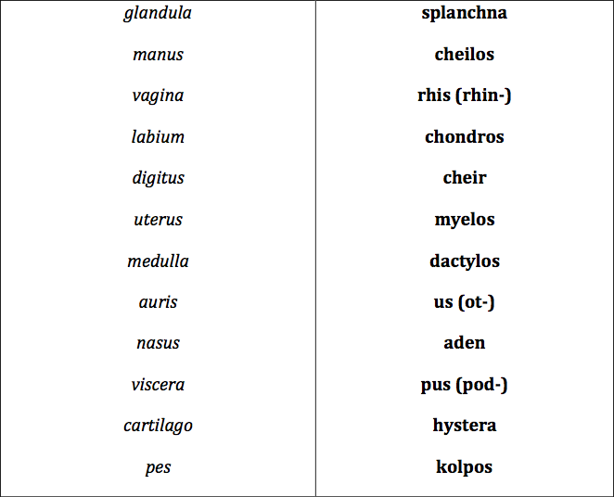
MATCH GREEK ELEMENTS WITH LATIN EQUIVALENTS

Slide 21
GIVE LATIN EQUIVALENTS (FULL FORM) TO GREEK ELEMENTS
mys………………….
osteon……………..
arthron……………
spondylos………..
gony………………..
stoma………………
soma……………….
kefale………………
MUSCULUS, I, M.
OS, OSSIS, n.
ARTICULATIO, ONIS, F.
VERTEBRA, AE, F.
GENU, US, N.
OS, ORIS, N.
CORPUS, ORIS, N.
CAPUT, ITIS, N.

Slide 22
NAME GREEK ELEMENTS WHICH CORRESPOND WITH LATIN WORDS
VAS
VENA
COR
REN
VESICA
LINGUA
MAMMA
CUTIS
ANGEION
FLEPS
KARDIA
NEFROS
KYSTIS
GLOTTA
MASTOS
DERMA
Notes:
Angiospasmus
Angioplastica
Phlebographia
Phlebothrombosis
Cardiothoracicus
Cadriopneumographia
Nephrectomia
Nephroureterectomia
Cystostomia
Cystotomia
Glossectomia
Glossopalatinus
Dermatomyositis
dermatoplastica

Slide 23
MATCH DEFINITIONS WITH GREEK ROOTS
The benign tumor made up of newly formed blood vessels is ?
Py-
The burning sensation caused by the return of acidic stomach contents into the oesophagus is called heartburn or ?
Pyr-
Lith-
Condition in which excess cerebrospinal fluid accumulates in the ventricles of the brain is ?
Haem-angi-
The surgical removal of fat beneath the skin is ?
Hydr-
An accumulation of pus in the Fallopian tube is ?
The surgical removal of a kidney stone through an incision into the kidney is ?
Lip-
Ur-
A toxic condition resulting from renal failure in which kidney function is compromised and urea is retained in the blood is ?
Notes:
Haemangioma – pyrosis - hydrocephalus – lipectomia - Pyosalpinx – Nephrolithectomia – Uraemia -

