Slide 1
Revision

Slide 2
???
How many declensions are there in Latin?
How do you decide on the declension of a noun?
  According to the genitive ending of the noun.
What are the Genitive endings of particular cases?
  1st -ae; 2nd -i; 3rd -is; 4th -us; 5th -ei
What is Genitive stem and how do you recognize it?
  a stem is a form to which affixes can be attached
  we take genitive form and we remove the genitive ending
    vena, ven-ae
    musculus, muscul-i; diameter, diametr-i
    auris, aur-is; corpus, corpor-is
    arcus, arc-us; genu, gen-us
    facies, faci-ei

Slide 3
Determine the stem of the following nouns and their declension:
E.g.: Nom.Sg. – cornu, Gen. Sg.–cornus, the stem – corn, the 4th declension.
cornu, us n _____________
systema, atis n_____________
paries, etis m_____________
articulatio, onis f _____________
oedema, atis n _____________
vertebra, ae f _____________
morbus, i m ______________
processus, us m _____________
facies, ei m _____________
tendo, inis m _____________
os, ossis n _____________
caries, ei f _____________
mandibula, ae f _____________
lac, lactis n _____________
remedium, ii n _____________
sanguis, inis m _____________
pars, partis f _____________

Slide 4
How do neuters behave?
  Nominative and accusative are identical in both singular and plural
  Nominative plural ending is -a
What is the function of Genitive?
  It expresses dependency of two nouns, possession
  It is translated into English using „of“
How does a word behave after a preposition?
  Its accusative or ablative form is used
Name 5 prepositions connected with accusative and 5 with ablative.
  Accusative – ad, post, ante, propter, inter, per, prope, contra, intra, extra
  Ablative – a/ab, cum, sine, e/ex, pro
  Both cases – in, sub

Slide 5
Adjectives
Latin adjectives are declined according to what paradigms:
  1st and 2nd declension: bonus, a, um
    Like paradigms nervus (m.), vena (f.),septum (n.)
  3rd declension: acer, acris, acre; brevis, e; simplex, simplicis
    Like paradigms auris (m.+f.) and rete (n.)
    Ablative singular has ALWAYS ending - i
Latin adjective has to match the noun in...?
  gender, case, number
  thus the endings do NOT have to look the same!
    diabetes mellitus, gen.: diabetae melliti
    rete venosum, gen.: retis venosi
    vulnus lacerum, gen.: vulneris laceri
    manus dextra, gen.: manus dextrae
    etc...

Slide 6
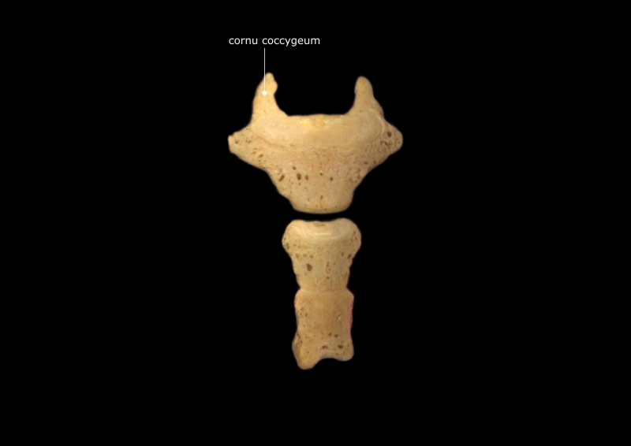
cornu, us n (coccygeus, a, um)
cornu coccygeum - coc·cyg·e·al cornu - two processes that project upward from the dorsum of the base of the coccyx to articulate with the sacral cornua. Synonym(s): cornu coccygeum, coccygeal horn, cornua coccygealia

Slide 7
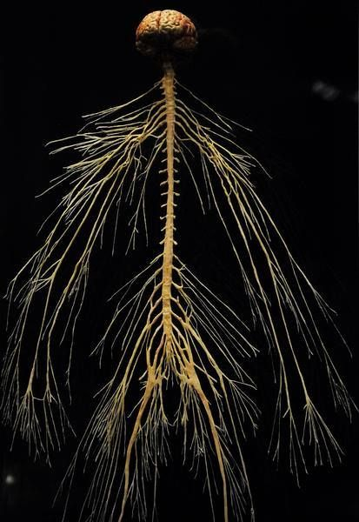
systema, atis n (nervosus,a, um)
Systema nervosum - nervous system - the organ system that, along with the endocrine system, correlates the adjustments and reactions of an organism to internal and environmental conditions.

Slide 8
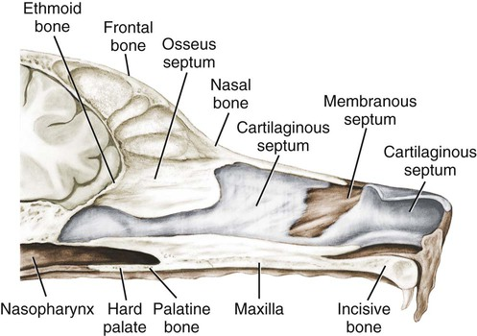
Septum nasi, i n (osseus, a, um)
Septum nasi osseum – bony nasal septum - the bones supporting the bony part of the nasal septum; these are the perpendicular plate of the ethmoid, the vomer, the sphenoidal rostrum, the crest of the nasal bones, the frontal spine, and the median crest formed by the apposition of the maxillary and palatine bones.

Slide 9
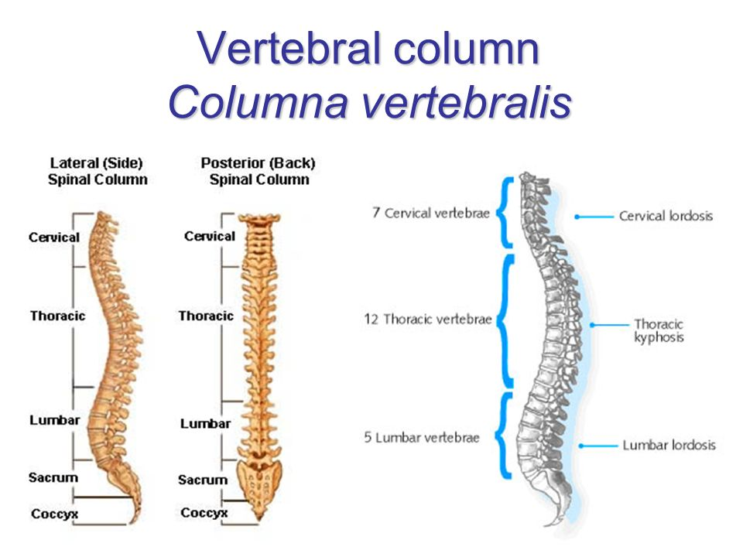
columna, ae f (vertebralis,e)
Columna vertebralis - vertebral column - the series of vertebrae that extend from the cranium to the coccyx, providing support and forming a flexible bony case for the spinal cord. Synonyms: columna vertebralis, spine, backbone, dorsal spine, rachis, spina dorsalis, spinal column, vertebrarum

Slide 10
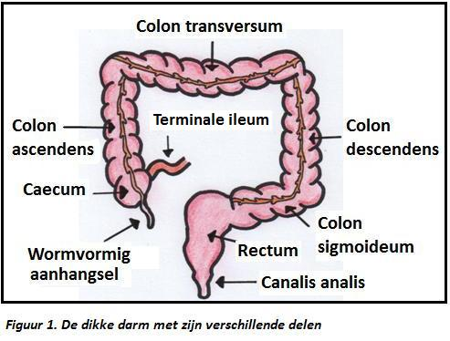
colon, i n (transversus, a, um)
Colon transversum - transverse colon - The part of the colon that lies across the upper part of the abdominal cavity.

Slide 11
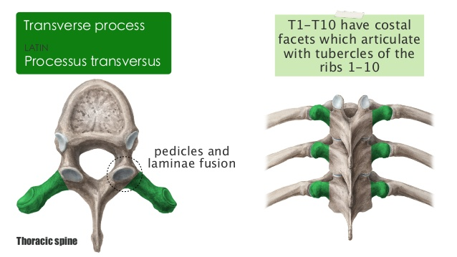
processus, us m (transversus, a, um) vertebrae
Processus transversus vertebrae - transverse process of vertebra - a bony protrusion on either side of the arch of a vertebra, from the junction of the lamina and pedicle, which functions as a lever for attached muscles.

Slide 12
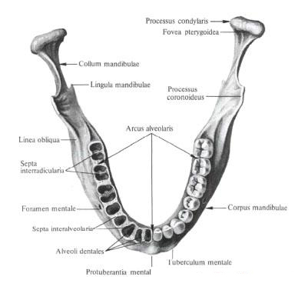
arcus, us m (alveolaris, e)
Arcus alveolaris – alveolar arch - the part of the upper or lower jawbones in which the teeth are set

Slide 13
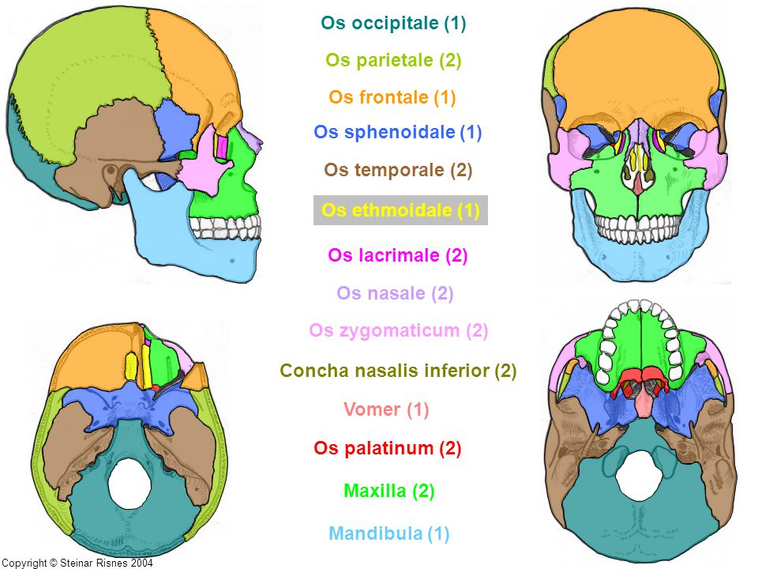
os, ossis n (ethmoidalis,e)
Os ethmoidale - ethmoid bone - an irregularly shaped bone lying between the orbital plates of the frontal bone and anterior to the sphenoid bone of the cranium

Slide 14
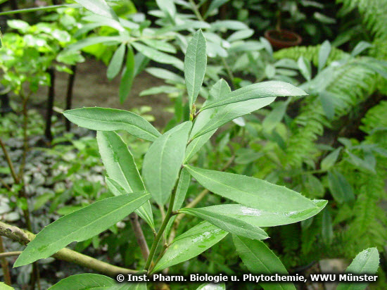
folium, i n (viridis, e)
Folium viride – green leaf

Slide 15
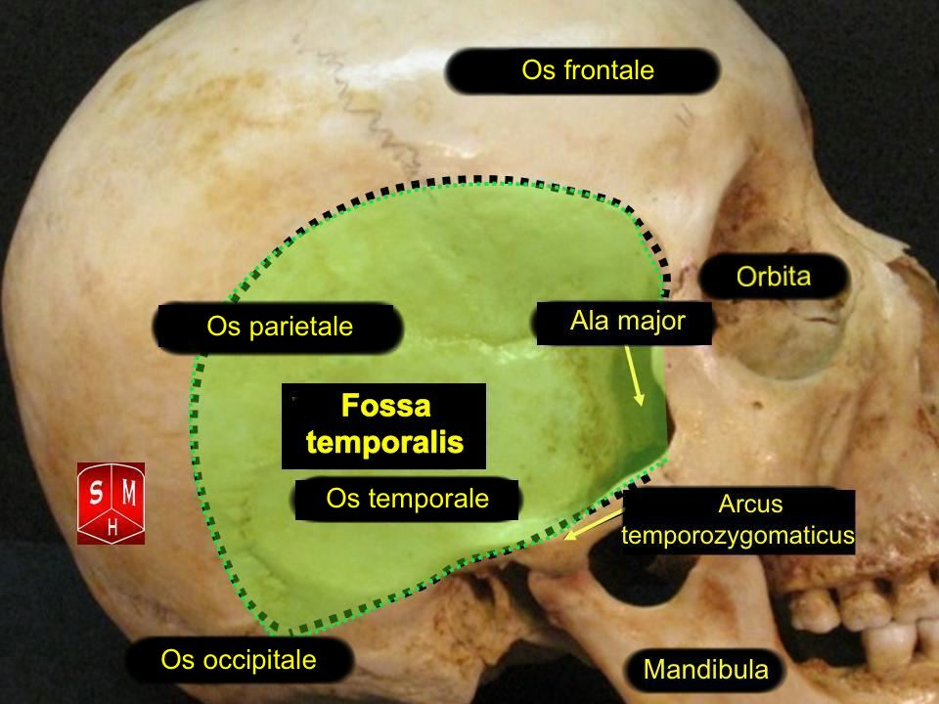
facies, ei f (temporalis, e)
Facies temporalis - temporal surface - the surface of a bone that contributes to the formation of the temporal fossa

Slide 16
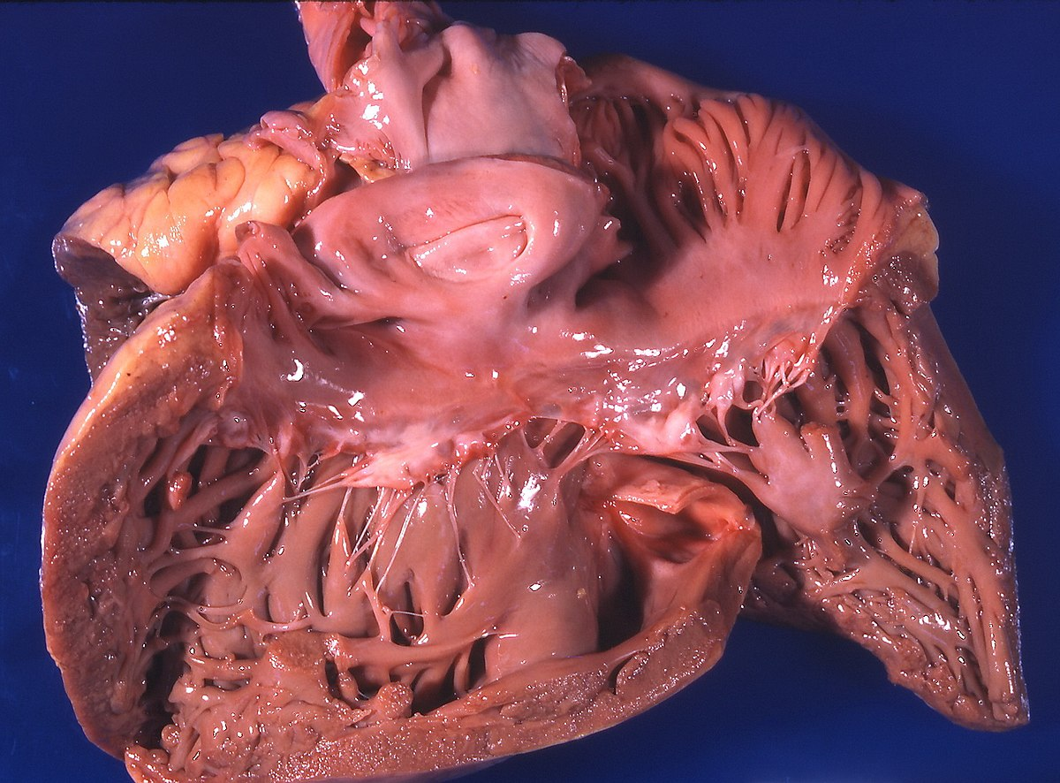
cor, cordis n (pulmonalis, e)
Cor pulmonale - pulmonary heart disease is an increase in bulk of the right ventricle of the heart, generally caused by chronic diseases or malfunction of the lungs. This condition can lead to heart failure.

Slide 17
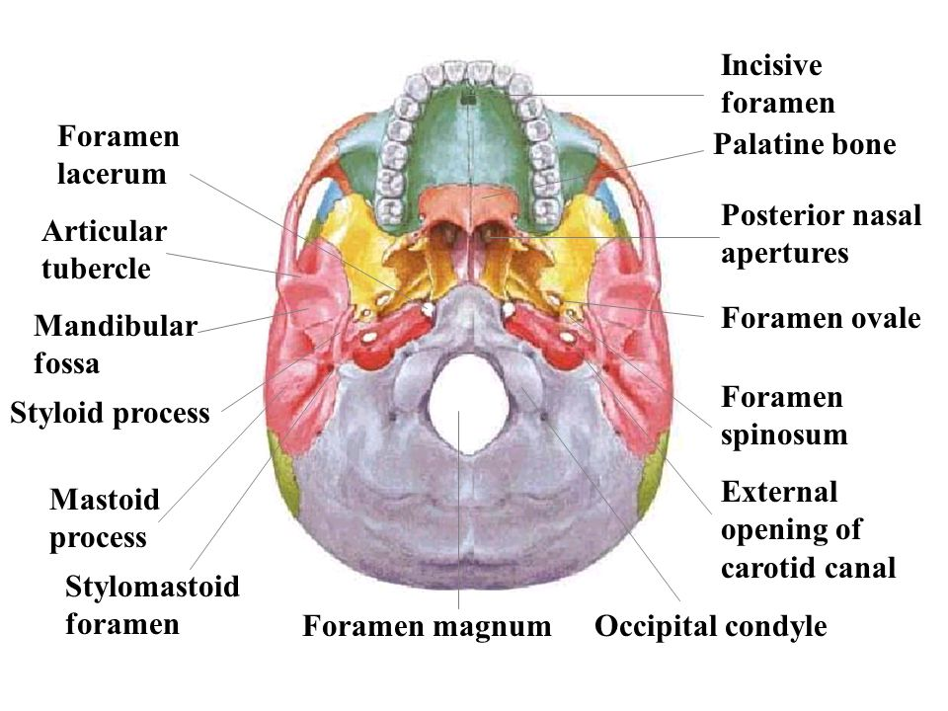
apertura, ae f (externus, a, um)
Apertura externa – external opening – e.g. apertura externa canalis carotici - external opening of carotid canal - a roughly circular opening on the inferior surface of the petrous portion of the temporal bone by which the internal carotid artery enters the carotid canal

Slide 18
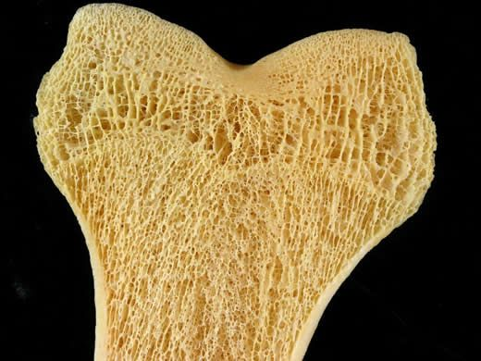
tela, ae f (spongiosus, a, um)
Tela spongiosa - the part of a bone (as much of the epiphyseal area of long bones) made up of spongy cancellous bone

Slide 19
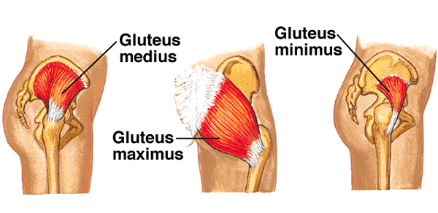
musculus, i m (glutaeus, a ,um)
Musculus glutaeus – gluteal muscle - any of the three muscles that form the buttocks: the gluteus maximus, gluteus medius, and gluteus minimus.

Slide 20
Confusing words I
Tell the difference between the words and make up illustrative phrases:
  dislocatio, onis, f. X dislocatus, a, um
    fractura costae verae secundae l.sin. dislocata
    dislocatio articulationis sacroiliacae l.dx.
  ruptura, ae, f. X ruptus, rupta, ruptum
    ruptura tendinum manus dextrae
    sutura parietis vaginae ruptae post partum
  perforatio, onis, f. X perforatus, a, um/perforans, ntis
    perforatio parietis gastris propter ulcus
    ulcus duodeni perforatum/perforans
  suspicio, onis f. X suspectus, a, um
    suspicio carcinomatis mammae l.sin.
    Infractio partis distalis tibiae l.dx. suspecta

Slide 21
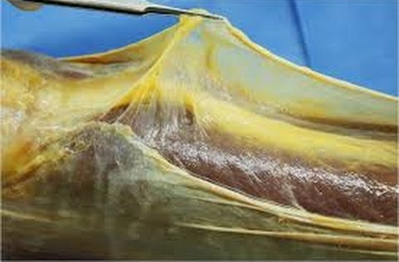
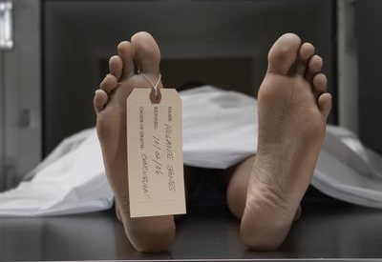
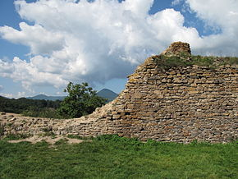
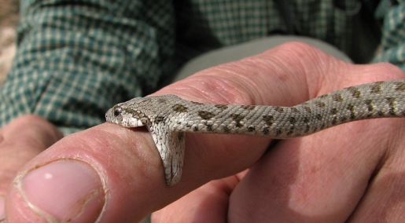
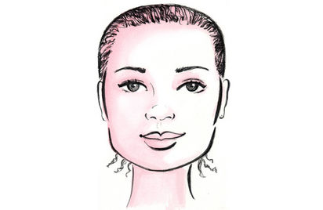
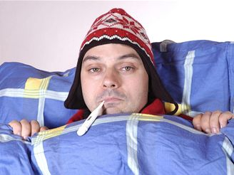

Confusing words II
Match the nouns with the pictures
morsus
paries
pars
mors
facies
morbus
fascia

Slide 22
Confusing words II
Match the nouns with the pictures
fascia, ae, f.
mors, tis, f.
paries, etis, m.
morsus, us, m.
facies, ei, f.
pars, tis, f.
morbus, i, m.
Notes:
ať studenti teď zkusí vytvořit nějaké fráze

Slide 23
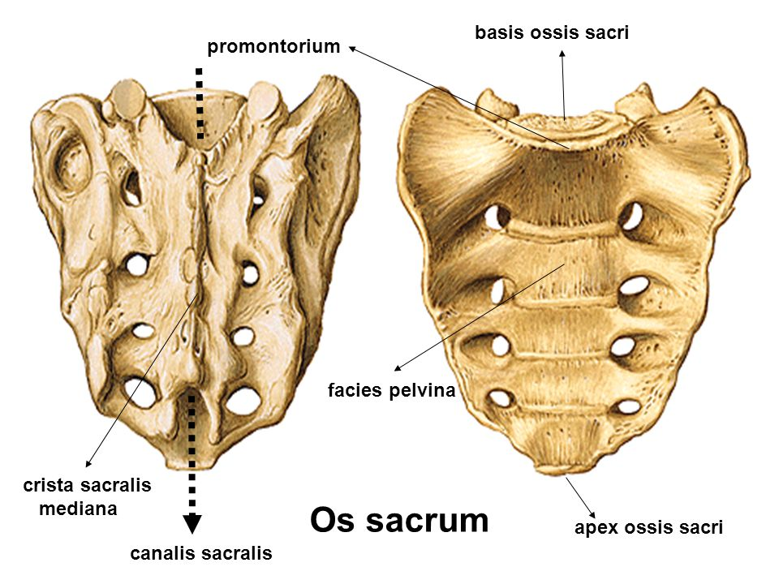
Translate
rupture of the wide fascia
  ruptura fasciae latae
death after an animal bite
  mors post morsum animalis
parts of a gall bladder
  partes vesicae felleae
pelvic surface of sacral bone
  facies pelvina ossis sacri
infectious diseases
  morbi contagiosi
perforation of the wall of the stomach
  perforatio parietis gastris

Slide 24
Form phrases from words in boxes and translate them into English
medicamenta contagiosum
morbum
contra
medicamenta contra morbum infectiosum
medicaments against infectious disease
acutus
pulmonis
dolor
dextri
dolor acutus pulmonis dextri
acute pain of right lung
symptomata
hepatitidis
acutae
symptomata hepatitidis acutae
symptoms of acute inflammation of the liver
collapsus
periculum
digestorii
systematis
periculum collapsus systematis digestorii
danger of a collapse of the digestive system

