Slide 1
Revision of 1st and 2nd declension

Slide 2
Translate and form reqired cases
 | wide ligament | mucous membrane | long period
nom. sg.
gen. sg.
acc. sg.
nom. pl.
gen. pl.
abl. pl.

Slide 3
 | wide ligament | mucous membrane | long period
nom. sg. | ligamentum latum | tunica mucosa | periodus longa
gen. sg. | ligamenti lati | tunicae mucosae | periodi longae
acc. sg. | ligamentum latum | tunicam mucosam | periodum longam
nom. pl. | ligamenta lata | tunicae mucosae | periodi longae
gen. pl. | ligamentorum latorum | tunicarum mucosarum | periodorum longarum
abl. pl. | ligamentis latis | tunicis mucosis | periodis longis

Slide 4
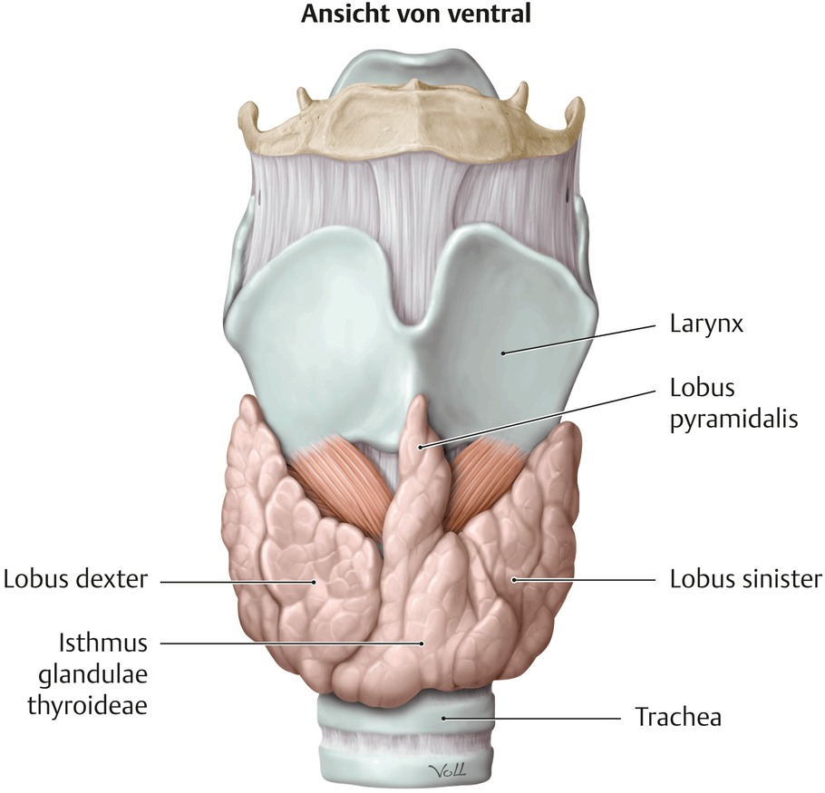
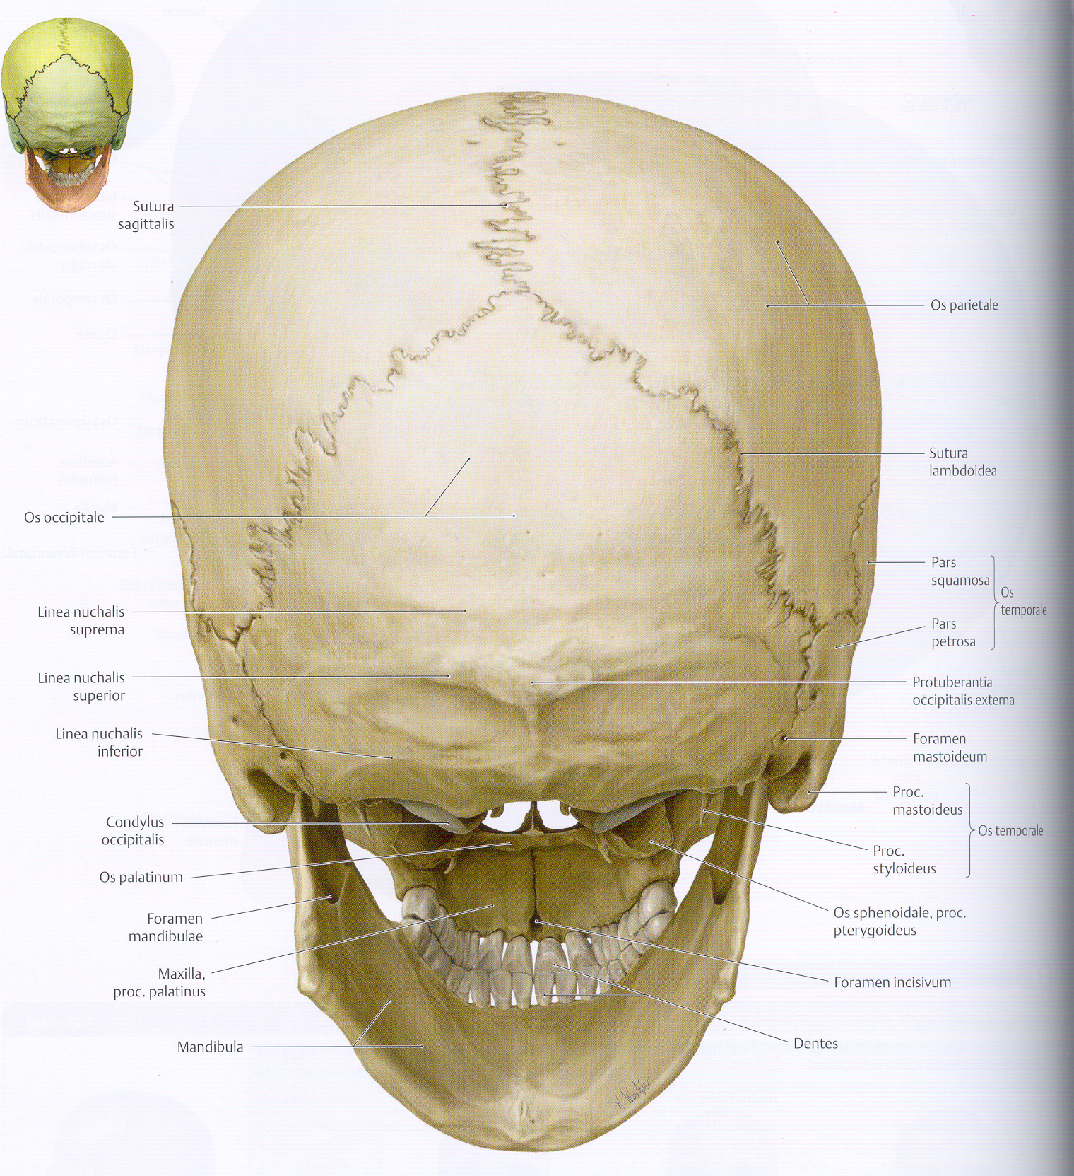
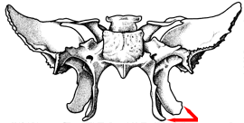
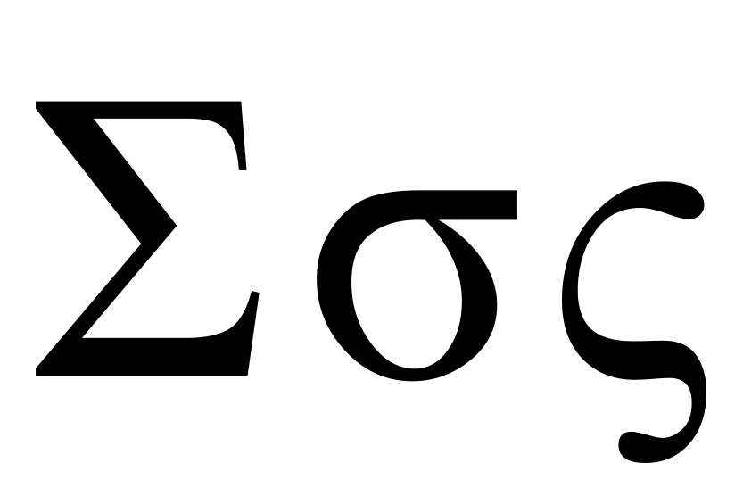
Adjectives ending in –oideus, a, um
Derived from Greek τὸ εἶδος „shape, picture“
processus pterygoideus
glandula thyroidea
colon sigmoideum
sutura lambdoidea
θυρεός = shield
πτέρυξ = bird wing

Slide 5
Translate
rupture of pterygoid muscle
ruptura musculi pterygoidei
rupture of pterygoid muscles
ruptura musculorum pterygoideorum
cancer of sigmoid colon
cancer / carcinoma coli sigmoidei
lobes of thyroid gland
Lobi glandulae thyroideae
anomaly of lambdoid suture
anomalia suturae lambdoideae

Slide 6
Correct the mistakes
massa pro suppositoria
in periodo longo
in hilo ovario
tuberculi costarum
mixtura cum ricini olei
post fracturam coste
nuclei ruberi
in ostio venae cavo
suppositoriis
longa
ovarii
tubercula
oleo
costae
rubri
cavae

Slide 7
3rd declension

Slide 8
3rd declension: characteristic features
Nouns of all three genders
abductor, ōris, m.
pelvis, is, f.
forāmen, inis, n.
Nom. sg. – various endings
Gen. sg. – always –is
The base for forming all other cases is genitive stem
we gain genitive stem when we remove ending -is from gen. sg.
abductor, abductōris -> abductōr-
pelvis, pelvis -> pelv-
forāmen, forāminis -> forāmin-

Slide 9
What is the genitive stem of following nouns
corpus, oris, n.
cutis, is, f.
caput, itis, n.
os, oris, n.
pollex, icis, m.
femur, oris, n.
frons, frontis, f.
auris, is, f.
corpor-
cut-
capit-
or-
pollic-
femor-
front-
aur-
cervix, icis, f.
pectus, oris, n. abdomen, inis, n.
crus, cruris, n.
pes, pedis, m.
hallux, ucis, m.
cervic-
pector-
abdomin-
crur-
ped-
halluc-

Slide 10
2 types of stems
Nouns of 3rd declension are divided into two types:
a) i-stems
masculines a feminines:
Having the same number of syllables in nominative and genitive singular:
a-xis, a-xis, m.
pub-ēs, pub-is, f.
Having 2 consonants preceeding the ending –is in the genitive singular:
dens, dentis, m.
pars, partis, f.
Neutrals:
nom. sg. ending in -e, -al or -ar (help: areal), there are only 4 of them:
rēte, rētis, n.; animal, ālis, n.; calcar, calcāris, n.; cochlear, aris, n.
b) consonant stems (all the rest)
pulmō, pulmōnis, m. ; cervīx, cervīcis, f.; abdōmen, abdōminis, n.

Slide 11
Maskulines and feminines
i-stem: pelvis, is f.
Consonant stem: dolor, oris, m.
the only difference between these two paradigms is genitive plural:
pelvium X dolorum
case | singular | plural
nom. | pelvis | pelv-ēs
gen. | pelvis | pelv-ium
ak. | pelv-em | pelv-ēs
abl. | pelv-e | pelv-ibus

Slide 12
Maskulines and feminines

Slide 13
Neutrals
case | singular | plural | singular | plural
nom. | rēte | rēt-ia | corpus | corpor-a
gen. | rēt-is | rēt-ium | corpor-is | corpor-um
ak. | rēte | rēt-ia | corpus | corpor-a
abl. | rēt-ī | rēt-ibus | corpor-e | corpor-ibus
abl. sg. (rētī X corpore),
nom.+acc. pl. (rētia X corpora)
gen. pl. (rētium X corporum)
Exceptions:
os, ossis n. (bone): gen. pl.: ossium
vās, vāsis n. (vesel): is in plural declined like septum: vāsa, vāsōrum...

Slide 14
Neutrals

Slide 15
Neutrals

Slide 16
What is the paradigm for following nouns?
cutis, is, f.
caput, itis, n.
os, oris, n.
pollex, icis, m.
femur, oris, n.
frons, frontis, f.
cut-
capit-
or-
pollic-
femor-
front-
auris, is, f.
cervix, icis, f.
pectus, oris, n. abdomen, inis, n.
crus, cruris, n.
pes, pedis, m.
hallux, ucis, m.
aur-
cervic-
pector-
abdomin-
crur-
ped-
halluc-

Slide 17
Example of declining noun from 3rd declension with 1st and 2nd declension adjective
Singular | Plural
margō liber | marginēs liberī
marginis liberī | marginum liberōrum
marginem liberum | marginēs liberōs
margine liberō | marginibus liberīs
Singular | Plural
cochlear parvum | cochleāria parva
cochleāris parvī | cochleārium parvōrum
cochlear parvum | cochleāria parva
cochleārī parvō | cochleāribus parvīs

Slide 18
Decline:
os longum
cavitas magna
rete venosum
canalis palatinus

