Slide 1
PHARMACOKINETICS

Slide 2
Basic principles of pharmacokinetics
Pharmacokinetics is aimed on this processes: absorption
distribution
biotransformation
excretion of drugs
and their relation to pharmacologic (therapeutic or toxic) effects

Slide 3
Pharmacokinetics
absorption A distribution D metabolism M excretion E
processes of ADME
invasion
“ADME“
elimination

Slide 4
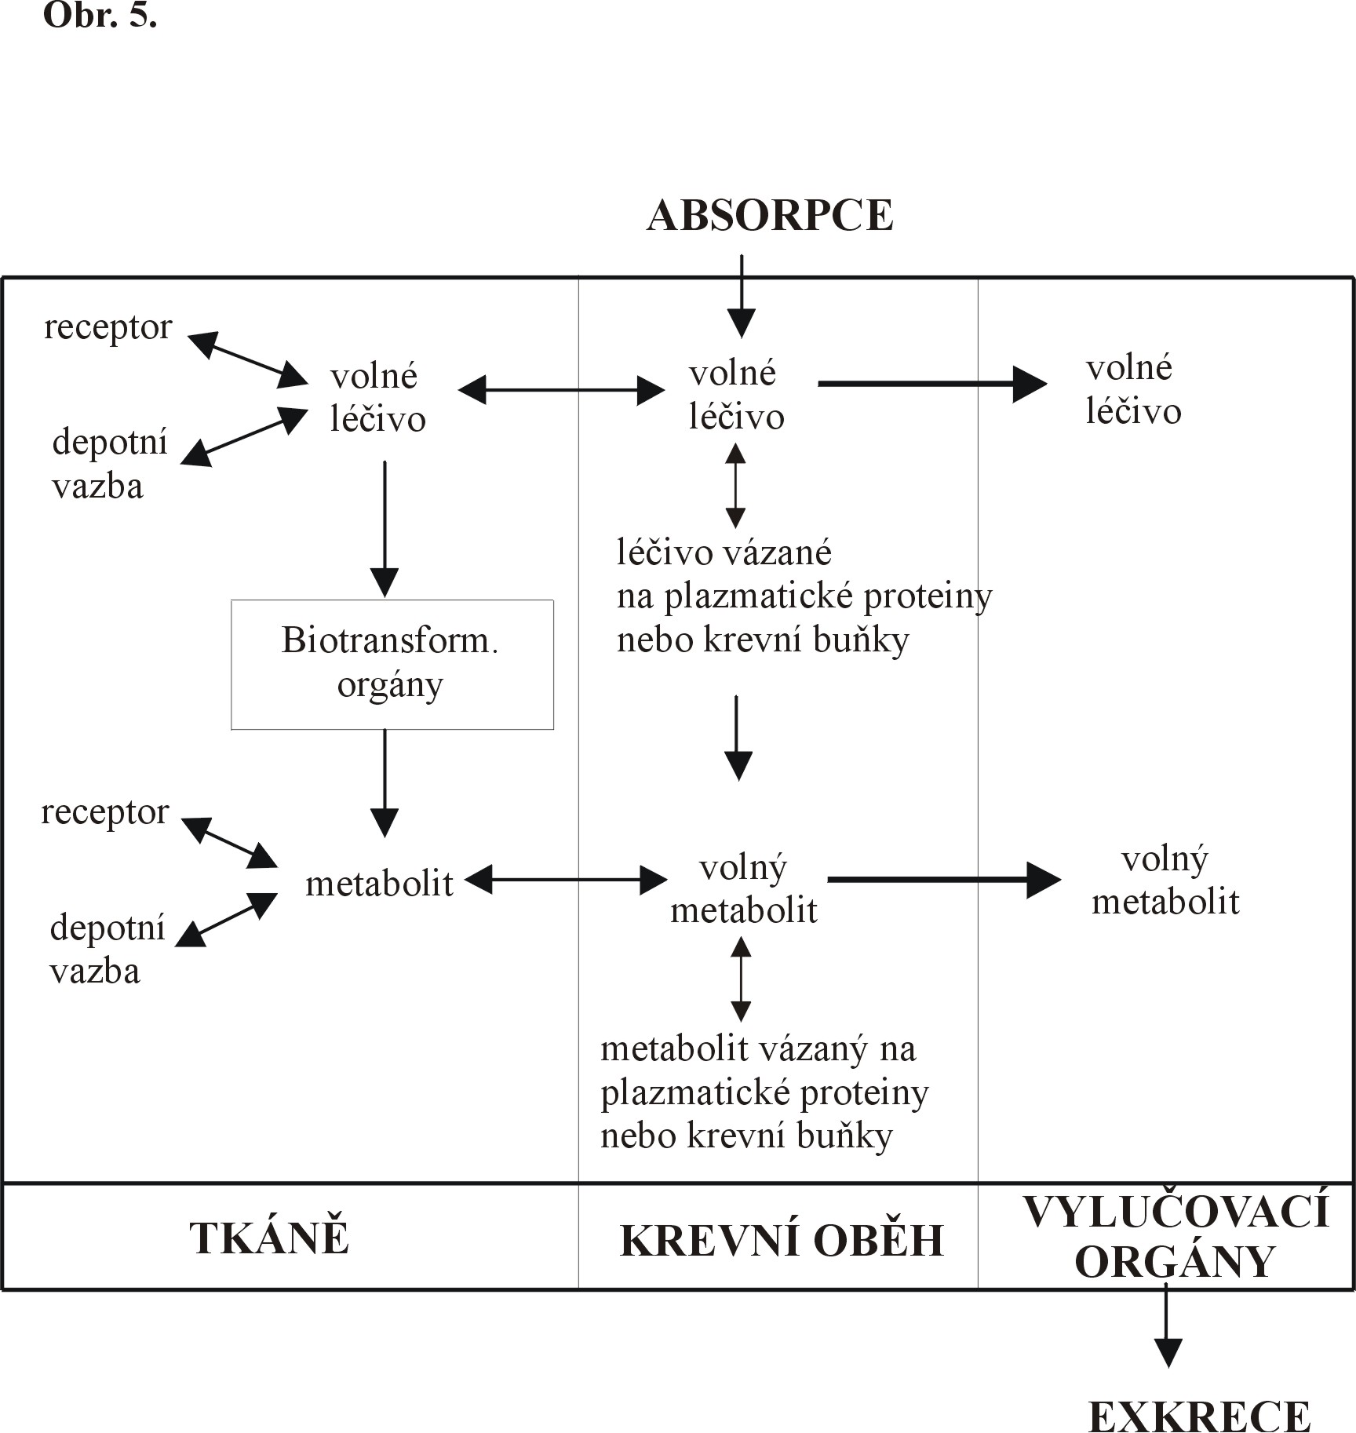
Administration of drug
Absorption
receptor
free
drug
free
drug
free
drug
depot
binding
drug bound to proteins or blood cells
Biotransformation
organs
receptor
metabolite
free
metabolite
free
metabolite
depot
binding
metabolite
bound to protein
or blood cell
TISSUES
BLOOD CIRCULATION
ORGANS OF
EXCRETION
EXCRETION

Slide 5
General rules for drug movement
Physical-chemical characteristic of drug
lipophilic vs hydrophilic, size, charge, pKa, solubility
Drug transmission through biological barriers
lipophilic - pasive diffusion
hydrophilic- pore transmission
active transport
vesicular transport – pinocytosis, phagocytosis
Drug binding
plasmatic proteins
blood cells
tissue binding
receptor binding
Tissue perfusion
brain, heart, liver and kidney
adipose tissue

Slide 6
Stomach pH 1-2
Parietal cell+ vascular endothelial cell
pH 7.2-7.4
AH >>> H⁺+A⁻
AH <<< A⁻ + H⁺
BH⁺ >>> B + H⁺
BH⁺ <<< B + H⁺
http://icp.org.nz/icp_t11.html

Slide 7
Absorption – routes of administration
penetration of dissolved drug from the site of administration to blood (systemic circulation) – necessary for general effect– systemic effect
Local effect:
on skin, mucosas or ventricles
absorption is undesirable – possible AE
ie. local corticoids, local anesthetics
Speed and extent of absorption are described by P-kinetic parameters:
C _{max} max. concentration of drug in plasma after single dose
T _{max} time, when drug reach c_{max} (speed)
F bioavailability (extent)

Slide 8
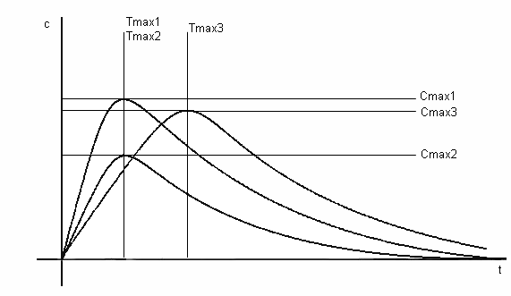
Concentration of drug
Time

Slide 9
Bioavailability- F
how much from the administered dose get to circulation
extravascular administration - 0-100% (resp. 0-1)
intravenous (intravascular) - 100% = 1
if F is < 20 % = 0 - 0,2 – it not worth to administer the drug by this way (some of them are administered through that - SET, bisfosfonates)
the measure of bioavailability is the area under the curve (AUC)
$$F =\frac{{AUC}_{po}}{{AUC}_{iv}}$$
http://icp.org.nz/icp_t6.html
Notes:
http://icp.org.nz/icp_t6.html
SET = systemic enzymotherapy

Slide 10
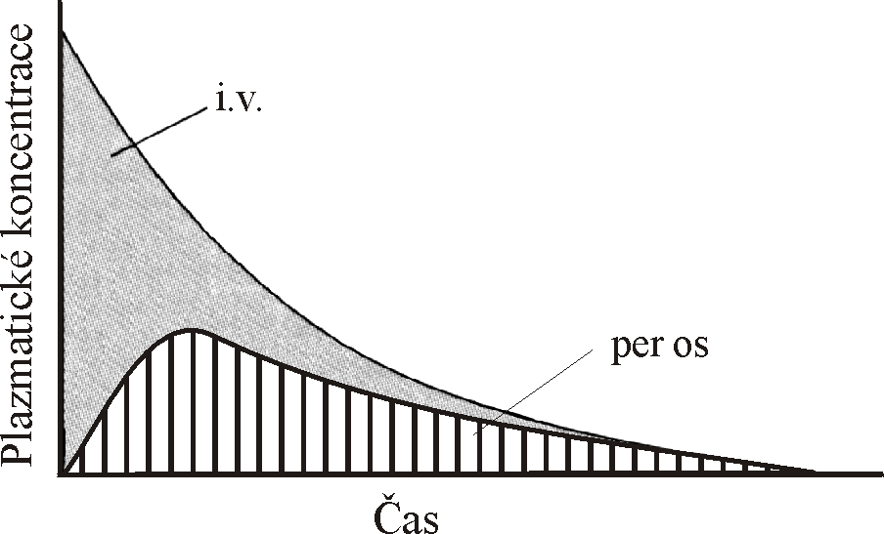
AUC – area under the curve

Slide 11
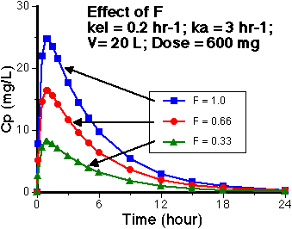
Effects of different bioavailability (F) on the pharmacokinetics

Slide 12
Bioavailability- F
Absolute bioavailability
comparing the AUC of administered drug in the test dosage form and the AUC after i.v. drug administration
Relative bioavailability
assess the expected biological equivalence of two preparations of a drug
if the relative bioavailability = 1 (100%) → tested preparation is bioequivalent to the reference

Slide 13
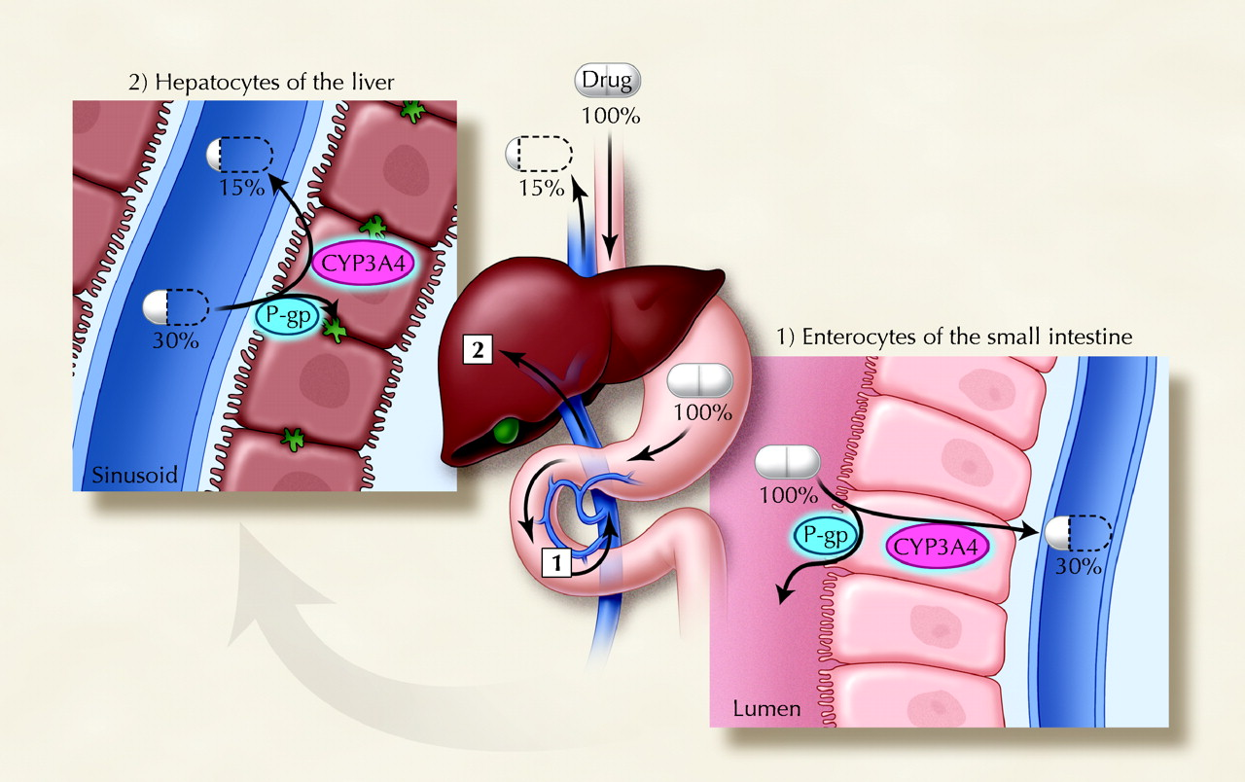
David G. Bailey, and George K. Dresser CMAJ 2004;170:1531-1532

Slide 14
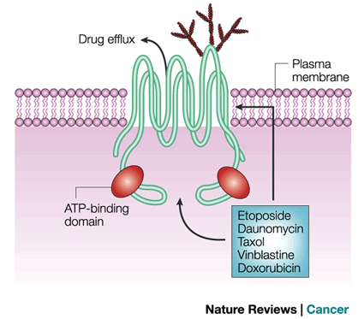
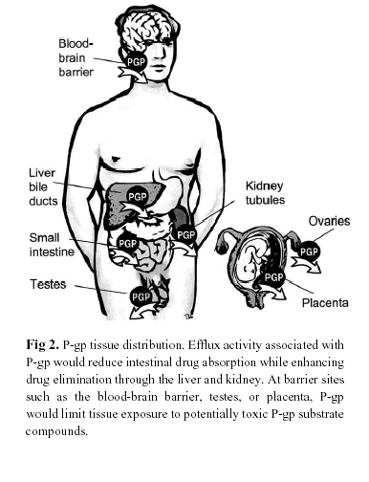
P-glycoprotein
transmembrane pump encoded by MDR1, ABCB1
drug efflux pump for xenobiotics
multidrug resistence to chemotherapeutics
Notes:
http://icp.org.nz/icp_t15.html?htmlCond=3

Slide 15
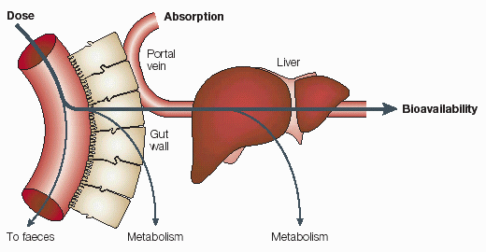
Presystemic elimination
First pass effect
http://icp.org.nz/icp_t6.html?htmlCond=1

Slide 16
Other factors influencing drug absorption
gender, weight, plasmatic volume, speed of gastric discharging
age - pH, bile, enzymes
pathophysiological defect – diseases of liver, inflammation ...
Body constitution (BW/LBM)
diet
- acceleration/ decceleration
- chemical incompatibilities
- GIT functionality

Slide 17
c
i.v.
i.m.
p.o.
s.c.
T [min]

Slide 18
Distribution
Penetration of drug from blood to tissues, dynamic proces where we are interested in:
speed of distribution- depends on:
bindings
membrane penetration
organ perfusion
status- distribution balance, free fractions of drug are equal in blood and tissue
Volume of distributionV_{d}
hypothetic, theoretical volume
rate between amount of drug in organism and plastmatic concentration
$$Vd=\frac{D . F}{C 0}\left[l\right]$$
http://icp.org.nz/icp_t3.html?htmlCond=0

Slide 19
The apparent volume of distribution, Vd, is defined as the volume that would contain the total body content of the drug at a concentration equal to that present in the plasma

Slide 20
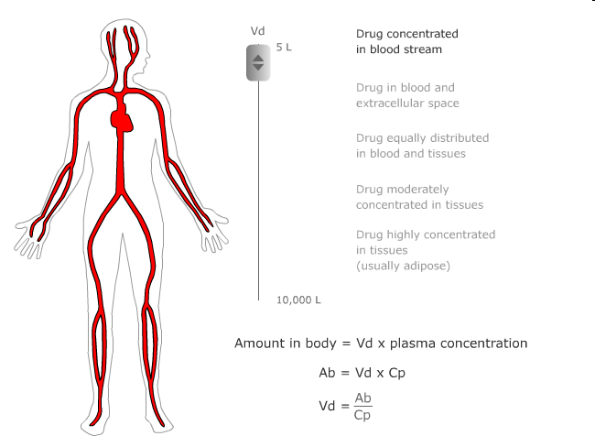

Slide 21
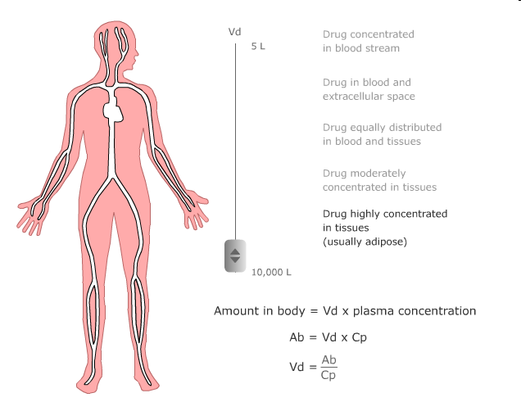

Slide 22
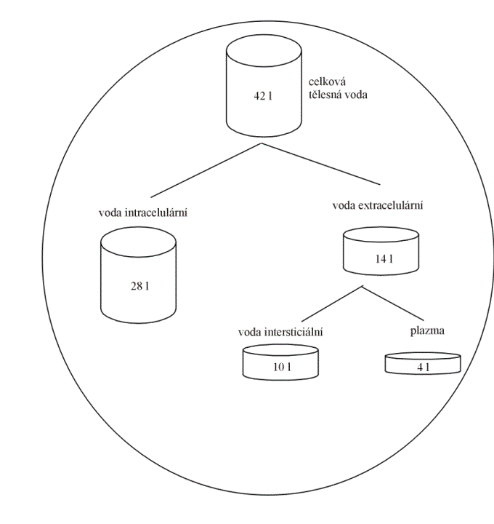
Vd = hypothetical volume,
Final value of Vd can be even 50000 liters (antimalarial drugs). What does this value tell us:
We can assess distribution of the drug in the body.

Slide 23
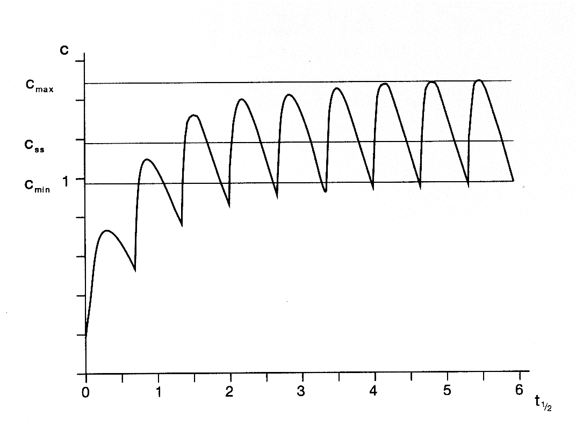
Distribution
Distribution volume - use:
Calculation of initial dose:
D = Vd . c_{T}

Slide 24
Distribution
Estimate the amount of drug in the body
M = Vd . C
Assessment of the effect of hemodialysis and hemoperfusion
drugs with higher Vd can not be eliminate from the body by these technics

Slide 25
Elimination of drugs
First-order elimination
Elimination speed is influenced by plasmatic concentration
Linear kinetics
Zero-order elimination
Elimination speed is not influenced by plasmatic concentration
Non-linear kinetics
Notes:
Vysvětleno na přednášce, lze se zeptat.

Slide 26
0 and 1st.-order elimination
non-linear
linear
10
conc.
10
2
8
8
2
5
6
6
2
2.5
4
4
1.25
2
2
1 2 3 4 5
time
1 2 3 4 5
time
Notes:
http://icp.org.nz/icp_t9.html?htmlCond=1
http://icp.org.nz/icp_t9.html?htmlCond=1

Slide 27
Biotransformation - metabolism
Predominantly in liver, but also in other organs and parts of body
Enzymatic processes
bioactivation (prodrug)
tamoxifen – endoxifen
cyclophosphamide – phosphoramide
biodegradation

Slide 28
Biotransformation - metabolism
Phase:
oxidation, hydrolysis → drug is still partly lipophilic
cytochromes P450, dehydrogenases
Phase:
conjugation → molecules becomes hydrophilic
Metabolites
- effective („more/less“)
- inneffective
- toxic

Slide 29
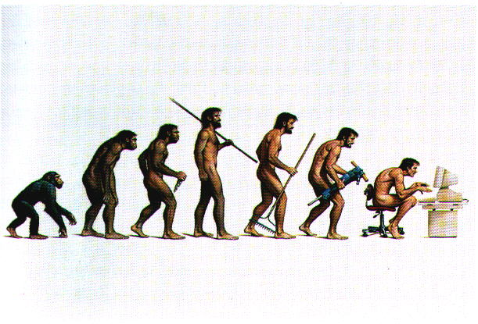
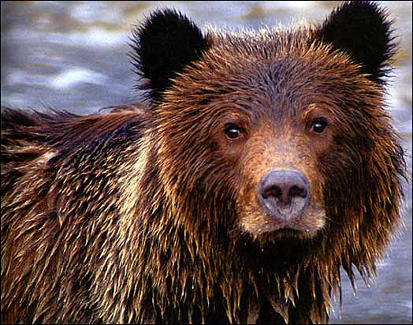
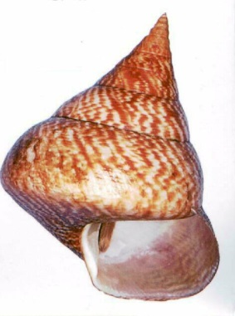
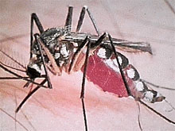
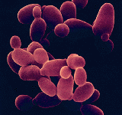
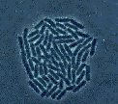
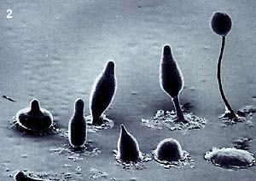
human
animals
plants
CYP 450
molluscous
insect
bacteria
yeasts
fungus

Slide 30
CYP 1A2
others
CYP 3A4
ostatní
CYP 2C9
2%
3%
CYP 2D6
10%
CYP 2C9
CYP 1A2
others
CYP 3A4
CYP 2D6
55%
30%

Slide 31
Inducers of CYP450
dexametazon
fenobarbital
rifampicine
fenytoin
St. John´s worth (Hypericum perforatum)
Maidenhair Tree (Ginkgo biloba)

Slide 32
Inhibitors of CYP450
antidepressants (fluoxetin, fluvoxamin, paroxetin)
chinin, chinidin
chloramphenicol, erytromycine
ketokonazol, itrakonazol
grapefruit juice

Slide 33
Excretion
kidneys
bile
lungs
Saliva, skin, hair, milk…

Slide 34
Excretion by kidney
MW < 60.000 D (MW of albumin = 68.000 D)
glomerular filtration
tubular secretion
organic acids
furosemide
thiazide diuretics
penicilins
glukuronids
organic bases
morfin
tubular reabsorption
diazepam
alkalization
natrium hydrogencarbonate
acidification
ammonium chloride

Slide 35
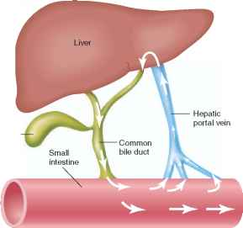
Excretion by liver
Substances permeate through 2 membranes of hepatocytes – basolateral and apical (canalicular)
Metabolites are excreted primary by pasive diffusion, further by active transport (glucuronides, bile acids, penicillins, tetracyclines, etc.)
Metabolites can be deconjugated by bacterial enzymes in intestine → release of lipophilic molecule → re-absorption
= ENTEROHEPATIC CIRCULATION

Slide 36
Glomerular capillary
Proximal tubulus
pH < 7
pH > 7
HA → H⁺+A⁻
H⁺+A⁻ ↔ HA
H⁺+A⁻ → HA
B⁺+OH⁻ →
BOH
B ⁺+OH⁻ ↔ BOH
BOH → B⁺+OH⁻
http://icp.org.nz/icp_t11.html

Slide 37
Pharmacokinetic parameters
Mathematic description of pharmacokinetic processes and its use in drug dosage

Slide 38
The guide for evaluation of pharmacokinetics in clinical practise is plasma concentration/time curve – problems with measuring in vivo

Slide 39
In accordance with concentration-time curves we determine pharmacokinetic parameters – model values, which proviídes us to describe P-kinetic processes
There are three possible manners of drug administration with regards to concentration-time curves:
single dose
continuous administration
repeated dose

Slide 40
Single dose
Invasion phase
C _{max}
T _{max}
Bioavailability - F
Volume of distribution - Vd
$$F=\frac{AUC po}{AUC iv}$$
$$Vd=\frac{D . F}{C 0}$$

Slide 41
Relationship of plasmatic conc. on time
C [mg/ml]
Cmax_{ter}
THERAPEUTICAL RANGE
Cmin_{ter}
lag time
Tmax
T [min]
INVASION ELIMINATION

Slide 42
Single dose
Elimination phase
Drug is eliminated from the organism with speed determined by:
Elimination rate constant:
Biological halftime – drug is totally eliminated after 4-5 halftimes
Clearance
= volume of plasma, which is fully cleaned from drug at time unit[l . h⁻¹]
$$ke=\frac{\ln{c1 −\ln{c2}}}{t2 −t1}$$
$$t_{1/2}=\frac{\ln{2}}{ke}=\frac{0,7}{ke}$$
${Cl}_{TOT}$ $=\frac{D}{AUC}=ke . Vd={Cl}_{REN}+{Cl}_{HEP} +{Cl}_{PUL }…$

Slide 43
ELIMINACE léčiva můžeme popsat
těmito parametry:
f_{U} - fraction unchanged
f_{U} = U / D = CL_{REN} /CL_{TOT}
Udává pokles koncentrace za určitý čas.
Amount of unchanged drug found in urine
f_{U} paracetamol = 3%
f_{U} gentamycine = 98%
Pro kinetiku 1. řádu platí:

Slide 44
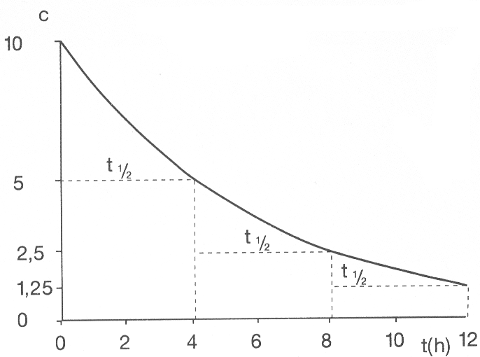
c_{t} = c₀ . e^{(-k.t)}
ln c_{t} = lnc₀ - k_{e}.t

Slide 45
First-order kinetics – semilogaritmic plot (i.v.)
ln (c)
c
c_{t} = c₀ . e^{(-k.t)}
10
ln ct = lnc₀ - ke.t
y = -ke . x +b
10
8
8
5
6
6
4
4
2.5
2
2
1.25
1 2 3 4 5
time
1 2 3 4 5
time

Slide 46
Compartment models
Notes:
Compartment = space, where is drug equally distributed

Slide 47
Compartment models– block schema
1- compartment model
D
i.v. intake
A (GIT)
D
k_{a}
Vd
Vd
k_{e}
k_{e}

Slide 48
Compartment models– block schema
2- compartment model
i.v. intake
D
k₁₂
Vd₁
Vd₂
central compartment
k₂₁
peripheral compartment
k₁₀

Slide 49
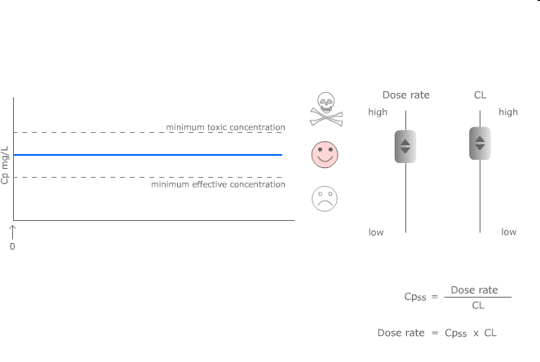
Continuous and repeated administration of drugs

Slide 50
Continuous administration
Intravenous (e.g. by infusio pump), transdermal (TTS), implant → administration of drug with constant speed (mg/min)
If duration of infusion is long enought, concentrations are increasing until the speed of elimination and inflow are the same – plato state is reached (concentration of plato is expressed as Css)

Slide 51
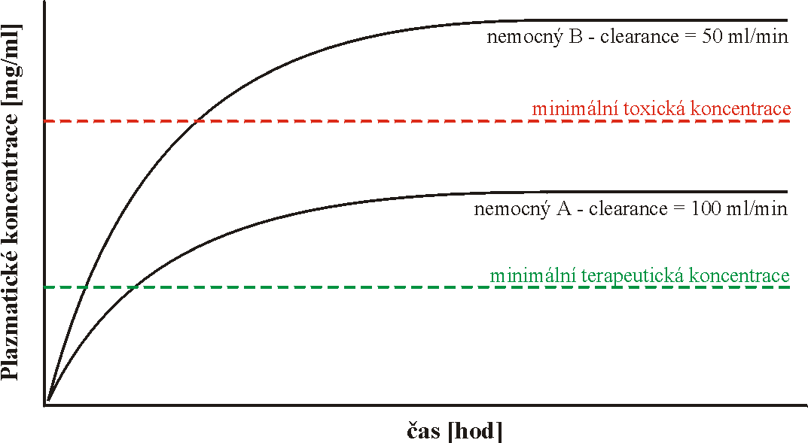
Continuous administration
patient B – clearence = 50ml/min
minimal toxic concentration
Plasmatic concentration
patient A – clearence = 100ml/min
minimal therapeutic concentration
Time

Slide 52
Continuous administration
In plato:
Drug is binded to all binding sites, which can be occupied (distribution is finished)
constant infusion speed supplements amount, which is eliminated from organism in same
speed of inflow [mg/min] = speed of elimination [mg/min]

Slide 53
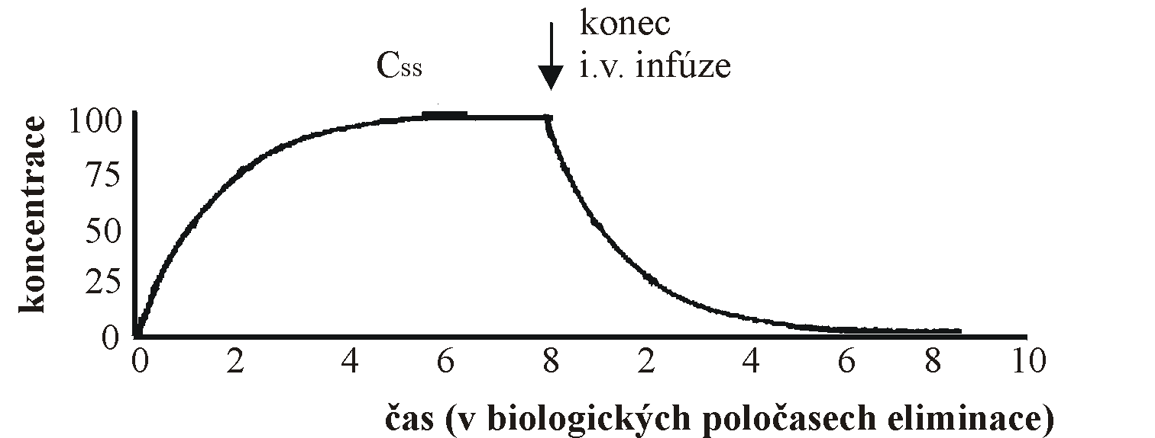
Continuous administration
End of i.v. infusion
Time (in biological halftimes)

Slide 54
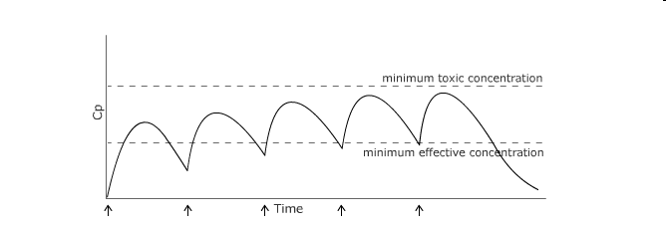
Repeated administration
intra- (repeated intravascular injection) or extravascular (i.e. per os)
rychlost přívodu [mg/min] = Cl x Css

Slide 55
Repeated administration
If doses are administered so close that first of them is not fully eliminated, cumulation starts or plato is reached
Instead of css, css_{plato} is described and it is an average concentration from all concentrations meaured during one dosage interval

Slide 56
Repeated administration
1) F – bioavailability – repeated administration is typical for p.o. administration
2) $τ$ – dosage interval – plasmatic concentrations are fluctuating among minimal and maximal numbers – after reaching steady state this fluctuation is stabilized between Cmax_{plato} and Cmin_{plato}
$$\frac{D . F}{τ}=Cl . css plato$$

Slide 57
Basic pharmacokinetic parameters (+computations)
c_{max} = maximal plasmatic concentration
t_{max} = time when c_{max} is reached
k_{a} = absorption rate constant
k_{e} = elimination rate constant
t_{1/2} = biological halftime
Vd = volume of distribution
Cl = clearance
AUC = area under the curve
$ke=\frac{\ln{c1 −\ln{c2}}}{t2 −t1}$ $\left[h^{−1}\right]$
$$t_{1/2}=\frac{\ln{2}}{ke}=\frac{0,7}{ke} \left[h\right]$$
$$Vd=\frac{D . F}{C 0}= \frac{F.D}{AUC . ke} \left[l\right]$$
${Cl}_{TOT}$ $=\frac{D}{AUC}=ke . Vd={Cl}_{REN}+{Cl}_{HEP} +{Cl}_{PUL }…\left[l.h^{−1}\right]$
$AUC$ $=\frac{D}{Cl}=\frac{co}{k_{e}}=\frac{D}{k_{e} . Vd} \left[mg . l^{−1 }. h\right]$

