Slide 1
AUTONOMIC NERVOUS SYSTEM

Slide 2
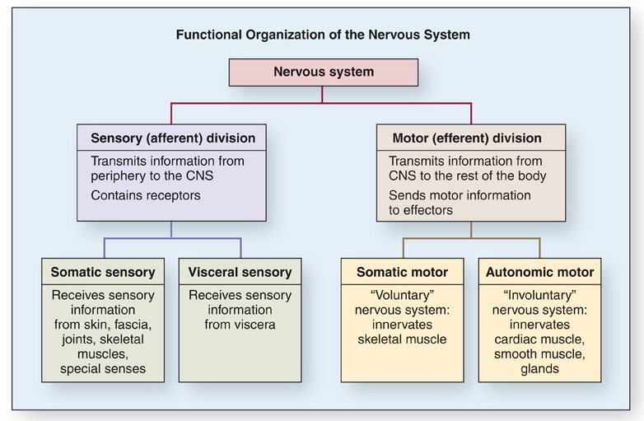

Slide 3
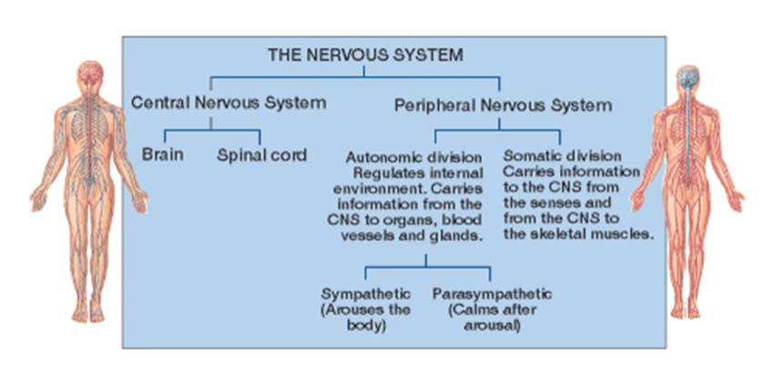

Slide 4
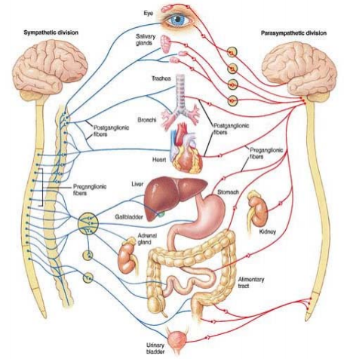
AUTONOMIC NERVOUS SYSTEM
Functions:
Contraction and relaxation of
smooth muscles
Function of all exocrine glands
Heart rate
Some metabolic processes

Slide 5
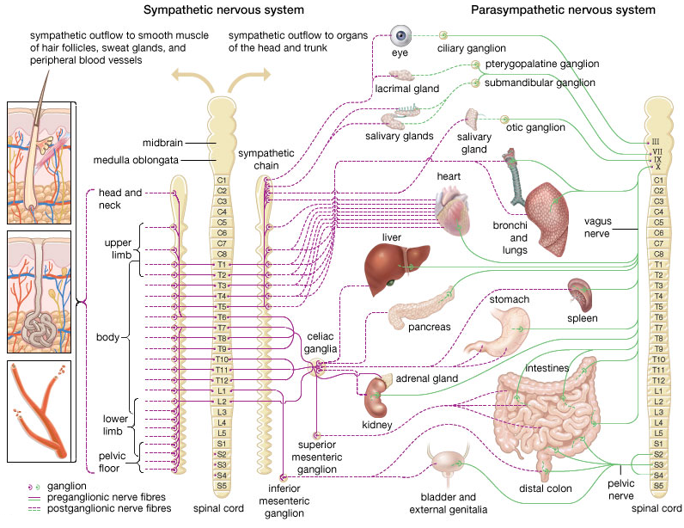

Slide 6
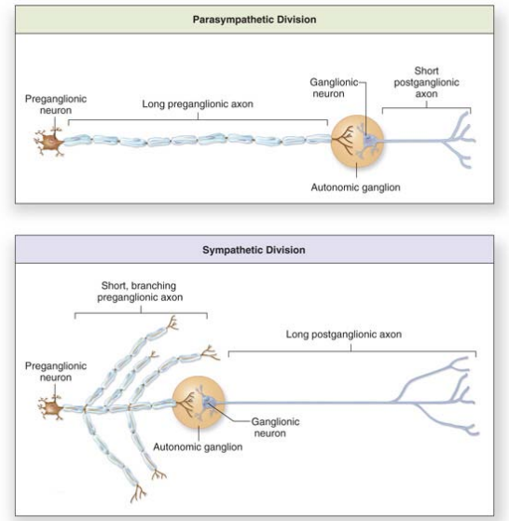

Slide 7
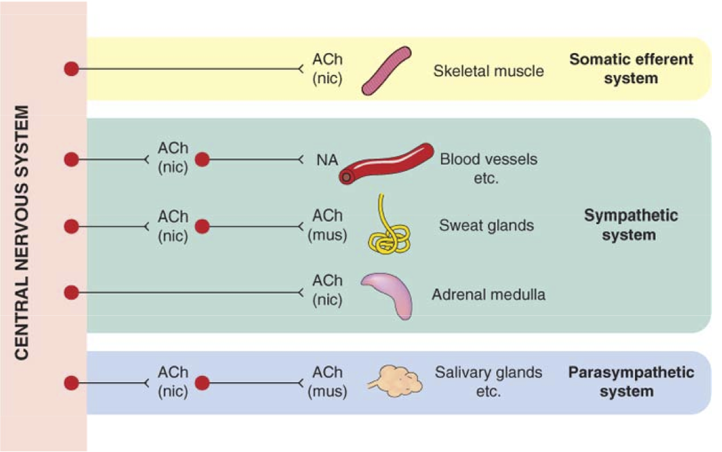

Slide 8
AUTONOMIC NERVOUS SYSTEM
sympathetic NS
ncl. intermediolateralis in
T1 – L2 segments of spinal cord
= thoracolumbar system
paravertebral ganglia
(tr. sympathicus) and
prevertebral ganglia
neurotransmitters
pregangl. – acetylcholine
postgangl. – norepinephrin
(ex. sweat glands and
piloerector muscle)
parasympathetic NS
parasympathetic nuclei
of CN III, VII, IX, X
segments S2 – S4
= craniosacral system
ganglia near the target
organ
neurotransmitter
acetylcholine

Slide 9
Sympathetic system
Catabolic reaction (activities that are mobilized during emergency and stress situations, “fight, fright and flight” responses)
Parasympathetic system
Anabolic reactions (activities associated with
conservation and restoration of body resources,
“rest and digest” responses)
anatomy
Notes:
9
The sympathetic system stimulates those activities that are mobilized by the organism during stress situations.
Increased activity of the sympathetic and following release of adrenergic neurotransmitters prepares the organism for FFF.

Slide 10
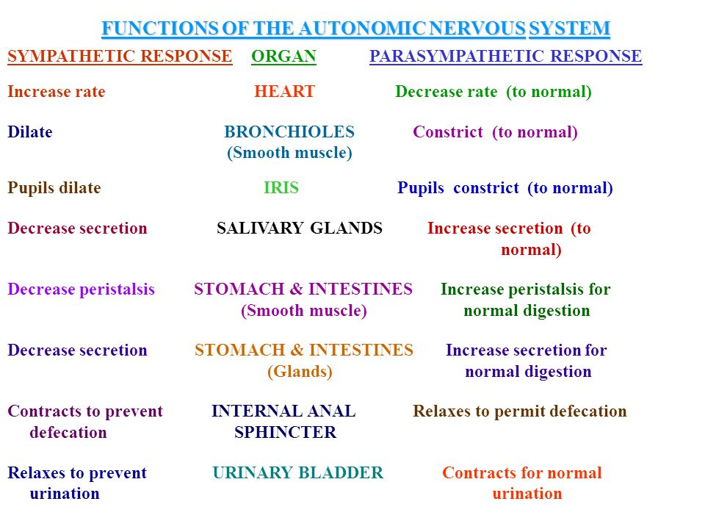

Slide 11
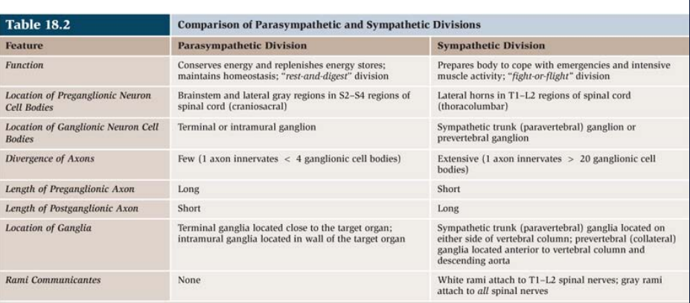

Slide 12
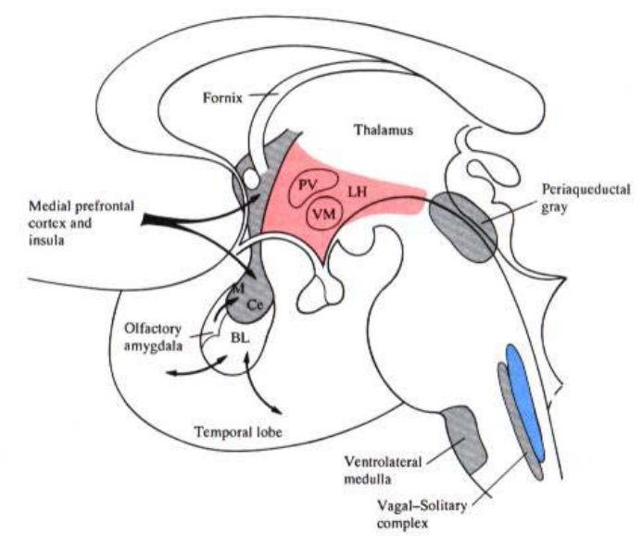
Central autonomic network (CAN)

Slide 13
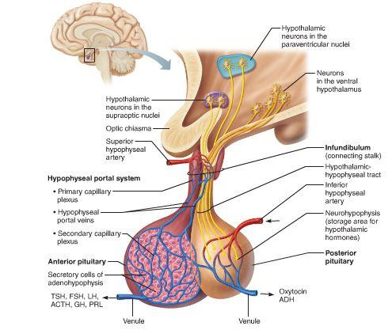
Paraventricular nucleus

Slide 14
PVN in CAN
DN of CN X
rVLM
sIMLN
cSN of CN V
NTS

Slide 15
Other hypothalamic nuclei in CAN:
Dorsomedial nucleus
Posterior hypothalamic nucleus
Mammillary nucleus
Lateral hypothalamic area - cardiovascular control, control of feeding, satiety and insulin release

Slide 16
Extrahypothalamic structures in CAN:
Control of symp. outflow
Locus coeruleus
Rostral and caudal VLM
Raphe nuclei
Control of parasymp. outflow
Central ncl. of amygdala
Dorsal ncl. of CN X
Raphe nuclei
PAG
Parabrachial ncl.

Slide 17
Limbic cortex – control of both autonomic outflows
Cingulate c.
Orbitofrontal c.
Insula
Rhinal c.
Hippocampus

Slide 18
Modulation of ANS
from brain cortex
tr. corticoreticularis → tr. reticulospinalis → preganglionic neurons
from hypothalamus
tr. hypothalamotegmentalis
tr. mammillotegmentalis
from hypothalamus and limbic forebrain
FLD → dorsolateral tegmentum
from amygdalar complex
→ hypothalamus
→ PAG – coordination of somatic and autonomic response to
behavior and defensive reaction → preganglionic neurons of S and PS divisions

Slide 19
Descendent modulatory pathways
fasciculus longitudinalis dorsalis (FLD)
fasciculus telencephalicus medialis (medial forebrain
bundle MFB)
tr. mammillotegmentalis

Slide 20
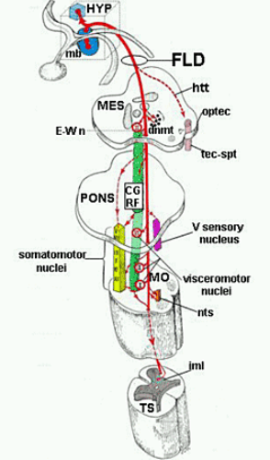
Fasciculus longitudinalis dorsalis

Slide 21
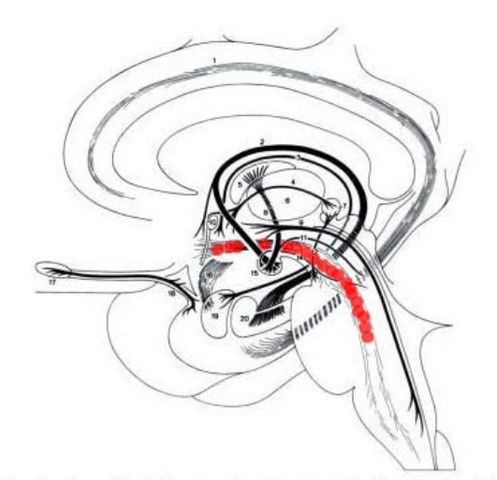
Fasciculus telencephalicus medialis

Slide 22
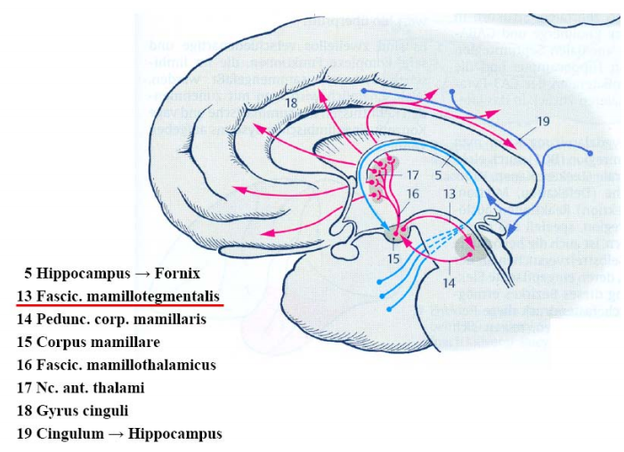
Tractus mammillotegmentalis

Slide 23
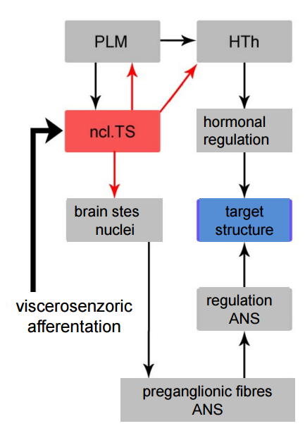

Slide 24
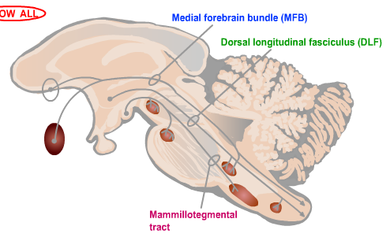


Slide 25
Hypothalamus
Nuclei of the anterior part
ncl. paraventricularis
stimulation of parasympathetic system
Stimulation of the anterior part of hypothalamus
miosis
decrease in heart rate and blood pressure
dilation of cutaneous arteries
increase in peristalsis and secretion in the GIT

Slide 26
Hypothalamus
Nuclei of the posterior part
ncl. mammillaris and hypothalamicus post.
stimulation of sympathetic system
Stimulation of the posterior part of hypothalamus
mydriasis
increase in heart rate and blood pressure
constriction of cutaneous arteries
decrease in peristalsis and secretion in the GIT
erection of hairs

Slide 27
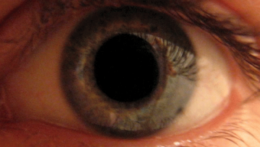
PUPILARY LIGHT REFLEX
a reflex that controls the diameter
of the pupil, in response to the
intensity of light (luminance) that
falls on the retina of the eye
mydriasis: dilation of the pupil
miosis: constriction of the pupil

Slide 28
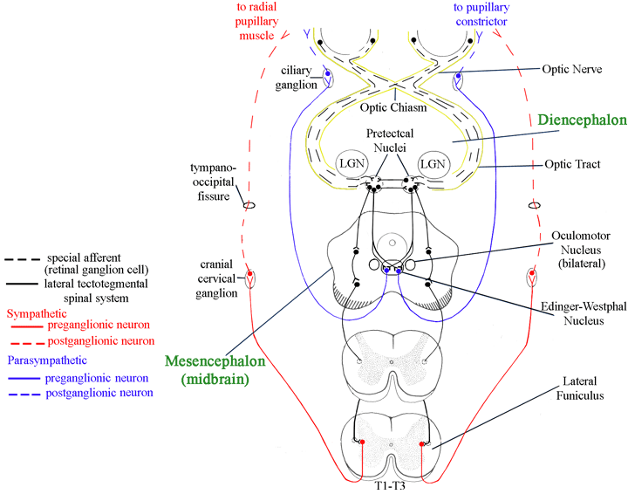

Slide 29
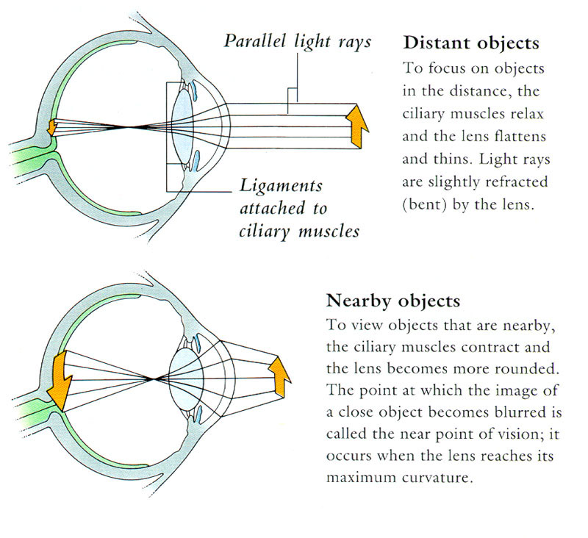
ACCOMMODATION

Slide 30
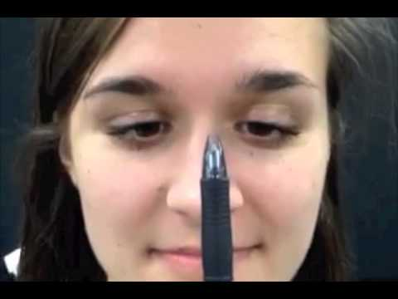
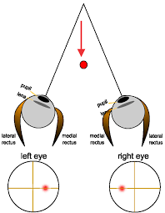
Near reflex triad: convergence
accommodation of the lens
pupillary constriction

Slide 31
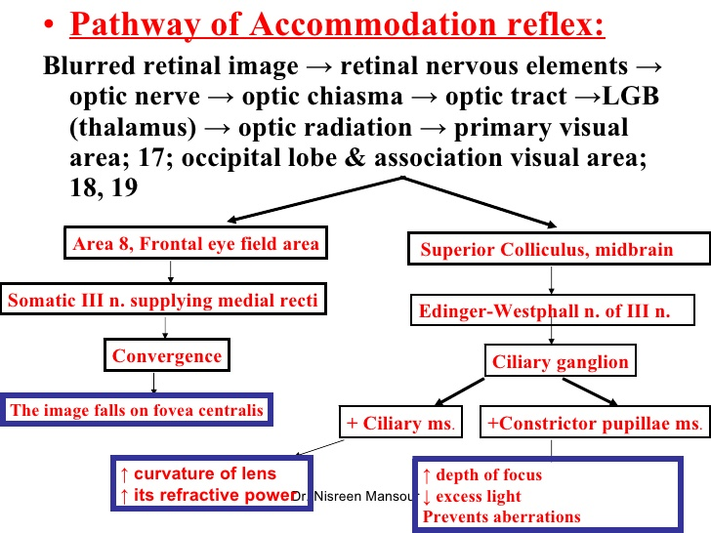

Slide 32
Illustrations were copied from:
Neuroscience Online, the Open-Access Neuroscience
Electronic Textbook
Department of Neurobiology and Anatomy
University of Texas Medical School at Houston

