Slide 1
Cycling in the Netherlands and its positive effect on public health
Luis Enke, Carlo Behnisch

Slide 2
Content
Cycling in Netherlands today
History
Comparison of means of transportation
Health effects of cycling
Current measures to improve cycling infrastructure

Slide 3
Cycling in Netherlands (=NL) today
NL have a population of 17 million people today and almost 23 million bicycles
One quater of all journeys are made by bicycle in NL
Road safety is among the best in the world, 1.1 Dutch bikers were involved in a fatal accident per 100 million miles traveled (2002-2005)
In Amsterdam 490,000 cyclists cycle 2 million km per day (2012)
There are 35,000km of dedicated bicycle paths compared to 140,000km road network (partly shared)

Slide 4
Brief history
1890 first bike paths were build in NL
1950 cars starting to become the dominant means of transport in NL with continuously increasing numbers
At this time bicycle paths were a measure to get cyclists off the road to make more space for cars
1970 high number of fatal traffic accidents, especially involving children, caused public outrage
1973 the oil crisis illustrated the dependence on oil

Slide 5
History II
Grassroot movement „Stop de Kindermoord“ achieved to turn around policies.
1990 strict liability for motor vehicle accidents (If the cyclist didn‘t intentionally cause the accident the motor-vehicle drivers insurence has to cover all damages)
1990 needs for cyclists were taken into account in urban planning (cyclists and pedestrians were prioritized over car traffic in living streets)
Motor-vehicle drivers are trained to think about cyclists in their environment
School children of 12y do „Verkeersdiploma“ as training. 75% of secondary school children ride by bike to school

Slide 6
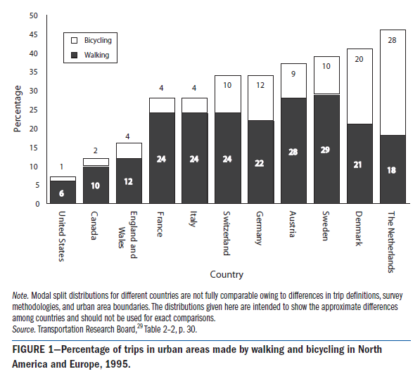
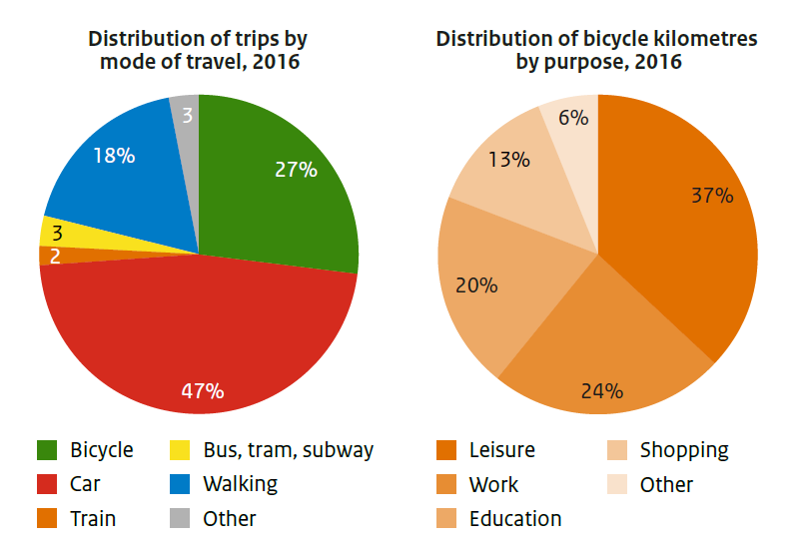
Comparing the means of transportation in urban areas

Slide 7
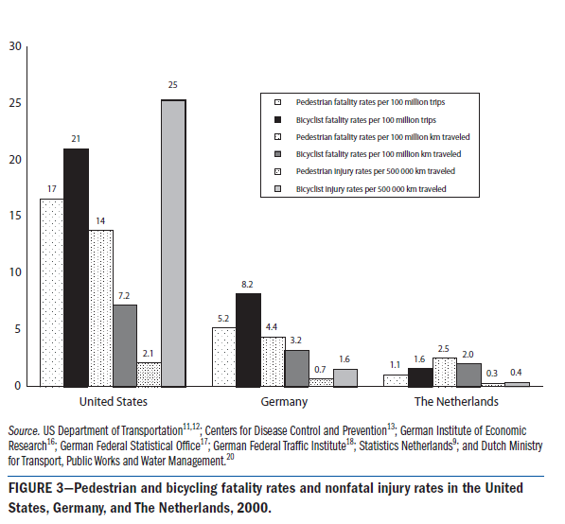
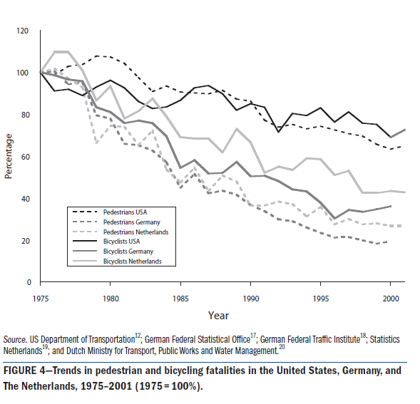
Comparing road safety

Slide 8
Comparison to the Czech Republic
High number of fatalities - 68 cyclists killed in 2015
9% of traffic fatalities are cyclists (1993-2011)
4.5 times greater risk of being killed in a traffic accident than in the NL
Fatalities usually due to absence of helmet
Total number of bicylces estimated at 4 million
Factors influencing road safety in CZR:
  Too little lateral clearance between cyclist and motor-vehicle
  Poor quality of roads or cylce paths
  Cycling network not properly interlinked

Slide 9
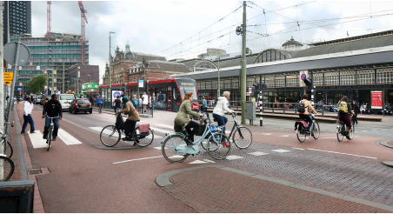
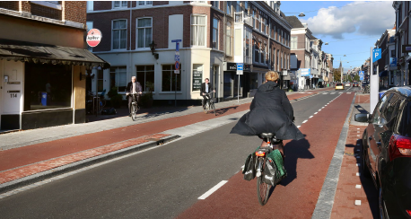
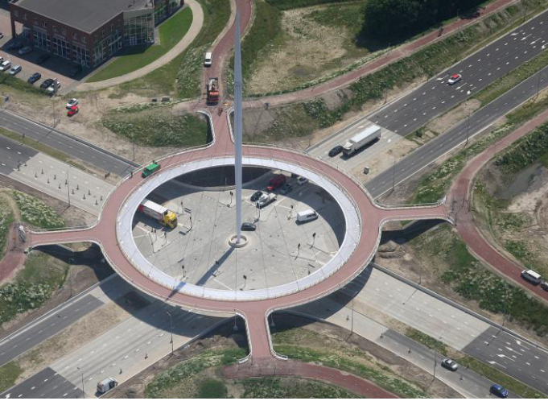
Why it is practical to ride a bike in NL
Safe, fast and reliable due to dedicated cycling highways, bridges and good cycling ways
Easy possibilities to lock a bicycle virtually everywhere
Good integration with railway and public transport system makes cycling suitable for longdistance travel in NL
The ministry of transport hopes to further increase usability of cycling by integrating E-bikes into the infrastructure

Slide 10
Economical benefits of cycling
Annual cost of riding a bike is only 300€ compared to annual 8500€ for a car
Riding a bike yields a social benefit of 0.68€ per Km while cars and buses cost 0.37€ and 0.29€ per Km traveled
Cyclists invest 3X more in local economy, they take shorter but more frequent shopping trips

Slide 11
Environmental benefits
Biking safes 0.2 g of Nox, 150g of CO2 and 0.01g of particulate matter per km
Half of passenger car trips are shorter than 7.5 km, one third is shorter than 5 km
Replacing trips shorter than 7.5 km will safe 2.0 megatons of CO2, 2.6 kilotons of NOx and 0.13 kilotons of particulate matter annually
Cycling improves public space, a moving car takes up 28x the space of a bicycle, a parked car takes up 10x the space of a parked bicycle

Slide 12
Health benefits
Cycling 30min per day is equivalent to the recommended weekly physical activity
Cycling prolonges life-expectancy by 3-14 month
Cycling to work everyday reduces risk of serious disease (-52% CV diseases, -40% Cancer)
Cycling is effective in preventing obesity and type 2 DM

Slide 13
Effects on mental health
59% of all cyclists associate cycling with joy, only 2% dislike it while driving a car to work is associated with stress
Regular physical activity is known to prevent depression
Cycling improves quality of life by increasing independence and flexibility.
If a good infrastructure is given, cycling is convenient, enjoyable and reliable
Especially great effect on population over 65y

Slide 14
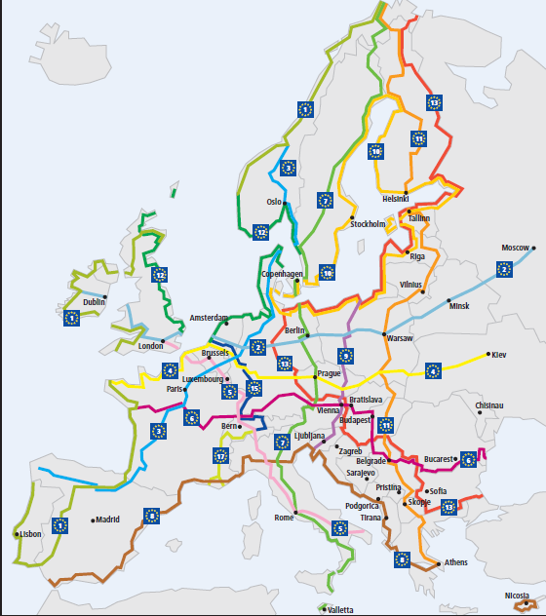
ECF European agenda
Cycling has become a fast growing market throughout the world
Pan European Masterplan for cycling (jointly managed by WHO and UN) consults countries on urban planning
Sweden: 125millio € budget which includes 25% subsidy for all E-bike sales untill 2020
Italy: All political groups agreed on the importance of cycling mobility
France: French minister of transportation announced to FUB a new ambitious cycling plan
Germany: Safed a 25million € budget for building cycling highways
NL: 100million € for cycling infrastructure and parking near railway stations.

Slide 15
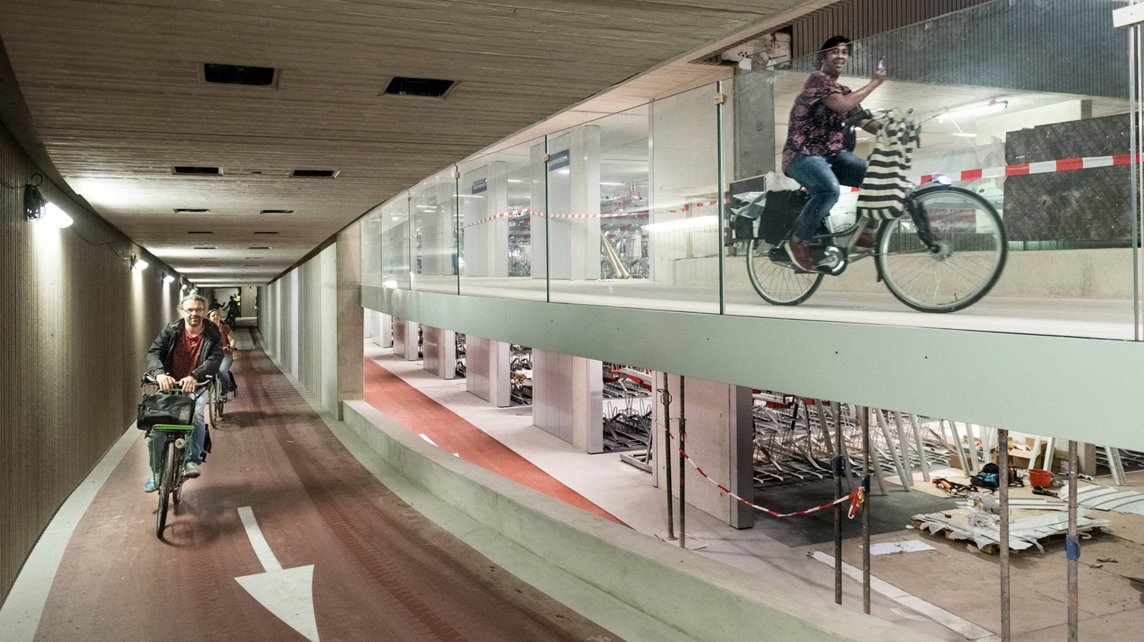

Slide 16
Sources
Fishman E, Schepers P, Kamphuis CBM. Dutch Cycling: Quantifying the Health and Related Economic Benefits. Am J Public Health. 2015;105(8):e13-e15. doi:10.2105/AJPH.2015.302724
Hamm L, Kansen, Maarten. Cycling Facts, Netherlands Institute for Transport Policy Analysis (KiM).; 2018. file:///C:/Users/carlo/Downloads/Cycling+facts+2018.pdf. Accessed May 1, 2019.
Kremers SPJ, de Bruijn G-J, Visscher TLS, et al. Associations between Safety from Crime, Cycling, and Obesity in a Dutch Elderly Population: Results from the Longitudinal Aging Study Amsterdam. J Environ Public Health. 2012;2012. doi:10.1155/2012/127857
Oja P, Titze S, Bauman A, et al. Health Benefits of Cycling: A Systematic Review. Vol 21.; 2011. doi:10.1111/j.1600-0838.2011.01299.x
Pucher J, Dijkstra L. Promoting Safe Walking and Cycling to Improve Public Health: Lessons From The Netherlands and Germany. Am J Public Health. 2003;93(9):1509-1516.
Dutch-Cycling-Vision_EN.pdf. https://www.dutchcycling.nl/images/downloads/Dutch-Cycling-Vision_EN.pdf. Accessed April 29, 2019.
ECF_ImpactReport_OnLine1.pdf. https://ecf.com/system/files/ECF_ImpactReport_OnLine1.pdf. Accessed May 3, 2019.
Bicycle Traffic in the Czech Republic: The Ways of Influencing the Behaviour of People Involved in It https://tots.upol.cz/pdfs/tot/2017/01/05.pdf

