Slide 1



CONTINUING EDUCATION
CLINICAL EDUCATION
RETREATMENT
MODULE 9

Slide 2


CONTINUING EDUCATION
CLINICAL EDUCATION
RETREATMENT

Slide 3
Quality of Endodontic Treatments
% Inadequate trt
% Failures (LEO)
Eckerbom et al. (1987)
Sweden
75
26,4
Eriksen et al. (1988)
Norway
59
34
Odesjö et al. (1990)
Sweden
70
24,5
Imfeld (1991)
Switzerland
64
31
Hülsmann et al. (1991)
Germany
62
60
De Cleen et al. (1993)
Holland
50,9
39,2
Städler et al. (1993)
Austria
57,8
25,9
Buckley et Spangberg (1995)
USA
58
31,3
Marques et al. (1998)
Portugal
53,8
21,7
Boucher et al (2001)
France
79
63

Slide 4
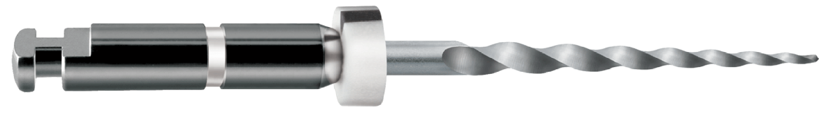
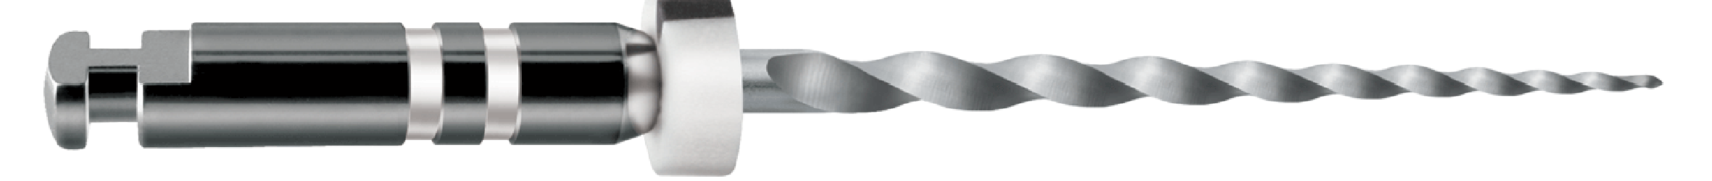
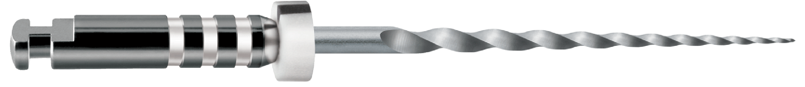
ProTaper Universal Retreatment
ProTaper « D »
16mm
D1
30–9%
18mm
D2
25–8%
22mm
D3
20–7%

Slide 5


ProTaper « D »
Decreasing Taper

Slide 6
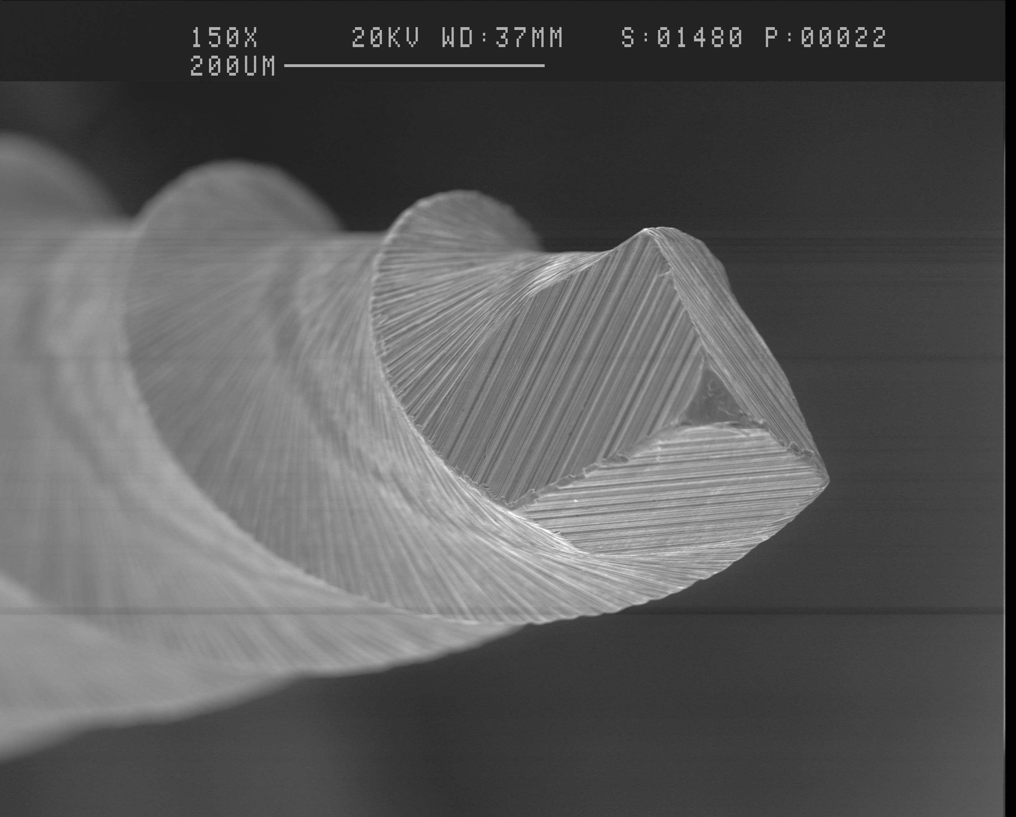
ProTaper D1
Active Tip : allows better initial penetration in the material
30
D1

Slide 7
Retreatment Sequence

Slide 8
RETREATMENT
If Insoluble resins
If Gutta Percha
If Soluble
Pastes
Ultrasonics
ProTaper D
No Solvent
Solvent
+
ProTaper D

Slide 9
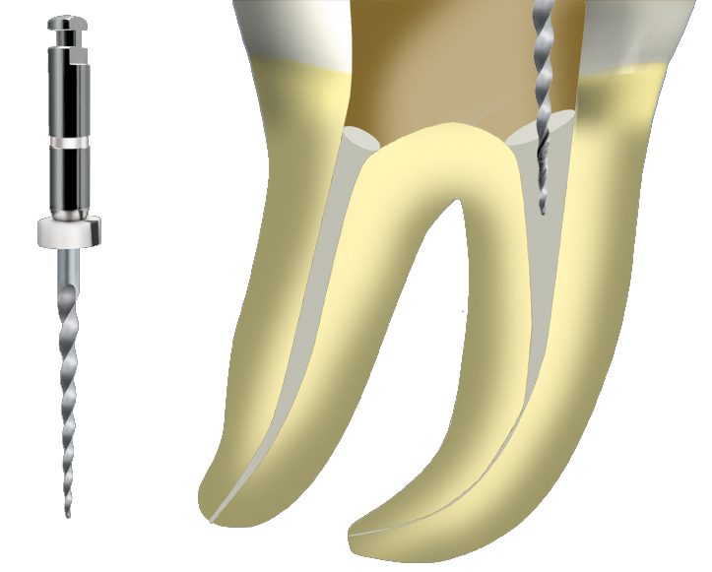
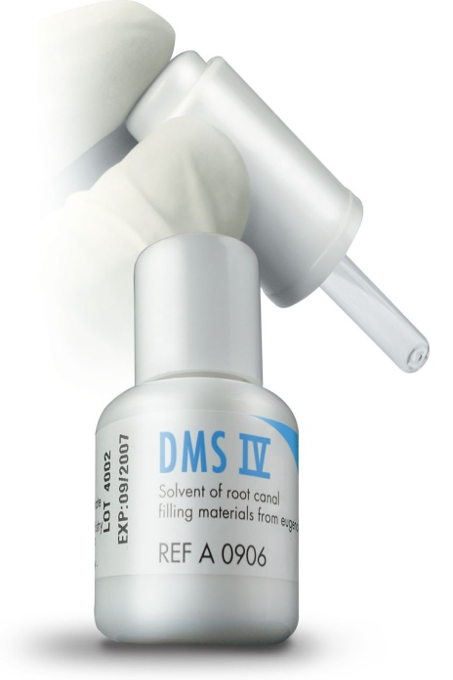
D1
Use DMS 4 to softened Gutta
If there is still material in the canal, move to D2
Use D1 with an in-and-out motion.
In case of blockage, do not force
take an X-Ray.

Slide 10
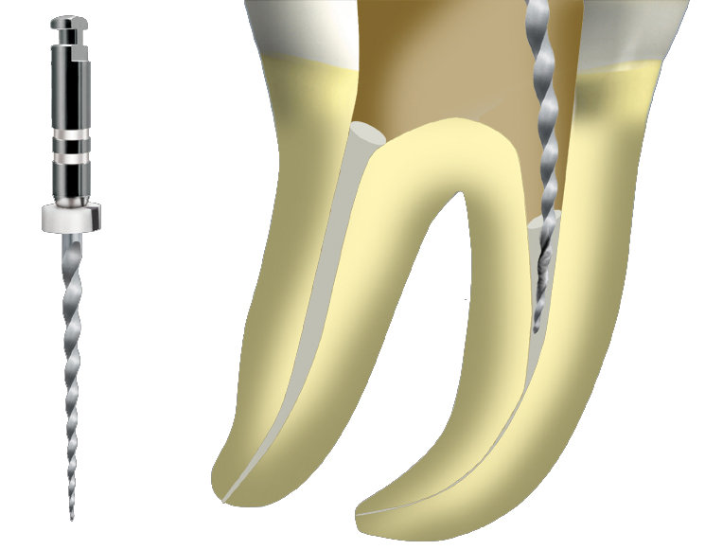
D2
Use D2 with an in-and-out motion
In case of blockage, don’t force.
take an X-Ray.
If there is still material in the canal, move to D3

Slide 11
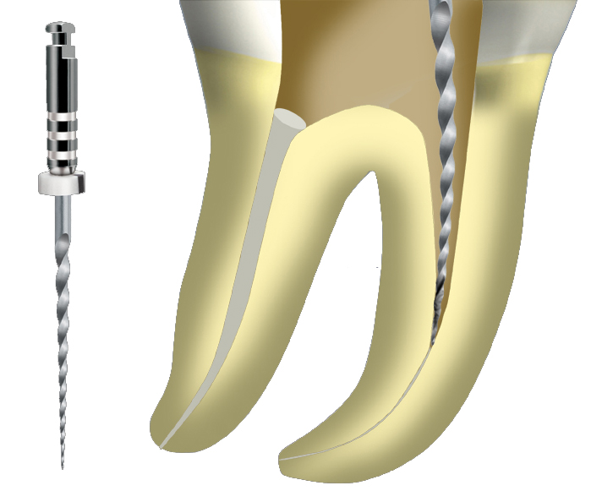
D3
Use D3 with an in-and-out motion
In case of blockade, don’t force.
take an X-Ray.
If there is still material in the canal or a ledge use a
C+ file

Slide 12
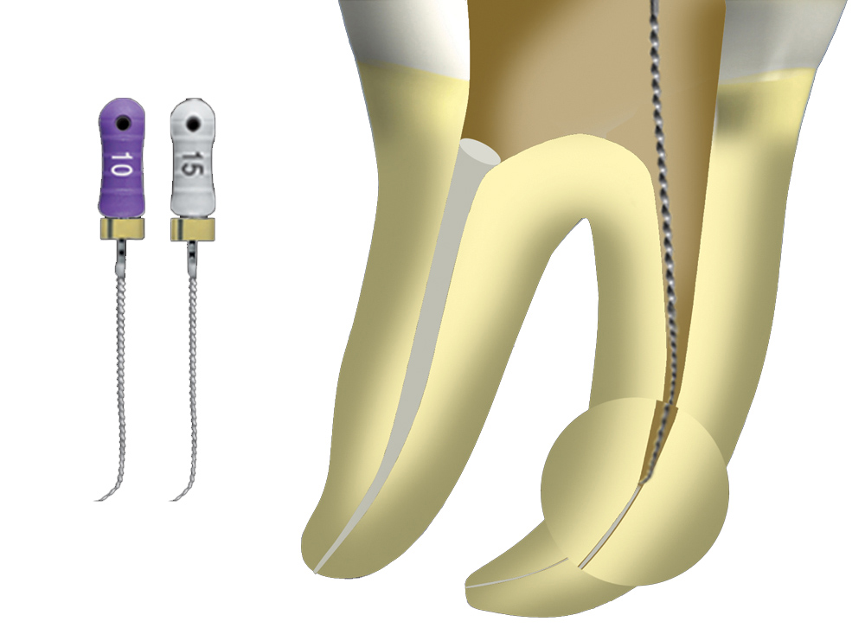
Bypass the
ledge with precurved
C+ files size
08, 10 or 15
18mm length

Slide 13
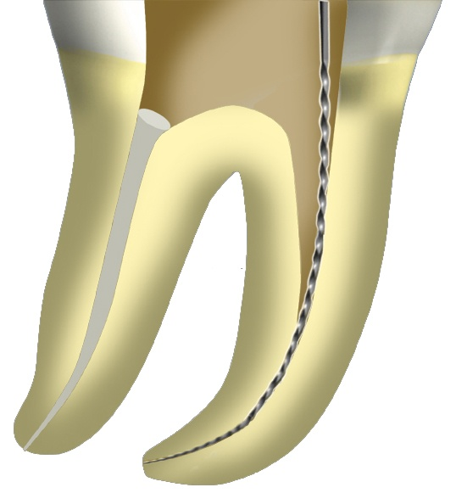
Check patency of the apical area and determine
Working Length
With Stainless Steel Hand File
Size 15

Slide 14
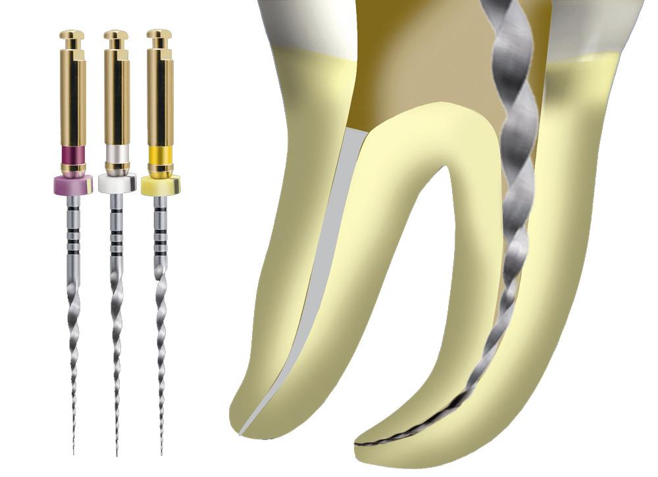
S1 S2 F1
Shape at Working Length

Slide 15
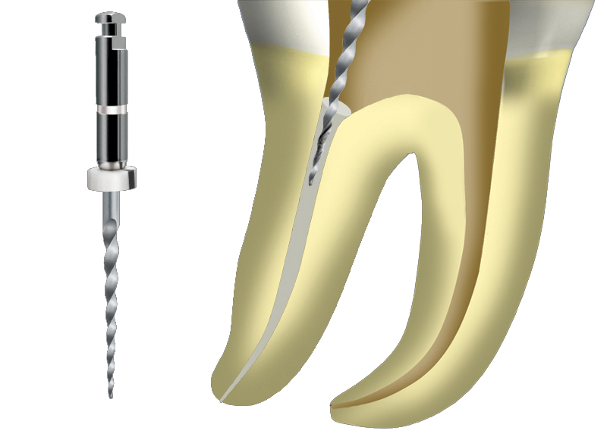
D1

Slide 16
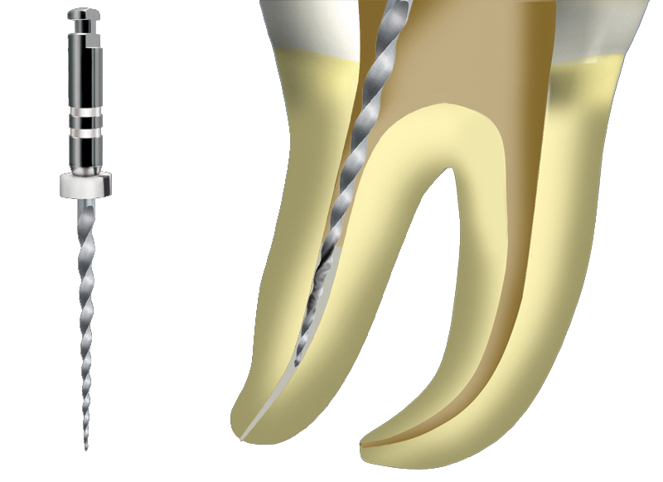
D2

Slide 17
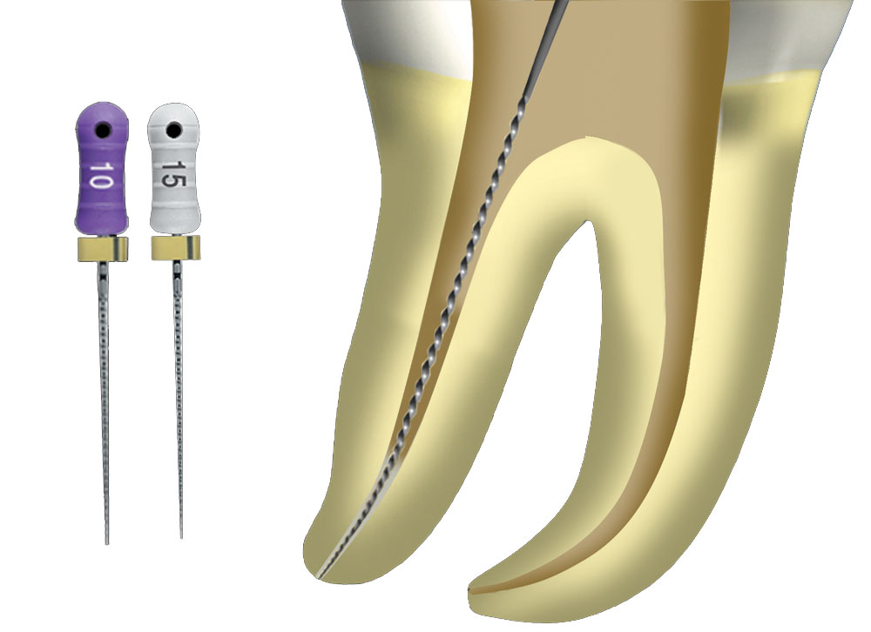
Use C+ Files
in the last mm of the canal
to avoid
debris extrusion

Slide 18
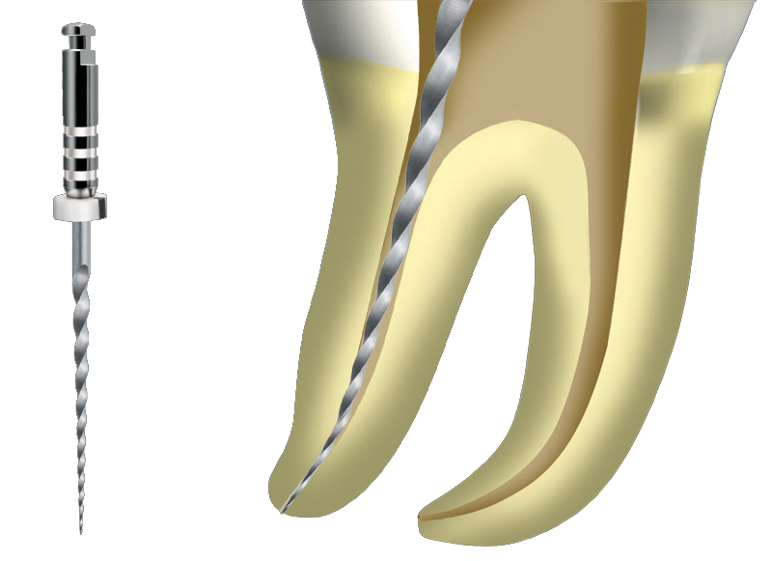
D3

Slide 19
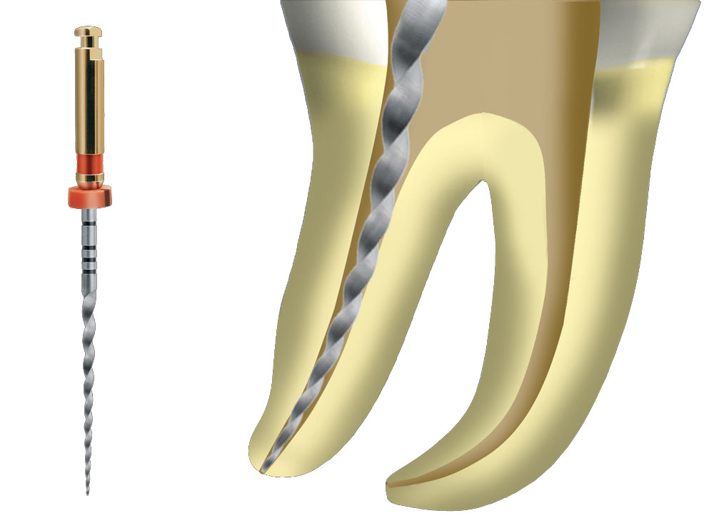
Additional Shaping at
Working Length
If needed
F2,F3…

Slide 20
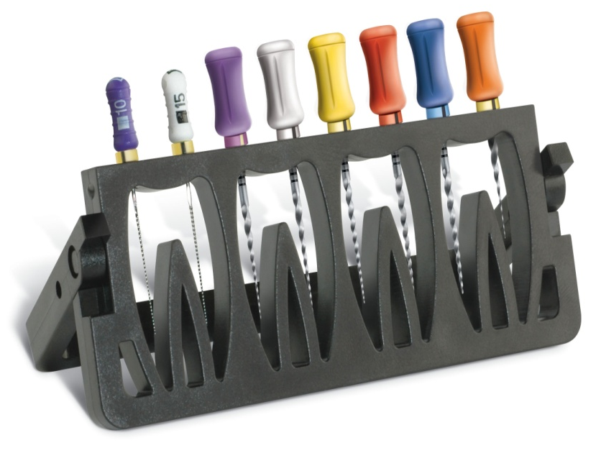
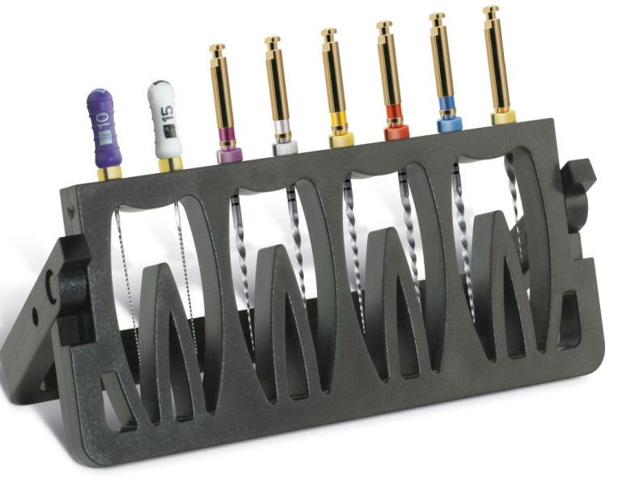
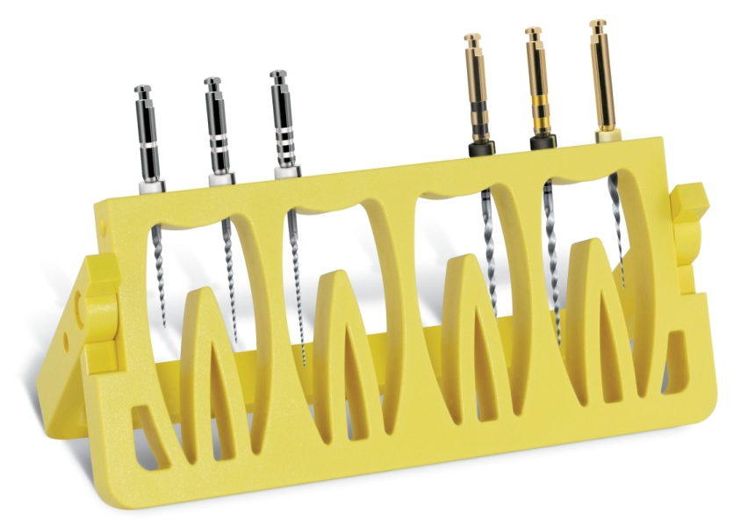
PROTAPER Sequencer
For better ergonomy

Slide 21

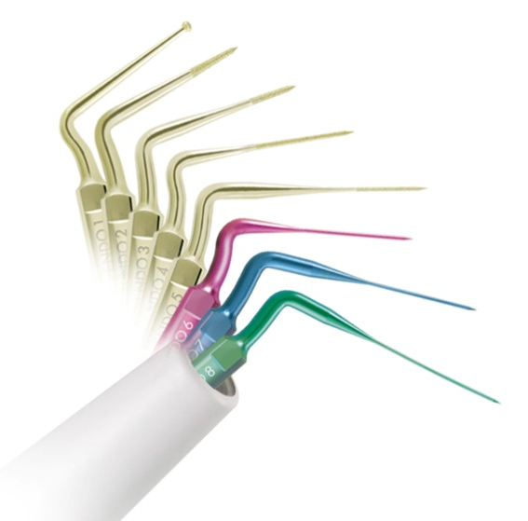

CONTINUING EDUCATION
CLINICAL EDUCATION
Posts Removal &
Broken Instruments Removal

Slide 22
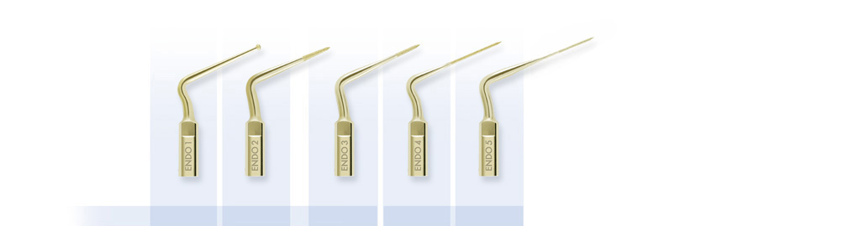
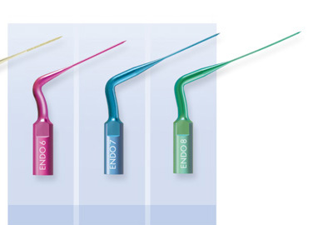
Abrasive coated instruments
Titanium instruments
ENDO1 ENDO2 ENDO3 ENDO4 ENDO5 ENDO6 ENDO7 ENDO8
17 mm 17 mm 18 mm 20 mm 24 mm 20 mm 24 mm 27 mm

Slide 23
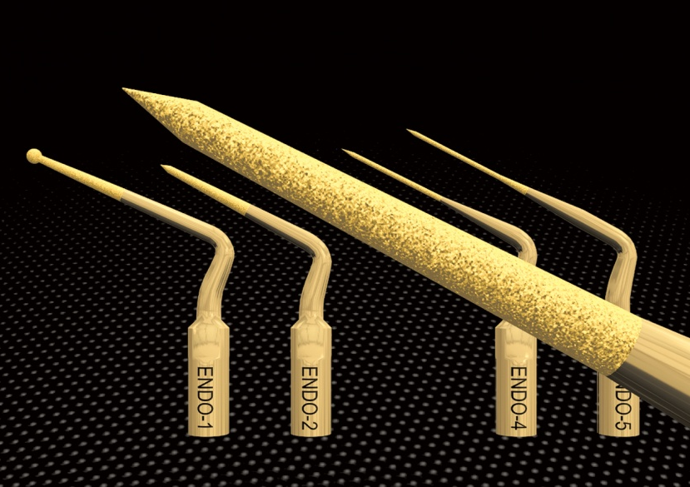
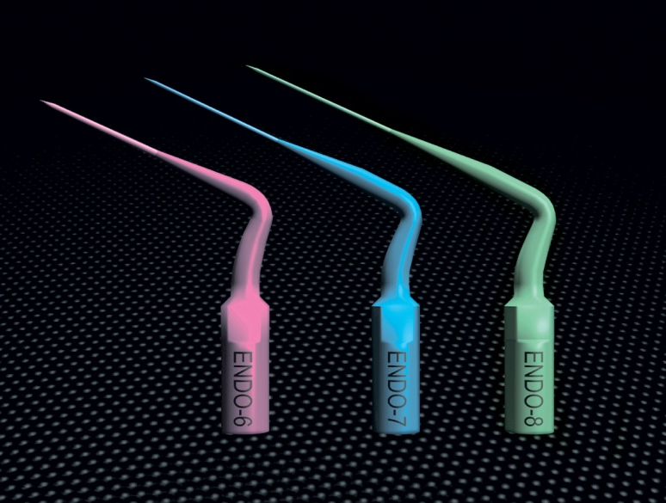
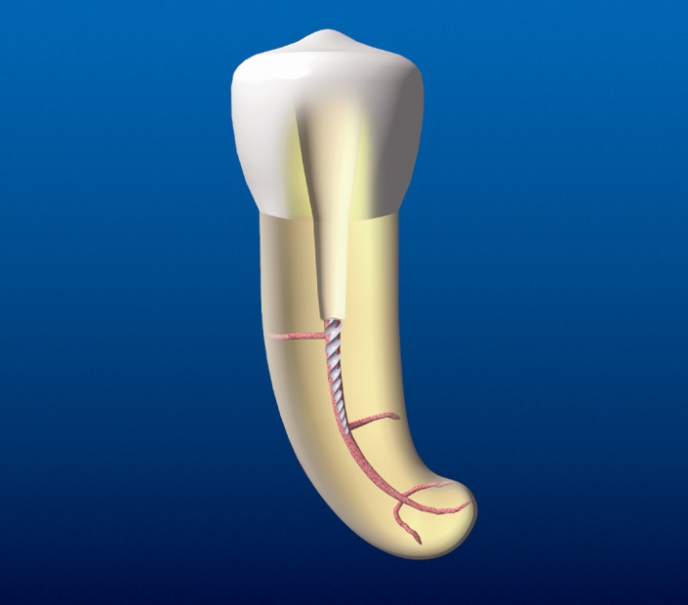
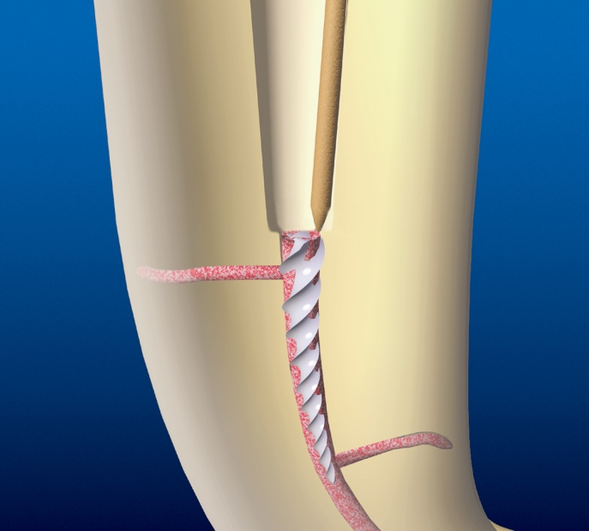
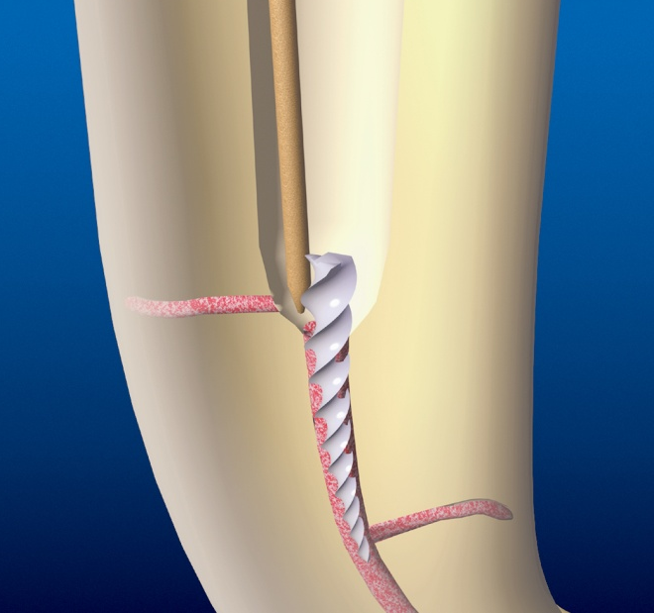
Broken Instruments Removal

Slide 24
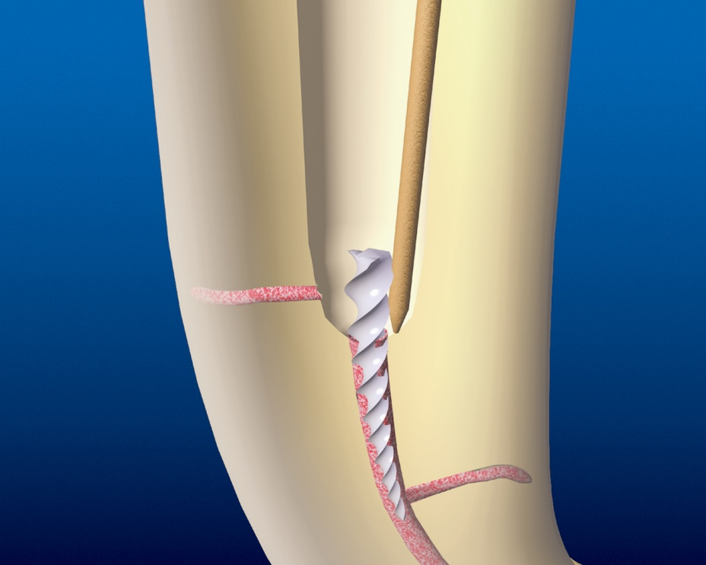
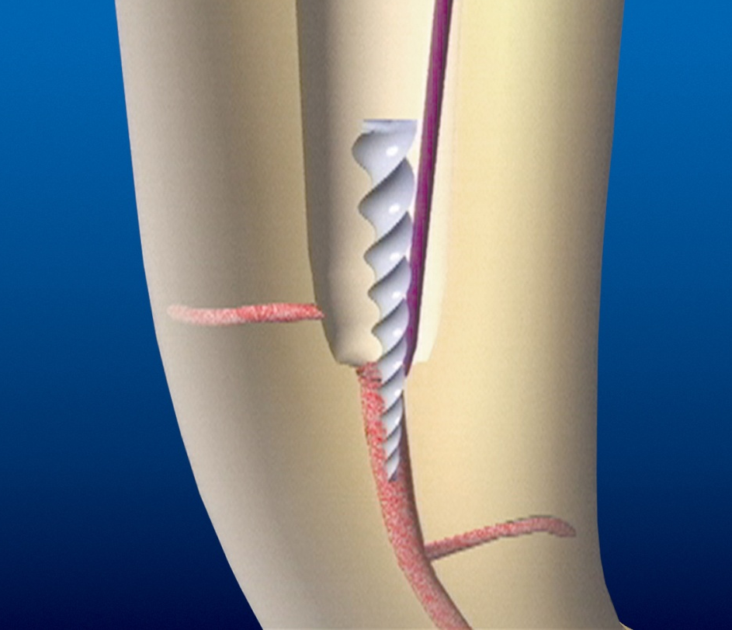
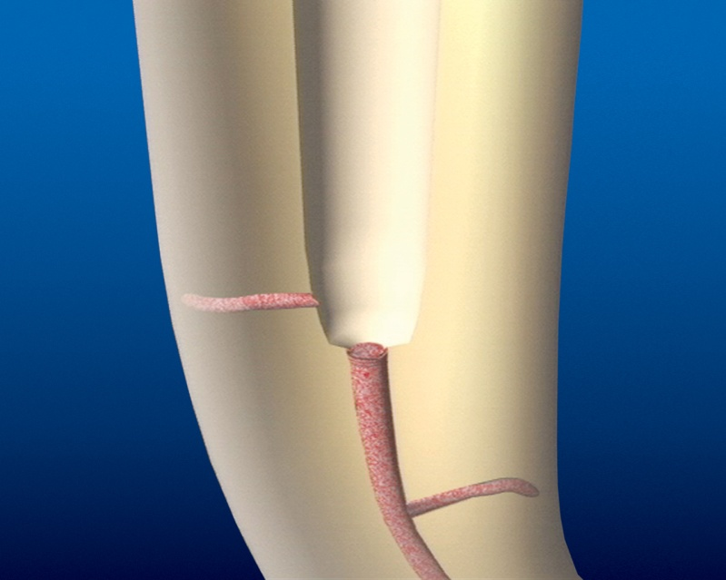


Slide 25
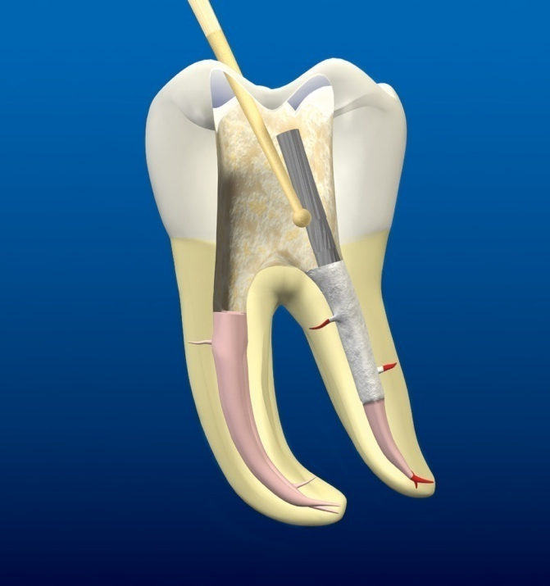
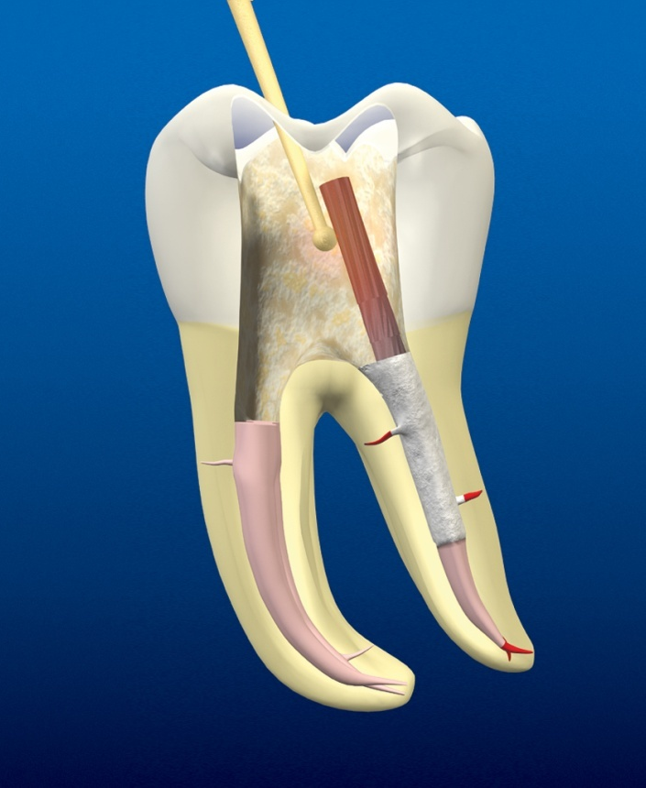
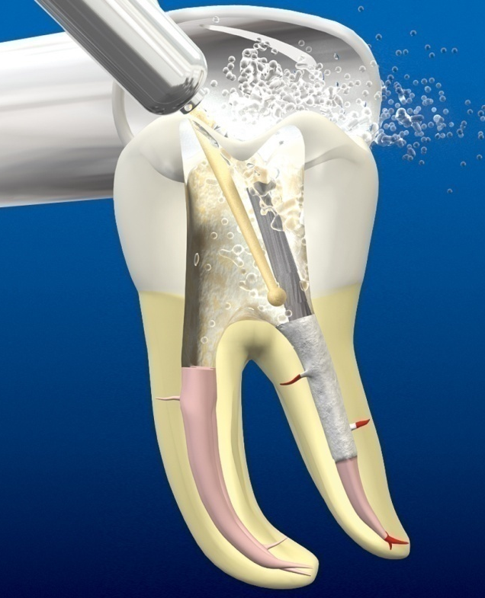
Posts Removal

Slide 26
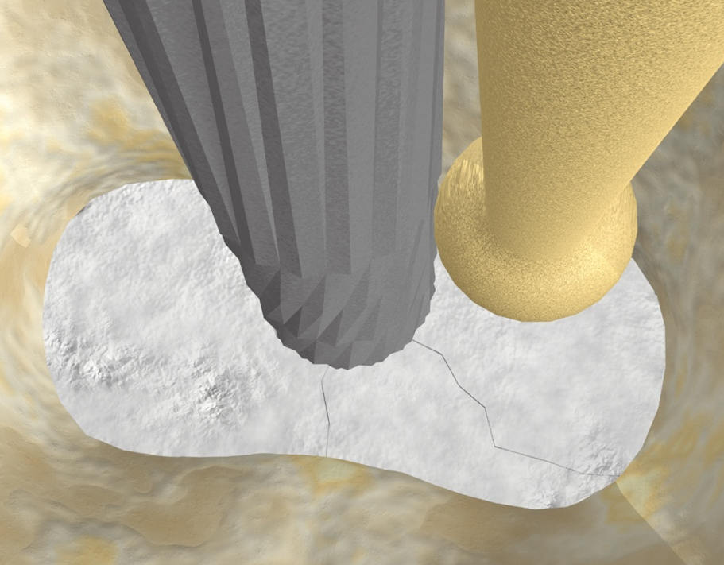
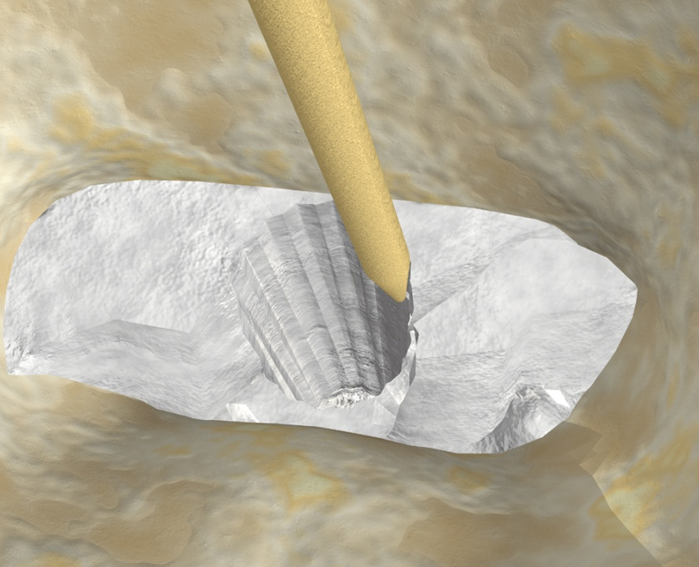
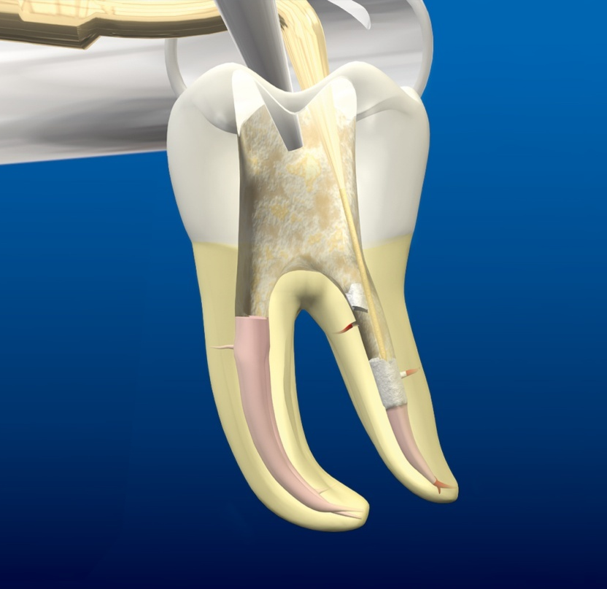

Slide 27

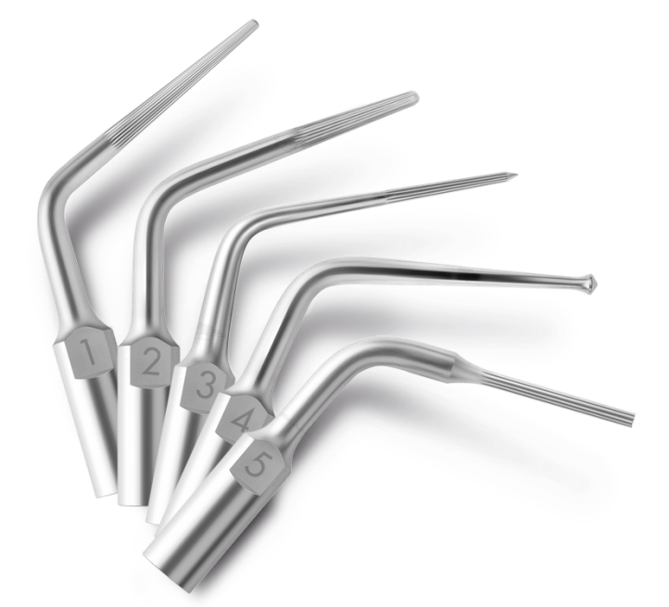

CONTINUING EDUCATION
CLINICAL EDUCATION
5 tips for access cavity refinement and canal orifice location

Slide 28
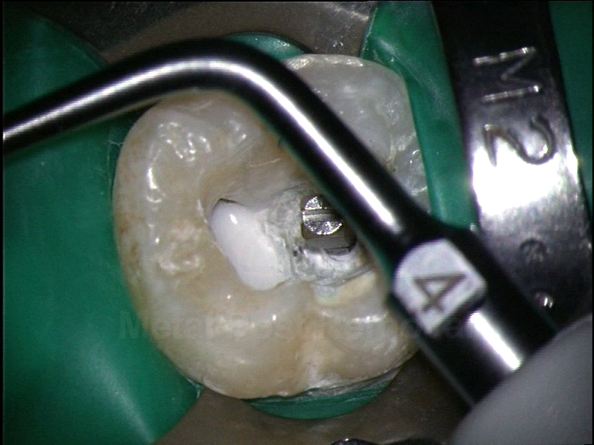
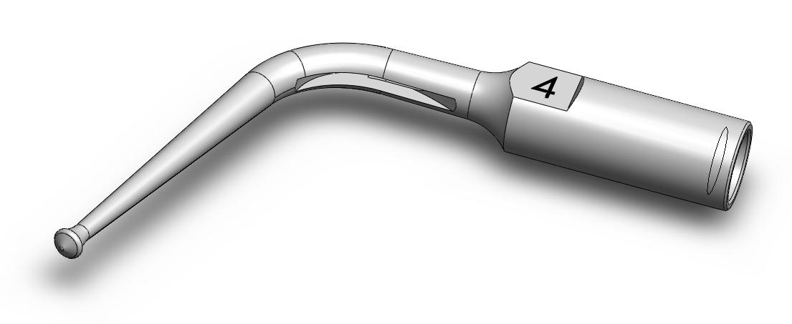
START-X™ #4 – METAL POST REMOVAL
  Specific design → suitable for working efficiently both on the top and on the sides of the metal post
  Water port → avoids over heating

Slide 29
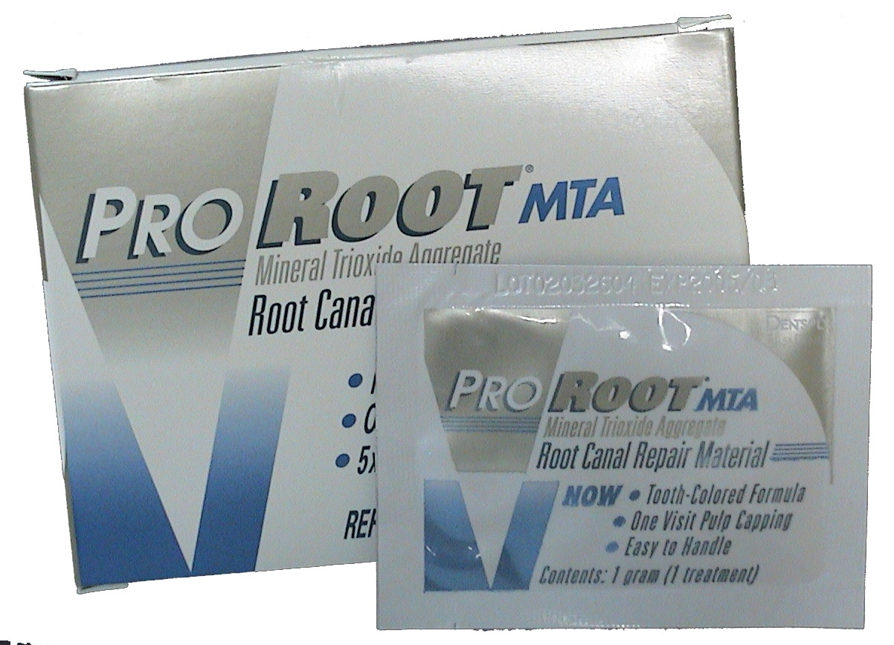
white
ProRoot MTA
MINERAL TRIOXIDE AGGREGATE

Slide 30

ProRoot MTA
PHYSICAL & CHEMICAL PROPERTIES
- pH 12,5
WORKING TIME 5 min.
- SETTING TIME 4 h.
R. COMPRESSION 67,3 MPa (Amalgam : 311,1 Mpa)
- RADIO OPACITY < Amalgam
> IRM et Super EBA

Slide 31

The two main properties of
ProRoot MTA
SEALING ABILITY
BIOCOMPATIBILITY

Slide 32
ProRoot MTA
INDICATIONS
PERFORATION REPAIR
APEXIFICATION (Apical Plug)
PULP CAPPING
ROOT-END FILLING MATERIAL

Slide 33
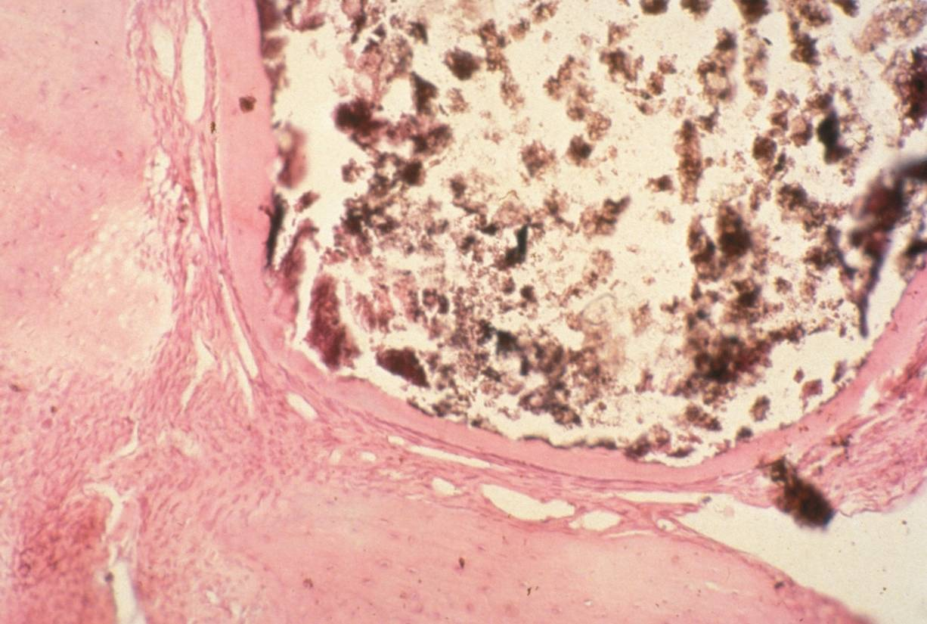
ProRoot MTA
For Perforation Repair
Lee et al. 1993
Pitt Ford et al. 1995
Nakata et al. 1998
Holland et al. 2001

Slide 34
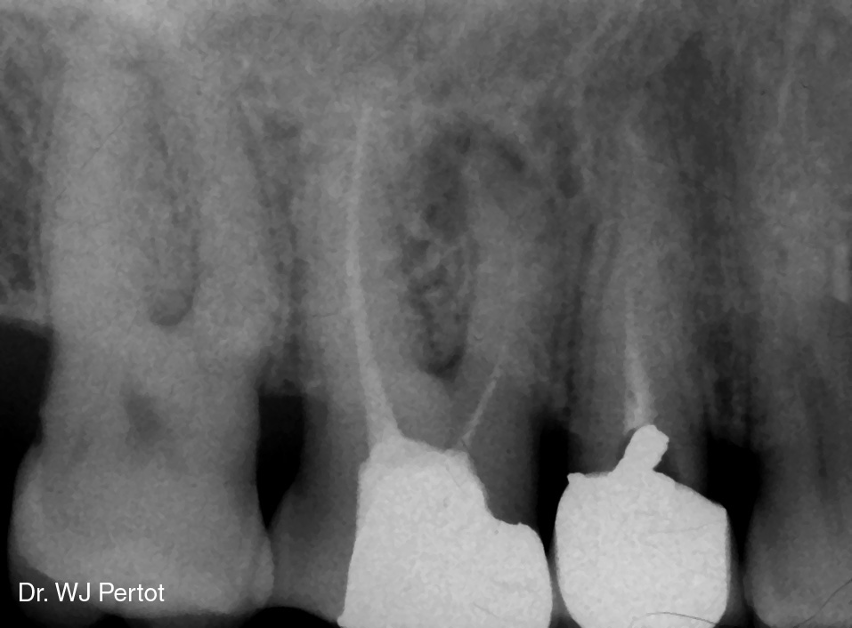

Slide 35
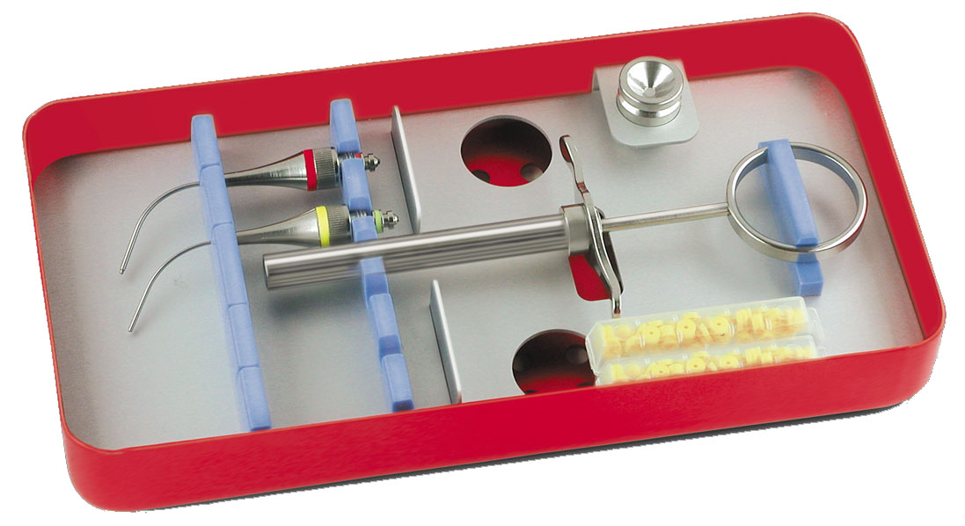
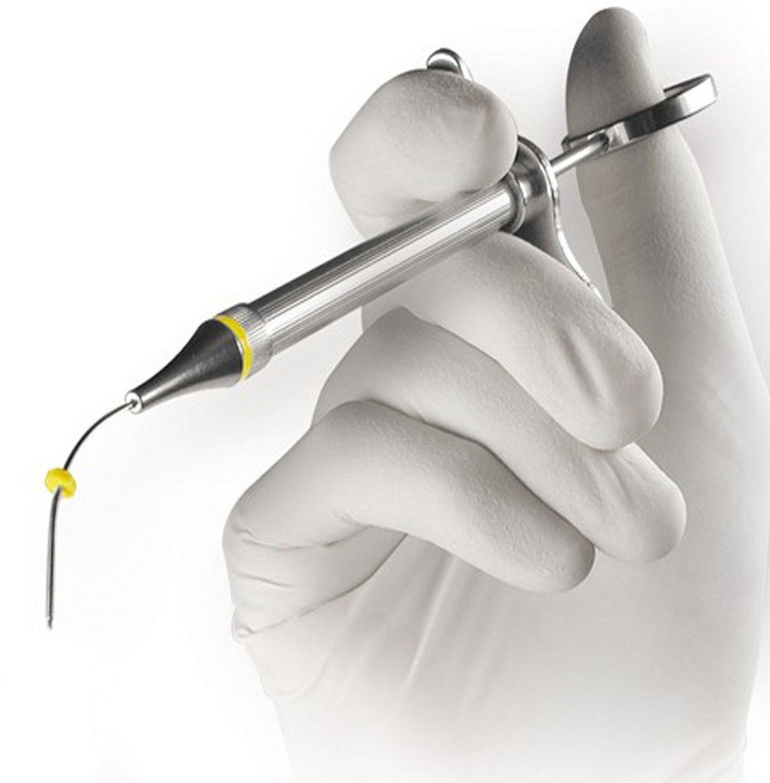
MTA GUN

Slide 36
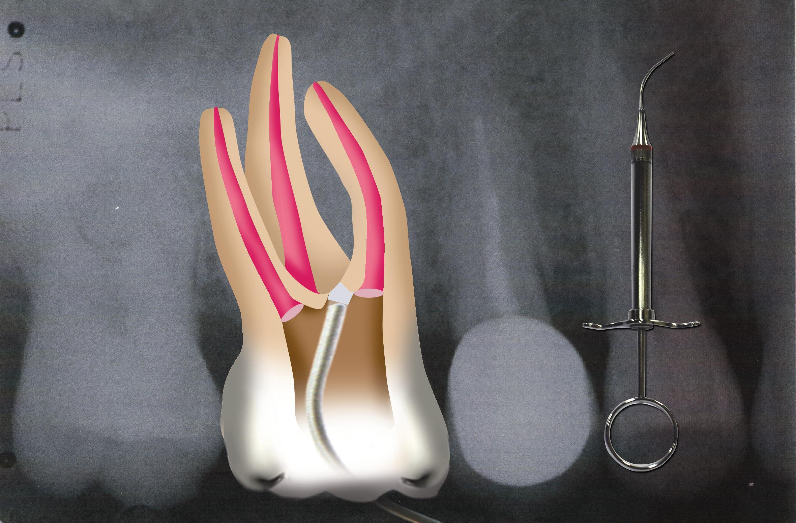

Slide 37
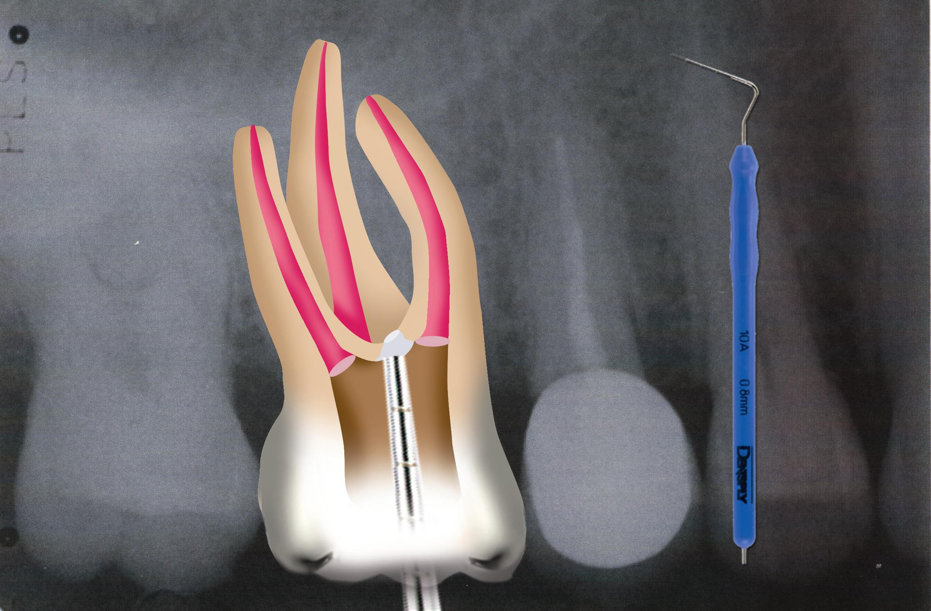

Slide 38
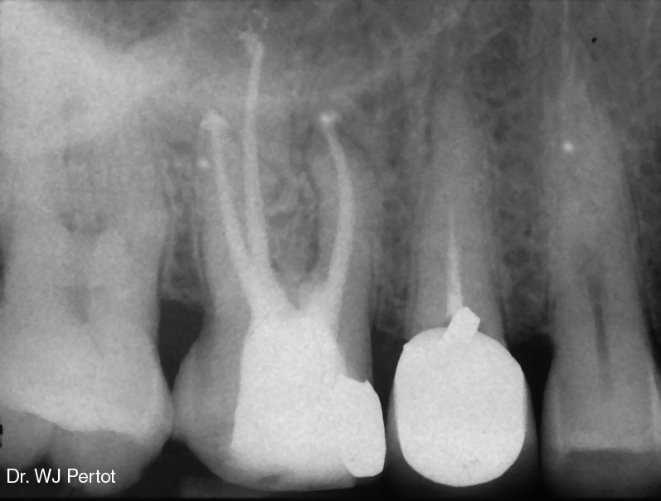

Slide 39
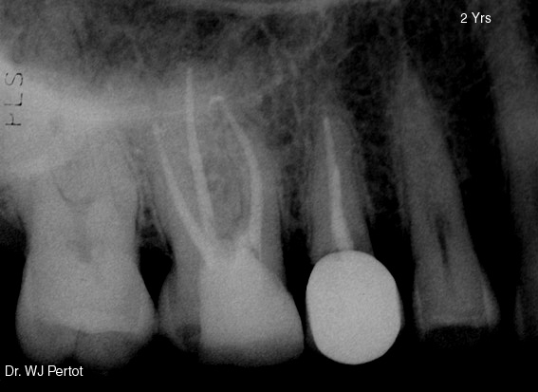

Slide 40
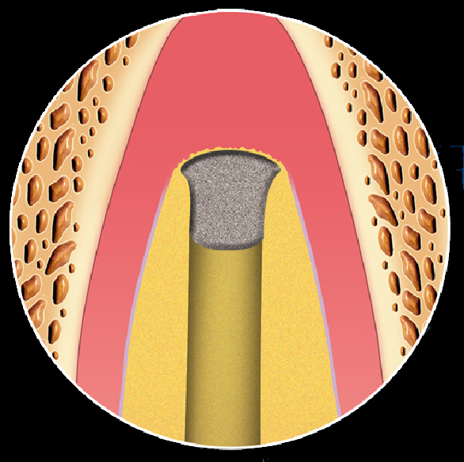
ProRoot MTA
For Apexification (Apical Plugs)
Tittle et al. 1996
Shahabang et al. 1999
Hachmeister et al. 2001
Felippe et al. 2006
Simon et al. 2007

Slide 41
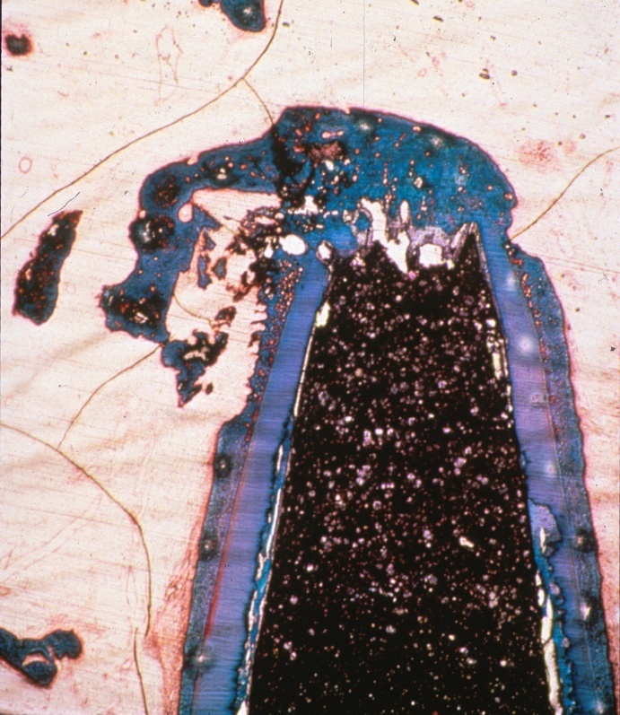
A comparative study of root-end induction using osteogenic Protein-1, calcium hydroxide and Mineral Trioxide Aggregate in dogs.
Shahabang et al. J Endodon 1999 ; 25 : 1-5.
Shahabang et al.
J Endodon 1999
% of roots with apical closure

Slide 42



Slide 43



