Slide 1
(VII.) Electrocardiography
Physiology

Slide 2
Electrocardiography
Definition: the process of recording the electrical activity of the heart
Keywords
Specialized excitatory and conductive system of the heart
equipment for ECG recording
limb and chest leads
unipolar and bipolar leads
heart vector, electrical axis of the heart

Slide 3
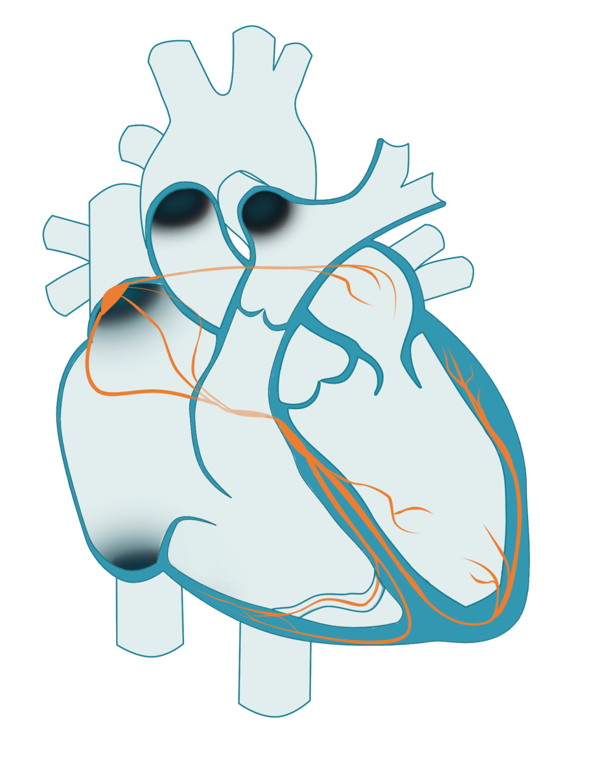
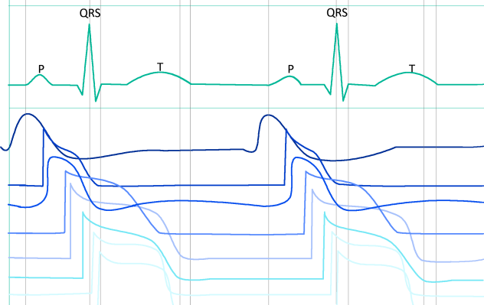
Specialized excitatory and conductive system of the heart
Sinoatrial node (SA)
internodal pathways
SA node
atrial myocard
Atrioventricular node (AV)
AV node
bundle of His
bundle branch
Bundle of His
Purkyne fibers
ventricular myocard
Bundle branch
Purkyne fibers

Slide 4
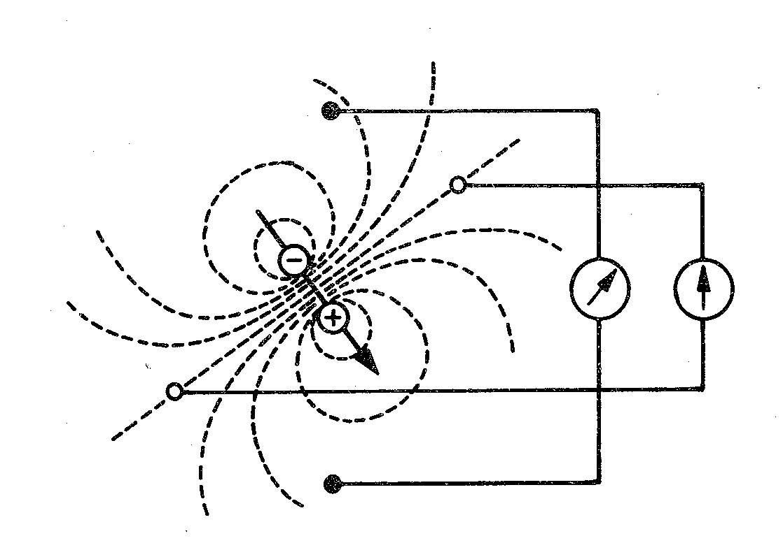
Electric dipole
Electrode: records electrical potential (Φ)
Elektric lead: connection of two electrodes
Recordes voltage between electrodes
Voltage: difference between el. potentials (V= Φ1- Φ2)
electrode
Φ2
lead
Φ1

Slide 5
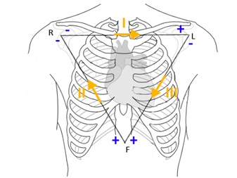
Einthoven´s triangle
(standard, limb, bipolar leads)
I
R
L
II
III
Bipolar leads: both electrodes are active (variable potential en electrodes)
F

Slide 6
Augmented leads
(Goldberger´s, limb, unipolar leads)
R
L
avR
aVL
Unipolar leads:
one electrode is active (variable el. potential) and the second one is indifferent (constant el. potential)
Active electrode is always positive
aVF
F

Slide 7
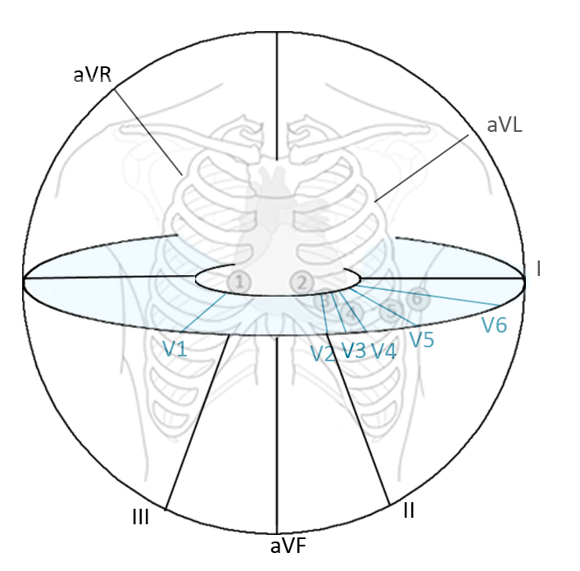
Chest leads
Wilson´s cental teminal
R
R
R
chest electrode
Chest electrode: connection of chest electrode and Wilson´s central terminal
Unipolar leads:
chest electrodes are active (positive) and Wilson´s central terminal is indifferent (el. potential 0 mV, electrically centre of the heart)
1
2
3
5
6
4

Slide 8
Leads acording to Cabrera
I
–
R
–
+
L
–
+
-
+
–
–
aVR
aVL
–
+
+
aVL
-30°
-
-
III
II
aVF
–
+
I
0°
+
+
+
–
F
–
aVR
+
30°
+
+
II
III
aVF
60°
120°
90°

Slide 9
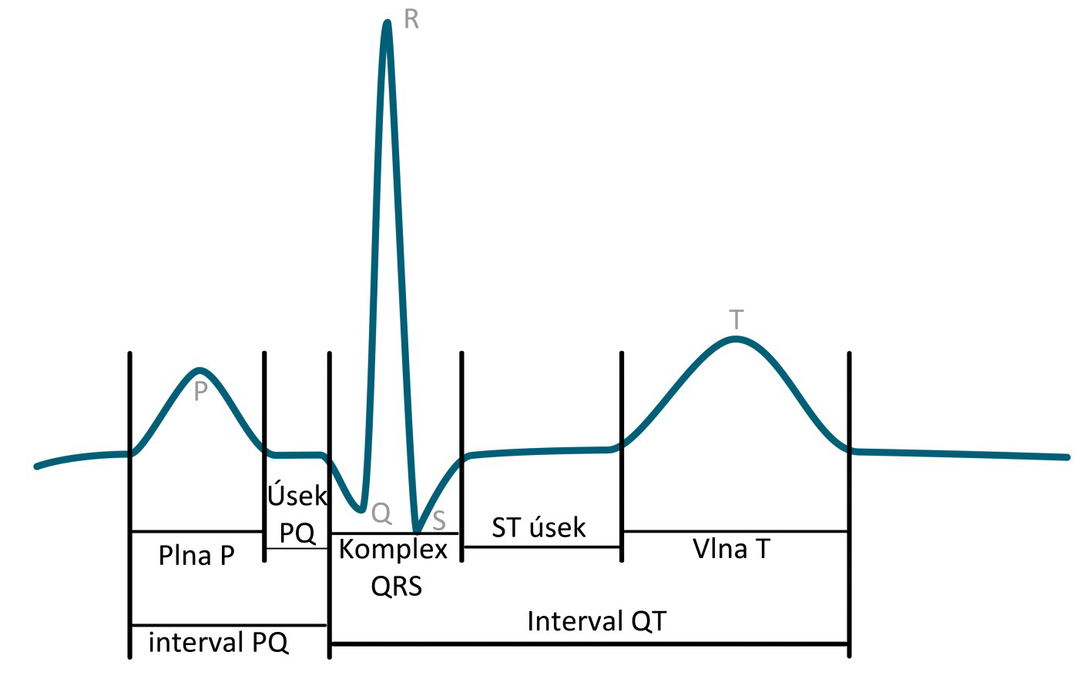
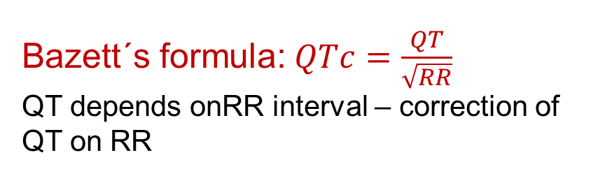
ECG description
name | Norm
P wave | 80 ms
Interval PQ (PR) | 120-200 ms
Segment PQ (PR) | 50-120 ms
Q | -
QRS | 80-100ms
R | -
S | -
segment ST | 80-120 ms
Interval QT | >= 420ms
wave T | 160 ms
R
T
P
PQ segment
ST segment
Q
S
Bazett´s formula:$QTc=\frac{QT}{\sqrt{RR}}$
QT depends onRR interval – correction of QT on RR
P wave
QRS complex
T wave
QT interval
PQ interval

Slide 10
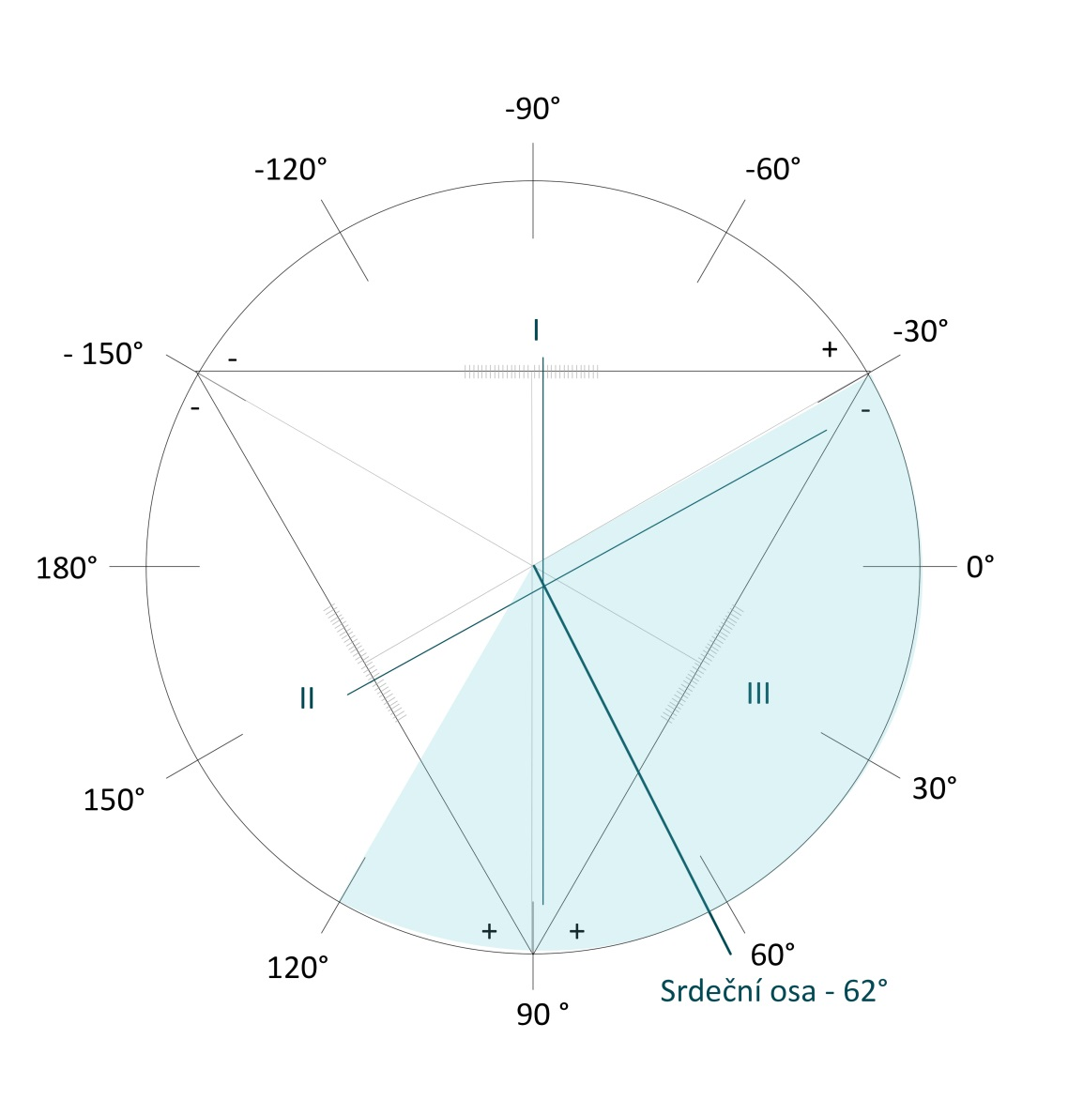
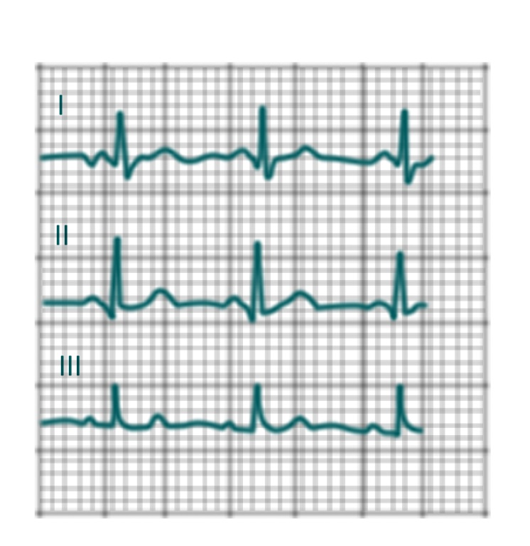
Electrical axis of heart
Average deviation of QRS complex in each lead
3. Drawing in triangle
2. Sumation of QRS complex
1. ORS of I,II and III lead
I | II | III
Q = -1 | Q = - 1 | Q = 0
R = 5 | R = 6 | R = 4
S = -1 | S = 0 | S = 0
3 | 5 | 4
L
R
I
–
+
–
–
3
II
5
III
Physiological interval: -30° - 110°
+
+
F

Slide 11
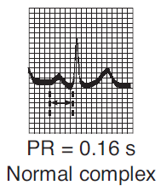
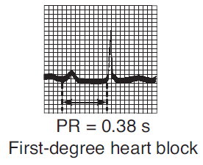
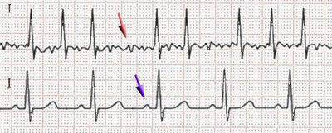
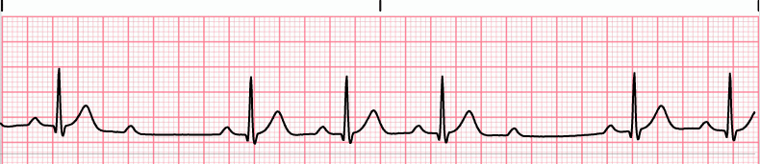
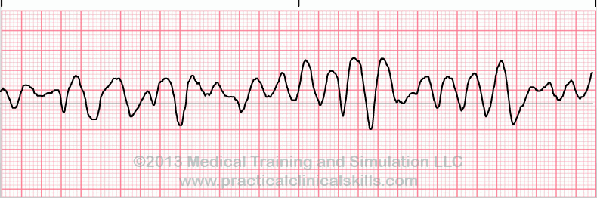
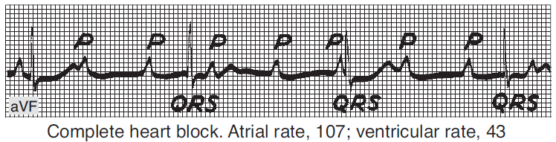
Diagnostic use of ECG
Atrioventricular block: conduction between the atria and ventricles of the heart is impaired
Arrhytmia: irregular heartbeat
Fibrillation: is the rapid, irregular, and unsynchronized activity of cardiac muscle fibers
fibrillation
AV block I. degree
normal
Atrial fibrillation
(absence of P, „jagged“ isolinia, irregular RR, HR 80 – 180 bpm)
AV block
II. degree
P
P
P
P
P
P
AV block
III. degree
Ventricular fibrillation
(heart cannot pump, brain damage after 3 – 5 min)
https://upload.wikimedia.org/wikipedia/commons/thumb/6/64/Afib_ecg.jpg/400px-Afib_ecg.jpg
http://www.qureshiuniversity.com/Ventricular%20Fibrillation.gif
https://ekg.academy/ekgtracings/313.gif

Slide 12
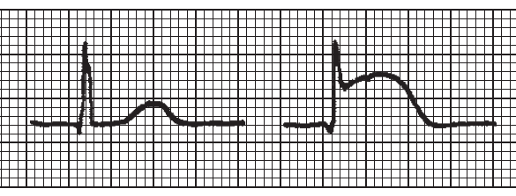
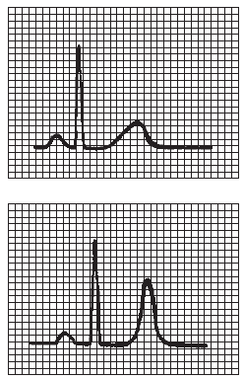
Diagnostic use of ECG
Myocardial ischemia, heart-attack
hyperkalaemia
A
B (ST elevation)

Slide 13
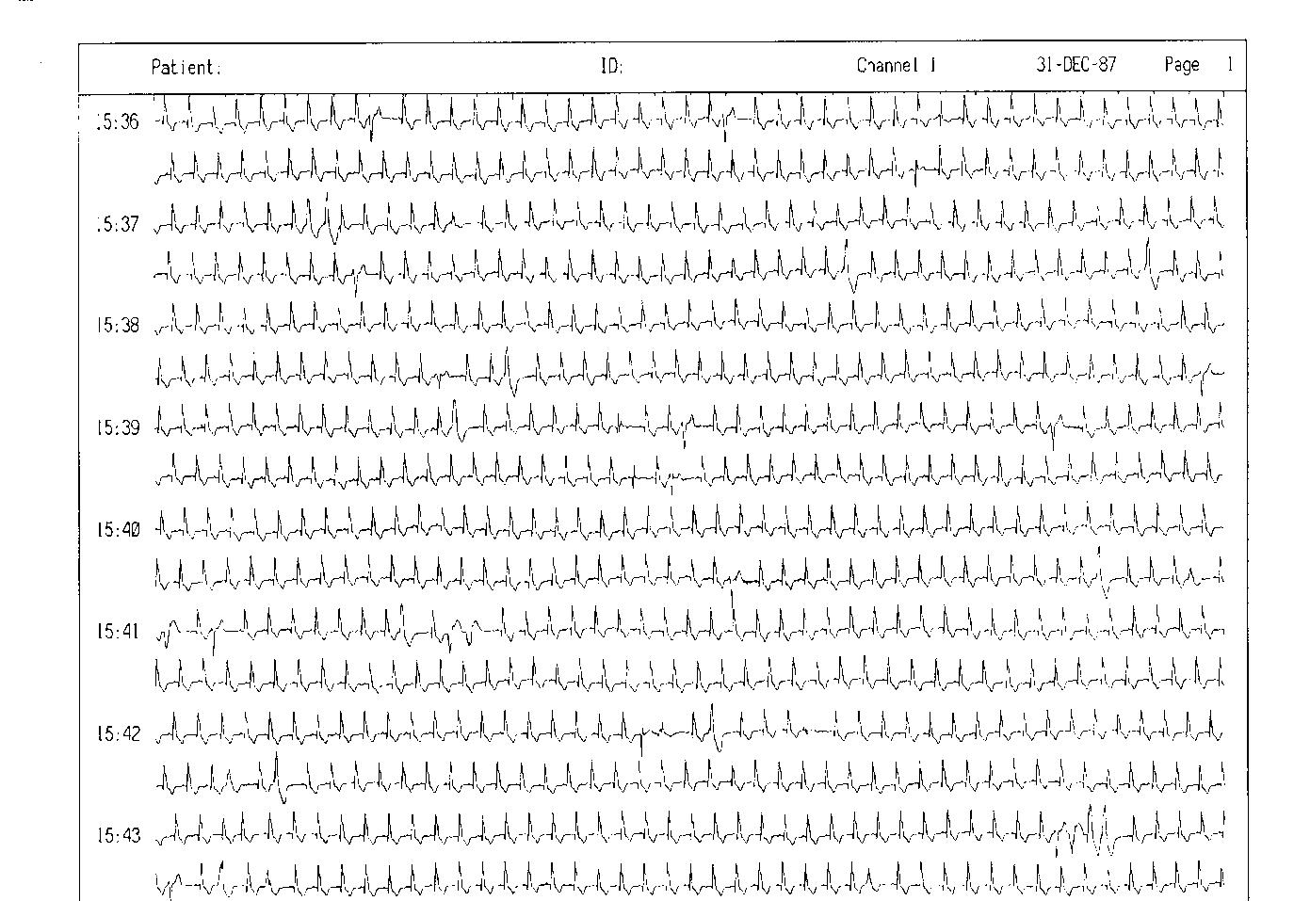
Diagnostic use of ECG
24-hour monitoring of ECG (Holter)

