Slide 1
(XI.) Digital model of aortic function
(XVI.) Blood flow in veins
Physiology I – practicals

Slide 2
Definitions of key words and symbols
Stroke volume (SV) – volume of blood ejected from the left ventricle to the aorta during one contraction
Heart rate (HR) – number of heart contractions per1 minute
Peripheral vascular resistance (R) – resistance of small arteries (mainly arterioles and capillaries)
Compliance of aorta (C_{a}) – ability of aorta to change its volume according to changes of blood pressure
Mean blood flow through circulatory system
Aortic volume
Q
HEART
SV, HR
V_{a}
Blood pressure in venous system
Blood pressure in arterial system
C_{a}
P_{v}
venous system
arterial system
P_{a}
R

Slide 3
Arterial blood pressure in case of changing circulatory parameters and cardiac output
P_{a}- P_{v}
ΔV_{a}
Q =
Q
C_{a}=
R
HEART
SV, HR
V_{a}
ΔP_{a}
C_{a}
P_{v}
venous system
arterial system
P_{a}
R
P_{a,m} - P_{v,m} = Q · R
ΔV_{a} ≅ SV
P_{a,m} = SV · HR · R + P_{v,m}
ΔP_{a} ≅
SV
ΔP
C_{a}
P_{a,m} ≅ SV · HR · R
P_{a,m}
Notes:
Stačí znát pouze rovnice v červeném pozadí a studenti si mohou sami (bez modelu) dovodit změny P_{a} při změnách SV, TF, R nebo C!
Rovnice pro P_{a,stř} v červeném pozadí ukazuje, že při zvýšení SV, TF nebo R dochází ke zvýšení středního arteriálního tlaku a naopak.
Rovnice pro ΔP_{a} v červeném pozadí ukazuje, že zvýšením SV nebo snížením C_{a} dochází k nárůstu pulsového tlaku a naopak.
Změny R tedy ovlivní P_{a,stř,} avšak ΔP_{a} zůstane nezměněn.

Slide 4
Model of aortic function
Calculation of P_{a}
Blood flow through aortic valve
F_{i} [ml/s]
Δ t
t [s]
  (P_{a} – P_{v})
  R
t = t+Δt
F_{o} =
HEART
SV, HR
F_{i}
C_{a}
P_{v}
venous system
arterial system
P_{a}
V_{a}
R
F_{o}
P_{a} = P_{a} +ΔP_{a}
ΔV_{a} = (F_{i} - F_{o})⋅Δt
  ΔV_{a}
    C_{a}
ΔP_{a} =
Notes:
Postupně (pro daný časový krok Δt) se počítá F_{i}, F_{o}, ΔV_{a}, ΔP_{a}, P_{a} a t. Tento postup se stále opakuje, až do dosažení času t.

Slide 5
Modeled situations
SV – increase: hyperhydration – rapid administration of i.v. infusion, intake of large amount of water in short time; decrease: dehydration, loss of blood (haemorrhage)
HR – increase: activation of sympathetic nervous system – stress, physical activity; decrease: increase of vague tonus, adaptation of heart in sportsmen (athletic heart)
R – increase: predominance of vasoconstriction – e.g. in cold environment; decrease: predominance of vasodilation – sauna, distributive shock (anaphylaxis, adrenal crisis)
C – higher values: in children, young people; lower values: in elderly people, atherosclerosis, elastic fibers degeneration – isolated systolic hypertension (systolic blood pressure is higher than normal, diastolic blood pressure is predominantly at normal level)

Slide 6
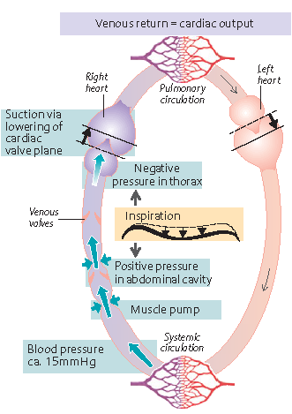

Mechanisms of venous return
Pressure gradient between venous system and right atrium („a force acting from behind“ – vis a tergo)
2
2. Suction effect of systole („a force acting from in front“ – vis a fronte)
4
3. Skeletal muscle contractions – muscle pump
5
4. Suction effect of inspirium – increased intraabdominal pressure and decreased intrathoracic pressure
3
1
5. Venous valves

Slide 7
Picture sources
Slide 7 – Atlas Of Physiology, Silbernagl & Despopoulos, Georg Thieme Verlag 2003

