Slide 1
Measurement of pulse wave velocity (XII.)
Dep. of Physiology, Fac. of Medicine, MU, 2015 © Jana Hrušková

Slide 2
Definition of pulse wave
Pulse wave arises during heart revolution, when blood is ejected.
Single pulse is propagated in arterial wall through whole arterial system

Slide 3
Pulse wave curve
Pulse wave is composed of two waves: forward traveling wave and backward traveling wave. Forward wave travels from the heart to periphery. Backward wave is rebounded from bifurcations of arteries in periphery. It travels to the heart, interferes with forward wave and both together form shape of the pulse wave curve.
Amplitude of pulse wave increases in periphery due to increased pulse wave velocity.
  The shape of the curve is depend on the place where it is measured. The smallest amplitude is common in radial artery, greatest one in dorsal pedis artery.
Heart
Backward traveling wave
Periphery
Forward traveling wave
Pulse wave in aorta
Pulse wave in periphery

Slide 4
Pulse wave velocity (PWV)
Velocity of pulse wave propagation varies from 6 m/s (in aorta) to 20 m/s (in periphery)
It is much greater than velocity of blood flow (0.8 – 1.0 m/s)

Slide 5
Factors affected the pulse wave velocity
  Age
  Sex
  Genetic load
  Smoking
  Obesity
  Diabetes
  Dyslipidaemia

Slide 6
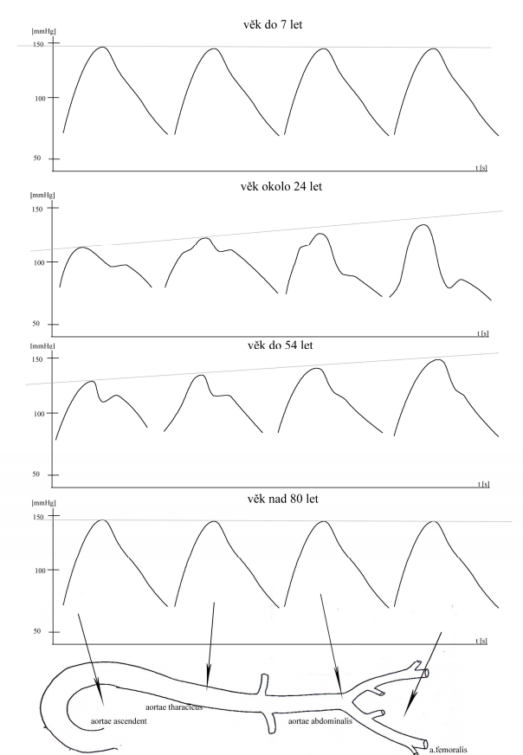
Changes of pulse wave in elderly people
Increased PWV and vanishing of typical characteristics of shape of the pulse wave due to:
Increased arterial stiffness
Increased blood pressure

Slide 7
Young man:
High arterial compliance → lower pulse wave velocity → backward wave meets forward wave during the beginning of diastole → lower pulse amplitude
Total wave
Forward wave
Backward wave
Elder man:
decreased arterial compliance → increased pulse wave velocity → backward wave meets forward wave during the end of systole → increased pulse amplitude
ŠPÁC, Jiří. Hypertenze a vlastnosti arteriální stěny. Kardiofórum, 2006, roč. 4, č. 4, s. 9-13. ISSN 1214-2255.

Slide 8
Changes of pulse wave in children
Increased PVW and vanishing of typical characteristics of shape of the pulse wave due to:
Smaller length of arterial system
Longer ejection time
  Relatively long ejection time to small body and higher heart rate leads to changes of summation of consecutive pulse waves

Slide 9
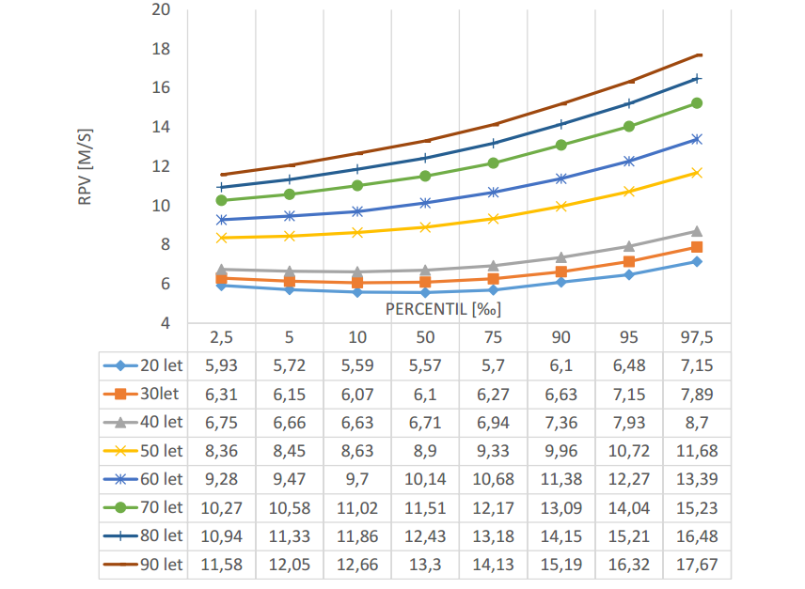
Normal values of PWV
Reference intervals for carotid-femoral index (PWV)
If the measured value is higher than 90. percentile for the age, it is the sign of cardiovascular pathology (such as atherosclerosis) and such person has significant higher risk for cardiovascular diseases.

Slide 10
Measurement of PWV
Direct method
  Catheterisation
Indirect methods
  Ultrasonography
  Sphygmography
  Bioimpedance analysis

Slide 11
Sphygmography
Carotid-femoral PWV („gold standard“) measured from pulse on a. carotis, a. femoralis and ECG.
Well reproducible method (differences between two measurement are < 5 %),
Arterial segment is analysed as complexly
In clinical practise, it is important to take in consideration the actual blood pressure. Arterial compliance is a function of blood pressure and arterial hypertension increases rigidity of the arterial wall.
Aortal PWV is the most important parameter, because it reflects dampening function of the central arterial system.
A
B
T1
T2
A
B
d
PWV= d/ (T2-T1)

