Slide 1
(VIII.) blood pressure in man (IX.) Non-invasive methods of blood pressure measurement
Physiology - practicals

Slide 2
Arterial blood pressure curve
Blood pressure (BP): pressure on vascular vall (continual variable)
Mean arterial pressure (MAP) : mean value of blood pressure in the inter-beat interval (IBI)
area under MAP = area above MAP
aproximation: MAP≈ DBP + 1/3 PP (PP = SBP – DBP)
Definition:
SBP - maximum of BP in the inter-beat interval
DBP – minimum of BP in the inter-beat interval
Attention: Values of SBP and DBP varies in different parts of cardiovascular system
SBP
Systolic blood pressure
area above MAP
MAP
Mean arterial pressure
PP
pulse pressure
DBP
Diastolic blood pressure
area under MAP
inter-beat interval

Slide 3
MAP is a function of cardiac output and total peripheral resistance
Mean arterial pressure (MAP)
Cardiac output
(CO)
Total peripheral resistance (TPR)
=
*
Heart rate
(HR)
Stroke volume
(SV)
*
SBP is given mainly by CO
DBP is given mainly by TPR

Slide 4
Blood pressure regulation
Short-term – neural control, mainly baroreflex
Medium-term – hormonal regulation, renin-angiotensin-aldosteron system (RAAS)
Long-term – hormonal regulation of blood volume

Slide 5
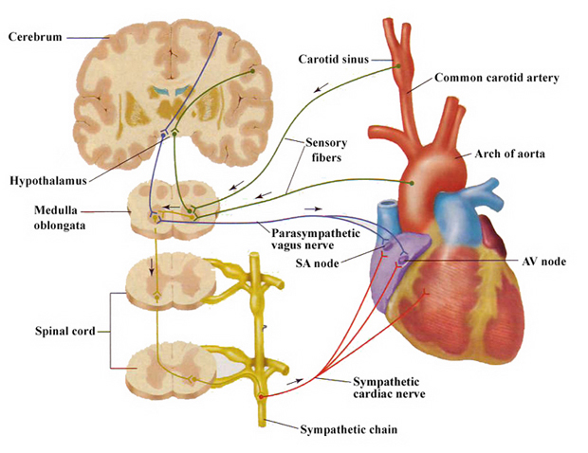
Short-term BP control: Baroreflex
Autonomic nervou system: sympathetic nerves (↑ BP, HR, SV a TPR) X parasympathetic nerves (↓BP, HR, SV a TPR)
Baroreflex: regulation of BP via changes of HR and TPR
baroreceptors – sinus caroticus + aorticus afferentation: n. vagus, n. glosopharingeus
Cardiac branch of baroreflex:
efferentation: n. vagus - SA node
sympathetic efferentation: change of HR and cardiac contractility
↑BP →↓HR and vice versa
Peripheral branch of baroreflex:
efferentation: sympathetic vascular innervation ↑BP →↓TPR and vice versa (vasoconstriction, venoconstriction)

Slide 6
Blood pressure changes
Short-term influences
blood volume - influence to SV (bleeding, dehydration)
external pressure to the vessels - intrathoracal a intraabdominal pressure (cough, defecation, childbirth, artificial ventilation)
position – orthostasis: higher DBP (↑TPR) a lower STK (↓venous return→ ↓heart filling → Starling principle→ ↓cardiac contraction → ↓SV)
CNS – emotions, mental stress,…
physical load – BP changes depend on intensity, duration and type of exercise
heat (↓ TPR), cold (↑ TPR)
alcohol, medicaments,…
Long-term influences
age (the fastest changes during childhood and adolescence)
sex (men: higher BP)

Slide 7
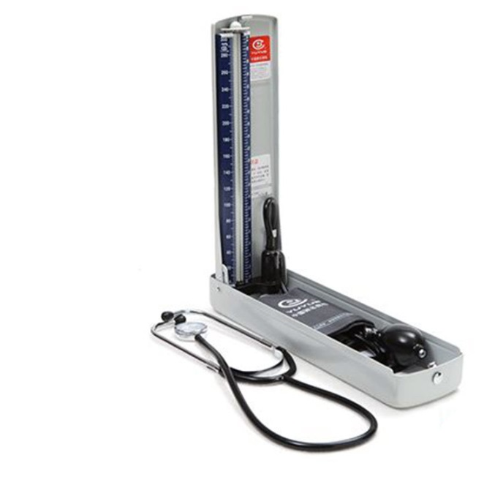
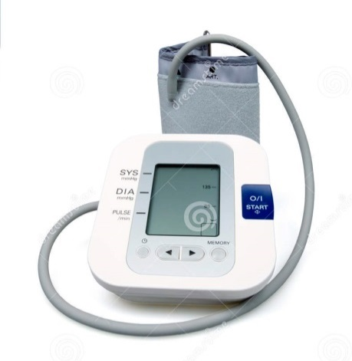
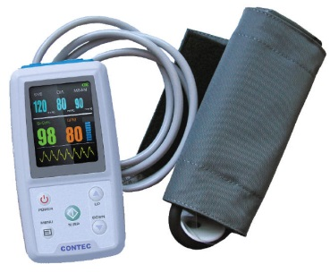
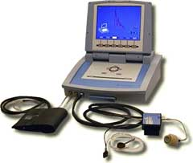
Methods of the arterial blood pressure measurement
In practicals:
Auscultatory
(sphygmomanometer,
stethoscope)
Palpatory
(sphygmomanometer)
Oscillometric
Another approaches:
24-hour blood pressure monitoring
Photoplethysmografic (volume-clamp method, Peňáz)

Slide 8
Laminar / turbulent flow, Korotkoff sounds
$$Re=\frac{v∙S∙ρ}{η}$$
laminar flow Re < 2000
turbulent flow Re > 3000
Reynolds number Re: predicts the transition from laminar to turbulent of flo v: velocity of blood flow
S: area of vascular lumen (π.r²)
ρ: density of blod
η: viskosit of blood
(higher in anemy)
cuff
a. brachialis
Re₂
r₁
r₂
v₂
v₁
Re₁
laminar flow
turbulent flow
closely behind narrowing of the artery:
S₁ < S₂ a v₁≈ v₂ → Re₁ < Re₂ → turbulent flow

Slide 9
Principles of blood pressure measurement
SBP
MAP
DBP
Korotkoff sound
(auscultatory method)
Pressure in the cuff
SBP
DBP
Pressure oscillations in the cuff
(Oscillometric method)
Continually measured BP
Blood flow in the artery

Slide 10
24-hour blood pressure monitoring
BP decrease during night: 10 - 15%
[mmHg]
Heart rate
Blood pressure
SBP
DBP
Heart rate
[bpm]
140
120
100
80
60
120
100
80
60
8
9
10
11
12
13
14
15
16
17
18
19
20
21
22
23
24
1
2
3
4
5
6
7
hours
waking
sleeping

Slide 11
During BP measurement following rules must be observed
Patient is sitting for a few minutes before the measurement.
Only validated apparatus must be used.
Perform at least two measurements in the course of 1–2 minutes.
Use cuff of standard size (12–13 cm width and 35 cm length); however smaller and bigger cuffs must be available for patients with smaller or bigger size of arm, respectively.
Cuff must be always at the level of heart of examined person.
Pressure in the cuff must be decreased slowly: 2mmHg/s.

Slide 12
methods | advantages | disadvantages | measured value
auscultatory | exact estimation of SBP/DBP easy, it doesnt require electricity | subjective, experience is necesary SBP/DBP from differen IBI | STK a DTK
oscillometric | exact estimation of MAP automatic, fast BP can be measured by layman, cheap (home measurement) | DBP/SBP is calculated (dependence on model, influence on shape of puls wave) SBP/DBP from different IBI false values during arrhytmia | MAP, sometimes SBP (it depends on device)
24 – hour BP monitoring | BP record from whole day diagnosis of white-coat hypertension | disruptive influence of measuring (during sleeping) SBP/DBP from different IBI | BP is mesured each 15 – 60 min
photople-thysmographic (Peňáz) | continual BP record possibility of beat-to beat SBP/DBP calculation (BP variability analysis) | measuring on the finger, brachial BP recalculating expensive device | continual BP record

Slide 13
Diagnosis of hypertension
 | blood pressure | SBP [mmHg] | DBP [mmHg] | posible complications
normal | optimal | <120 | <80
 | normal | 120 – 129 | 80 – 84
 | high normal | 130 – 139 | 85 – 90
hyper-tension | stage | 140 – 159 | 90 – 99 | without organ changes
 | 2. stage | 160 – 179 | 100 – 109 | hypertrophy of L ventricle, proteinuria, angiopathy, ...
 | 3. stage | > 180 | > 110 | morphological and functional changes of some organs, retinopathy, heart and renal insufficiency, ischemia of CNS, bleeding in CNS
isolated systolic hypertension: SBP> 140 and DBP <90
high normal BP – annual monitoring recomended
home measurement to exclude white coat hypertension
hypertension is diagnosed when:
average BP from 4 – 5 examinations is > 140/90
BP during a home measurement repeatedly > 135/80
mean BP from 24-hour monitoring is > 130/80

Slide 14
Changes of blood pressure during exercise
increase of BP depends on the type, intensity and duration of the load
sympathetic activation: changes in the cardiovascular system serve to satisfy metabolic needs of working muscle
impact of exercise on blood pressure
increased cardiac output → ↑STK
Redistribution of blood in the body - metabolic vasodilation in muscle (muscle increases blood flow), vasoconstriction in the GIT, skin and kidneys → maintaining or slight change in DBP (depending on the extent of the TPR decrease)
vasoconstriction in the skin is temporary, since thermoregulatory mechanisms dominate
DBP increases during isometric muscle work (eg. weightlifting)
after exercise: decrease of BP on the initial or a slightly lower value, the blood flow in the muscle remains elevated until recovery
Recovery interval is determined by the parasympathetic tone (can be increased training)

