Slide 1
1. SUPERIOR OR SUPERIUS?
MAIOR OR MAIUS?
ANTERIOR OR ANTERIUS?
Vena cava
superior
Cornu
maius
Arteria
anterior
Membrum
superius
Ductus
maior
Ductus
anterior
Extremitas
superior
Ala
maior
Segmentum
anterius
Palpebra
superior
Musculus
maior
Margo
anterior
Labium
superius
Curvatura
maior
Bronchus
anterior
Facies
superior
Flexura
maior
Nucleus
anterior
Meatus
superior
Fossa
maior
Cornu
anterius
Arteria
superior
Foramen
maius
Nodus
anterior
Plexus
superior
Tuberculum
maius
Tuberculum
anterius
Segmentum
superius
Circulatio
maior
Radix
anterior
Regio
superior
Pelvis
maior
Crus
anterius
Notes:
REVISION

Slide 2
2. PUT COMPARATIVES AND SUPERLATIVES INTO THE PLURAL
Musculi longi
longiores
longissimi
Cavitates parvae
minores
minimae
Radices latae
latiores
latissimae
Defectus magni
majores
maximi
Gradus parvi
minores
minimi
O-tiones acutae
acutiores
acutissimae
Foramina parva
minora
minima
Infarctus recentes
recentiores
recentissimi
Ossa brevia
breviora
brevissima
Partes molles
molliores
mollissimae
Therapiae longae
longiores
longissimae
Notes:
REVISION

Slide 3
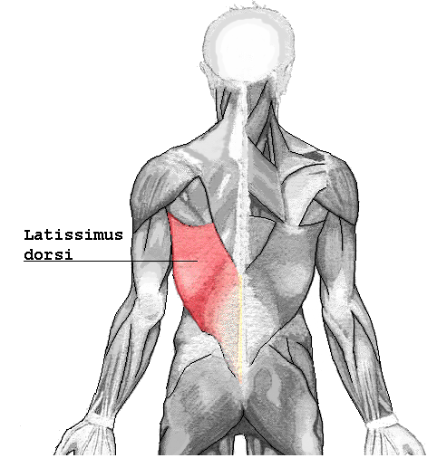
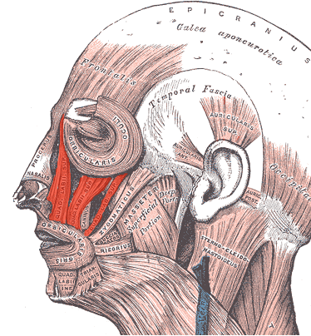
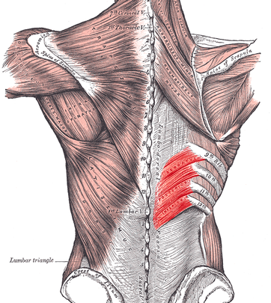
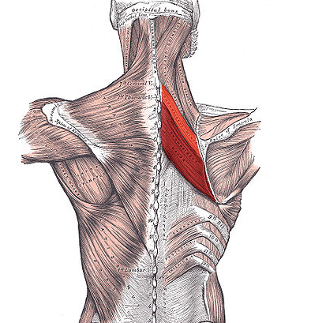
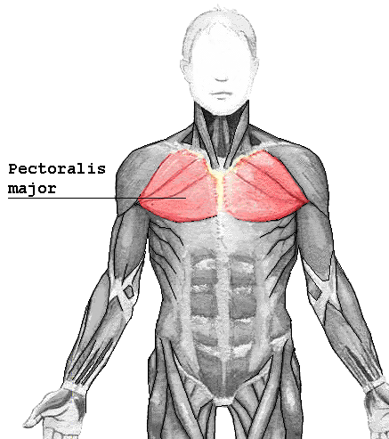
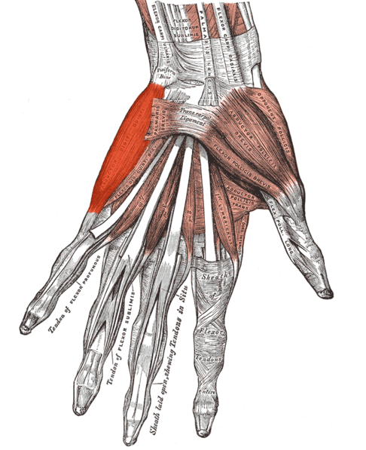
B
C
A
D
F
E
Notes:
REVISION: M. latissimus dorsi; M. levator labii superiori; M. serratus posterior inferior; M. rhomboideus major et minor; M. pectoralis major; M. abductor digiti minimi

Slide 4
EXPRESSING POSITION
PREPOSITIONS
COMPARATIVE FORMS
ADJECTIVES
PREFIXES

Slide 5
A) PREPOSITIONS
WITH ABLATIVE
  corpus alienum in aure interna
  vulnus morsum sub genu l.dx.
WITH ACCUSATIVE
  funiculus umbilicalis circum collum fetus
  tumor ad hepar increscens

Slide 6
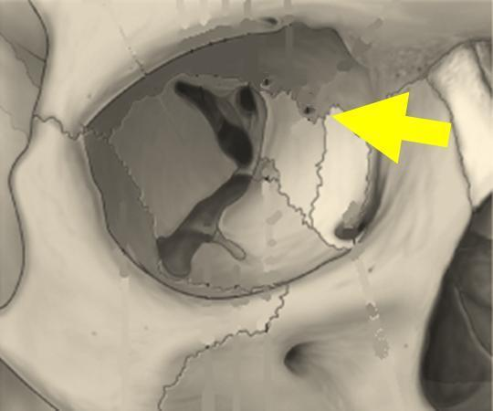
B) COMPARATIVE FORMS
foramen ethmoidale
anterius / posterius
Anatomy: differentiating two or more structures of the same kind, e.g. pelvis minor/major
Clinical terminology: terms that can be described by both opposite adjectives, e.g. circulatio major/minor, gradus minoris/majoris
Notes:
Foramen ethmoidale anterius / posterius

Slide 7
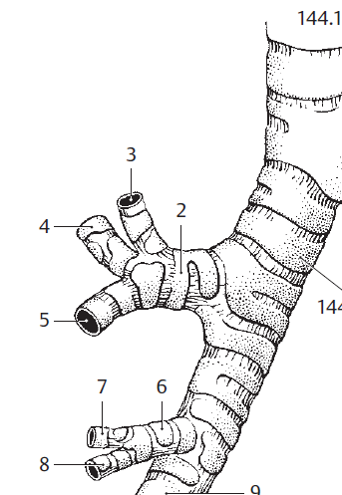
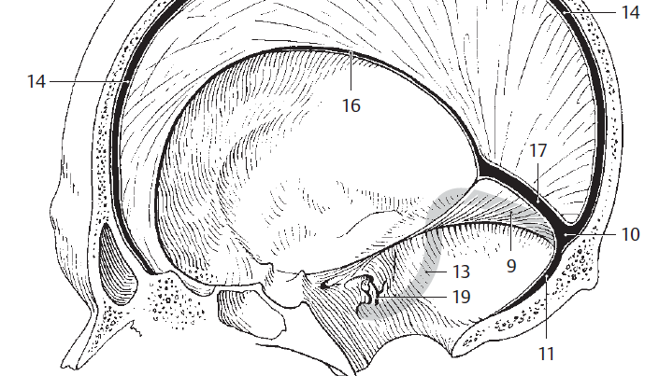
C) ADJECTIVES
bronchus segmentalis apicalis
bronchus lobaris superior dexter
sinus sagittalis superior / inferior
Notes:
(2) bronchus lobaris superior dexter – for the superior lobe of the right lung; (3) bronchus segmentalis apicalis – bronchus for apical segment
Sinus sagittalis superior / inferior
**Rostralis: a) resembling a beak: fascia retinens rostralis; b) situated toward rostrum (oral+nasal region): canalis vomerorostralis (between vomer and sphenoidal rostrum); this may mean superior (to spinal cord) or anterior (to brain)

Slide 8
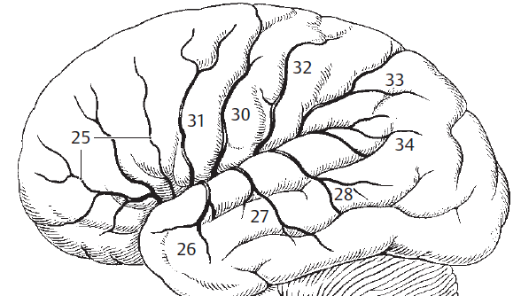
25 a. frontobasalis lateralis
26 a. temporalis anterior
27 a. temporalis media
28 a. temporalis posterior
30 a. sulci centralis
31 a. sulci precentralis
32 a. sulci postcentralis
33 aa. parietales anterior et posterior

Slide 9
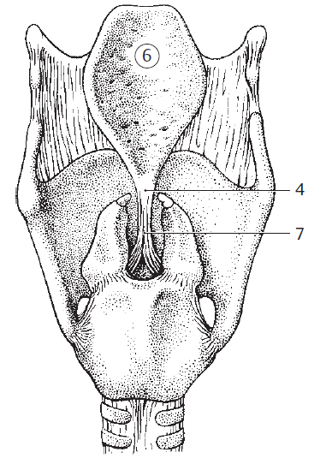
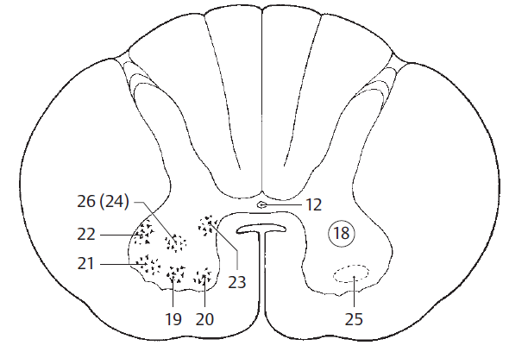
D) COMBINED TERMS
lig. thyroepiglotticum
nucleus anterolateralis 19
n. anteromedialis 20
n. posterolateralis 21
n. retroposterolateralis 22
n. posteromedialis 23
Notes:
Ligamentum thyroepiglotticum (7) – attaches epiglottis to thyroid cartilage; nuclei (19-23)

Slide 10
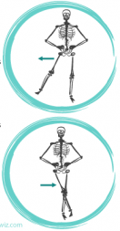
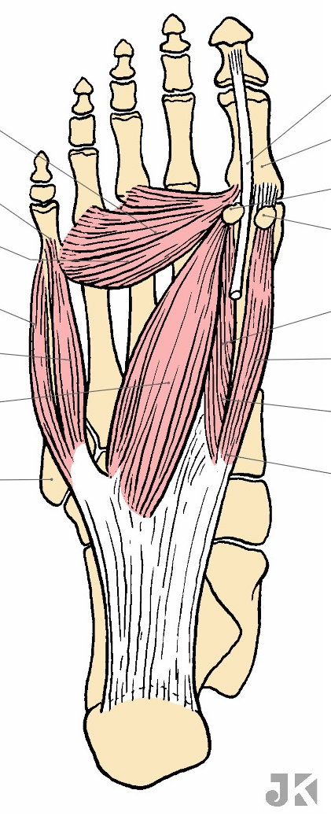
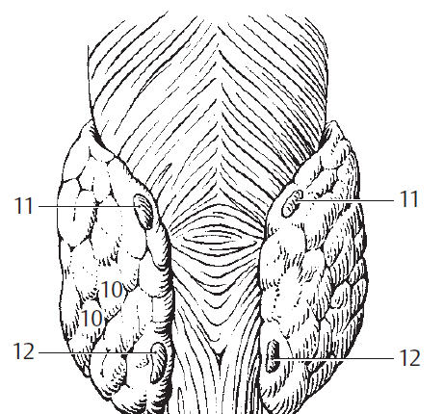
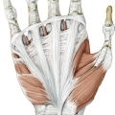
E) PREFIXES
ab-
ad-
apo-
par(a)-
Notes:
m. adductor hallucis; m. abductor digiti minimi; m. abductor hallucis – toto jsem myslela že by mohli zvladnout pojmenovat sami…; aponeurosis palmaris (aponeurosis = flat tendinous structure); glandulae parathyroideae superiores et inferiores (11, 12)

Slide 11
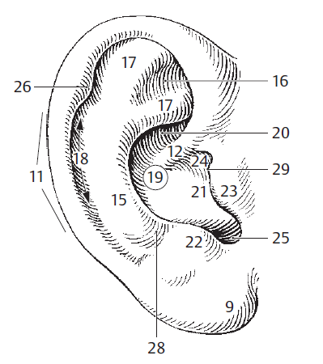
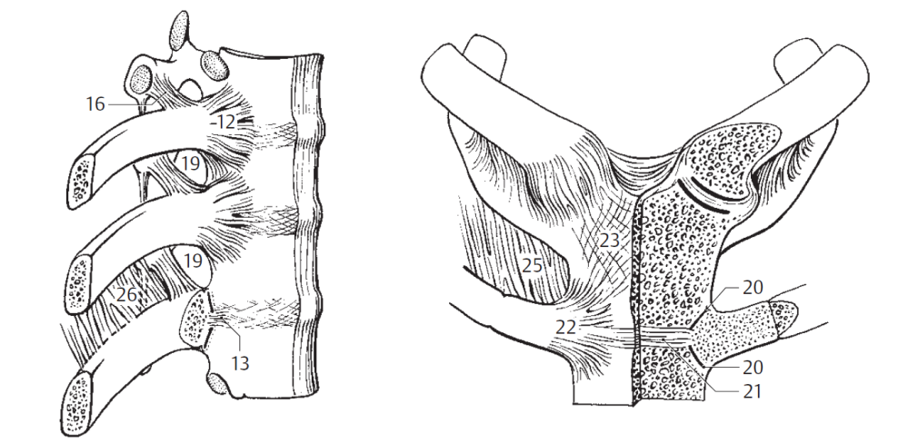
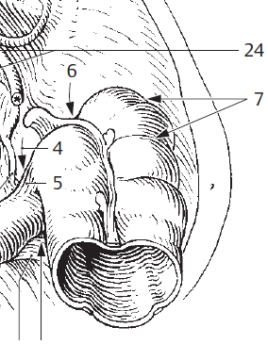
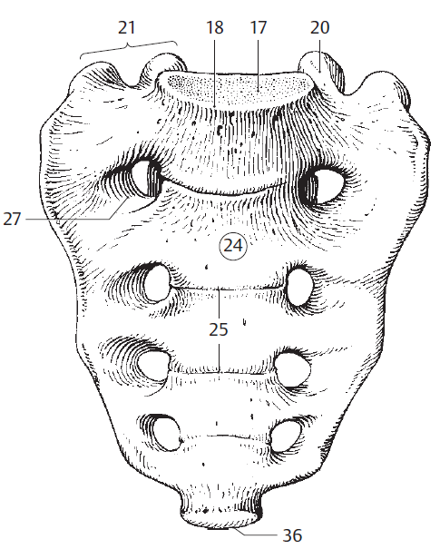
membrana intercostalis interna / externa
helix / ant(i)helix
recessus retrocaecalis
promontorium ossis sacri
Notes:
Membrana intercostalis interna (26) / externa (25); helix (11) antihelix (15); recessus retrocaecalis (6); promontorium (pro + mons, ntis) (18) = prominent margin of the body of S1 vertebra

Slide 12
GUESS THE MEANING OF THE PREFIX AND ANALYZE THE TERMS
INJECTIO
intravenosa
intraarterialis
intramuscularis
subcutanea
ABSCESSUS
intracranialis
retrocaecalis
extraduralis
epiduralis
paraurethralis
perirenalis
GLANDULA
sublingualis
submandibularis
hypogastrica
parotidea
suprarenalis
Notes:
INJECTIONS: put into a vein; put into an artery; into a muscle; under the skin
ABSCESSES: located inside the skull; behind caecum; out of dura mater; on dura mater; next to urethra; around kidney
GLANDS: located under the tongue; under lower jaw; under stomach; next to ear; above kidney

Slide 13
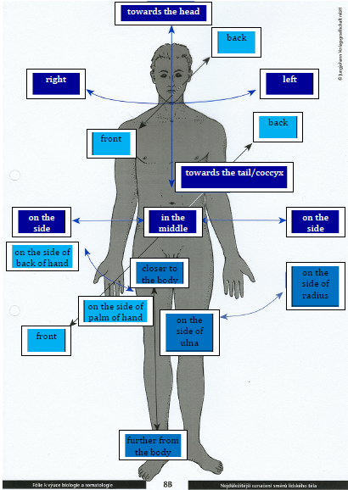

Slide 14
True or False?
YES NO
1. In anatomical position the palmar surface is in posterior position.
2. The sternum is anterior to the heart.
3. The clavicles are mediales to the sternum.
4. The elbow is proximalis to the wrist.
5. The aorta is ventralis to the spinal column.
6. The skin is profundus to the muscles.
7. The blood drawn from a fingertip is peripheralis.
✓
✓
✓
✓
✓
✓
✓

Slide 15
Fractures - addition
Dislocated fractures
Classification
Fracture healing
Tooth fractures

Slide 16
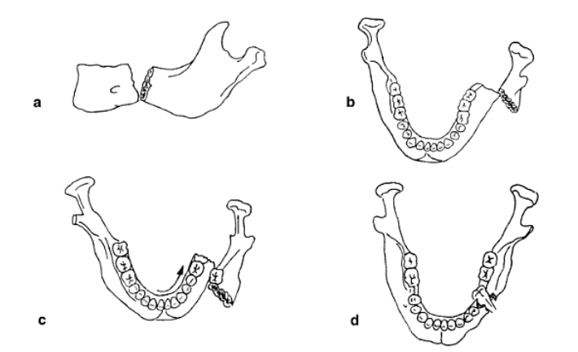
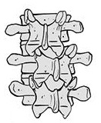
Dislocated fractures
ad latus
ad axim
ad peripheriam
ad longitudinem
cum contractione
cum distractione

Slide 17
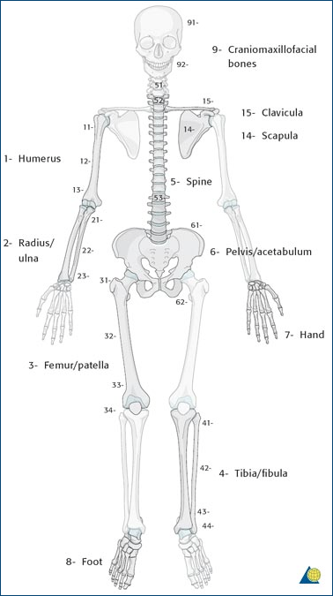
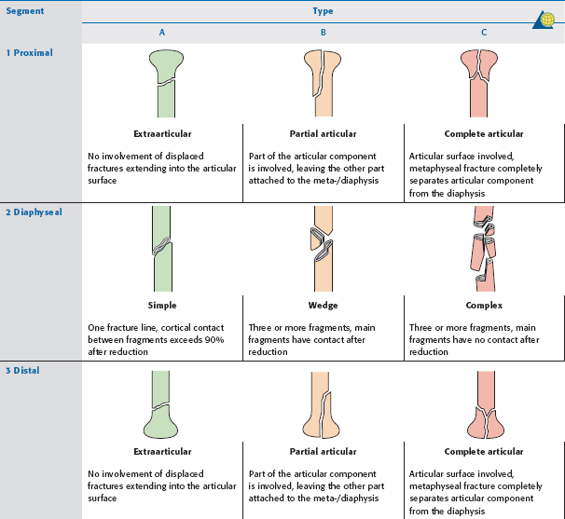
AO Classification of fractures
S 4220 Fractura colli chirurgici humeri l. dx. comminutiva AO 11-C1
Notes:
první číslo – vyjadřuje postiženou kost (1 humerus, 2 předloketní kosti, 3 femur, 4 bérec, 5 páteř, 6 pánev, 7 ruka 8 noha)
druhý údaj – určuje segment kosti (u dlouhých kostí – 1 prox.epimetafýza, 2 diafýza, 3 distální epimetafýza)
- třetí údaj ukazuje typ zlomeniny – A-C, u každé části je konkrétní

Slide 18
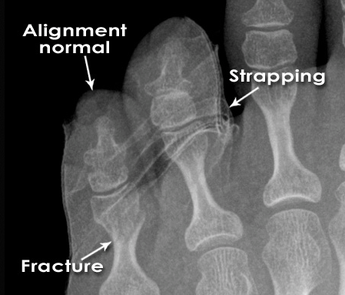
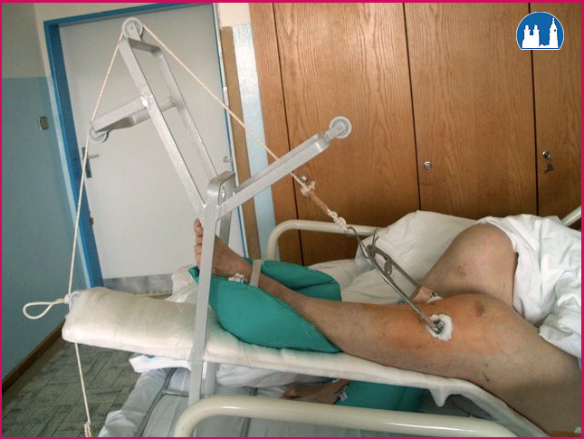
Fracture Healing:
1: REPOSITIO = REDUCTIO fragmentorum
  CLOSED (short /long term)
Notes:
is a medical procedure to restore fracture or dislocation to the correct alignment. This sense of the term "reduction" does not imply any sort of removal or quantitative decrease but rather implies a restoration: re ("back [to normal]") + ducere ("lead"/"bring"), i.e., "bringing back to normal."
Use of plates, screws, and wires was first documented in the 1880s and 1890s. Early surgical fixation initially was complicated by many obstacles, such as infection, poorly conceived implants and techniques, metal allergy, and a limited understanding of the biology and mechanics of fracture healing.[1] During the 1950s, Danis and Muller began to define the principles and techniques of internal fixation.

Slide 19
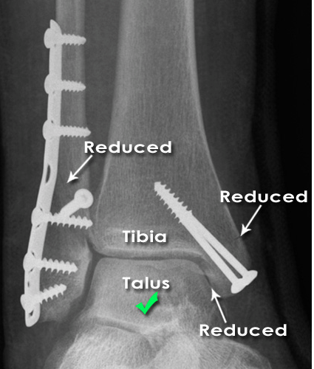
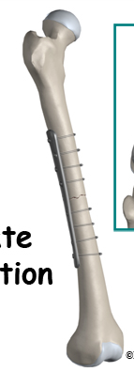
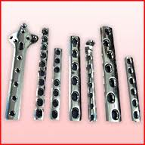
Fracture Healing:
2: FIXATIO = STABILISATIO fragmentorum
INTERNAL FIXATION

Slide 20
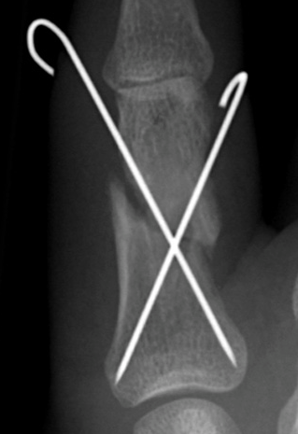
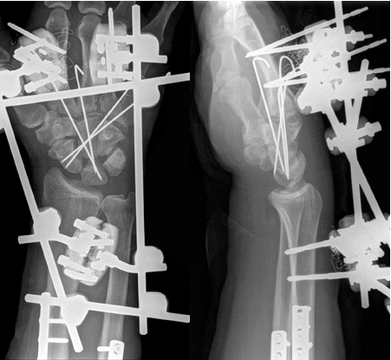
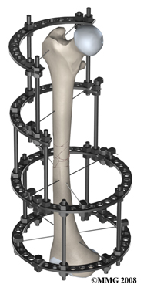
Fracture Healing:
2: FIXATIO = STABILISATIO fragmentorum
Notes:
Kirschner

Slide 21
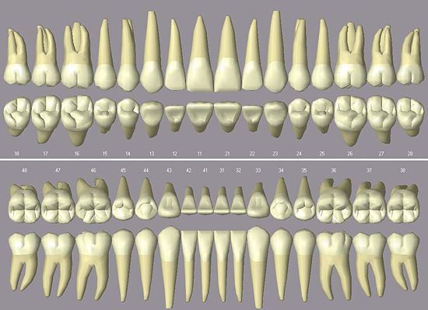
Name types of permanent teeth
4
3
2
1
2
3
4

Slide 22
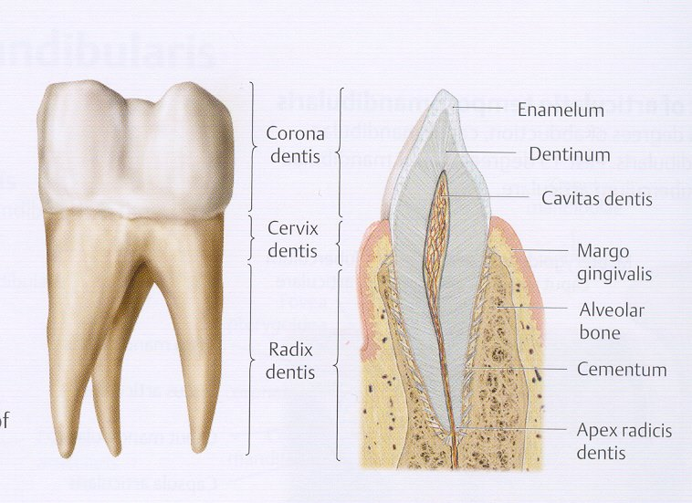

Slide 23
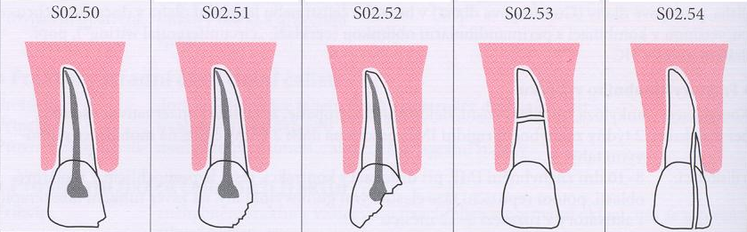
Translate types of tooth fractures :
ICD S 02.50-54
Fracture of
tooth
enamel
Simple fracture of the tooth crown not penetrating to the
dental pulp
Complicated fracture of the tooth crown penetrating to the dental pulp
Fracture of the tooth root
Fracture of the tooth crown and tooth root
Notes:
Fractura enameli dentis; fr. coronae dentis smplex ad pulpam dentis non penetrans; fr. coronae dentis complicata ad pulpam dentis penetrans; fr. radicis dentis; fr. coronae et radicis dentis

Slide 24
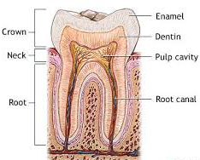
1) Number types of tooth decay based on its severity, start from the simplest
2) Identify all adjectives, which declension are they?
4
3
6
2
5
1
caries profunda simplex
caries media
caries ad pulpam penetrans
caries superficialis
caries profunda pulpae proxima
caries incipiens

Slide 25
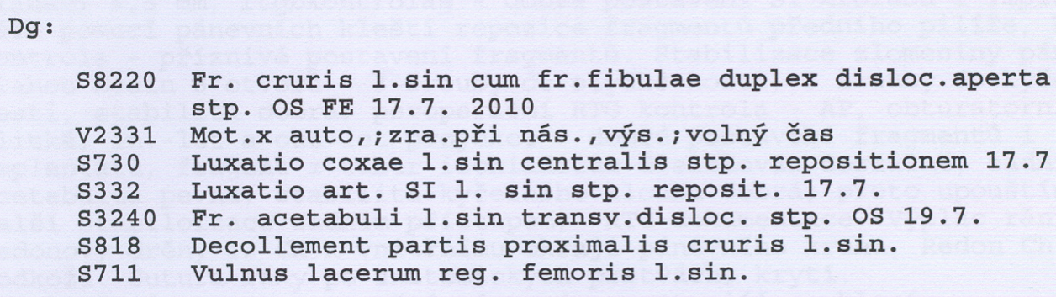
Authentic reports :1
Décollement = severe damage of soft tissues
Notes:
Toto je doplnková možnosť, diagnózy som stiahla z Katkinho Webu, Compact

Slide 26
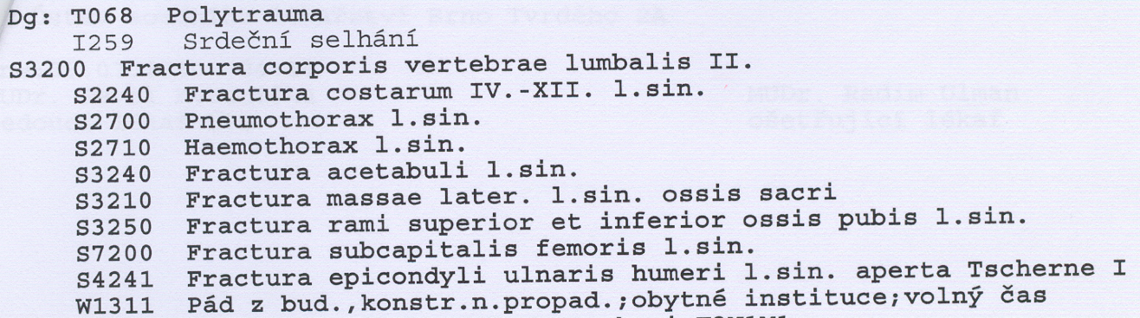

Authentic reports :2
Fr. aperta TSCHERNE I
- open fracture with small skin injury without its contusion
- negligible bacterial contamination
Profesor Dr. Harald Tscherne (1933), Traumatology Clinic, Hannover: Classification of fractures published in 1982, T. divides fracture into open and closed. The most important for him is the degree of the soft tissues damage.

Slide 27
Create a clear Latin diagnose based on the passages in red
A 52-year-old man came to the emergency department at this hospital because of debilitating weakness in his legs and hips; he was unable to stand and had edema of the legs with extension to the waist. He reported increased irritability and bruising on his arms.
The chest CT scan obtained the next day showed a lung abscess in the left upper lobe and bilateral pleural effusions. MRI of the abdomen revealed diskitis of the second and third lumbar vertebrae and an abscess extending into the right diaphragmatic crus. MRI also revealed compression fractures of the L2 and L3 vertebral bodies with enhancement, T₂-weighted hyperintensity, and very mild enhancement of the intervertebral disk, as well as an associated adjacent dorsal epidural abscess, adjacent psoas muscle abscesses bilaterally, and dorsal paraspinal muscle abscesses.
MRI of the brain performed 10 days after admission showed an ischemic lesion in the right medial temporal lobe.
Notes:
HOMEWORK?

