Slide 1
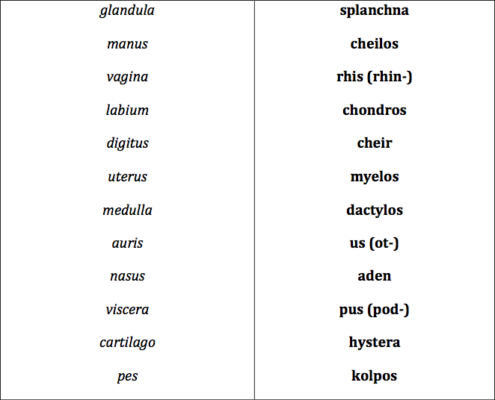
MATCH GREEK ELEMENTS WITH LATIN EQUIVALENTS

Slide 2
MATCH THE ITEMS IN THE TWO COLUMNS
chrom-o-, chromat-o-
blue
chlor-o-
color
cyan-o-
black, dark
erythr-o-
green
leuc-o-
grey
xanth-o-
red
poli-o-
white, colorless
melan-o
yellow

Slide 3
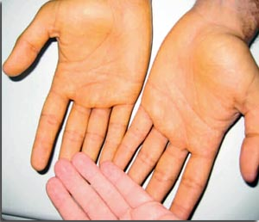
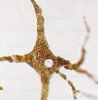
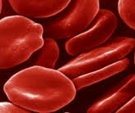
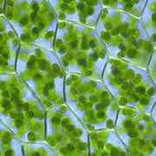
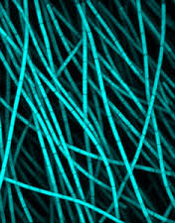
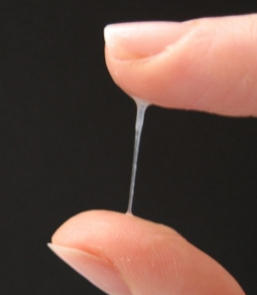
FORM COMPOUND WORDS WITH NAMES OF COLOURS
1. A yellowish discoloration of the skin is known as .…….…….derma
2. A cell producing the dark pigment (…………...) is called ……………………cytus
3. A decreased number of red blood cells is ………………..penia
4. The green pigment of plant leaves and algae is ………………phyllum
5. A group of photosynthetic bacteria containing a blue pigment is ………….bacteria
6. An excessive discharge of white (or sometimes yellowish) mucus from the vagina is ………………..rrhoea
Notes:
Xanthoderma – melanocytus – erythrocytopenia – chlorophyllum (on) - cyanobácteria - leucorrhoea

Slide 4
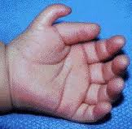
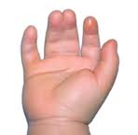
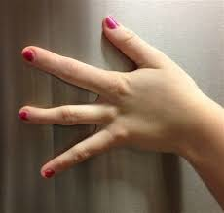
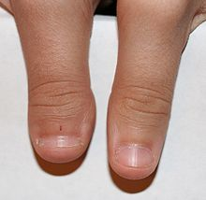
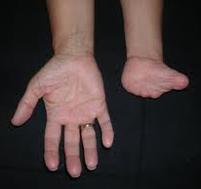
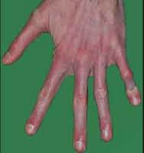
NAME WHAT KIND OF “-DACTYLIA” IS ON THE PICTURE
1
2
3
4
5
6
7
SYNDACTYLIA POLYDACTYLIA MACRODACTYLIA ARACHNODACTYLIA ADACTYLIA
BRACHYDACTYLIA OLIGODACTYLIA

Slide 5
PATHOLOGICAL STATES AND DISEASES
MEDICAL INTERVENTIONS AND EXAMINATIONS

Slide 6
FORM COMPOUND TERMS WITH THE GIVEN GREEK ELEMENT
“pain, ache, suffering” of the body part or organ
-ALGIA
Pain in the JOINT(S)
Arthr-algia
STOMACH pain
Gastr-algia
Pain along the course of NERVE(S)
Neur-algia
TOOTHache
Odont-algia
Pain in the HIP JOINT
Cox-algia
HEADache
Cephal-algia
Pain in the UTERUS
Metr-algia
Pain in the BREAST
Mast-algia/Mamm-algia
Pain in the SMALL INTESTINE
Enter-algia
Notes:
+ ODYNIA is synonymic!!!!

Slide 7
EXPLAIN THE MEANING OF COMPOUND and DERIVED WORDS
1) Biochemistry: dissolution, destruction of cells
2) Clinical terminology: gradual subsiding of the symptoms of an acute disease
-LYSIS
Pyretolysis
Reduction of fever
Haemolysis
Disintegration of red blood cells
Spondylolysis
Defect in the connection between vertebrae
Spasmolysis
Relaxation of muscle spasms
Dialysis
Separation of smaller and larger molecules
Osteolysis
Dissolution or degeneration of bone tissue
Necrolysis
Disintegration and dissolution of dead tissue
Bacteriolysis
Dissolution or destruction of bacteria

Slide 8
unspecified pathology of
prolapse of
-PATHIA
-PTOSIS
Psychopathia
mind
Prolapse of uterus
hystero/metro-
heart pathology
cardio-
Gastroptosis
stomach
Neuropathia
nerves
Prolapse of Fallopian tube(s)
salpingo-
cartilage disorder
chondro-
Coloptosis
colon
Angiopathia
vessels
Prolapse of kidney
nephro-
cell disorder
cyto-
Blepharoptosis
eyelid
Rhinopathia
nose
tongue pathology
glosso-
Myopathia
muscles

Slide 9
recording, imaging of
-GRAPHIA
Mamm-o-graphia
A breast examination with imaging technology
Angi-o-graphia
A vessels examination with some type of viewing/recording device
Radi-o-graphia
Internal organs examination by taking X-ray photographs
Electr-o-cardi-o-graphia
The process of recording electrical impulses of the heart

Slide 10
measurement of sth
-METRIA
Crani-o-metria
Measurement of SKULL
Pelvi-metria
Measurement of PELVIS
Cephal-o-metria
Measurement of HEAD
Odont-o-metria
Measurement of TEETH
Oste-o-metria
Measurement of BONES
Cyst-o-metria
Measurement of BLADDER

Slide 11
visual examination of the interior of a body organ, broadly also any inspection of a body part
-SCOPIA
Inspection of FETUS-
Fetoscopia
Inspection of PHARYNX-
Pharyngoscopia
Inspection of ANUS-
Anoscopia
Inspection of ABDOMINAL CAVITY-
Laparoscopia
Inspection of LARGE INTESTINE-
Colo(no)scopia
Inspection of THORACIC CAVITY-
Thoracoscopia
Inspection of VAGINA-
Colposcopia
Inspection of EYE-
Ophthalmoscopia

Slide 12
cutting, incision to sth
-TOMIA
incision to artery-
arteriotomia
incision to bronchus -
bronchotomia
incision to skull -
craniotomia
incision to lobe -
lobotomia
incision to muscle -
myotomia
incision to pericardium -
pericardiotomia
incision to perineum (pubic region) -
episiotomia
incision to vein -
phlebotomia
incision totympanum -
tympanotomia

Slide 13
excision, surgical removal of a part of or a whole organ
-ECTOMIA
Removal of FINGER -
Dactylectomia
Removal of STOMACH -
Gastrectomia
Removal of LIVER -
Hepatectomia
Removal of LARYNX -
Laryngectomia
Removal of LOBE -
Lobectomia
Removal of BREAST -
Mastectomia
Removal of PANCREAS -
Pancreatectomia
Removal of PROSTATE -
Prostatectomia
Removal of UTERUS-
Hysterectomia

Slide 14
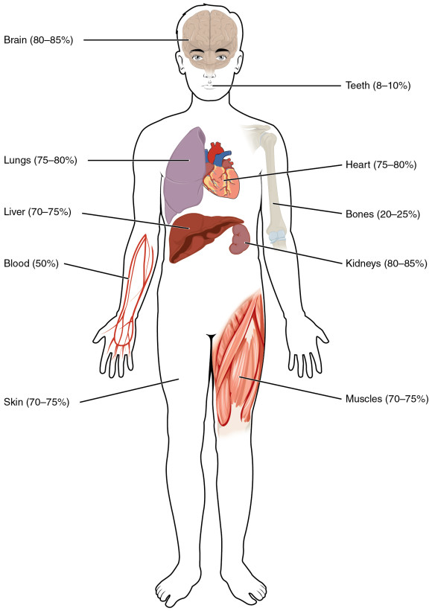
DECIDE WHETHER THE COMPOUND WORD CONTAINS GREEK
ELEMENT CORRESPONDING WITH THE LABELLED BODY PART:
Encephalopathia
STOMATO-
✓
Somatologia
Thoracographia
✓
Phlebotomia
CARDIO-
Cholecystitis
HEPATO-
Otoscopia
OSTEO-
Adenocarcinoma
Nephrostomia
✓
(HAEM)ANGIO-
MYO-
Podarthritis
Myeloneuritis
FEMOR-

Slide 15
ANALYZE THE MEDICAL TERMS INCL. GREEK ODÓUS, ODONTOS:
toothache
inflammation of the tissues surrounding teeth
hypersensitivity of teeth
the field of medicine dealing with teeth
benign tumour of tooth-tissue origin
tooth development
pathological fear of dental care, dentistry
visual examination of oral cavity
surgical removal of tooth
ODONTALGIA
PERIODONTITIS
ODONTOHYPERAESTHESIA
ODONTOLOGIA
ODONTOMA
ODONTOGENESIS
ODONTOPHOBIA
ODONTOSCOPIA
ODONTECTOMIA
Notes:
Handout 5 – time to prepare

Slide 16
FORM MEDICAL TERMS BASED ON DEFINITIONS:
Use the root MYO-(S)-
Benign tumor in a smooth muscle
Inflammation of a muscle
Formation of multiple tumors in a smooth muscle
Heart muscle
Muscular tissue in the uterus
(adj.) Referring to the heart muscle
Recording the strength of a muscle contraction
Medical field studying muscles
Removal of a muscular tissue tumour
Surgical incision to a muscle
Plastic surgery to repair a muscle
MYOMA
MYOSITIS
MYOMATOSIS
MYOCARDIUM
MYOMETRIUM
MYOCARDIACUS
MYOGRAPHIA
MYOLOGIA
MYOMECTOMIA
MYOTOMIA
MYOPLASTICA
Notes:
Handout 6

Slide 17
CREATE COMPOUND MEDICAL TERMS FROM
THE GIVEN COMPONENTS AND FIGURE OUT THEIR MEANING:
hyster- – salping- – graphia
pan – hyster- – salping- – oophor- – ectomia
olig- – erythr- – cyt- – aemia
thrombos – cyt- – penia
pneum- –(h)aem- – pericardium
cyst- – ureter – pyel- – nephr- - itis
hepatic- – duoden- – anastomosis
hysterosalpingographia
panhysterosalpingoophorectomia
oligoerythrocytaemia
thrombocytopenia
pneumohaemopericardium
cystoureteropyelonephritis
hepaticoduodenoanastomosis
Notes:
Time to prepare

Slide 18
FIGURE OUT THE CLINICAL TERMS BASED ON DEFINITIONS
ANGIOPLASTICA
Plastic surgery to repair a blood vessel (e.g. a narrowed artery) is…
An X-ray examination of a vessel using radio-opaque dye so the vessel shows up is…
related to the heart and the chest region …
An abbreviation C-PG stands for examination of the heart function and breathing, in Latin it is called…
Surgical operation to make a permanent opening into the pelvis of kidney from the surface is…
Surgery to make an opening between the bladder and the abdominal wall is…
Surgical removal of tongue is...
Plastic surgery of breasts is…
Replacement of the damaged skin by skin taken from a donor is…
ANGIOGRAPHIA
CARDIACUS
CARDIOPNEUMOGRAPHIA
NEPHROSTOMIA
CYSTOSTOMIA
GLOSSECTOMIA
MASTOPLASTICA
DERMATOPLASTICA
Notes:
Time to prepare: Angioplastica; Angiographia; Cardiacus; Cardiopneumographia; Nephrostomia; Cystostomia; Glossectomia; Mastoplastica; Dermatoplastica

Slide 19
READ THE DIAGNOSES, GIVE THE FULL FORMS OF THE ABBREVIATED TERMS. EXPLAIN THE COMPOUNDS.
secundum (prep.!) = according to

