Slide 1
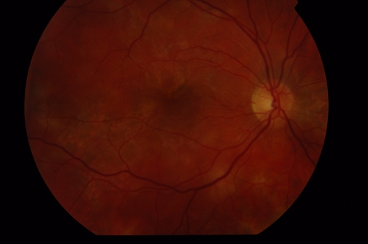
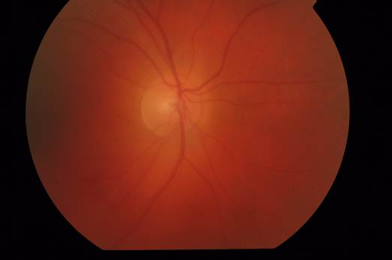
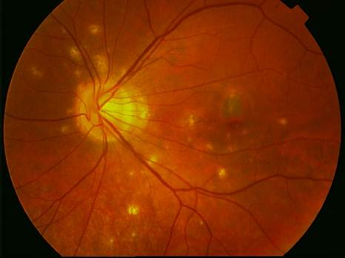
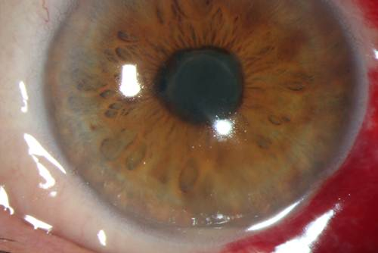
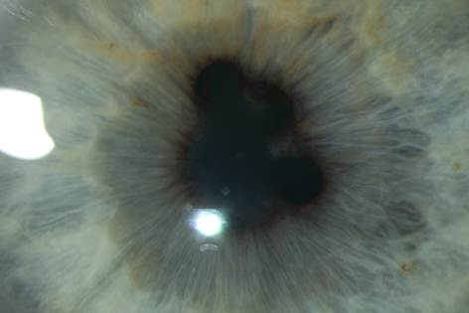
Inflammation of THE Uvea - uveitiS
MUDr. Karkanová Michala, Oční klinika LF MU a FN Brno
Head prof. MUDr. E. Vlková, CSc.

Slide 2
anatomy and physiology of the uvea
3 parts:
iris (iris)
ciliary body (corpus ciliare)
choroid (choroidea)
Function:
regulating the entry of light into the eye pupil
acomodation
production of aqueous humor
food security of the light-sensitive elements and the retinal pigment epithelium

Slide 3
Definition of uveitis
Uveitis – inflammation of the uvea
Intraocular inflammation causes damage of the endothelium of intraocular vessels with the collapse of the blood-barrier.
There is a dilation of blood vessels, leakage intravascular content into the intravascular space, migration of leukocytes and other cells.

Slide 4
classifiCATION of uveitis
Anatomical:
front (iritis, iridocyclitis)
intermediate (pars planitis, cyclitis, vitritis)
rear(choroiditis, chorioretinitis)
all parts (panuveitis)
Clinical:
acute - symptoms suddenly, lasting no longer than 6 weeks
chronical - gradual onset of symptoms, duration of more than 6 weeks

Slide 5
classification of the uveitiS
Patological:
nongranulomatous – acute formation, short duration, significant ciliary injection, small precipitates on the corneal endothelium,cells in the anterior chamber, fibrinous exudate, disability choroid rare
granulomatous – slow fomation, protracted course, significant ciliary injection, sintered large precipitates on the corneal endothelium, iris nodules, vitritis, often affected choroid

Slide 6
classification of the uveitis
According to the etiology:
Exogennous (injury uvea, microorganism invasion from the outside)
Endogennous (inner, systemic inflammatory origin)
uveitis associated with systemic disease
(eg. ankylosing spondylitis, sarcoidosis, tuberculosis,
multiple sclerosis)
uveitis associated with parazitic infection (eg. toxokarosis)
uveitis associated with viral infection (eg. herpes simplex)
uveitis asscoiated with fungal infection (eg. candida)
idiopathic uveitis (comprises about 25% of all uveitis)

Slide 7
Acute Front NonGranulomatous iridocyclitis
Signs and symptoms:
eye pain, photophobia, epiphora
ciliary injection
small precipitates on the corneal endothelium, abundant cells in the anterior chamber, in the course of severe fibrinous exudate in the anterior chamber
hypopyon
rear synechiae formation (adhesions between the iris and lens)
dilation of blood vessels in the iris
weeks duration of inflammation
chronic complications (formation of rear synechiae in case of delayed treatment, complicated cataract development)
treatment: corticosteroids locally, parabulbar, if necessary, generally, mydriatics, in the case of viral etiology antivirals

Slide 8


AcutE Front nONGRAnulomatous iridocyklitiS
Notes:
8

Slide 9
AcutE FRONT nONgranulomatous iridocyklitiS
Etiology:
HLA B27+ izolation, Ankylozing spondilitis ( M. Bechtěrev), Reiter syndrom, M. Crohn, Colitis ulcerosa,
Psoriatic artritis
M. Behcet – triad: iritis, aphtous stomatitis, ulcers on genital
Glaukomatocyklic crizis (Posner-Schlossman syndrom) – attacks slight iritis associated with high intraocular pressure elevation
Phacoanafylaktic uveitis – imunological reaction on free proteins of the lens
Viral diseases – Herpes simplex, zoster in combination with keratitis
(maybe nongranulomatous and granulomatous type)

Slide 10
ChronicAL FRONt iridocyclis
Signs and symptoms:
creeping course, variable symptoms, usually no pain or only mild pain
mild ciliary injection, mostly pale bulb,
a small amount of precipitates on the corneal endothelium, a small number of cells in the anterior chamber
lower tendency to the formation of the rear synechiae,
chronic complications according to the disease activity (formation of complicated cataract, secondary glaucoma)
Treatment: corticosteroids and nonsteroidal anti-inflammatory drugs locally, if necessary parabulbar or in total, mydriatics, and according to etiology

Slide 11
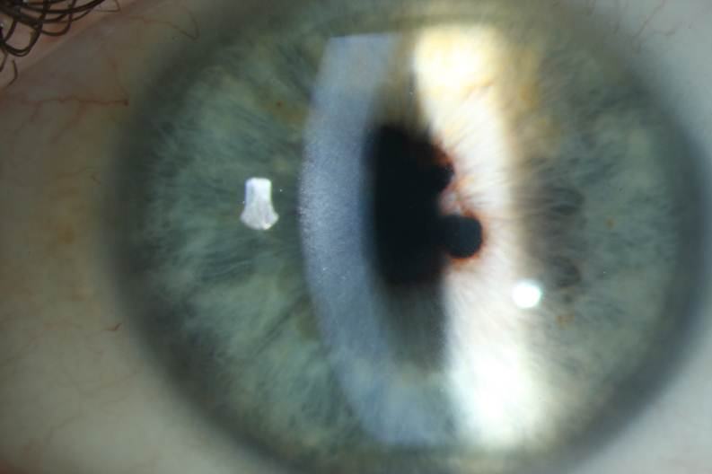
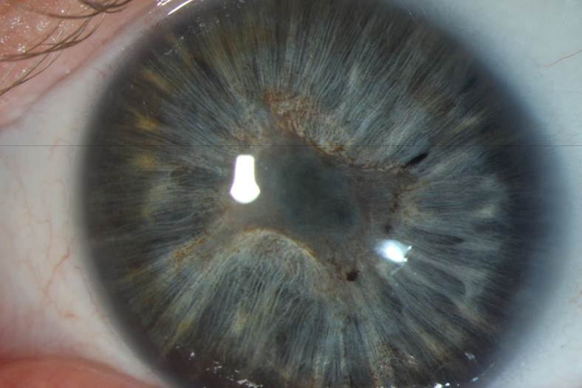
ChronicAL FRONt iridocyclitis
Notes:
11

Slide 12
Chronic Front iridocyclitis
Etiology:
Juvenile rheumatoid arthritis
Fuchs heterochromic iridocyclitis (heterochromy – difference in color due to diffuse iris stromal atrophy)
Sarcoidosis (granulomatous inflammation type)
Syphilis ( roseolae of iris )
Lyme disease
TBC ( granulomatous inflammation type, yelow nodules on iris)

Slide 13
Intermediate uveitis (Cyclitis, Pars planitis)
Manifestations, symptoms, etiology:
creeping course, without pain, decrease vision- opacities, fog
mostly pale bulb
vitritis - vitreous opacities (snowballs, snow benches)
minimal tendency to form the rear synechiae
with increased activity of inflammation macular edema
chronic complications (development of complicated cataract, macular epiretinal membranes, preretinaland subretinal neovascular membranes)
Treatment: according to the disease activity monitoring, corticosteroids overall or intravitreal corticosteroids, immunosuppressants (cyclosporine), biological therapy, PPV
possible link with MS, Lyme disease or unclear

Slide 14
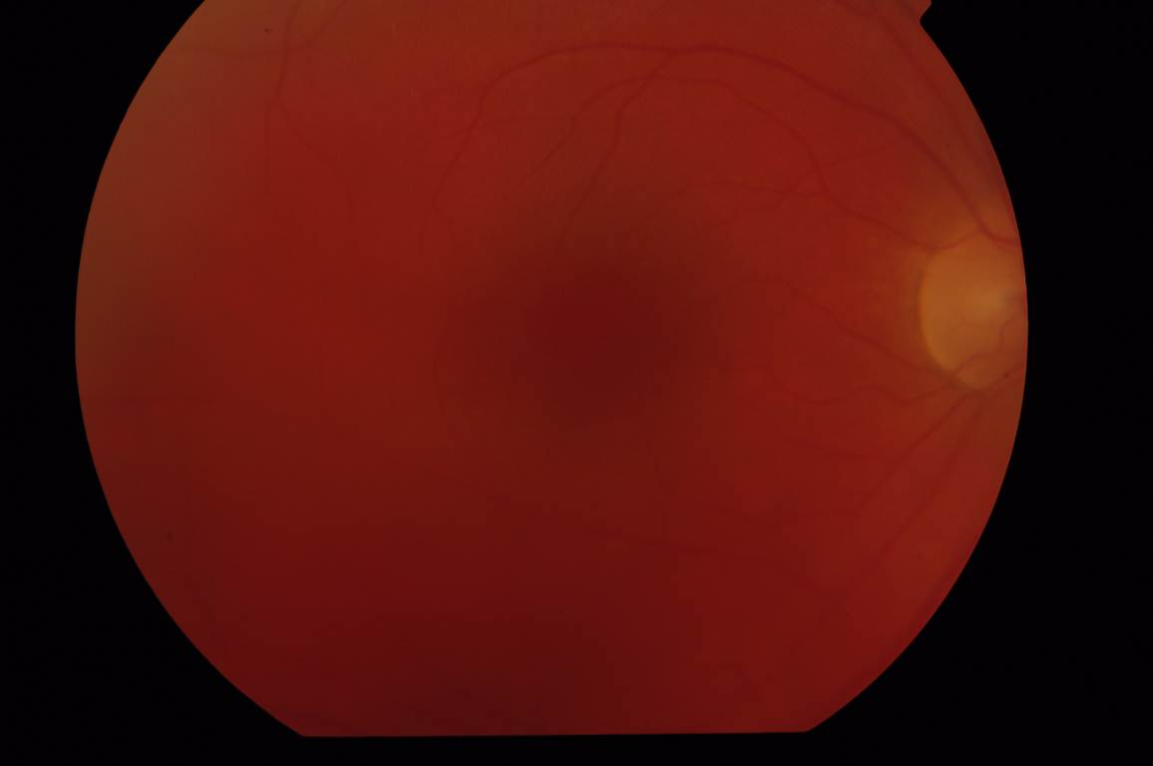
intermediate uveitis (Cyclitis, Pars planitis)
Notes:
14

Slide 15
REAR uveitiS ( chorioretinitiS, choroiditiS)
Manifestations symptoms:
beginning acute and insidious, without pain, decrease vision- vitreous opacities, fog
mostly pale bulb
vitritis - vitreous opacities
ill-defined plump yellow inflammatory bearing affecting the retina and choroid (focal or multifocal)
with increased activity of inflammation macular edema
chronic complications (development of chorioretinal scars)
Treatment: due to etiology, in infectious etiology causally antibiotics, antivirals systemically, in autoimmune etiology systemic corticosteroids or immunosuppressive systemically
in the differential diagnosis must be ruled malignant disease of intraocular lymphoma

Slide 16
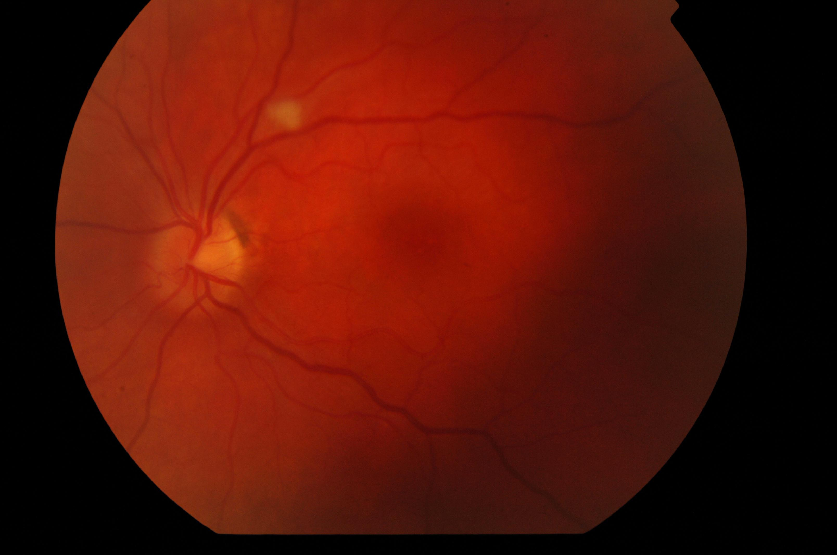
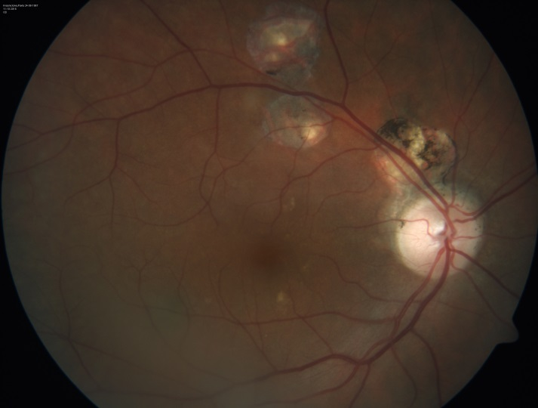
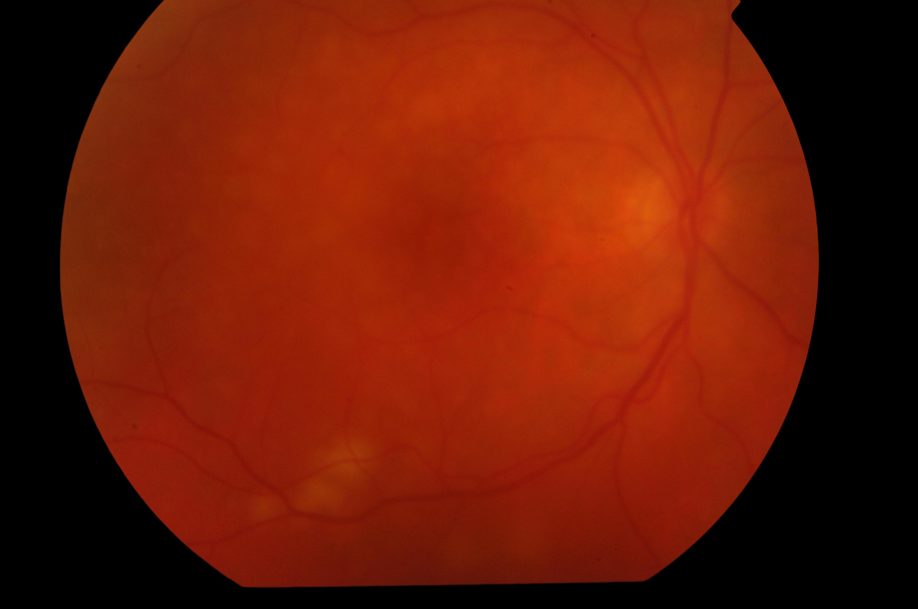
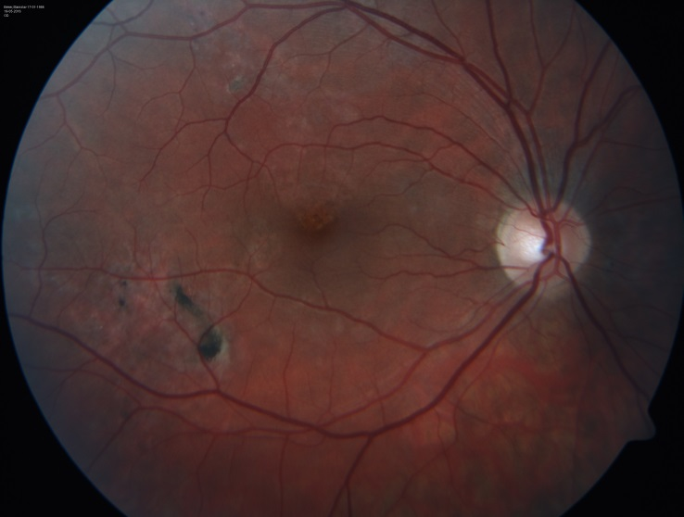
REAR uveitiS ( chorioretinis, choroiditis)
Notes:
16

Slide 17
REAR uveitiS ( chorioretinitiS, choroiditiS)
Etiology:
Toxoplasmosis (frequently)
Toxocarosis
Candidosis (in patient with decreased imunity)
Sarcoidosis,TBC (granulomatous inflammation type)
Herpes simplex, zoster retinitis
CMV retinitis ( in immunocompromised patients)
White dot syndroms (isolated autoimmune inflammation against retinal structures)
Sympathetic ophthalmia
Vogt-Koyanagi-Harada syndrom (uveoencefalitis)

Slide 18
PanuveitiS
Inflammation of the whole uveal tract - the most common etiology:
Toxoplasmosis
Sarkoidosis,TBC
M. Behcet
Syphilis
Sympathetic ophthalmia
Vogt-Koyanagi-Harada syndrom (uveoencefalitis)

Slide 19
Endophthalmitis
Severe form of intraocular inflammation affecting intraocular tissue structures, but does not go beyond the sclera.
Exogenous - postoperative (acute 1-14 days after surgery, chronic two weeks up to two years after surgery), post-traumatic
Endogenous - hematogenous transmission of pyogenic bacteria or mold for generalized septicemia
Frequently agent: Staphylococcus, Streptococcus, Candida, Propionibacterium, Klebsiella, Haemophilus, Escherichia

Slide 20
EndophthalmitiS
Manifestation, Symptoms:
Acute endophthalmitis – pain, sudden decrease in vision, conjunctivitis, edema of the eyelids, corneal edema, hypopyon, vitritis, necrosis of the retina
Chronic endophthalmitis – without pain, visual acuity decreased only slightly, hypopyon just sometimes, mild vitritis
Treatment:
ATB, antimycotics in infusions, eventuel. intravitreal
PPV

