Slide 1

Assessment of Physical Activity
Mgr. Robert Vysoký, Ph.D.
Department of Public Health – Faculty of Medicine - Masaryk University Brno
Programme: General Medicine, Seminar: Public Health II

Slide 2
Introduction
Physical activity has a fundamental role in the prevention and treatment of chronic disease
Increasing physical activity is a key component of recommendations to decerease morbidity and mortality (Haskell WL, Lee IM, Pate RR et al., Med Sci Sports Exerc, 2007)
Monitoring physical activity levels is important for surveillance, for assessing the effectiveness of interventions and for physical activity prescription
Investigation of the dose-response relationship between physical activity and health outcomes is dependent on a reliable and valid responsive assessment of physical activity
Physical inactivity is defined as the fourth of the major risk factors of global mortality

Slide 3
Introduction
Approximately 60 years ago, Jeremy Morris and colleagues showed that the incidence of coronary artery disease in bus conductors who climbed up and down stairs of double-deck buses and postal carriers who delivered the mail on foot was lover than that of relatively inactive bus drivers or postal office workers, who spent most of their occupational time sitting
Since then – numerous other investigators have confirmed the strong link between physical activity and health
In 1992, the American Heart Association included physical inactivity as a major risk factor for coronary artery disease
The deleterious effects of physical inactivity are associated with many of the most common chronic diseases - cardiovascular diseases, T2DM, hypertension, obesity, osteoporosis, depression and breast and colorectal cancers

Slide 4
Introduction
In USA chronic diseases cause 7 in 10 deaths and accout for 70% of all healthcare spending
The financial impact of physical inactivity for all US adults was 251 billion USD
The first public health recommendations for physical activity in USA were released and in 2008 EBM culminated in the firs-ever federal guidelines for physical activity
It includes the following recommendations:
adults should avoid inactivity (some physical activity is better than none)
substantial health benefits are obtained from accumulating, in bouts of ≥ 10 minutes, 150 mintes per week of moderate-intensity or 75 minutes per week of vigorous-intensity aerobic activity
additional and more extensive health benefits are obtained by increasing aerobic activity to 300 minutes per week at moderate intensity or 150 minutes per week at vigorous intensity
muscle strenghtening activities of moderate to high intensity should be performed ≥ 2 days per week

Slide 5
Introduction
For assessing physical activity we have subjective (self-report) and objective (accelerometry) measurement methods
The assessment of PA is needed to allow the clinician to provide specific recommendations for patients identified as insufficiently active
With documented health benefits of physically active lifestyle as its guiding principle, scientific statement recommends that PA be assessed regularly, as are the other risk factors
The primary objectives of this statement are:
provide the rationale for the importance of assessing PA
explain key concepts involved in the assessment of PA
provide an overview of options for assessment of PA available to clinicians and researchers

Slide 6
Significance and promotion of optimum movement activity in prevention and treatment of civilization diseases
Chronic non-infectious diseases of mass occurrence in the prevention context
Metabolic diseases (T2D, obesity), cardiovascular diseases, certain oncologic diseases and diseases of the movement apparatus -high incidence in the general population
Connected with life style and are a result of the discrepancy between slowly changing human genotype and fast changing environment (as a result of anthropogenic acivities)
Genetic (non-influenced) risk factors are interacting with strong (but influenced) risk factors of environment and life style
Physical inactivity as risk factor is a cause of 1.9 million of deaths a year worldwide
Identified as 4th out of the major risk factors of total mortality (6 % deaths worldwide)
Notes:
Chronic non-infectious diseases of mass occurrence, such as metabolic diseases (T2D, obesity), cardiovascular diseases, certain oncologic diseases and diseases of the movement apparatus, show high incidence in the general population.
These diseases are connected with life style and are a result of the discrepancy between slowly changing human genotype and fast changing environment (as a result of anthropogenic acivities).
Genetic (non-influenced) risk factors are interacting with strong (but influenced) risk factors of environment and life style.
Movement activity as risk factor is a cause of 1.9 million of deaths a year worldwide.
Identified as 4th out of the major risk factors of total mortality (6% deaths worldwide)

Slide 7
Promotion of physical activity – global and European strategy
Documents on promotion of physical activity in Europe:
are based on a complex preventive program “Global strategy for nutrition, physical activity and health” (WHO 2004)
The green book (2005): to enforce and promote healthy nutrition and movement activity
The white book of sport (2007)
Notes:
Documents on promotion of movement activity in Europe:
-are based on a complex preventive program “Global strategy for nutrition, physical activity and health” (WHO 2004)
-The green book (2005): to enforce and promote healthy nutrition and movement activity
-The white book of sport (2007)

Slide 8
The importance of optimal PA for primary prevention of civilization diseases and movement apparatus disorders
Humans - morphological and functional adaptation for life style which required good physical fitness
We are phylogenetically adapted to bipedal locomotion, periodical and uniform static and dynamic load
Current life style – up to 60% of world population suffers from major lack of physical activity, sedentary lifestyle
Excessive static postures
Lack of medium intensity dynamic load
Population groups at risk: women and seniors, children and youth, individuals with special needs (need of targeted applied MA)
each population group – different requirements on intensity, duration and type of MA to fulfill the criteria for optimum MA
Notes:
Humans are morphologically and functionally adapted for life style which required good physical fitness
We are phylogenetically adapted to bipedal locomotion, periodical and uniform static and dynamic load
Current life style – up to 60% of world population suffers from major lack of physical activity, sedentary lifestyle
Excessive static postures (additionally with unsuitable postural position of individual body parts)
Lack of medium intensity dynamic load
Population groups at risk: women and seniors, children and youth, individuals with special needs (need of targeted applied MA)
each population group – different requirements on intensity, duration and type of MA to fulfill the criteria for optimum MA

Slide 9
The importance of optimal PA for primary prevention of civilization diseases and movement apparatus disorders
Optimization of PA especially for untrained population
The expected effect: increase of health oriented fitness level
Not a need to reach maximum physical performance regardless the possibility of health complications
No quantification or evaluation of physical performance – evaluation of PA in regards to risk factors or increased markers of these risk factors, in regard to limitation in clinical state or movement limitations
Optimal level of PA positively supports and affects:
cardiorespiratory and neurohumoral system
optimum shape and function of movement system (muscular balance, physiologic vertebra and spinal position, range of motion, joins flexibility and strength)
PA should not overload movement apparatus, the aim is to add PA to successful functional and morphological adaptation for environmental burden
Notes:
The importance of optimum MA for primary prevention of civilization diseases and movement apparatus disorders
Optimization of MA especially for untrained population
The expected effect of application of individually selected MA – increase of health oriented fitness level
Not a need to reach maximum physical performance regardless the possibility of health complications
No quantification or evaluation of physical performance – evaluation of MA in regards to risk factors or increased markers of these risk factors, in regard to limitation in clinical state or movement limitations
Optimum MA positively supports and affects:
-cardiorespiratory and neurohumoral system
-optimum shape and function of movement system (muscular balance, physiologic vertebra and spinal position, optimum movement range, joins flexibility and strength)
-MA should not overload movement apparatus, the aim is to add MA to successful functional and morphological adaptation for environmental burden

Slide 10
Recommended PA is “individually optimal” under these conditions:
Current health status, PA and functional and morphological components of health oriented physical fitness
Functional components of physical fitness: cardiorespiratory system and neuromuscular fitness
Morphological (structural) components of physical fitness: anthropometry (height and weight), selected circumference characteristics and indexes (BMI), assessment of nutrition lifestyle
Notes:
Recommended MA is “individually optimal” under these conditins:
It is based on current health status, current MA, functional and morphological components of helth oriented physical fitness
Functional components of physical fitness: cardiorespiratory system and neuromuscular fitness
Morphological (structural) components of physical fitness: anthropometry (height and weight), selected circumference characteristics and indexes (BMI), assessment of nutrition lifestyle

Slide 11
Negative results of insufficient PA level
Due to lack of PA, the physiological fitness level decreases during life
It has major role in occurrence of cardiometabolic and oncologic diseases
Development of supportive movement apparatus disorders
Movement apparatus diseases – second place in the cause of absence at work, cause longest lasting absence at work
MA diseases – low mortality rate
Secondarily, they lead to health complications in late adult and senior age:
-stressing the RF
-limited movement, limits everyday life activity
-movement immobilization leads to health complications (osteoporosis, fractures, bronchopneumonia, urinary infections, depressive state)
Notes:
Negative results of insufficient MA level
Due to lack of MA, the physiological fitness level decreases during life
It has major role in occurrence of cardiometabolic and oncologic diseases
Development of supportive movement apparatus disorders
MA diseases – second place in the cause of absence at work, cause longest lasting absence at work
Prevalence in 16-30% Czech adult population (age dependent, more frequent in women)
Painful status at ca 40% adults
MA diseases – low mortality rate
Secondarily, they lead to health complications in late adult and senior age:
-stressing the RF
-limited movement, limits everyday life activity
-movement immobilization leads to health complications (osteoporosis, fractures, bronchopneumonia, urinary infections, depressive state)

Slide 12
Physical acivity assessment - introduction
Observation of actual individual PA levels includes:
Determination of the type, frequency, intensity and total amount of performed PA
data are collected using questionnaires
Disadvantages : under or overestimation
For ongoing monitoring and obtaining details – use of aids (step meter, accelerometer)
For the possibility of international comparison of MA level in population – GPAQ/IPAQ
Observing PA performed not only at leisure time, but also at work and sport
Observed PA monitored during 7 days (minimum continual PA 10 minutes)
Total amount of PA displayed in MET minutes
MET is a unit of intensity of physical load
1 MET equals to common oxygen consumption (=3.5 mL/kg/min equals to resting metabolism)= resting energy consumption of organism ca 1 kCal/kg/hour
Notes:
Movement acivity assessment - introduction
Observation of actual individual MA levels includes:
Determination of the type, frequency, intensity and total amount of performed MA
data are collected using questionnaires
Disadvantages : under or overestimation
For ongoing monitoring and obtaining details – use of aids (step meter, accelerometer)
For the possibility of international comparison of MA level in population – GPAQ/IPAQ
Observing MA performed not only at leisure time, but also at work and sport
Oberved MA monitored during 7 days (minimum continual MA 10 minutes)
Total amount of MA displayed in MET minutes
MET is a unit of intensity of physical load
1 MET equals to common oxygen consumption (=3.5 mL/kg/min equals to resting metabolism)= resting energy consumption of organism ca 1 kCal/kg/hour

Slide 13
Recommended total amount of physical activity
Adults
-600 MET minutes per week – 150 minutes MA of medium intensity
-frequency: 3-5 times a week
-recommended also postural therapy, muscular dysbalances therapy
-for adults over 65, resistance training and balance therapy
Children (5-17 years old)
-minimum of 60 minutes PA of medium to high intensity
-variety of exercises
-balanced development of aerobic fitness and muscular strength
-flexibility exercises, deftness and balance
-prevention of one-sided burden
-compensational exercises
Notes:
Recommended total amount of movement activity
Adults
600 MET minutes per week – 150 minutes MA of medium intensity
-frequency: 3-5 times a week
-recommended also postural therapy, muscular dysbalances therapy
-for adults over 65, body-building and balance therapy
Children (5-17 years old)
-minimum of 60 minutes MA of medium to high intensity
-variety of exercises
-balanced development of aerobic fitness and muscular strength
-flexibility exercises, deftness and balance
-prevention of one-sided burden
-compensational exercises

Slide 14
Key Concepts for Understanding Physical Activity Assessment
Physical Activity – definition
The most popular and widely cited definition of PA was published by Caspersen et al. (1985): „any bodily movements produced by skeletal muscles that result in energy expenditure“
PA can be clasified as structured (planned, or incidental to promote health and fitness benefits) and incidental (not planned and usually is the result of daily activities at work, at home, or during transport)

Slide 15
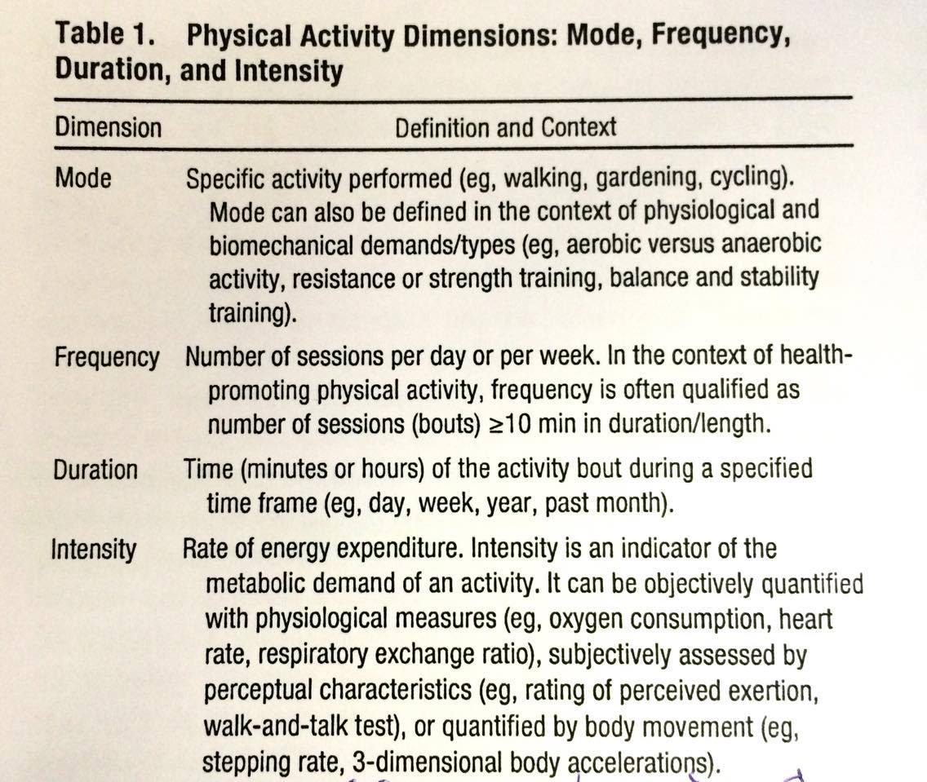

Dimensions of PA
Domains of PA
Central to undrestanding the assessment of PA

Slide 16
Quantifying Units of Measure Indicative of PA Level
Exercise (or exercise training) is a component of leisure time PA, and is where planned, structured and repetitive bodily movements are performed to improve or maintain one or more components of physical fitness (Howley ET, Med Sci Sport Exerc 2001)
Physical fitness (PF) comprises cardiorespiratory endurance (assessed by measured or estimated VO_{2max} , muscle endurance and muscle strenght
Flexibility, balance, agility nad coordination are additional components of PF
Distinction between PA and PF is the intraindividual day-to-day variability
PA will vary on a daily basis, whereas PF will remain relatively static, taking time to change

Slide 17
Quantifying Units of Measure Indicative of PA Level
PA results in an incerease in energy expenditure (EE) above resting levels, and the rate of EE is directly linked to the intensity of the PA
The energy expended during PA is just of the 3 components of total daily energy expenditure (TEE):
60-75% resting energy expenditure
15-30% physical activity related energy expenditure (PAEE)
10% thermic effect of food
PAEE is the most variable portion of TEE
In extremly active individuals, PAEE may constitute 60-70% of TEE
PA are commonly quantified by determining the EE in kilocalories or by using metabolic equivalent (MET) of the activity

Slide 18
Quantifying Units of Measure Indicative of PA Level
Kilocalories
One liter of oxygen consumption is aproximatelly equal to 5 kcal energy
Example: 70kg individual walking for 30 minutes at 4 mph, which results in an oxygen consumption of 1 L/min. For 30-minute walk, the individual would consume 30 L of oxygen. EE would be 150kcal (30 Lx5 kcal/L).
PAEE would be 112,5 kcal (30 Lx5-1.25[5-1.25 (resting kilocalories expenditure)] kcal/L)
Metabolic Equivalent (MET)
Is common unit used to express exercise intensity
1 MET represents the resting energy expenditure during quiet sitting and is defined as 3.5 mL O₂.kg⁻¹.min⁻¹ or 250 mL/min of oxygen consumed, which represents the average value for a standard 70-kg person

Slide 19
Quantifying Units of Measure Indicative of PA Level
Metabolic Equivalent (MET)
METs can be converted to kilocalories (1 MET=1kcal.kg⁻¹.min⁻¹
Oxygen consumption increases with intensity of PA, for quantifying the intensity of PA is to use multiples of resting EE
Physical Activity Intensity
Moderate and vigorous intensity PA can be defined in both absolute and relative terms
Absolute intensity is determined by the external work performed, whereas relative intensity is determined relative to an individual´s level of cardiorespiratory fitness (VO_{2max})

Slide 20
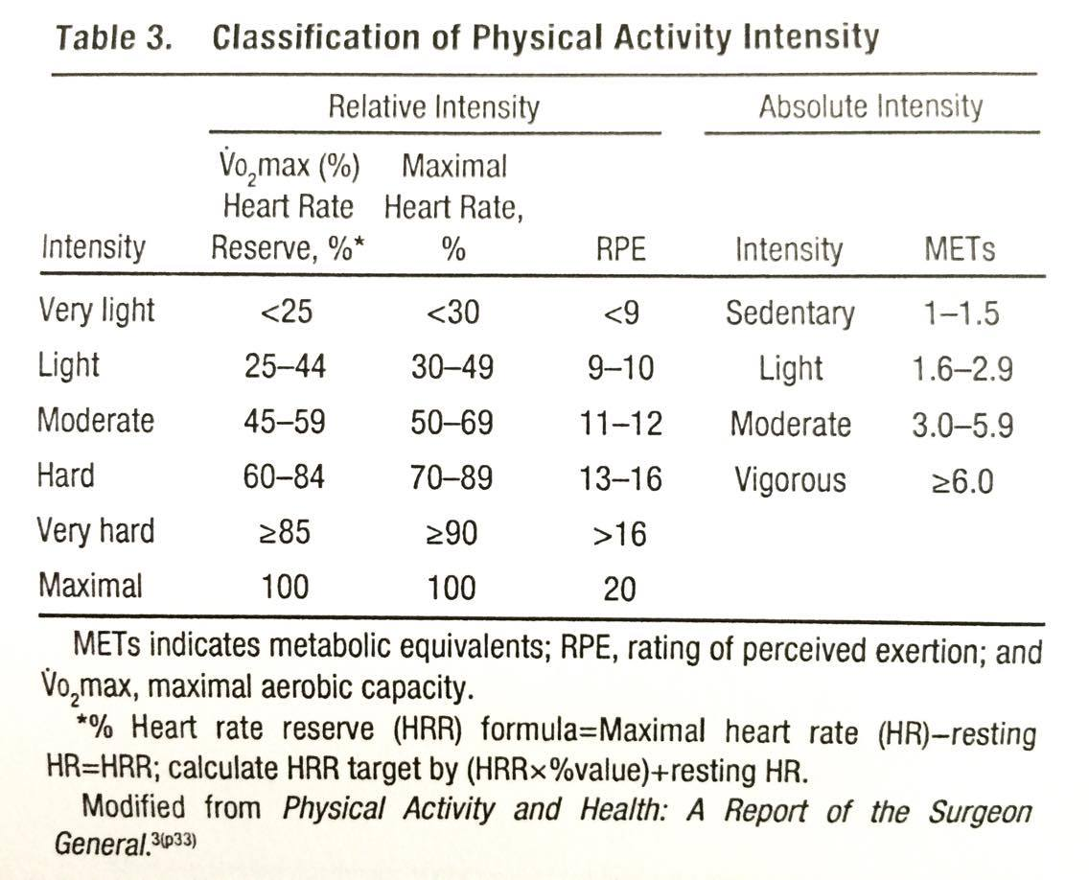
Quantifying Units of Measure Indicative of PA Level

Slide 21
Available Methods of Assessing PA
Subjective methodologies rely on the individual either to record activities as they occur to recall previous activities (questionnaires and diaries/logs)
Objective methodologies include all wearable monitors that directly measure 1 or more biosignals, such as acceleration, heart rate, or some other indicator of PA or EE, as they occur.

Slide 22


Slide 23
Subjective Methods of Assessing PA
Consideration for researchers when using
questionnaires
What exactly is the questionnaire designed to measure: which dimension (s) and domain (s) of PA?
What is the time frame for the questionnaire?
Has the instrument been tested for reliability?
Has appropriate validation been undertaken, that is, against an objective measure?
Was the validation undertaken in a similar population?
What is the primary outcome of the questionnare and does this fit with the research question?
How will the questionnaire be administered (face-to-face, by telephone, Internet, through post)?
How will be data cleaned, reduced and analysed?
What will constitute an outlier or an invalid recording?
What will be done with missing data, and in case of inputing data what will the basis of these decisions be?
For which population has the questionnaire been designed?
What is the responsiveness of the questionnaire?

Slide 24
Subjective Methods of Assessing PA
A) Physical Activity Questionnaires
To identify the dimensions and domains of PA behaviors from either self-reported responses or interviews
1. Global Physical Activity Questionnaires
Provide a quick overview of a person´s PA level
Typically short (2 – 4 items) and used to identify whether an individual meets a PA standard (e.g. 150 min/wk of moderate to vigorous PA) or provide a classification (e.g. active versus inactive)
Preferred in many clinical settings, epidemiological studies and surveillance settings for their ease administration, brevity and ability to determine a PA score
2. Short Recall Physical Activity Questionnaires
Provide a quick assessment of the total volume of PA classified by dimension of intensity level or by domain
Are often used to determine the proportion of adults meeting national PA guidelines in surveillance and descriptive epidemiology settings and to identify PA behavior change in intervention studies
Generally have from 7 to 12 items and can be self-administered or interviewer administered
A physical activity score can be a simple ordinal number, with higher numbers reflecting greater levels of activity, or a volume score computed by multiplying the frequency in sessions pre week (or month), minutes per session, and intensity of the activity recalled. The intensity often expressed as METs.
International Physical Activity Questionnaire (IPAQ)

Slide 25
Subjective Methods of Assessing PA
The „Compendium of Physical Activities of Energy Costs of Human PA“ was published in 1993, with updates in 2000 and 2011.
This publication provides a comprehensive list of physical activity MET values for use in scoring PA questionnaires
3. Quantitative History Physical Activity Questionnaires
Are detailed surveys often performed over the past month of year or over a lifetime
May contain 20 to 60 detailed questions and are usually interviewer administered
Are used in epidemiological studies to understand what types and intensities of PA contribute to mortality, as well as to examine various types of morbidities and health-enhancing behaviors
Bone Loading History Questionnaire (PA performed at various ages from childhood to the past year for determination of hip and spine weight-bearing and bone-loading activities)

Slide 26
Subjective Methods of Assessing PA
B) Physical Activity Diaries/Logs
Often used to obtain a detailed hour-by-hour or activity-by-activity record of one´s PA and sedentary behaviors
To evaluate the psychometric properties of PA questionnaires and as an adjunct to objective monitoring
Are completed by the user and can be form of a paper-and-pencil booklet or a cell phone programmed to remind the performed in the past 1 to 4 hours.
Recorded informations: the time an activity started and stopped,a rating of intensity, and the mode/type of activity
Can be scored by use of the „Compendium of Physical Activities“
The Bouchard Physical Activity Record is a well-known PA log that has users identify 1 of 9 types of movement behaviors preformed every 15 minutes. The activities are rated on a 1 to 9 scale that corresponds to a range of 1.0 to 7.8 METs

Slide 27
Objective Methods of Assessing PA
Accelerometers
Considerations for researchers when using accelerometers
One, two or three-dimensional accelerometry?
Decide the primary outcome of the study; total activity, type, time spent at different intensity, or estimates PAEE
At the outset make a decision about the minimal wearing time to constitute a valid day
What will constitute an outlier or an invalid recording?
What time interval will be selected?
What will be dome with missing data?
How many days will be measured?
Is there going to be a time lag between initializing the monitor and participant wearing? If so, can the data analysis programme handle this delay?
How are accelerometers going to be distributed and returned (face-to-face/mail)?
Have sufficient instruction on placement, wearing and contact details been supplied?
Are participants going to be contacted by phone, SMS or mail during the planned assessment to encourage compliance?
Are participants going to be asked to keep concurrent activity logs or detail wearing and non-wearing times?

Slide 28
Objective Methods of Assessing PA
Accelerometers
When a person moves, the body is accelerated in relation to muscular forces responsible for the acceleration of the body and to EE
Measure in one (vertical), two (vertical and medo-lateral) or three (vertical, medo-lateral and anterior-posterior) planes by measuring the amplitude and frequency of acceleration
The device is enclosed in a case and then attached to the body (hip, ankle, wrist, lower back)
Able to record high-resolution data data, as well as store data for several weeks

Slide 29
Objective Methods of Assessing PA
Accelerometers
Accelerometer Data Transformation
The main data outcome from accelerometers is a recording of body acceleration and deceleration
This measurement (raw data) is typically recorded in units of acceleration due to gravity (g) and expressed as acceleration in meters per second squared (m/s²)
This is then further transformed into other units, most common unit of measure is the count, which can be expressed in different ways: counts per second, counts per minute, or summed as total counts per day.
Detailed data are collected between 5 and 60 s
Published data on cut point for sedentary activities from one the most frequently used bands typically ranges from 100-800 counts per minute, for moderate activities 1900-8200

Slide 30
Objective Methods of Assessing PA
Accelerometers
Accelerometer Data Converted to Meaning
Physical Activity Outcomes
The strongest relationship is seen in walking and jogging activities
Typically used to determine habitual activity, which necessitates measurement over multiple days (4-9 days children, 3-5 days adults)
Is important, that the recording period allows for the measurement of activity during the week and also at weekends.
To correctly interpret the information from the recording period, it is important to account for the fact that the activity level may also vary according to the season (higher level during spring and summer coimpared with autumn and winter)
For assessment of PA, accelerometers must be calibrated to translate monitor signals into energy expenditure units (kcal or METs) or activity intensity categories
More information: Ward DS, Evenson KR, Vaughn A, Rodgers AB, Troiano RP. Accelerometer use in physical activity: best practices and research recommendations. Med Sci Sports Exerc 2005; 37:S582-588.

Slide 31
Objective Methods of Assessing PA
Heart Rate Monitoring
There is a linear relationship between the increase in HR and the increase in EE during dynamic exercise involving the large muscle groups
Relationship varies within and between individuals; factors such as age, sex, weight and fitness level modulate this relationship as do ambient temperature, body posture and emotional state (anxiety or stress)
Measures of PA derived from HR monitoring are typically time spent in physical activities at different intensity levels (moderate and vigorous) and PAEE
The accuracy of estimating outcomes indicative of PA from HR monitoring is improved by calibrating an individual´s heart rate nad EE response (via oxygen consumption measurement) to different levels of activity, thus accounting for variation across individual HR response

Slide 32
Objective Methods of Assessing PA
Heart Rate Monitoring
Considerations for researchers when using HR
What level of calibration is required?
If individual calibration is to be undertaken using indirect calorimetry, decide on which activities most likely will be performed by the volunteers while free living
How many days will the monitor be worn?
In data analysis what is going to constitute an outlier?
Provide practical information on how to use the monitor
How are monitors going to be distributed and returned (face-to-face, mail), have sufficient instructions on placement and wearing and contact details been supplied?
Are participants going to be contacted by phone, SMS or email during the planned assessment to encourage compliance? Can incentives be used?

Slide 33
Objective Methods of Assessing PA
Combined Accelerometer and Heart Rate Monitors
An important development in the assessment of PA
An early model was developed and piloted nearly 10 years ago
In these devices, the pros of each method are combined
At lower levels of intensity, HR is less accurate at estimating EE; this is the level that accelerometers are most accurate at
Advantage is, that these new monitors are waterproof and the intention is that participants do not remove, except to replace pads that have perished
The combined motion sensor is an accurate predictor of EE

Slide 34
Objective Methods of Assessing PA
Combined Accelerometer and Heart Rate Monitors
Consideration for researchers when using combinad
accelerometer and HR monitor sensors
What level of calibration is required? Will calibration methods used commonly for fitness testing be adequate?
Is the participant confident and competent at placing the device, that is, have sufficient explanation and written instructions have been given?
Supply participants with additional pads to replace as required

Slide 35
Objective Methods of Assessing PA
Pedometers
Pedometers are relatively simple and inexpensive devices, which measure the number of steps taken
Better accuracy has been reported at faster walking speeds but not running
Most pedometers are accurate in the measurement of the number of accumulated steps during walking, and may be useful when monitoring the effect of an intervention aimed to increasing walking
One of the most promising uses of pedometers is as a motivational tool to achieve a predetermined target of daily accumulated steps
An advantage of pedometers is that they can also be used in elementary school children and preschool children

Slide 36
Objective Methods of Assessing PA
Pedometers
Consideration for researchers when using pedometers
The aims and primary outcome of the study should be carefully considered to ascertain whether a pedometer would be an adequate measure of activity
What type of activities is the population to be studied likely to engage in?
Number of monitored days, what will constitute valid wearing time

Slide 37
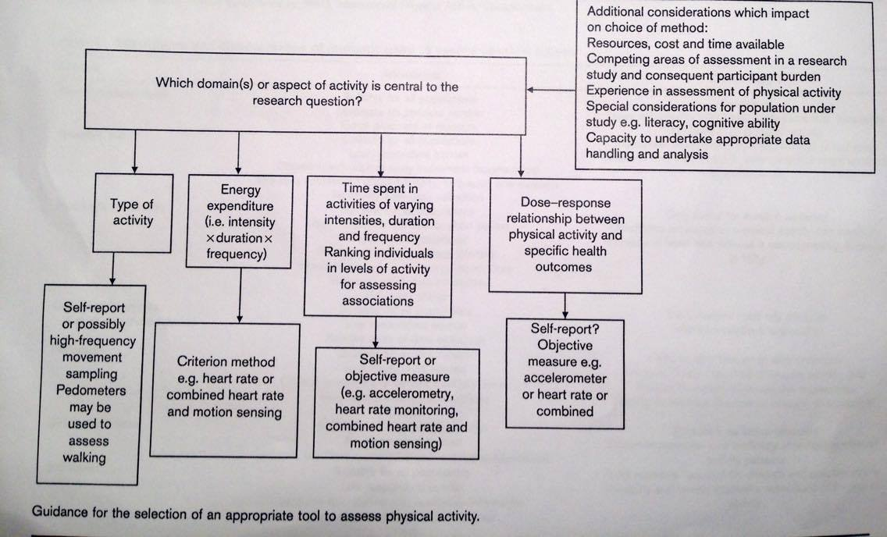
Selection of an appropriate tool to assess PA
Selection of the method is a crucial decision
Careful consideration must be given to the research question in the first place, and the dimension or domain of PA to be assessed

Slide 38
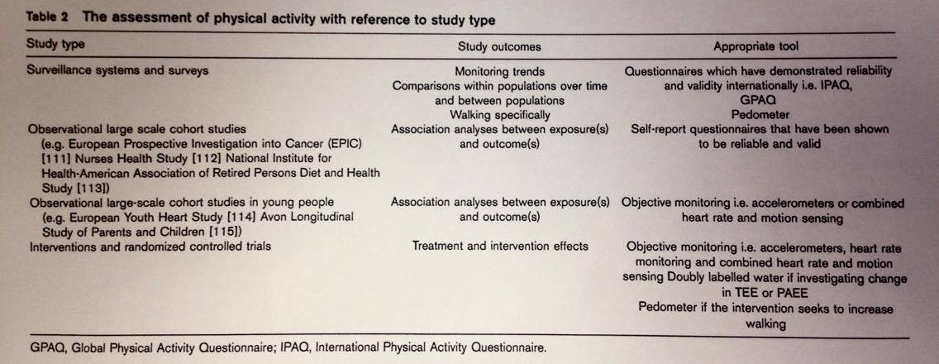
Influence of study type on methodology choice
The specific study type and design has an important bearing on the choice of method to measure PA

Slide 39
Assessment of cardiorespiratory fitness – outputs for prescription of cardiometabolic or other internal diseases
Need of evaluation of absolute and relative contraindication of physical training before any prescription of PA!
Perform complex examination and cardiorespiratory fitness examination:
determine maximal aerobic capacity by stress test = CPX = cardiopulmonary exercise testing (spiroergometry)
always risk factors CVD
also for asymptomatic individuals, who have been inactive for more than 3 years and are planning on doing systematic PA of medium to high intensity (men below 40, women below 50)
The benefits: exact evaluation of physical fitness and effective setting up of PA training plan, finding of non-physiological states unprofound until now
Notes:
Assessment of cardiorespiratory fitness – outputs for prescription of cardiometabolic or other internal diseases
Need of evaluation of absolute and relative contraindication of physical training before any prescription of movement activity
Perform complex examination and cardiorespiratory fitness examination:
-determine maximum aerobic capacity by spiroergometry under load
-always risk factors CVD
-also for asymptomatic individuals, who have been inactive for more than 3 years and are planning on doing systematic MA of medium to high intensity (men below 40, women below 50)
The benefits: exact evaluation of physical fitness and effective setting up of movement activity plan, finding of non-physiological states unprofound until now

Slide 40
Assessment of cardiorespiratory fitness – outputs for prescription of cardiometabolic or other internal diseases
Need of finding any possible contraindications before testing (blood circulation insufficiency, inflammation of myocardium, any other serious cardiopulmonary diseases)
Outputs:
assessment of maximal aerobic capacity (VO_{2 max}), volume of exhaled CO₂, ratio of respiratory exchange, breath frequency, total ventilation, lung volume, hemodynamic reaction to stress
maximum heart rate
anaerobic thershold
Notes:
Need of finding any possible contraindications before testing (blood circulation insufficiency, inflammation of myocardium, any other serious cardiopulmonary diseases)
Outputs:
assessment of maximum aerobic capacity (VO_{2 max}), volume of exhaled CO₂, ratio of respiratory exchange, breath frequency, total ventilation, lung volume, hemodynamic reaction to stress
-maximum heart rate
-anaerobic thershold

Slide 41
Assessment of cardiorespiratory fitness – outputs for prescription of cardiometabolic or other internal diseases
Parameter VO₂max shows the maximum oxygen amount that can be transported from outside, absorbed and used to cover energy needs during PA by individuals
Cardiac patients – parameter VO₂peak
Average listed values for the Czech untrained population:
women 35 mL/kg/min
men 45 mL/kg/min
Maximum aerobic capacity is displayed in the multiples of one metabolic equivalent: 1 MET=3.5 mL/kg/min
Notes:
VO₂max shows the maximum oxygen amount that can be transported from outside, absorbed and used to cover energy needs during MA by individuals
Average listed values for the Czech untrained population:
women 35 mL/kg/min
men 45 mL/kg/min
Maximum aerobic capacity is displayed in the multiples of one metabolic equivalent: 1 MET=3.5 mL/kg/min

Slide 42
Assessment of cardiorespiratory fitness – outputs for prescription of cardiometabolic or other internal diseases
Recommended training intensity with cardio protective results:
50-85 % VO₂max
by percentage of heart rate reserve (HRR) 50-85%
Start at low end of HRR percentage (min 10 minutes of training), after 30 minutes slowly increases load intensity
During training: check HR and blood pressure (pause-load-rest), check symptoms during training (emphysema, tiredness, chest pain, lower limb pain)
VO₂max is an important prognostic marker for individuals with CVD
Kavangh et al. (2002, 2003) reports that with every improvement of VO₂max by 1 mL/kg/min improves the prognosis by 9%
(Kavanagh T, Mertens DJ, Hamm LF, et al. Prediction of long-term prognosis in
12 169 men reffered for cardiac rehabilitation. Circulation. 2002;106(6):666
671.)
reaching 22 mL/kg/min is an optimum results (prognosis improved by 40-60%)
Notes:
Recommended training intensity with cardio protective results:
-50-85 % VO₂max
by percentage of heart rate reserve (HRR) 50-85%
XXXX
Start at low end of HRR percentage (min 10 minutes of training), after 30 minutes slowly increases load intensity
During training: check HR and blood pressure (pause-load-rest), check symptoms during training (emphysema, tiredness, chest pain, lower limb pain)
VO₂max is an important prognostic marker for individuals with XXX
Kavangh et al. (2002, 2003) reports that with every improvement of VO₂max by 1 mL/kg/min improves the prognosis by 9%
reaching 22 mL/kg/min is an optimum results (prognosis improved by 40-60%)

Slide 43
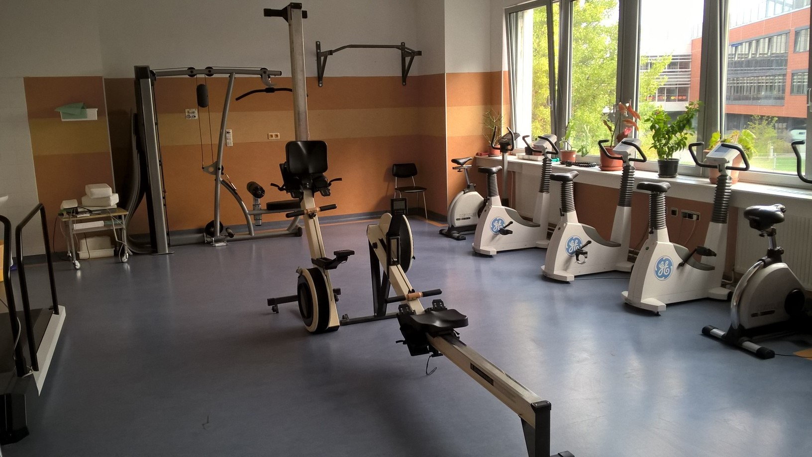



Thank you for your attention!
Robert Vysoký, PT., Ph.D.
Department of Public Health – Faculty of Medicine MU Brno
E-mail: vysoky.rob@gmail.com

