Slide 1
HYGIENE OF ADOLESCENS
Mgr. Robert Vysoký, Ph.D.
Ústav ochrany podpory zdraví LF MU
2018

Slide 2
1. Introduction to the problem
Hygieia or Hygeia - the ancient Greek goddess of health and cleanliness
HYGIENE in a Modern Concept - a set of rules and measures aimed at preserving health
Hygiene of children and adolescents - follow-up on (especially) preventive and social pediatrics
Protection and promotion of health in puberty and adolescence with regard to specific risks
The WHO defines adolescence as a separate risk group

Slide 3
Introduction to the problem
Safe, healthy and clean environment - the foundation for healthy growth and development of the child
Environmental risks multiplied by poor social and economic conditions
More than 3 million children die each year for both infectious and non-infectious diseases (negative impacts of the material and social environment)
Respiratory diseases (air pollution), diarrheal diseases (water contamination, hygienic habits), malaria, HIV (maternal-child transmission)
Malnutrition (1/3 of all child deaths)

Slide 4
Introduction to the problem
Prevention of childhood obesity - one of the main priorities
42 million children under 5 years of age worldwide is suffering by overweight
In adulthood, chronic non-infectious diseases can also develop:
- DM II. type
- CVA
- musculoskeletal disorders
- some oncological diseases
Medium and low income countries - the "double burden" (the threat of infectious diseases and the current rapid increase in chronic non-infectious diseases)

Slide 5
Introduction to the problem
Particular attention is paid to the prevention of juvenile health problems
Prevention of sexual and reproductive health (sexually transmitted diseases including HIV / AIDS, unwanted and premature pregnancies)
The area of addictive substances abuse and the area of mental health
In the Czech Republic, the Department of Hygiene of Children and Juveniles (HDM) has been established at the KHS (Public Health Protection Authorities)
The head of the department performs a doctor - a graduate of specialized education in the field of HDM with certain/set practice
Field supervision is performed by the assistant of the hygienic service (public health assistant - VOŠ, Bc.)

Slide 6
Introduction to the problem
Departmen of HDM performs state health surveillance and works with other KHS departments.
It monitors the obligations of individual entities provided by Act No. 258/2000 Coll. On Public Health Protection (all types of children's and school facilities, including school canteens and children's recovery facilities - sanatorium, outdoor playgrounds and sandboxes)
Within the State Health Institute - the Health Support Center was established with the Department of Hygiene of Children and Juveniles.
Monitoring health and healthy development indicators of children and young people, their living and working conditions.
Conduct studies of the context of external conditions vs. healthy development of children and adolescents
Results of studies - creation of preventive programs
Programs to promote healthy lifestyles, the process of promoting health in schools, preventing child violence, child injuries and socially pathological phenomena

Slide 7
Introduction to the problem
Who educates children and adolescents to health
lifestyle?
- Family
- school
- doctor
Factors affecting healthy growth and development
of juveniles:
- environmental - environmental conditions and lifestyle (including technological and information risks)
- social
- economical

Slide 8
Introduction to the problem
Preventive, curative and dispensary care for children and
adolescent - in the competence of general practitioners
- system of preventive health checks (Ministry of Health Decree No. 3/2010 Coll.)
Part of the preventive health check is:
- evaluation of anthropometric features
- evaluation of the somatic findings/discovery
- evaluation of psychomotor and psychosocial development
Important is cooperation with family and pedagogical staff and educators, staff of authorities for protection of public health

Slide 9
2. Prevention of child injuries
Injury - health damage caused by a sudden external cause
Typology of injuries
- according to cause (circumstances of origin): eg traffic, sports, domestic, violent, ...
- according to consequences: eg light, moderate, heavy, with permanent health consequences, fatal ...
- according to other criteria

Slide 10
Prevention of child injuries
Accident statistics:
The most common causes of accidents/injuries in individual age categories
Types and numbers of child injuries
National Register of Child Trauma/injuries: Characteristics, reason and history of origin, importance
http://www.detskeurazy.cz/

Slide 11
Prevention of child injuries
Large differences between states in injury and mortality
Very well developed accident prevention (Sweden, the Netherlands, Great Britain)
In the Czech Republic there is a high accident rate, injuries are the most frequent cause of death among children and adolescents, the third most frequent cause in the whole population
43% of children's deaths (0-14) result from traffic accidents
10% of child deaths by drowning
by location - most often home, surrounding of home, sports, school
National Action Plan on Prevention of Child Injuries 2007-2017
Objective: To reduce child morbidity and mortality, frequency and severity in the Czech Republic

Slide 12
3. Injuries of children and adolescents
Factors
- socio-economical (alcohol and drugs, violence, family)
- physical (place of injury, weather, temperature, daytime, risk environment ...)
Socio-economic status of the family
- an important role in the incidence of injuries
- family influence (departure/deviation from multigenerational cohabitation, divorce ...)
- few safe spaces to play, lack of finances for protective aids, less supervision and interest of parents ...
- families with social pathology (child as a witness or victim of violence)
Notes:
Child and youth injuries are affected by many factors that are directly related to the occurrence of health damage:
socio-economic factors - alcohol and drug use acceptance, violence acceptance, family
Physical Factors – place of injury, Weather, Temperature, Daytime, Seasons, Risk Environment
Socio-economic status of the family
Significant roles in the incidence of injuries, mostly accidents resulting from negligent surveillance, dangerous and unprotected environments, inadequate education for safe behavior.
From the point of view of the function and power of the influence of the family - there is a negative deviation from the multigenerational coexistence of families, single parent families, high divorce rate - family conflicts.
Socio-economic conditions affect injuries:
living in poor quality areas, dense traffic in surroading, little safe space to play, lack of funds for the purchase of protective equipment, not very safe means of transport, obsolete home appliances, less supervision and interest of parents ...
in families with social pathology the child is often a witness or a victim of violence

Slide 13
Types of injuries of children and adolescents
Traumacentrum, Scoring Systems (PTS)
Types of injuries by age:
- neonatal age (up to 1 month of age): fall in transit, scalding, risk of food inhalation
- infant age (1-12 months): scalding (pull down of cloth), burns (cooker), electrical injuries (socket), falls (pram, bed, stairs), inhalation of a foreign body
- toddlers (1 to 3 years): most often fatal injuries and poisoning, inhalation and subsequent suffocation (beads, nuts), injuries by sharp objects (knives, scissors, crayons), falls (sharp corners, stairs, bike) poisons (medicines, plants, chemicals), drowning (swimming pools, tanks), scalds (capsize of containers)
- pre-school age (4-6 years): accidents related to leisure and sports activities (bicycle), falls, poisoning, burns
- school age (7-14 years): falls and srash in sports, school injuries, burns, drownig, traffic injuries (pedestrians, cyclists), violence
- Adolescence (15-18 years of age): Risking in terms of increased self-confidence, risk behaviors, alcohol and drug abuse; traffic and sport injuries
Notes:
Caring for an injured child is concentrated in traumatology centers, scoring systems are used to evaluate the condition and classify injured children.
PTS - Pediatric Trauma System
Developed in the mid-1980s of the last century.
Based on the evaluation of 6 indicators, each assigned one of three weightings, respecting age specifics.

Slide 14
The most common places of injury
Home environment
- in children under 3 years of age
- 2/3 of accidents for children under 14 and 1/3 in adolescence
- kitchens, garden pools
- getting familiar with proper use and at the right time
Transport environment
- co-driver, bike, child as a pedestrian
Free time activities
- cycling (intersections, roundabouts, more often boys 4:1)
- afternoon hours, seasonal occurrence (spring, summer)
- bicycle transport (seats, helmets)
Adrenalin sports
- football, paintball, skateboard, in-line skates, scooters, trampoline, inflatable attractions, winter sports
- children admire them and want to try them, overestimation of strenght, risks
- Fractures, head and brain injuries
- the use of specific protective equipment for the activity in question
Playground
School

Slide 15
Accident risk according to phases of psychomotor development of children
important for assessing risk factors and targeting preventive activities
small children - motor skills, but insufficiently developed cognitive skills to recognize hazards
- field of view 30% narrower than adults (retardation of fast reflexes)
- poor estimate of the speed of moving objects
- the ability to distinguish common sounds from dangerous little developed to pre-school age
- the center of gravity of the body placed higher (instability, loss of balance - falling into the pool ...)
- risk awareness based on experience (prediction of danger only from the 8th year, often suppressed by other perception, interest)

Slide 16
4. Lifestyle disorders - addiction and prevention options
Risky behavior
- conduct endangering life, health or social integrity of the individual, or behavior directed against the interests of the society in the standards contained and the defined laws
- behavior threatening integration of an individual into society

Slide 17
Risky behavior
there is a demonstrable increase in health, social, educational and other risks to individuals or society
Primary Prevention of Risk Behavior - is a set of any health, social, educational or other interventions and measures to prevent the occurrence of risk behaviors
Preventing further progress, mitigating already existing forms and manifestations of risk behavior or helping to address its consequences

Slide 18
Risky behavior
Adolescent risk behaviors – addictive substances abuse, aggressive behavior, social maladaptation, and reproductive health disorders
Abuse of addictive substances - we are at the top of Europe (46% of our 16-year experience with marijuana)
Recently, the methodology of individual prevention is in the form of interviews with a doctor - the CRAFFT questionnaire
Previously the school environment domain
Sources of risk behavior:
- biological (genetics, congenital or acquired defects, psychiatric dg.)
- psychological (long-term anxiety, frustration, depression, deprivation, emotional lability, defensive reaction to traumas experienced ...)
- social (they explain risk behavior on the background of the relationship between the individual and society)
Notes:
C (car): Jel/a jsi někdy v autě či na motorce řízené někým pod vlivem alkoholu či jiné drogy anebo jsi někdy řídil/a motocykl pod vlivem alkoholu či jiné drogy?
R (relax): Napil/a ses někdy alkoholu či bral/a jsi někdy nějakou drogu, aby ses uvolnil/a, měl/a ze sebe lepší pocit anebo abys dobře zapadl/a mezi kamarády?
A (alone): Pil/a jsi někdy alkohol nebo sis vzal/a nějakou drogu, když jsi byl/a o samotě?
F (forget): Stalo se ti někdy, že jsi zapomněl/a, co jsi dělal/a, když ses napil/a alkoholu nebo jsi vzal/a nějakou jinou drogu?
F (family/friends): Řekl ti někdo z rodiny či kamarádů, že bys měl/a omezit své pití nebo braní jiné drogy?
T (trouble): Dostal/a ses někdy do obtíží, když jsi pil/a alkohol či bral/a jiné drogy?

Slide 19
Risky behavior
Bullying - "one or more pupils deliberately, usually repeatedly tortures and enslave their classmate or classmates and uses aggression and manipulation to do so" (Kolář, 2001).
Cyberbullying - Dangerous communication phenomena implemented through information and communication technologies that result in harm or other damage to victm (Kopecký, Krejčí, 2010).
Toxicomania - a state of addiction to a particular drug with consequent physical or mental disorders, this situation is detrimental to individuals and society as a whole.
Alcohol - a psychotropic substance that acts mainly to increase mood, a legal drug.
Tabacism (smoking) - "day-to-day addiction", leading to psychological and physical addiction, endangering life and health, legal drug.

Slide 20
Risk behaviors - educational factors
Society is a unit and affects on teenage children through various educational elements (educators)
These can act positively, preventively, but also negatively
The function of educational elements is fulfilled by social groups and the various persons with whom the teenager enters into different relationships
The main educators - social groups in which adolescents are relatively permanently incorporated and which therefore have the possibility of long-term influence (family, school, peer group or interest group)

Slide 21
Addiction of adolescents
Definition of addiction
Recurrent drug use - addictive substance
It is manifested by changes in experience and behavior
The irresistibility of the urge to use the addictive substance continuously or periodically for its effects on the psyche
Psychological addiction - a person thinks he/she needs to continue using the drug to cope with their lives.
Physical adiction- the body becomes accustomed to the presence of the drug, and the individual has to use it (avoidance of the withdrawal syndrome)
Drug addiction (according to WHO, 1969) - The mental state of periodic or chronic intoxication that damages both individuals and society caused by repeated use of the natural or synthetic drug "

Slide 22
Overview of the most common types of addiction
Computers and the Internet
addictive and impulsive
the most endangered is child population group
individuals neglect school responsibilities
by playing inappropriate games, the virtual world can coincide with the real world
lower social level due to frequent playing
dangerous encounters with a virtual person in reality

Slide 23
Overview of the most common types of addiction
Eating disorders
Mental bulimia
It is a eating disorder where an individual (in most cases a woman) is suffering from repeated fits of overeating and subsequently seeking an extreme solution to reduce the effects of already-consumed foods.
Often linked to mental anorexia
After a seizure, they are punishing themselves by vomiting, using laxatives to reduce the effects of ingested foods as much as possible.
Repeated vomiting causes:
- increased muscle irritation,
- epileptic seizures
- heart disorders
- muscle weakness ...

Slide 24
Overview of the most common types of addiction
Mental anorexia
There is an intentional reduction in body weight
The illness begins inconspicuously and for a long time may not be noticeable
Thanks to the inappropriate example of the perfect body of today's world, a lot of girls feel thick and try to reduce their weight.
much more energy is emitted than it is received
Hair loss, nail breaking, bone thinning, osteoporosis, cold sensitivity, psychological problems and irritability
It sometimes results in omission of menstruation and infertility, organ damage
A large percentage of suicidal tendencies
The treatment is very lengthy and takes place in specialized institutions and clinics.
Overeating
Associated with other mental disorders, they usually follow a traumatic situation (loss of a close relative, operations, accidents, injuries and other stressful situations).
It leads to obesity with its health consequences

Slide 25
Overview of the most commonly used addictive substances
Alcohol addiction
Due to the simplicity of the chemical structure of alcohol, the penetration into the tissues is very fast and simple. It passes through the mucous membrane of the digestive tract and into the bloodstream.
Liver cirrhosis, mucosal damage, nerve inflammation, and alcoholic stress
Together with cigarette smoking, it affects the cancer of the tongue, the oral cavity, the larynx, the pharynx and the esophagus.
Psychological consequences, the so-called delirium of tremens (hallucinations), psychoses - the worsening of social as well as family ties.

Slide 26
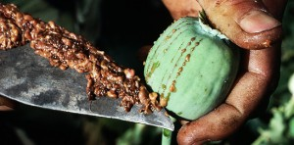
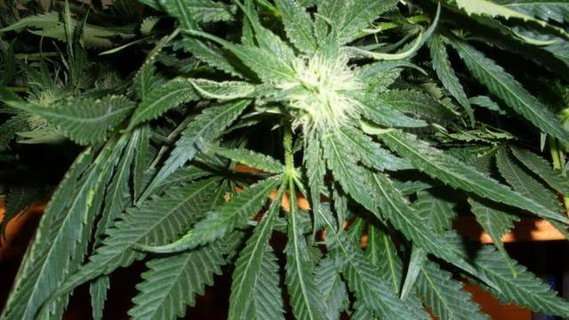
Overview of the most commonly used addictive substances
Opioids
Made from dried sap of immature poppy, but they are also semi-synthetic and synthetic.
Effects may be euphoria, but it mainly has suppressive effects - somnolence, feelings of vomiting and confusion
Dependence on opiates is also threatening people who use them for health reasons
They cause psychic and somatic addiction
Heroin, codeine, morphine, opium, hydromorphone, braun and methadone
Kanabinoids
Marijuana
One of the most commonly used addictive substances in the Czech Republic
It is a natural substance that comes from Indian cannabis
Euphoria, deterioration in coordination, distorted perception of time and space, increased sensitivity to some stimuli, accelerated or slowed thinking, groundless laughter
Health risks are: respiratory tract inflammation (bronchitis), lung cancer, impaired attention and memory, psychotic symptoms

Slide 27
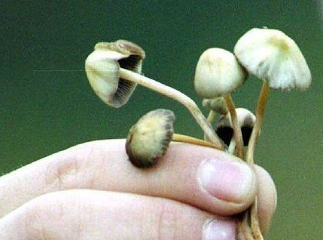
Overview of the most commonly used addictive substances
Hallucinogenic fungi and LSD
psilocybe mushroom - used in raw, but also in heat-treated form
LSD is lysergic diethamide
Hallucinogens are abused to induce altered sensory perception, hallucinations, another view of time and space, another view on the person's own.
enlargement of the pupils, flushing in the face, increased sweating, tremor, dizziness, dry mouth, nausea, perception disorders, euphoria, sometimes anxiety and depression, over-estimation of self-abilities, faults of judgment, delusions
due to anxiety aggression to yourself and surrounding may occur
There is overheating of the body, irresistible thirst, restlessness

Slide 28
Overview of the most commonly used addictive substances
Organic solvents
A group of addictive substances, which are also referred to as volatile substances or inhalation drugs.
solvents, adhesives, diluents, gaseous substances
The individual volatile substances are: toluene - methylbenzene (C6H5 - CH3), trichlorethylene (ClHC = CCl2), used in industrial workplaces, the most dependent are employees of this branch
Toluene is freely available in drugstores and is relatively inexpensive
It can be inhaled directly from the bottle, but more commonly the inhalation (sniffing) of toluene vapors from the impregnated fabric
The effect occurs within a few minutes and is short-term - it disappears within a few tens of minutes if inhalation does not proceed or is not repeated
Volatile substances induce feelings of euphoria, hallucinations, depression/sedation and sleep
Longer use results in emotional and behavioral disorders, aggressiveness and a large brain cell loss.
There is a very rapid psychological dependence

Slide 29
Overview of the most commonly used addictive substances
Pervitin and amphetamines
Previously used as antidepressants, nowadays they are used in cases of bulimia and narcolepsy (sudden falling asleep without cause)
Pervitin is used intravenously or by taking snuff
The main effects are euphoria, hyperactivity, insomnia, anorexia, accelerated thinking and speech
Health risks is aggressiveness when the effect disappears (after three to four hours), followed by somnolence and depression
Neurological and cardiac disorders, CNS disorders; worsening of concentration and memory, and the development of psychotic symptoms.

Slide 30
Addiction - Preventive intervention
Primary prevention
The goal is to prevent the use of addictive substances, including alcohol and tobacco
Restrict or stop experimenting with addictive substances
Education for "healthy behavior"
Primary prevention needs to be started so early that children learn in various forms to reject the addictive substances they are offered and resist to addictions
They should learn to build a ranking of their own values and positive motivation

Slide 31
Addiction - Preventive intervention
Effective primary prevention must include a system of follow-up activities:
- primary prevention programs
- information and advisory services
- coordination activity
- educational activities for school prevention, pedagogues and parents
Main points of primary prevention:
- to get into the minds of children and youth and to inform them about addictive substances and addictions
- to inform about their health risks and social impacts
- promote healthy attitudes and standards that a child has acquired against addictive substances and addictions
- offering leisure activities and lifestyle without having to use addictive substances

Slide 32
Addiction - Preventive intervention
Nonspecific primary prevention programs
activities that are not directly related to addictive substances but are focused on a healthy lifestyle
Sport activities and interest groups
Created by independent organizations and pedagogical-psychological councils, where organizers go directly to schools

Slide 33
Addiction - Preventive intervention
Selective primary prevention programs
For groups, where the possibility of addiction and substance abuse is increased
Efficiency criteria: strategies used, increased intensity, school collaboration with parents and other organizations
Programs of indicated primary prevention
Oriented on groups and individuals, where risk factors and undesirable social phenomena are already present
Low-threshold facilities for children and youth:
for children and youth, who spend their free time on streets or in a party
their free time is not organized in any way
Free of charge, there is no exact time schedule for arrivals and departures
the choice of activities depends entirely on visitors (listening to your own music, watching own movies, table games, sports equipment, musical instruments ...)
counseling and prevention services, where children and young people can confide in their problems or feelings or just talk to workers to help them deal with their situations

Slide 34
Hazardous sexual behavior
A set of behavioral manifestations accompanying sexual activities and showing a demonstrable increase in health, social and other types of risks
Relatively frequent forms of sexual behavior (unprotected sexual intercourse, promiscuous behavior, risky sexual practices, etc.)
These include forms combining multiple types of risky phenomena (substance abuse, sexual abuse, sexual violence, public humiliation in connection with inappropriate presentation of personal videos and photographs on the Internet).

Slide 35
Hazardous sexual behavior
Among sexual risk behaviors with high potential impacts on reproductive health we include:
- an early beginning of sexual life
- promiscuity
- prostitution
- high frequency of sexual intercourse and unprotected sex despite the awareness of possible infection
Consequences:
- sexually transmitted diseases, inflammatory diseases,
- early pregnancy and abortions
- the ultimate consequence is sterility and serious to fatal health problems.

Slide 36
Sexually Transmitted Diseases (STD)
Most infections are easy to treat and virtually harmless to reproductive health
Sexual, urinary tract, oral and rectal mucosa. The course is inflammatory with the presence of symptoms
Sometimes asymptomatic, so the infected will carry the disease to the partners without the knowledge of their own infectivity
On the territory of the Czech Republic, 1,452 cases of infectious diseases were reported in the Register of Sexual Diseases, of which 737 cases of syphilis and 709 gonococcal gonorrhea infections (IHIS 2012)
Among the diseases with a negative impact on reproductive health are: gonorrhea, syphilis, chlamydia infections, acute condylomas, herpes labialis and candidiasis

Slide 37
Sexually Transmitted Diseases (STD)
The epidemiology of sexually transmitted diseases is closely related to social behavior and the status of an individual in society
The main factors influencing the likelihood of infection include:
- sexual risk behavior
- sexual orientation
More than 28% of reported diseases concerned homosexual men and 7% bisexual
Women stated in 90% heterosexuality
Transmission occurred at 80% after unprotected contact, 5% of whom were drug users
Education belongs into socio-economic factors related to the occurrence of diseases
Unprotected heterosexual and homosexual contact can also lead to HIV transmission
In 2011, 167 new cases of HIV were diagnosed, with 26 infected persons suffering from AIDS status (IHIS, 2012)

Slide 38
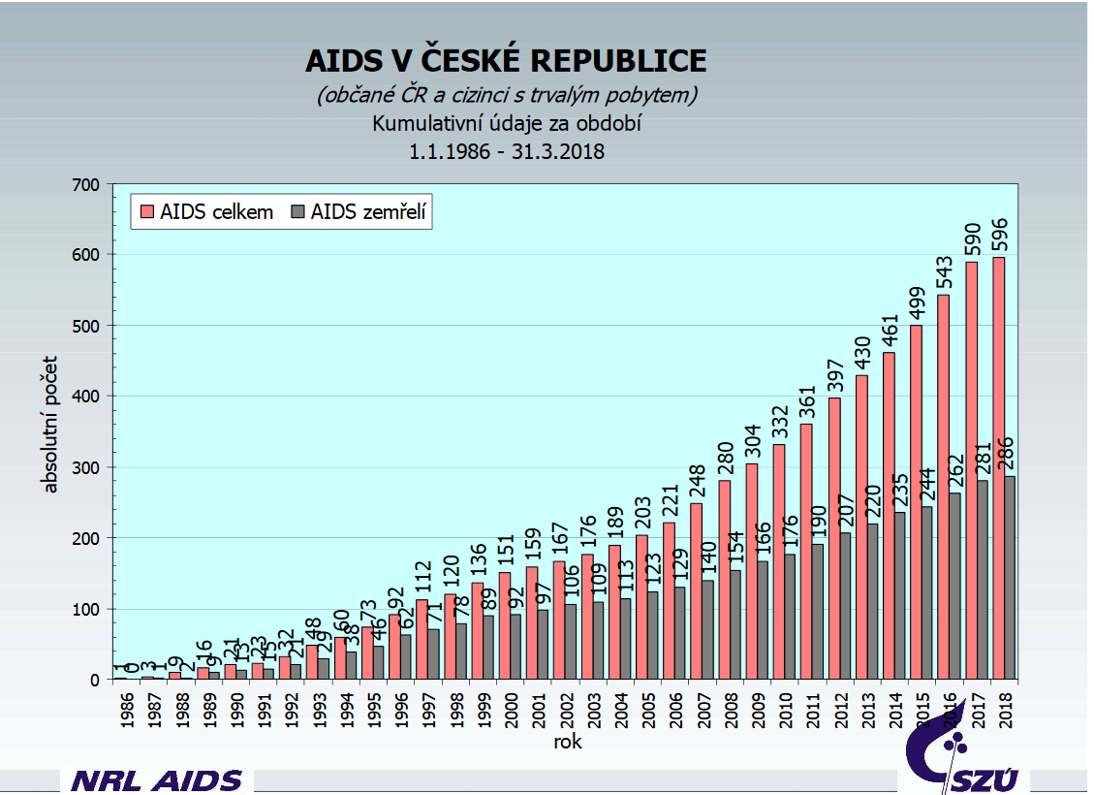

Slide 39
https://zpravy.aktualne.cz/domaci/syfilis-kapavka-i-hiv-pocty-nakazenych-v-cesku-rostou-nejvic/r~ba9891e85bed11e7a0580025900fea04/?redirected=1527021340

