Slide 1

Smoking and health
prof. MUDr. Drahoslava Hrubá, CSc.
Mgr. Jana Fialová, Ph.D.
Doc. Ing. Martin Krsek, CSc., MSc
Department of Public Health
Faculty of Medicine
Masaryk Univerzity

Slide 2
WHO
SMOKING IS THE MOST IMPORTANT SINGLE PREVENTABLE (!) CAUSE OF MORBIDITY AND MORTALITY
SMOKING CONTRIBUTES TO:
MORTALITY: annually 6 mil. victims worldwide
MORBIDITY: at least to 25 different diseases
DISABILITY: the second leading factor

Slide 3
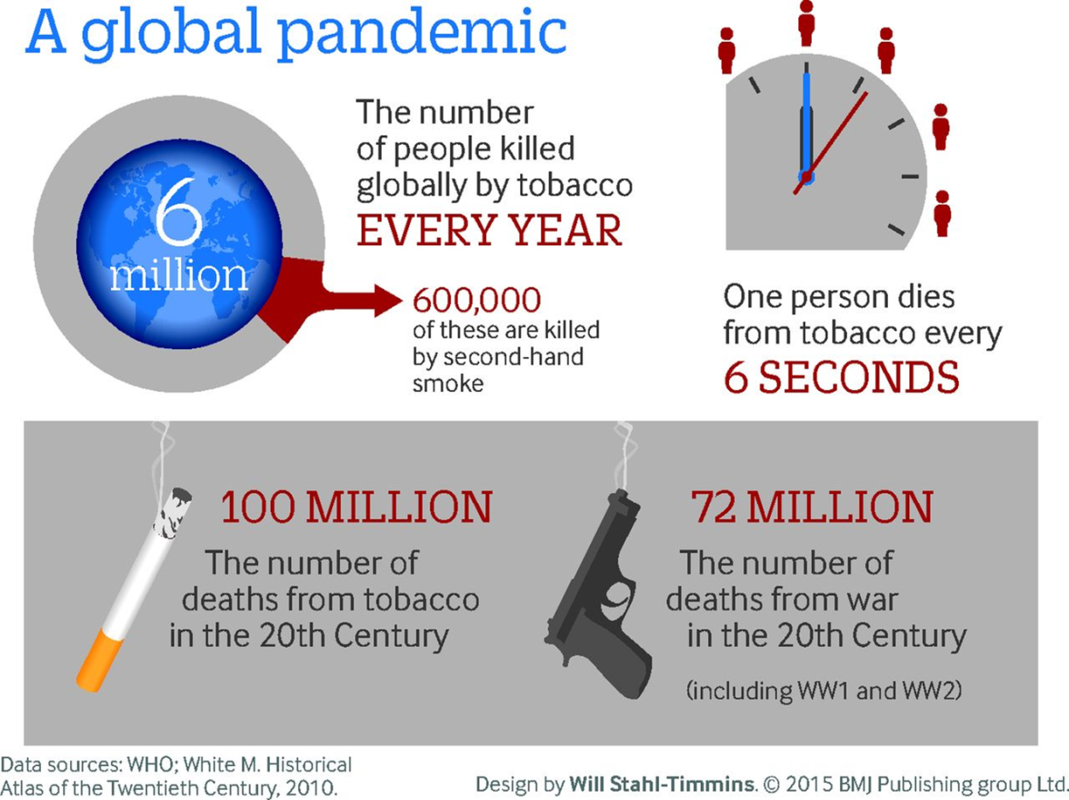
More people die every year
from smoking than from : murder, AIDS, suicide, drugs, car crashers and alcohol together!

Slide 4
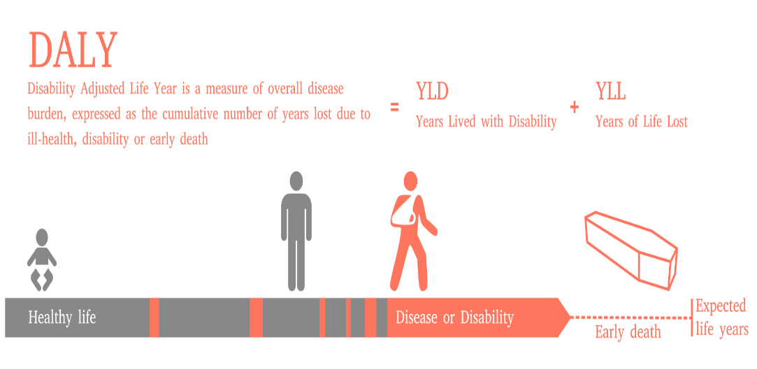
GLOBAL BURDEN of DISEASES
ATTRIBUTABLE EFFECTS of 67 RISK FACTORS in 21 WORLD REGIONS
On DALYs (disability-adjusted life years) =
  YLD (sum of years lived with disability) +
  YLL (years of life lost)
FIVE LEADING FACTORS:
(1) HYPERTENSION
(2) TOBACCO SMOKING
(3) ALCOHOL USE
(4) DIETARY – MALNUTRITION
(5) PHYSICAL INACTIVITY
Notes:
The disability-adjusted life year (DALY) is a measure of overall disease burden, expressed as the number of years lost due to ill-health, disability or early death. It was developed in the 1990s as a way of comparing the overall health and life expectancy of different countries.

Slide 5
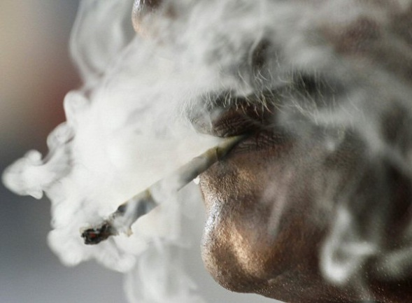
Smoking
Inhalation of tobacco smoke, most effective way for intoxication by nicotine
Tobacco products for smoking :
CIGARETTES, PIPES, CIGARS
BIDIS, KRETEKS, STICS
WATER PIPES
SMOKELESS: SNUFF (MOIST, DRY), CHEWING TOBACCO
NICOTINE DELIVERY SYSTEMS (e-cigarettes)
HEATED-NOT-BURN TOBACCO PRODUCTS (IQOS –PM),
ALL FORMS OF TOBACCO ARE ADDICTIVE AND LETHAL
Notes:
Obrázek - zdroj: ČTK/AP http://magazin.ceskenoviny.cz/zpravy/koureni-a-rakovina-aneb-nejde-jen-o-plice/1165944

Slide 6
Smoking
Nicotine content:
1 cigarette 1 - 3 mg of nicotine,
1 cigar cca 10 mg of nicotine
Inhaling
into mouth only - absorbs 5% of nicotine,
deep inhalation – absorbs 70%,
very deep inhalation with holding breath - 95% of nicotine

Slide 7
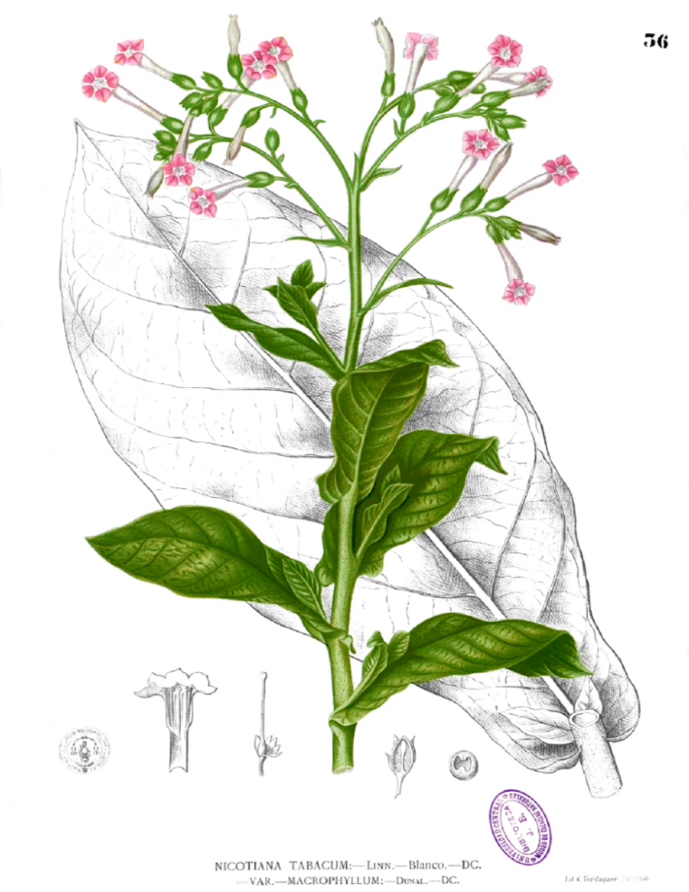
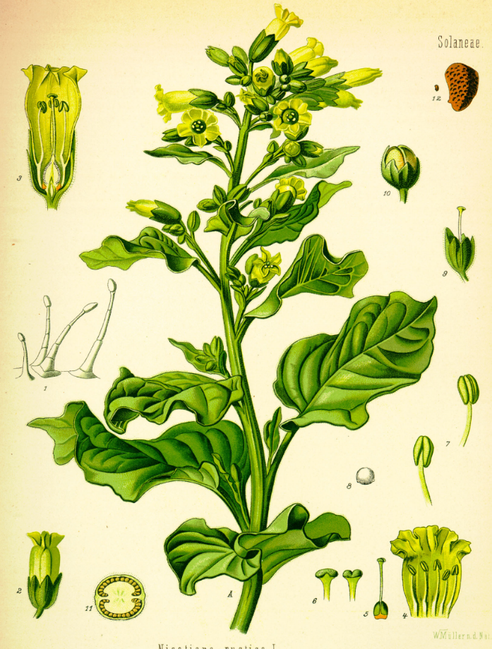
Tobacco plants
Nicotiana tabacum
Nicotiana rustica L.
French ambassador in Portugal, Jean Nicot de Villemain sent tobacco and seeds to Paris in 1560
Notes:
Nicotiana tabacum – tabák viržinský; původ Mexiko, pravděpodobně kříženec planých druhů N. sylvestris a N. tomentosa.
Nicotiana rustica L. – tabák selský – lidově Machorka, jeden z původních botanických druhů.

Slide 8
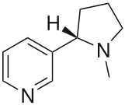
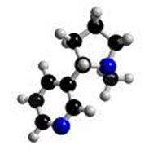
Nicotine
Plant alkaloid (from plant family Solanaceae)
Human lethal dose - cca 60 mg
Stimulating effects in nervous system
Increase digestive tract activity, increase blood pressure, cardiac acceleration, vasoconstrictor effects, related tissue and organ hypoxia
It is not a carcinogen itself
But - its metabolites are
E.g. NNK - nicotine-nitrosamine ketone: a strong mutagen and a carcinogen present in tobacco smoke, naturally occurring in tobacco leaves of industrially treated tobacco crops in the presence of light
C₁₀H₁₄N₂
Notes:
Solanaceae: potatoes, eggplant, tomatoes, peppers… , but rich of nicotine is tobacco only
NNK is a compound that is naturally synthesized in tobacco leaves that are exposed to light: the pyrrolidine ring in the nicotine opens and turns the nicotine into NNK. Most of the NNK found in tobacco smoke originates from nicotine burning.^{[2]}
Sun-cured tobaccos (a.k.a. "Oriental") contain very little NNK and other TSNAs due to low-nitrate soil, lack of nitrate fertilizer, and sun-curing. Flue-cured tobacco (a.k.a. "Virginia" tobacco^{[4]}), especially when using an open flame, contains most of the NNK in American blended tobaccos^{[5]} although Marlboro's "virginia blend" had the lowest levels of NNK per nicotine out of many tested with the exception of Natural American Spirit.^{[6]}

Slide 9
IN CIGARETTE SMOKE
ABOUT 5.000 CHEMICALS with
  IRRITATION,
  TOXIC,
  CARCINOGENIC,
  TERRATOGENIC, EMBRYOTOXIC EFFECTS

Slide 10
Chemicals in tabacco smoke
WHO: Tobacco smoke is human carcinogenic mixture
arsenic - a toxic element, used since ancient times as a rat poison
benzene - carcinogenic, naturally occurring in oil, benzopyrene - a highly carcinogenic and mutagenic substance, a typical product of incomplete combustion
dioxins (a group of the strongest known poisons), DDT (a very effective insecticide, until the late 1960s used to kill harmful insects, then banned in most countries) - both highly persistent
formaldehyde - formerly used as an insecticide to kill moths, as a disinfectant and sterilizing agent, as a part of chipboard adhesives or in the manufacture of carpets
cadmium - heavy metal, strongly cumulative in kidneys, chemically similar to Zn - blockages and changes in biochemistry. cycles (insulin cycle),
hydrogen cyanide - one of the most poisonous gases (used in gas chambers during World War II, as well as a mouse poison)
nickel - a highly toxic element, highly teratogenic
lead - a toxic element, especially dangerous for children - causes slowing of mental development and behavioral disorders
TSNA - Tobacco-specific nitrosamines - a group of highly cancer-causing substances that are present only in tobacco products, are involved in many types of cancer, can damage reproductive organs
Notes:
Arsenic-containing pesticides
The tobacco plant contains nickel and several other toxic metals, most probably absorbed from the soil, fertilizing products or from pesticides

Slide 11
Chemicals in tabacco smoke
Carbon monoxide (CO) - toxic gas; preferential binding to hemoglobin molecules - decreases the amount of oxygen-transferring oxygen, significantly lower overall oxygenation of the organism. The main component of exhaust gases.
Nitrogen dioxide (NO₂) - highly toxic gas, airway inflammation - from light to lung edema. They are involved in the formation of acid rains and the formation of photochemical smog.
Nitric oxide (NO) - toxic gas, in the presence of corrosive moisture. In the human body it is formed in the cardiovascular and nervous system, it affects the vasodilatation, the signal molecule, the neurotransmitter function; in medicine, use in the release of smooth muscle cramps during asthma. At higher doses - heart weakness. Releases in exhaust gases and works in acid rain.
Tar - A mixture of chemicals (predominantly toxic and cancer-causing) such as polycyclic aromatic hydrocarbons (PAHs) or aromatic amines; has a dense oily or greasy consistency. In tobacco smoke it is dispersed in the form of an aerosol, 90% of which is deposited in the lungs of the smoker, 10% returns with exhaled smoke back to the atmosphere in its immediate vicinity.

Slide 12
SMOKING HAS
IMMEDIATE EFFECTS
MIDLE- TERM EFFECTS
LONG-TERM EFFECTS
    ON HUMAN HEALTH

Slide 13
* IMMEDIATE EFFECTS
ACTIVATION OF BRAIN RECEPTORS
CARDIOVASCULAR CHANGES
HYPOXEMIA
IRRITATION

Slide 14
NICOTINE IN BRAIN
NICOTINE REACHES THE BRAIN WITHIN 10-20 SECONDS AFTER THE PUFF (small molecule)
WITHIN 20-30 MINUTES AFTER TRANSDERMAL/SALIVA TRANSPORT
NICOTINE OCCUPIES THE SPECIFIC CHOLINERGIC RECEPTORS AND INDUCES THEIR ACTIVATION

Slide 15
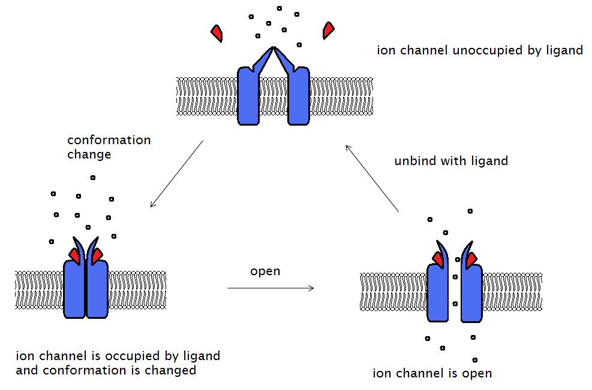
ACETYLCHOLINE RECEPTORS - nAChRs
TWO UNITES: ALPHA, BETA
SEVERAL SUBUNITES
PRESENT ON NEURAL CELLS (both central and peripheral), and
ON TISSUE CELLS
SOME SUBUNITES ARE NICOTINE SPECIFIC (activated by nicotine)
Notes:
Receptory v celém těle, některé jsou specifické pro nikotin
An acetylcholine receptor (abbreviated AChR) is an integral membrane protein that responds to the binding of acetylcholine, a neurotransmitter.
Nicotinic acetylcholine receptors are particularly responsive to nicotine

Slide 16
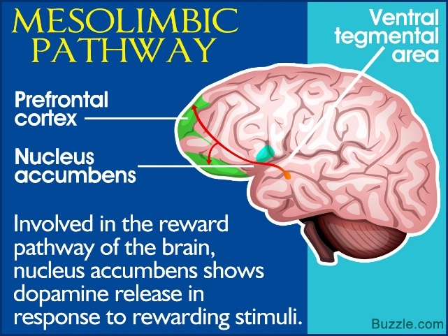
DENSITY of nAChRs
IN THE BRAIN IS NOT HOMOGENOUS
ACCUMULATION IN NUCLEUS ACCUMBENS =>
LIMBIC AREA
AFTER THEIR ACTIVATION => SERIES OF PHYSIOLOGICAL EVENTS
Notes:
Limbic area – ovlivňuje pocity (závislost)

Slide 17
RELEASE OF NEUROTRANSMITTERS:
DOPAMINE
SEROTONINE
ACETYLCHOLINE
EPINEPFRINE, NOREPINEPHRINE,
BETA-ENDORPHINE
ACTH (adrenocorticotropic hormone),
ADRENALINE

Slide 18
EFFECTS OF NICOTINE
WELL BEEING (DOPAMINE)
COPING THE STRESS (ACTH)
BETTER SHORT-TERM PERFORMANCE (ACETYLCHOLINE, ADRENALINE)

Slide 19
THESE EFFECTS
CAN PRODUCE MANY NATURAL DAILY EVENTS:
FOOD, SEX
MUSIC, SUCCESS
FRIENDLY ENVIRONMENT

Slide 20
DUE TO THESE REWARDS
SMOKERS REPEATE PUFFS,
RAISE THE NUMBER DAILY SMOKING CIGARETTES
LIGHT ON AUTOMATICALY IN SPECIFIC SITUATIONS
DEVELOP ADDICTION

Slide 21
Two faces of tobacco companies
NICOTINE IS THE ADDICTING AGENT IN CIGARETTES“
Private statement, Brown &Williamson official in 1983
  „I BELIEVE THAT NICOTINE
  IS NOT ADDICTIVE“
  Sworn testimory before
  the US Congress;
  CEOs of the seven leading
  tobacco companies in 1994

Slide 22
SMOKING ADDICTION
80 – 85% OF CURRENT SMOKERS WILL BE DEPENDENT, SIMILARLY LIKE CURRENT USERS OF HEROINE OR COCCAINE
ABOUT ONE THIRD OF OCCASSIONAL SMOKERS WILL BE DEPENDENT

Slide 23
SMOKING IS A DISEASE
DEPENDENCE ON SMOKING IS NOT A LACK OF WILLING OR „BAD HABIT“ BUT
CHRONICAL, PROGRESSIVE AND RELAPSING DISEASE
BOTH PHARMACOLOGICAL AND BEHAVIORAL ADDICTION

Slide 24
ALTERED DOPAMINERGIC SYSTEM
PREMATURAL ACTIVATION OF FETAL RECEPTORS
(30-fold higher affinity for the neurotransmitter Ach)
DECREASED AMOUNT OF NEURAL CELLS IN THE BRAIN
SUDDEN INFANT DEATH SYNDROME
IMPAIRED NEURO-PSYCHOLOGICAL DEVELOPMENT
BEHAVIORAL and COGNITIVE PROBLEMS in later life
Notes:
Jde o prenatální změny

Slide 25
ALTERED SEROTONERGIC SYSTEM
MAJOR PSYCHIATRIC DISORDERS (SCHIZOPHRENIA, DEPRESSION)
2-3 times HIGHER FREQUENCY OF SUICIDES
SMOKING CAUSES DEPRESSION
DEPRESSION CAUSES SMOKING
Notes:
Dospělí – dlouho kouří, serotonin se už nevyplavuje - sebevraždy

Slide 26
CARDIOVASCULAR CHANGES
VASOCONSTRICTION: SKIN, CORONARY, BRAIN, ABDOMINAL, VERTEBRAL, PLACENTAL ARTERIES
HIGHER BLOOD PRESSURE
HIGHER HEART RATE
HIGHER HEART VOLUME/MIN
DECREASED SKIN TEMPERATURE

Slide 27
MECHANISMS OF ACTION
BY QUICK ADMINISTRATION OF NICOTINE:
ACTIVATION OF SYMPHATETIC NERVOUS SYSTEM
RELEASE OF SUPRARENAL HORMONES (ADRENALINE, NORADRENALINE)

Slide 28
VASOCONSTRICTION
CONTINUE EVEN AFTER THE CIGARETTE IS SMOKED
FOR ANOTHER 30 – 45 min
AS NICOTINE IS PRESENT IN BLOOD

Slide 29
HYPOXEMIA
DECREASED AMOUNT OF BLOOD DUE TO VASOCONSTRICTION (caused by nicotine)
DECREASED AMOUNT OF OXYGEN IN BLOOD (caused by carbon monoxide – COHb)
DECREASED BLOOD-TISSUE TRANSPORT OF OXYGEN (caused by hydrogen cyanid HCN)
Notes:
cyanide ion halts cellular respiration by acting as a non-competitive inhibitor for an enzyme in mitochondria called cytochrome c oxidase.

Slide 30
IN PREGNANCY
LOCAL PLACENTAL NECROSIS (caused by cadmium)
POWERFULL AFFINITY OF FETAL HEMOGLOBIN TO CARBON MONOXIDE ENHANCES COHb LEVELS BY 25% (fetal x maternal blood)

Slide 31
OXIDATIVE STRESS
IN PLACENTAL TISSUE IMPAIRES DEVELOPMENT AND FUNCTION DUE TO DAMAGES OF DNA,
INCREASING : APOPTOSIS AND CELLULAR DEATH

Slide 32
HYPOXEMIA and HYPONUTRITION
FETAL GROWTH RETARDATION = FETAL TOBACCO SYNDROME => programing of OBESITY, LIPID AND GLUCOSE METABOLISMS
=>RISE RISK of CVD
RISK OF PRE-TERM BIRTH
RISK OF INTRAUTERINE DEATH

Slide 33
PRENATAL EXPOSURE
ALTERATES THE LUNG DEVELOPMENT
MODIFIES THE REPRODUCTIVE DEVELOPMENT
RISES THE RISK OF CONGENITAL MALFORMATIONS
SUDDEN INFANT DEATH SYNDROME

Slide 34
HYPOXEMIA IN ADULTS
HEART ATTACK (IM)
CEREBROVASCULAR ATTACK (STROKE)
WRINKLING, PREMATURE AGEING
IMPAIRED WOUND HEALING
LEG AND HAND PAIN, GANGRENE – PERIPHERAL VASCULAR DISEASE

Slide 35
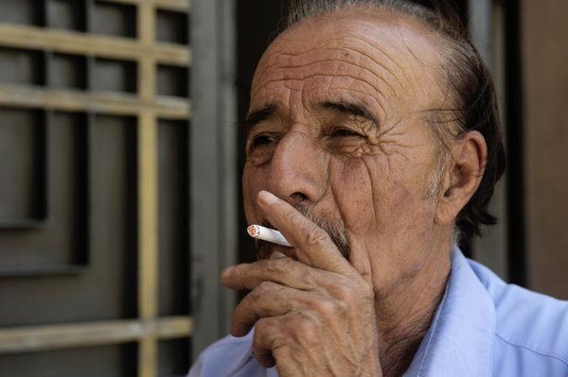
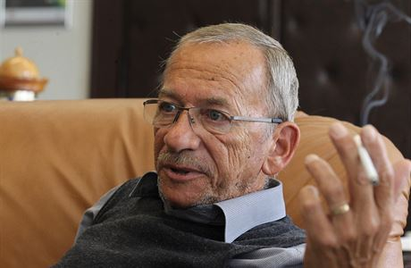

Slide 36
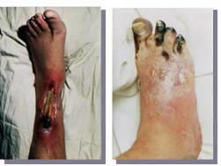

Slide 37
IRRITATION
EYES: excessive tearing, blinking, stinging
NOSE: bad smell, stinging, phlegm
NASOPHARYNX: cough, chest could
STRESS DUE TO DYSCOMFORT

Slide 38
SHORT/MIDL-TERM EFFECTS
IMPAIRED IMMUNITY
HORMONAL DYSBALANCE
IMPAIRED BLOOD LIPIDS
IMPAIRED HEMOCOAGULATION
CHRONIC INFLAMMATION

Slide 39
IMMUNE SYSTEM
IMPAIRED RESISTANCE TO INFECTION
CONTRIBUTION TO ALLERGIES
INFANTS AND CHILDREN ARE THE MOST
VULNERABLE POPULATION
IMPAIRED RESISTANCE TO CANCER (Natural Killers)
Notes:
Důležitější u dětí – nevyvinutý imunitní systém
Cigarette smokers had a significantly lower proportion of NK cells than did subjects who had never smoked

Slide 40
MALE REPRODUCTION
IMPOTENCE (erectile dysfunction)
IMPAIRED SPERMIOGENESIS: deformity, loss of motility, reduced number, aneuploid sperm cells
INFERTILITY
FETAL MALFORMATIONS

Slide 41
SMOKING INCREASES ED
FROM 2005 (Austoni et al.) studies in many populations: China, Middle East, Europe, America
OR = 1,4 – 3.1 with respect to other causes of ED
Smoking effects on ED are dose dependent
Notes:
OR – odds ratioes – relativní riziko

Slide 42
MOLECULAR MECHANISMS
PARASYMPATHETIC NERVOUS SYSTEM INDUCES SMOOTH MUSCLE RELAXATION => ALLOWS ARTERIAL PRESSURE BLOOD INTO THE CORPUS CAVERNOSUM VIA ACTION of NITRIC OXIDE (NO)
NICOTIN IS SYMPATICOMIMETIC,
LEVELS OF NO – are altered by smoking

Slide 43
SMOKING CESSATION
NO CONSISTENT RESULTS ABOUT THE MAGNITUDE OF THE BENEFITS WITH REGARD TO ED
HISTORY OF SMOKING PRODUCE SILENT VASCULAR INSULT THAT PERSIST OVER TIME

Slide 44
BETTER PROGNOSIS
IS BELIEVED FOR YOUNGER MEN WITHOUT SO LONG SMOKING HISTORY and
WITH LACK OF COMORBIDITIES.
Kovac JR et al. Effects of cigarette smoking on erectile dysfunction
Andrologia 2014;
Doi: 10.1111/and.12393

Slide 45
FEMALE REPRODUCTION
PAINFUL MENSTRUATION
EARLIER MENOPAUSE
INFERTILITY
ECTOPIC PREGNANCY
PLACENTA PRAEVIA
PREMATURE BIRTH
SPONTANEOUS ABORTION

Slide 46
BOTH ACTIVE AND PASSIVE SMOKING ARE RISKS (OR):
ACTIVE SMOKERS:
ABORTIONS ……....1.16
STILLBIRTHS………1.44
ECTOPIC PREG. … 1.43
PASSIVE SMOKERS
………..1.17
………. 1.55
………. 1.61

Slide 47
SMOKING
SEEMS TO BE PROTECTIVE for the development of
PREECLAMPSIA (high blood pressure, proteins in urine)
BUT IT IS NOT A REASON FOR KEEPING SMOKING DURING PREGNANCY!!!, AS OTHER RISKS PREVAILE THIS BENEFIT

Slide 48
OTHERS
HORMONAL DYSBALANCE CONTRIBUTES TO:
DIABETES MELLITUS and COMPLICATIONS
OSTEOPOROSIS
HIP FRACTURES
By the ANTIESTROGENIC EFFECT OF NICOTINE

Slide 49
BLOOD LIPIDS
INCREASED LEVELS OF
- TOTAL CHOLESTEROL
- LDL – CHOLESTEROL
VLDL – CHOLESTEROL
DECREASED LEVELS OF
- HDL- CHOLESTEROL
Notes:
LDL a HDL vznikají v nás, nejsou z potravy
LDL:HDL – je důležitější než celková koncentrace cholesterolu

Slide 50
HEMOCOAGULATION
ENHANCED ACTIVITY OF THROMBOCYTES and
FACTOR VIII =>
ARTERIAL THROMBOSIS (IM, stroke, gangrene in periferies)

Slide 51
SMOKING IS RESPONSIBLE
FOR 25% OF ISCHEMIC HEART DISEASES
FOR 25% OF VASCULAR DISEASES (stroke, Burger d., aneurysma, macular degeneration, cataracts)
FOR EARLIER ATHEROSCLEROSIS
FOR 75% OF CHRONIC OBSTRUCTIVE PULMONAL DISEASE (chr. bronchitis, emphysema)

Slide 52
EXPOSURE TO ETS
INCREASES THE RISK OF ACUTE CORONARY SYNDROM by 25 – 30 %:
INCREASED THROMBOGENESIS and
LDL-CHOLESTEROL OXIDATION
DECREASED ABILITY TO EXERCISE
ACTIVE INFLAMMATORY PATHWAY
IMPAIRED VASCULAR REPAIR
Notes:
LDL oxidation – je tedy opět aktivní a jde o ten „špatný“ chol.

Slide 53
SMOKING CONTRIBUTES TO
STOMACH AND DUODENAL ULCERS
GUM DISEASES – GINGIVITIS, PERIODONTITIS
TEETH LOOSE
PROGRESSION OF PRESBYACUSIS
PSORIASIS and other skin diseases
TREMOR

Slide 54
MENTAL HEALTH:
Smoking negative influences:
- brain development,
- memory
Smoking is a risk factor for Alzheimer disease
Smoking is a protective factor for Parkinson disease
Notes:
Významné u dětí, ale od 35 roku se u dospělých zhoršuje paměť

Slide 55
* LONG-TERM EFFECTS
TOBACCO SMOKE CONTAINS OVER 5.000 CHEMICALS,
67 OF WHICH ARE CONFIRMED or SUSPECTED HUMAN CARCINOGENS (within the list of appr. 73 confirmed human chemical carcinogens)

Slide 56
CARCINOGENS IN SMOKE
POLYCYCLIC AROMATIC H. (benzo/a/pyrene)
HEAVY METALS (Cd, As)
RADIOACTIVE POLONIUM 210
INDUSTRIAL CARCINOGENS: beta-naphthylamine, 4-aminobiphenyle, benzene, formaldehyde

Slide 57
TOBACCO SPECIFIC NITROSAMINES
formed from nicotine and related compounds by a nitrosamine reaction that occurs during the curing and processing of tobacco:
NNK: 4-(methylnitrosamino)-1-(3-pyridyl)-1-butanone
NNAL
NNN
And many others
Notes:
NNK - velmi potentní plicní karcinogen, v tabáku jiné, které se jinde nevytvoří
Kdy kouří - puberta _ proliferace prsní tkáně
- laktace
konec těhotenství
Vše zhoršuje

Slide 58
SMOKING IS RESPONSIBLE
FOR 90-95% OF ALL LUNG CA
FOR 40-60% OF HEAD/NECK CA
FOR 40-60% OF KIDNEY/BLADDER CA
FOR 30% OF CERVICAL CA
FOR 30% OF GASTRIC/PANCRETIC CA
FOR COLON, LIVER, BREAST CA
Notes:
U rakoviny prsů – dva typy studií
Protektivní – estrogenní působení někdy
2) rizikové – v prsní tkáni …. PAV na DNA – u kuřáků více

Slide 59
LUNG CARCINOGENS
ACTIVE SMOKING ……. 90 %
PASSIVE SMOKING …… 4 %
OCCUPATION …………. 5 %
(radiation, asbestosis, Cr, Ni, PAH, plast additives, benzin…)
ENVIRONMENT ………. . 1 %

Slide 60
CARCINOGENESIS
GENOTOXIC EFFECTS:
INITIATION of DNA MUTAGENIC CHANGES
2. REPLICATION
EPIGENETIC EFFECTS:
INFLUENCE ON APOPTOSIS
1. PROMOTION
2. PROGRESSION
3. METASTASES

Slide 61
CONSEQUENCES: PROMOTION
CELL´S PROLIFERATION
ANTI – APOPTOSIS
PROTEIN SYNTHESIS
MITOCHONDRIA DYSFUNCTION
INCREASING of REPLICATIVE LIFESPAN of CARCINOGENIC CELLS
Notes:
Toto dělá hlavně nikotin
Protein synthesis – nádor je lépe vyživovaný

Slide 62
CONSEQUENCES: PROGRESSION and INVASION
ANGIOGENESIS =>
SUPPORT FOR THE TUMOR GROWTH
DECREASED CELLS´ ADHERENCE =>
METASTASIS
Notes:
Angiogenesis is the physiological process through which new blood vessels form from pre-existing vessels,^{[1][2][3]} formed in the earlier stage of vasculogenesis

Slide 63
ROLE OF microRNAs
PROBABLY MORE THAN 1000
KNOWN MORE THAN 700
TISSUE SPECIFIC
DETECABLE IN 12 BODY FLUIDS
SOME OF THEM EARLIER MARKERS OF CARCINOGENIC CHANGES
Notes:
A microRNA (abbreviated miRNA) is a small non-coding RNA molecule (containing about 22 nucleotides) found in plants, animals and some viruses, that functions in RNA silencing and post-transcriptional regulation of gene expression
Časový marker některých nádorů – kouření na ně působí

Slide 64
SMOKING KILLS
HALF OF ALL LIFETIME USERS
HALF OF THEM WILL DIE BETWEEN
30-69 YEARS OF AGE
IN THE 20th CENTURY
100 MILLION PEOPLE DIED FROM TOBACCO USE

Slide 65
SMOKING KILLS PHYSICIANS
British Medical Doctors Study (Doll, Lopez, Peto): smokers lost
5 YEARS OF LIFE - 1951-1971
8 YEARS OF LIFE – 1971-1991
10 YEARS OF LIFE – 1991-2006

Slide 66
The British Doctors' Study 1951 - 2001
The longest prospective study - addressed more than 34,000 British doctors (more than 2/3 get involved). Basic hypothesis - "Smoking is a major cause of lung cancer". In 1951-1971, the difference in life span of smokers and non-smokers was 5 years, after another 20 years 8 years, and the latest study found a 10-year loss of life for British doctors-smokers as compared to lifetime non-smokers.

Slide 67
SMOKING KILLS NON-SMOKERS
MAIN STREAM
800-900º C
16% O₂
6,0-6,7 pH
SIDE STREAM
600º C
2% O₂
6,7-7,5 pH

Slide 68
DANGER FOR NON-SMOKERS
SECONDHAND SMOKE
ENVIRONMENTAL TOBACCO SMOKE
PASSIVE SMOKING
INVOLUNTARY SMOKING
Side stream + smoker´s expiration + chemicals interaction
Notes:
ETS – zbytek – stárne, mění se

Slide 69
SIMILARITIES and DIFFERENCES
THE NUMBER OF CHEMICALS in MS and SS ARE THE SAME
THE LEVELS OF CHEMICALS ARE HIGHER in SS COMPARRED TO MS
DUE TO IMPERFEKT BURNING

Slide 70
RATIO SS : MS - IRRITANTS
ACROLEIN 8 – 15
FORMALDEHYDE 10 – 15
AMONIUM 73
NITROGEN OXIDES 4 – 10
FORMAMIC ACID 1,5
NAFTALENE 16
Notes:
8-15x víc v SS než v MS

Slide 71
RATIO SS : MS - TOXINS
CARBON MONOXIDE 2 – 5
TOLUENE 6 – 8
NICOTINE 2,6-3,3
NICKEL 13 – 30
POLONIUM 210 1 – 4
PCDD, PCDF (dioxins, furans) 2

Slide 72
RATIO SS : MS - CARCINOGENS
BENZENE 5 – 10
NITROSAMINES 20 – 100
2-NAFTYLAMINE 30
4-AMINOBIFENYLE 30
BENZO/A/PYRENE 2,5 – 3,5
TAR 1,7

Slide 73
INDOOR CONCENTRATIONS OF NICOTINE
WORK-PLACES 20 ug/m³
CONFERENCE HALL 40 ug/m³
RESTAURANTS 26-28 ug/m³
CARS 40 ug/m³
HOMES 7-11 ug/m³
HOSPITALS 0,01- 4 ug/m³

Slide 74
INDOOR CONCENTRATIONS OF NITROSAMINE NNK
BARS 10 – 24 ug/m³
RESTAURANTS 1 – 3 ug/m³
TRAINS 5 ug/m³
CARS 29 ug/m³
OFFICES 26 ug/m³
HOMES 2 ug/m³

Slide 75
THIRDHAND SMOKE
SOME CHEMICALS IN ETS ARE ABSORBED IN WALLS, CARPETS, CLOTHES, FURNITURE
AND ARE RE-EMITTED INTO THE INTERIER

Slide 76
THIRDHAND SMOKE
NICOTINE + NITRIC ACID + NO_{X}
= > INTERACTIONS = >
NITROSAMINES NNK, NNA, NNN
(mutagenic, carcinogenic)
CONTAMINATION OF CLOTHES, SKIN, CARPETS, FORNITURE for many hours, days, weeks, years

Slide 77
1st EXPERIMENTAL STUDY:
MICES EXPOSED TO THIRDHAND SMOKE
LIVER: FIBROSIS, STEATOSIS
BLOOD: INCREASED TOTAL and LDL CHOLESTEROL, DECREASED HDL CHOLESTEROL
PRE-DIABETIC DEFECTS OF INSULIN METABOLISM
LUNG: FIBROSIS, INCREASED NUMBER of MACROPHAGES => OXIDATIVE STRESS
SKIN: KERATINOSIS, LESS FIBRILLAR COLLAGEN
HYPERACTIVITY, ANXIETY

Slide 78
EXPOSURE TO ETS - CHILDREN
UNPLEASANT DYSCOMFORT
IRRITATION
IMPAIRED IMMUNITY
RESPIRATORY INFECTIONS, ALERGY
Sudden infant death syndrome
LEUKEMIA, BRAIN TUMORS
The most vulnerable group – immature biological structures, faster breathing frequency, lower breath zone, specific habits - climbing on four, licking hands ...

Slide 79
EXPOSURE TO ETS - ADULTS
UNPLEASANT DYSCOMFORT
IRRITATION
ACCUTE CORONARY ISCHEMIA
CHRONIC OBSTRUCTIVE PULMONARY DISEASE
LUNG CANCER

Slide 80
HEALTH CONSEQUENCES OF EXPOSURE TO ETS:
AN HOUR A DAY IN A ROOM WITH SMOKER
IS NEARLY A HUNDRED TIME MORE LIKELY TO
CAUSE LUNG CANCER IN A NON-SMOKER
THAN TWENTY YEARS SPENT IN A BUILDING
CONTAINING ASBESTOS
Sir Richard Doll, 1989

Slide 81
BAN OF SMOKING ON PUBLIC PLACES
18 months after implementation:
INCIDENCE of MI DECLINED BY 33%
from 150.8 to 100.7 / 100.000
INCIDENCE of SUDDEN CARDIAC DEATH DECLINED BY 17% from 109.1 to 92.0 / 100.000
Minnesota Study , Arch.Intern.Med. Doi: 10.1001/2013.jamainternmed.46

Slide 82
SMOKE-FREE LEGISLATION
LOWERED RATES OF HOSPITAL ADMISSIONS for:
RR
CORONARY EVENTS ……… 0.848
OTHER HEART DIS. ………… 0.610
CEREBROVASCULAR DIS. … 0.840
RESPIRATORY DIS. ………… 0.760
Circulation 2012; 126: 2177 - 2183
Notes:
risk ratio (RR) or relative risk is the ratio of the probability of an outcome in an exposed group to the probability of an outcome in an unexposed group

Slide 83
ANTENATAL EXPOSURE
GROWTH RETARDATION
DELAYED LUNG DEVELOPMENT
ACTIVATION OF nAChs (by NICOTINE) = NEUROTERRATOGENICITY (CONDUCT DISORDERS, ADHD, REDUCED MENTAL / SCHOOL PERFORMANCES)

Slide 84
PRENATAL PROGRAMING
EXPOSURE TO MATERNAL SMOKING
=> CHANGES IN FETAL METABOLISM
OUTLAST AFTER DELIVERY
=> OBESITY, HYPERTENSION, DAMAGES SERUM LIPIDS´ RATES in CHILDHOOD and ADULTHOOD

Slide 85
CONCLUSSION
CIGARETTE IS UNIQUE ARM KILLING BY ITS BOTH ENDS
GLOBAL TOBACCO EPIDEMY IS WORSE TODAY THAN 50 YEARS AGO AND MAY BE WORSE IN ANOTHER 50 YEARS
SMOKING IS THE MOST IMPORTANT PREVENTABLE RISK FACTOR

Slide 86
SMOKING CESSATION
DEATH IN OLD AGE IS INEVITABLE,
BUT DEATH BEFORE OLD AGE IS NOT
Sir Richard Peto, 2006
https://is.muni.cz/www/2422/um
Notes:
Professor of Medical Statistics and Epidemiology at the University of Oxford, His career has included collaborations with Richard Doll beginning at the Medical Research Council Statistical Research Unit in London. He is a leading expert on deaths related to tobacco use. He was knighted for his services to epidemiology and to cancer prevention in 1999,
Peto's paradox is the observation, named after Richard Peto, that at the species level, the incidence of cancer does not appear to correlate with the number of cells in an organism.

Slide 87
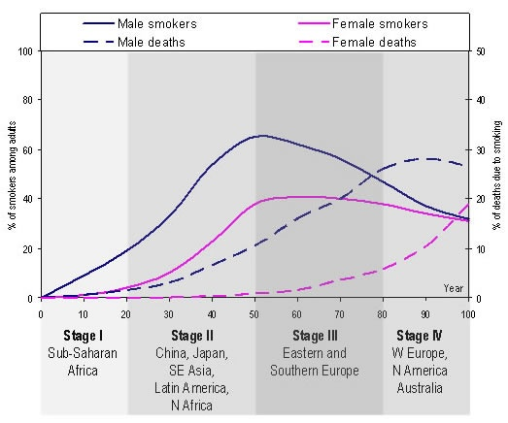
Smoking epidemic/pandemic

Slide 88
THE RISK IS BIG
ABOUT HALF OF SMOKERS ARE KILLED
THOSE KILLED IN MIDDLE AGE LOSE 10, 20, 30 OR MORE GOOD YEARS
www.deathsfromsmoking.net

Slide 89
STOPPING SMOKING WORKS
EVEN IN EARLY MIDDLE AGE (40y) THOSE WHO STOP, AVOID MOST OF THEIR RISK OF BEING KILLED BY TOBACCO
STOPPING BEFORE MIDDLE AGE WORKS EVEN BETTER

Slide 90
Prevalence of smoking in the Czech Republic
The overall prevalence over the past 15 years:
  30% (2012) - 25.2% (2017)
  By gender:
  Men 36%, Women 26% (2012)
  Men 30%, Women 20% (2017)
  By age:
  under 15 - up to 33%, 15-24 years: 43%, 25-44 years: 33%, 45-64 years: 28%, over 65: 20% (2012)
  15-24 years: 36%, 25-44 years: 27%, 45-64 years: 26%, over 65 years: 15% (2017)

Slide 91
Prevalence of smoking in the Czech Republic
The use of other tobacco products than cigarettes:
pipes, cigars, water pipes
2 - 2.5% (2012) 4.7% (2017)
e-cigarettes 1.7% (2012), 5.2% (2017)
Smokeless tobacco: 2.5% (2017)
SZÚ 2017: http://www.szu.cz/uploads/documents/szu/aktual/uzivani_tabaku_2017.pdf

Slide 92
IMMIDIATE BENEFITS OF STOPPING
WITHIN 20 - 30 MINUTES:
THE BLOOD PRESURE AND HEART RATE WILL DROP TO THE REST VALUES
THE SKIN TEMPERATURE (LEGS) RAISES BY 2º C

Slide 93
SHORT-TERM BENEFITS OF STOPPING
WITHIN 6 – 8 HOURS
COHb LEVELS WILL DROP TO THE NORMAL VALUES (< 1%)
WITHIN 72 HOURS
PULMONARY FUNCTIONS WILL IMPROVE (1sec forced expiration)
Notes:
Pulmonary function – bronchokonstrikční látky ( test na astma)

Slide 94
MIDDLE-TERM BENEFITS OF STOPPING
WITHIN 2 MONTHS
MALE SPERM DAMAGES CAUSED BY SMOKING WILL BE REPAIRED
WITHIN THE 1st TRIMESTER
THE RISK OF PREGNANCY PROBLEMS AND FETAL BODY POOR DEVELOPMENT WILL DECREASE

Slide 95
MIDDLE-TERM BENEFITS OF STOPPING
WITHIN 1st YEAR
THE BLOOD LIPID PROFILE WILL BE IMPROVED,
THE PARAMETERS OF HEMO-COAGULATION WILL BE IMPROVED
THE RISK OF AC. CARDIAC ISCHEMY and STROKE WILL DECREASE

Slide 96
LONG-TERM BENEFITS
WITHIN 5 YEARS
THE RISK OF CVD DEATH WILL BE SIMILAR AS FOR NEVER-SMOKERS
THE RISK OF SMOKING-RELATED CANCERS WILL START THE DECREASED TRENDS
Notes:
CVD – zlepšení už po roce – není CO a vasokonstrikce, snížení akutních srdečních příhod

Slide 97
LONG-TERM BENEFITS
WITHIN 10 – 20 YEARS
THE RISKS OF SMOKING-RELATED CANCER´S DEATH WILL BE SUBSTANTIALLY DECREASED, ALMOST TO THE LEVELS FOR PEOPLE WHO NEVER SMOKED

Slide 98
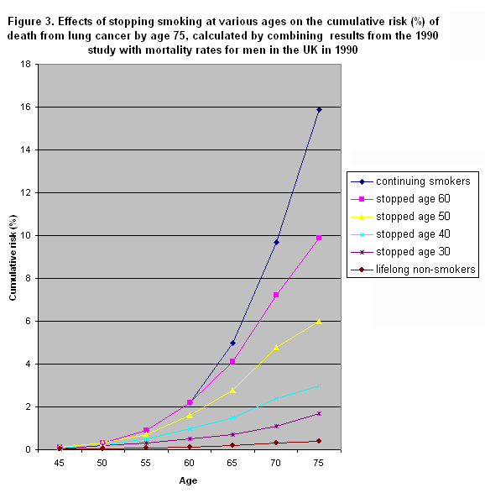
LONG-TERM BENEFITS

Slide 99
CONCLUSIONS
THE RISK IS BIG
STOPPING SMOKING WORKS
EFFECTIVE SUPPORT OF SMOKING CESSATION WILL CHANGE THE DEATH EPIDEMIC WITHIN 10-20 YEARS

Slide 100
SMOKERS ARE:
AT THE BEGINNING:
CURIOSITY SEEKING PEOPLE.
UNHAPPY, UNSUCCESSFUL PEOPLE
LAZY PEOPLE
LATER ON:
DEPENDENT PEOPLE

Slide 101
CRITERIA OF ADDICTION
USING THE DRUG LONGER THAN EXPECTED
USING THE DRUG DESPITE OF HEALTH PROBLEMS
A LOT OF TIME PER DAY IS SPENT BY EFFORT TO OBTAIN THE DRUG /or BY USING THE DRUG

Slide 102
CRITERIA - continue
USER NEGLECTS SOME ACTIVITIES WHERE USING OF DRUG IS BANNED
SHORT-TERM ABSTINENCE RESULTS IN THE REPEATEDLY OCCURING WITHDRAWAL SYMPTOMS and RELAPSE

Slide 103
TOLERABILITY
THE SAME DOSE CAUSES LOWER EFFECTS
FOR THE SAME EFFECTS THE INCREASED DOSE IS NECESSARY

Slide 104
WITHDRAWAL SYMPTOMS (WS)
EXCITABILITY, NERVOUS, STRESSED
ATTENTION DISABILITY
COGNITIVE PROBLEMS
DEPRESSION
ANXIETY

Slide 105
WITHDRAWAL SYMPTOMS
POORER WEIGHT CONTROL -> OVERWEIGHT
EXPECTORATION
CONSTIPATION

Slide 106
WS – TIMING
WITHIN 2 HOURS AFTER THE LAST CIGARETTE
WAVES WITH DIFFERENT FREQUENCY AND INTENSITY
SEVERAL DAYS – WEEKS – MONTHS - YEARS

Slide 107
WS - CAUSES
LACK OF NICOTINE
LACK OF SOCIAL CONTACTS
CRAVING FOR SMOKING
INCREASED FOOD INTAKE
DECREASED BASAL METABOLISM

Slide 108
WITHDRAWAL SYMPTOMS
ARE NOT HARMFUL FOR HEALTH
ARE THE MANIFESTATION OF THE DRUG ELIMINATION
ARE THE MOST FREQUENT CAUSE OF RELAPS

Slide 109
POWER OF DEPENDENCE
IS SIMILAR AS FOR HEROINE or COCAINE: 80-85 % of current users,
32 % of occas.smokers, 20 % of occasional users of cocaine/heroine
ADOLESCENTS ARE MORE VULNERABLE (the pleasure effects of smoking are percieved after lower levels of nicotine)

Slide 110
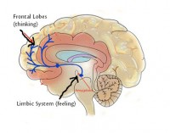
ADDICTION TO SMOKING
IS A PEDIATRIC PROBLEM
SMOKERS USUALY START SMOKE BEFORE the age 18 YEARS
TIME DISCREPANCY OF LIMBIC and FRONTAL CORTEX MATURATION =>
DISPOSITION TO RISK and
LOW RESPONSIBILITY

Slide 111
WHAT TO DO?
KEEPING SMOKERS´ RIGHTS:
TO BE INFORMED ABOUT HAZARD
TO BE EXCLUDED FROM RISK SITUATIONS
TO BE MOTIVATED TO DECISSION
TO BE SUPPORTED IN THEIR EFFORT TO STOP SMOKING
Notes:
Mají právo kouřit, ale né kdykoliv a kdekoliv
Mají právo na pomoc

Slide 112
WHAT IS THE BEST WAY?
THE „5A“ PROGRAMME:
ASK
ADVICE
ASSESS
ASSIST
ARRANGE FOLLOW-UP
http://apps.who.int/iris/bitstream/handle/10665/112836/9789241506946_eng.pdf;jsessionid=9CF5056D2A25D72B74145B5B7B1B49F2?sequence=1

Slide 113
1. ASK EVERY PATIENT:
DO YOU SMOKE?
HOW MANY CIGARETTES DAILY?
HOW MANY YEARS?
AT WHICH AGE DID YOU START?
AT WHICH MORNING TIME DO YOU LIGH YOUR FIRST CIGARETTE?
WOULD YOU LIKE TO STOP?
HAVE YOU SOME EXPERIENCES WITH STOPPING?

Slide 114
1A: CONGRATULATION
TO EVERYBODY WHO:
HAS NEVER SMOKE
HAS STOPPED SMOKING:
ASK HIM/HER ABOUT PROBLEMS,
SUPPORT HIS/HER EFFORT TO BE NON-SMOKER

Slide 115
2. ADVICE
TO EVERY SMOKER TO STOP, because
FAMILY HISTORY (HEREDITARY VULNERABILITY)
SMOKER´S HEALTH HISTORY
CURRENT HEALTH STATUS
SOCIAL IMAGE, MODEL ROLE
HIS/HER CHILDREN HEALTH

Slide 116
ADVICE IS ESSENTIAL
PEOPLE KNOW THE SMOKING HAZARD IN GENERAL
PEOPLE FEEL PERSONAL IMMUNITY AGAINST THE DAMAGES
SUCH FEELINGS ARE FALSE, ERRORNEOUS AND VERY DANGEROUS

Slide 117
SUPPORT OF ADVICE
USE THE BOOKLETS, LEAFLETS, PICTURES, …
FOR TARGET POPULATION OF SMOKERS (CHILDREN, TEENAGERS, PREGNANT WOMEN, WORKERS, MINORS, SENIORS…)
RECOMMEND THE SPECIAL CENTRE

Slide 118
MOTIVATION TO QUIT-5Rs
PERSONAL RELEVANCE TO A PATIENT
RISK OF SMOKING COULD BE STRESSED
EMPHASIZE REWARDS (health, money)
ROADBLOCKS (identify barriers)
REPETITION EACH TIME OF VISIT
Notes:
Road blocks – časový plán – i během kouření – kdy a kde kouřím; mít jen 1 krabičku; ztížit si kouření – je zima, nechce se mi ven, dát ji na skříň, jen´1 cigaretu
Vztek – co s ním kouření dělá

Slide 119
3. ASSESS THE LEVEL OF DEPENDENCE
FAGERSTROM´S QUESTIONNAIRE:
6 QUESTIONS
MAXIMUM 10 „BAD POINTS“
4 LEVELS OF DEPENDENCE
LOSS OF AUTONOMY
THINKING ABOUT TREATMENT

Slide 120
FAGERSTROM´S QUESTIONNAIRE
1. How soon after you wake up do you smoke your first cigarette?
After 60 minutes 0
31-60 minutes 1
6-30 minutes 2
Within 5 minutes 3
2. Do you find it difficult to refrain from smoking in places where it is forbidden?
No 0
Yes 1
3. Which cigarette would you hate most to give up?
The first in the morning 1
Any other 0
4. How many cigarettes per day do you smoke?
10 or less 0
11-20 1
21-30 2
31 or more 3
5. Do you smoke more frequently during the first hours after awakening than during the rest of the day?
No 0
Yes 1
6. Do you smoke even if you are so ill that you are in bed most of the day?
No 0
Yes 1

Slide 121
FAGERSTROM´S QUESTIONNAIRE
Under 3
Your level of nicotine dependence is still low. You should act now before your level of dependence increases.
4-5
Your level of nicotine dependence is moderate. If you don't quit soon, your level of dependence on nicotine will increase until you may be seriously addicted. Act now to end your dependence on nicotine.
6-10
Your level of dependence is high. You aren't in control of your smoking– it is in control of you! When you make the decision to quit, you may want to talk with your doctor about nicotine replacement therapy or other medications to help you break your addiction.

Slide 122
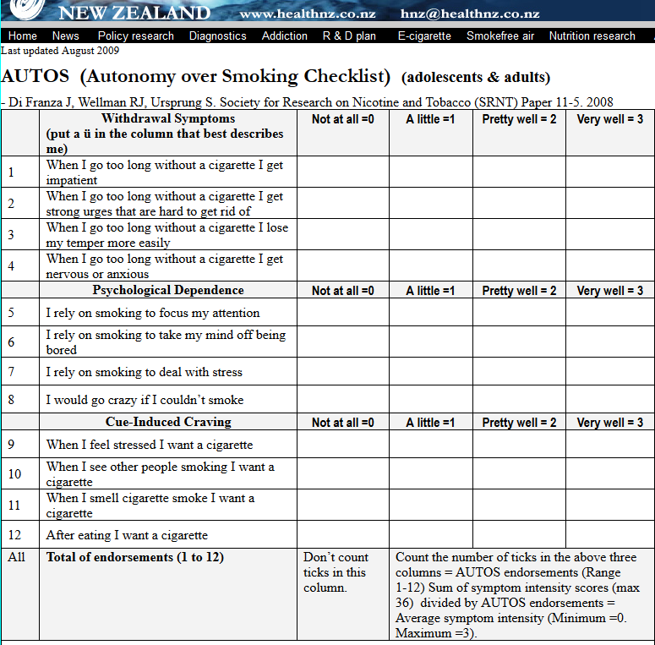
http://www.healthnz.co.nz/DiFranzalasc.htm

Slide 123
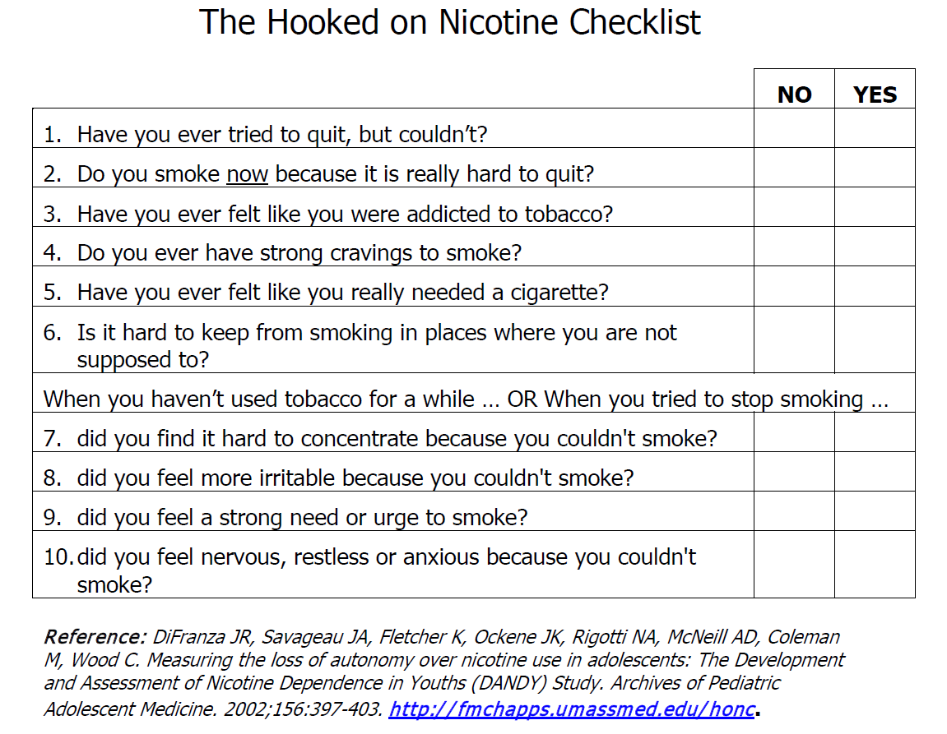
https://www.umassmed.edu/globalassets/attocpenn/the_hooked_on_nicotine_checklist.pdf?_t_id=1B2M2Y8AsgTpgAmY7PhCfg%3D%3D&_t_q=HONC&_t_tags=language%3A%2Csiteid%3Ab5a143c9-b51e-4bac-9eab-62560b986673&_t_ip=192.197.205.213&_t_hit.id=UMassMedicalSchool_Models_Media_GenericMedia/_5988cfa9-f23e-48dc-8117-5a8bb1754254&_t_hit.pos=2
Notes:
Už jedna kladná odpověď = snížení autonomie, jsi v tom

Slide 124
4. ASSIST WITH THE START
HELP TO CHOOSE THE STRONGEST MOTIVE
INICIATE TO CHOOSE THE DAY „D“
EVALUATE THE RISK SITUATIONS: „TO KILL TIME“, „PLEASURE“, „STRESS“

Slide 125
ASSIST - continue
CHOOSE THE REPLACEMENT IN THE RISK SITUATIONS: WHAT TO DO WITHOUT CIGARETTE?
THE DIFFICULT AVAILABILITY
CHANGE THE ATTITUDES: CIGARETTE IS NOT A FRIEND, BUT THE WORST ENEMY

Slide 126

MEDICAL SUPPORT - NRT
REPLACING NICOTIN FROM SMOKING BY OTHER SOURCES:
CHEWING GUMS:
NICORETTE – 2, 4 mg: RULES FOR RIGHT CHEWING
PATCHES:
- NICORETTE – 16 hours – 5, 10, 15 mg
- NIQUITINE – 24 hours – 7, 14, 21 mg
Notes:
Kouření – fyziologická, ale i behaviorální závislost – čili NRT odstraní tu fyziologickou, ta přijde na řadu až později.

Slide 127
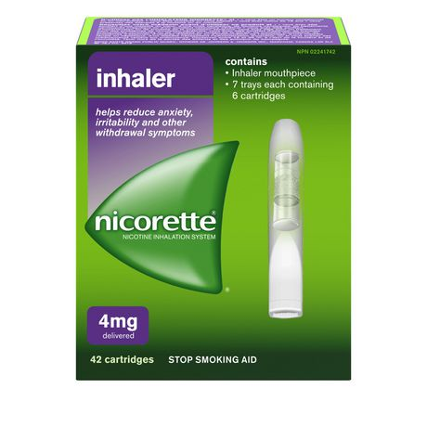
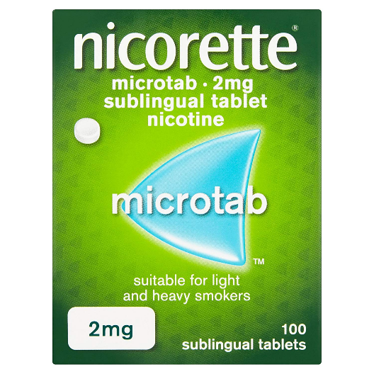
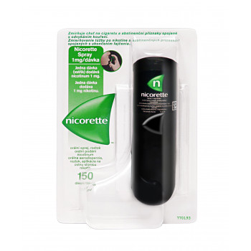
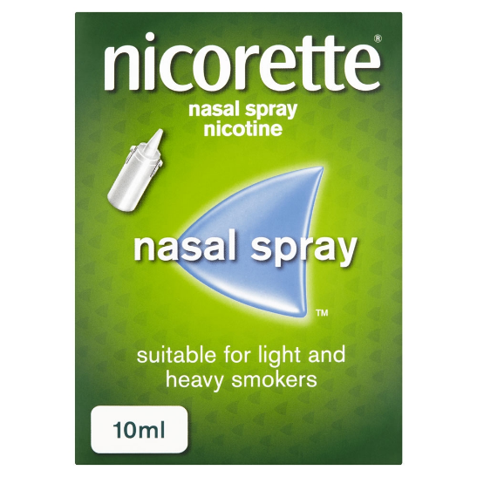
NRT - continue
INHALERS
SUBLINGUAL TABLETS
ORAL/NASAL SPREY

Slide 128
HOW TO USE NRT?
„AD LIBIDUM“ at the beginning (1 – 3 months)
GRADUALLY LOWERING THE DOSAGE (next 3 months; each new lower dosage kept for 1 week, at least)

Slide 129
E-CIGARETTES / ENDS
POOR CONTROL OF INHALED NICOTINE
OTHER HARMFUL CHEMICALS, EVEN IN LOWER LEVELS THAN IN TRADITIONAL CIGARETTES
KEEPING THE SMOKING BEHAVIOR RITUALS
NO KNOWLEDGE ABOUT THE HEALTH RISKS

Slide 130
NRT´S SAFETY AND HAZARD
DECREASED WITHDRAWAL SY.
SLOW RELEASE OF NICOTINE WITHOUT VASOCONSTRICTION
CROSS PLACENTAL BARRIERE
ANTENATAL ACTIVATION nAChRs -> NEUROTERRATOGENIC EFFECTS
MULTIPLE CARCINOGENICITY
Notes:
I e-cigarety mají těch 30 minut než začnou působit
Není vasokonstrikce – i kardiaci mohou použít
Projde přes placentu

Slide 131
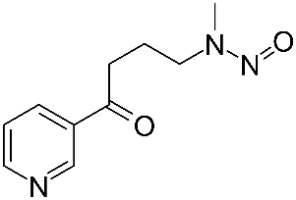
NICOTIN IS A COMPLETE CARCINOGEN
NICOTIN IS NOT MUTAGENIC!
IT CAN BE PARTIALLY METABOLISED TO NNK => INDIRECT INITIATOR OF CARCINOGENICITY
REVASCULARISATION OF CARCINOMA/METASTATIC TISSUES => HIGHER PROGRESSION (epigenetic carcinogen)
Notes:
Tabacco specific nitrosamins – NNK - nicotine-derived nitrosamine ketone
Epigenetic carcinogen – nikotin už sám o sobě - revascularisation

Slide 132
BUPROPION
ANTIDEPRESSIVE DRUGS:
ZYBAN, WELLBUTRINE
COMBINATION WITH NRT

Slide 133
VARENICLINE - CHAMPIX
AGONIST OF NICOTINE:
ACTIVATION of nAChRs
- > RELEASE OF DOPAMINE - >
- > CIGARETTE IS NOT ONLY UNIQUE SOURCE OF PLEASURE
ONE WEEK BEFORE STOPPING
Notes:
Začnu užívat ještě když kouřím – snížím tím počet cigaret

Slide 134
CONTRAINDICATIONS
IN PREGNANCY – CATEGORY C (all the supportive drugs) neuroterratogenic effect is possible (latest studies - no?)
CHILDREN, ADOLESCENTS – NO EXPERIENCES YET (with bupropion, vareniclin)
Notes:
Category C. Animal reproduction studies have shown an adverse effect on the fetus and there are no adequate and well-controlled studies in humans, but potential benefits may warrant use of the drug in pregnant women despite potential risks.

Slide 135
NEW RECOMMENDATION
TO EXCLUDE PERSONS WITH PSYCHIATRIC DISORDERS
NEUROPSYCHOLOGICAL OBSERVATION OF VARENICLINE USERS
CARDIOVASCULAR EVENTS
Notes:
Podle studií je dobré hlídat psychiatrické pacienty
CV problémy – mohou nastat

Slide 136
VACCINATION
AFTER UNSUCCESSFUL ATTEMPTS: THE HIGH-MOLECULAR COMPLEX
NICOTINE + ANTIBODIES = >
IMPOSSIBILITY TO REACH THE BRAIN
Notes:
Velká molekula se nedostane do mozku

Slide 137
FIRST RESULTS:
BIVALENT VACCINE
5 DOSES of 400 ug
IN ONE MONTH INTERVALS
SAFE, SPECIFIC, RARE SIDE EFFECTS
HIGH INDIVIDUAL VARIABILITY IN PRODUCTION OF ANTIBODIES
Notes:
Ale tvorba antibodies nemusí být dostatečné – stačí na 2-3 cigarety a pak už neúčinkuje

Slide 138
Duration and success of cessation
Treatment of min. 6 months
Abstinence longer than a year - 2 - 3% of smokers can abstain alone and without help
With counseling (treatment under professional supervision) + psychotherapy = increased success rate up to 30%
75 - 85% of smokers would like to stop
30-35% are trying to (repeatedly)
5 - 10% of smokers will succeed

Slide 139
FUTURE RESEARCH
OPTIMAL TIME-SCHEDULE
OPTIMAL DOSES with the respect to
GENETIC POLYMORPHISM of CYP2A6
QUICK RELEASE OF NICOTIN
COMBINATION
NEW TREATMENT
NEW (safe sources of) ADDICTION
Notes:
Tiem scheduel – všeobecně – rozklad nikotinu různě rychlý - individualizovat
Cytochrome P450 2A6 (CYP2A6) is the principal enzyme involved in the metabolic activation of tobacco-specific nitrosamines to their ultimate carcinogenic forms and metabolism of nicotine.
Rychlé uvolnění – není třeba u těch patches
Rychlé uvolnění – spray, inhalátor?

Slide 140
RELAPS
TO TRY „ONLY ONE“ PUFF
COFEE, VINE
FRIENDS
SEEK THE MORE PLEASURE
STRESS
EASY AVAILABILITY OF TOBACCO
Notes:
Nikotin/cigareta stále v podvědomí – nikdy ani 1 cigaretu!

Slide 141
5. ARRANGE FOLOW-UP
RELAPS MAY BE STRESSFUL FOR SMOKER
TO ENHANCE SMOKER´S RECENT MOTIVATION TO STOP OR FIND NEW ONE
BETTER ARRANGEMENT
Notes:
Výraznější pomoc
Přehodnotit dřívější motivaci, posílit ji, nebo nahradit novou
Obvykle až 5.-6. pokus je úspěšný

Slide 142
CONCLUSION
THE RISK IS BIG
STOPPING SMOKING WORKS
THE EARLIER START OF STOPPING, =>
THE BETTER RESULTS
FOR SMOKER
FOR SMOKER´S RELATIVES
FOR THE WHOLE SOCIETY
NOT FOR THE TOBACCO COMPANIES

Slide 143
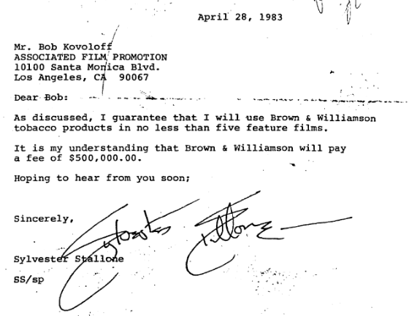

Slide 144
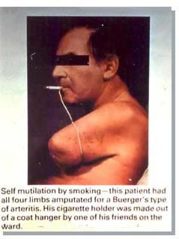

Slide 145
RECOMMENDATION
FOR NO - SMOKERS:
DO NOT START TO SMOKE
DO NOT ALLOW TO BE A VICTIM OF RUTHLESS SMOKERS

Slide 146
MY RECOMMENDATION
FOR SMOKERS:
DO RESPECT THE NO-SMOKERS´ RIGHTS TO BREATHE THE CLEAN AIR !!!
DO CLEAN THE TOXIC WASTAGE (butts)
DO MAKE THE RIGHT DECISION (TO STOP SMOKE)
DO KEEP IT

Slide 147
BECAUSE …
THE LIFE WITHOUT TOBACCO IS
MORE FREE
MORE MODERN
MORE CLEAN
MORE AROMATIC
MORE SENSUOUS
MORE ….

