Slide 2
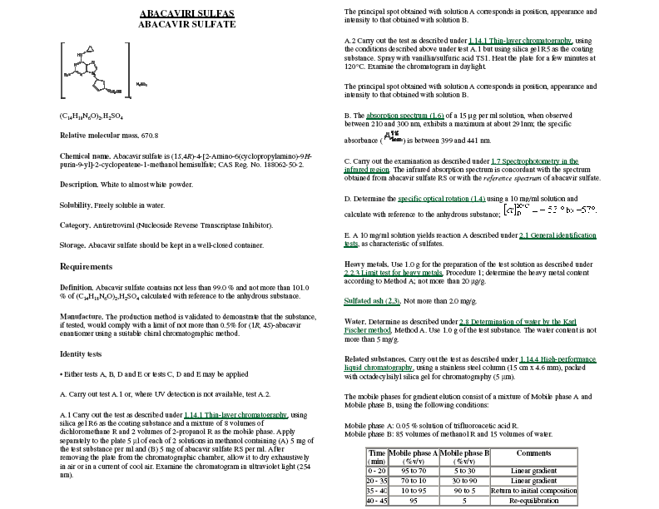
Chemical name in
accordance with IUPAC
nomenclature rules
Cross-reference to
a general method
CAS number
International chemical
reference substance (ICRS)

Slide 3
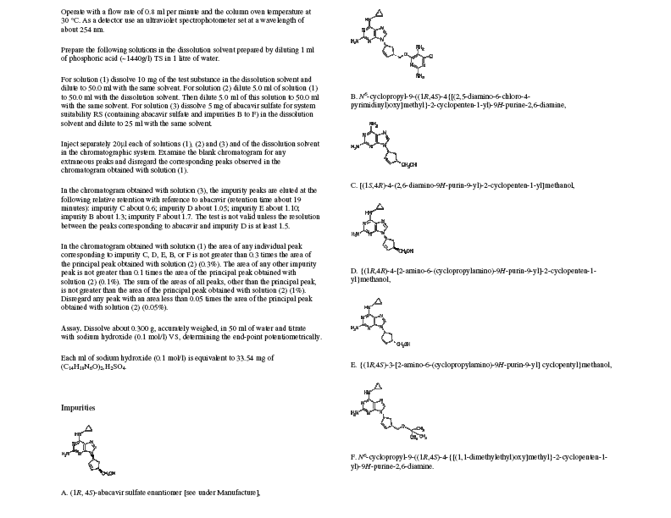

Slide 4
Cross-reference to
the general monograph

