Slide 1
Glucocorticoids

Slide 2
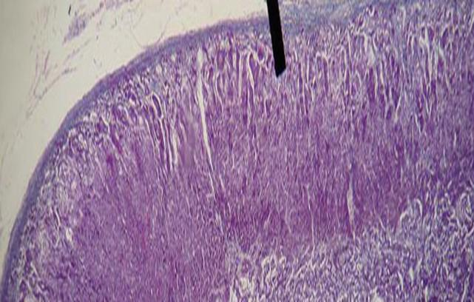
Adrenal cortex - physiology
Zona glomerulosa – mineralocorticoids production - aldosteron 10 – 15% of tissue, controlled by ATII a K⁺.
Zona fasciculata 75% of tissue, controlled by ACTH, „stock“ of cholesterol, its releasing and transformation to cortizol = main human glucocorticoid.
Zona reticularis 10 – 15 % of tissue – androgens, gestagens, cortisol production.
Zona glomerulosa
Zona fasciculata
Zona reticularis

Slide 3
Adrenal medulla - physiology
A-cells – adrenaline - 80 % catecholamines secreted to the blood. Adrenalin secretion based on n
Nerve impulse →physical and psychological stress (crisis situation) →alarm reaction → adaptation stage → ↑ glucosis, lactate, free fatty acids concentration, → exhaustion stage.
N-cells – noradrenaline – causes contraction of blood vessels (except heart vessels), thereby ↑ blood pressure.

Slide 4
Glucocorticoids - regulation
pain
stress
ADH
pyrogens
histamine
↓ BP
↓ glycaemia
+
+
+
+
+
+
+
hypothalamus
-
CRH
corticoliberine
+
hypophysis
-
+
ACTH
corticotropine
Suprarenal gland
+
cortisol

Slide 5
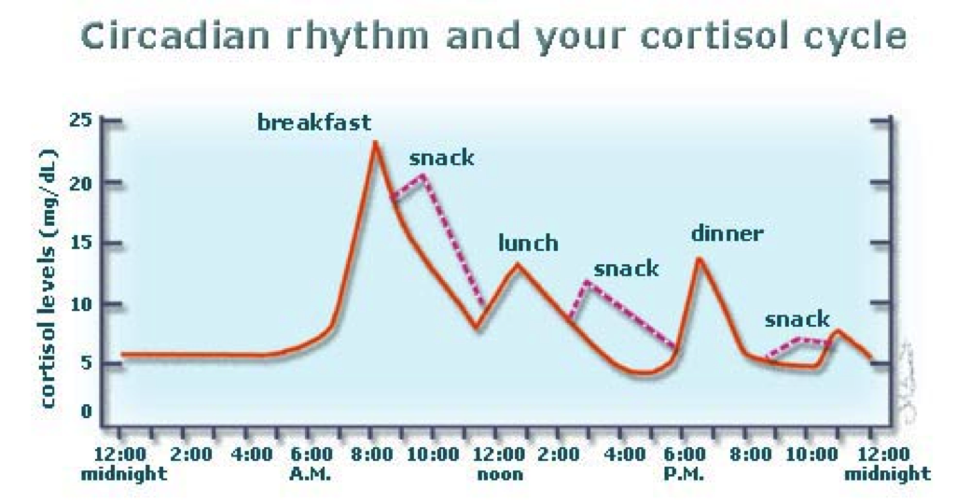
Endogenous and exogenous cortisol secretion
Resting – 20 – 25 mg/24 hours
Stress: 10 times higher
Maximum: 6 – 8 hours a.m.
Exogenous corticoids usage – endogenous secretion downturn

Slide 6
Mechanism of action in cellular level
Specific
Glucocorticoid
Receptor-hormon komplex
Receptor
Receptor in cytoplasma – slower efekt

Slide 7
Mechanism of action in cellular level
Specific
Change of proteosynthesis
Notes:
Protein může působit již uvnitř buňky.

Slide 8
Glucocorticoids
influence sugar, fat and protein metabolism
have anti-inflammatory and anti-allergic effect
have immunosuppressive effect (in many branches – in next slides)
have antiproliferative effect
Hydrocortisone (cortizol)

Slide 9
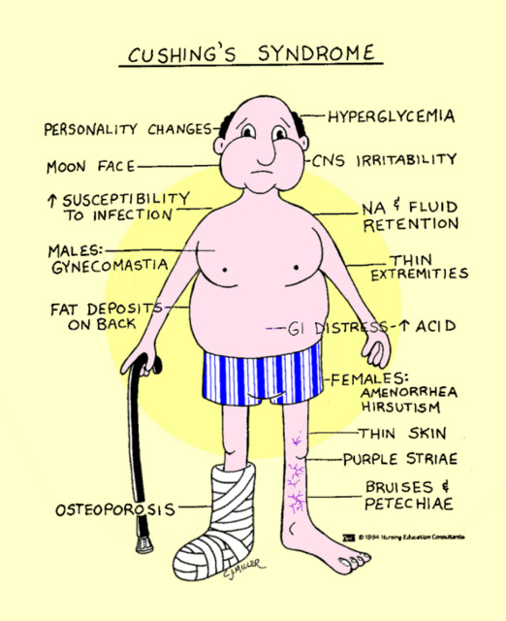
GCs and sugar, fat and protein metabolism
reduced glucose uptake and reduced glucose utilisation in the cell
Proteolysis, tissue
proteins = aminoacids decomposition of tissue proteins ↑ gluconeogenesis
catabolism (glucose formation from non sugar residues)
↑ glycaemia
Connective tissue
muscle atrophy
fibroblasts growth stopping ↑ of insulin secretion
↓osteoblasts, ↑osteoclasts
↓collagen synthesis
↓Ca resorption from intestine,
kidneys (osteoporosis)
↑ storage of glycogen in the liver lipogenesis support, lipolysis inhibition
fat deposition, redistribution,
↑glycerol, aminoacids in blood
Fats: ↑ lipolysis, facilitation of lipid absorption, fat redistribution

Slide 10
Other effects
CNS: Euphoria / psychotic disorder after high doses / depression
GIT: Increasing formation of HCl and pepsin in the stomach
BLOOD: ↑ Tro, Ery, circul. ↓lymfocytes, ↓eosinofils
LUNGS: ↑ formation of pulmonary surfactant
HCl – hydrochloric acid

Slide 11
GCs and congenital developmental defects
GK and ions
Permissive effect to:
- Development of organs of the fetus
- Development and maturation of intestinal enzymes
- Increases the synthesis of surfactant in the lungs of the fetus
- Suppresses bone growth
Ions
- Decreased calcemia
- Increased potassium loss
- Sodium and chloride retention

Slide 12
Regulatory effects
Negative feedback on the hypothalamus and the anterior lobe of the pituitary gland
reduced release of endogenous glucocorticoids
Vazotropic - GCs - vasoconstriction, decrease of permeability of vessels, suppression of edema
At cell level:
in place of acute inflammation: decrease in migration and leucocyte activity
in place of chronic inflammation: decrease proliferation of blood vessels and fibrosis
In place of lymphoid tissue: decrease B and T lymphocyte expansion
Towards the mediators of inflammation and immunological reaction:
Decrease of cytokine production and activity, decreased synthesis of PGs

Slide 13
Anti-inflammatory – cascade inhibition of AA
glucocorticoids
Membrane phospholipids
lipocortins
Phospholipase A2 A2
Inh. 5-LOX - antileukotriens
Arachidonic acid
A-A
NSAID
lipoxygenase
PROSTAGLANDINS
PROSTACYCLINS
THROMBOXANS
cyclooxygenase
LEUKOTRIENS
eikosanoids
Fagycytosis mobilisation
Blood vessel permeability change
Inflammation
inflammation

Slide 14
Anti-inflammatory effect
AA cascade inhibition
Migration and leucocyte function disruption
Antibody production reduction
All types of inflammation regardless of origin!
(aseptic, viral, bacterial, parasitic….)

Slide 15
Immunosupressive effect
Inhibition of antigen recognition
Inhibition of the effector phase of the immune response (cell lysis)
! CAUTION:
Inhibition CELL MEDIATED immunity
ANTIBODY immunity is affected significantly less and in GSc higher doses

Slide 16
Anti-inflammatory effect
Decreased histamine release from basophils
Inhibition of the formation of inflammatory mediators and allergic reactions (cytokines, complement components, kallikrein ...)

Slide 17
Anti- proliferative effect
Block cell cycle
Induction of differentiation
GCs - lymphocyte disintegration (acute and chronic lymphocytic leukemia, lymphomas, myelomas)

Slide 18
Effect and equipotent doses of CSs
Substance | Equip.dose | Anti infl. effect | Mineral. effect
Cortisol | 20 mg | 1 | 1
Cortisone | 25 mg | 0,8 | 0,8
Prednisone | 5 mg | 4 | 0,8
Prednisolone | 5 mg | 4 | 0
Methylpredn. | 4 mg | 5 | 0
Triamcinolone | 4 mg | 5-10 | 0
Dexamethasone | 0,75 mg | 25 | 0
Bethametasone | 0,6 mg | 25 | 0
Fludrocortisone | - | 10 | 125

Slide 19
GCs effects, anti-inflammatory, immunosupressive and other effects
Strong anti-inflammatory and immunosuppressive action
INHIBITION OF ACUTE AND CHRONIC DISEASE, INFLUENCE OF ALL TYPES OF INFLAMMATORY REACTIONS
Inhibition of healing repair processes, prevention of graft rejection
Mineralocorticoid effects: sodium retention, potassium depletion
Blood and lymphatic system: ↓ lymphocytes, ↓ eosinophils in circulation, ↑ platelets, erythrocytes and HB
Kidneys: glucocorticoids maintain the ability of the kidneys to secrete water, retain glomerular filtration, tubular resorption, prevent the transfer of water to cells and maintain extracellular fluid volume
Heart and vessels: allow for increased sensitivity to the vasoactive effect of catecholamines and ATII, increased myocardial contractility and vascular tone
CNS: mood regulation, strong insomnia
GIT: increased secretion of HCL and pepsin, increased absorption of lipids from the intestine, decreased absorption of Ca
Bone metabolism: osteoporosis (metabolism of Ca, P, collagen synthesis and degradation, osteoblasts / clasts)
Pulmonary surfactant: cortisol - an endocrine stimulant for pulmonary surfactant formation

Slide 20
Systemically administered GCs
1-4 times efficient than cortisol
prednisolone, prednisone
hydrokortisone
5-15times efficient than cortisol
methylprednisolone (Solu-Medrol)
triamcinolone
paramethasone
fluprednisolone
approx 30times efficient than cortisol
bethametasone
dexamethasone
Short term acting
Medium term acting
Long term acting
(stronger axis supression)
Notes:
ad 1. poločas cca 8-12h.
ad 2. poločas cca 12-36h
ad3 poločas cca 36-72h

Slide 21
Glucocorticoids therapeutical regimen types
Short term application of high doses
A) single (2-4 g methylprednisolone)
Polytraumatas, septic, toxic shock
Hydrocortisone 30 mg / kg
B) repeated (methylprednisolone, hydrocortisone, dexamethasone)
Anaphyl. shock, status asthmaticus, hypoglycemic coma ...
Duration up to 48 hours
Exceptionally up to 7 days

Slide 22
Glucocorticoids therapeutical regimen types
C) Pulse therapy
Short-term infusions for several days
Originally in transplant rejection
Today predominantly in immune-mediated diseases resistant to
standard therapy
D) Prolonged therapy
In most branches
Primarily for anti-inflammatory and immunosuppressive effects
Dosage and length depends on the current status of the patient
Strength differences, duration and frequency of adverse effects
No hydrocortisone with respect to mineralocorticoid activity

Slide 23
Glucocorticoids – adverse events
Before therapy start:
potential infection elimination
fasting glycaemia
diabetes compensation
preventive application of D vitamine
anti-ulcer treatment
Notes:
23

Slide 24
Glucocorticoids – adverse events
During the therapy:
DM monitoring compensation
monitoring of mental state
myopathy and osteporosis prevention (K, Ca, rehab., exercise)
thromboembolic prevention
consultation the centre for growth hormone treatment in
pediatric medicine

Slide 25
Glucocorticoids – adverse events prevention
Prevention
- Application of the lowest effective dose
- If possible local applications
Combination with other drugs
Circadian therapy / alternating therapy
Minimizing the use of depot medication (circadian rhythm disruption, local trophic changes after application)
Notes:
25

Slide 26
Glucocorticoids – adverse events
^{Immunosuppression}
- ↑ susceptibility to infections, activation of latent infections
^{- Slow wound healing}
- Even with local administration
Supression of endogenous glucocorticoid production
- Acute inadequacy when suddenly discontinuing higher doses
- Prevention = complete therapy by gradual dose reduction
^{Osteoporosis}
- Risk only for chronic therapy
^{- Densitometric examination}
^{Mineralocorticoid effect}
^{- Water retention and Na +}
^{- ↑ TK, loss of K +}

Slide 27
Glucocorticoids – adverse events
Hyperglycemia, steroidal diabetes
Muscle weakness, myopathy, atrophy
Psychotropic effects
Insomnia, motor agitation, vertigo, euphoria, depression
Psychic habit
GIT
Exacerbation of gastric ulcer
Intestinal perforation, acute pancreatitis
KVS
- HT, atherosclerosis, cardiomyopathy, ↑ coagulopathy, arrhythmia

Slide 28
Glucocorticoids – adverse events
Eye
Induction of glaucoma (↑ intraocular pressure)
Corneal ulceration in keratitis herpetica
Endocrine
Growth inhibition in children (therapy longer than 6 months)
Amenorrhea, potency and libido decrease
Skin
atrophy
Intradermal bleeding
Acne, hirsutism

Slide 29
Glucocorticoids – interactions
Prednisone reduces the plasma levels of salicylates and oral anticoagulants.
The effect of prednisone is reduced by barbiturates, phenytoin, rifampicin.

Slide 30
Therapeutic indications
Diseases of connective tissue, rheumatological diseases and collagenoses (RA, SLE, SS, DM…)
Severe forms of allergic reactions
Non-infectious inflammatory diseases of the eye
Severe skin disorders
Haematological diseases
Malignant diseases
Conditions after organ transplantation
Inflammatory gastrointestinal disease
Non-inflammatory respiratory disorders
Renal Disease
Immunalternative disease in neurology
Substitution therapy for secondary adrenocortical insufficiency
Congenital adrenal hyperplasia

Slide 31
Corticoids in clinical practice

Slide 32
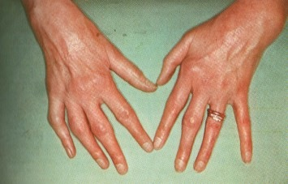
Rheumatoid arthritis
Glucocorticoids are used during periods of acute symptoms disease.
to bridge the period until the onset of effect DMD (MTX).
Recent studies, however, show that small doses of glucocorticoids have
modifying effect and slowdown the X-ray progression of the disease.
Prednisone at doses up to 10 mg daily or every other day. Only
Exceptionally, it is necessary to take higher doses, and it is only
In the case of very active disease, extra-articular symptoms, it´s better to start therapy with GK pulse therapy.
Biological treatment is currently the most effective RA treatment and, in a number of cases, it can decisively slow down or stop the progression of the disease:
Chimeric monoclonal antibody against TNF-alpha infliximab,
Fully human monoclonal antibody against TNF-alpha-adalimumab
Soluble receptor for TNF-alpha etanercept
Monoclonal chimeric anti-CD20 molecule – rituximab
CTLA4 molecule linked to a modified Fc portion of human IgG1 - abatacept

Slide 33
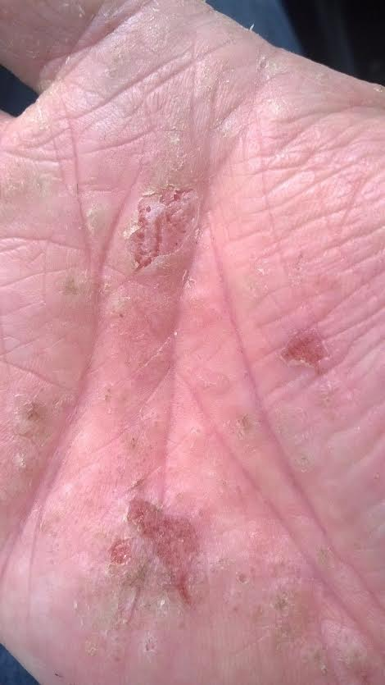
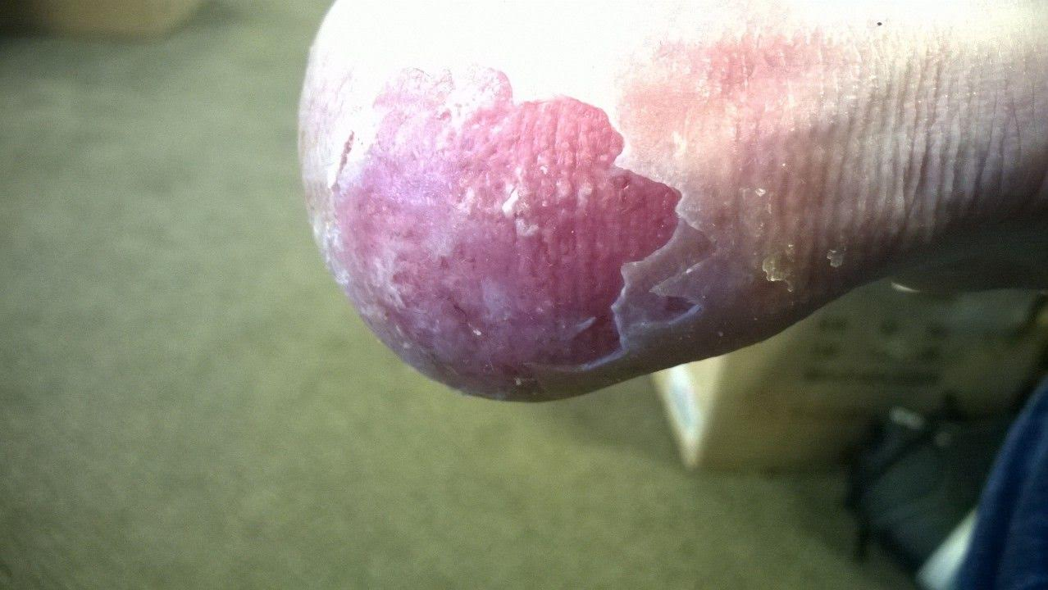
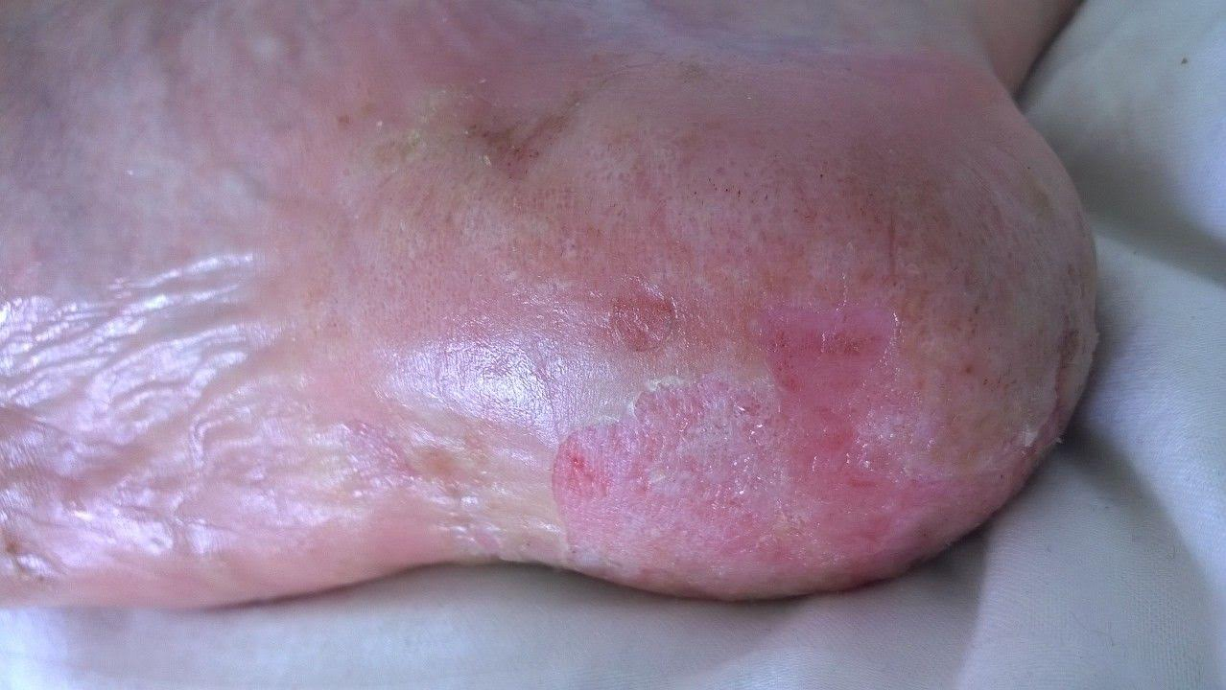
Skin diseases
Eczema dyshidroticum, before therapy
Hand-foot syndrom
Man 35 years old
2 – 3 years of hands eczema, after 1 year added hands eczema
Status of treatment with local corticosteroids for 2 years
Extreme impact on quality of life!

Slide 34
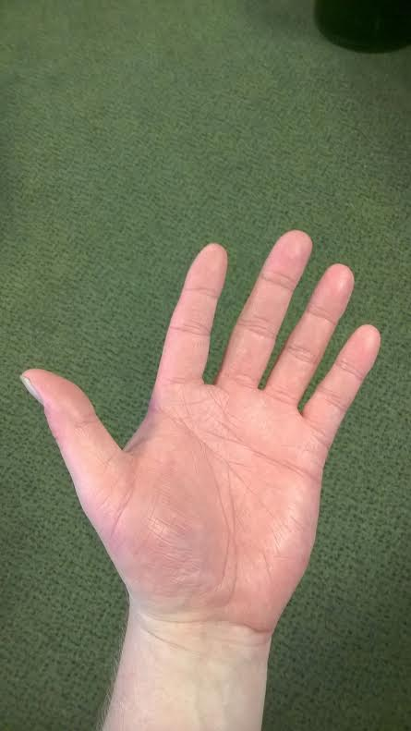
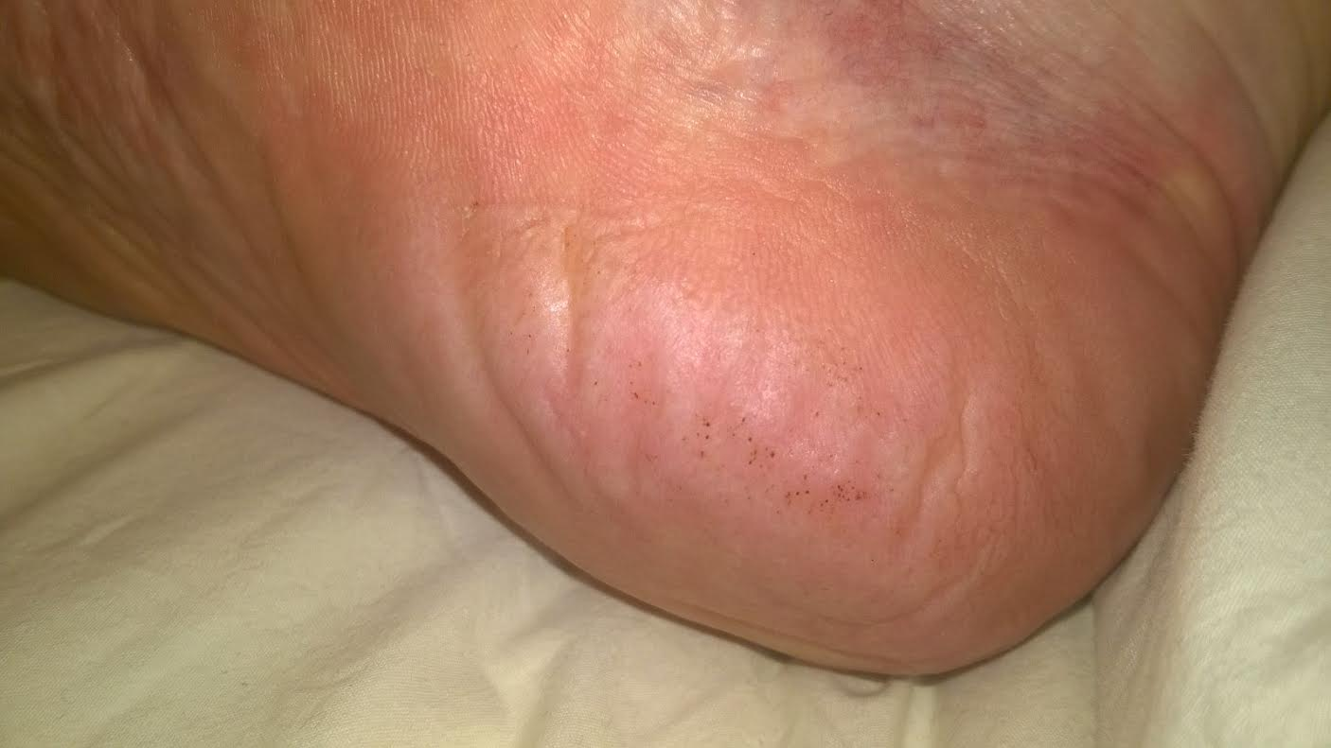
Skin diseases
Eczema dyshidroticum, after therapy
Prednison 50 mg / daily – 1 month
Proton pump inhibitors

Slide 35
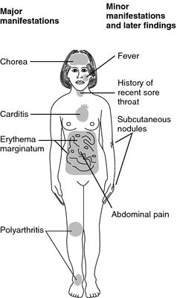
GCs and rheumatic fever
Rheumatic fever - a consequence of URT infection by hemolytic streptococcus
Hospitalization, bed rest - we can not reliably rule out heart disease - we use GCs corticosteroids instead of salicylates (prevention of heart muscle and valves damage)
The initial dose of Prednisone 60 mg - with gradual reduction, we can withstand treatment for at least 4 weeks.
Penicillin antibiotics to eradicate infection
URT – upper respiratory tract

Slide 36
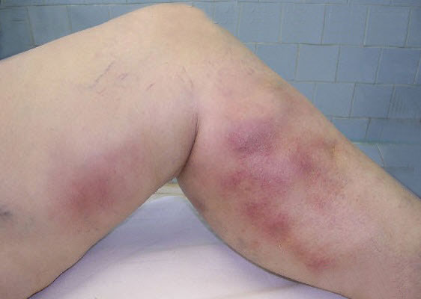
Thrombophlebitis
Movement, pressure bandage, legs elevation
Anti-inflammatory therapy (NSA), antibiotics at infection etiology, vascular treatment (troxerutin), anticoagulants
In case of migrating thrombophlebitis, corticosteroids are indicated in the failure of the above treatment of 20 - 40 mg daily

Slide 37
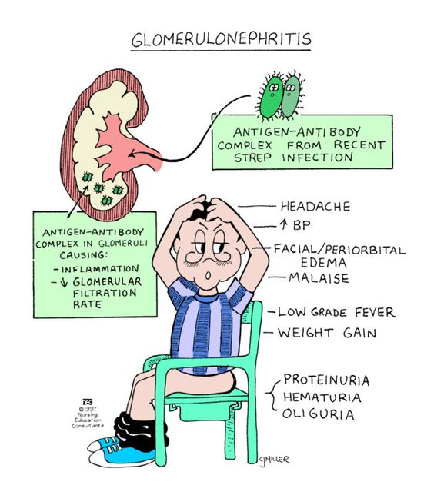
Fast progressive glomerulonephritis
Destruction of most glomeruli caused by:
- antibodies against neutrophil cytoplasm,
- antibodies against basal glomerulus membrane,
immunocomplexes
Not treated → kidney failure
Immunocomplex glomerulonephritis therapy:
Prednisone 1mg /kg, dose decrease very slow, not
earlier than 3 months, to achieve a dose of 20 mg/
day in combination with Cyclophosphamide

Slide 38
Glucocorticoids in the treatment of rheumatoid arthritis
GK in supraphysiological doses are the most potent anti-inflammatory drug in the RA (except for biological treatment)
Long-term administration - problem
Treatment examples:
A) HD Prednisone 60 mg / day or day or day
HD Methylprednisolone 48mg / day or daily
For 1 - 2 months followed by a gradual decrease depending on the clinical condition
We want remission of the disease, great side effects
B) LD Prednison - less than 7.5 mg / day
LD Methylprednisolone - less than 6 mg / day
C) An alternative type of treatment - from the original 5 mg of prednisone daily, we switch to 10 mg daily
We already have control over the disease, we want control over the symptoms, sine side effects
D) Combination treatment type - methotrexate, sulfasalazine, cyclosporine, cyclophosphamide 6-12 weeks according to
Clinical condition
Concomitant treatment of long-term medication GK: densitometry, vitamin D, calcium ulcer, potassium-sparing diuretic, as needed

Slide 39
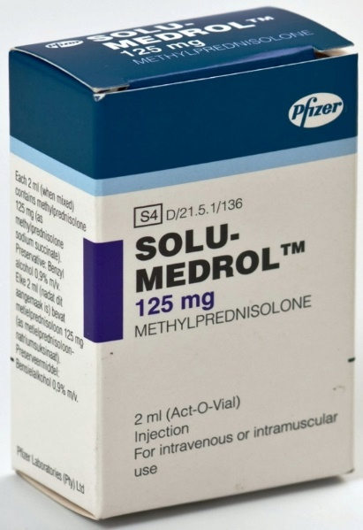
Pulse therapy of glucocorticoids in the treatment of rheumatoid arthritis
High doses of corticoids i. v. every second day
250 - 1000 mg of methylprednisolone (Solu-Medrol) in infusion
In cases of very active RA
In life threatening visceral RA manifestations (lung fibrosis)
Disease activity decrease will be exposed in lab tests (FW, CRP)
Indication: only on bed
Efficacy assessment: if pulse treatment leads to disease regression
(clinical condition improvement) for 6 - 8 weeks = effective
If the effect lasts only a few days, repeating pulse treatment is irrelevant.

Slide 40
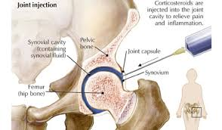
GCs Intra-articular therapy GK in AR
Principles of intra-articular administration of corticosteroids
Strict aseptic conditions of application
Exclusion of infection on the skin and around the entrance, acute or chronic overall infectious disease
Good knowledge of application technique only in the joint with synovialitis (warm joint, effusion).
Maximum 2 - 3 times a year
Medication: Methylprednisolone acetate Depo-Medrol, or betamethasone Diprophos

Slide 41
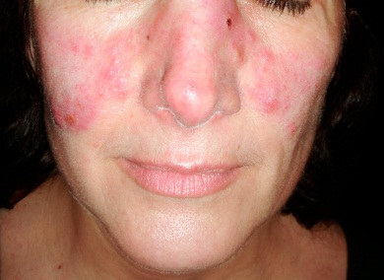
GCs in SLE
SLE – multiorgan disease – Abs against cell nucleus structures
SLE – disability of the heart, vessels, lungs, blood elements, kidneys, CNS…
GCs - the most important drugs in the treatment of SLE
Rapid suppression of inflammatory and fulminant forms
Indications:
- mild forms 5 - 10 mg Prednisone daily
- severe forms with visceral affection of 20 - 60 mg Prednisone/day
- very serious forms - pulse GCs therapy
Therapeutic combinations: azathioprine, cyclophosphamide, methotrexate, cyclosporin

Slide 42
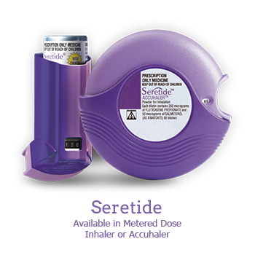
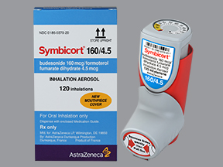
Inhalation GCs in asthma treatment
The most effective preventative antiasthmatics
Improve pulmonary function, reduce bronchial hyperreactivity, reduce exacerbations, improve quality of life
Beclomethasone dipropionate, budesonide, fluticasone propionate
Inhaled corticosteroids have a better safety profile than oral
Fixed combination - fluticasone + salmeterol (Seretide Discus)
- budesonide + formoterol (Symbicort Turbuhaler)

Slide 43
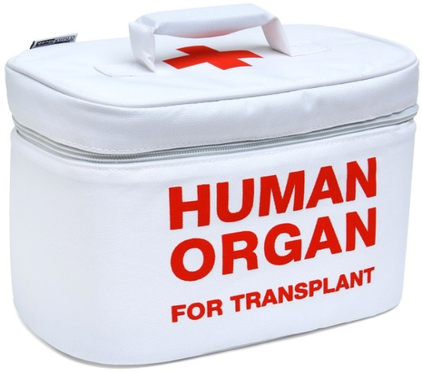
Acute rejection in transplant organs
Sudden deterioration of graft function on immune basis
It occurs in the first three months
Diagnosis of rejection - biopsy and histology result
Therapy:
Pulse treatment of corticosteroids 250 - 500 mg of methylprednisolone 3 - 5 days leading to a graft stabilisation in majority of patients
In case of corticoresistance - antithymocytic globulin

Slide 44
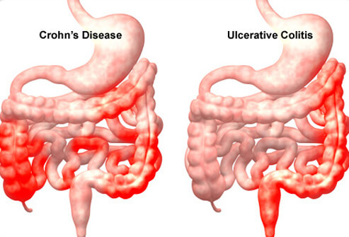
Non-specific intestinal inflammation
Etiopathogenesis is unclear
Autoimmune disease direct to own intestine cells
Crohn's disease, proctocolitis (colitis ulcerosa)
Therapy is focused on influencing:
- mediators of inflammatory processes
- suppression of immunological changes
Corticosteroids: „Attack“ treatment in high disease activity
Application: tablets, suppositories, klyzma, parenteral application
Topical administration of KK: budesonide (Entocort klyzma/infusion), gastro-resistant capsules (advantage - minimal absorption from the digestive tract, minimal administration)
Highly active Crohn's Morbus: 1 - 1.5 mg / kg i.v. inf.

