Slide 1
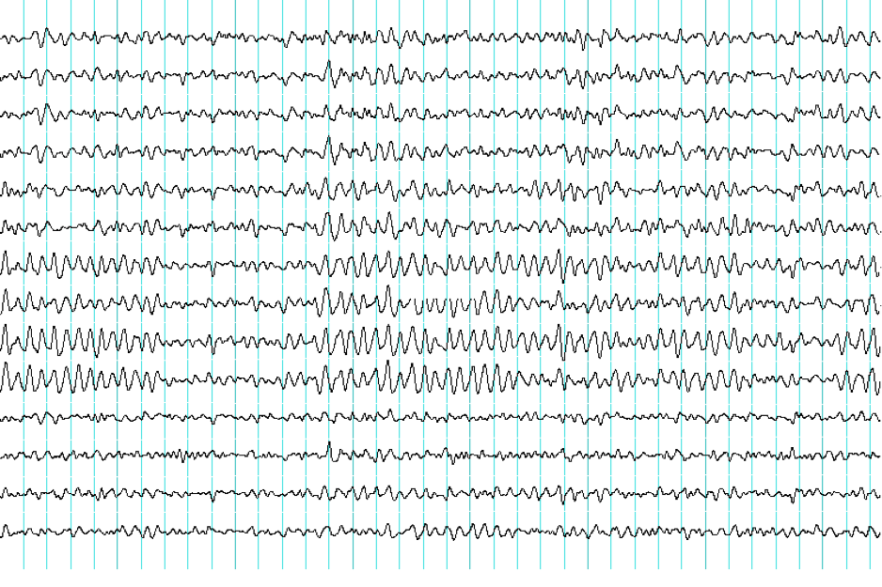
XLIII. Electroencephalography
XLIV. Evoked potentials

Slide 2
Electroencephalography (EEG)
method used for the registration of electrical potentials of the brain
Hans Berger (1929)
        scalp EEG
        electrocorticogram (ECoG)
        stereoelectroencephalogram (SEEG)
        macro EEG
        micro EEG

Slide 3
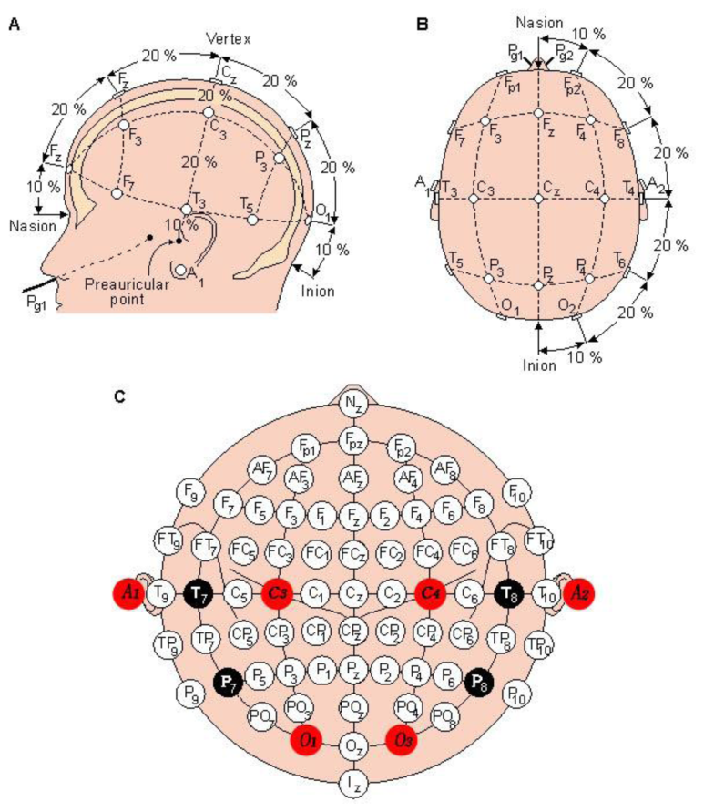
Electroencephalography
placement of electrodes: system 10 - 20

Slide 4
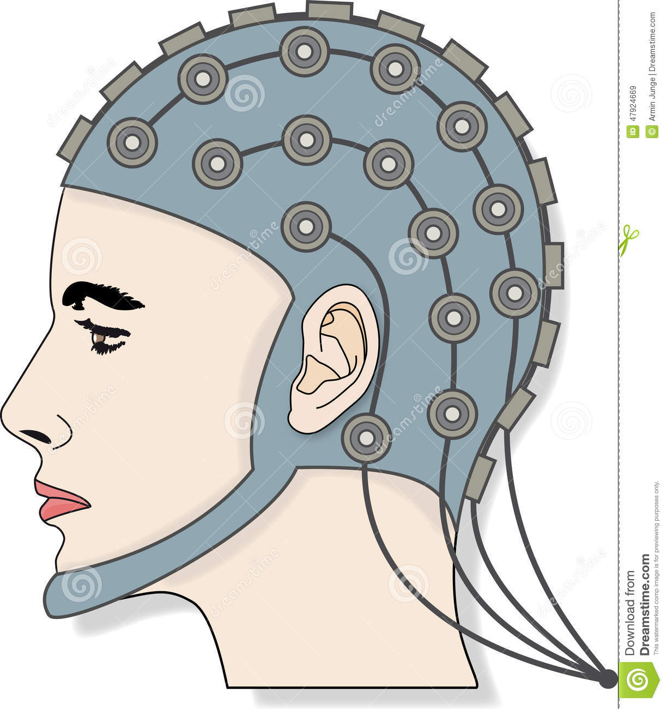
Electroencephalography
attachment of electrodes during scalp EEG
www.dreamstime.com

Slide 5
Electroencephalography
alpha rhythm: frequency 8-13 Hz, noticeable with eyes closed, in awake, healthy and mature brain, especially in parietooccipital lobes
beta rhythm: frequency 14-30 Hz, noticeable with open eyes, sometimes constantly over frontal area. Phenomenon of suppression of the alpha rhythm by opening eyes – alpha attenuation reaction (AAR).
theta rhythm: frequency 4-7 Hz, noticeable in children, in healthy adult only during waking sleep stages
delta rhythm: frequency 1-3 Hz, in neonates and infants, in healthy adults only during deep non-REM sleep

Slide 6
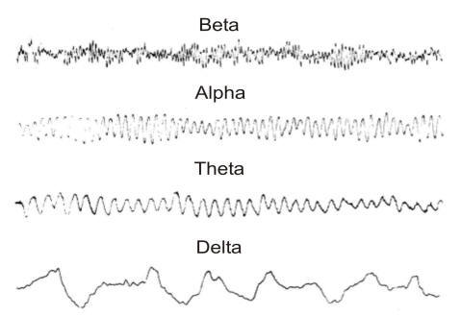
Electroencephalography
EEG waves

Slide 7
Electroencephalography
EEG record - example

Slide 8
Evoked potentials (EP)
electrical manifestation of brain activity triggered by external sensory stimulus
evaluation of the functional state of the nerve pathway
TYPES OF EP:
VEP (visual)
AEP (auditory)
SEP (somatosensoric)
MEP (motoric)
SSEP (stable)
ERP (cognitive)

Slide 9
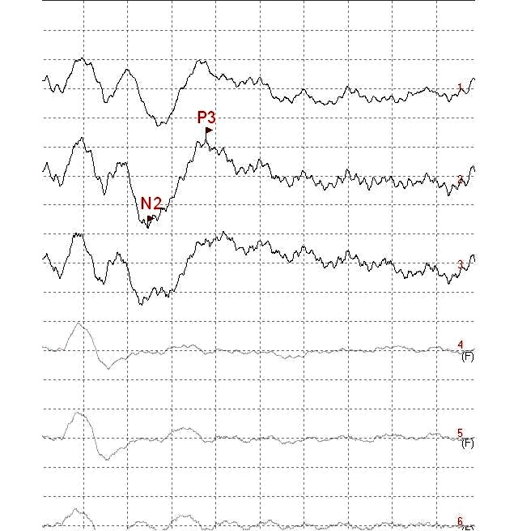
Evoked potentials
wave p300 (mean latency 300ms)

