Slide 1
Estimation of visual acuity

Slide 2
Snellen´s optotype
Landolt´s circles
Pflüger´s hooks

Slide 3
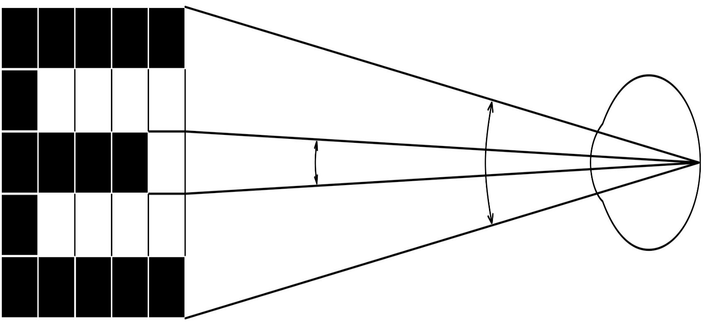
5´
1´
Physiological base: 1 minute - is the limit of two-point discrimination in a normal eye
Visus is the ratio of the distance from which the tested person could read letters of a given size, i.e. here 5 m,
to the distance from which a normal eye can read them which is the number found at the corresponding line of the table.
The fraction is not evaluated, i.e. one writes:
V = 5/5 (normal eye)
V = 5/10 (reduced acuity)

