Slide 1
Expressing position
«a particular way in which someone or something is placed or arranged, in relation to something or someone else»

Slide 2
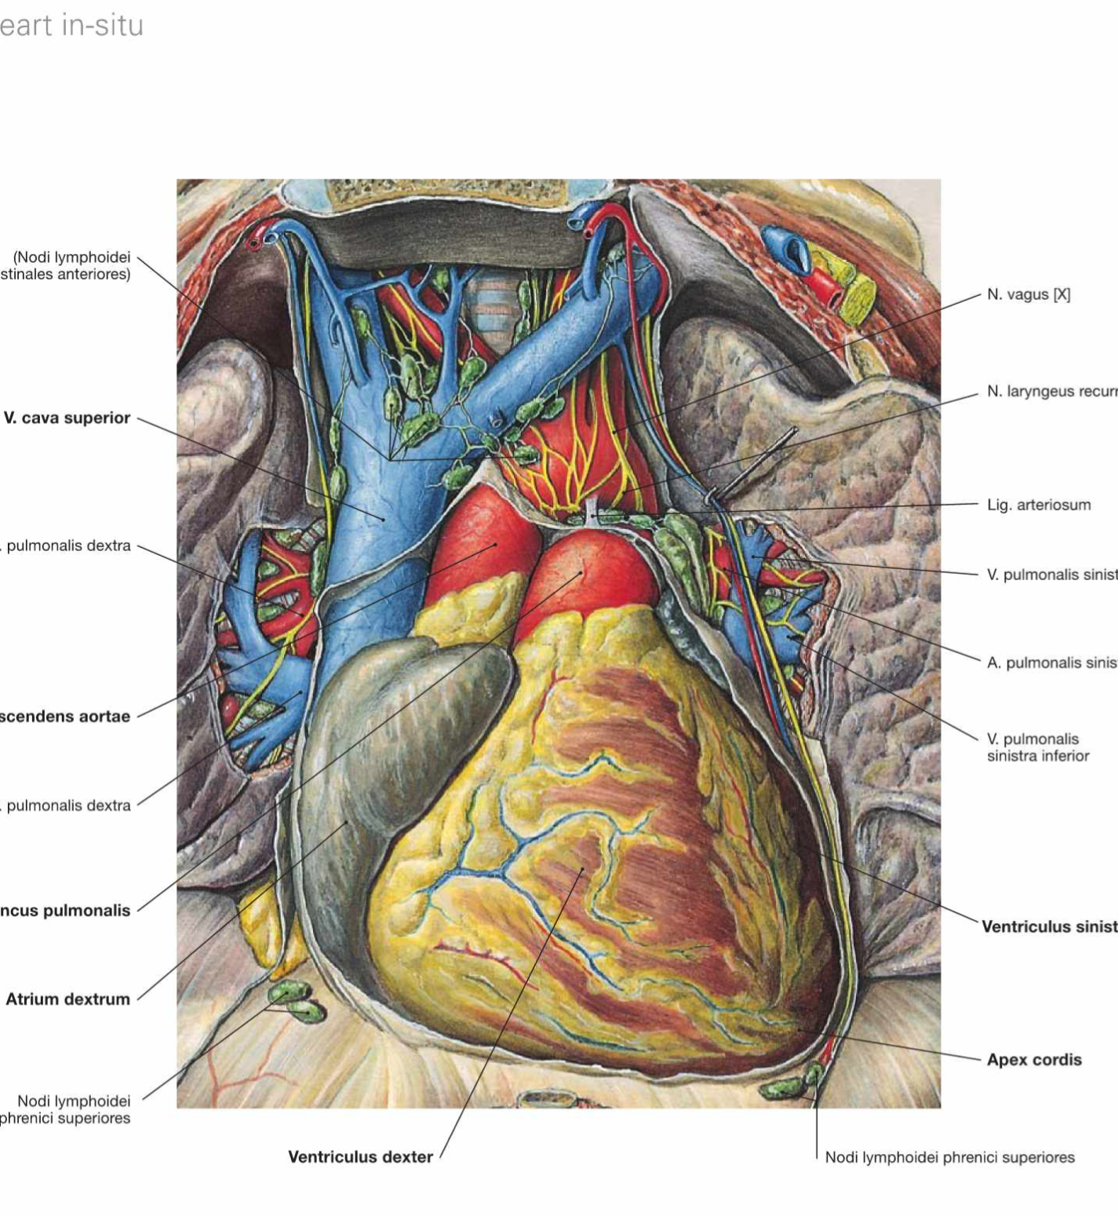
Use of grammar
Adjectives
  Ex: linea medialis
Prefix- is a word part attached to the begining of a word root to modify its meaning
  Ex: Suprarenalis
Prepositions
  Ex: in situ
Comparative form
  Ex: maximus / medius /minimus

Slide 3
General terms
Locus, i, m.
Situs, us, m
Positio, onis, f
Localis, e
Examples
  In situ
  Loco typico
Example. Organa loco typico. This is the typical location of the organs

Slide 4
How to express lateral and medial positions?
With noun: Latus, eris, n.
  lateris dextri (l.dx.)
  lateris sinistri (l.sin.)
  lateris utriusque (l. utr.)
With adjective:
  lateralis, e
  medialis, e
Superlative form
  latissimus
=Side
=right side
=left side
=both sides
= located on the same side
=

Slide 5
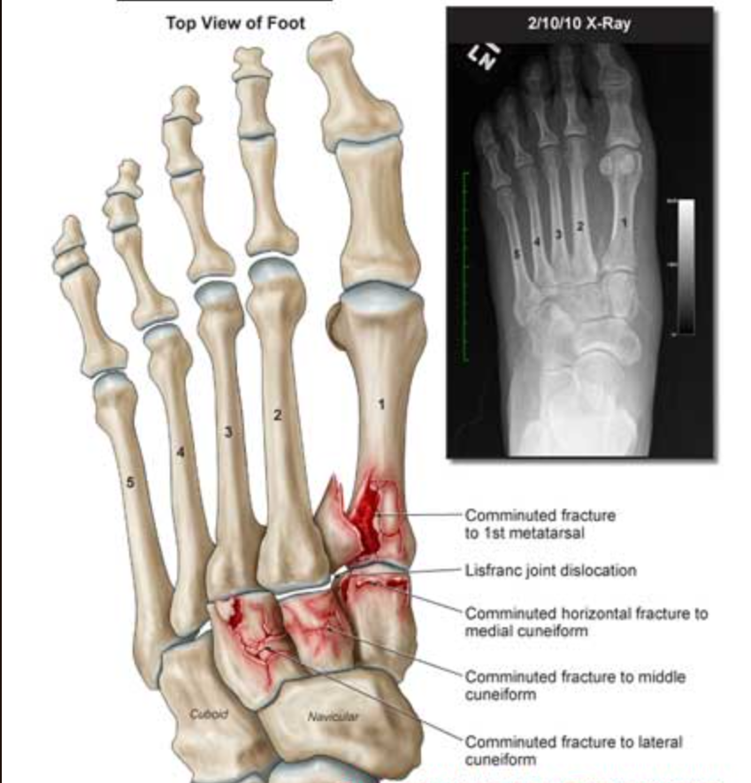
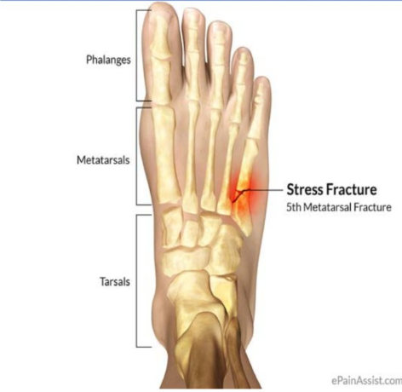
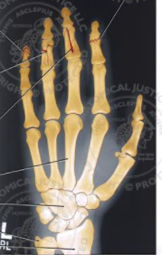


Fractura pedis lateris dextri

Slide 6
How to express anterior and posterior positions?
Spina iiliaca Anterior Superior
Spin
E
Anterior position = before
  Antero-
  Ante-
  Prae-
  Pro-
  Example:
  Spina iliaca anterior superior
Posterior position= after
  Postero-
  Post-
  Retro-
  Meta-
Example:
Spina iliaca posterior superior

Slide 7
How to express superior and inferior positions?
Comparative form of «super»=over
Superior,ius = Higher, «being more
above»
- Spina iliaca anterior superior
Prefixes
  Supero- superomedialis
  supra-/super – supraclavicularis superficialis
  Epi (Upon) - epidermis
  Hyper (Over) - hyperacusis
Comparative form of «inferus»=low
Inferior, ius = Lower
Prefixes
  Infero- inferoposterior
  Infra- infraorbitalis
  Sub- sublingualis
  Hypo- hypodermis

Slide 8
How to express internal and external positions?
Internal= on the inside
Positive form
  internus, a, um = “internal” – M. obturatorius internus
  Intimus,a,um = “innermost” – tunica intima
Prefixes
  Intra- haemorrhagia intracranialis
  Endo- endocardium
External= on the outside
Positive form
  externus, a, um
Prefixes
  extra- Extrahepatic ductus biliares
  ecto-/exo- ectopic

Slide 9
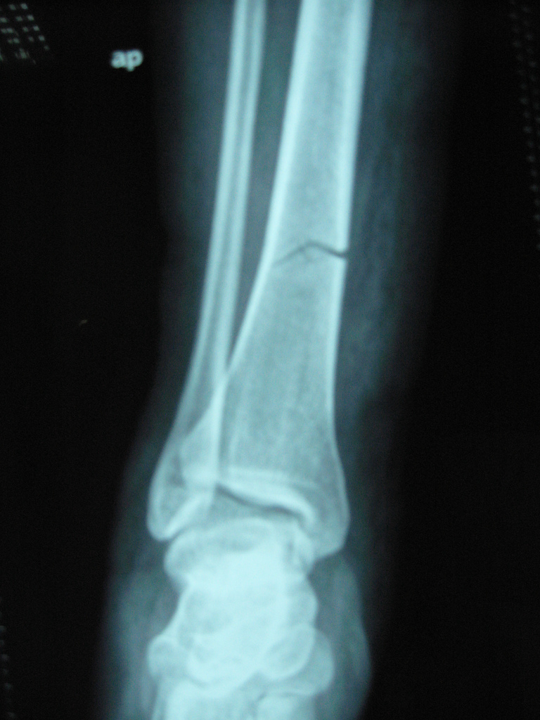
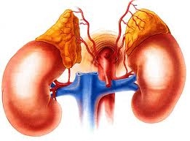
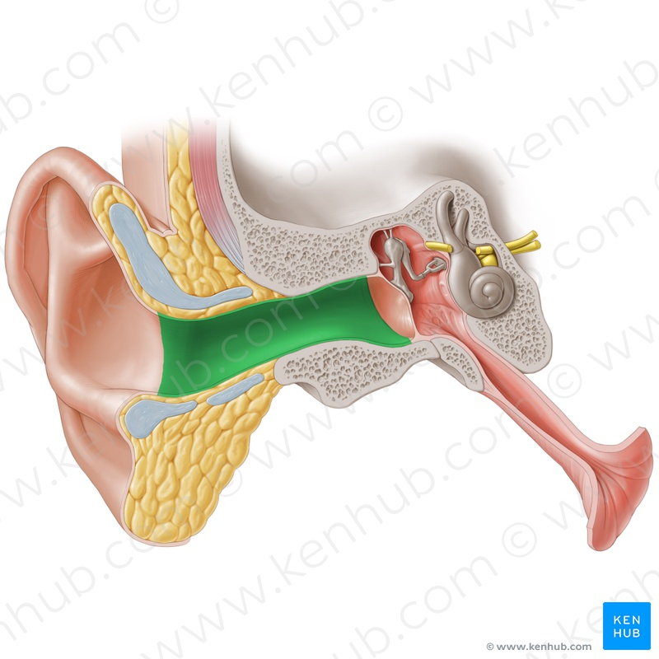
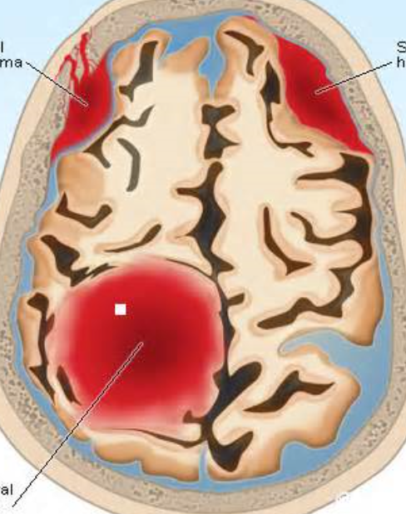
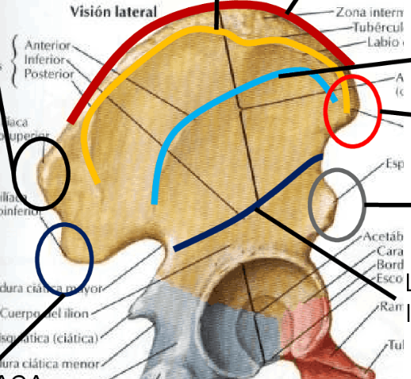

3.
2.
1.
4.
5.

Slide 10
Gratias pro audientia agemus
Fractura tibiae Lateris sin
Glandula suprArenalis
Meatus acusticus exTernus
Haemorrhagia Intracranialis
Linea glutea iNferior

