Slide 1
Connective tissue proper
Cartilage

Slide 2
Connective tissue
forms an extensive compartment in the body and can be considered as the "glue" that holds the body and organs together.
3 types of CT: connective tissue proper / cartilage / bone
consistency is from soft gel-like (areolar CT) to hard (bone)
originate from embryonic CT = mesenchyme (derivate of mesoderm)
function of CT: supporting, nutritive (diffusion of nutritives from blood vessels)

Slide 3
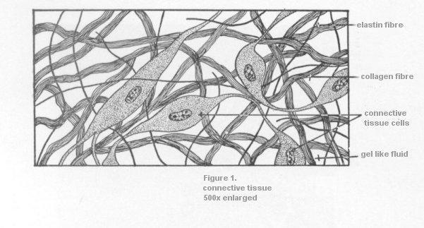
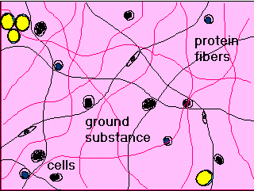
Connective tissue
All types of CT consist of cells and intercellular matrix secreted by some of those cells. The intercellular matrix consists of fibres and ground substance

Slide 4
Connective tissue
Types of CT | Classification | Cells | intercellular | matrix
 |  |  | Fibres | Ground substance
CT proper | Mesenchyme Mucose CT Loose CT Dense CT - regular - irregular Reticular CT Adipose CT - white fat - brown fat | Fixed: fibroblasts and fibrocytes, reticular cells, pigment cells, adipose cells, histiocytes, mast cells, plasma cells, Free: macrophages, leukocytes | collagen reticular elastic
Cartilage | Hyaline Elastic Fibrocartilage | chondroblasts and chondrocytes | collagen elastic
Bone | Fibrilar Lamellar - compact - spongy | osteoblasts, osteocytes | collagen | mineralized

Slide 5
Connective tissue
Ground substance: occupies the space between the cells and fibres of CT
colorless, transparent, homogenous substance of mucose consistency
high water content
in specially prepared sections, has an amorphous appearance. In routine preparations, it is lost during the fixation and dehydration process, and only cells and fibres can be seen.
Consists of : glycosaminoglycans (hyaluronic acid, chondroitinsulfate, dermatansulfate, keratansulfate, heparansulfate)
proteoglycans – (aggrecan, syndecan, fibroglycan)
glycoproteins – (fibronectin, chondronectin, laminin, osteocalcin, osteonectin, osteopontin)

Slide 6
Connective tissue - fibers
Fibres: There are three types of fibres secreted by connective tissue cells: collagen fibres, reticular fibres, and elastic fibres. The abundance of different types of fibres varies in different CTs. Each type of fibre is formed by proteins made of long peptide chains.
Collagen fibres: - the most common type of fibres arranged into bundles - flexible fibres with a high tensile strength - in LM: wavy lines of variable width and indeterminate length. - in EM: fibres are seen to be made up of thread-like subunits called collagen fibrils – made of protein COLLAGEN (Several types of collagen have been identified- type I collagen in the dermis of the skin, bone, tendon, organ capsules and many other areas, type II in cartilage, type IV in the basal lamina (of basement membrane) of epithelia)

Slide 7
Connective tissue - fibers
Reticular fibres: - are closely related to collagen fibres. - made up of protein COLLAGEN (type III collagen fibrils- fibres do not form bundles, and can be displayed with special silver preparations (impregnation) - fibres are arranged into network which provides a supporting net (the lymphnodes, the spleen). They are also found around adipocytes, small blood vessels, nerves and muscle cells.
- are produced by fibroblasts, the reticular fibres that support
the stroma of hemopoietic and lymphatic tissue are made
by special cells called reticular cells.

Slide 8
Connective tissue - fibers
Elastic fibres:
-
thinner than collagen fibres and are arranged in a branching pattern to form a three dimensional network, they give tissue the ability to stretch and distension
composed of two structural components:
protein ELASTIN and microfibrils (microfibrils consist of a fibrillar glycoprotein)
- are found in certain ligaments (elastic ligaments), some cartilage (auricle,epiglottis) and in large arteries (elastic arteries).
- elastic fibres are produced by fibroblasts(in the case of elastic arteries, it is produced by the smooth muscle cells of the tunica media)
- they do not stain very well with eosin and in routine preparations usually cannot be distinguished from collagen fibres. Elastic fibres are selectively stained with special dyes such as orcein and resorcin-fuchsin.

Slide 9
Connective tissue - cells
many different kinds of cells can be found in CTs, some of the cells in CTs are fixed - they are permanent residents in the CT
other cells are wandering (free) - they are transient migrants who enter the CT from the blood in response to specific stimuli.

Slide 10
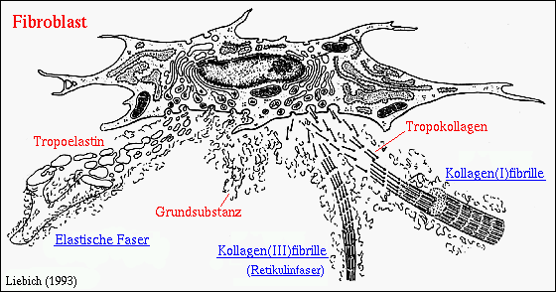
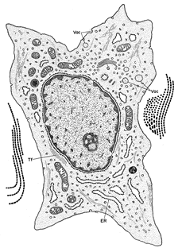

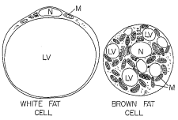
Fibroblasts: the principal cells of connective tissue. they produce precursors of all types of fibres (collagen, reticular, elastin) and ground substance. EM: rER, GA
Reticular cell: stellate cells production of collagen III of reticular fibres EM: rER, GA
Pigment cells: (melanocytes) production of pigment melanin cells originate from neuroectoderm
Adipose (fat) cells: Also called adipocytes, these cells are specialized to store neutral fat. White fat – univacuolar cells (one large lipid droplet) Brown fat – multivacuolar cells ( several small lipid droplets)

Slide 11
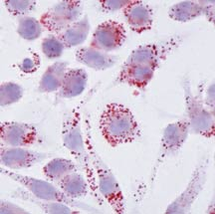
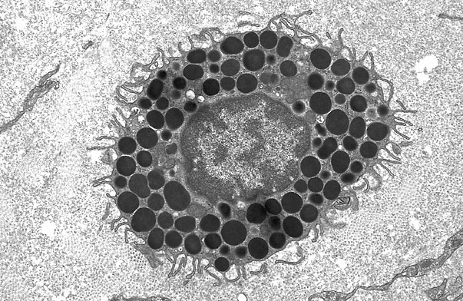
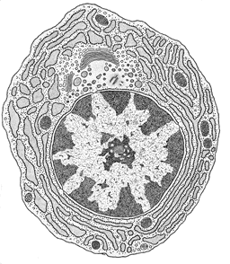
Histiocytes: are phagocytic cells (fixed macrophages), after activation transform into migrating form – free macrophages (detection of macrophages phagocyting some dye)
Mast cells: with granules containing histamine, heparin and anaphylactic factors. When released in response to an antigen, they cause hypersensitivity reactions, allergy and anaphylaxis.
Plasma cell: with voluminous cytoplasm and typical appearance of nucleus („clock“). Plasma cells are derived from B-lymphocytes and produce antibodies against a specific antigen. They have a limited migratory ability and a short life.

Slide 12
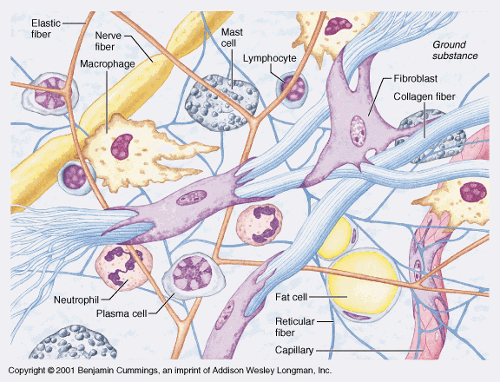
Wandering cells:
Neutrophils: white blood cells - phagocytes in the early stages of acute inflammation.
Eosinophils: white blood cells that - in the lamina propria of the GI tract, and at sites of allergic reaction and parasitic infection.
Basophils: white blood cells - similar to mast cells in having vasoactive agents released in response to an allergen.
Lymphocytes: cells responsible for immune responses that circulate in the blood. Normally, only small numbers are found in the CTs throughout the body. The number increases dramatically at certain sites of tissue inflammation. They are also very numerous in the lamina propria of the respiratory and gastrointestinal tracts, where they are involved in immunosurveillance. The lamina propria is a layer of loose CT lying immediately beneath the epithelium.
Monocytes: white blood cells - will give rise to all the phagocytes of the mononuclear phagocytic system.

Slide 13
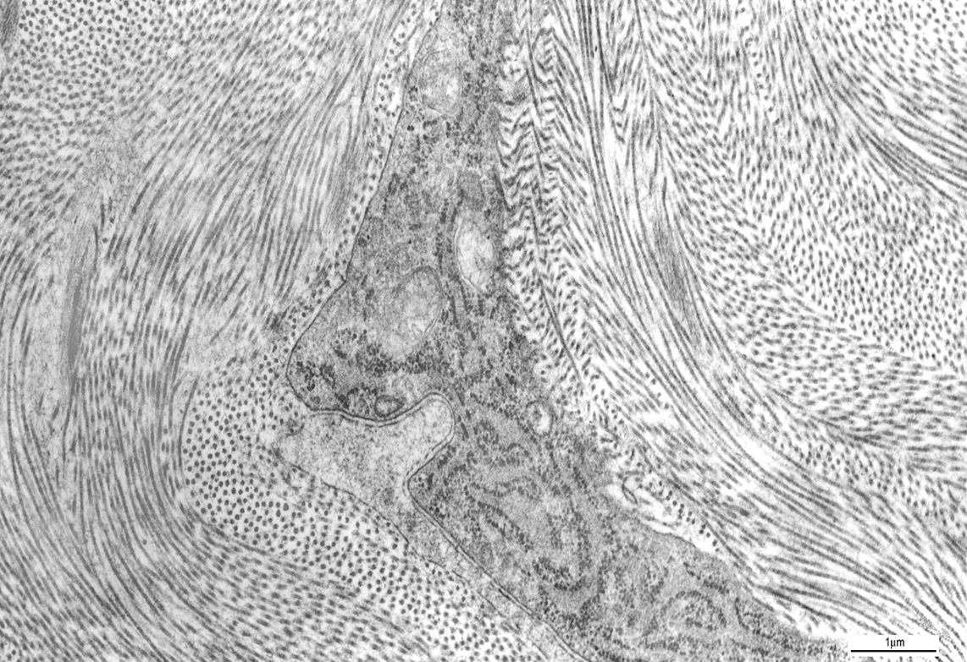
Fibroblast + collagen fibrils
Notes:
Corneal stroma (TEM) – hamster
Fibroblast, collagen microfibrils

Slide 14
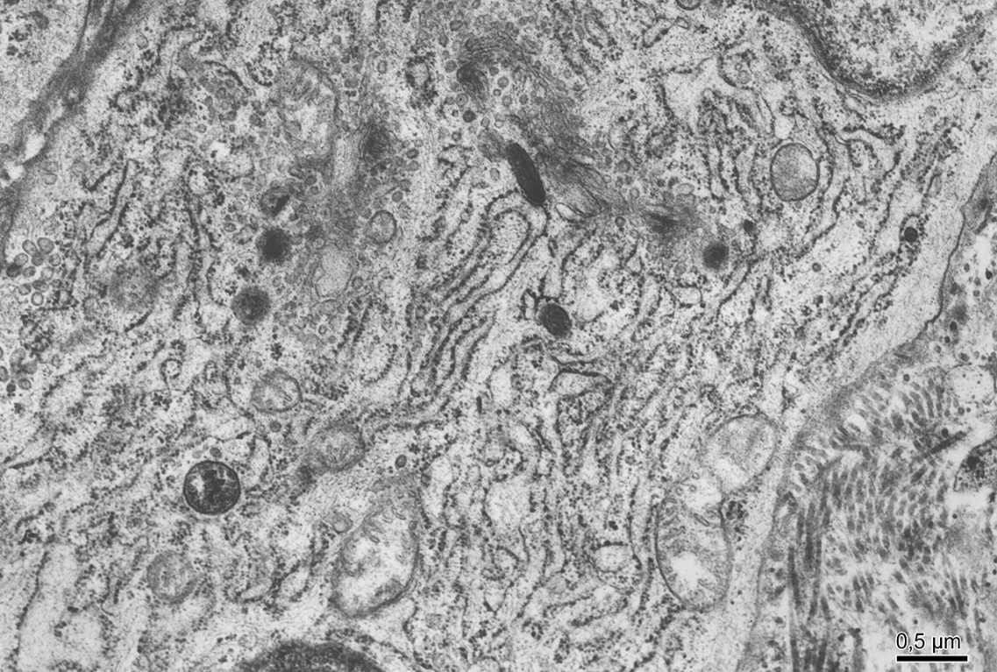
Fibroblast – synthetically active cell
GA
GER
CMF
Notes:
Fibroblast:
GA –Golgi apparatus
GER – granular endoplasmic reticulum
CMF- collagen microfibrils

Slide 15
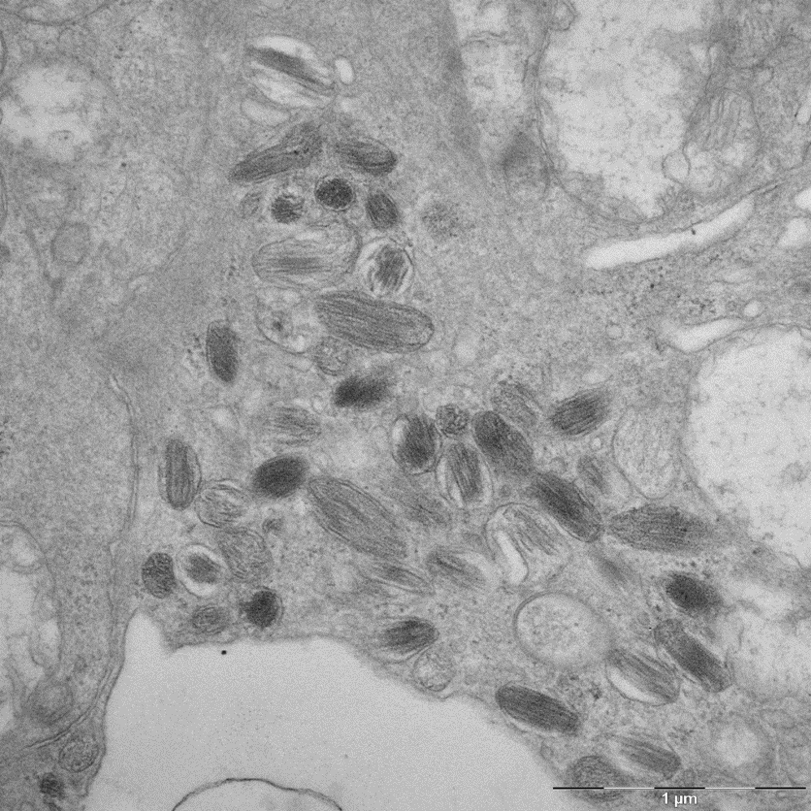
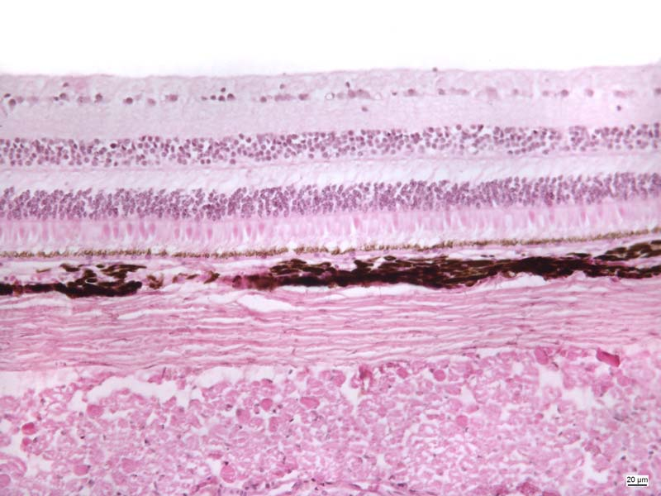
Pigment cells
melanosomes
Notes:
Pigment cells – posterior part of the eye, melanocyte of iris (TEM)

Slide 16
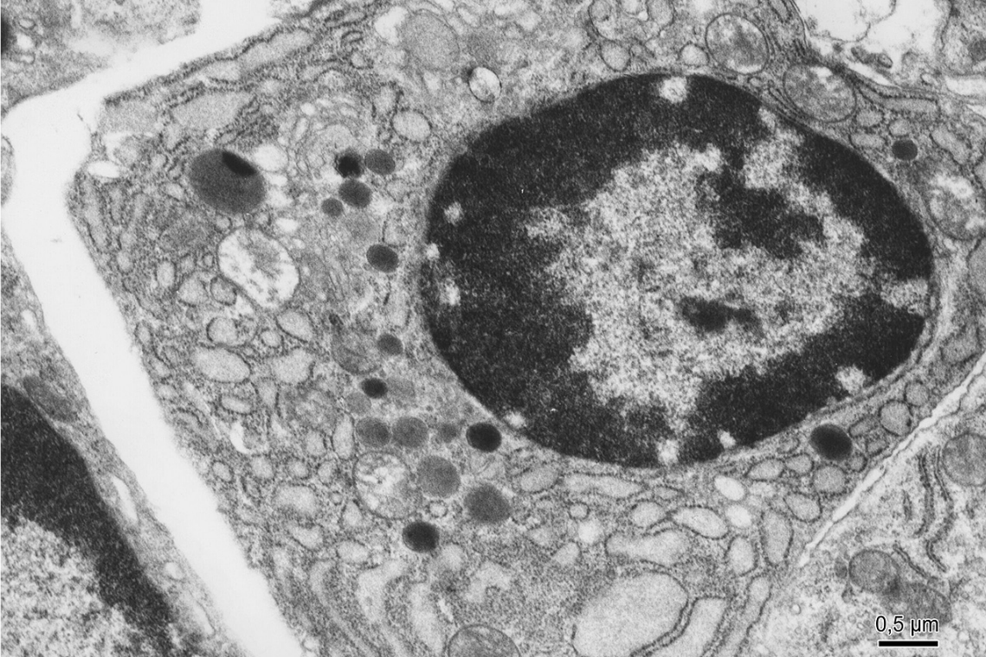
Plasma cell
GER
Notes:
Plasma cell (TEM)
GER – granular endoplasmic reticulum

Slide 17
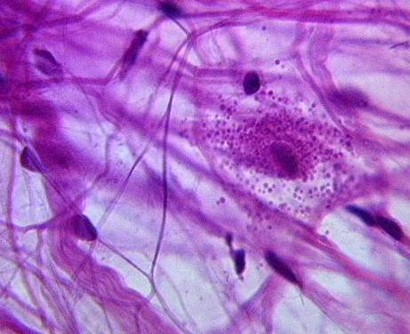
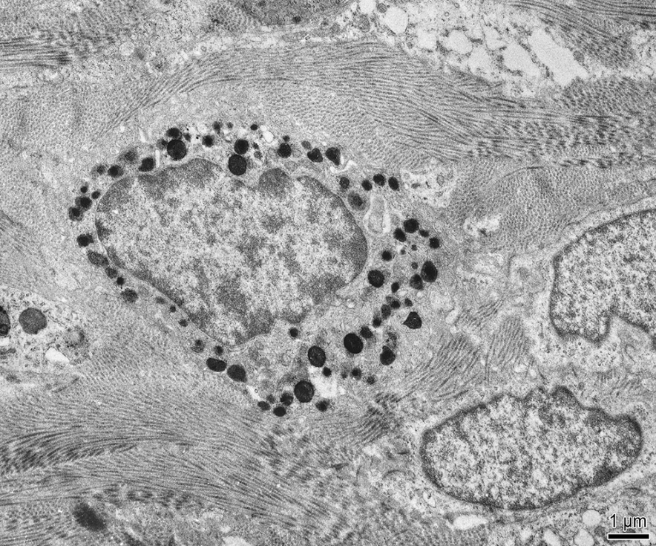
Mast cell
http://www.gwc.maricopa.edu
Dense secretory granules
Notes:
Mast cell
Dense secretory granules

Slide 18
Connective tissue proper
Classification of connective tissues:
CTs are classified on the basis of types of cells, fibres and ground substance, and on the organization of fibres.
- Loose
Dense (regular, irregular)
Elastic
Reticular
Adipose
Mucose
Mesenchyme

Slide 19
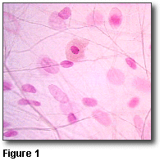
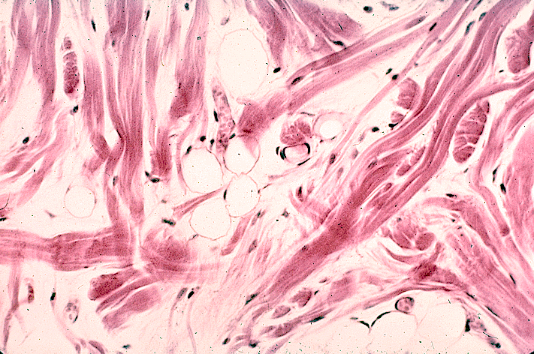
Connective tissue proper
Loose (areolar) CT:
- cellular type of CT – all types of cells
abundant ground substance and thin and relatively sparse fibres (mainly collagenous)
viscous gel-like consistency
- important for the diffusion of oxygen and nutrients, phagocytosis; connective function
- examples of occurrence: beneath epithelia as lamina propria, submucosa – distinct layer of the wall of hollow tubular organs

Slide 20
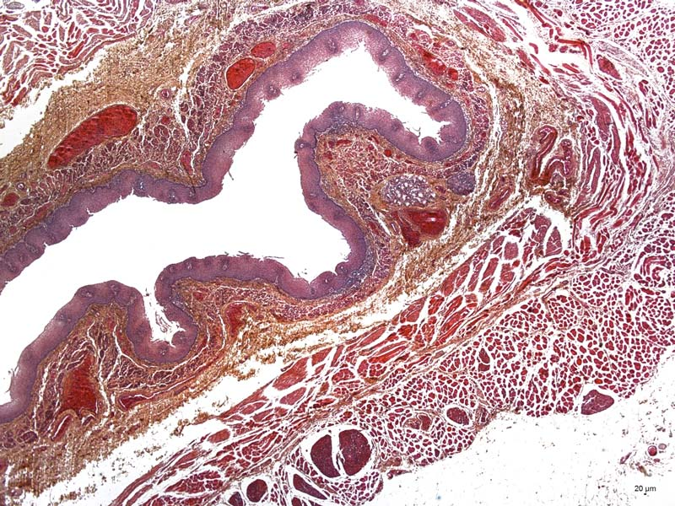
Loose connective tissue - Esophagus
Notes:
Esophagus – HES (saffron)

Slide 21
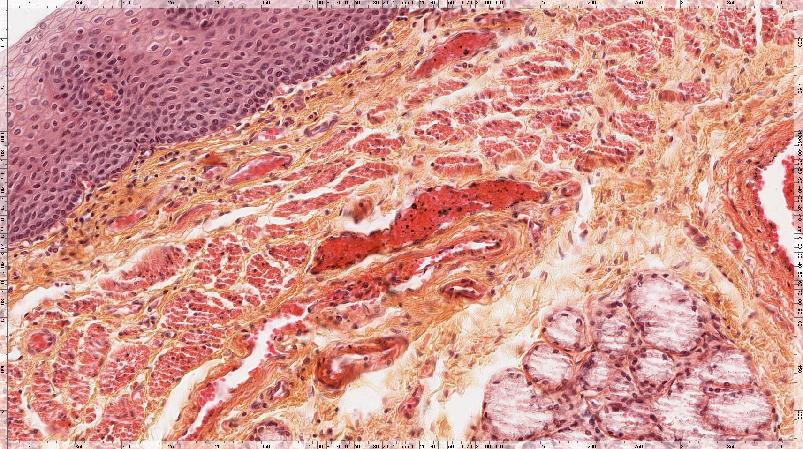
Loose connective tissue – mucosa, submucosa

Slide 22
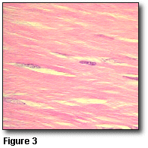
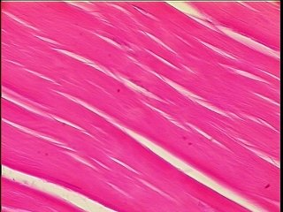
Connective tissue proper
Dense regular CT:
collagenous fibres packed in dense regular arrays, between which lie rows of cells.
examples of occurrence: in tendons, ligaments, (some also contain large amounts of elastic fibres and are called elastic ligaments), and aponeuroses.

Slide 23
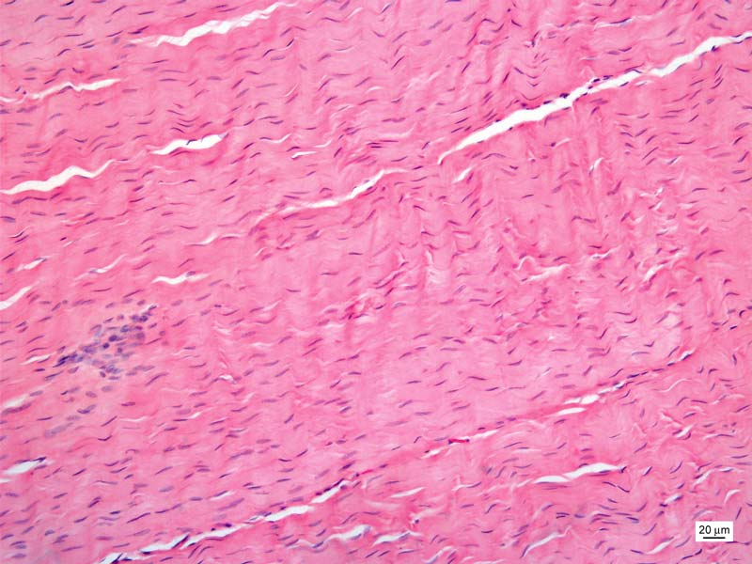
Dense connective tissue regularly arranged - Tendon

Slide 24
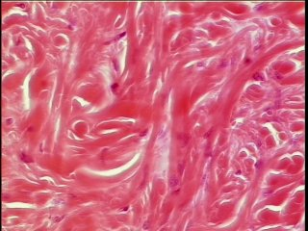
Connective tissue proper
Dense irregular CT:
collagenous fibres form a bundles running in various directions (hence irregular)
fibroblasts are usually the only cell type present
little ground substance is present.
examples of occurrence: is found on the outside of many organs as fibrous capsule, in the dermis of the skin

Slide 25
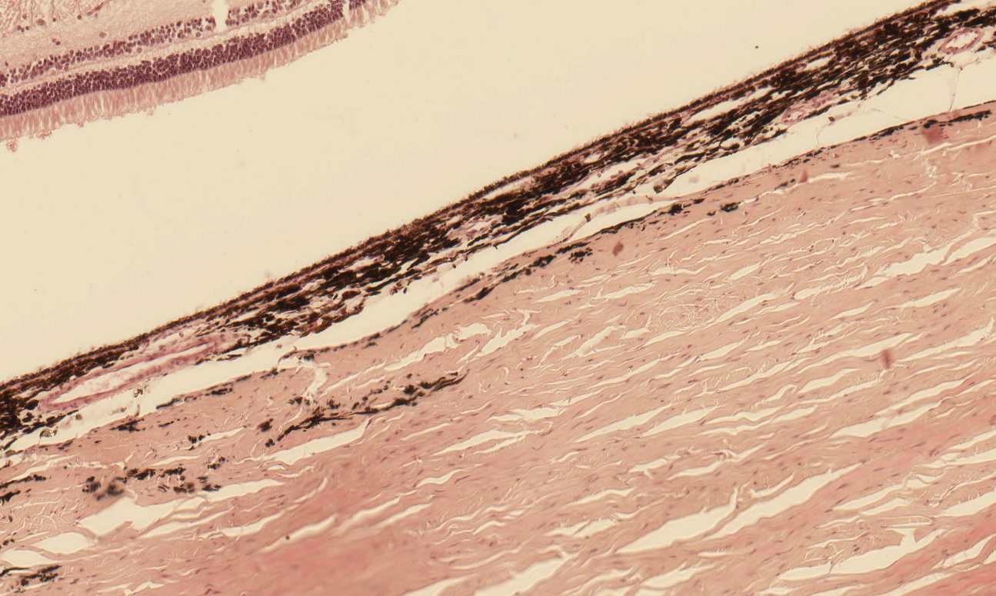
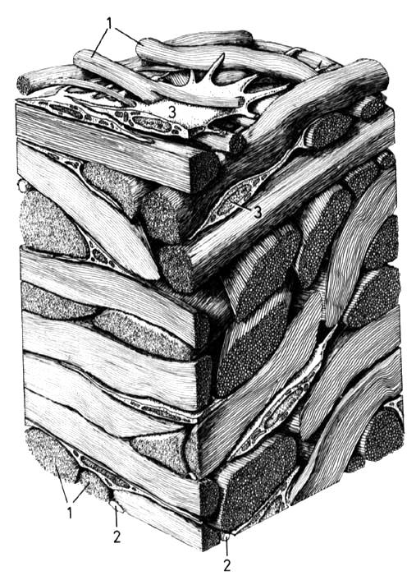
Dense connective tissue irregularly arranged - Sclera
http://jmugica2003.blogspot.cz/

Slide 26
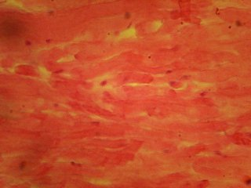
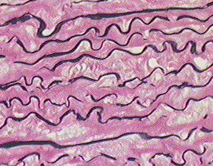
Connective tissue proper
Elastic CT:
bundles of elastic fibres (elastin causes yellow colour of CT)
cells and ground substance are scarce
mechanical functions
examples of occurrence: ligamenta flava (spinal column), vocal ligaments
elastic fibres are present as elastic membranes in the wall of blood vessels (selectivel staining  )

Slide 27
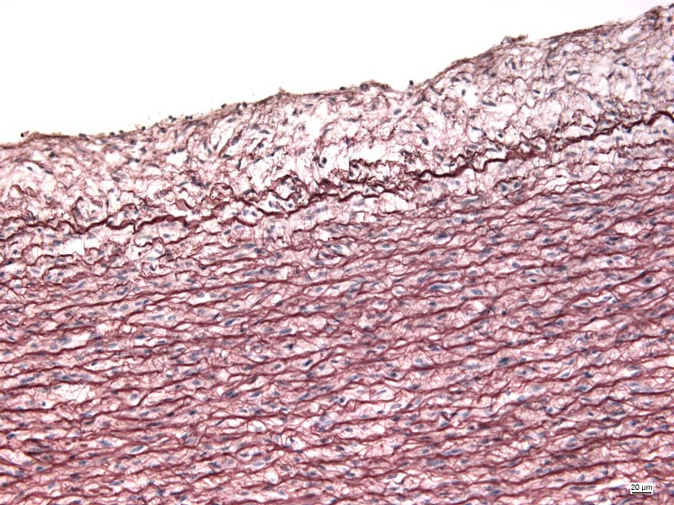
Elastic membranes - Aorta
Notes:
Aorta - orcein

Slide 28
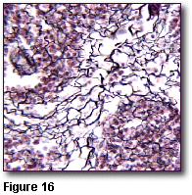
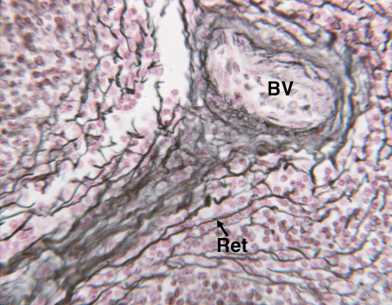
Connective tissue proper
Reticular CT:
consists of reticular cells and reticular fibres
serves as supporting network for free cells (lymfocytes or hematopoietic cells)
examples of occurrence: some lymph organs, bone marrow

Slide 29
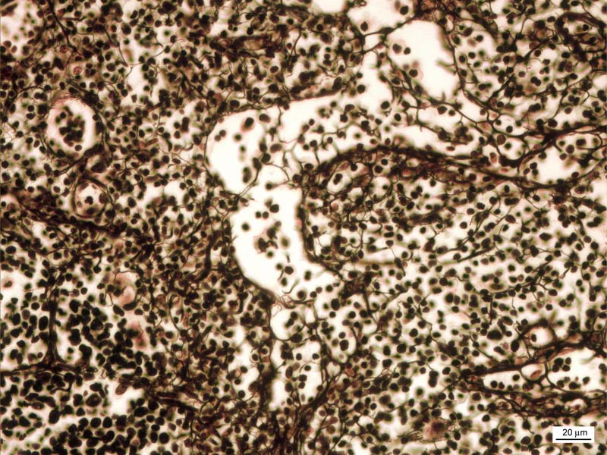
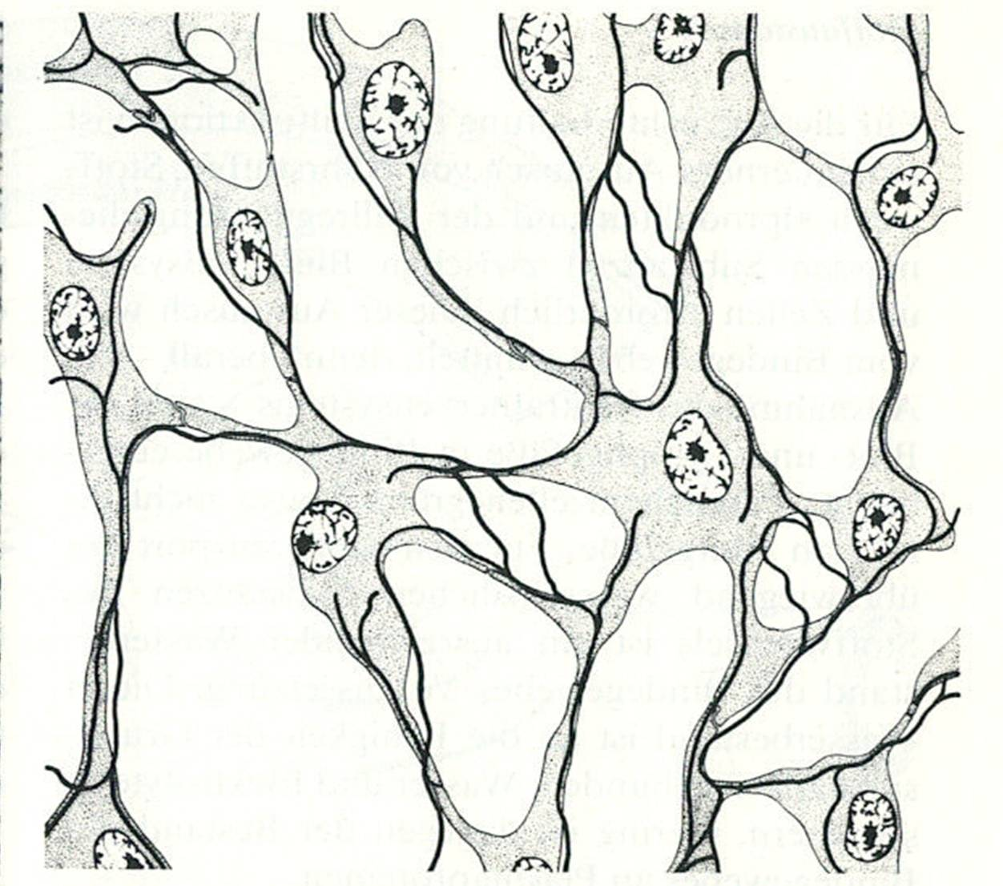
Reticular tissue – Lien (impregnation)
http://quizlet.com
Notes:
Lien - impregnation

Slide 30
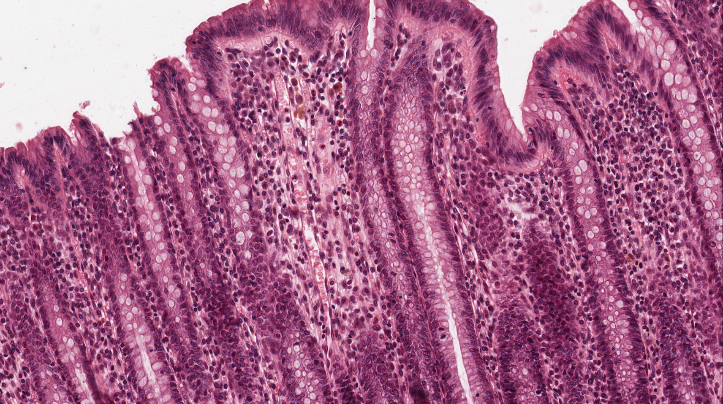
Reticular connective tissue - intestinum crassum (HE)

Slide 31
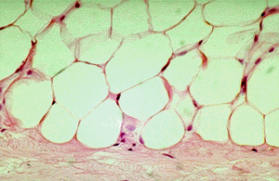
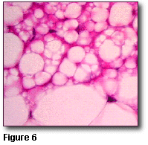
Connective tissue proper
Adipose CT:
adipocytes are specialized to store fat, are found throughout loose connective tissue
adipocytes are the predominant cell present, the tissue is called adipose tissue
in white or unilocular fat, adipocytes contain a single, large lipid droplet surrounded by a thin layer of cytoplasm. The lipid mass compresses the nucleus to an eccentric position, producing a "signet ring" appearance.
A different kind of adipose tissue is known as brown or multilocular fat, contains fat droplets of varying sizes. The cells are smaller than those of white fat, with an eccentric round nucleus. Brown fat has a very limited distribution in adult humans, but is found in many animals. In hibernating animals, the oxidation of brown fat warms the blood flowing through it during arousal from hibernation. Human newborns, whose large surface to volume ratio can result in heat loss, also have a lot of brown fat. Most of it disappears during the first decade of life.

Slide 32
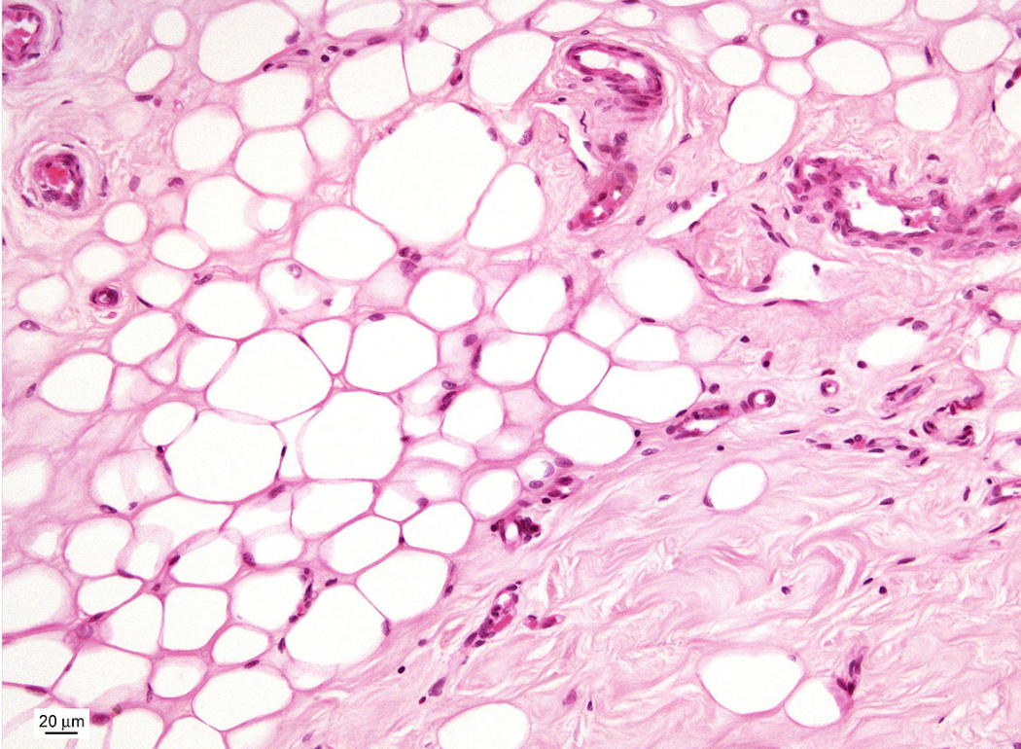
Adipocytes
Notes:
Adipose tissue – mamma non lactans

Slide 33
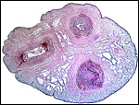
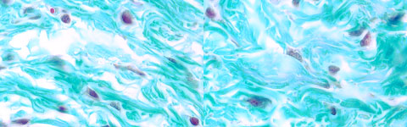
Connective tissue proper
Mucose CT = Wharton´s jelly
present in the umbilical cord (in adults is found in the iris of the eye and in dental pulp of deciduous teeth.)
- the ground substance is more viscous or jelly-like than in mesenchyme, fibroblasts are the predominant cell type, and the number of fibres increases with age.

Slide 34
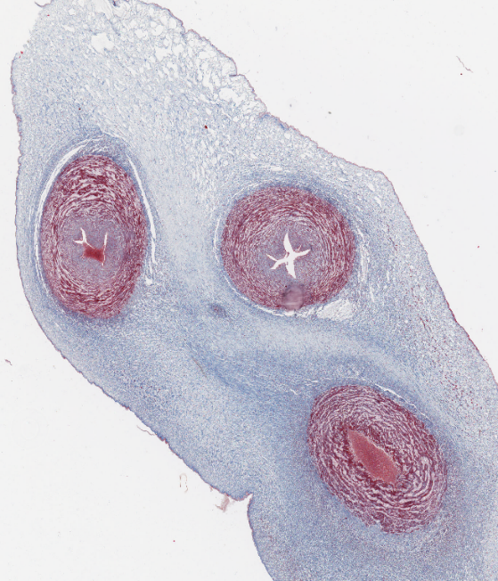
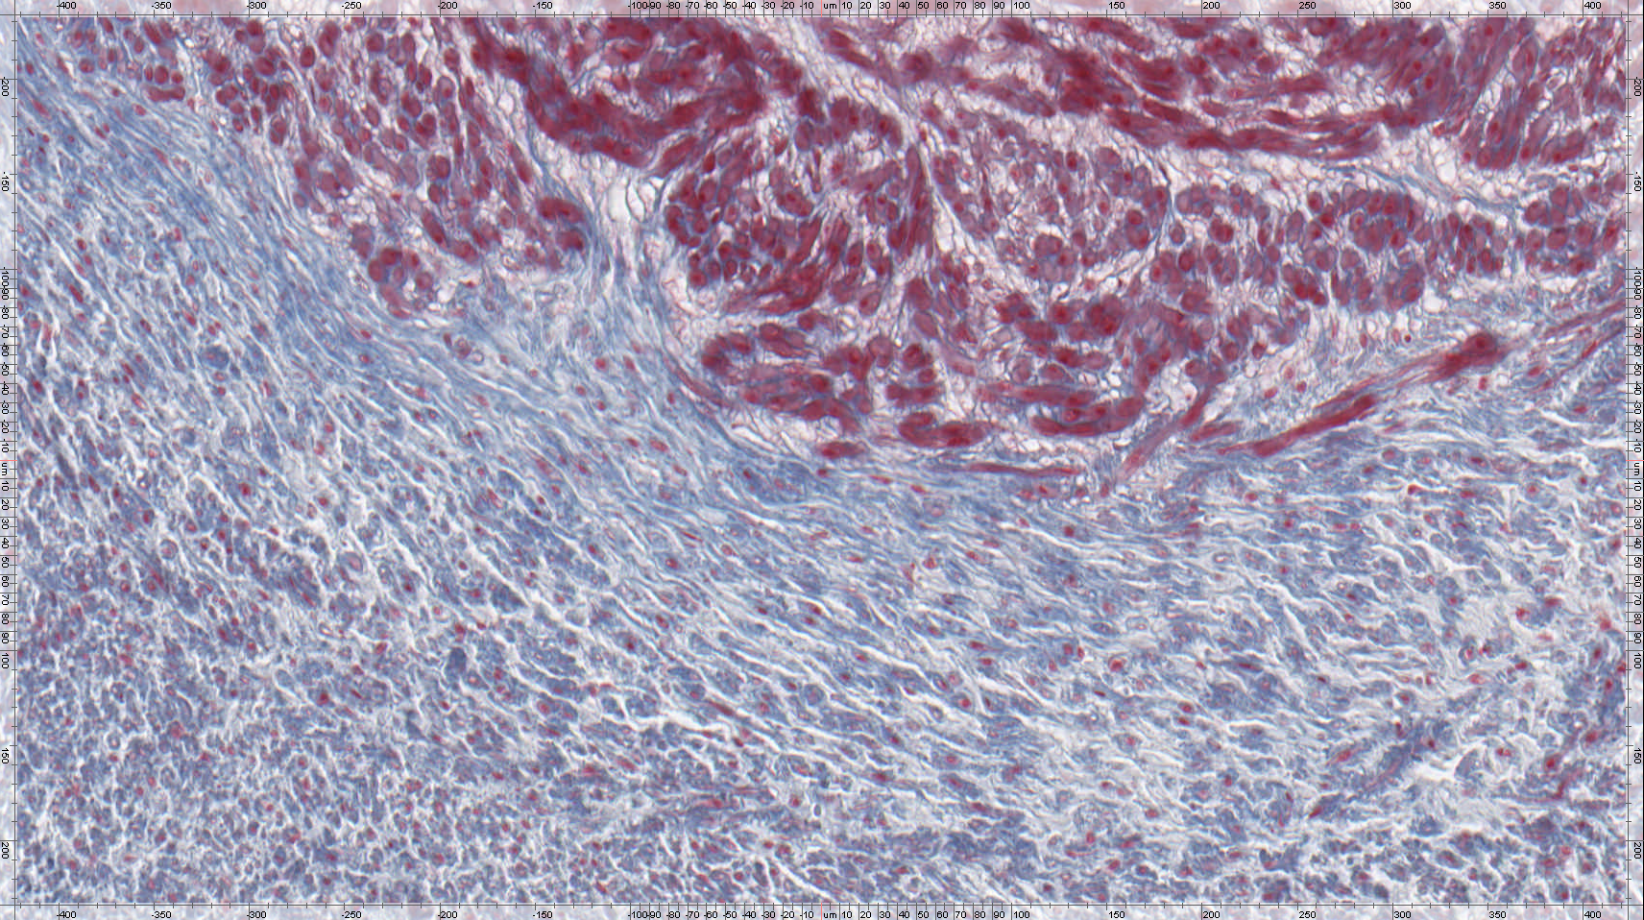
Wharton´s jelly – Funiculus umbilicalis
Nuclei of fibrocytes - violet
Collagen fibers - blue
Notes:
Funiculus umbilicalis - AZAN

Slide 35
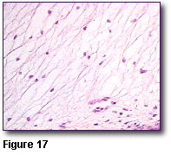
Connective tissue proper
Mesenchyme:
- contains fairly uniform appearing, small spindle-shaped cells whose processes extend and contact those of other cells to form a three dimensional cellular network, ground substance fills the intercellular spaces, fibres are present, but are very fine and sparse.

Slide 36
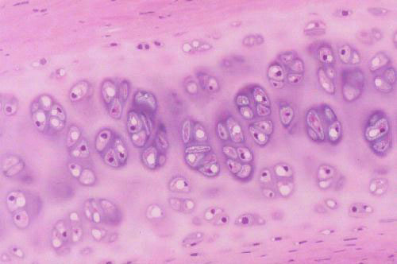
Cartilage
type of connective tissue whose cells, called chondrocytes, secrete extracellular substances of ground mater and proteins of collagen or elastic fibres

Slide 37
Cartilage
Consists of :
chondrocytes (and chondroblasts) in lacunae
extracellular matrix.
  MATRIX: Consists of FIBERS + GROUND SUBSTANCE
    ground substance: Consists of glycosaminoglycans - hyaluronic acid, keratan sulfate, chondroitin sulfate.
    basophilia of matrix is due to to the glycosaminoglycans
    AVASCULAR: All cartilage does not contain blood vessels
    nutrients are received via passive diffusion from blood vessels in the perichondrium.
  PERICHONDRIUM: Dense connective tissue (capsule) around the cartilage.
    is not found on the articular surfaces of long bones and on the surface of fibrocartilage.
    contains blood vessels which provides nutrients to the cartilage.

Slide 38
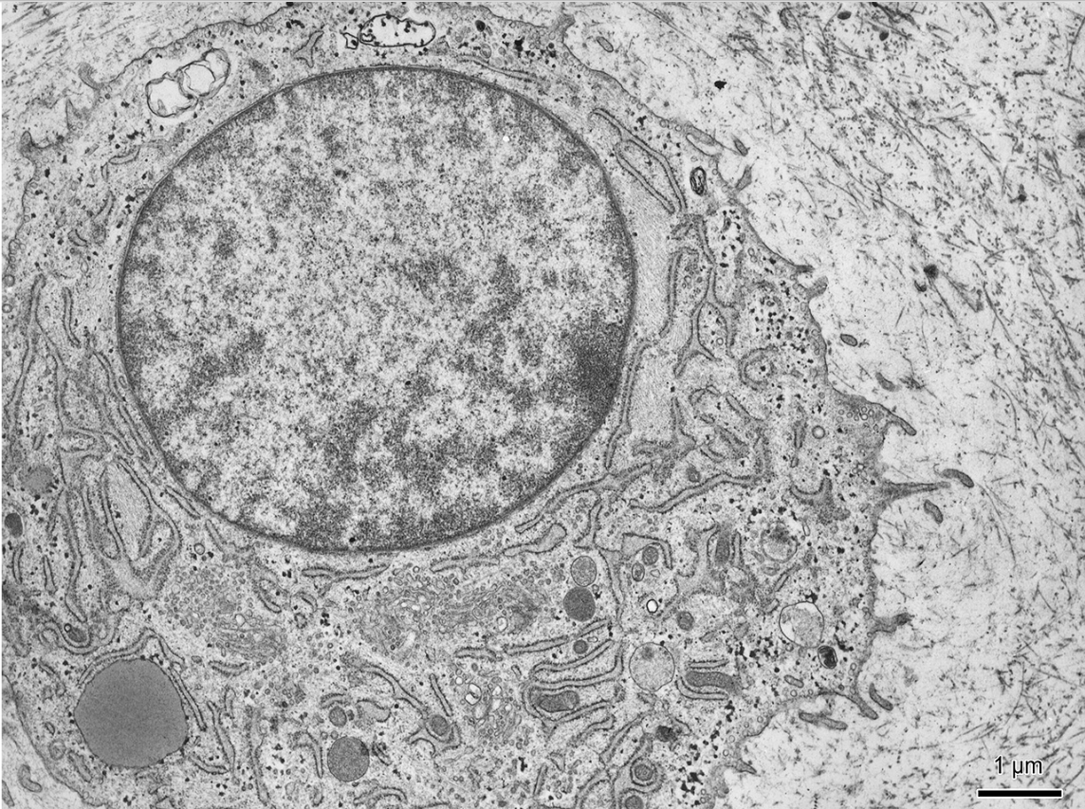
Chondrocyte

Slide 39
Cartilage
  CHONDROCYTES (and chondroblasts): are located within little caves called lacunae, which they fill during life, during tissue preparation, chondrocytes shrink and frequently fall out, and lacuna appear only partially filled or empty.
    - they have lots of ER and secrete the extracellular matrix components .
      produce matrix components: 1) glycosaminoglycans - hyaluronic acid, keratan sulfate, chondroitin sulfate, 2) chondronectin (increases adhesiveness of chondrocytes to matrix) .
      produce proteins of fibers (collagen II or elastin). Collagen fibers are not distinguishable in slides as their refractive index is almost identical to that of the ground substance.
  DEVELOPMENT: Mesenchymal cells aggregate to start formation. The Perichondrium is formed.
    INTERSTITIAL GROWTH: Formation of isogenous groups leads to an expansion of the cartilage from within the cartilage (isogenous groups are mitotic clusters of chondrocytes in mature cartilage, formed by interstitial growth during cartilage development
    APPOSITIONAL GROWTH: Adding cells from the Perichondrium. Layers from the perichondrium are added from the outside perimeter.
  CARTILAGE REGENERATION: Regeneration is limited because cartilage is avascular.
  (some appositional regeneration can occur from chondroblasts around the periphery)

Slide 40
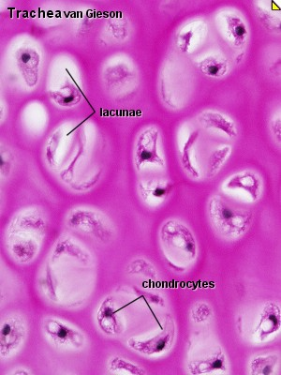
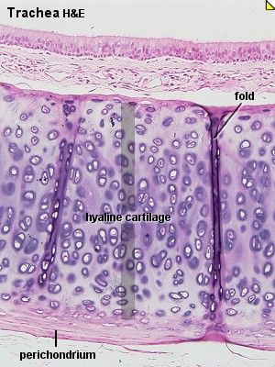
Cartilage - types
  HYALINE CARTILAGE: most common, basic type
  FIBERS: Collagen Type II (Cartilaginous Collagen)
  Chondrocytes form isogenic groups, ground substance around them shows an intensive basophilia and so forms basophilic capsule – isogenic group + basophilic capsule = chondron or teritorium, ground substance among them = interteritorium
    DISTRIBUTION:
      Nasal cartilage
      Trachea, bronchi, large cartilages of larynx
      Articular ends of bones

Slide 41
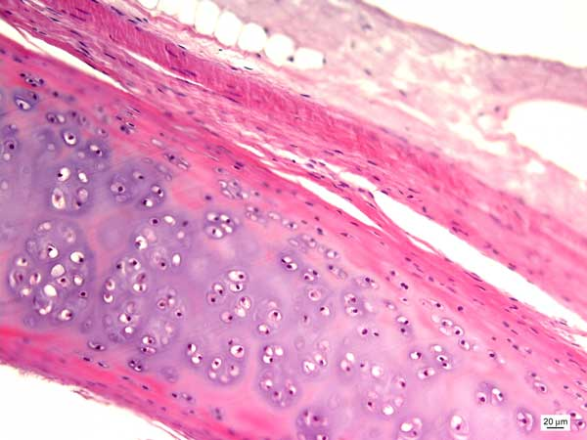
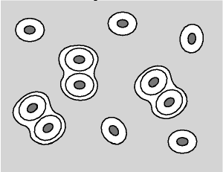
Hyaline cartilage - trachea (HE)
http://www3.delta.edu/

Slide 42
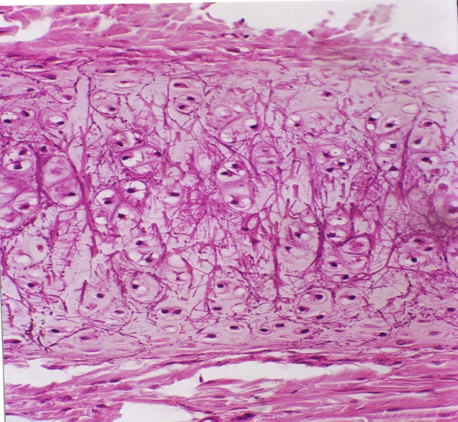
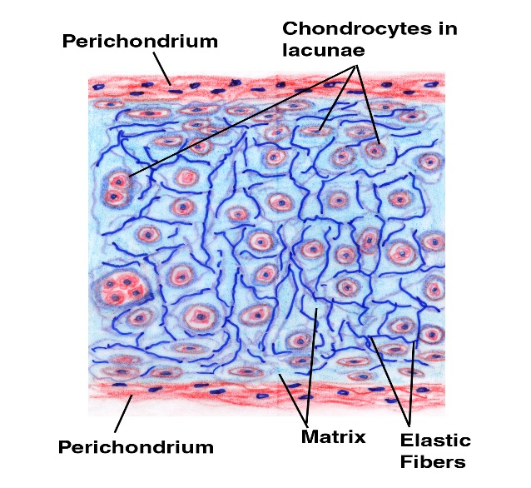
Cartilage - types
  ELASTIC CARTILAGE:
    FIBERS: Elastins (proteins of elastic fibers)
    Chondrocytes (in lacunae) are dispersed difusely, are not arranged in isogenic groups.
    MICROSCOPIC APPEARANCE: Under low light, when you focus in and out, you can see refraction of the elastic fibers under the microscope. Elastic fibers can be visualized by staining with orcein or resorcin fuchsin.
    DISTRIBUTION:
      Auditory tube + auricle of ear
      Epiglottis
      Small laryngeal cartilages

Slide 43


Elastic cartilage – auricula (HE)
http://www3.delta.edu/

Slide 44

Elastic cartilage (fuchsin)
perichondrium

Slide 45


Cartilage - types
  FIBROCARTILAGE: Found in places where high stress occurs.
    DISTRIBUTION: It never occurs alone. It is closely associated with either dense connective tissue or with hyaline cartilage.
      Intervertebral Disks
      Articular Disks
      Pubic Symphysis
    STRUCTURE: It has no perichondrium
    GROWTH: It grows more like connective tissue (i.e. interstitial growth) due to the absence of a perichondrium.
    FIBERS: Collagen Type I
    Chondrocytes are not numerous, they are flattened and arranged in rows due to press of thich bundles of collagen fibers.

Slide 46


Fibrocartilage – intervertebral disc (HE)
http://www3.delta.edu/

Slide 47


Slide 48

Light microscope
Eyepieces
Objective lens
Stage with speciment holder
On/Off
Light control
Condenser and Iris aperture
Stage controls
Coarse focus
Fine focus
Light source with diaphragm

Slide 49
Instructions
• Turn on the light.
• Start with the 4x objective.
• Put the slide on the stage – cover glass must be above
• Look through the scope and focus. Use the coarse focus knob at first, until the image is more or less in focus; then switch to the fine focus.
• Adjust the light. Not too bright, not too dim.
• Adjust the oculars.
• Switch to the 10x objective. A slight adjustment with the fine focus knob should get it just right. If you lose the focus and can't see your specimen at all, go back to the 4x and start again.
• Switch to the 40x objective if you want to see more detail. Don't use the 100x!
• When you want to look at a new slide, switch back to the 4x before changing slides.
• Only one slide is out of the box at the moment! Do not remove more!
• When you're done with the scope, switch to the 4x and turn the light all the way down before turning it off.
• At the end of lesson, the box with slides is checked in your presence before you leave your place

Slide 50

Various shapes on different sections of tubular structures
Cross section
Longitudinal section
Oblique section

Slide 51
Connective tissue proper:
Slides:
Wharton´s jelly (99. Funiculus umbilicalis)
Loose (areolar) connective tissue (11. Esophagus)
Dense connective tissue - irregular (89. Posterior part of the eye)
Reticular tissue (68. Lien – impregnation)
Elastic membranes (62. Aorta)
Atlas EM:
Fibroblast (42)
Plasma cell (43)
Mast cell (44)
Collagen fibers (42, 44)

