Slide 1
Nervous tissue

Slide 2
Nervous tissue
Neurons
Glial cells
CNS: oligodendrocytes, astrocytes, ependymal cells, microglia
PNS: satellite cells, Schwann´s cells
Synapse
Myelin sheat

Slide 3
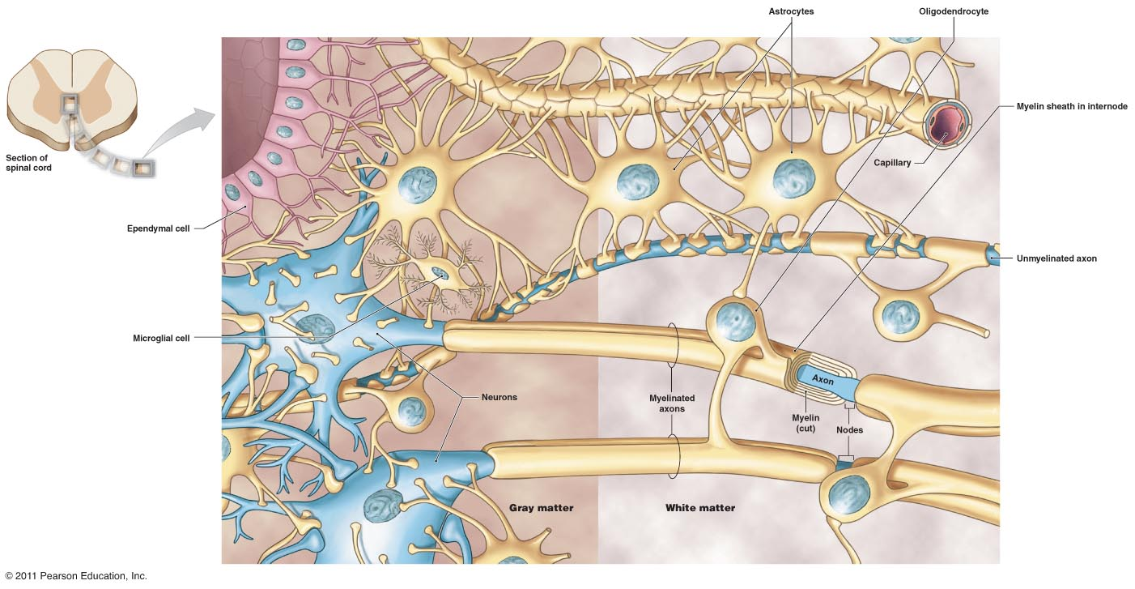
Nervous tissue

Slide 4
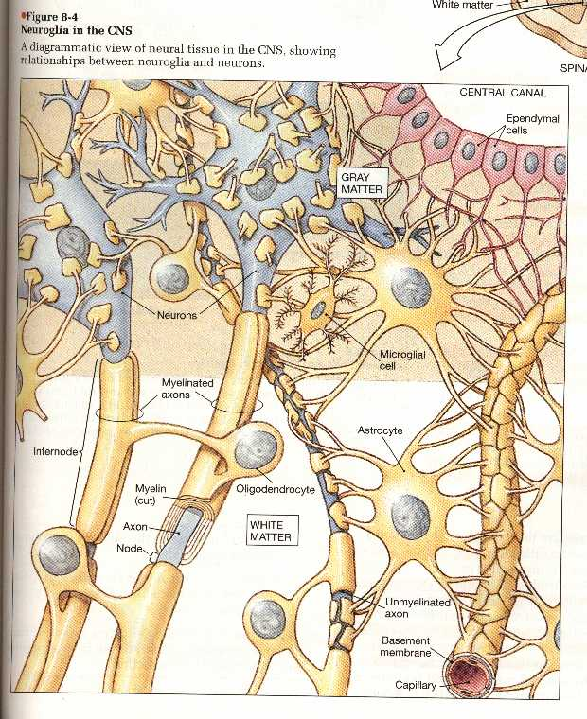

Slide 5
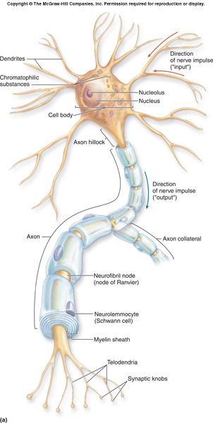
Neuron
Nerve cells are very variable in appearance, shape and size
- cell body - called soma or perikarion
- processes extending from the nerve cell to communicate with other cells
there are two types of processes:
dendrites (receive impulses )
axons (neurits) (transmit impulses )
All nerve cells have one axon, which is usually the longest process that extends from the cell and one or more (hundreds) dendrites(shorter and thicker than the axon)
Synapse - the junction where a nerve cell communicates with another nerve cell or an effector cell (eg. muscle fibre), can be chemical and electric
Neurotransmitter – substance at the terminal part of the axon with chemical synapses releases substances which acts on the membrane of the other cell

Slide 6
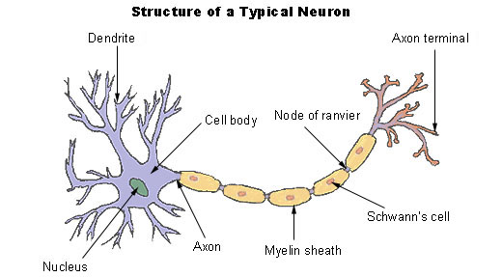
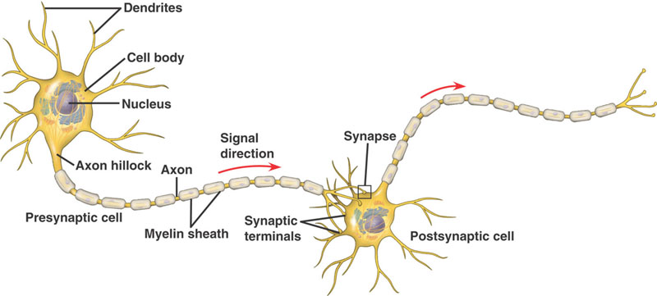
Main parts of neuron Dendrites Cell body Axon (neurit) Axon terminal

Slide 7
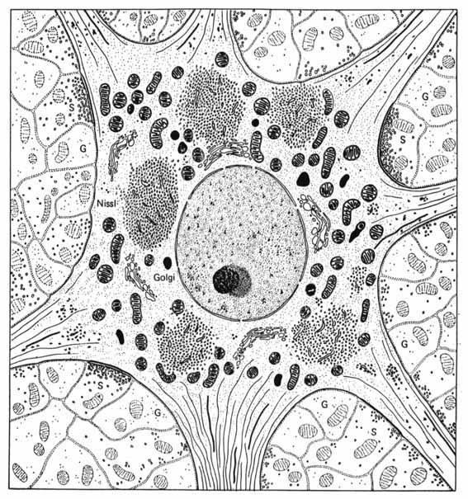
Perikaryon
Cell body – PERIKARION: contains nucleus and most cytoplasm with organelles:
nucleus – round or oval, very light, with prominent nucleolus
rough ER (called Nissl´ substance) – involved in synthesis of proteins (neurotransmitters)
other usual organelles (mitochondria, Golgi apparatus, lysosomes)
neurofibrils – neurofilaments and neurotubules
pigment lipofuscin

Slide 8
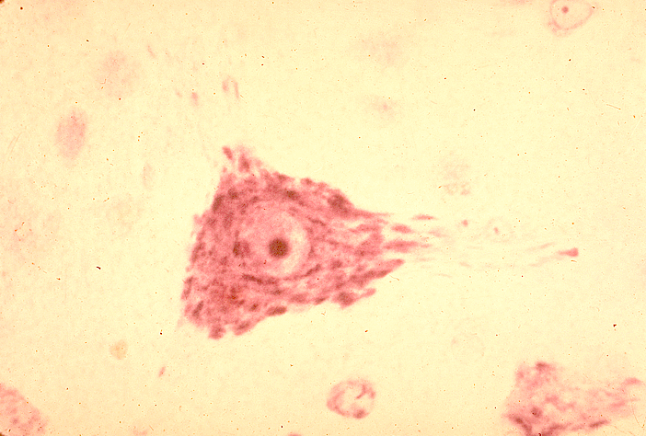
perikaryon (pyramidová buňka z cortex cerebri)
Nissl substance
axon
dendrite
nucleolus
nucleus

Slide 9
Perikaryon
Cells of Cajal
Cortex of brain
Purkynje cells
cerrebellum
Spinal ganglia neuron
Motoric neurons
Spinal cord
Pyramidal cells
Cortex of brain

Slide 10
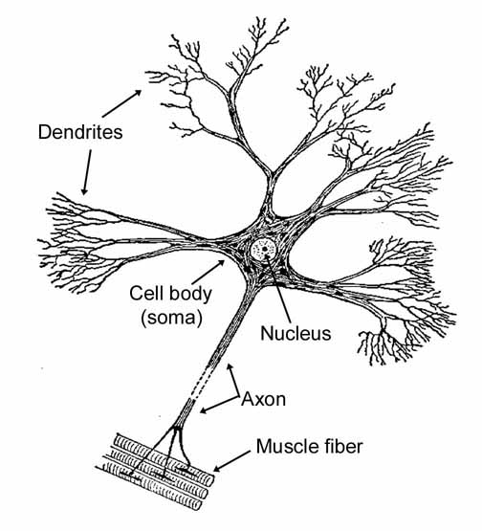
Dendrites
Dendrites – input structure – receive signals; number of dendrites: one – several hundreds
short, branched processes with structure similar to perikarion (cytoplasm + organelles + neurofibrils)
incoming signals summate to initiate action potential highly branched tree structure

Slide 11
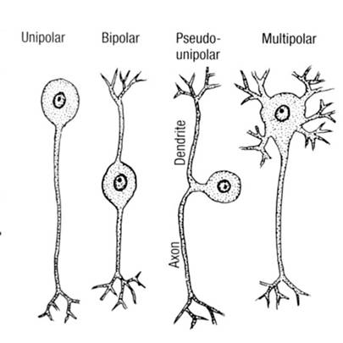
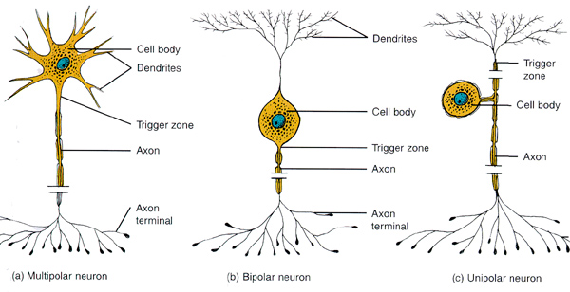
Classification of neurons according to number of processes (dendrites):
  Multipolar neuron – several dendrites extend from body found in brain & spinal cord
  Bipolar neuron – one dendrite and one axon (in retina of eye)
  Unipolar neuron – one process only, link to axon (sensory neurons)
  Pseudounipolar neuron – one short process divides later into dendrite and axon (spinal ganglia)

Slide 12
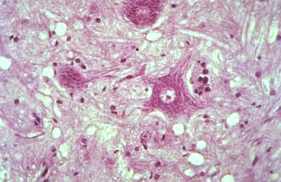
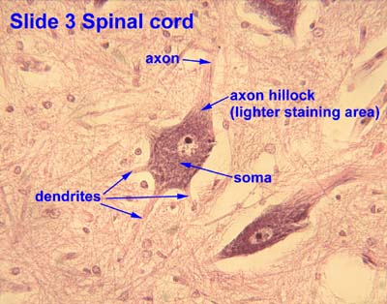
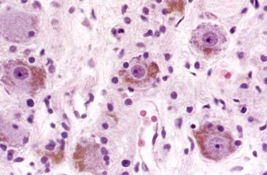
1
2
1, 2 – multipolar. neurons: Nissl bodies
3 – pseudounipolar neurons:lipofuscin
3

Slide 13
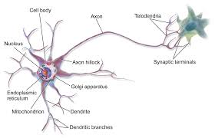
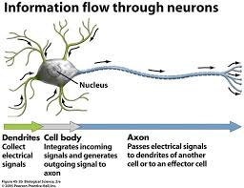
AXON – only one
no protein synthesis here
Trigger zone - where nerve impulses arise
Axon hillock – the cone-shaped base of the axon, its cytoplasm is free of rER (Nissl substance)
Axons terminal - end with fine branching with „terminal boutons“ – mitochondria and synaptic vesicles containing neurotransmitters
Axon hillock and terminal are not covered with oligodendrocytes (in CNS) or Schwann cells (in PNS)
Serves for impulses transmission and for axonal transport of neurotransmitters and nutrients

Slide 14
Classification of neurons according to length of axon:
    Golgi type I – long axon (up to 1 m) – somatic motor neurons
    Golgi type II - short axon (in μm)
Classification of neurons according to function:
sensitive neurons – (afferent) conduct informations from receptors to CNS
motor neurons – (efferent) conduct infirmations from CNS to effector cells: somatomotor to skeletal muscle and visceromotor to smooth muscle cells, cardiomyocytes or glandular cells
interneurons (97 %)

Slide 15
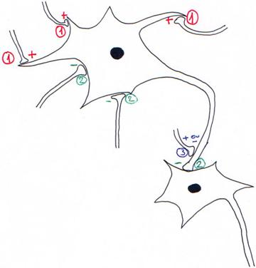
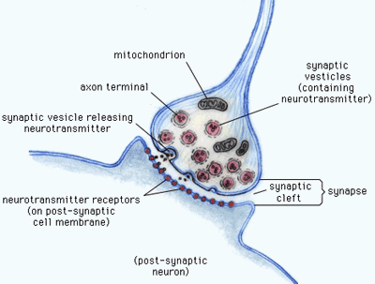
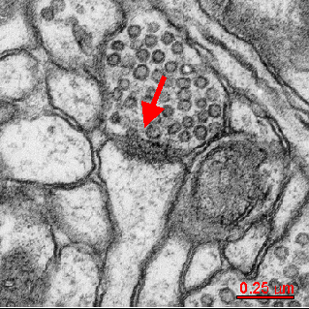
Synapses
NEURON – NEURON
Presynaptic neuron - conducts signal to a synapse // synaptic vesicles with neurotransmiter
Synaptic cleft (20-30 nm thick)
Postsynaptic neuron - conducts signal from a synapse // receptors on cell membrane
Axodendritic (1)
Axosomatic (2)
Axoaxonal (3)
Dendrodendritic synapses

Slide 16
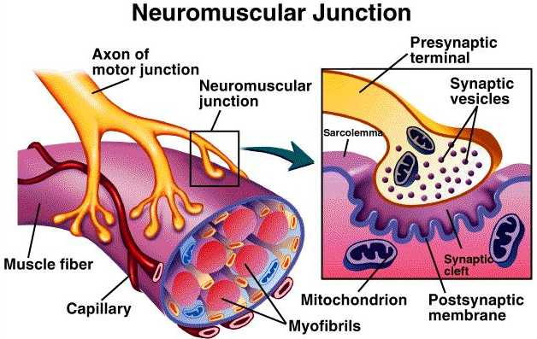
NEURON – EFFECTOR CELL
Effector cells – muscle cells (in smooth muscle = neuromuscular spindle, in skeletal muscle = motor-end-plate), cardiomyocytes, glandular cells

Slide 17
Chemical Synapses
Presynaptic cell releases neurotransmitters from synaptic vesicles
Act on the postsynaptic cell (help initiate AP)
Neurotransmitters can excite or inhibit
Neurotransmitters (acetylcholine, serotonin, norepinepherine and epinephrin, dopamine, GABA, …)
Neurotransmiter must be removed to prevent continual firing of neurons
Enzymatically - acetylcholineresterase
Many pharmaceuticals and drugs modulate this effect
Cocaine block removal of dopamine
Electrical Synapses
Without synaptic vesicles; synaptic cleft – only 2 nm thick
Depolarizating wave continues from presynaptic to postsynaptic membrane
Morphologically (in electron microscope) it looks like communicatin intercellular connection: gap junction (nexus)

Slide 18
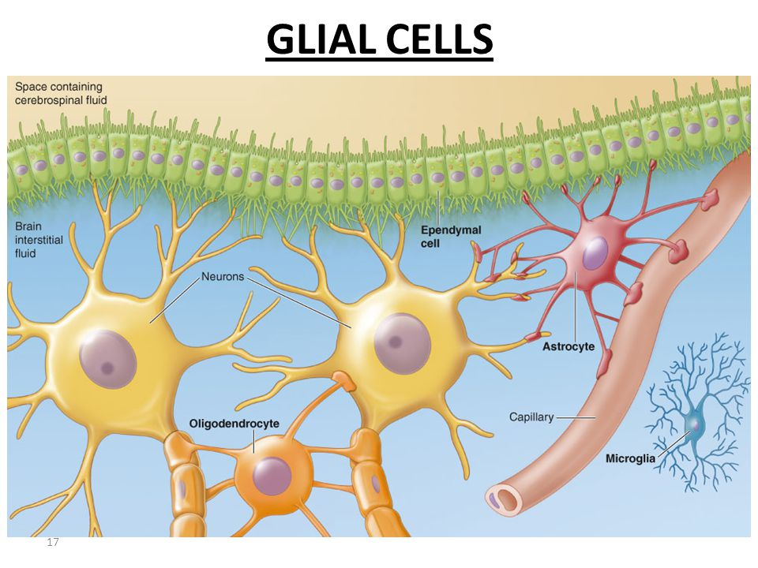
Support cells
essential to the function and survival of nerve cells
CNS and PNS each have their own specific types of support cells
Support cells in the CNS:
general term for support cells in the CNS is glia or neuroglia
here are four types of neuroglial cells. Oligodendrocytes - myelin-secreting cells of the CNS
Astrocytes - provide physical and metabolic support
for nerve cells
Microglia (microglial cells) - phagocytes of CNS
Ependyma (ependymal cells) - lining brain cavities
and central canal in spinal cord

Slide 19
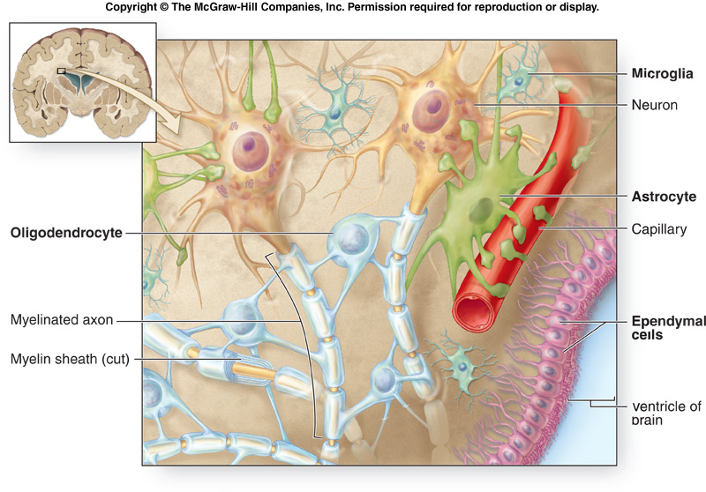
CENTRAL GLIA

Slide 20
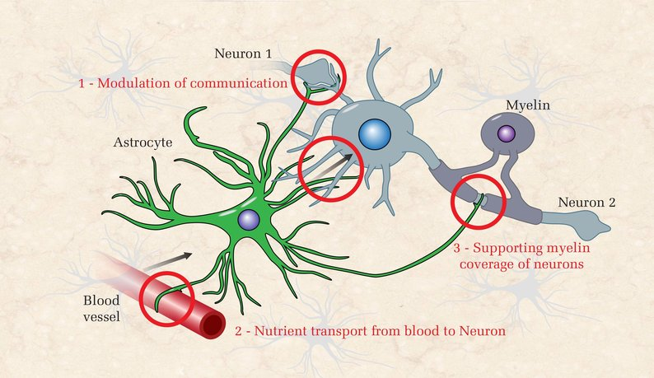
Astrocytes
the largest of the neuroglial cells with processes that extend between neurons and blood vessels
ends of the processes expand to form end feet, which cover large areas of the outer surface of the blood vessel or axolemma
play a role in the movement of metabolites and wastes to and from neurons
may be involved in regulating the tight junctions in the capillaries that form the blood-brain barrier
cover the bare areas of neurons, at nodes of Ranvier and synapses
two kinds of astrocytes are identified
protoplasmic
fibrous astrocytes, contain prominent bundles of intermediate filaments, but the filaments are more numerous in fibrous astrocytes. (fibrous astrocytes are more prevalent in white matter, protoplasmic ones in grey matter)

Slide 21
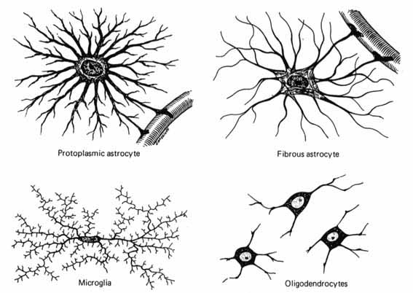

Slide 22
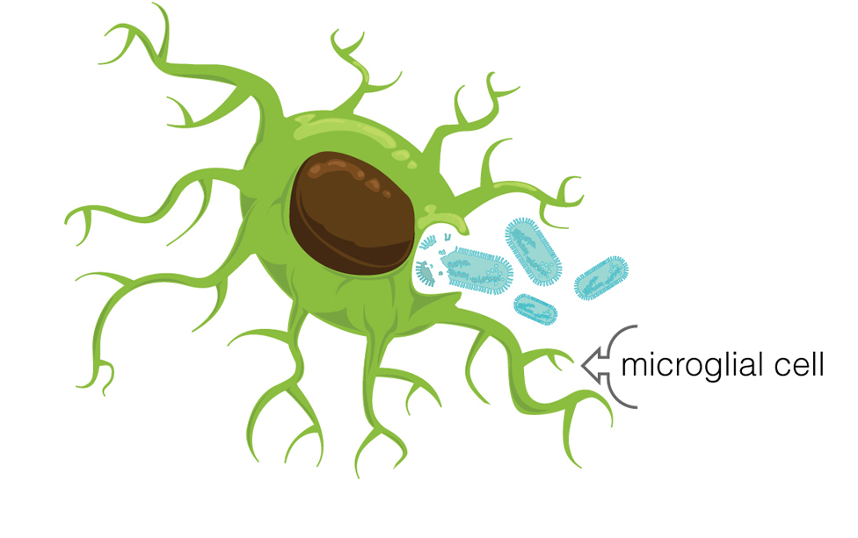
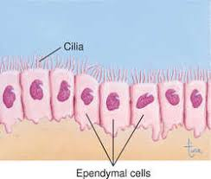
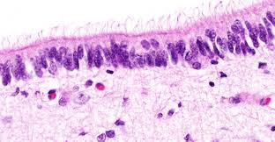
Microglia
- the smallest of the glial cells, with short twisted processes
are the phagocytes of the CNS, considered part of the mononuclear phagocytic system
are believed to originate in bone marrow and enter the CNS from the blood
In the adult CNS only in small numbers, but proliferate and become actively phagocytic in disease and injury.
Ependymal cells
cuboidal to columnar cells in one layer lining the fluid-filled
brain ventricles and central canal (canalis centralis) in spinal cord
is involved in cerebrospinal fluid production in som regions (choroid plexus)

Slide 23
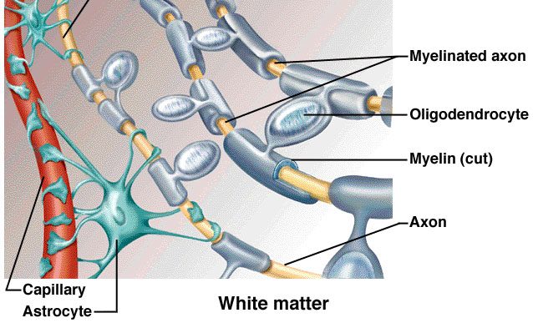
Oligodendrocytes
have few processes, found in rows between axons
the myelin sheath around axons is formed by concentric layers of oligodendrocytes plasma membrane -each oligodendrocyte gives off several tongue-like processes that contacts axon, where each process wraps itself around a portion of the axon, forming an internodal segment of myelin !!!
one oligodendrocyte may myelinate one axon or several, in the CNS, nodes of Ranvier (between myelinated regions) are larger than those of the PNS,and the larger amount of exposed axolemma makes saltatory conduction more efficient
Unmyelinated axons in the CNS are truly bare, that is they are not embedded in any glial cell process. (In contrast to the situation in the PNS, described below.)

Slide 25
Support cells in the PNS:
support cells of the PNS : satellite cells and Schwann cells
Satellite cells
surround the cell bodies of the neurons in ganglia
small cuboidal cells form a complete layer around the nerve cell body, but only their nuclei are visible in routine preparations
controll microenvironment around the nerve cell body, providing electrical insulation and a pathway for metabolic exchange
- nutrition and isolation of neurons in ganglia

Slide 26
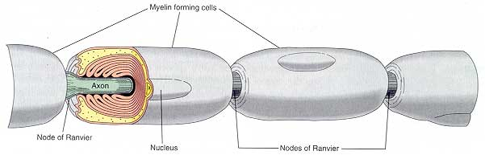
Schwann cells
- responsible for the myelination of axons in the PNS
( Schwann cell wraps itself, jelly roll-fashion, in a spiral around a short segment of an axon. During the wrapping, cytoplasm is squeezed out of the Schwann cell and the leaflets of plasma membrance of the concentric layers of the Schwann cell fuse, forming the layers of the myelin sheath. An axon's myelin sheath is segmented because it is formed by numerous Schwann cells arrayed in sequence along the axon. The junction where two Schwann cells meet has no myelin and is called the node of Ranvier (the areas covered by Schwann cells being the internodal regions).

Slide 27
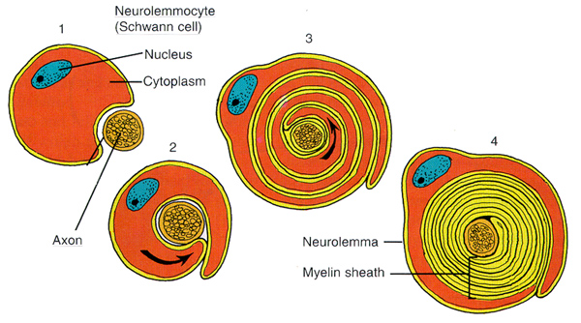
Sheaths of axons:
Schwann sheath (neurilemma) – Schwann cells surround the axon (gray fibers)
Myelin sheath – lipoprotein product of Schwann cells in PNS and oligodendrocytes in CNS - electrically insulates axon - inreases speed of nerve impulse - wraps around one axon many times and has a lamellar appearance
Many axons are wrapped in a lipid-rich covering called myelin. This myelin sheath insulates the axon from the surrounding extracellular component and increases the rate of electrical conduction. The myelin sheath is discontinuous at intervals called the nodes of Ranvier. The area covered with myelin is called internodal area (internodium). In myelinated axons, the voltage reversal (that is, the impulse propagation) can occur only at the nodes, and the impulse "jumps" from node to node. This is called saltatory conduction. In unmyelinated axons, the impulse is conducted more slowly, moving as a wave of voltage reversal along the axon.

Slide 28
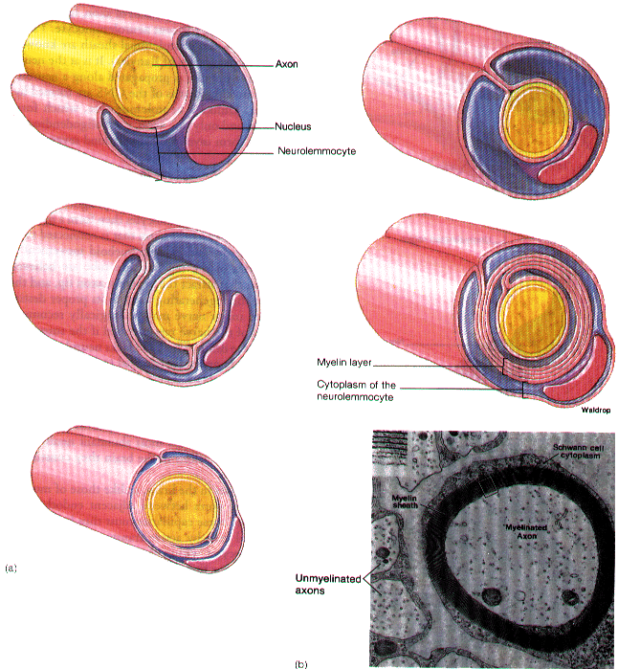
The lack of Schwann cell cytoplasm in the concentric rings of the myelin sheath is what makes it lipid-rich. Schwann cell cytoplasm is however found in several locations. There is an inner collar of Schwann cell cytoplasm between the axon and the myelin, and an outer collar around the myelin. The outer collar is also called the sheath of Schwann or neurilemma, and contains the nucleus and most of the organelles of the Schwann cell. The node of Ranvier is also covered with Schwann cell cytoplasm, and this is the area where the plasma membranes of adjacent Schwann cells meet. (These adjacent plasma membranes are not tightly apposed at the node, so that extracellular fluid has free acess to the neuronal plasma membrane.) Finally, small islands of Schwann cell cytoplasm persist within successive layers of the myelin sheath, these islands are called Schmidt-Lanterman clefts.
Myelination (development of myelin sheath):

Slide 29
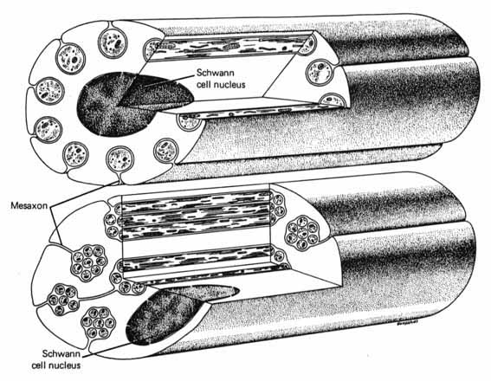
Not all nerve fibres is the PNS are covered with myelin, some axons are unmyelinated. In contrast to the situation in the CNS, unmyelinated fibres in the PNS are not completely bare, but are enveloped in Schwann cell cytoplasm. The Schwann cells are elongated in parallel to the long axis of the axons, which fit into grooves on the surface of the Schwann cell. One axon or a group of axons may be enclosed in a single groove. Schwann cells may have only one or up to twenty grooves. Single grooves are more common in the autonomic nervous system.

Slide 30
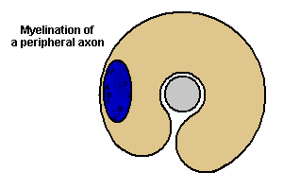
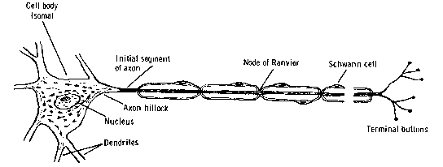
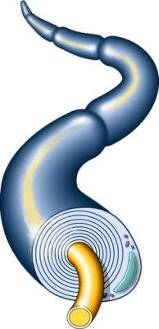
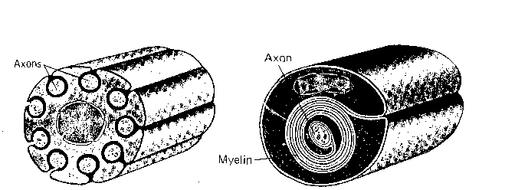
PERIFERNÍ GLIE: SCHWANNOVY BUŇKY

Slide 31
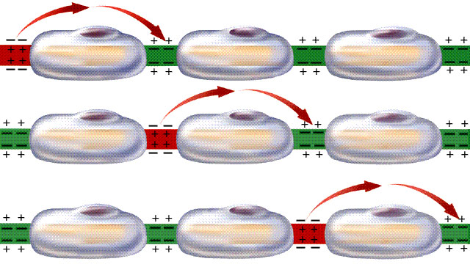

Slide 32
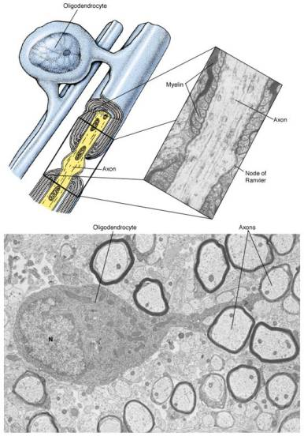
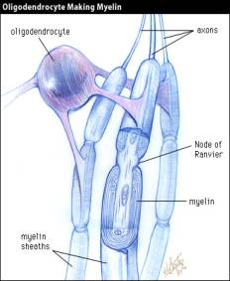
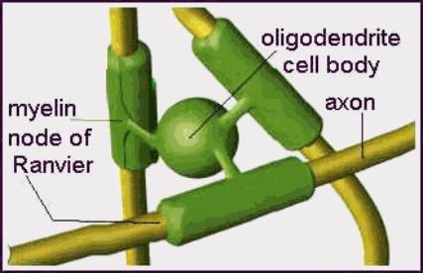
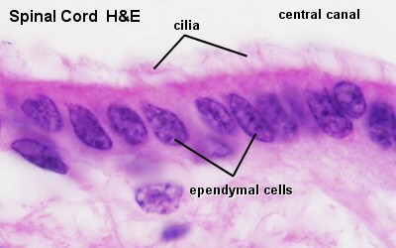

Slide 33
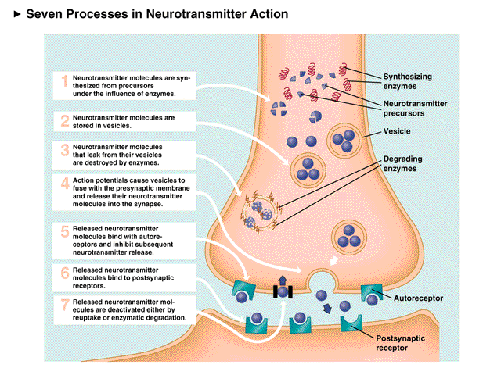

Slide 34
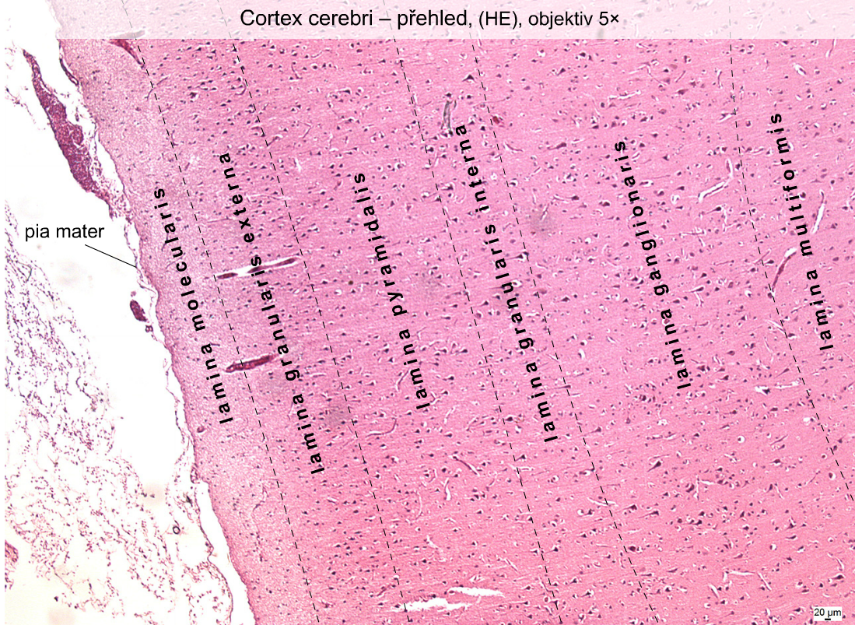

Slide 35
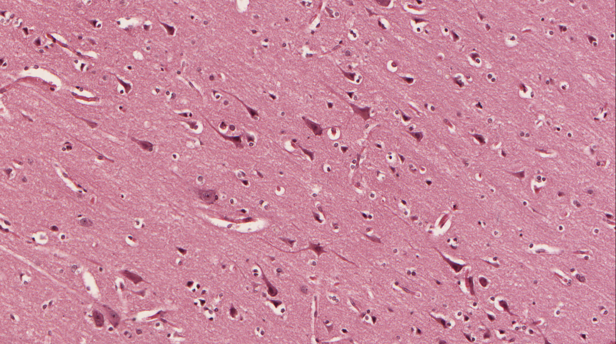
Cortex cerebri – Pyramidal cells – multipolar neurons

Slide 36
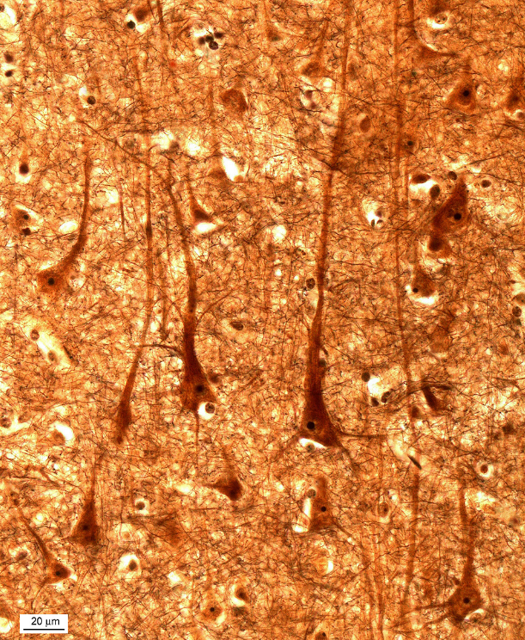
Cortex cerebri – Pyramidal cells – multipolar neurons

Slide 37
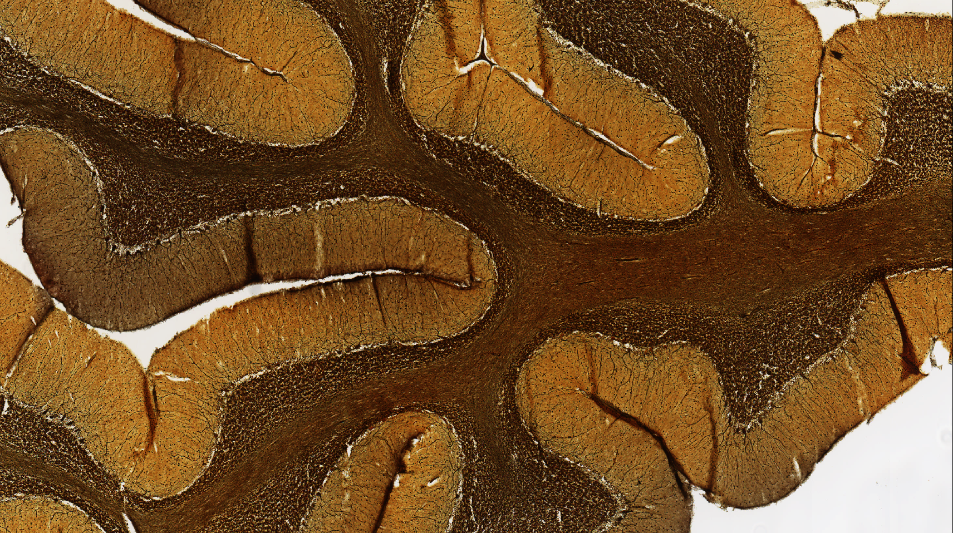
Cerebellum

Slide 38
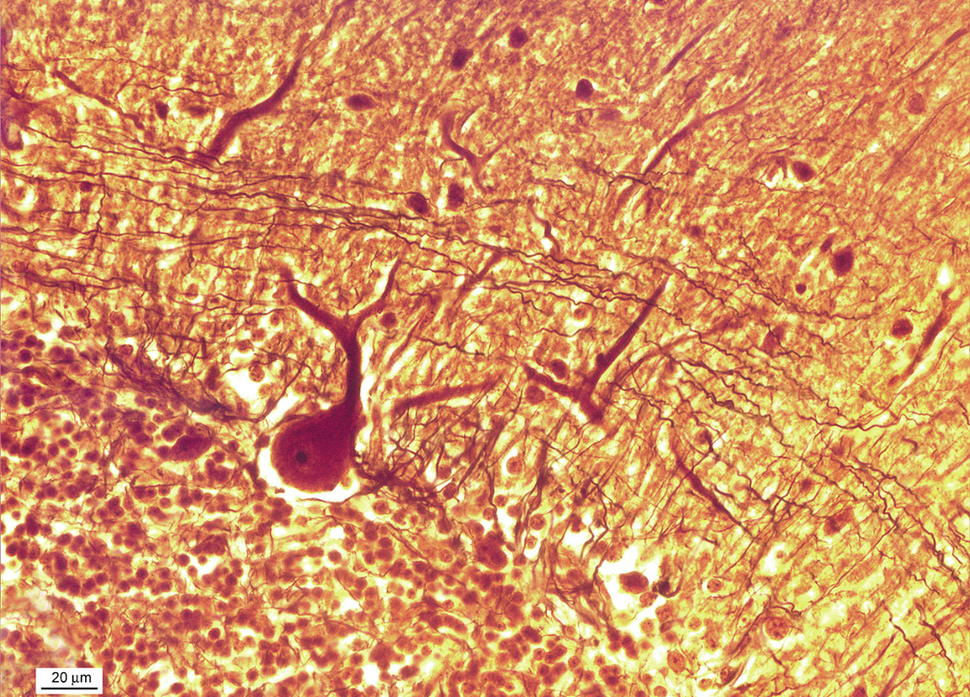
Cerebellum – Purkynje cell

Slide 39
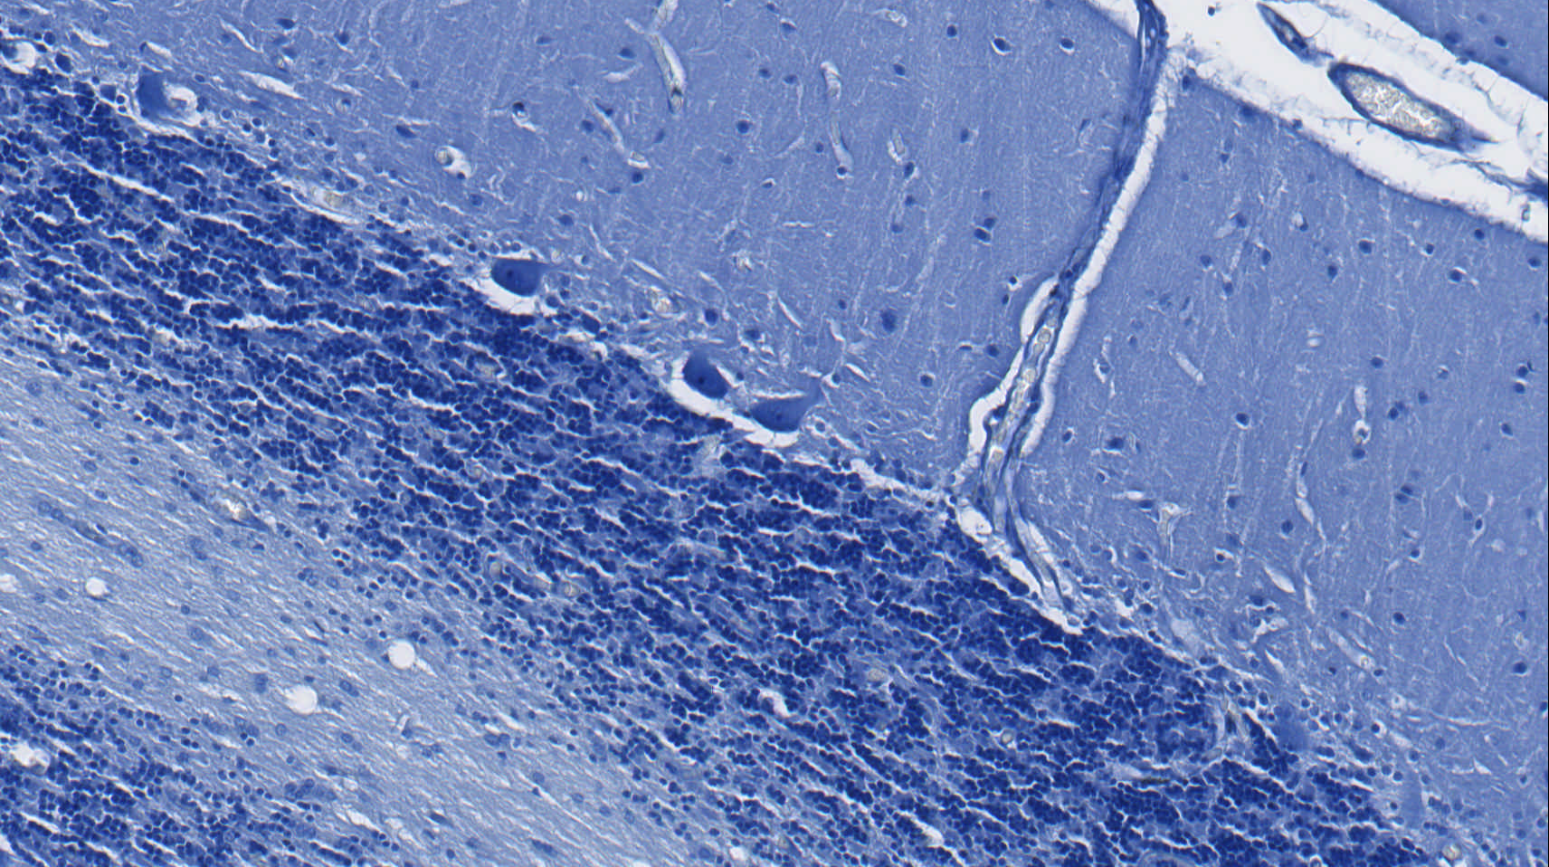
Cerebellum - Nissl bodies
Notes:
Nisslova substance – Purkyňovy buňky mozečku

Slide 40
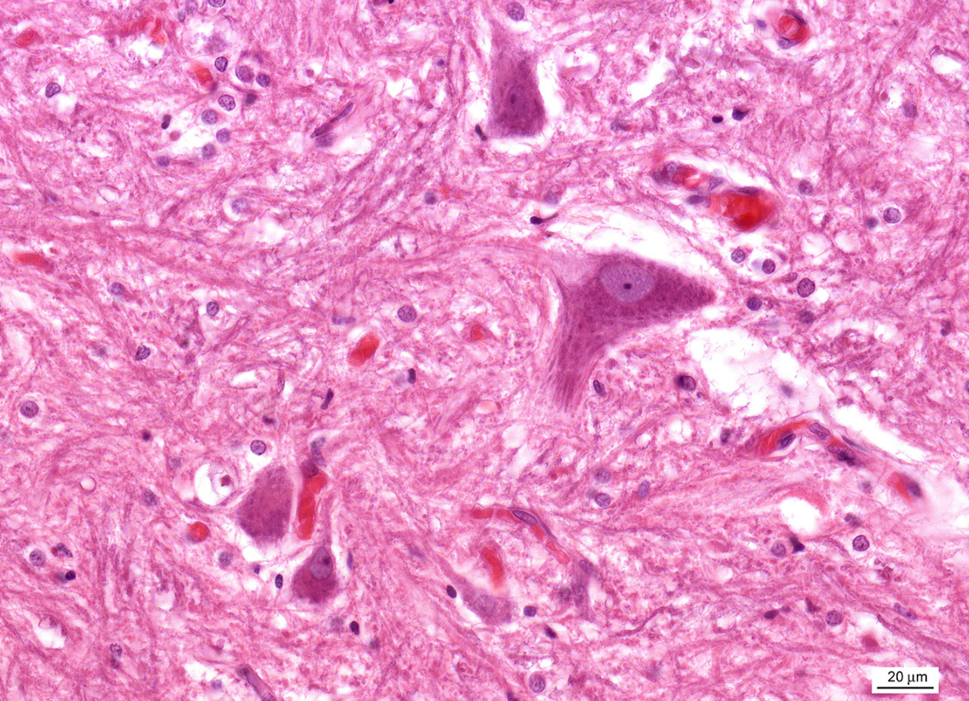
Axon hillock
Nissl bodies
Notes:
Kořenové buňky předního míšního rohu psa

Slide 41
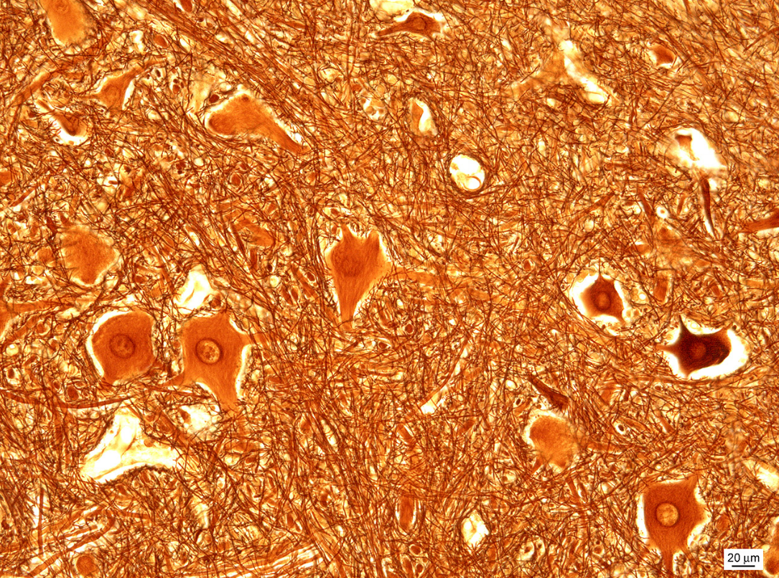
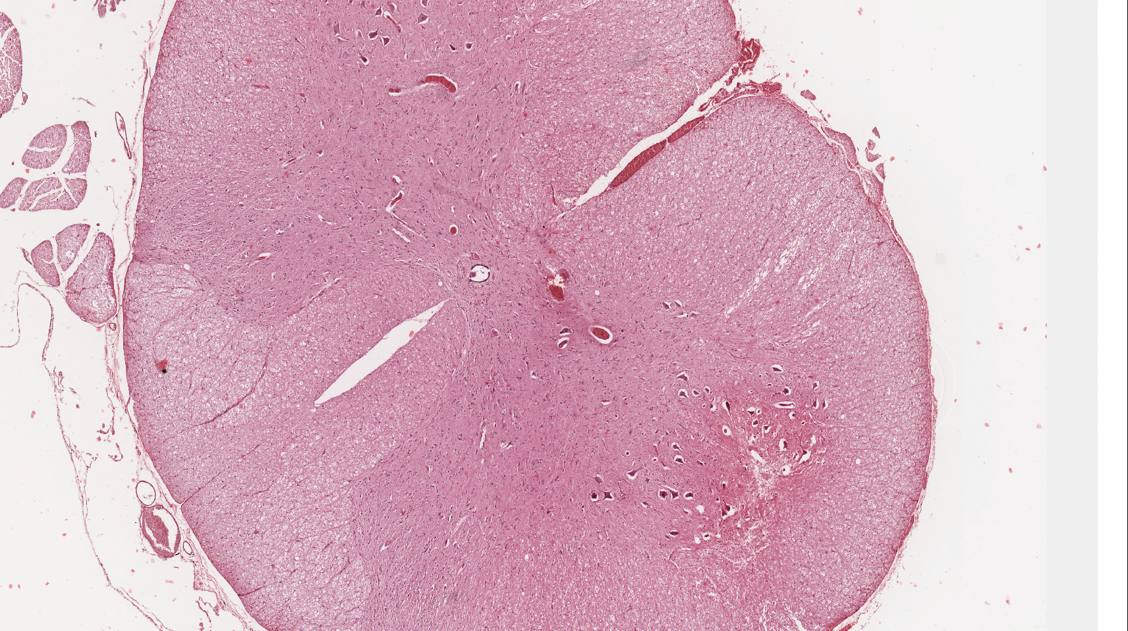
Medulla spinalis
Somatomotoric multipolar neurons

Slide 42

Somatomotoric multipolar neurons
Myelinated axons

Slide 43

Medulla spinalis – ependymal cells

Slide 44



Ganglion spinale
Pseudounipolar neurons
Satellite cells

Slide 45

Vegetative ganglion – ganglion cells (multipolar neurons), satellite cells

Slide 46

Ganglion cells with lipofuscin

Slide 47

Peripheral nerve – longitudinal section
Node of Ranvier

Slide 48

Myelin sheaths with nodes of Ranvier – peripheral nerve (OsO₄)

Slide 49

Motor end-plates in motor unit
Axon terminals
Muscle fibers
Motor
end-plate

Slide 50


Motor end-plates (localization of acetylcholinesterase)

Slide 51


Axons with Schwann sheath
Nucleus of Schwann cell
Myelin sheath

Slide 52


Presynaptic ending

Slide 53
NERVE TISSUE
Slides:
Pyramidal cell (75, 76. Cortex cerebri)
Purkinje cell (77. Cerebellum)
Nissl substance (78. Cerebellum)
Somatomotoric multipolar neuron (79. Medulla spinalis)
Pseudounipolar neuron (81. Ganglion spinale)
Axon with myelin and Schwann sheath (84, 86. Peripheral nerve)
Myelin sheath (87. Peripheral nerve)
Motor end plate (acetylcholinesterase detection)
Atlas EM:
Nucleus (3) and cytoplasm of neuron (55)
Axons with sheaths (56, 58)
Presynaptic endings (57)

