Slide 1
Blood

Slide 2
Warning
  please, do not manipulate the microscope,
  they are prepared for your study of blood smears after presentation,
  you will get instructions, how to study blood smears.

Slide 3
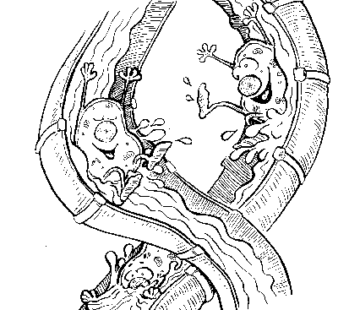
Blood
Plasma & Blood cells

Slide 4
Composition of plasma
Water – 90 %
Proteins – 7 % (albumins, globulins, fibrinogen)
Other components – 3 % (blood gasses, nutrients, hormones, enzymes, vitamins, electrolytes)

Slide 5
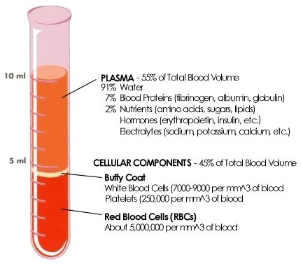
Hematocrit: the volume of blood cells per unit volume of blood

Slide 6
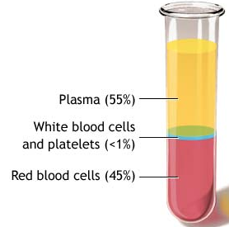
Blood Hematocrit
♂ 42 – 52 %
♀ 37 – 47 %
55 % plasma
90 % H₂O
7 % plasma proteins
3 % -AMAs, saccharids, lipids
-hormones
-electrolytes
45 % blood corpuscles

Slide 7
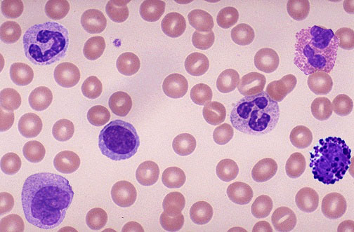
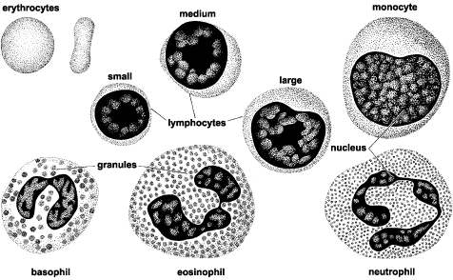
Blood cells (formed elements)
Red blood cells – erythrocytes
White blood cells – leukocytes
Platelets – thrombocytes

Slide 8







BLOOD CORPUSCLES
ERYTHROCYTES
7,2 - 7,6 μm
neutrophilic 10 - 12 μm
eosinophilic 12 - 14 μm
basophilic 8 - 10 μm
lymphocytes 6 - 8 / 10 -12 μm
monocytes 12-20 μm
GRANULOCYTES
(polymorphonuclears)
LEUKOCYTES
AGRANULOCYTES
(mononuclears)
THROMBOCYTES
2 – 4 μm

Slide 9
REMEMBER forever!
Erythrocytes: 4 – 6 millions/ 1 μl of blood
Leukocytes: 5,000 – 9,000 / 1 μl
Thrombocytes: 150,000 – 250,000/ 1 μl
NEVER FORGET !

Slide 10
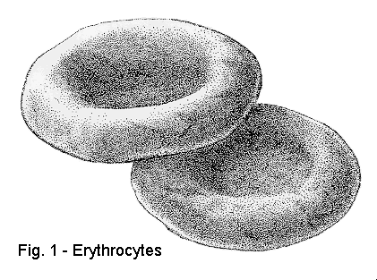
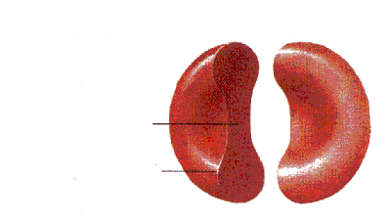
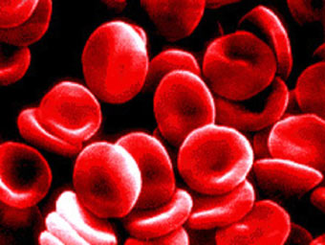
ERYTHROCYTES
4 – 6 million/μl
Shape: biconcave disc,
dumble-shaped (cross section)
Size: 7.4 μm in diameter (= normocyte)
Structure: plasmalemma, cytoplasm + hemoglobin 33 % absence! of the nucleus and cell organelles
Lifespan: 120 days

Slide 11
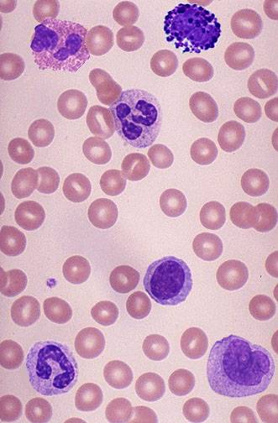
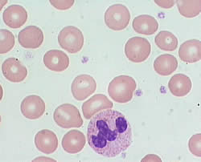
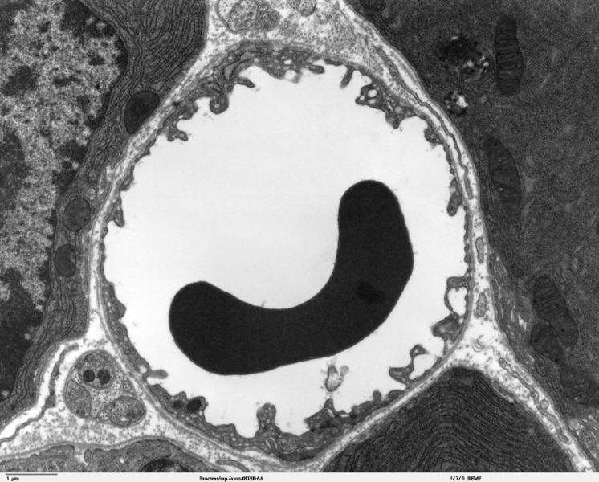

Slide 12
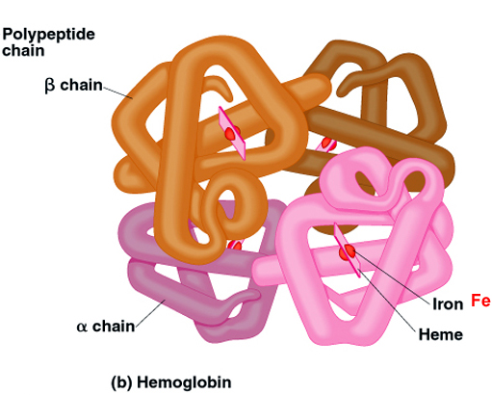
Hemoglobin
a conjugated protein: 4 polypeptide chains + heme groups = protoporphyrin ring with ferrous iron (Fe²⁺ )
Hb F (fetal)
Hb A (adult)
normochromatic ery: 32±2 picogramms (hyper-, hypo-)

Slide 13
<Important terms>
Polyglobulia – an increased number of ery
Anemia – a decreased number of ery
Poikilocytosis – an occurrence of different shaped ery (spherocytes, elliptocytes, drepanocytes = sickle cells, etc.)
Anisocytosis – an occurrence of different sized ery (microcytes, macrocytes)

Slide 14
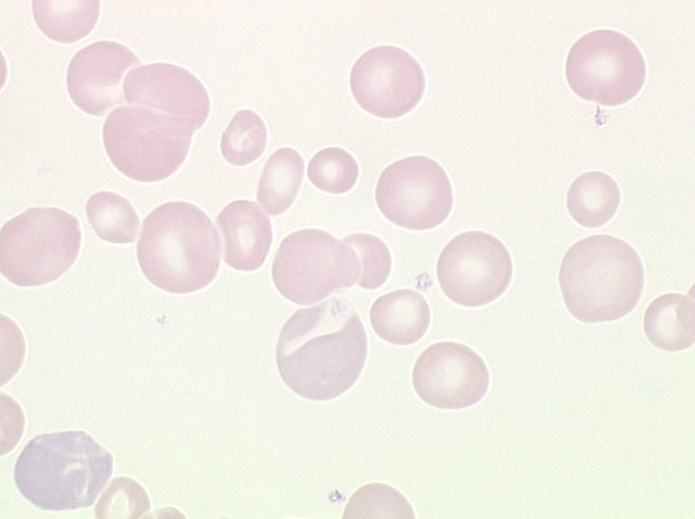
Anisocytosis
Microcytes ∅ < 6.5 μm
Normocytes
∅ ± 7.4 μm
Macrocytes ∅ > 8 μm

Slide 15

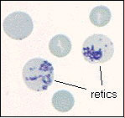
Reticulocytes
Immature ery are released from the bone marrow into the peripheral blood (0.5 – 1.5 %)
They contain the rests of organelles – ribosomes, mitochondria – substantia reticulofilamentosa (brilantcresyl blue staining is used for detection)
maturation into ery – during 24 hours

Slide 16
Functions of ery
transport of oxygen from the lungs
transport of carbon dioxide from the tissues

Slide 17
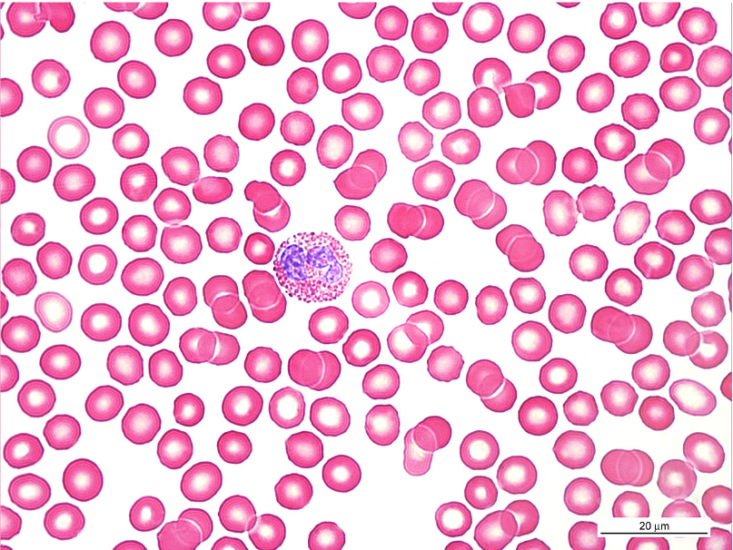
ERYTHROCYTES
Ery
Eos
Ery
polyglobulia - polycythaemia / anemia / anisocytosis / poikilocytosis
Notes:
Erytrocyty (Ery), eosinofilní granulocyt (Eos).
Nátěr periferní krve, panoptické barvení (Pappenheim), imerze, CZV: 1000X
Polyglobulia, anemia, anisocytosis, poikilocytosis.

Slide 18
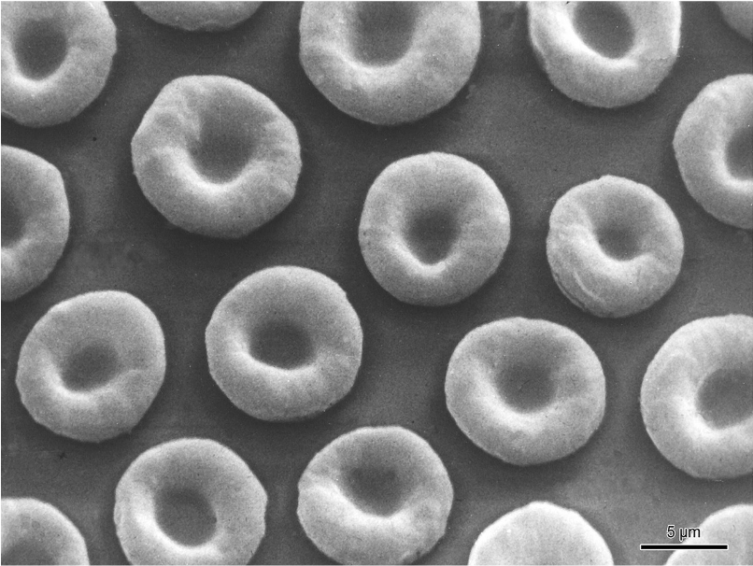
ERYTHROCYTES
Notes:
Erytrocyty (REM).

Slide 19
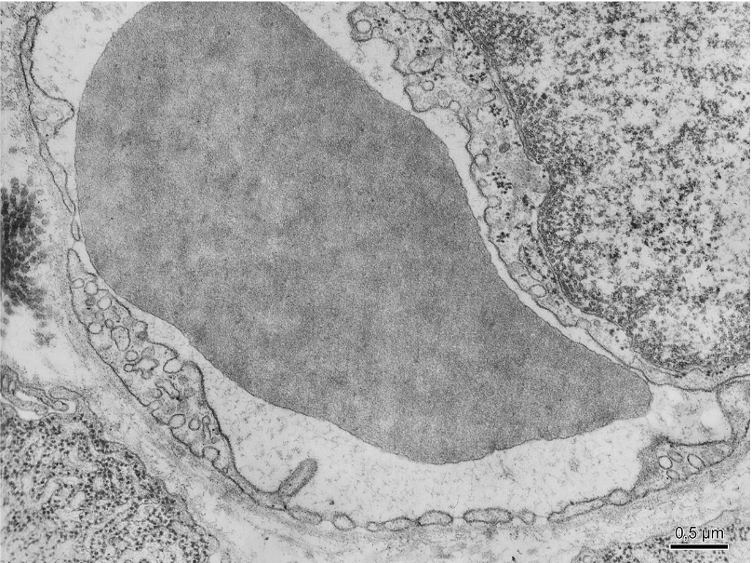
ERYTHROCYTE
Notes:
Erytrocyt ve fenestrované kapiláře (TEM).

Slide 20
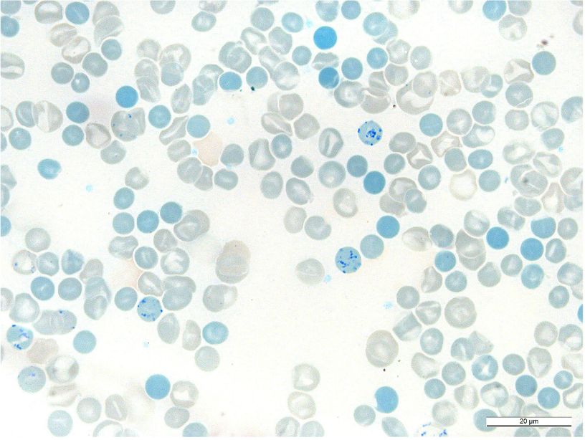
RETICULOCYTE
substantia
reticulofilamentosa
Notes:
Retikulocyt (šipky.
Nátěr periferní krve, brilantní kresylová modř, imerze, CZV: 1000X

Slide 21
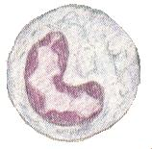
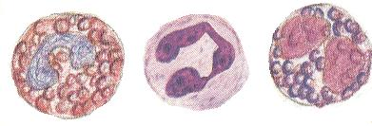

LEUKOCYTES
Granulocytes:
- neutrophils
- eosinophils
- basophils
General characteristic
Polymorphonuclears with
acidophilic cytoplasm and
Specific + azurophilic granules
Agranulocytes
- lymphocytes
- monocytes
General characteristic
Mononuclears with
basophilic cytoplasm and
azurophilic granules

Slide 22
Granulocytes
General charcteristic:
polymorphonuclears – different shape of nuclei
band segmented with chromatin bridges
acidophilic cytoplasm – bright-pink
specific granules – with special enzymes
azurophilic granules – with lysosomal enzymes
all granulocytes are able to migrate from the vessels and by diapedesis invade a site of inflamation

Slide 23
Granulocytes neutrophils – eosinophils - basophils
band
12-14 μm
10-12 μm
10 μm
segment

Slide 24
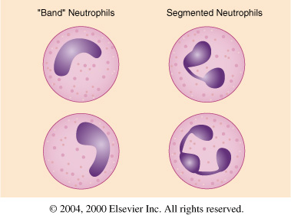
Neutrophil granulocytes
(neutrophils)
71 % of all white blood cells (DWCC)
∅ 10 – 12 μm
Cytoplasm: bright pink (eosinophilic = acidophilic )
Specific granules: neutrophilic (∅ 0.3 μm) (alcaline phosphatase, kolagenase, lysozyme, …)
Nucleus: band-shaped (4 %) or segmented (67 %) (2-5 segments)

Slide 25
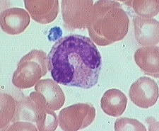
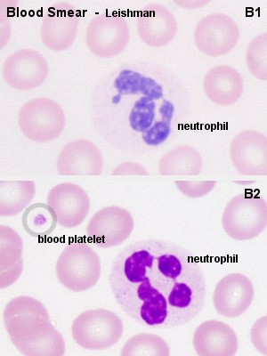
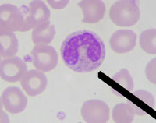

Slide 26
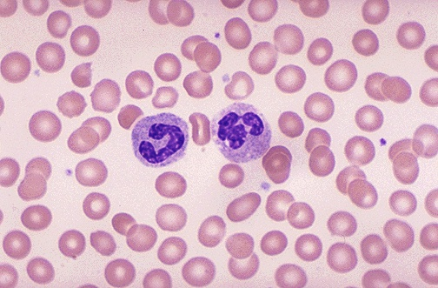
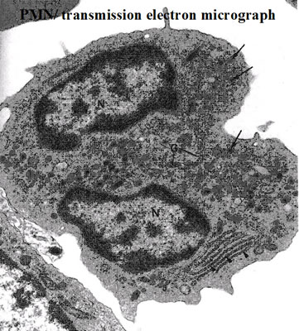

Slide 27
Functions of Neutrophils
a central role in inflammatory processes – Neu invade, by diapedesis from the vessels, sites of infection in response to factors (e.g. cytokines) released by cells which reside at an infection site.
cell membrane receptors allow Neu to recognise foreign bodies (bacteria, tissue debris), which they begin to phagocytose and destroy.
The Neu die once their supply of granules has been
exhausted. Their lifespan is only about
one week. Dead neutrophils and tissue debris are the
major components of pus.

Slide 28
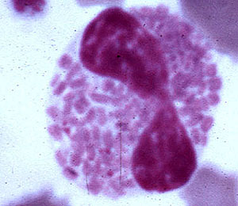
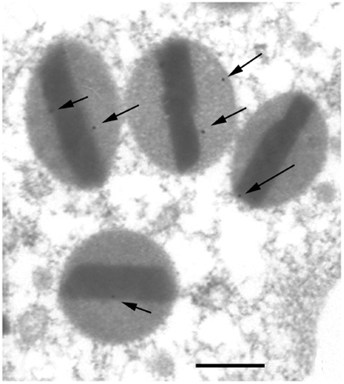
Eosinophil granulocytes
(eosinophils)
1– 4 % of all white blood cells (DWCC)
∅ 12 – 14 μm
Cytoplasm: bright pink (eosinophilic = acidophilic )
Specific granules: eosinophilic (∅ 0.5 – 1 μm) (enzymes: acid phosphatase, peroxidase,histaminase, arylsufatase …)
Nucleus: dumb-belt, (2 segments) chromatin bridge

Slide 29
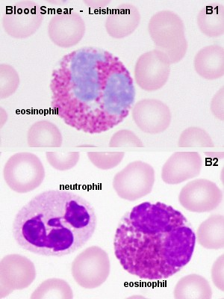
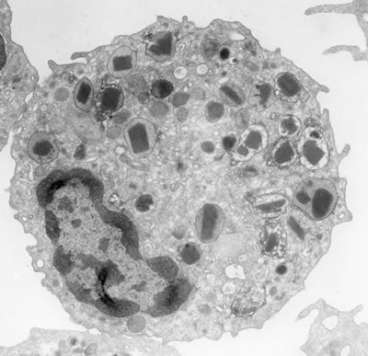

Slide 30
Functions of Eosinophils
phagocytosis of antibody-antigen complexes and prevention of the immune system from "overreacting„
eos are involved in the response of the body against parasitic infections, which are accompanied by an increase in the number of eosinophils.

Slide 31
Basophil granulocytes
(basophils)
up to 1 % of all white blood cells (DWCC)
∅ up to 10 μm
Cytoplasm: bright violet-pink (lightly basophilic )
Specific granules: (∅ 2 μm) (heparin, histamin, …)
Nucleus: „shape of dick S“

Slide 32
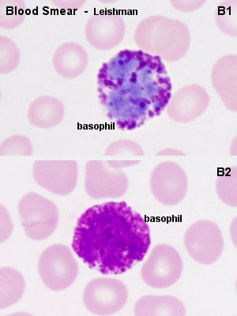
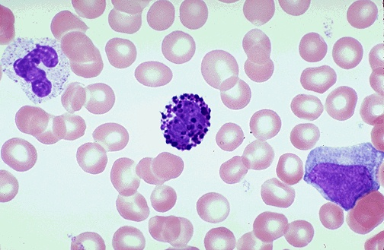
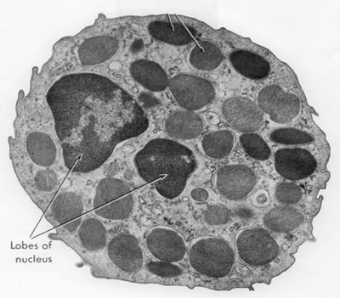

Slide 33
Functions of Basophils
heparin and histamine are vasoactive substances. They dilate the blood vessels, make vessel walls more permeable and prevent blood coagulation. They facilitate the access of heparinocyte in a site of infection.
antibodies produced by plasma cells (activated B-lymphocytes) bind to the receptors on the plasma membrane of basophils. If these antibodies come into contact with antigens, they induce the release of the contents of the basophil granules.

Slide 34
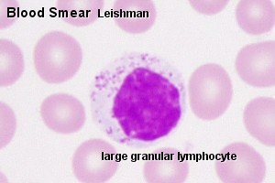
Agranulocytes
General charcteristic:
mononuclears – shape of nuclei is spherical, oval or bean-shaped
basophilic cytoplasm – blue
NO specific granules
azurophilic granules – with lysosomal enzymes

Slide 35
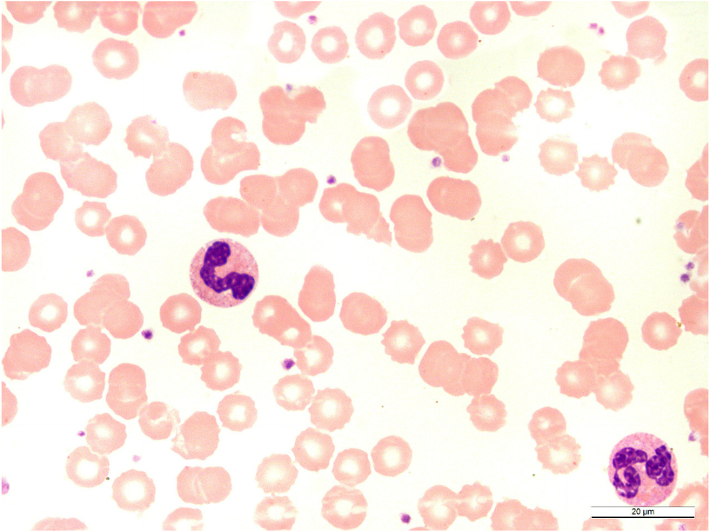
NEUTROPHILIC GRANULOCYTES
- bands, segments -
Neu-B
Neu-S
Notes:
Neutofilní granulocyt – tyčka (Neu-T), segment (Neu-S); trombocyty (šipka).
Nátěr periferní krve, panoptické barvení (Pappenheim), imerze, CZV: 1000X

Slide 36
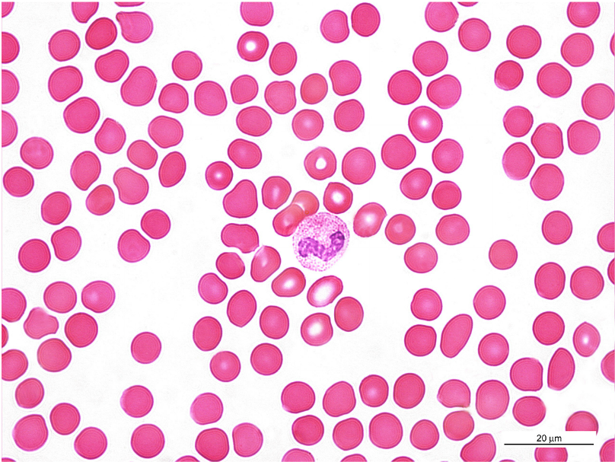
NEUTROPHILIC GRANULOCYTE
„BAND“
Notes:
Neutrofilní granulocyt – tyčka.
Nátěr periferní krve, panoptické barvení (Pappenheim), imerze, CZV: 1000X

Slide 37
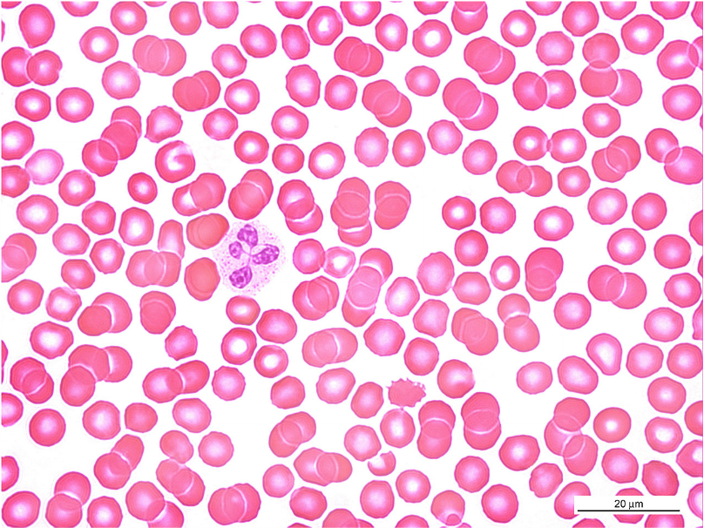
NEUTROPHILIC GRANULOCYTE
„SEGMENT“
Notes:
Neutrofilní granulocyt – segment
Nátěr periferní krve, panoptické barvení (Pappenheim), imerze, CZV: 1000X

Slide 38
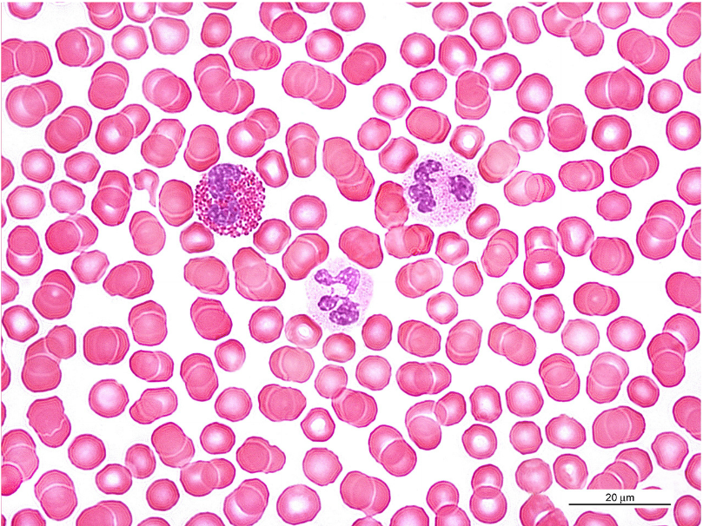
EOSINOPHILIC GRANULOCYTE
Eos
Neu
Notes:
Eosinofilní granulocyt (Eos), neutrofilní granulocyty (Neu).
Nátěr periferní krve, panoptické barvení (Pappenheim), imerze, CZV: 1000X

Slide 39
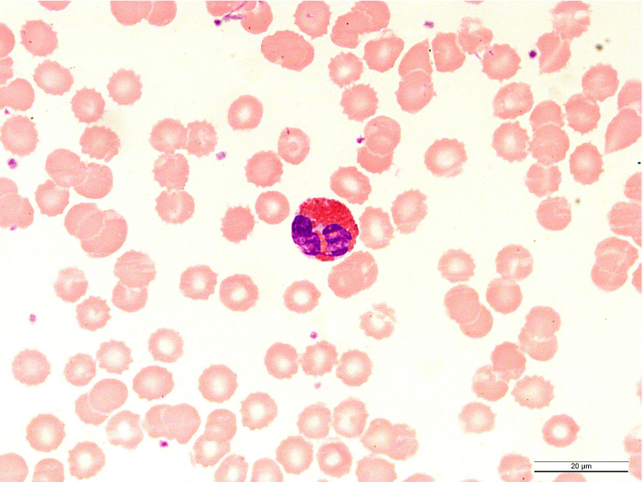
EOSINOPHILIC GRANULOCYTE
Notes:
Eosinofilní granulocyt (Eos).
Nátěr periferní krve, panoptické barvení (Pappenheim), imerze, CZV: 1000X

Slide 40
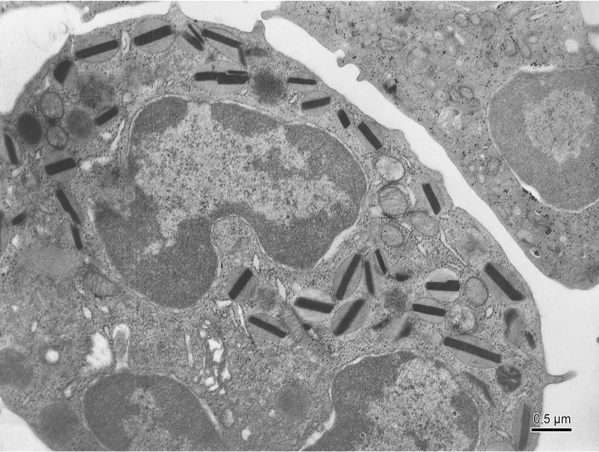
EOSINOPHILIC GRANULOCYTE
Notes:
Eosinofilní granulocyt (TEM).

Slide 41
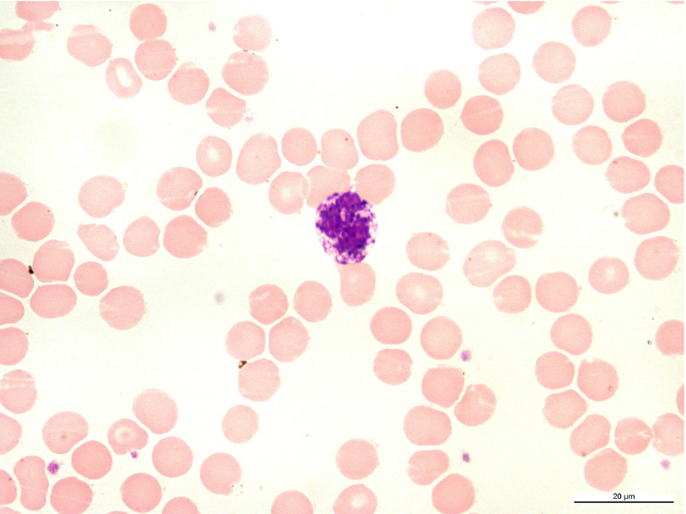
BASOPHILIC GRANULOCYTE
Notes:
Basofilní granulocyt.
Nátěr periferní krve, panoptické barvení (Pappenheim), imerze, CZV: 1000X

Slide 42
LYMPHOCYTES
Classification:
- according to origin – T-Ly (thymus), B-Ly
(bone marrow ≅ bursa of Fabricius in birds)
- according to the size – small (∅ 8 μm),
medium (∅ 10-12 μm), large (∅ 16-18 μm),
- according to the function – natural killer cells,
helper cells, memmory cells, supressor cells,
- according to life-span

Slide 43
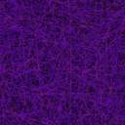
Lymphocytes - structure
20 % of all white blood cells (DWCC)
small, medium-sized, large Ly
cytoplasm – dark blue, contains non-specific azurophilic granules with lysosomal enzymes (hydrolases) and numerous ribosomes
nucleus – round, hyperchromatic – coarse grains of heterochromatin (dark violet colour)

Slide 44
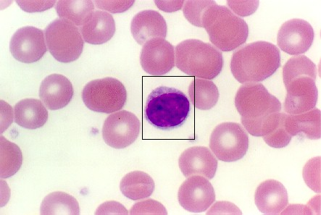
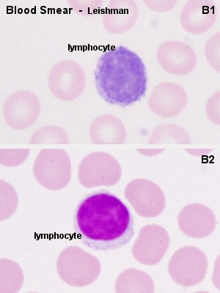
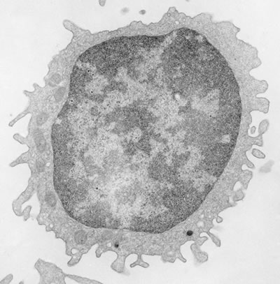

Slide 45
Functions of Lymphocytes
B-lymphocytes differentiate into antibody producing plasma cells and so they represent "humoral immunity"
T-lymphocytes represent the "cellular immunity" and may attack foreign cells, cancer cells and cells infected by e.g. a virus

Slide 46
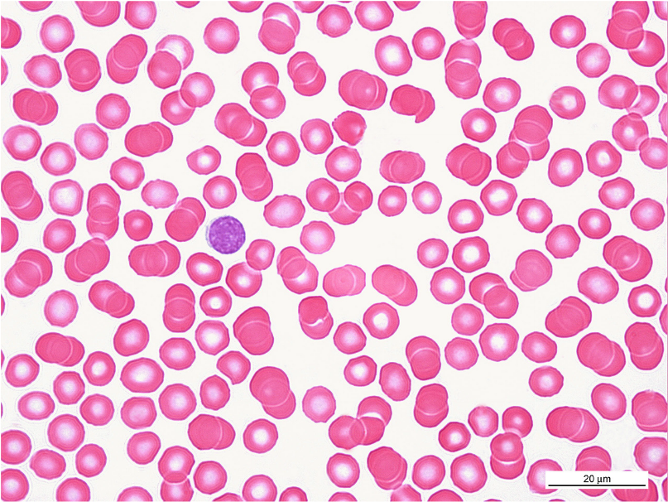
LYMPHOCYTE
Notes:
Lymfocyt.
Nátěr periferní krve, panoptické barvení (Pappenheim), imerze, CZV: 1000X

Slide 47
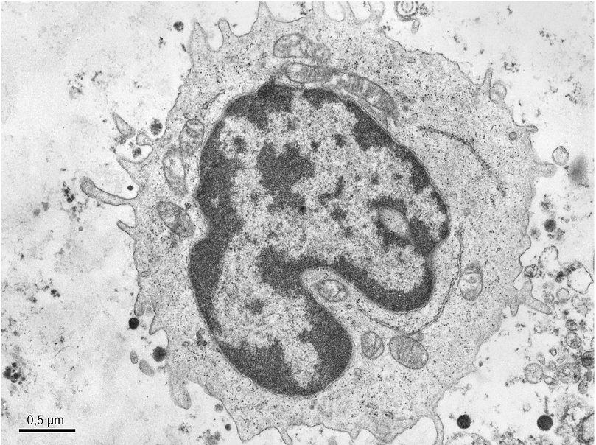
LYMPHOCYTE
Notes:
Lymfocyt (TEM).

Slide 48

MONOCYTES
5 % (DWC), ∅ 15 – 20 μm
cytoplasm – voluminous, bright blue, contains non-specific azurophilic granules with lysosomal enzymes (hydrolases) and numerous ribosomes
nucleus – oval to bean-shaped, finely dispersed chromatin

Slide 49
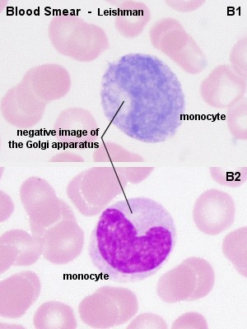
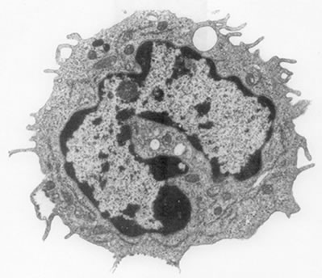

Slide 50
Functions of Monocytes
monocytes enter the connective tissue they differentiate into macrophages. At sites of infection macrophages are the dominant cell type after the death of the invading neutrophils.
macrophages phagocyte microorganisms, tissue debris and the dead neutrophils.
mono also give rise to osteoclasts, which are able to distroy bone. They are of importance in bone remodelling.

Slide 51
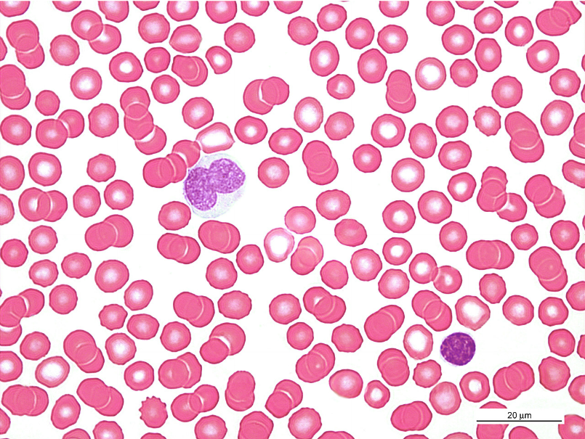
MONOCYTE and LYMPHOCYTE
Mono
Ly
Notes:
Monocyt (Mono), lymfocyt (Ly).
Nátěr periferní krve, panoptické barvení (Pappenheim), imerze, CZV: 1000X

Slide 52

MONOCYTE and „NEUTROPHIL“
Mono
Neu
Notes:
Monocyt (Mono), Neutrofilní granulocyt - segment (Neu).
Nátěr periferní krve, panoptické barvení (Pappenheim), imerze, CZV: 1000X

Slide 53

MONOCYTE
fagosomes
Notes:
Monocyt (TEM).

Slide 54
THROMBOCYTES (blood platelets)
150,000 – 300,000 / 1 μl of blood
thrombocytosis X thrombocytopenia
- are not cells, but cytoplasmic fragments of large cell (megakaryocyte) in bone marrow
shape: spindle-shaped discoid plate
size: 2 – 4 μm
cytoplasm – basophilic (bright violet-blue), contains microtubules and α,δ and λ granules:
alpha granules – fibrinogen, …
delta granules – serotonin, Ca ions, ATP and ADP,…
lambda granules – are small lysosomes

Slide 55
Platelet structure
Hyaloplasm contains microtubules (on the periphery of platelet)
Granuloplasm contains granules

Slide 56
Functions of thrombocytes
Platelets assist in haemostasis, the arrest of bleeding.
Serotonin is a vasoconstrictor. Its release from thrombocytes, adhering to the walls of a damaged vessels, is sufficient to close even small arteries. Platelets, which come into contact with collagenous fibers in the walls of the vessel, swell, become "sticky" and activate other platelets to undergo the same transformation. This cascade of events results in the formation of a platelet plug (or platelet thrombus). Finally, activating substances are released from the damaged vessel walls and from the platelets. These substances mediate the conversion of the plasma protein prothrombin into thrombin. Thrombin catalyzes the conversion of fibrinogen into fibrin, which polymerizes into fibrils and forms a fibrous net in the arising blood clot. Platelets captured in the fibrin net contract leading to clot retraction, which further assists in haemostasis.

Slide 57

THROMBOCYTES
BLOOD PLATELETES
Ly
Neu
Notes:
Trombocyt (šipky), nutrofilní granulocyt – segment (Neu), lymfocyt (Ly).
Nátěr periferní krve, panoptické barvení (Pappenheim), imerze, CZV: 1000X

Slide 58




Slide 59

How to prepare blood smear?

Slide 60

How to prepare blood smear - I
Smears of peripheral blood must be made immediately.
Step 1. Place drop of blood about 1cm from the frosted end of a clean slide.

Slide 61

How to prepare blood smear - II
Step 2. hold the end of a second slide (“spreader”) against the surface of the first slide at an angle of 30-45 degrees.

Slide 62

How to prepare blood smear - III
Step 3. draw it back to contact the drop of blood. Allow the blood to spread and fill the angle between the two slides.

Slide 63

How to prepare blood smear - IV
Step 4. Push the “spreader” slide at a moderate speed forward until all of the blood has been spread into a moderately thin film.

Slide 64

How to prepare blood smear - V
prepared smear for fixation (methyl alcohol, 3-5 minutes) and staining (special panoptic method according to Pappenheim can be used)

Slide 65

Light microscope manipulation
DO NOT USE TODAY
Course adjustment knob
ONLY
Fine adjustment knob
YOU CAN USE TODAY

Slide 66

Light microscope manipulation
focuse a picture in LM and look at it with both eyes
regulate a distance between the eyepices so, you can see one focused circular field
bad correct

Slide 67

Light microscope manipulation
Look at the slide only through the right eyepiece and focuse some point in the picture.
Without refocusing, look at the left eyepiece.
In doing so, screw the ring below the left eyepiece to focuse the same point.
So, the dioptric correction is set up.
Now, you can start to study blood
smear in your LM ☺

Slide 68



Ery 7.4 μm
Neu – band
10 – 12 μm
Neu – segment
Baso 10 μm
Eos 12-14 μm
Platelet 2 – 4 μm
Mono 15 – 20 μm
Lymfo 8 μm

Slide 69
How to study blood smear in LM?
Lens of immersion objective /magnifying 100x/ is immersed into drop of immersion oil and blood smear is prepared for study.
Swich on the microscope and check the picture in the microscope.
If the image is not sharp, focus it using microscrew! If it is not possible, contact your teacher.

Slide 70
How to count leukocytes in blood smear?
blood smear have to be systematicaly viewed (for fear to count some cells several-times)
or

Slide 71
How to count leukocytes in blood smear?
differential white cell count (DWCC) is an important hematologic sreening which helps to diagnose
leukocytes percentage is the result of this investigation
100 white cells must be count and registered in the table prepared for all types of leukocytes (Neu-bands, Neu-segments, Eos, Baso, Ly, Mono)
arithmetic sum of each type of leukocytes represents their percentage (%)

Slide 72
Table
 | 1 | 2
Neu bands | /
Neu segments | //// // | ///
Eos |  | /
Baso
Ly | // | ////
Mono |  | //
 | 10 cells | 10 cells
9 | 10 | results | norm
// |  |  | 4 %
//// / | /// |  | 67 %
/ | // |  | 3 %
 | / |  | 1 %
/ | //// |  | 20 %
 |  |  | 5 %
10 cells | 10 cells | 100% | 100 %

Slide 73

Differential white cell count (DWCC)
Total number of leukocytes: normal values
Neutrophils - bands | 4 %
- segments | 67 %
Eosinophils | 3 %
Basophils | 1 %
Lymphocytes | 20 %
Monocytes | 5 %
 | ∑ = 100 %

Slide 74
Anomalies of DWCC
 | ⬆ Increased number | ⬇ Decreased number
Neutrophils* | neutrophil granulocytosis | neutrophil granulocytopenia
Eosinophils | eosinophil granulocytosis | eosinophil granulocytopenia
Basophils | basoophil granulocytosis | basoophil granulocytopenia
Lymphocytes | lymphocytosis | lymphocytopenia
Monocytes | monocytosis | monocytopenia
* sum total of bands and segments has to be compared with norm;
normal value is 71 % (4 % bans + 67 % segments)

Slide 75
Normal ratio of neutrophil bands and segments
(B : S) is 4 % : 68 % = 1 : 17
Turn to the left – bands are increased
Turn to the right – segments are increased in peripheral blood
turn turn
to the left to the right
turn turn
to the left to the right
B | 2S | 3S | 4S | 5S

Slide 76

BLOOD
Slide
Peripheral blood smear, panoptic staining (method of Pappenheim), immersion oil, magnif. 1000x

Slide 77
Blood vessels are categorized by function :
Arteries conduct blood away from the heart and have proportionately more smooth muscle and elastic tissue than veins of comparable size.
  Arteries are commonly sub-categorized into elastic arteries (the largest one), muscular arteries (middle-sized), and arterioles.
Veins return blood to the heart.
The composition of the wall varies among arteries and veins.

Slide 78


Bloodstream organization
veins
arteries
venules
arterioles
postcapillaries
precapillaries
capillaries

Slide 79
Structure of blood vessel wall
tunica interna (intima)
  endothelium + subendothelial connective tissue
________membrana elastica interna__________
tunica media
  smooth muscle tissue – circularly oriented
________membrana elastica externa__________
tunica externa (adventitia)
  loose connective tissue + nerves + vasa vasorum
  (+ longitudinal smooth muscle – only in veins)

Slide 80



Endothelium
is a specialized form of mesenchyme-derived epithelium
simple squamous epithelium – 1 layer of flattened cells forms a thin, waterproof and antithrombogenic lining of all blood vessels, heart and lymphatic vessels

Slide 81
Function of endothelium
the control of blood pressure by vasoconstriction and vasodilation,
blood clotting,
formation of new blood vessels (angiogenesis),
control of the passage of materials and the transit of white blood cells into and out of the blood,
in some organs, there are highly differentiated endothelial cells to perform specialized 'filtering' functions (renal glomerulus in kidney, blood-brain barrier, placental barrier).

Slide 82


ERY
lumen
Pinocytic vesicles
Zonula occludens
2
1
blood
Pinocytic
vesicles
Endothelial cells (1,2)
tissue

Slide 83

Blood capillaries

Slide 84

Blood capillaries
diameter from about 8 µm (to 30-40 µm)
lumen is lined by 1-2 endothelial cell
reticular fibers surround the capillaries
capillary bed between arteries and veins
pericytes
3 types of capillaries continuous
fenestrated
sinusoids

Slide 85




Slide 86

Function of capillaries (1)
respiratory gasses, nutrients and waste products change between blood and tissues
The illustration shows the healthy state of the cells in well vascularized tissue ☺

Slide 87

Function of capillaries (2)
allow the blood cells to pass throughout their wall into the connective tissue (by diapedesis)
Neutrophils
microphages
Eosinophils
Basophils
mast cells
Lymphocytes
plasma cells
Monocytes
macrophages

Slide 88

Continuous capillaries
The smallest: cca 8 μm
The wall: - endothelium – 1-2 cells (zonulae occludentes and nexuses) - lamina basalis - pericytes - reticular fibers
only allow small molecules, water and ions to diffuse
Example of occurrence:
muscle tisue, brain

Slide 89

Fenestrated capillaries
Endothelial cells with fenestra („windows“) 70 nm ∅, diaphragm (thinner than plasma membrane) boards fenestrum
continuous basal lamina
in the organs with quic and intensive metabolism and substances change
allow small molecules and limited amounts of protein to diffuse
Exampl of occurrence:
intestinal villi, endocrine glands

Slide 90


Capillaries with pores
special type of fenestrated capillaries
not fenestra with diaphragm, but opened pores are in endothelium
in glomeruli of renal corpuscles
Pores
capillary
lumen
basal lamina

Slide 91

Sinusoidal capillaries (sinusoids)
∅ from 8 to 40 μm
endothelium – fenestra, pores and intercellular clefts; some cells are able to phagocyte
incomplete basal lamina
reticular fibers
allow erytrhocytes and serum proteins to enter.
Example of occurrence:
liver, spleen, bone marrow

Slide 92

Endothelium
Tunica interna
<lungitudinally>
Membrana elastica interna
Tunica media
<circularlly>
(Membrana elastica externa)
Tunica externa
<longitudinally>

Slide 93



Tunica interna (intima) TI
endothelium
subendothelial connective tissue – thin layer of elastic + collagen fibers (longitudinally oriented)

Slide 94

Tunica media TM
consists of smooth muscle cells and elastic membranes in varying proportions (circularly oriented)
is thicker in arteries than in veins
Compare aw – vw:

Slide 95


Tunica externa (adventitia) TA
fibrous connective tissue + smooth muscle cells in veins (logitudinally)
is thicker in vein; is the thickest layer in large veins [1] and veins of low limbs [2]
contains vessels and nerves (vasa et nervi vasorum) in large vessels
2
1

Slide 96


Slide 97


Compare the wall structure
of artery and vein
adventitia
media (+ intima)

Slide 98
Arterial part of bloodstream
According to diameter, morphological differences and ratio of elastic fibers and smooth muscle cells:
Arterioles ∅ < 0.5 mm
Muscular arteries (small and middle-sized)
∅ 0.5 – 1 mm
Elastic arteries (large: aorta and arteries
growing from aorta)

Slide 99


Arteriole
∅ < 0.5 mm
The wall
TI: endothelium + subendothelium
membrana elastica int.
TM: smooth muscle cells (cca circular 5 layers)
TA: fibrocytes, reticular (+collagen) fibers

Slide 100

Muscular artery
TI: endothelium + subendothelium (with smooth muscle cells (longit.)
membrana elastica int.
TM: up to 40 layers of smooth muscle cells, elastic and collagen fibers
membrana elastica ext.
TA: loose connective tissue
„circular“
„longitudinal“
TM+TA arrangement
is spiral, but …

Slide 101


Elastic artery
TI: endothelium + subendothelium (100 μm wide layer of connective t.)
TM: up to 40-60 layers of fenestrated elastic membranes, small amount of smooth muscle cells and reticular fibers
TA: loose connective tissue (+ vasa et nervi vasorum)

Slide 102



Portal circulation: arterial or venous
two capillary systems side-by-side
1
2
3
capillaries vessel capillaries WHERE?
1: glomerulus eferent arteriole renal tubules capillaries in KIDNEY
2: GIT organs vena portae hepatic sinusoids in LIVER
3: hypothalamus hypophyseal vein adenohypophysis in HYPOPHYSIS

Slide 103

Venous part of bloodstream
Venules ∅ 0.2 – 1 mm
Small and medium sized veins ∅ 1 – 9 mm
Large veins (v. cava inf. et. sup. - the largest vein)
Valves - pocket-like duplication of endothelium scaffolded by elastic c.t. - protection against venous reccurence

Slide 104


Venule
∅ < 0.2 - 1 mm
The wall
TI: endothelium only
TM: smooth muscle cells (cca circular 1-3 layers)
TA: thick layer of loose connective tissue

Slide 105

Small and medium-sized venules
Vein + artery
∅ 1 – 9 mm
TI: endothelium + irregular layer of subendothelium + valves
TM: irregular, thin layer of smooth muscle cells, elastic and collagen fibers
TA: thick layer of loose connective tissue with smooth muscle cells
Vein from lower part of body

Slide 106

Large veins
TI: endothelium + subendothelium (+smooth muscle cells)
TM: thin layer of connective tissue + reduced amount of smooth muscle cells
TA: longitudinal bundles of smooth muscle cells in loose connective tissue (vasa et nervi vasorum)

Slide 107


The heart is the hardest working muscle in the human body.
Hollow muscular organ – blood pump
Rythmic contraction
Involuntary muscle

Slide 108

Pericardial sac: pericardium + epicardium
PERICARDIUM
Outer (parietal) layer
Pericardial cavity
EPICARDIUM
Inner (visceral) layer
Pericardial cavity - contains 15 – 50 ml of serous fluid serves as lubricans;
- is lined with mesothelium

Slide 109

The wall of heart
Epicardium
Myocardium
Endocardium
-------------------

Slide 110


Slide 111

Endocardium
(homologous to intima of blood vessels)
Consists of:
Endothelium
Subendothelium – thin connective tissue layer
Elastic-muscular layer – dense c.t. (elastic fibers, smooth m. cells)
Subendocardium – c.t. + vessels, nerves and distal part of conducting system (ventricular bundles and Purkinje fibers)
Attention!
Purkinje fibers ≠ Purkinje cells

Slide 112




Slide 113




NEXUSES

Slide 114
Myocardium
cardiomyocytes „working“
„conducting“
cells in right ventricle – natriuretic factor (when intravascular volume increases, this factor is released and causes natriuresis and diuresis in kidney)
atrial myocardium is thinner than ventricular
„left heart“ myocardium is thinner than „right heart“
cords of cardiomyocytes are ended on heart skeleton
damage of myocardium - infarction
low regeneration of myocardium – by scar (decreases function of heart muscle)

Slide 115

Heart skeleton
Trigonum
fibrosum sin.
Trigonum
fibrosum dx.
Anulus
fibrosus sin.
Anulus
fibrosus dx.
Pars membranacea interventricularis

Slide 116

Endocardial valves
Plates of dense connective tissue (continuous with heart skeleton)
covered with endocardium.

Slide 117


Epicardium
Mesothelium lines pericardial space
and so it covers outer surface of epicardium
and inner surface of pericardiu
Pericardial space
mesothelium
connective tissue
subepicardial c.t.
myocardium

Slide 118

hearty thanks for your attention

Slide 119

Muscular artery

Slide 120
Aorta

Slide 121
Vein from lower part of body
intima
adventitia
media

Slide 122
Vena cava
intima
media
adventitia

Slide 123


Slide 124
Lymphatic vessells
Lymphatic vessels (often just called lymphatics) are channels which drain excess fluid ("lymph") from tissues.
In most peripheral tissues, some plasma seeps out of capillaries. A portion of this is taken back up in venules while the rest drains into terminal lymphatic channels, also called lymphatic capillaries. A shift in the balance between fluid entering and leaving tissues (e.g., increased vascular permeability due to inflammation) can result in accumulation of tissue fluid, or edema.
All lymphatic vessels eventually lead "downstream" to the thoracic duct, which empties into the vena cava (a point where blood pressure is quite low; higher pressure would impede drainage).
Lymphatic vessels resemble blood vessels with exceptionally delicate walls (and, of course, without red blood cells). Smaller lymphatic vessels consist of little more endothelium.

