Slide 1
Frailty syndrom
Frailty- weak bone, prone to fracture
Loss of body weight 4-5 kg/year
Exhaustion
Low muscle strength / handgrip 20 %
Low velocity of gait 20 %
Dimisched physical activity 20 %

Slide 2
Frailty syndrom
Subclinicaly
Early frail
Late frail
Endstage frailty syndrom: terminal geriatric deterioration

Slide 3
Frailty syndrom
Tendency to falls and to fractures
Tendency to decompensation of other comorbidities
Loss of cognitive functions
Help in daily activities
Sarcopenia
Osteoporosis
Bone density corelates with serum level of vit D
Low level of vit. D corelates with loss of cognitive functions

Slide 4
Prevalence
Mostly in higher age
In 7 % of people above 65 y. living at home
In 25 % of people at the age above 75 years
Loss of muscles of 20 % in people 65-70 let
Loss of muscles of 60 % in people above 80 years
The cause: long lasting insuficiency of vit D

Slide 5
Risk factors of frailty syndrom
Cardiovascular diseases
Diabetes mellitus
Atherosclerosis
Renal diseases
Neurological diseases
Obesity
Hormonal dysfunction
Parkinson syndrom
Multiple sclerosis
Condition after cerebrovascular disease
Cataracta

Slide 6
Prevention and treatment of frailty syndrom
Frailty syndrom is reversible
Nurishment and uptake of proteins 1,3 g/kg/day
Vit D 800 IU/day till 2000 IU/day
Vigantol 1 drop = 500 IU, alpha kalcidol 1 µg
Walking, resisted exercise for maintaing of muscle strength
Exercise for balance and stability
Prevention of atherosclerosis, management of metabolic diseases
Mangement other comorbidities
To relieve of pain
Stop walking when talking

Slide 7
Sarcopenia
Loss of muscle material of 20-30 %
Dysbalance between synthesis and degradation of muscles
(myostatin, glucorticoids, sexual hormons, insulin, IGF-I )
Osteopenia follows sarcopenia
Bedridden patients
Sedentary way of life
Worsening of physical condition

Slide 8
Sarcopenia
Muscle densitometry: bellow 2 SD - male bellow 7,26 kg/m2
- female bellow 5,45 kg/m2
MRI examination
Hand grip- dynamometer
Flexion and extension of knee joint
Maximal rate of breathing out
Velocity of walking
Test for maintaining of balance
Get up and go test
Test of climbing stairs

Slide 9
Consequences of sarcopenia
Diminished physical activity
Sarcoporosis
Higher risk of falls

Slide 10
Medication in sarcopenia
Vit D 800 IU/day till 2000 IU/day
Vigantol 1 drop = 500 IU
Alpha calcidol 1 µg
Testosteron
Ghrelin
Leptin
Growth hormon secretogoga
Estrogens

Slide 11
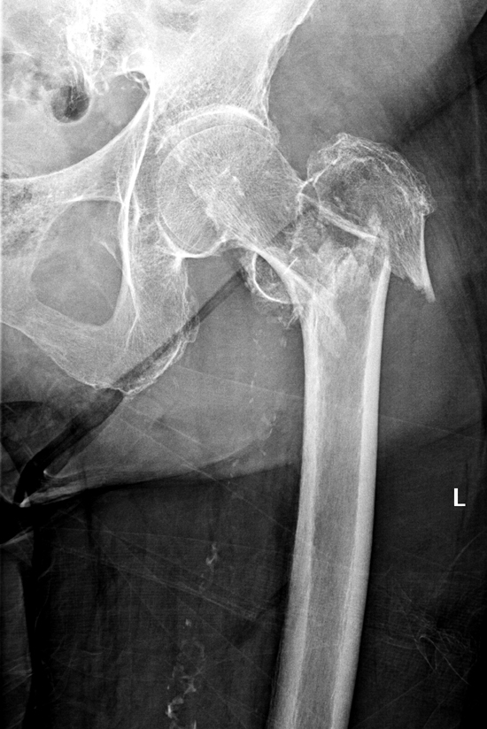
Management
Farmacotherapy of osteoporosis diminisched the risk
of fragility fractures only in 20-50 %
The whole patient with osteoporotic syndrom
+ frailty syndrom
+ sarcopenie
+ osteoarthrosis
+ other comorbidities
Prevention of falls

Slide 12
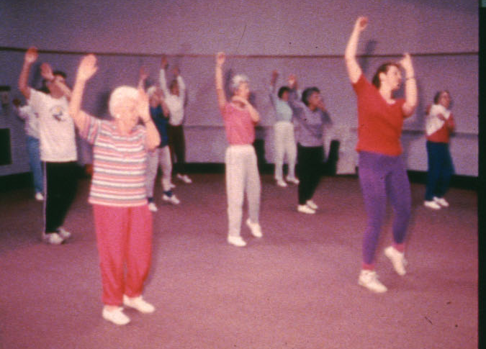
Physiotherapy

Slide 13
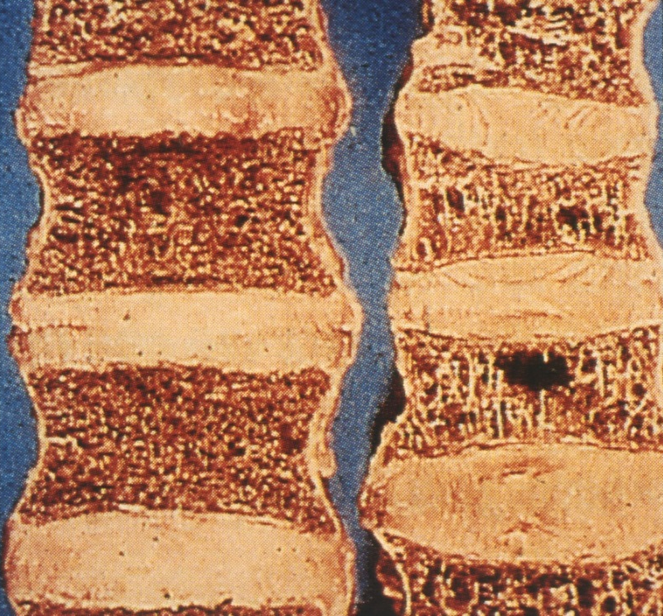
Medication for osteoporosis
Bisphosphonates
- Alendronate (Fosavance)
- Risedronate (Actonel)
- Ibandronate (Bonviva)
- Zolendronate (Aclasta)
Denosumab (Prolia)
Stroncium ranelate (Protelos)
Parathormon, teriparatid
– synthetic parathormon 1-34 fragment
(Forsteo)
SERM- bazedoxifen

Slide 14
New agents
Sclerostin antibodies
Sclerostin – inhibitor of osteoblasts
produced by osteocytes
Romosozumab
Blosozumab
Inhibitors of katepsin K
- inhibit bone resorption
Odanatocibe
Sclerostin- přirozený negativní regulátor kostní formace
Je produkován osteocyty
Sclerostin stimuluje kostní resorpci přes RANKL
Je inhibitor osteoblastů

