Slide 1
Pathology of the reproductive systems.
Pathology of the breast
V. Žampachová
I. PAÚ LF MU

Slide 2
Male genital system

Slide 3
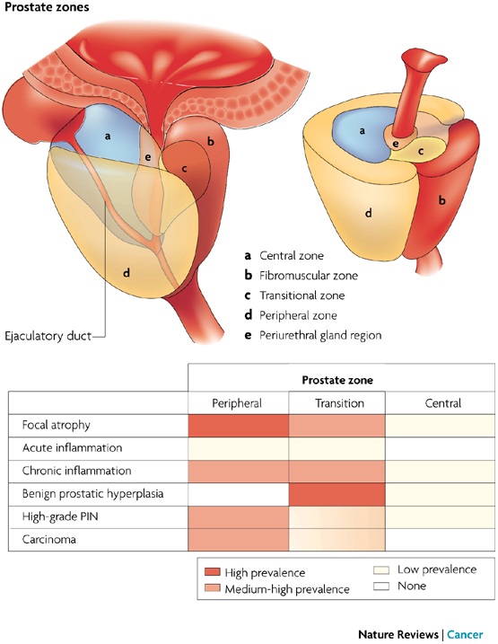
Prostatitis, benign prostatic hyperplasia
www.nature.com

Slide 4
Prostatitis
  Bacterial (acute purulent)
    Systemic symptoms, dysuria, frequency, local pain
    Ascending infection in UTI (urinary tract infection)
    Iatrogenic (cathetrisation, surgery, …)
    ATB therapy
  Chronic prostatitis/ chronic pelvic pain syndrome
    Most common (90%)
    Recurrent chronic genitourinary pain
    Sexual dysfunction

Slide 5
Benign prostatic hyperplasia
epidemiologic factors:
  age (BPH prevalence rising with age, 70% by age 60, 90% by 80)
  geographic/racial (low in Asia, more common in W Europe)
pathogenesis:
  not completely clear
  hormonal dysbalance
Gross: nodular hyperplasia
  periurethral (transition zone) mostly affected→ urethral compression + obstruction

Slide 6
Benign prostatic hyperplasia
  Clinical signs + complications: partial → complete urethral obstruction, urinary residuum, risk of infection lower urinary tract symptoms (disturbances of the urine flow)
    Storage symptoms – nocturia, frequency, urgency
    Voiding symptoms – weak stream
  acute/chronic urinary retention, bladder trabecular hypertrophy, cystitis
+ ascending infection – pyelonephritis,
Hydronephrosis.
Benign, but setting for possible preneoplastic changes
Th: surgery, drugs

Slide 7
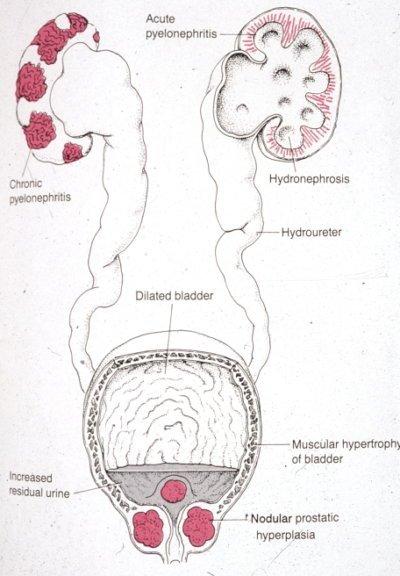
Complications of prostatic
hyperplasia

Slide 8
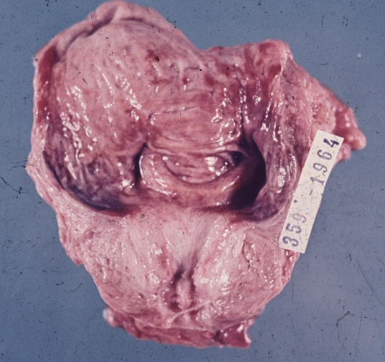
Benign prostatic hyperplasia

Slide 9
Benign prostatic hyperplasia - implications
Urination more than every 2 hours
More than once during the night
Weak, interrupted urine stream
Difficulty emptying the bladder
Genital/pelvic pain
Pain associated with intercourse
Urine leakage
Possible pelvic floor disorder

Slide 10
Prostatic cancer
↑ incidence
  1st – 3rd of the most common male malignancies (prostate – lungs – colorectal)
peripheral zone of prostate, dorsal part (palpation per rectum- digital rectal examination)
dg.:
  needle biopsy (by suspicion – nonspecific signs, general screening questioned)
  transurethral resection ( BHP treatment – incidental)
Spread: regional LN, bones (!diff. dg. of pain x local mechanic origin)

Slide 11
Prostatic cancer
Risk factors:
  Age
  African American
  Family history
  High-fat diet
  Alcohol consumption
Protective factors:
  Physical activity
  Tomato (lycopene)

Slide 12
Prostatic cancer
Staging/grading important for therapy method choice
Low grade tumors in older males/limited survival expectations – observation – watchful waiting
Any tumor in younger males – therapy
  Surgery
  Radiation
  Hormone therapy (androgen deprivation)
  Chemotherapy
Age ˃ 50 years + unknown cause of musculoskeletal pain + past history of prostatic cancer: suspicion!!

Slide 13
Prostatic cancer therapy complications
Urinary incontinence (may be temporal)
Impotence/sexual dysfunction
Rectal injury with fecal incontinence, diarrhea
Muscle atrophy, osteoporosis
Pelvic physical therapy necessary – pre- + postoperative

Slide 14
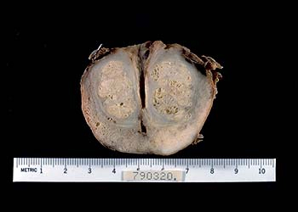
Prostatic arcinoma (dorsal, blue) + benign hyperplasia (central)

Slide 15
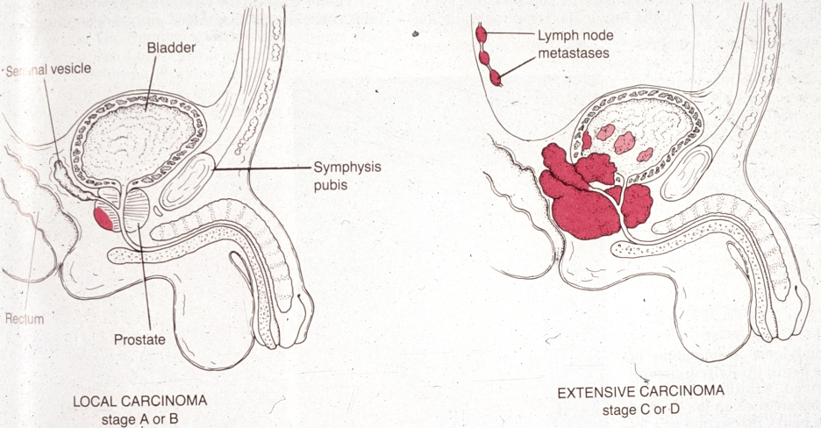
Prostatic cancer

Slide 16
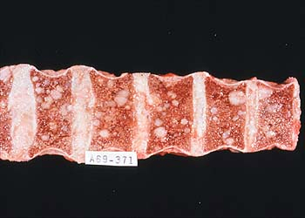
Prostatic cancer – spine metastases

Slide 17
Disorders of the testes
Congenital defects
  cryptorchidism (undescended testis) – infertility, ↑ risk of testicular cancer
Inflammation: orchitis/epididymitis, mostly bacterial (in UTI, sepsis)
Epididymis >>> testis
Viral (mumps) → possible infertility
  Testicular torsion: sudden onset of severe scrotal pain, without immediate surgery → necrosis (haemorrhagic infarction due to twisting of vessels) – ! emergency

Slide 18
Testicular tumors
Germ cell tumors
Testicular enlargement, firm consistency, may be painful
Regular testicular self-examination
Metastasis
  Regional (retroperitoneal) lymph nodes
  Lung, liver
  Bones – late metastasis (pain)

Slide 19
Germ cell tumors
~90 % of primary testicular tumors
Most common solid organ tumors in young males (15-35 years)
Classification:
  Seminoma: 4th decade, good prognosis, combined therapy
  Non-seminomatous tumors: variable types – variable age; different prognosis
Serum tumor markers:
  detection in serum, tissues
  important in diagnosis, monitoring the response to therapy, patient check-up after therapy

Slide 20
Germ cell tumors
Prognosis: early detection (stage I, limited to the testis) – 95% cured
Therapy: combination of surgery (orchiectomy, LN dissection) + radiotherapy, chemotherapy
Implications:
  Possible lymphedema, infertility + sexual dysfunction
  Side effects + toxicity of chemo/radiotherapy
  Second malignancy possible

Slide 21
Germ cell tumors Characteristics
age laboratory serum marker
Seminoma 30-50 10% HCG
Embryonal 20-30 90% HCG/AFP
carcinoma
Yolk sac <3 90% AFP
Choriocarcinoma 20-30 100% HCG
Teratoma no predilection possible HCG,AFP
Mixed tu 15-30 possible HCG,AFP

Slide 22
Penile disorders
Inflammations
  balanoposthitis (glans + inner surface of the prepuce)
    STD (gonorrhoea, genital herpes, syphilis …)
    risk factors:
      phimosis, chronic mechanical/chemical irritation
      Immunodeficiency (DM) - candidiasis

Slide 23
Penile disorders
Benign epithelial tumors
    condyloma accuminatum – viral wart
      HPV 6, 11
Malignant epithelial tumors
    invasive squamous cell carcinoma
      geography (Latin America, East Asia)
      circumcision - protective factor (↓HPV, carcinogenes in smegma)
      risk factor – smoking, occupational (mineral oil, tar)
      Macro: non-healing red patch, ulcer, verruca

Slide 24
Penile disorders
Erectile dysfunction: impotence
Risk factors: age, smoking, medical history (DM, heart disease, hypertension, obesity, alcoholism, local surgery, drugs
Causes: organic (neurogenic, venogenic, arteriogenic) x psychogenic (more common in young)
Sensitive situation /questions, diagnosis necessary
Treatment: pharmacology, prosthetic devices, pelvic floor exercises

Slide 25
Female genital tract

Slide 26
Menopause
1 year without menses
Perimenopause: hormonal decline, menstrual cycle irregularity
Physiological changes: reduced hormones‘ level incl. growth hormone, changes in tissue responsiveness mainly to estrogen throughout the body (skin, bone, muscles, heart, intestinal tract, blood vessel, brain, bladder)

Slide 27
Menopause
Clinical signs:
  Thermoregulatory + vasomotor changes (hot flashes, night sweats)
  Sleep disturbances
  Anxiety, mood swings, irritability
  Fatigue
  Pain: headache, peripheral and/or spinal joint pain
  Vaginal atrophy, infections
  Sexual dysfunction
  Pelvic floor dysfunction / prolapse

Slide 28
Menopause
Musculoskeletal system changes
Muscle mass decline, slower repair
Osteoporosis: ↑ resorption →↓ bone mass (density); risk factors: smoking, low calcium + vitamin D; beneficial: exercise
↑ peripheral (periostal) bone growth – part of osteoarthritis
↑ fracture risk
Kyphosis – spinal deformity

Slide 29
Menopause
Medical management:
Hormone replacement therapy: decreasing benefits + increasing risk with the HRT duration + postmenopausal age (thrombosis, hormone-sensitive cancers, stroke)
Alternative + complementary therapy: individual results possible; not significant benefits in studies

Slide 30
Menopause – implications for the terapists
Regular physical activity (↓ the risk for weight gain, fat distribution)
  Moderate-intensity: reduction of osteoporosis, cardiovascular disease, sleep disturbances
  Resistance training: reduction of muscle loss (+ adequate nutrition)
Pelvic floor muscle rehabilitation

Slide 31
Genital tract infections
Genital tract – open to the outside, barriers necessary
Barrier function - vaginal flora, endocervical mucus; during fertile age
Predisposing factors – nonexistent barrier (age), barrier defect (loss of protective vaginal flora, menstruation, abortion, delivery + residua, instrumentation and other mucosal microtraumata, systemic diseases, drugs,…)

Slide 32
Genital tract infections
Ascending infection most usual (sexually transmitted disease/infection – STD/STI; G- fecal bacteria – E. coli, Proteus,…)
Lower genital tract (STD – HSV, molluscum contagiosum, HPV, trichomonas, chancroid, granuloma inguinale; endogenous – candida)
Entire genital tract (STD – gonorrhea, chlamydia, mycoplasma, syphilis; endogenous – enteric bacteria), may end in pelvic inflammatory disease

Slide 33
Sexually Transmitted Infections
Sexually Transmitted Disease - STD
Infection transmitted through vaginal, anal or oral sex
Every sexually active individual is at risk
Women acquire infections from men more than men from women
2/3 of STD occur in people under 25 yrs of age
Infection by multiple agents common (↑ risk)
Fetus or infants – vertical transplacental or perinatal transmission of STD → abortus, inborn defects, neonatal infection. Diagnosis + treatment!!

Slide 34
Genital warts
May be asymptomatic; single or multiple painless cauliflower-like growths on the vulva, vagina, perineum, urethra, cervix, anus
Productive infection – low risk types (6, 11)
Other subtypes of HPV (i.e. 16, 18) strongly associated with cervical dysplasia and/or carcinoma
HPV - higher risk of vaginal, vulvar, penile, anal dysplasia/carcinoma
Some types in oral/laryngeal carcinoma
Vaccination preferably before start of sexual activity; males + females, 2 doses sufficient

Slide 35
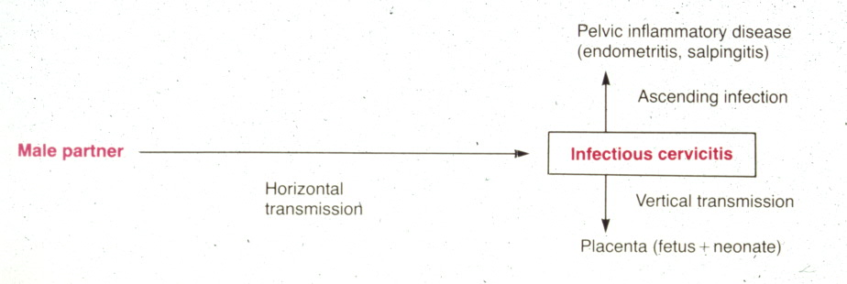
STI - complications

Slide 36
Pelvic inflammatory disease
Infection + inflammation of upper genital tract (endometritis, salpingitis – fallopian tube inflammation, tuboovarian abscess, pelvic peritonitis)
May lead to infertility, ectopic pregnancy, sepsis
Signs: pelvic pain incl. chronic, painful intercourse, painful menstruation, vaginal bleeding; in acute stage incl. fever, chills
Prevention of STD

Slide 37
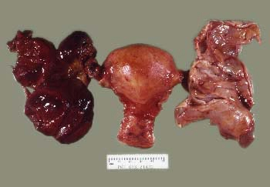
PID – chronic inflammation + ovarian torsion – hemorrhagic necrosis

Slide 38
Endometriosis
Foci of functional endometrium (glands + stroma) in an ectopic localisation – outside of the uterus; possible retrograde flow + migration, implantation, ?vascular spread, ?inborn
  Ovaries, cavum Douglasi, fallopian tubes, peritoneum, bladder, umbilical skin, … lung, bones …)
  Estrogen dependent, changes during menstruation cycle
  Hemorrhagic (chocolate) cysts, hemosiderin pigmentation, scarring
  Pain (dysmenorrhea – painful menstruation, dyspareunia), adhesions, infertility
  Possible source of endometrioid adenocarcinoma

Slide 39
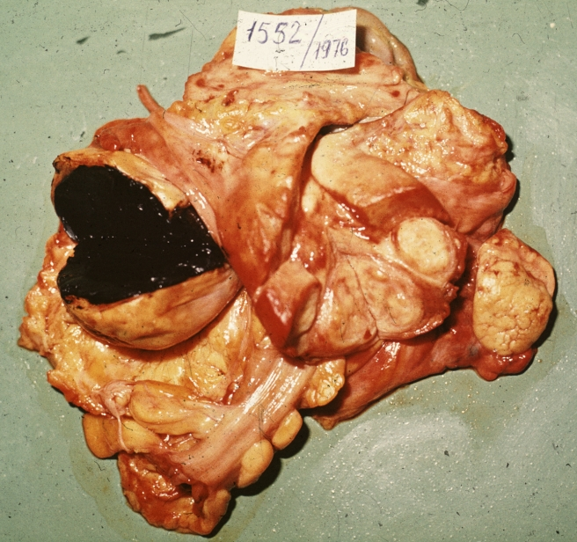
Endometroid cyst

Slide 40
Ovarian cystic disease
Non-neoplastic
  inclusion cyst: small, from superficial epithelium
  functional cyst: stages of ovum maturation/release: follicular, luteal
  polycystic ovary syndrome: systemic metabolic/hormonal disorder, obesity, infertility, male type of face/body hair,
  endometriosis
Neoplastic: according to the tissue of origin: surface epithelial tumors, germ cell tu, sex-cord stromal tu, metastatic tu, etc.

Slide 41
Ovarian cystic disease
Signs: according to the size + localization, hormone production
  Pain, abdominal pressure
  Discomfort during urination, bowel movement, intercourse
  Sudden/sharp pain: rupture, torsion
  Endometrial changes due to excessive hormone level (mostly estrogen)

Slide 42
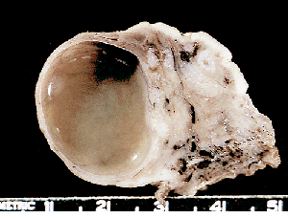
Follicular cyst
Non-ruptured (no ovulation) enlarging follicle
Prolongated estrogen release without progestins
Endometrial hyperplasia common

Slide 43
Ovarian tumors
3rd most common tumors of female genital tract
80% benign, mostly 20-45 years of age
20% malignant, 40-65 years of age, commonly late diagnosis (metastatic disease) → high mortality
Risk factors variable, according to the type of tumor
Familiar genetic factors (+ breast ca), nulliparity → risk of ovarian carcinoma
90% sporadic

Slide 44
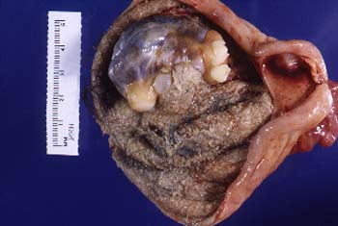
Dermoid cyst – mature cystic teratoma: most common female germ cell tumor, benign

Slide 45
Ovarian cancer
Signs: abdominal bloating/discomfort, flatulence, local pelvic pain, fatigue
No reliable screening test, marker Ca-125 used
Pelvic ultrasound possible
High risk of recurrence
Lung, liver, lymph node metastasis
Treatment: surgery (→premature menopause), chemotherapy (side effects)

Slide 46
Surface epithelial tumors
Biologic potential
Benign
  commonly in form of cystadenoma
Low malignant potential
  borderline malignancy – moderate atypias, mitotic activity, architectonic changes (multilayering, irregular papillary budding), ! no invasion, but non-invasive peritoneal implants possible
Malignant
  carcinoma

Slide 47
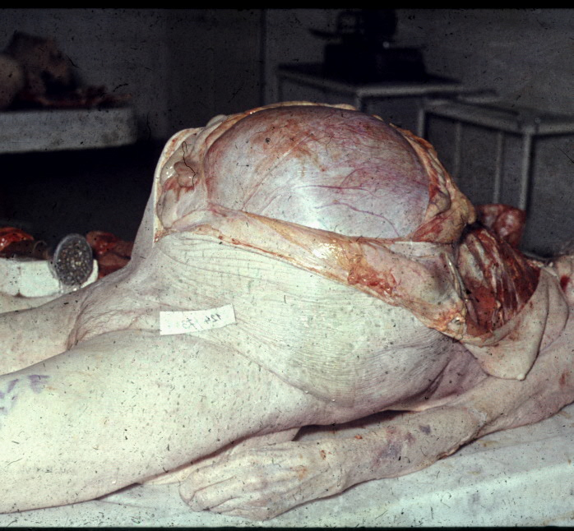
Mucinous cystic tumor of low malignant potential

Slide 48
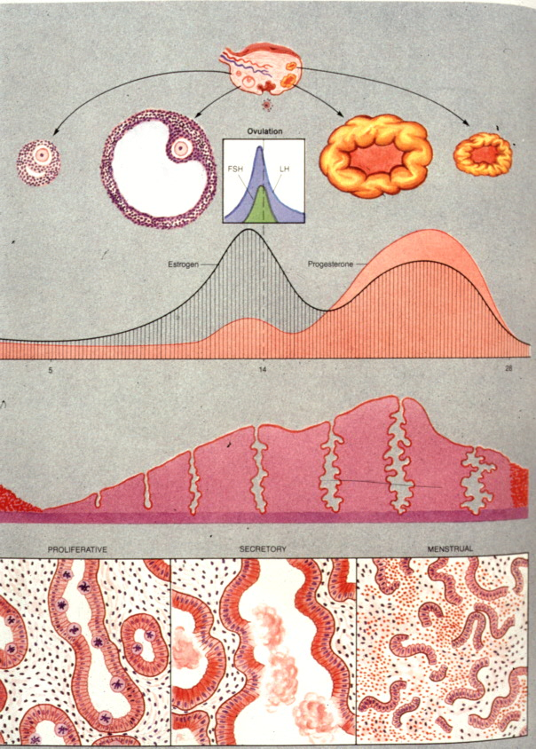
Menstruation cycle
Early proliferation
Late proliferation
Early secretion
Late secretion
Menstruation

Slide 49
Disorders of menstruation cycle
Psychogenic – sec. amenorrhea, psychogenic sterility
Hypothalamic
Pituitary – idiopatic, secondary (inflammation, tumors,…)
Gonadal
Uterine
Metabolic – endocrine (thyroid, adrenals), hepatic
Nutritional

Slide 50
Abnormal menstruation cycle
Usual clinical presentation – abnormal bleeding
Hormonal dysbalance, variable origin
Non-secretory ← abnormal estrogenic stimulation
  ↑ E → hyperproliferative → hyperplastic endometrium (anovulatory cycle)
Secretory ← abnormal progestins
  ↓ P → hyposecretory endometrium (luteal phase insufficiency)
  ↑ P exogenous (contraception) - stroma-glandular dissociation – pseudo-decidualized stroma + atrophic glands
Irregular, mixed ← E+P dysbalance
  irregular shedding – mixed secretory + menstrual + proliferative

Slide 51
Endometrial polyp
up to ¼ women during fertile life
common in climacterium
dysfunctional bleeding
possible cause of infertility
possible start/localisation of endometrial ca

Slide 52
Tumors of the uterine body
Endometrial lesions:
  Non-physiological non-invasive proliferation of endometrium, benign lesion (reactive) → premalignant condition (monoclonal)
  Endometrial carcinoma
Tumors of myometrium:
  Smooth muscle tumor: leiomyoma (fibroid)

Slide 53
Endometrial carcinoma
Most common malignant tumor of female genital tract
  2. cervical ca, 3. ovarian tumors
type I: perimenopause (55-65 years of age)
  Cca 80%
  Risk factors:
    unopposed estrogenic stimulation – endo-/exogenous
    DM, obesity, early menarche - late menopause
    Infertility, nulliparity (childless)
    Precursor: atypical endometrial hyperplasia
  Better prognosis, lymphatic spread possible

Slide 54
Endometrial carcinoma
type 2 – cca 15-20%, not directly connected with permanent estrogenic stimulation, in later postmenopause, high grade, aggressive, worse prognosis
Staging – according to the invasion into the uterine wall, cervix, surrounding structures

Slide 55
Endometrial carcinoma
Signs: abnormal bleeding – menometroragia in pre- and perimenopause, metrorrhagia in postmenopause;
uncommonly accidental finding
rarely - generalisation
Gross: exophytic, ulcerated, whitish

Slide 56
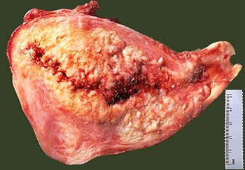
Endometrial carcinoma

Slide 57
Leiomyoma
  most common benign female tumor (usual in later reproductive age), 40-70% of females
  size: mm - cca 20 cm
  symptoms due to localisation/topography (bleeding, pain, infertility, compression of adjacent organs)
  in pregnancy ↑ risk of abortion, uterine rupture, possible barrier of normal delivery
  uterus myomatosus (multiple leiomyomas)
  common regressive changes (edema, fibrosis, hyalinisation, calcification)

Slide 58
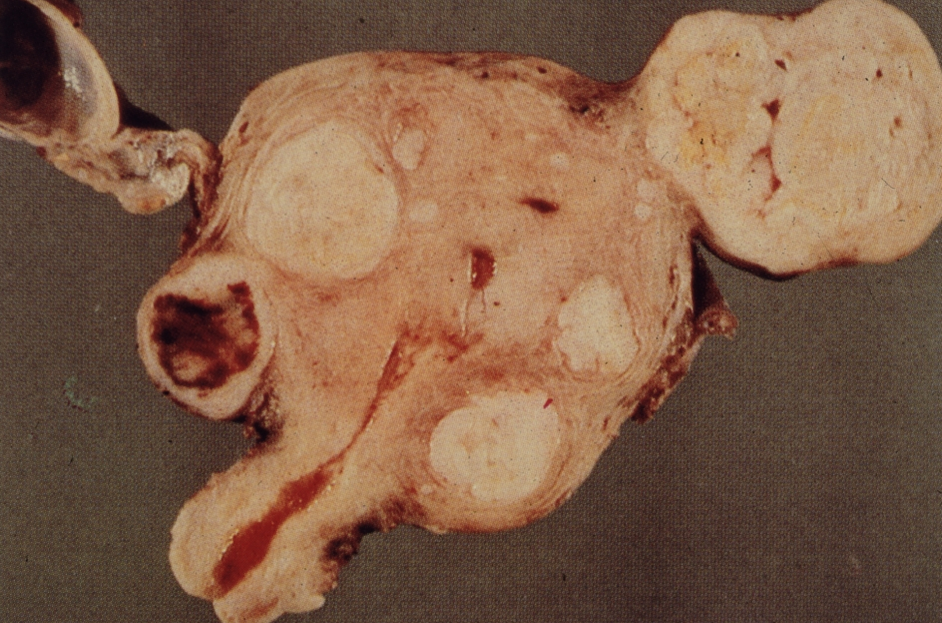
Leiomyoma

Slide 59
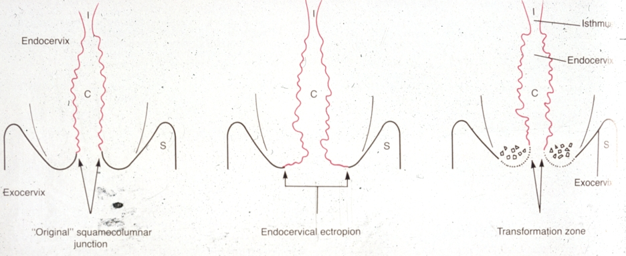
Cervical epithelium
Transformation zone: immature epithelium, risk zone for HPV infection, preneoplastic changes

Slide 60
Cervical cancer - precursors
LR (low-risk) HPV (6,11) →→ koilocytic atypia of squamous cells
Cervical dysplasia – intraepithelial neoplasia associated with HR (high-risk) HPV:
  HR HPV:
    16, 18, 31, 33, 35
  deregulation of the cell cycle, ↑ proliferation, ↓ or arrested maturation
Other risk factors: smoking, high number of births, multiple sexual partners, young age at 1st intercourse (˂17 years), oral contraceptives (in combination with other risk factors), ↓ immunity, other STD

Slide 61
Cervical cancer - precursors
2 categories of cervical epithelial lesions, according to the risk of progression and clinical management:
  LSIL (low-grade squamous intraepithelial lesion)
  = CIN I (cervical intraepithelial neoplasia), exophytic or flat condylomatous lesion
    mostly self-limited (viral clearance), productive infection, lower rate of progression
    only regular check in young, local excision in older females
  HSIL (high-grade squamous intraepithelial lesion)
  = CIN II/III + carcinoma in situ (non-invasive carcinoma)
    majority persists or progresses to invasive carcinoma
    treatment necessary in any age (very careful observation in pregnancy, CIN II in young females)

Slide 62
Invasive cervical squamous cell carcinoma
almost always by HSIL progression
mostly starts in the transformation zone
growth:
  local progression
    size + depth of the invasive component (bleeding)
    direct invasion into adjacent organs (bladder, rectum), fistulae
    regional LN metastases
  distant metastases via blood (lung, liver, bone marrow)
↑ incidence, but mostly lower stages (if screened), ↓ mortality
Treatment side effects common
Prevention: vaccination (incl. males), most common types are covered by the immunization, crossed immunity possible; further evolution ? – spread of less common types possible

Slide 63
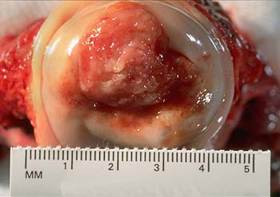
Cervical cancer

Slide 64
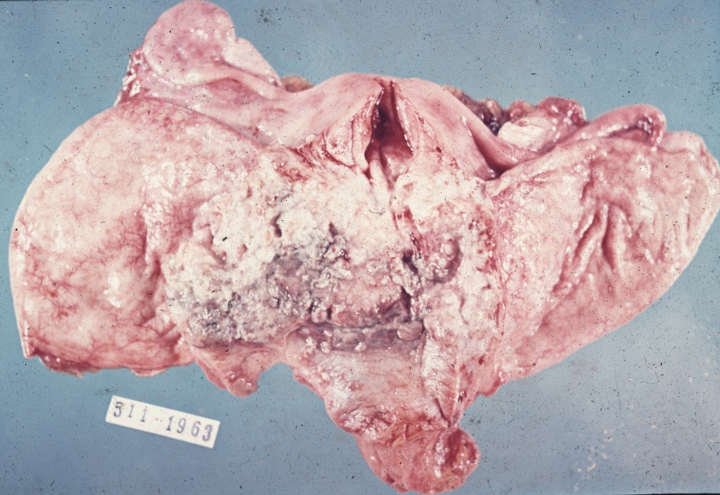
Cervical cancer – late stage

Slide 65
Pelvic floor disorders
Lesions of variable pelvic structures:
  Organ based / medical treatment (UTI, PID, …)
  Common musculoskeletal disorders (lumbar, sacroiliac dysfunction) – treated by most physical therapist
  Special musculoskeletal disorders (painful bladder syndrome, pelvic floor muscles dysfunction) - treated by specialist physical therapist

Slide 66
Pelvic floor disorders
Pelvic organ prolapse
Cystocele: bladder prolapse (loss of support), displacement of the bladder, bulging of anterior vaginal wall
Rectocele: rectum prolapse, bulging of posterior vaginal wall
Uterine prolapse: herniation of the uterus into vagina, variable stages, protrusion to the outside possible

Slide 67
Pelvic floor disorders
Risk factors: multiple pregnancies, familial risk, aging, history of heavy weight lifting, obesity, chronic constipation, chronic cough
Signs varible, not directly related to the stage
  Sense of heaviness/pressure in perineum
  Foreign „lump“ in the vagina
  Backache, bleeding (irritation)
  Cystocele: frequency/urgency, incontinence
  Rectocele: incomplete emptying, constipation

Slide 68
Pelvic floor disorders
Treatment:
  surgery,
  mechanical treatment (pessary)
  Conservative: pelvic floor muscles rehabilitation/strengthening, biofeedback, stimulation
! Exacerbation of prolapse during other exercises (increased intraabdominal pressure)

Slide 69
Breast

Slide 70
Benign breast disorders
Benign epithelial lesions
benign alterations in ducts and lobules
common lesions (benign breast changes)
classification according to the risk of developing subsequent breast carcinoma
  Nonproliferative/non-atypical lesions (cyst, fibrosis, usual hyperplasia, …) no risk
palpable irregularities (lumps, granularity), +/-tender
etiology:
    hormone dependent
    inflammation-associated
  diff. dg.: malignant tumors

Slide 71
Benign breast disorders
Symptom + findings
  Cyclical swelling, tenderness
  Breast pain
  Cysts
  Nodularity
  Nipple discharge
  Infections, inflammations

Slide 72
Benign breast disorders
Fibroadenoma
  Most common breast tumor in young females (peak incidence before 30 years)
  Benign, circumscribed, mobile, rubbery
  May be painful before menses
  Proliferating ducts + increased amount of stroma

Slide 73
Breast cancer
  Atypical hyperplasia (ductal, lobular)– 5x ↑ risk of invasive cancer
Carcinoma in situ: intraductal (DCIS)
lobular carcinoma in situ (LCIS)
Monoclonal neoplastic lesions
Direct precursors of invasive cancer
High relative risk of subsequent invasive carcinoma (10x)
Histopathological diagnosis necessary

Slide 74
Breast cancer
commonest malignancy in females in high-income countries
rising incidence
falling mortality
  screening + better diagnostics
  known modifiable risk factors
  more effective therapy
metastases
  lymphatic spread – regional LN (mostly axillary)
  hematogenous spread (bones, lung, liver, brain…)

Slide 75
Breast cancer
Risk factors:
  Age (65+ x younger)
  High endogenous estrogen levels, chronic inflammation (incl. obesity)
  Early menarche (˂12 years), late menopause (˃55 years)
  No full-term pregnancy, no breastfeeding
  Late age (˃30 years) at first full term pregnancy
  Smoking, alcohol
  Radiation exposure
  Hormone replacement therapy (long-term)

Slide 76
Breast cancer
Sporadic carcinomas (≈95%)
  accidental sequential mutations
  mostly perimenopausal/postmenopausal, old age (50-75)
Familial carcinomas (≈ 5%)
  hereditary mutations in some TSG (BRCA1, BRCA2…)
  typical in young females (after age of 20)
  possible multicentric, bilateral → prophylactic mastectomy
  ↑ risk of ovarian carcinomas

Slide 77
Breast cancer
Invasive carcinoma of non-specific type (former invasive ductal carcinoma)
Invasive lobular carcinoma
Others
Screening: mammography, ultrasound
Signs: palpable mass, firm, irregular, painless
  New asymmetry, distortion
  Nipple discharge
  Axillar lympadenopathy

Slide 78
Breast cancer
Diagnosis by histopathology
  Core-cut biopsy
  Excision
Molecular markers important for diagnosis, prognosis, treatment
Combined treatment:
  Surgery
  Radiation
  Hormonal therapy
  Biologic therapy
  Chemotherapy

Slide 79
Breast cancer - implications
Possible help with diagnosis
  Upper quadrant symptoms of unknown origin
  Axillar lymphadenopathy – compression of adjacent structures
  Signs of recurrence; local/regional/distant metastasis
Preoperative assessment of general and local functional status
Postoperative rehabilitation, complications and their prevention (lymphedema, decreased range of movements, scarring)
Side effects of chemo-, radiotherapy, hormonal therapy, …

