Slide 1

4H 4T
.
Pavel Štětka, MD
ARK FNUSA Brno

Slide 2
4H 4T
H-K, Ca , Mg T-toxiny
Pavel Štětka, MD
ARK FNUSA Brno

Slide 3
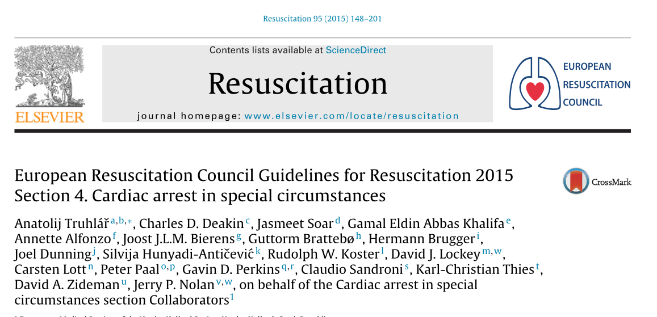

Slide 4
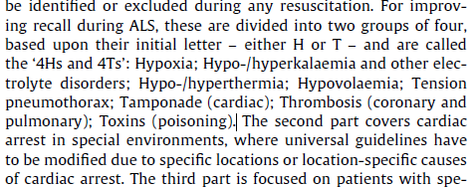

Slide 5

72year men with DM II type-insulin depend., CKD on chronic haemodialysis emergency bcs.- dyspnoe, 2 min CPR
A+B :oti+VCV
C :PEA
D : coma

Slide 6
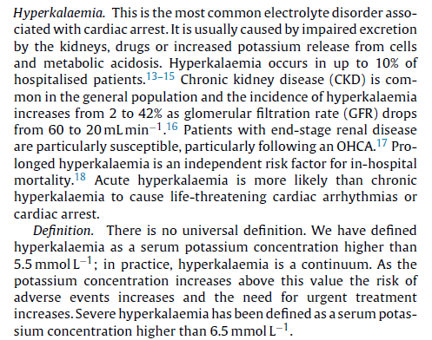

Slide 7
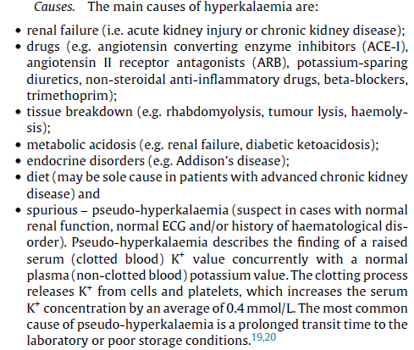

Slide 8
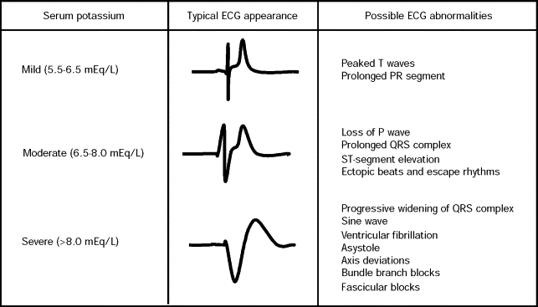

Slide 9
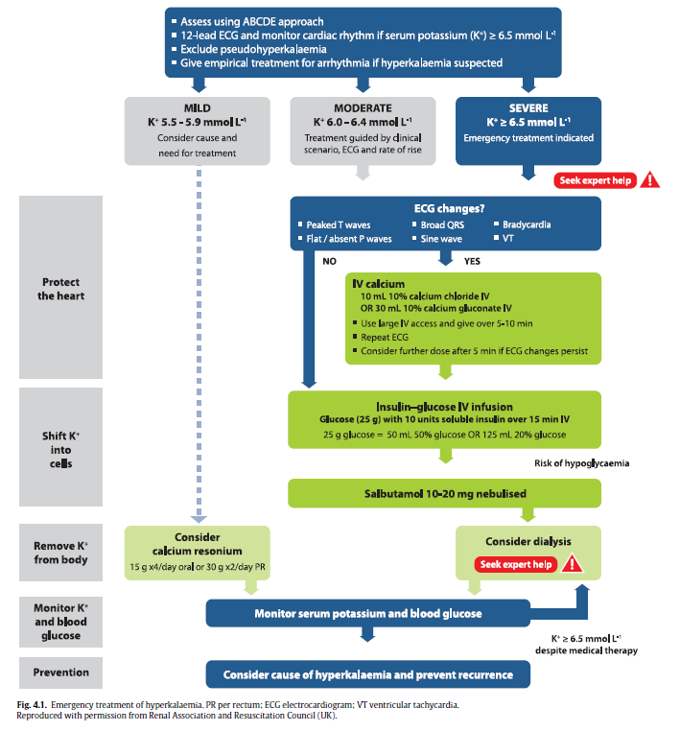

Slide 10
27 year men , psoriasis emergency bcs.- coma, hypotension, bradycardia
A+B : spont ventilation-RF 10, spo293%,
C : BP 75/45 HR sinus.bradycardia 42/min
D : GCS E1 V2 M5

Slide 11
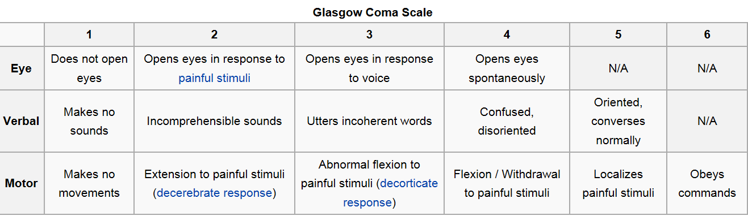

Slide 12
cardiac arrest and intoxication
Rare cause
Young people
Cause of CPR- cardiotoxicity +secondary insult- airway obstruction , aspiration, hypotension
Prolonged CPR –how long?
Toxicology center in CR

Slide 13
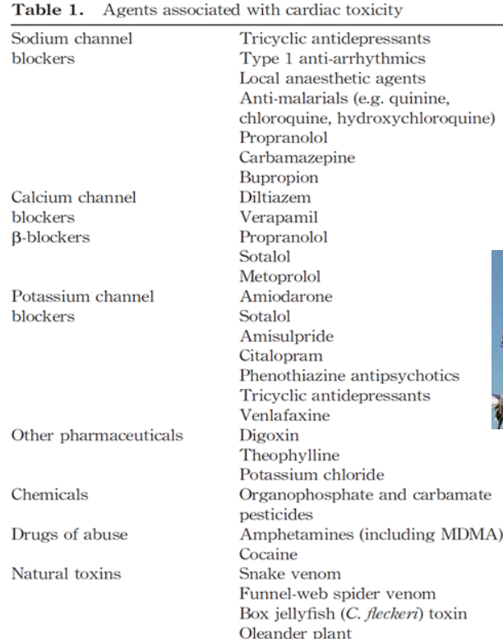

Slide 14
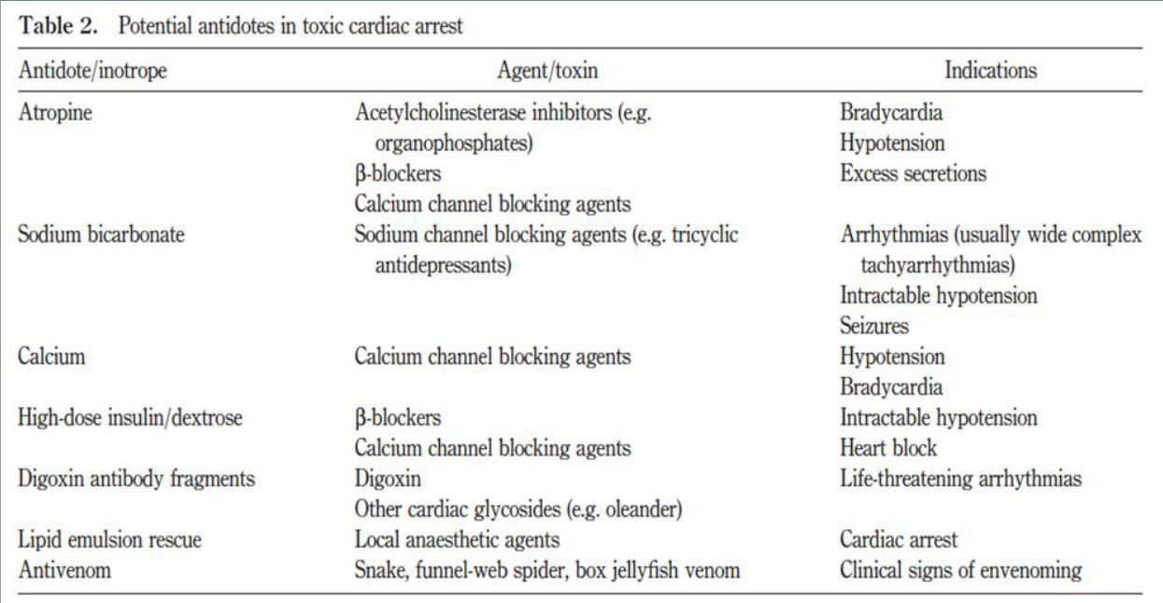

Slide 15
