Slide 1
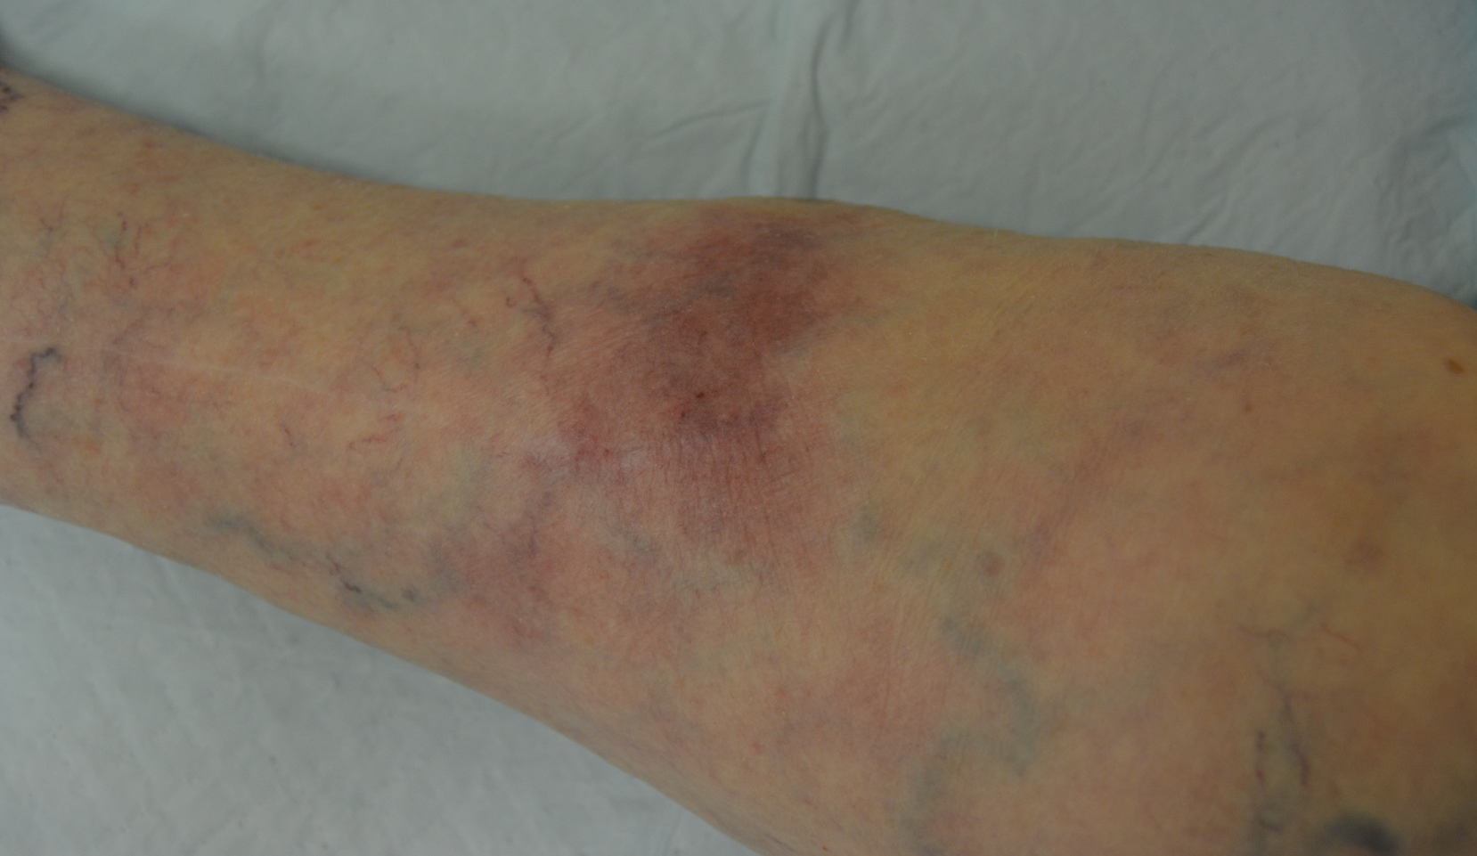
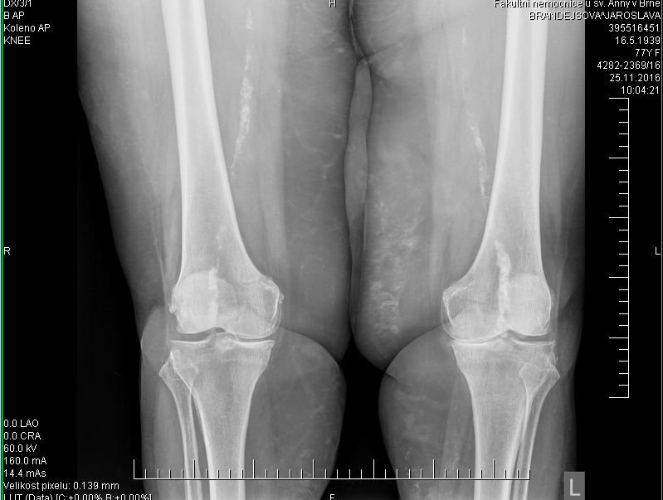
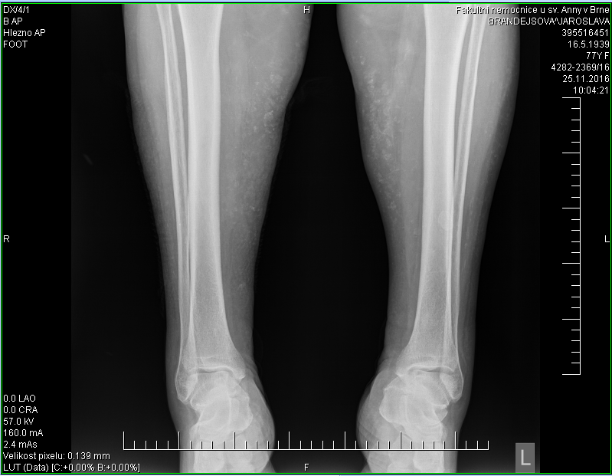
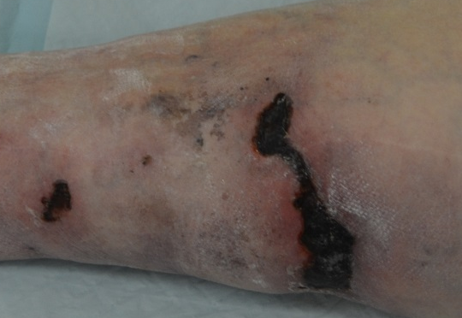
The case of nonuremic calciphylaxis in a polymorbid female
M. Nečas, V. Vašků
Ist. Dept. of Dermatovenereology, Masaryk University Faculty of Medicine and St. Anne’s Faculty Hospital in Brno
Introduction
Calciphylaxis, or calcific uremic arteriolopathy, is a rare condition that develops on the basis of obliterating calcification of small and medium vessels, resulting in tissue ischemia and necrosis.
It is a very serious, progressive disease that often has a fatal outcome. It affects primarily dialyzed patients, but can also occur in nonuremic patients. It appears mostly in the 5th decade of life and it is more common in women than men (2-3: 1). It affects mostly the white race. The prognosis is extremely unfavorable with mortality up to 80%. Initially it presents with painful livid lesions similar to livedo reticularis or panniculitis. Sometimes the formation of hemorrhagic blisters and usualy development of ulcerations with black necrotic crusts follows. The lesions are mostly located on the legs (distal type) or in the area of adipose tissue in buttocks, thighs, abdomen or chest (proximal type), rarely affecting acral parts of the body (fingers, genitalia).
In the treatment a multidisciplinary approach is necessary. Local defect treatment or debridement is applied, sometimes vacuum therapy or larvotherapy (Lucilia sericata) is recommended. Systemic antibiotics are often needed for the prevention of defect infection. Hyperbaric oxygen therapy may be helpful. Supportive analgesic treatment (opioids rather than NSADs) is necessary in most cases. Other therapeutic options include sodium thiosulphate, increased dialysis frequency (to reduce phosphorus levels), kidney transplantation, phosphate binders - sevelamer, lanthanum, bisphosphonates (etidronate), calcimimetics - cinacalcet, parathyroidectomy or vitamin K.
Case description
Results and outcome:
According to the clinical picture and finding of calcifications in soft tissues and lower limb vessels on the X-ray images (figure 3 and 4), a suspicion of calcific uremic arteriopathy (calciphylaxis) was raised and the patient was thoroughly examined. She had slightly elevated creatinine and CRP, mild anaemia, positive ANA (1:80 – nuclear type). Other examinations were without any pathology, including calcium, phospate, parathormone and vitamin D levels. Yet overdose of vitamin D and calcium substitution treatment after thyroidectomy with parathyreoidectomy was considered as triggering factor of calciphylaxis and therefore this substitution therapy was terminated. The etiology of calciphylaxis in this patient however seems to be more complex with chronic inflammation, diabetes, corticotherapy, and atherosclerosis of lower limb blood vessels as contributing factors. Subsequently, she was released home with local wound healing treatment. But she he did not appear for further check ups and by phone contact with the patient's son it was found that an amputation of the right leg had been required because of extensive gangrene and that the patient had subsequently died in February 2017.
A a 78-year-old polymorbid female (coronary artery disease, angina pectoris syndrome, ischemic disease of the lower limbs, metabolic syndrome, obesity, autoimmune hepatopathy on low dose corticosteroid treatment, and thyroid and parathyroidectomy many years ago) was reffered to our department with about 3 months lasting livid infiltrates (figure 1) on both legs in November 2016. At that time the lesions exulcerated to produce two necrotic defects on the right shin (figure 2).
The patient was admitted to our clinic to specify the diagnosis and for further treatment
Fig. 1: livid infiltrates (figure 1) on the right leg
Risk factors of calciphylaxis:
Renal failure (with dialysis) with hyperphosphatemia, hypocalcaemia,
secondary hyperparathyroidism and vitamin D deficiency
Obesity, diabetes mellitus, malnutrition, malignancies
Autoimmune diseases (SLE, RA, antiphospholipid sy ..)
Hepatic disease, high serum aluminum level
Warfarinization, corticotherapy, trauma (eg., insulin injection)
Hypercoagulable states: protein C, S and antithrombin III deficiency
Administration of calcium salts and vitamin D analogues
Fig. 3 and 4: calcifications in soft tissues and lower limb vessels
Conclusion:
It is necessary to think of calciphylaxis not only in uraemic patients but also in non uraemic polymorbid patients, with risk factors, incl. coagulopathy and chronic inflammation.
Treatment must be multidisciplinary. Better understanding of etiopathogenesis could lead to more effective management of this serious condition.
Fig. 2: two necrotic defects on the right shin

