Slide 1
Autosomal dominant disorders
General information regarding AD inheritance

Slide 2
Autosomal dominant - definition
Genetics referring to a mode of inheritance, in which the presence of only one copy of a gene of interest on one of the 22 autosomal chromosomes, will result in the phenotypic expression of that gene
In other words: only one of the two homologous genes is mutated and although another normal gene is present (heterozygosity), the illness still appears

Slide 3
Rules for autosomal dominant inheritance
Both males and females express the allele and can transmit it equally to sons and daughters
Every affected person has an affected parent
In affected families, the ratio of affected to unaffected children is almost always 1:1
If both partens are unaffected, all the children are unaffected

Slide 4
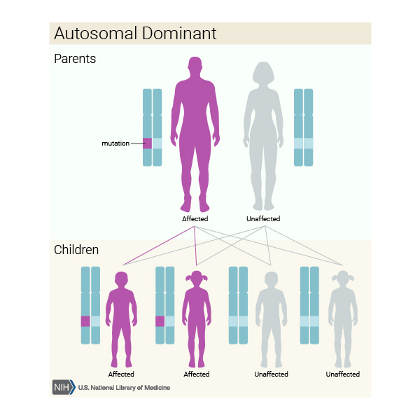

Slide 5
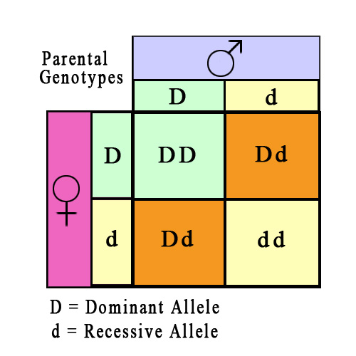
Estimation of risk
Using a Punnett square, based on Mendel´s laws
B – dominant allele, BB – homozygote, Bb – heterozygote
For the offspring of a heterozygote and an unaffected homozygote:
Bb x bb → 1Bb, 1bb → ½ or 50%
For the offspring of two heterozygotes:
Bb x Bb → 1BB, 2Bb, 1bb → ¾ of 75%
For the offspring of a dominant homozygote (extremely rare) with an unaffected partner:
BB x bb → Bb → 1 or 100%

Slide 6
Autosomal Dominant Disorders
Specific information regarding a select few disorders

Slide 7
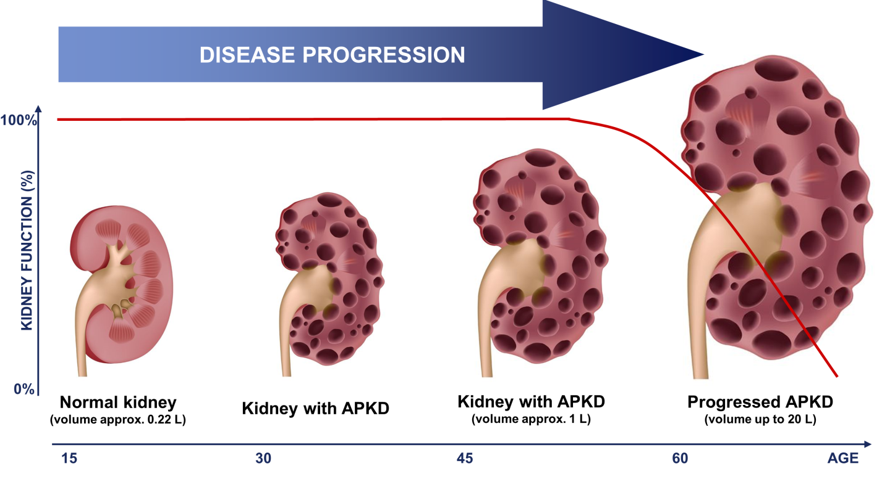
AD Polycystic Kidney Disease
Mutated gene - PKD1 and PKD2 (Polycystic Kidney Disease gene)
Pathophysiology - Mutated PKD1 or 2 plus a mutation in anything which can result in cell proliferation causes dilation of the tubules and fluid secretion. Once the cyst expands to more than 2mm, it closes off from the parent tubule and then fluid can enter only via transepithelial secretion - this leads to slowly enlarging cysts.

Slide 8
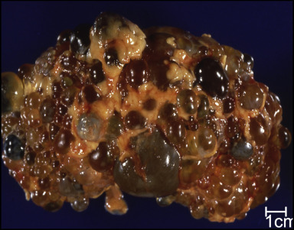
PKD contd.
Symptoms - Acute loin pain, Haematuria, Hypertension, Uremia due to Kidney failure, Anemia due to Chronic Kidney disease.
Treatment - Aquaretics, Analgesics, Renal Cyst Aspiration, Laparoscopic Cyst Decortication, Chemical Ablation of the Celiac Plexus, Nephrectomy, Dialysis, Transplant.
Prognosis - GFR remains normal for decades before kidney function starts to progressively deteriorate.

Slide 9
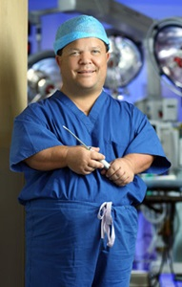
Achondroplasia
Mutated gene – FGFR3 - Fibroblast Growth Factor 3 mutation
Pathophysiology - In normal development FGFR3 has a negative regulatory effect on bone growth. In achondroplasia, the mutated form of the receptor is constitutively active and this leads to severely shortened bones. Cartilage is not able to fully develop into bone, causing the individual to be disproportionately shorter in height.

Slide 10
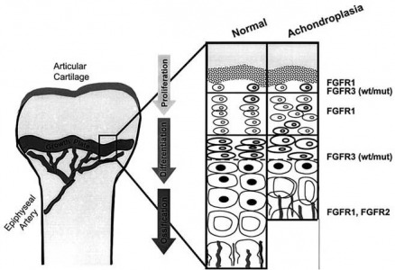
Achondroplasia contd.
Symptoms – Disproportionate dwarfism, shortening of proximal limbs, Short fingers and toes, Large head with prominent forehead frontal bossing, small midface with flattened nasal bridge, varus or valgus deformities, frequent ear infections
Treatment – No known cure. Controversial limb-lengthening surgery
Prognosis - Very good.10 years shorter life expectancy.

Slide 11
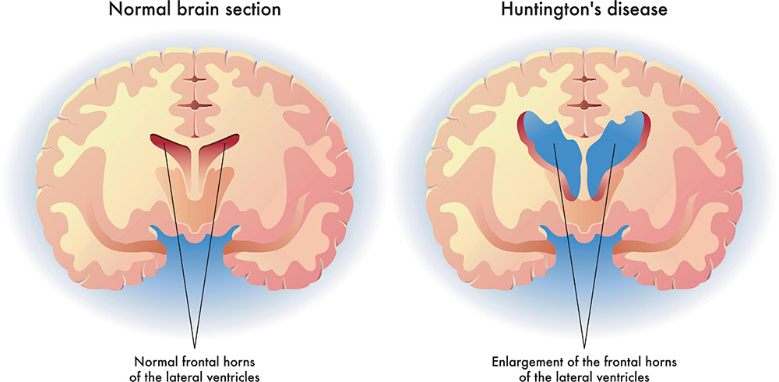
Huntington’s disease
Mutated gene – HTT (Huntingtin gene)
Pathophysiology - The mutated form of the Huntingtin gene is toxic to certain cell types in the brain. It is this brain cell death that results in the symptoms

Slide 12
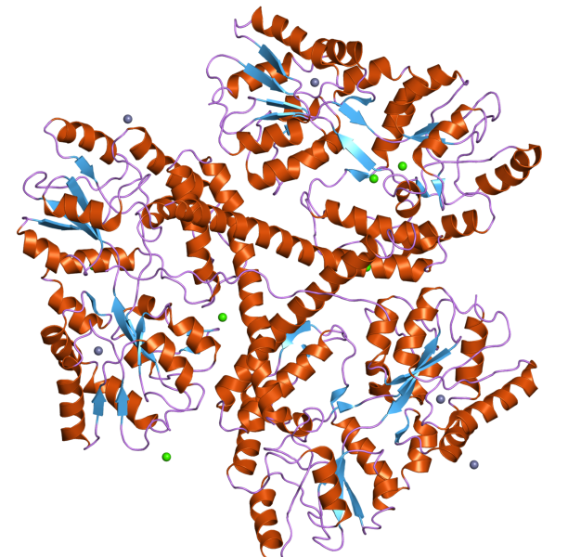
HD contd.
Symptoms – Subtle problems with mood/mental abilities. Decreased coordination, unsteady gait progressing to uncoordinated, jerky body movements, inability to talk. Dementia.
Treatment – No cure. Caregiving.
Prognosis – 15-20 years from diagnosis

Slide 13
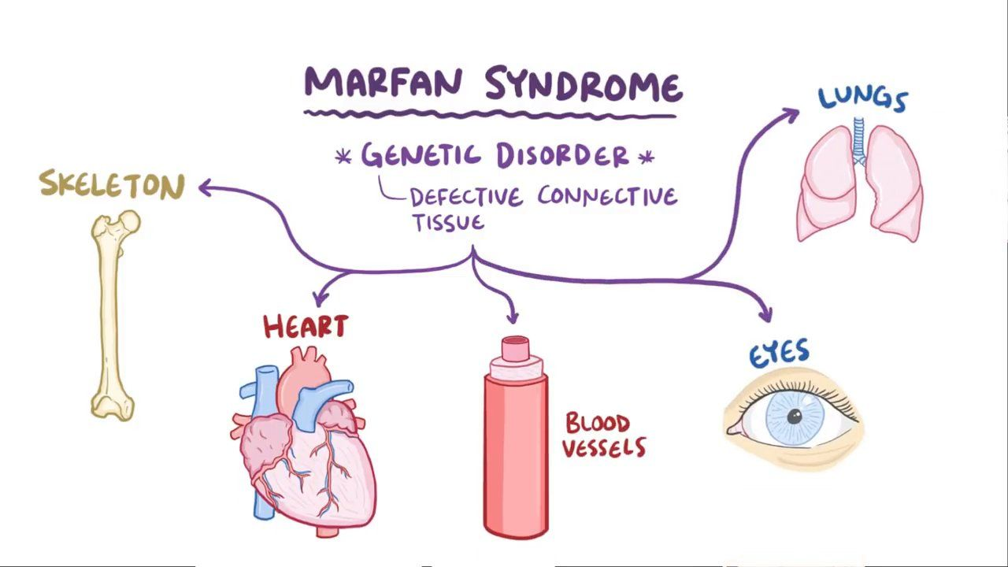
Marfan Syndrome
Mutated Gene – FNB1 (Fibrillin 1)
Pathophysiology – Fibrillin 1 is a glycoprotein component of the extracellular matrix. It is essential for proper formation of the ECM, including biogenesis and maintenance of the elastic fibres.

Slide 14

Marfan Syndrome contd.
Symptoms – Tall, thin build. Long arms, legs and fingers. Flexible fingers and toes, scoliosis. Increased risk of mitral valve prolapse and aortic aneurysm.
Treatment – No cure. Regular check-ups to monitor heart health (valves and aorta). Medication to prevent aortic dilation (antihypertensives)
Prognosis – Often normal life expectancy

Slide 15
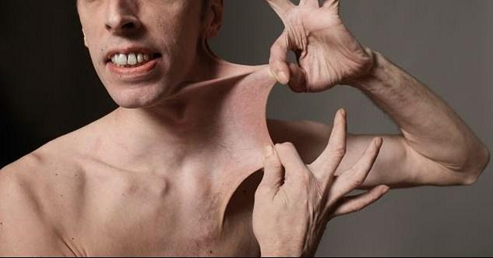
Ehlers-Danlos Syndrome
Mutated Gene – Any from a number of various genes regarding Collagen and GAG biosynthesis.
Pathophysiology - Defects in structure and processing of collagen resulting in clinical symptoms.

Slide 16
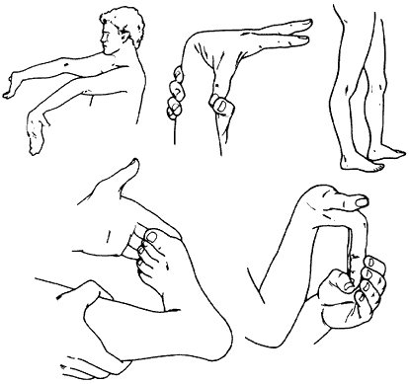
EDS contd.
Symptoms – Loose joints, joint pain, stretchy skin, abnormal scar formation. Aortic dissection, Joint dislocations, scoliosis, early osteoarthritis.
Treatment – No cure. Supportive treatment, physical therapy to strengthen muscles and joints.
Prognosis - Normal life expectancy unless it is a form which affect blood vessels.

Slide 17
References
Pritchard, Dorian J. and Korf, Bruce R. (2013), Medical genetics at a glance, 3rd edition
https://ghr.nlm.nih.gov/primer/inheritance/inheritancepatterns
https://knowgenetics.org/patterns-of-inheritance/
https://en.wikipedia.org/wiki/Polycystic_kidney_disease
https://en.wikipedia.org/wiki/Achondroplasia
https://en.wikipedia.org/wiki/Huntington
https://en.wikipedia.org/wiki/Marfan_syndrome
https://en.wikipedia.org/wiki/Ehlers%E2%80%93Danlos_syndromes

