Slide 1
Cystic Fibrosis
Daniela Strasser
Pubudu Wanni Arachchige

Slide 2
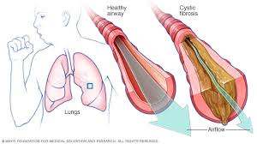
What is it?
Cystic Fibrosis is a heredity disease that affects the lungs, the digestive tract, pancreas, liver and kidneys
The body produces thick and sticky mucus and secretions that can clog the lungs and obstruct the pancreas
Different people have different degrees of symptoms
There is no known cure

Slide 3
Etiology
CF is due to a mutation in the CF gene on chromosome 7
The CF gene encodes a protein known as the cystic fibrosis transmembrane regulator (CFTR), which is a chloride channel essential in production of sweat, digestive juices and mucus.
The abnormal CFTR protein in the patients with the disease leads to disruption of this chloride channels on the cells

Slide 4
Etiology
Chloride channel disruption prevents them from regulating the flow of chloride ions and water across the cell membranes
As a result, cells that line passageways of lungs, pancreas, etc. produce mucus that is unusually thick and sticky, clogging the airways and various ducts
Several mutations of the gene can occur, which determines the severity of the symptoms

Slide 5
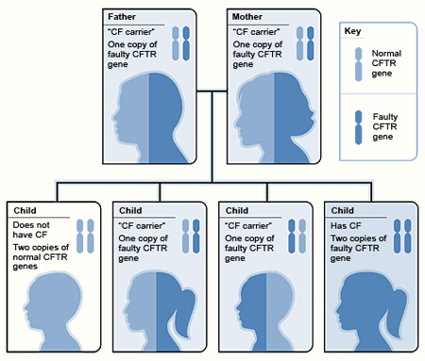
Etiology
The disease is inherited autosomally recessive
It means that the parents each carry one copy of the mutated gene but they don't show signs and symptoms

Slide 6
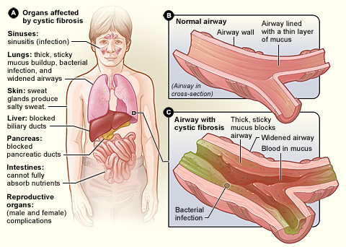
Symptoms
Salty-tasting skin
Persistent coughing
Shortness of breath and wheezing
Malnutrition and poor growth due to obstruction of the pancreatic digestive enzymes, which cause pancreatitis
CF’s obstruction of the lungs and impaired mucociliary clearance increase the risk of lung infections (bronchitis and pneumonia)
Increased risk of diabetes and osteoporosis
Infertility (male – congenital absence of vas deferens)
Meconium ileus in newborns

Slide 7
Epidemiology
CF is the most common life-limiting autosomal recessive disease among people of European heritage
around 1 in 25 people of Northern European descent and 1 in 30 of Caucasian Americans is a carrier of a CF mutation
Although technically rare, CF is ranked as one of the most widespread life-shortening genetic diseases

Slide 8
Diagnosis
Newborn screening using a genetic test or a blood test. The genetic test shows whether a newborn has faulty CFTR and the blood test shows newborn’s pancreas function
Sweat test: doctor triggers sweating by applying pilocarpine on skin and then he uses and electrode to provide a mild electrical current to deliver the medication through he skin. The sweat is collected on a pad/paper and then analyzed . High levels of salt confirm diagnosis of cystic fibrosis
Couple planning for pregnancy or are expecting can test for CFTR mutations and calculate the risk for the child

Slide 9

Treatment
There is definite cure but management of the disease can allow survival well into adulthood
Antibiotics: many CF-patients are on one or more ATB at all times, even when healthy, to prophylactically suppress infection
Airway clearance: for example postural draining and percussion to get rid of mucus in lungs, chest physiotherapy
Aerosolised medication loosen secrections like hypertonic saline

Slide 10
Treatment
Nutritional therapy: pancreatic enzyme supplements, vitamin supplements
Ibuprofen and azithromycin have been found to preserve and improve lung function
CFTR modulators: newer drugs targeting faulty CF-causing gene
Lung transplant

Slide 11
Sources
https://www.medicalnewstoday.com/articles/147960#treatment
https://www.medicinenet.com/cystic_fibrosis/article.htm
https://www.cff.org

