Slide 1
Hereditary cancer syndromes
Jesika Agarwala
Dorthe Aslaksen
Leonor Conceicao

Slide 2
Content
General information
Hereditary breast and ovarian cancer syndrome
Li-Fraumeni syndrome
Cowden syndrome
Lynch syndrome
Familial adenomatous polyposis
Peutz-jeghers syndrome

Slide 3
General
A hereditary cancer syndrome is a type of inherited disorder in which there’s a higher than normal risk of certain types of cancer
Caused by mutations in certain genes passed from parent to child
Mutations: inherited x acquired (somatic)
Most cancers are caused by acquired mutations
Cancer running in families due to similar behaviour x cancer running in families due to inherited genetic mutations
Pattern of cancer can be seen in families
Several close family members with same type of cancer
Cancer at early age
Two or more cancer types in the same person
Notes:
https://www.cancer.gov/publications/dictionaries/cancer-terms/def/hereditary-cancer-syndrome
https://www.cancer.org/cancer/cancer-causes/genetics/family-cancer-syndromes.html

Slide 4
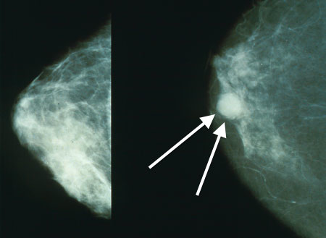
Hereditary breast and ovarian cancer syndrome
Due to autosomal-dominant inherited gene mutation in BRCA1 or BRCA2 genes
Risk is higher with BRCA1 mutations
Positive family history
BRCA: tumour suppressor gene coding for a DNA repair protein
Increased risk of breast and ovarian cancer, and some other types like fallopian tube cancer, primary peritoneal cancer, male breast cancer etc.
Breast cancer is the most common malignancy in women
BRCA mutation in 5-10% of all women with breast cancer
BRCA positive women develop breast cancer 15-20 years earlier than women without the mutation, bilateral breast cancer is more common in addition to other cancers subsequently
Notes:
https://next.amboss.com/us/search/BRCA
https://www.cancer.org/cancer/cancer-causes/genetics/family-cancer-syndromes.html

Slide 6
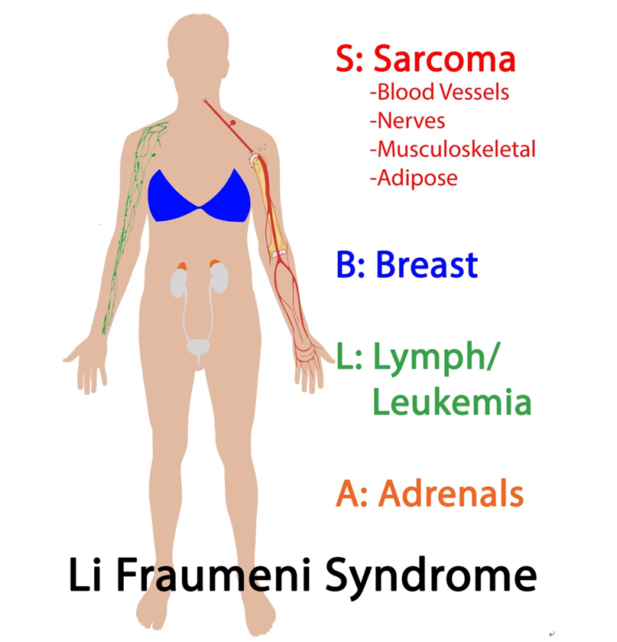
Li-Fraumeni syndrome
Autosomal-dominant mutation of p53 tumor suppressor gene
Normally: p53 is expressed as a result of DNA damage → cell cycle arrest
→ repair. DNA can’t be fixed; Apoptosis of cell.
Predispose to cancer development
Presentation
Early cancer development
Variety of primary cancers in the same person
Development of multiple cancer types throughout life
Classical LFS malignancies: sarcoma, breast, brain and adrenal glands (80%)
Breast cancer is especially high risk → females have almost 100% lifetime risk of developing cancer
Males: 73% lifetime risk
Risk of developing invasive cancer in LFS
By age 30: 50% in LFS, 1% in healthy person
By age 70: 90% in LFS, 18% in healthy person
Notes:
https://next.amboss.com/us/article/_k05qT#Z1985a31dbf1506f09075f6ab891e8653
https://en.wikipedia.org/wiki/Li%E2%80%93Fraumeni_syndrome
https://www.ncbi.nlm.nih.gov/pmc/articles/PMC4544764/

Slide 7
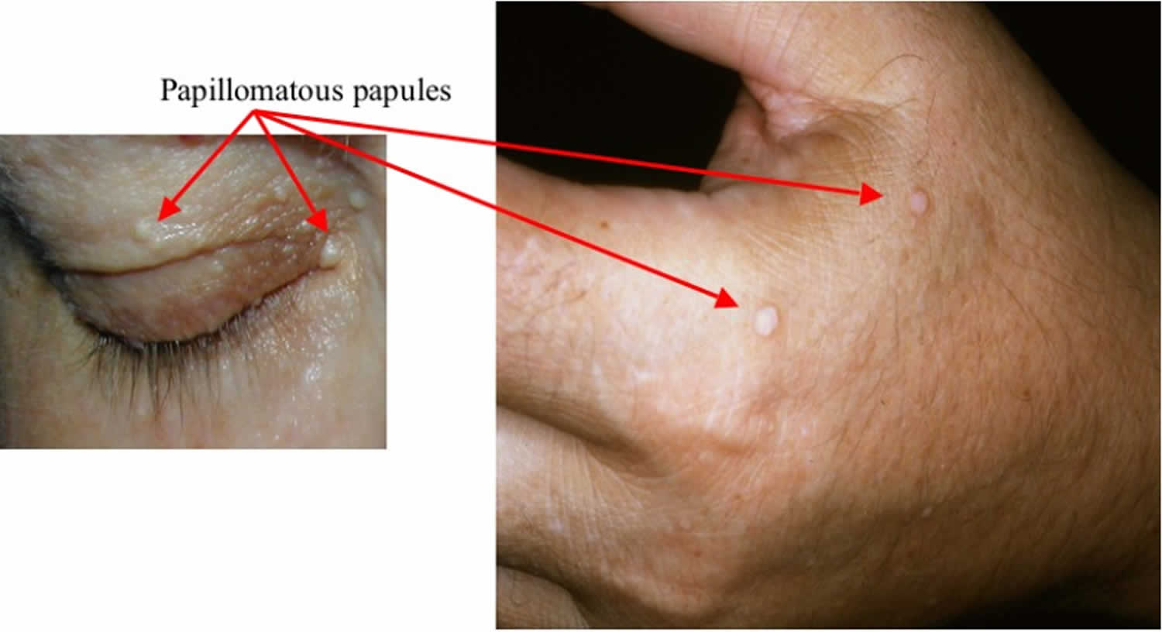
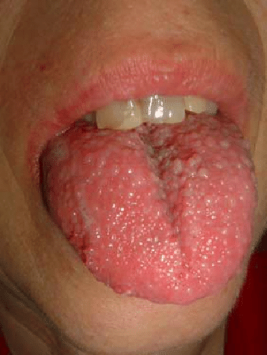
Cowden syndrome
Also known as multiple hamartoma syndrome
Autosomal dominant mutation of tumour suppressor gene PTEN
PTEN gene negatively regulates receptor tyrosine kinase pathway and facilitate repair of DNA errors
Characterized by multiple overgrowths of hamartomas
Multiple GI polyps
Skin and mucous membranes: papules, hyperkeratosis
Thyroid disorders in >50% (multinodular goiter, adenoma)
Benign breast disorders: fibroadenomas, intraductal papillomas
Associated malignancies:
breast adenocarcinoma,
thyroid adenocarcinoma,
skin SCC
Notes:
https://next.amboss.com/us/article/US0b_2#Z84269f80a825854f962ffe97bda750be
https://en.wikipedia.org/wiki/Cowden_syndrome

Slide 8
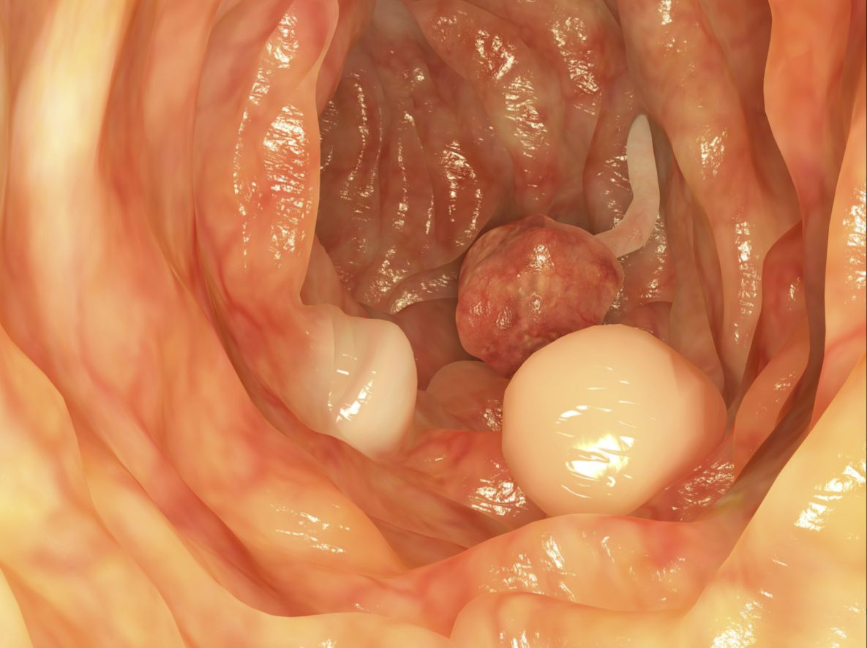
Lynch syndrome
Hereditary nonpolyposis colorectal cancer
Autosomal dominant mutation in mismatch repair genes (varying penetrance)
Associated with higher risk of colorectal, gastric and endometrial cancer
Most common cause of inherited CRC
Development of a small number of colonic adenomas with a significant risk of malignant change
70-80% lifetime risk of developing CRC
Average onset: 44 years old
Patients are often asymptomatic until they
present with symptoms of advanced cancer
Notes:
https://next.amboss.com/us/article/fS0k_2#Z223291f8ddc1791ddb38550c25b8a05c

Slide 9
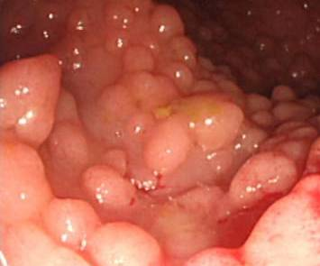
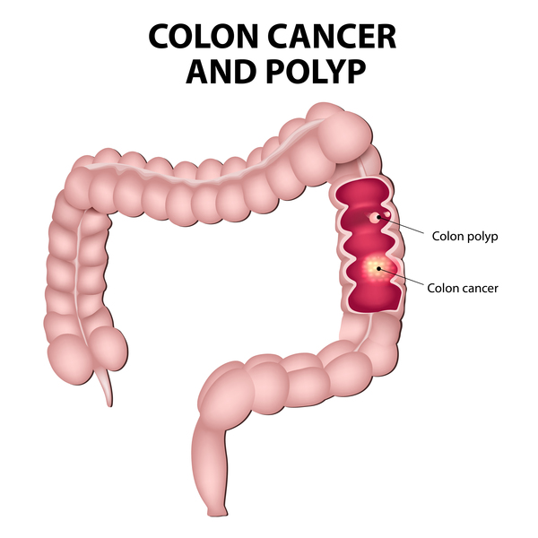
Familial adenomatous polyposis
Autosomal dominant mutation of APC gene (tumour suppressor gene)
Characterized by formation of a high number of adenomatous polps in the epithelium of large intestine
Initially asymptomatic until it progresses to colon cancer
100% risk of colorectal cancer by age of 45
1:10 000-30 000 live births, M = F
Variants
Attenuated FAP: 10-100 polyps only, later onset of CA
Gardner syndrome: FAP + extracolonic tumours (bone, soft tissue)
Turcot syndrome: FAP + brain tumours
Notes:
https://en.wikipedia.org/wiki/Familial_adenomatous_polyposis
https://next.amboss.com/us/article/US0b_2#Z5bdf4eb7f83b58635cb0126c9fb0d3c5

Slide 10
Peutz-jeghers syndrome
Autosomal dominant genetic disorder, meaning that anyone with it has a 50% chance of passing it to their offsprings.
Characterized by:
Benign hamartomatous polyps in the GIT
Hyperpigmented macules in the lips and oral mucosa (melanosis)
A gene is associated with the mutation. On chromosome 19, the STK11 gene, a tumor supressor gene.
Patients have increased risk for carcinomas of the lungs, breasts, liver, ovaries, uterus, testes…

