Slide 1
Goals of Care Conversations – Part 2
Mapping the Future: Clarifying Priorities
Notes:
FACILITATOR NOTES:
Before the Training
Familiarize yourself with the content and flow of your session / run through your complete slide deck
Practice for timing and transitions
Have hand-outs ready for distribution
Have white board (or flip chart) and markers available
Test your access to the slides and video functionality in advance
Arrive at the room early
When You Arrive
Watch the Time: Make sure you have a clock in your line of vision that displays time visibly
Arrange the room: If you have a large room and few attendees, ask people to move to the front
Keep in mind:
Speak up - make sure the whole room can hear
Look up - keep focus on the audience; not your notes
Get Started
Introduce yourself
Base your introduction on the one you created and refined in the VA Facilitator preparation training
State the vision and purpose of this training initiative, and how this training relates
Tell a short (3-4 sentence) personal story about the challenges of discussing goals of care, what you’ve learned, and why this motivates you to train others

Slide 2
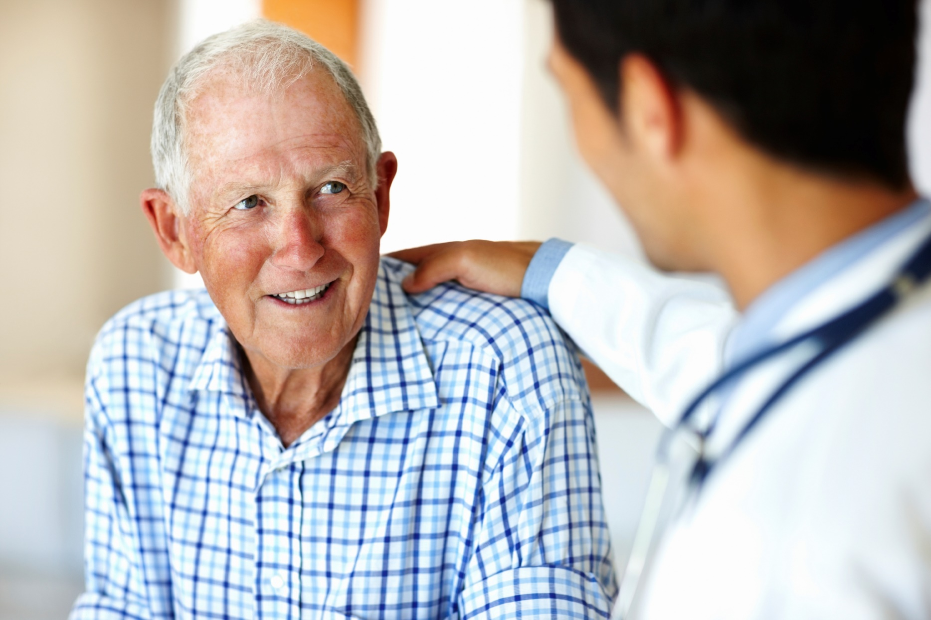
Mapping the Future Module
Mapping the Future:
Clarifying Priorities

Slide 3
Serious Illness Communication Skills Training
Delivering Serious News
Conducting Goals of Care Conversations
Part 1 - Reframing: We’re in a Different Place
Part 2 - Mapping the Future: Clarifying Priorities
Part 3 - Aligning with Patient Values
Part 4 - Discussing Life-Sustaining Treatments
Notes:
FACILITATOR NOTES:
“Today’s session is the second in a series designed to teach the skills required to conduct a goals of care conversation with high-risk patients and their families. Today we will talking about how to elicit the patient’s values and priorities for their care.”

Slide 4
REMAP: Discussing Goals of Care
Reframe
Expect emotion
Map out what’s important
Align with patient values
Plan treatment to match patient values
Notes:
FACILITATOR NOTES:
Last time we introduced you to REMAP, a talking map for discussing goals of care. At that session, we spoke about the first two steps, “Reframe” and “Expect Emotion”
Today, we’re going to cover the third step, “Mapping out what’s important”

Slide 5
REMAP: Review Reframe (examples)
“Given where you are in your illness, it seems like a good time to talk about where to go from here.”
“We’re in a different place than we were [X] months ago.”
Notes:
FACILITATOR NOTES:
Who remembers what reframing is?
Can you give some examples?
Facilitator should lead discussion of different kinds of statements that might work, and click through them:
“Given where you are in your illness, it seems like a good time to talk about where to go from here”
“We’re in a different place than we were [X] months ago”

Slide 6
Review: Expect Emotion
How would you respond?
“Are you sure we’ve tried everything?”
“There has always been another treatment that worked!”
“Are you saying we’re giving up?”
Notes:
FACILITATOR NOTES:
Practice responding to emotion with the group using these statements in a “Call and Response” format, where you say these things while looking directly at a learner and encourage them to respond. Once you get a response (good or bad) move on to another person and do the same.

Slide 7
Review: Expect Emotion
Ask permission to transition to next topic
“Is it okay if we talk now about where we go from here?”
Notes:
FACILITATOR NOTES:
The facilitator should then ask how participants might move the conversation forward after responding to emotion.
Emphasize the need to ask permission to continue, and to “signpost” the next part of the conversation.

Slide 8
Review: How’s it going?
What’s worked?
What’s been challenging?
Have you gotten stuck?
Notes:
FACILITATOR NOTES:
Lead a discussion about what the participants have put into practice since the last session.
“Thinking back over your clinical experiences since the last Module, have you had a chance to try these skills?”
Ask:
What went well? (Explore this with participants – encourage them to tell the stories of how any of these tools have made conversations easier)
Where did they got stuck? (Explore the stuck places participants have encountered and help them deconstruct where the challenges lie. It will usually be about addressing the emotion, instead of the facts.)
What was most surprising?
Stay positive

Slide 9
What We Will Learn
Reframe
Expect emotion
Map out what’s important
Align with patient values
Plan treatment to match values
Notes:
FACILITATOR NOTES:
Today, we’re going to talk about how to move the conversation forward to start talking about patient’s goals by mapping out what’s important to them.
We will learn to ask what patients and surrogates are hoping for, as well as what they are worried about and want to avoid.

Slide 10
How We Will Learn
Define skills (lecture)
Observe skills in action (videos)
Practice (drills)
Notes:
FACILITATOR NOTES:
This session will take less than an hour.
We will start with with an outline of the skills that we’ll learn.
I’ll then show you some videos that give you examples of what these look like in action.
However, learning communication is like learning to improve at a sport, or a musical instrument. You only get better with practice and we’ll have a chance to do that, in a very easy and not-scary way.

Slide 11
REMAP: Map Out What’s Important
You must know the patient’s goals and values before creating a plan
Only way to know is by asking
If asked correctly, the question makes sense and isn’t scary
Notes:
FACILITATOR NOTES:
Go through the bullet points. The most important point for this slide: in order to be able to plan a treatment that matches patient goals and values, you must first make sure you have an exploratory conversation that helps you tap into those core goals and values.

Slide 12
REMAP: Map Out What’s Important (examples)
“Given this situation, what’s most important to you?”
“Knowing that time may be limited, what things are most important?”
“As you think about the future, what do you want to avoid? What do you want to make sure does not happen to you?”
“As you look at the future, what seems more important, the quality of your life or how long you live?”
Notes:
FACILITATOR NOTES:
Here are examples of words you can use to ask patients about their goals and values in a non-intrusive way.

Slide 13
REMAP: Mapping with Surrogate
Make sure that you are asking what is most important to the patient - NOT to the surrogate
“If your dad was sitting here, what would he say is most important?”
“What would your mom be worried about in this situation?”
“If your son was sitting here and could hear what we are saying, what would you want to avoid?”
Notes:
FACILITATOR NOTES:
When you are talking to a surrogate, instead of a patient directly it helps to ask about what would be important to the patient so you aren’t putting the decision making weight on the surrogate and you are able to talk about what the patient would want.

Slide 14
REMAP: Mapping Tips
Be curious
Ask multiple exploratory questions – don’t stop after getting one or two answers
Don’t have an agenda or respond with judgment to patient desires
Notes:
FACILITATOR NOTES:
Here are some helpful tips to think about while mapping:
Be interested and curious about what’s most important to the patient.
Thoroughly explore the patient’s values, goals, and priorities – don’t stop after hearing one or two things.
This conversation is about the patient’s goals; be careful not to impose your agenda or values, and do not try to talk the patient out of their goals or tell them their goals are unrealistic.
Resist the urge to ask the patient to rank their goals at this point in the discussion. Understanding the trade-offs (such as the risks and odd of success of treatments that would be required to pursue named goals) may be necessary in order for the patient to make informed decisions about what’s most important.

Slide 15
REMAP: Map Out The Future
Notes:
FACILITATOR NOTES:
Set up the video carefully:
“Here is an example of a doctor asking a patient what’s most important.”
“Pay close attention to the words used, and we’ll discuss what you saw at the end.”

Slide 16
What specifically did the doctor do that you liked?
Notes:
FACILITATOR NOTES:
After the video, turn to the audience and ask:
What specifically did the doctor do that you liked?
Or…
What did the doctor say?
Make sure that they catch all the things that happen here:
Patient has a hard time answering the “what’s most important” question, and the doctor frames it a different way again
Doctor probes further: “What would ‘enjoy life’ look like?”
You may also want to ask: What was the effect of what the doctor said on the patient?

Slide 17
Time to Practice!!
Notes:
FACILITATOR NOTES:
Tell the group: “Now that you’ve heard and seen what these skills look like, let’s practice them”
If this group has a lot of new learners that weren’t at one of the earlier sessions, then ask the group, “How do athletes or musicians practice?”
Facilitate the responses, and then (if they haven’t gotten there on their own), talk about drills. Something like,
“Even the world’s best athletes or musicians do drills every day. Basketball players practice shot after shot and pass after pass. Professional musicians play 30-60 minutes of scales every day – even though they know them by heart. Drills build and retain muscle memory, and also allow us to learn new things.”
We’re going to practice using the words we’ve been talking about, and we’re going to make it really easy for you by giving you exact words to say.
It may seem easy, or even silly, but it’s just like a great basketball player practicing layups” (or choose another similar analogy that you’re comfortable with).

Slide 18
Drill Instructions
Review drill as a group
Divide into pairs to practice the drill
Practice the drill script (person with bigger feet goes first)
Switch roles
Debrief with one another:
How did it feel to say the words?
One thing clinician noticed
One thing patient noticed
Notes:
FACILITATOR NOTES:
Walk the group through the drill instructions. At the end, ask if there are any questions and make sure there is complete clarity in the room about how to do this.
Ask the group to divide into pairs.
Read the first two drills out loud – or, better yet – have two learners in the audience read them out loud for you using the slides.
Then, have the people that just demonstrated, switch roles and do the two drills again.
Then, explain that after these two drills, you’ll debrief.
Hand out the drill sheets and have the pairs practice together using their drill sheets, reminding them to switch roles after they complete one round.

Slide 19
Drill A: Map (Patient Knows Values)
Clinician
Patient
Given this situation, what’s most important?
I admire your fight, and I can see how important it is for you to know that you’re not giving up.
It’s important to me that I don’t give up – I don’t want to look back and regret that I didn’t give it everything I had.
Notes:
FACILITATOR NOTES:
Either read or have the two learners read out loud this drill.

Slide 20
Drill A: Map (with Surrogate)
Clinician
Surrogate
If your dad was sitting here and could hear the things we are saying, what would he think?
Tell me more.
He would never want to be hooked up to all of these machines.
Notes:
FACILITATOR NOTES:
Either read or have the two learners read out loud this drill as well.

Slide 21
Drill: REMAP (Patient Knows Values)
Drill Instructions: Swap Roles
Clinician
Patient
Notes:
FACILITATOR NOTES:
Ask them to switch roles and show again.
When done demonstrating the drill, ask everyone to do the two drills in their groups of two using the drill sheets.
Walk around the room and observe how they are doing, and when it looks like everyone has completed both drills, call for the switch.

Slide 22
Drill: Debrief
How did it feel to say the words?
One thing clinician noticed
One thing patient noticed
Notes:
FACILITATOR NOTES:
After everyone has done the drills, ask each of the dyads to answer these questions just to each other. Give them 2-3 minutes to run through this exercise.

Slide 23
Drill B: Map (Patient Not Sure)
Clinician
Patient
Clinician
Patient
Given this situation, what’s most important?
What if you start by telling me about the things in your life that matter most right now?
I’m not sure what to tell you.
Notes:
FACILITATOR NOTES:
Now demonstrate the next three drills by reading them out loud, or having two learners read them out loud.

Slide 24
Drill B: Map (Patient Not Ready)
Clinician
Patient
Given this situation, what’s most important?
This is a tough situation for anyone.
I don’t feel ready to decide. It’s hard…
Notes:
FACILITATOR NOTES:
Either read or have the two learners read out loud this drill as well.

Slide 25
Drill B: Map (What is Patient Worried About?
Drill B: Map (What is Patient Worried About?)
Clinician
Patient
As you think about the future, is there anything you worry about?
That helps me better understand what you’re thinking.
I don’t want to end up on a breathing machine like the last time I was in the hospital. I never want to go through that again.
Notes:
FACILITATOR NOTES:
Either read or have the two learners read out loud this drill as well.
(Note: This drill is asking about what the patient worries about, rather than what’s most important.)

Slide 26
Drill Instructions: Swap Roles
Drill Instructions: Swap Roles
Clinician
Patient
Notes:
FACILITATOR NOTES:
Ask them to switch roles and show again.
When done demonstrating the drill, ask everyone to do the two drills in their groups of two.
Walk around the room and observe how they are doing, and when it looks like everyone has completed both drills, call for the switch.

Slide 27
Drill: Debrief
Drill: Debrief
How did it feel to say the words?
One thing clinician noticed
One thing patient noticed
Notes:
FACILITATOR NOTES:
After everyone has done the drills, Ask them to talk with their partners and answer the three questions:
How did it feel to say the words?
One thing the clinician noticed
One thing the patient noticed
Then lead a group discussion about their reactions to practicing these words.

Slide 28
What surprised you? What do you want to take forward? Anywhere you might get stuck?
Notes:
FACILITATOR NOTES:
This is the debrief where deeper learning takes place.
Ask everyone to write about each of these questions for 1-2 minutes.
Then, lead a group discussion asking people to volunteer something they wrote in response to one of these questions.

Slide 29
Summary: REMAP
REMAP: a talking map for goals of care
Map out what’s important
Identify worries, what the patient wants to avoid
What’s one thing you’re going to try this week?
Notes:
FACILITATOR NOTES:
Summarize very quickly and then ask everyone to write down on a piece of paper the one thing they’re going to try out this week, and keep that paper in their wallet/purse/pocket.
Then thank the group, express appreciation for their willingness to practice and engage, and close the session.

Slide 30
Goals of Care Conversations
Goals of Care Conversations training materials were developed and made available for public use through U.S. Department of Veterans Affairs contracts with VitalTalk
[Orders VA777-14-P-0400 and VA777-16-C-0015].

