Slide 1
Chemical injuries
Etiology:
Acid burns (liquefaction necrosis) and alkali burns ( coagulation necrosis )
Clinical manifestations According to the intensity of impact the degree of necrosis - adnexa – conjunctiva- cornea anterior uveal irritation
Treatment
First aid ( mechanical removal of noxy , intensive water rinses ) surgical - removal of necrotis tissue
Complications: symblefara, leucoma, secondary glaucoma

Slide 2
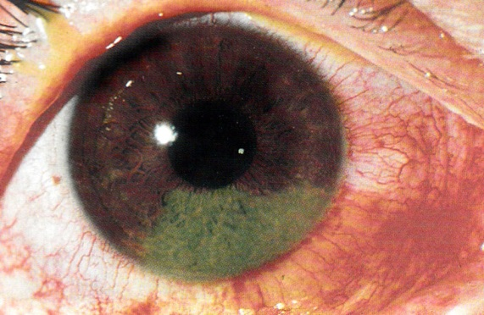
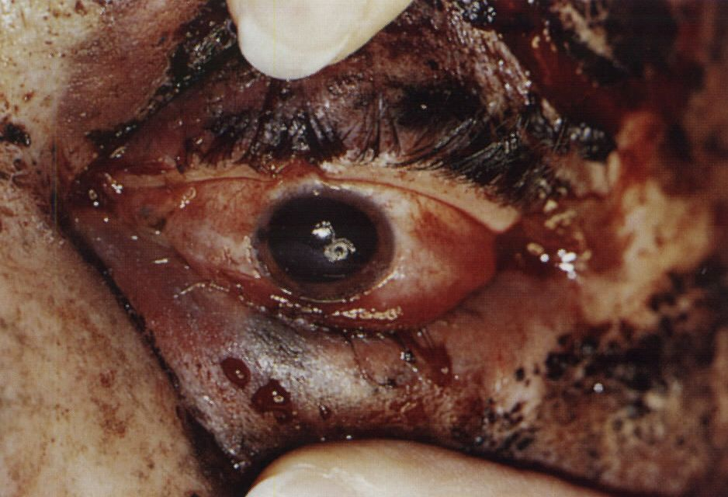
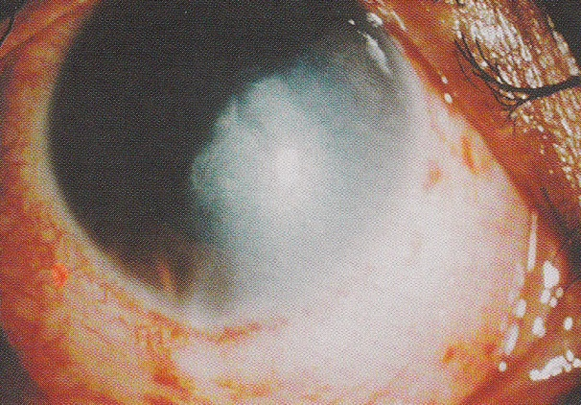
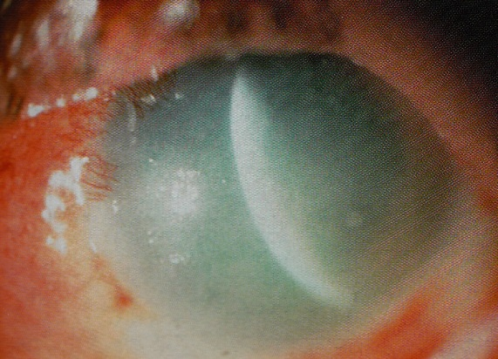
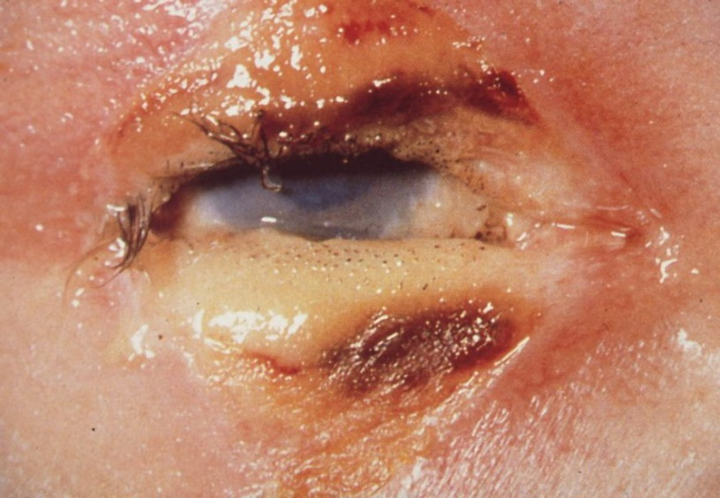
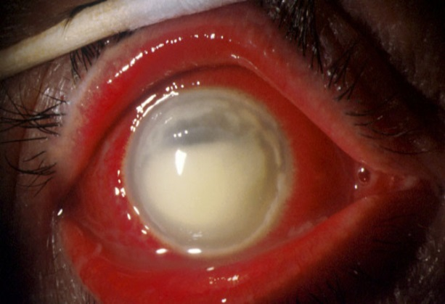
Chemical injuries
Termic injuries

Slide 3
Termic injuries
Etiology:
Effect of high temperature (explosion, burning , liquid , steam) IR and UV radiation.
Clinical manifestations Depending on the degree of intensity of acting noxy I. - IV. degree burns ( adnexa , conjunctiva , cornea) .
treatment
First Aid - cold compresses ,
Targeted therapies - according to the degree of disability medical or surgical (necrosis ) Complications:
Scarring ( eyelid and conjunctiva) and vascularization (cornea )

Slide 4
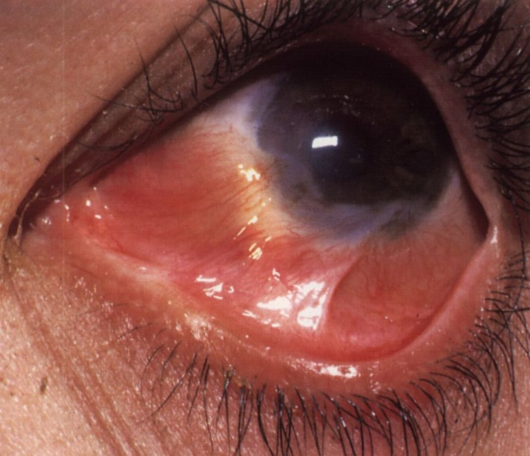
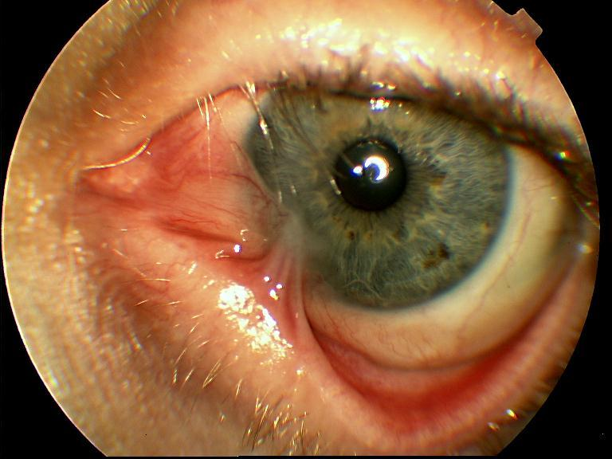
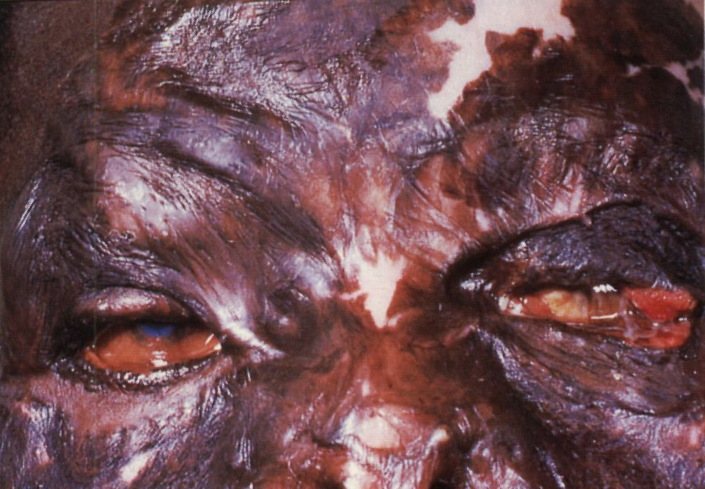
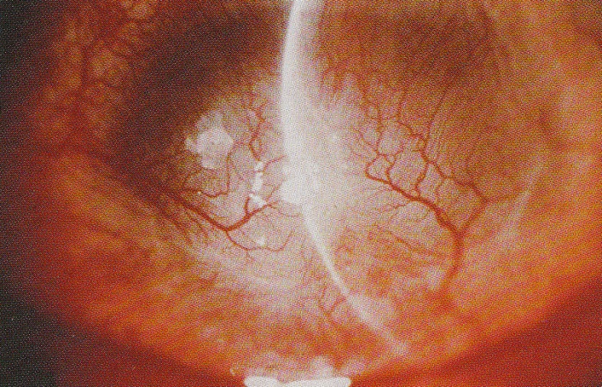
Complications

Slide 5
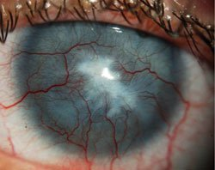

Slide 6
Tear gas and electric injuries
Tear gas substances Gases , sprays, liquids
Clinical manifestations Blepharospasm , epiphora , conjunctivitis , corneal epithelial damage
Treatment: topic ATB epitelizancia
Electricity
The combination of thermal changes in the anterior segment of the eye, cataract formation

Slide 7
Radiation damage
Infrared radiation - heat damage
UV radiation (electric arch, germicidal emitters , sunray , stay in the alpine environment - snow ) - Ophthalmia ELECTRICA Ophthalmia nivalis
Eyelid erythema , blepharospasm , epiphora , forein body sensation, pain , corneal epithelial defects ( mikroerosions ) .
Treatment - short term local anesthetics , antibiotics , epitelizancia
Ionizing radiation - secondary damage to the eye during irradiation within the Cancer Therapy .
Like symptoms of electric ophthalmia
Cataractogenic effect - local therapy of orbital tumors (doses above 30 Gy ) .
Damage laser radiation - depending on the energy, wavelength and focusing - damage to the retina ( scarring ) .
Damage to sunlight - solar retinopathy ( eclipse of the sun) - damage to the macula .

