Slide 1
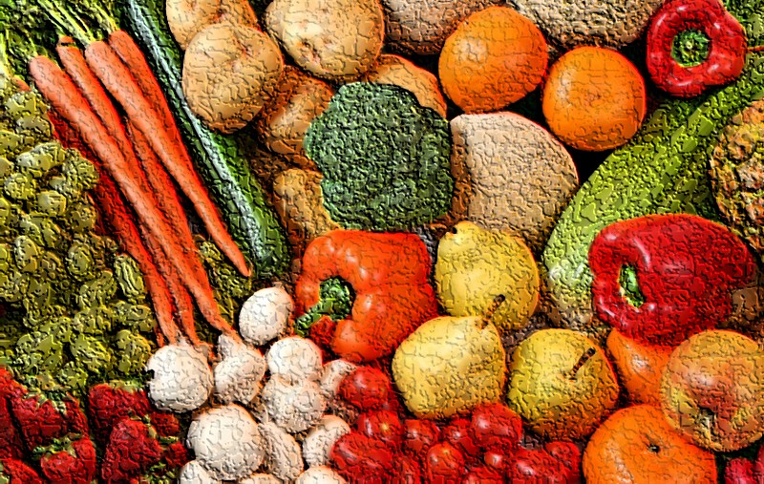
NUTRITION
Seminar
Department of Public Health
Academic year 2018/2019

Slide 2
Why nutrition?
Diet and body weight are related to health status. Good nutrition is important to the growth and development of children. A healthful diet also helps reduce risks for many health conditions, including:
Overweight and obesity
Heart disease
High blood pressure
Dyslipidemia (poor lipid profiles)
Type 2 diabetes mellitus
Some cancers
Osteoporosis
Dental caries
Constipation
Diverticular disease
Malnutrition
Vitamin A, iodine-deficiency
Iron-deficiency anemia
…
General information

Slide 3

Why are nutrition and weight status important?
Individuals who are at a healthy weight are less likely to:
Develop chronic disease risk factors, such as high blood pressure and dyslipidemia.
Develop chronic diseases, such as type 2 diabetes, heart disease, osteoarthritis, and some cancers.
Experience complications during pregnancy.
Die at an earlier age
BMI [= weight (kg) / height (m²)]
Underweight | <18.5
Normal weight | 18.5–24.9
Overweight | 25-29.9
Obesity | BMI of 30 or greater
General information

Slide 4
Food Based Dietary Guidelines (FBDG)
simple messages on healthy eating, aimed at the general public
Nutrition education tool translating scientific knowledge and dietary standards and recommendations into an understandable and practical form for use by those who have little or no training in nutrition.
FBDG are generally based upon scientific evidence on the relationship between diet and chronic disease risk, taking into account nutrient recommendations.
They give an indication of what a person should be eating in terms of foods rather than nutrients, and provide a basic framework to use when planning meals or daily menus.
Foods are classified into basic groups according to similarity of nutrient content or some other criteria.
WHY? BALANCED, ADEQUATE AND VARIED DIET
to help consumers in planning an overall healthy diet, while achieving an adequate nutrient intake
General information
Notes:
http://www.eufic.org/article/en/page/RARCHIVE/expid/food-based-dietary-guidelines-in-europe/

Slide 5


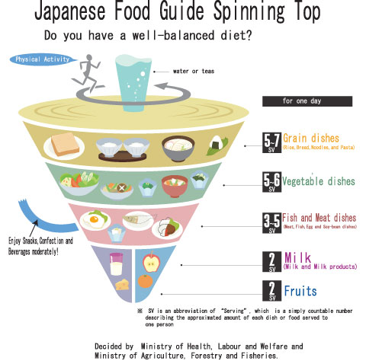
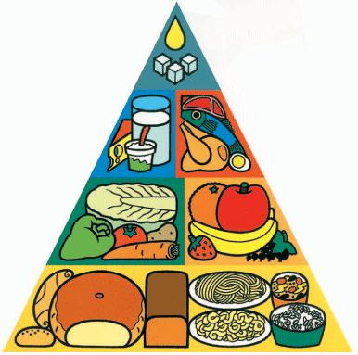
FBDG graphic formats
Notes:
http://www.eufic.org/article/cs/page/RARCHIVE/expid/food-based-dietary-guidelines-in-europe/
Německá skládačka
Španělské kolo
Maďarský dům
Francouzské schody
My Plate – USA
Kanadská duha
Japonská káča
Čínská pagoda
Japonsko, pagoda!!!

Slide 6

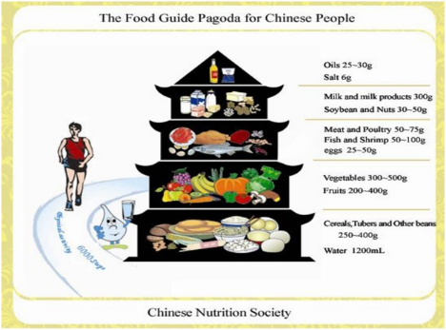

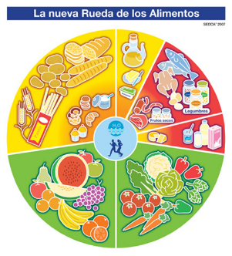
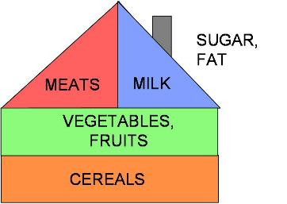

Slide 7
FOOD LABELING - REGULATION (EU) No 1169/2011
Mandatory particulars:
The name of the food
The list of ingredients (in descending order by weight)
Any ingredient or processing aid listed in Annex II or derived from substance or product listed in Annex II causing allergies or intolerances used in the manufacture or preparation of a food and still present in the finished product, even if in an altered form
The quantity of certain ingredients or categories of ingredients
The net quantity of the food
The date of minimum durability or the ΄use by΄ date
General information
Notes:
http://ec.europa.eu/food/safety/labelling_nutrition/labelling_legislation/index_en.htm
http://eur-lex.europa.eu/legal-content/EN/TXT/?uri=uriserv:OJ.L_.2011.304.01.0018.01.ENG&toc=OJ:L:2011:304:FULL

Slide 8
FOOD LABELING - REGULATION (EU) No 1169/2011
Any special storage conditions and/or conditions of use
The name of business name and adress of the food business operator
The country of origin or place of provenance where provided for
Instructions for use where it would be difficult to make appropriate use of the food in the absence of such instructions
With respect to beverages containing more than 1,2 % by volume of alcohol, the actual alcoholic strenght by volume
A nutrition declaration
General information
Notes:
http://ec.europa.eu/food/safety/labelling_nutrition/labelling_legislation/index_en.htm
http://eur-lex.europa.eu/legal-content/EN/TXT/?uri=uriserv:OJ.L_.2011.304.01.0018.01.ENG&toc=OJ:L:2011:304:FULL

Slide 9
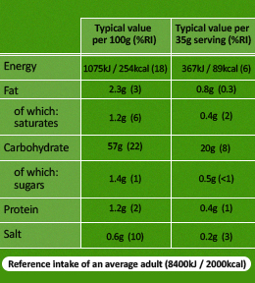
Nutrition declaration
The mandatory nutrition declaration shall include the folowing:
  a) energy value
  b) the amounts of fat, saturates, carbohydrate, sugars, protein and salt
General information

Slide 10
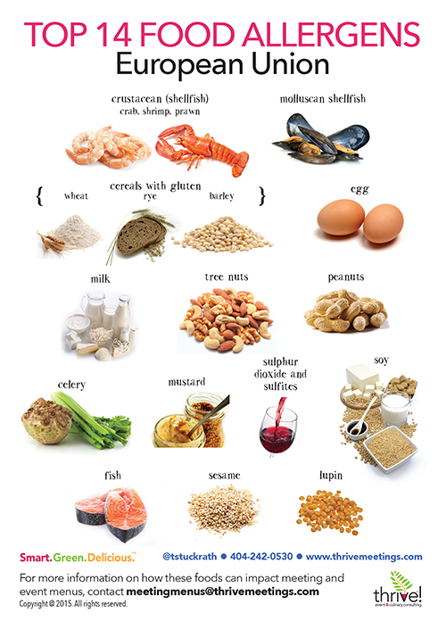
Allergens I
Food ingredients that must be declared as allergens in the EU
1. Cereals containing gluten, namely: wheat (such as spelt and
khorasan wheat), rye, barley, oats or their hybridised strains,
and products thereof, except:
(a) wheat based glucose syrups including dextrose
(b) wheat based maltodextrins
(c) glucose syrups based on barley
(d) cereals used for making alcoholic distillates including ethyl
alcohol of agricultural origin
2. Crustaceans and products thereof
3. Eggs and products thereof
4. Fish and products thereof, except:
(a) fish gelatine used as carrier for vitamin or carotenoid preparations
(b) fish gelatine or Isinglass used as fining agent in beer and wine
General information
Notes:
FOOD LABELING
REGULATION (EU) No 1169/2011

Slide 11
Allergens II
5. Peanuts and products thereof
6. Soybeans and products thereof, except:
(a) fully refined soybean oil and fat
(b) natural mixed tocopherols (E306), natural D-alpha tocopherol, natural
D-alpha tocopherol acetate, and natural D-alpha tocopherol succinate
from soybean sources
(c) vegetable oils derived phytosterols and phytosterol esters from
soybean sources
(d) plant stanol ester produced from vegetable oil sterols from
soybean sources
7. Milk and products thereof (including lactose), except:
(a) whey used for making alcoholic distillates including ethyl
alcohol of agricultural origin
(b) lactitol
General information

Slide 12
Allergens III
8. Nuts, namely: almonds (Amygdalus communis L.), hazelnuts
(Corylus avellana), walnuts (Juglans regia), cashews (Anacardium
occidentale), pecan nuts (Carya illinoinensis (Wangenh.) K. Koch),
Brazil nuts (Bertholletia excelsa), pistachio nuts (Pistacia vera),
macadamia or Queensland nuts (Macadamia ternifolia), and products
thereof, except for nuts used for making alcoholic distillates including
ethyl alcohol of agricultural origin
9. Celery and products thereof
10. Mustard and products thereof
11. Sesame seeds and products thereof
12. Sulphur dioxide and sulphites at concentrations of more than
10 mg/kg or 10 mg/litre in terms of the total SO₂ which are to be
calculated for products as proposed ready for consumption or as
reconstituted according to the instructions of the manufacturers
13. Lupin and products thereof
14. Molluscs and products thereof
General information

Slide 13
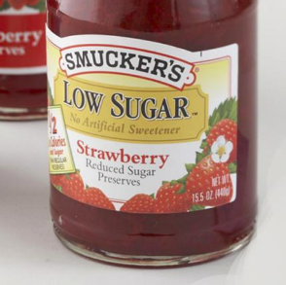

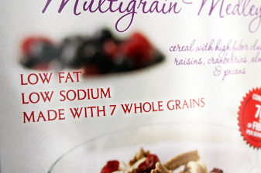
Nutrition claim…
…any claim which states, suggests or
implies that a food has particular
beneficial nutritional properties due to:
The energy (calorific value) it:
  (a) provides
  (b) provides at a reduced or increased rate or
  (c) does not provide
The nutrients or other substances it:
  (a) contains
  (b) contains in reduced or increased proportions or
  (c) does not contain
Nutrition claims are only permitted if they are listed in the Annex
of Regulation (EC) No 1924/2006, lastly amended by Regulation (EU) No 1047/2012.
General information

Slide 14
Permitted nutrition claims - examples
LOW SUGARS
A claim that a food is low in sugars, and any claim likely to have the same meaning for the consumer, may only be made where the product contains no more than 5 g of sugars per 100 g for solids or 2,5 g of sugars per 100 ml for liquids.
LOW FAT
A claim that a food is low in fat, and any claim likely to have the same meaning for the consumer, may only be made where the product contains no more than 3 g of fat per 100 g for solids or 1,5 g of fat per 100 ml for liquids (1,8 g of fat per 100 ml for semi-skimmed milk).
HIGH FIBRE
A claim that a food is high in fibre, and any claim likely to have the same meaning for the consumer, may only be made where the product contains at least 6 g of fibre per 100 g or at least 3 g of fibre per 100 kcal.
HIGH OMEGA-3 FATTY ACIDS
A claim that a food is high in omega-3 fatty acids, and any claim likely to have the same meaning for the consumer, may only be made where the product contains at least 0,6 g alpha-linolenic acid per 100 g and per 100 kcal, or at least 80 mg of the sum of eicosapentaenoic acid and docosahexaenoic acid per 100 g and per 100 kcal.
General information
Notes:
http://ec.europa.eu/food/safety/labelling_nutrition/claims/nutrition_claims/index_en.htm

Slide 15
Permitted nutrition claims - summary
Low energy
Energy-reduced
Energy-free
Low fat
Fat-free
Low saturated fat
Saturated fat-free
Low sugars
Sugars-free
With no added sugars
Low sodium/salt
Very low sodium/salt
Sodium free or salt-free
No added sodium/salt
Source of fiber
High fiber
Source of protein
High protein
Source of (name of vitamin/s) and/or (name of mineral/s)
High (name of vitamin/s) and/or (name of mineral/s)
Contains (name of nutrient or other substance)
Increased (name of the nutrient)
Reduced (name of the nutrient)
Light/lite
Naturally/natural
Source of omega-3 fatty acids
High omega-3 fatty acids
High monounsaturated fat
High polyunsaturated fat
High unsaturated fat
General information

Slide 16
Health claim…
…any statement about a relationship between food and health
The Commission authorises different health claims provided they are based on scientific evidence and can be easily understood by consumers. The European Food Safety Authority (EFSA) is responsible for evaluating the scientific evidence supporting health claims.
"Vitamin D is needed for the normal growth and development of bone in children.“
„Iodine contributes to normal functioning of the nervous system.“
Regulation (EC) No 1924/2006
General information
Notes:
REGISTR http://ec.europa.eu/food/safety/labelling_nutrition/claims/register/index_en.htm
OBRÁZKY OBALŮ!!!

Slide 17
Useful references
EFSA - http://www.efsa.europa.eu/
EUFIC - www.eufic.org
Journals:
American journal of clinical nutrition
Nutrition reviews
Journal of the American College of Nutrition
Journal of the Academy of Nutrition and Dietetics
Clinical nutrition
European journal of clinical nutrition
Nutrition bulletin
General information

Slide 18
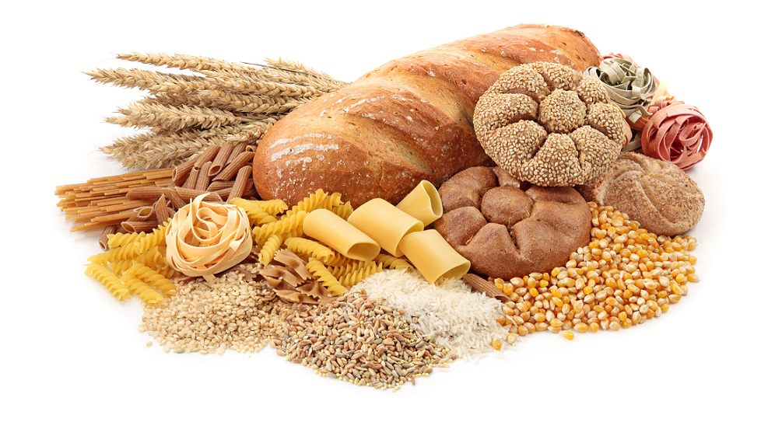
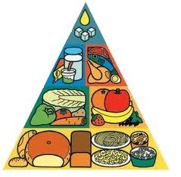
GRAINS

Slide 19


Grains group
all foods made from wheat, rice, oats, cornmeal, barley, such as bread, pasta, oatmeal, breakfast cereals, tortillas,…
3-6 portions a day
  1 portion = 1 slice of bread (60 g), 1 roll, 1 scoop of cooked rice or pasta (125 g), 1 bowl of breakfast cereals
carbohydrates (starch) → energy → 1 g = 17 kJ (4,2 kcal)
fibre
B vitamins (thiamin, niacin)
minerals (magnesium)
proteins - incomplete
Grains

Slide 20
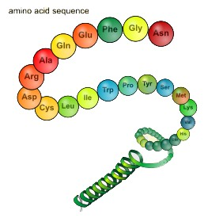
Incomplete proteins…
…limiting aminoacids
…is any indispensable amino acid falling below the amount recommended in the amino acid reference pattern
wheat – lysine
legumes (soya) – methionine (cystein)
corn – tryptophan
rice – lysine, threonine
Grains

Slide 21
Carbohydrates 1 g = 17 kJ (4,2 kcal)
Classification:
Monosaccharides – glucose, fructose,
galactose
Disaccharides – sucrose, lactose, maltose
Polysaccharides – starch, resistant starch,
glycogen
The Acceptable Macronutrient Distribution Range for carbohydrates is 45–65 %.
Function:
Energy
Glycogen-carbohydrate storage
Protein-sparing action
Antiketogenic effect
Heart action
Central nervous system
Grains
Notes:
SKRÝT

Slide 22

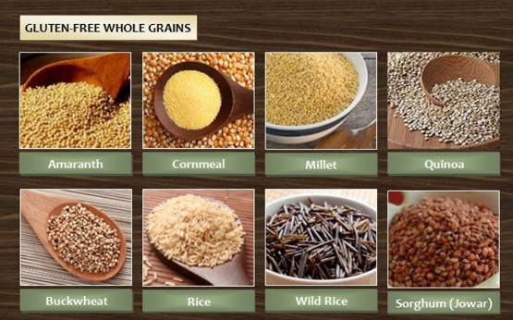
Gluten
GLUTEN
wheat, rye, barley, oats and all products of them (pasta, bread, rolls,
breakfast cereals, crackers, pastry and other grain-based foods)
GLUTEN FREE
rice
corn, cornmeal
buckwheat
quinoa
amaranth
wild rice
millet …pseudocereals
Celiac disease – autoimmune
disease, not allergy
Grains
Notes:
Cornmeal – kukuřičná mouka
Sorghum – čirok
Teff – milička
CELIAKIE NENÍ ALERGIE

Slide 23
Whole grains
Grains
Notes:
BRAN – otruby - The part of the grain that contains the most dietary fiber.

Slide 24
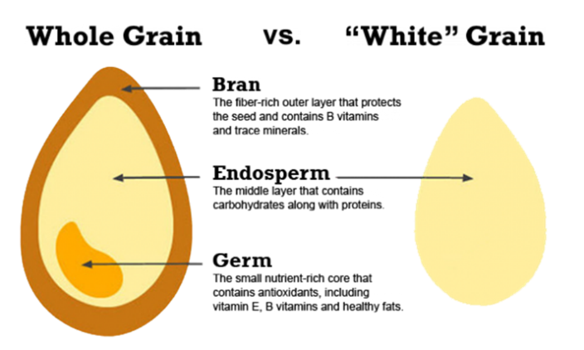

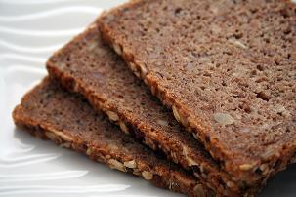
Grains

Slide 25

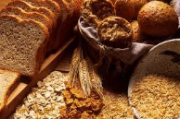
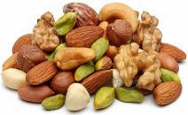
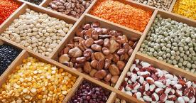
Dietary fibre
"Dietary fiber is the edible parts of plants or analogous carbohydrates that are resistant to digestion and absorption in the human small intestine with complete or partial fermentation in the large intestine. Dietary fiber includes polysaccharides, oligosaccharides, lignin, and associated plants substances. Dietary fibers promote beneficial physiological effects including laxation, and/or blood cholesterol attenuation, and/or blood glucose attenuation.“
(AACC International)
Whole grains, fruits, vegetables, legumes, nuts and oily seeds
Recommended fibre intake for adults … 25–30 g per day
Grains
Notes:
http://www.aaccnet.org/INITIATIVES/DEFINITIONS/Pages/DietaryFiber.aspx

Slide 26
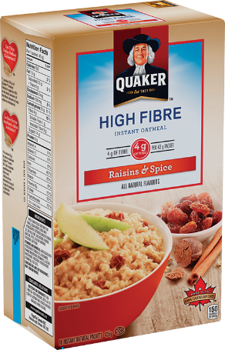

NUTRITION CLAIMS about fibre
SOURCE OF FIBRE A claim that a food is a source of fibre, and any claim likely to have the same meaning for the consumer, may only be made where the product contains at least 3 g of fibre per 100 g or at least 1,5 g of fibre per 100 kcal.
HIGH FIBRE A claim that a food is high in fibre, and any claim likely to have the same meaning for the consumer, may only be made where the product contains at least 6 g of fibre per 100 g or at least 3 g of fibre per 100 kcal.
Grains

Slide 27
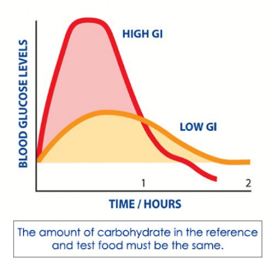
Glycemic index
Carbohydrate foods are digested and absorbed
at different rates.
GI is a relative measure of the effect of different
carbohydrate-containing foods on blood glucose level.
A food with a high GI will raise blood glucose to a greater
extent than a food with a low GI.
A number of factors influence the rate and duration of the glycemic response - the type and form of the carbohydrate eaten, the cooking and processing methods used, the time of day the carbohydrate is ingested or the amount of other nutrients in the food, such as fat or protein or fiber. In addition, individuals differ in their metabolism, which can also affect the glycemic response.
For prevention and control of conditions such as obesity, diabetes and heart disease and has also dietary advice for sport, for example which foods should be eaten in the hours before and after physical exertion.
GI does not refer directly to quantified food exchanges → Glycemic Load
Grains
Notes:
The effect of particular foods is compared with the effect of a glucose solution on blood glucose.
In clinical practise, GI was measured by studying blood glucose levels over a 2-hour period following ingestion of 50 g of glucose and after consuming a 50-g carbohydrate portion on the test food.
The glucose dose was assigned the rating of 100, and individual foods were rated accordingly.
Both the quantity and quality of carbohydrate influence the glycemic response
GL was introduced to quantify the overall glycemic effect of a portion of food
GL gives a relative indication of how much that serving of food is likely to increase your blood-sugar levels
GLYCEMIC LOAD (GL) = GI/100 x Net Carbs
(Net Carbs are equal to the Total Carbohydrates minus Dietary Fiber)
(GL = GI × dietary carbohydrate content)
Glycemic Loads below 10 to be „low“
Glycemic Loads above 20 to be „high“
The higher the GL, the greater the expected elevation in blood glucose and in the insulinogenic effect of the food
The long-term consumption of a diet with a relatively high GL (adjusted for total energy) is associated with an increased risk of type 2 diabetes and coronary heart disease

Slide 28
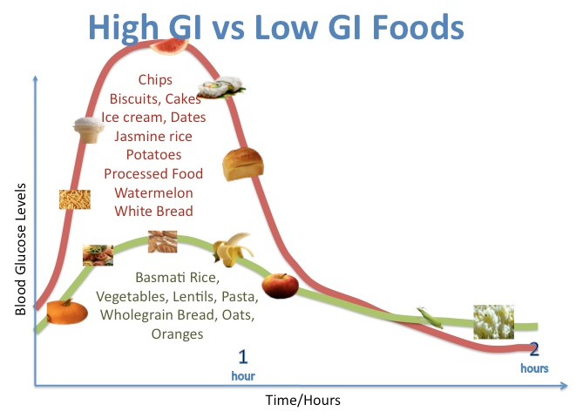
Grains

Slide 29
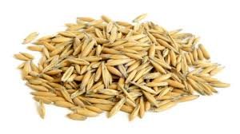
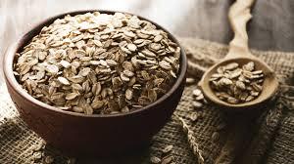
Health claims about beta-glucans
Beta-glucans contribute to the maintenance of normal blood cholesterol levels.
The claim may be used only for food which contains at least 1 g of beta-glucans from oats, oat bran, barley, barley bran, or from mixtures of these sources per quantified portion. In order to bear the claim information shall be given to the consumer that the beneficial effect is obtained with a daily intake of 3 g of beta-glucans from oats, oat bran, barley, barley bran, or from mixtures of these beta-glucans.
Consumption of beta-glucans from oats or barley as part of a meal contributes to the reduction of the blood glucose rise after that meal.
The claim may be used only for food which contains at least 4 g of beta-glucans from oats or barley for each 30 g of available carbohydrates in a quantified portion as part of the meal. In order to bear the claim information shall be given to the consumer that the beneficial effect is obtained by consuming the beta-glucans from oats or barley as part of the meal.
Grains

Slide 30
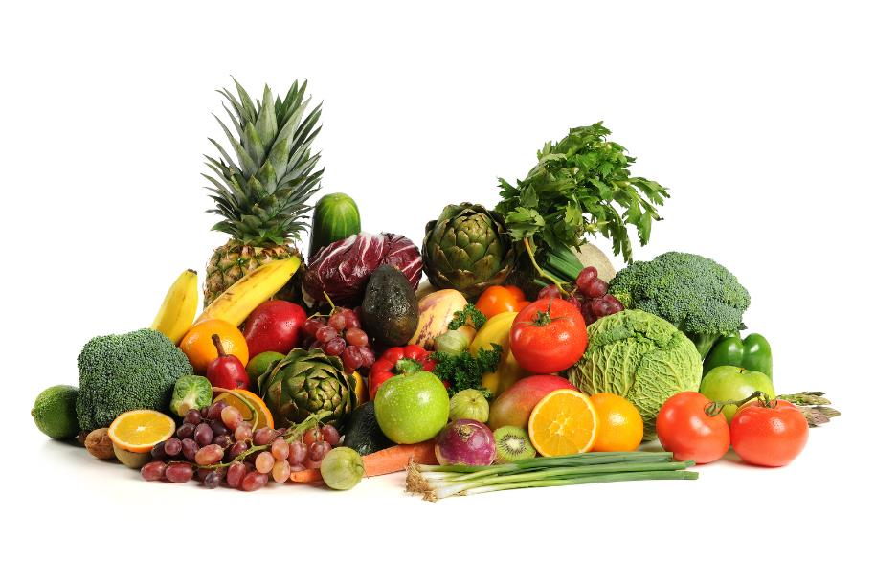
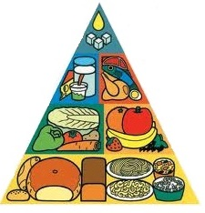
FRUITS AND
VEGETABLES

Slide 31
Nutrient content (apple)
Fruits and Vegetables

Slide 32
…and those are?
pigments – carotenes (ß-carotene, lycopene), xantophylls, chlorophylls
phenolic compounds, polyphenols
flavonoids, isoflavonoids
lignans, lignins
glucosinolates
… and much more, serving as:
provitamins, antioxidants,
anticarcinogenic, antibacterial stuff etc.
Utilization?
Fruits and Vegetables

Slide 33
3–5 servings; a serving is…
FRUITS
banana, apple, orange – 1x 100 g
berries – a bowl 150–200 ml
juice – 250–300 ml, not diluted
VEGETABLES
carrot, sweet pepper, medium-sized tomato – 1 piece
raw leafy vegetables – a bowl 150–200 ml
cooked, including potatoes – 125 g
juice – 250–300 ml, not diluted
Fruits and Vegetables

Slide 34
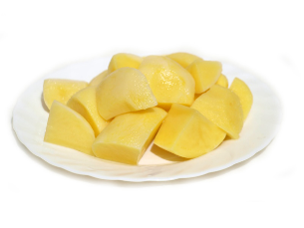
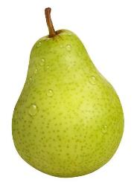
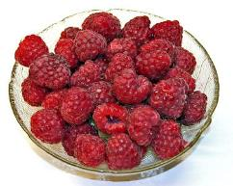


To imagine that better
Fruits and Vegetables

Slide 35
Health claims
dried plums
  dried plums/prunes contribute to normal bowel function – 100 g per day
huge number of vitamins and minerals
  vitamins – mainly vit. C
    normal function of the immune system
    normal collagen formation for blood vessels, bones, cartilage etc.
    normal energy-yielding metabolism
    normal psychological functions … etc. etc. – 15 authorised claims
  minerals – mainly potassium (K)
    normal functioning of the nervous system
    normal muscle function
    maintenance of normal blood pressure
Sources?
Fruits and Vegetables

Slide 36
Vitamin C
Food | Vitamin C (100 g)
Sweet peppers, red | 191 mg
Black currant | 166 mg
Broccoli | 121 mg
Brussels sprouts | 95 mg
Kiwi | 93 mg
Cauliflower | 77 mg
Strawberries | 66 mg
Red cabbage | 52 mg
Orange, lemon | cca 50 mg
Fruits and Vegetables

Slide 37

One veggie, two faces
Nutrient | Value per 100 g
Energy | 47 kcal / 200 kJ
Fat | 0,2 g
Saturated | 0 g
Carbohydrates | 10,1 g
Sugar | 8,3 g
Protein | 1,2 g
Salt | 0,9 g
Fruits and Vegetables

Slide 38

Fruit or juice?
Nutrient | Value per 100 g
 | ORANGE | SMOOTHIE | JUICE
Energy | 49 kcal / 205 kJ | 56 kcal / 235 kJ | 43 kcal / 180 kJ
Fat | 0 g | 0,3 g | 0 g
Carbohydrates | 10 g | 14,4 g | 9 g
Sugars | 7,3 g | 12,1 g | 9 g
Protein | 0,9 g | 0,6 g | 0,7 g
Fibre | 2 g | 1,7 g | 0,1 g
Vitamin C | 50,7 mg | 41 mg | 30 mg
Antioxidants (ORAC) | 2 103 | 1 566 | 900
Fruits and Vegetables

Slide 39
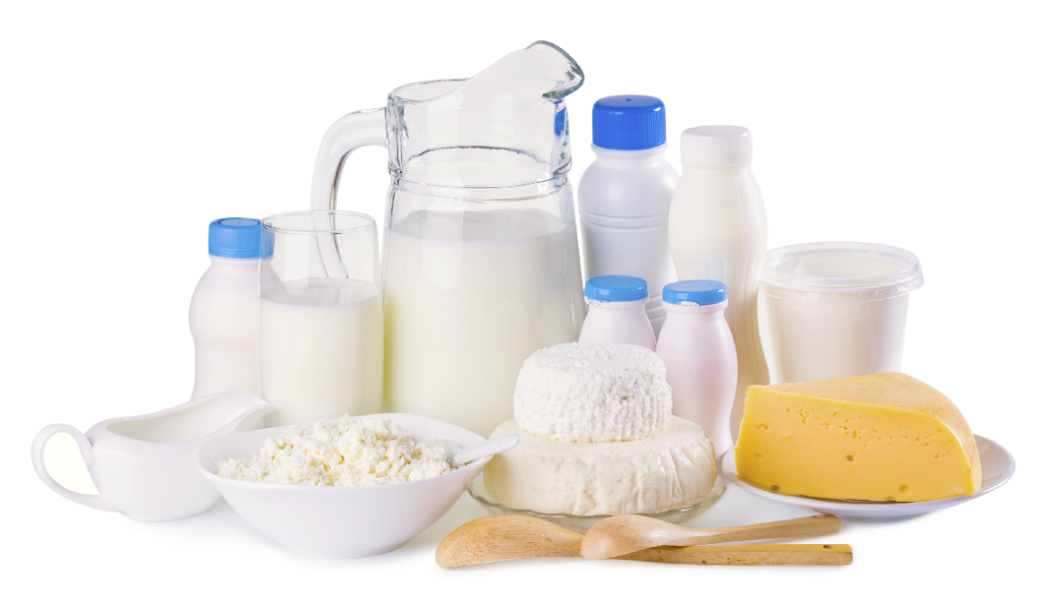
MILK AND
DAIRY PRODUCTS

Slide 40
Milk and dairy products
they are for example: yoghurt, cheese, milk, cottage cheese, fermented milk products and other
they provide a range of nutrients → the main are protein, calcium, vitamin B₁₂, riboflavin and other
dairy proteins…
  have a high nutrition value (like those in meat, fish and egg)
  contain satisfactory proportions of all the aminoacids that are essential to the human organism
Milk and dairy products

Slide 41
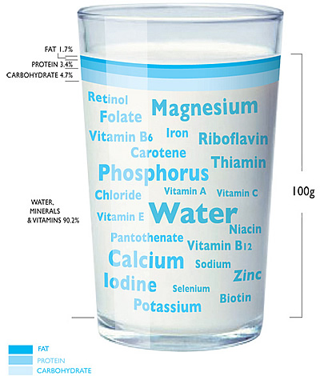
Composition of cow’s milk
Component | Amount in 100 ml | Percentage
Water | ~ | 87,0 %
Lactose | 5,0 g | 4,8 %
Fat | 4,1 g | 4,0 %
Proteins | 3,3 g | 3,2 %
Calcium | 110 mg | 0,1 %
Riboflavin (vitamin B₂) | 0,18 mg | ~
Vitamin B₁₂ | 0,4 μg | ~
*recommended daily allowance
Milk and dairy products

Slide 42
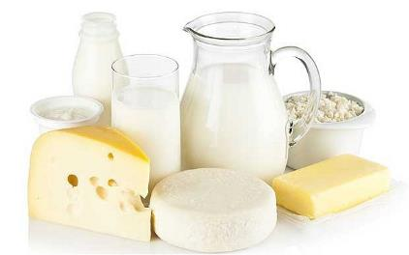
Servings and recommendation
one glass/cup of milk (250 ml)
one pot of yoghurt (200 ml)
cheese 55 g
…or like your palm/your fist/your hand
2–3 servings per day
Milk and dairy products

Slide 43
Calcium 800 mg per day (health claims)
Calcium contributes to normal blood clotting.
Calcium contributes to normal energy-yielding metabolism.
Calcium contributes to normal muscle function.
Calcium contributes to normal neurotransmission.
Calcium contributes to the normal function of digestive enzymes.
Calcium has a role in the proces of cell division and specialization.
Calcium is needed for the maintenance of normal bones.
Calcium is needed for the maintenance of normal teeth.
nutrition claim: „SOURCE OF CALCIUM“
other sources of calcium are 30 g poppy = 150 g cabbage = 200 g broccoli = (50 g of hard cheese = yoghurt 150 g = 250 ml milk)
Milk and dairy products

Slide 44
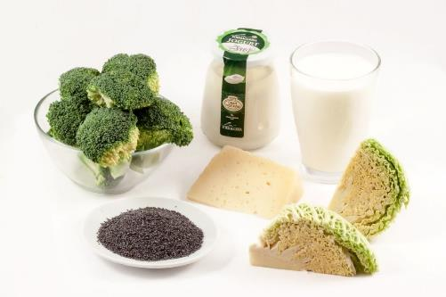
Calcium absorption
calcium absorption from vegetables such as broccoli, cauliflower and kale is higher than from milk and diary products
Milk and dairy products
Notes:
Tabulka využitelnosti výpníku – intake x uptake

Slide 45
Milk as a source of calcium
availability = cca 30 %
content in milk and dairy
  cheese – 300–450 mg/50 g (serving)
  milk – 330 mg/250 g (porce)
  yoghurt – 280 mg/150 g (porce)
Food | Availability
Cauliflower, broccoli | > 50 %
Watercress
Cabbage, sprouts
Almonds | cca 20 %
Sesame seeds
Beans
Spinach | < 5 %
Rhubarb
Milk and dairy products

Slide 46
Allergy to CMP vs. lactose intolerance
What is the difference?
Milk and dairy products

Slide 47
Allergy to cow’s milk
is an abnormal response of the body's immune system to milk and products containing milk
allergy related to lactoglobulin, lactalbumin and casein
symptoms of milk allergy: wheezing, vomiting, hives and digestive problems, anaphylaxis (a severe, life-threatening reaction)
treatment: food-elimination diet
Milk and dairy products

Slide 48
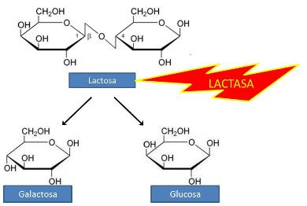
Lactose intolerance (hypolactasia, lactase-non persistence)
ASIANS | 98 %
AFRICANS | 78 %
CZECHS | 6–20 %
SCANDINAVIANS | 10 %
primary lactose intolerance is a genetically
influenced reduction of intestinal lactase
secondary lactose intolerance can develop
as a consequence of infecton of the small
intestine, inflammantory disorders or
malnutrition
symptoms: abdominal bloating and
cramping, flatulence, diarrhea after
lactose consumption
treatment:
  lactose-free or low-lactose diet
Milk and dairy products
Notes:
Možná s nízkým obsahem laktose 1 g 100g/100ml
laktose free 10 mg ve 100g/100ml ???

Slide 49
Live yoghurt cultures (health claims)
Live cultures in yoghurt or fermented milk improve lactose digestion of the product in individuals who have difficulty digesting lactose.
in order to bear the claim, yoghurt or fermented milk should contain at least 10⁸ Colony Forming Units of live starter microorganisms (Lactobacillus delbrueckii subsp. bulgaricus and Streptococcus thermophilus) per gram
Milk and dairy products

Slide 50
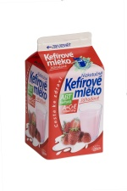

Read labels!
Nutrient | Sweetened dairy | Normal dairy
Energy | 69 kcal / 290 kJ | 40 kcal / 170 kJ
Fats | 1 g | 1 g
Proteins | 3 g | 3 g
Carbohydrates | 12 g | 5,4 g
Milk and dairy products

Slide 51

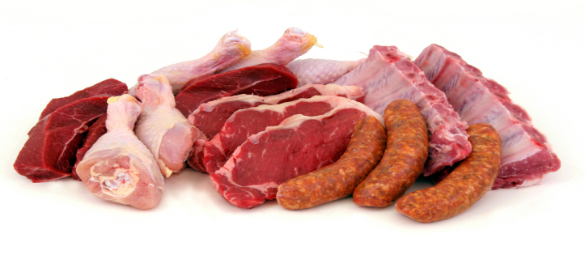
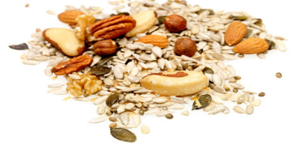
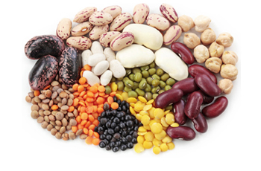
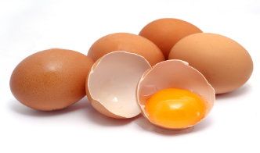
MEAT, FISH AND SEAFOOD, EGGS, LEGUMES, NUTS AND SEEDS

Slide 52






 | Energy kJ/100 g | Water g/100 g | Protein g/100 g | Fat (SFA) g/100 g | Carb g/100 g
EGGS Chicken eggs | 575 | 76,1 | 12,5 | 9,2 (2,5) | 1,3
MEAT Lean beef – raw Lean beef - stewed | 427 823 | 73,3 55,9 | 22,3 36,9 | 1,3 (0,6) 5,3 (2,3) | 0 0
FISH Tuna | 610 | 69,5 | 23,7 | 5,6 (1,3) | 0
LEGUMES Lentils – dried Lentils – boiled | 1372 466 | 9,8 62,4 | 69,6 23,6 | 0,7 0,4 | 48,5 16.3
NUTS Almonds | 2520 | 4,7 | 20,2 | 52,7 | 7,3
SEEDS Sesame seeds | 2380 | 3,2 | 24,5 | 45,9 (8,5) | 13,9
www.nutridatabaze.cz

Slide 53



PROTEIN FOODS

Slide 54
PROTEIN
Function:
- building blocks for bones, muscles, cartilage, skin, and blood
- building blocks for enzymes, hormones, and vitamins
- proteins are one of three nutrients that provide energy
Protein:
- high biological value = protein contains the essential amino acids in the right proportion required by humans (meat, poultry, fish, eggs, milk, cheese and yogurt)
- low biological value = one or more essential amino acids are present in too short amount (plants, legumes, grains, nuts, seeds and vegetables)
!!! Legumes contain relatively low quantities of the essential amino acid methionine (which is found in higher amounts in grains)
The amino acid that is in the shortest supply in relation to need is termed the limiting amino acid
Essential amino acid = indispensable amino acids that cannot be produced during metabolism by the body and therefore must be provided by our diet
Non - essential amino acid = dispensable amino acids that can be produced endogenously in the body from other proteins
Protein foods

Slide 55

Servings
1-3 portions a day
80 g cooked meat
2 eggs
100 g or 250 ml cup of boiled legumes
www.pav.rvp.cz
Protein foods

Slide 56
MERCURY
vit. B₁₂, A
Omega 3: EPA, DHA
Fe, Zn
vit. D
PROTEIN FOODS
Omega 3: ALA
All essential amino acids
FIBRE

Slide 57
Fish and seafood: EPA, DHA, vit. D
HEALTH CLAIM/RELATIONSHIP:
EPA (eicosapentaenoic acid) and DHA (docosahexaenoic acid):
- maintenance of normal cardiac function¹, blood pressure², blood concentrations of triacylglycerols³
DHA:
- maintenance of normal (fasting) blood concentrations of triacylglycerols⁴
MATERNAL INTAKE:
- DHA maternal intake contributes to the normal brain development of the foetus and breastfed infants⁵
- DHA maternal intake contributes to the normal development of the eye of the foetus and breastfed infants⁶
vitamin D:
- absorption and utilisation of calcium and phosphorus and maintenance of normal blood calcium concentrations, maintenance of bones and teeth, normal muscle function, normal function of immune system and inflammation response, cell division⁷
Protein foods

Slide 58
Conditions for using the claims
¹The claim may be used only for food which is at least a source of EPA and DHA as referred to in the claim SOURCE OF OMEGA 3 FATTY ACIDS as listed in the Annex to Regulation (EC) No 1924/2006. In order to bear the claim information shall be given to the consumer that the beneficial effect is obtained with a daily intake of 250 mg of EPA and DHA.
²The claim may be used only for food which provides a daily intake of 3 g of EPA and DHA. In order to bear the claim, information shall be given to the consumer that the beneficial effect is obtained with a daily intake of 3 g of EPA and DHA. When the claim is used on food supplements and/or fortified foods information shall also be given to consumers not to exceed a supplemental daily intake of 5 g of EPA and DHA combined. The claim shall not be used for foods targeting children.
³The claim may be used only for food which provides a daily intake of 2 g of EPA and DHA. In order to bear the claim, information shall be given to the consumer that the beneficial effect is obtained with a daily intake of 2 g of EPA and DHA. When the claim is used on food supplements and/or fortified foods information shall also be given to consumers not to exceed a supplemental daily intake of 5 g of EPA and DHA combined. The claim shall not be used for foods targeting children.
⁴The claim may be used only for food which provides a daily intake of 2 g of DHA and which contains DHA in combination with eicosapentaenoic acid (EPA). In order to bear the claim, information shall be given to the consumer that the beneficial effect is obtained with a daily intake of 2 g of DHA. When the claim is used on food supplements and/or fortified foods information shall also be given to consumers not to exceed a supplemental daily intake of 5 g of EPA and DHA combined. The claim shall not be used for foods targeting children.
⁵Information shall be given to pregnant and lactating women that the beneficial effect is obtained with a daily intake of 200 mg of DHA in addition to the recommended daily intake for omega-3 fatty acids for adults, i.e.: 250 mg DHA and EPA. The claim can be used only for food which provides a daily intake of at least 200 mg DHA .
⁶Information shall be given to pregnant and lactating women that the beneficial effect is obtained with a daily intake of 200 mg of DHA in addition to the recommended daily intake for omega-3 fatty acids for adults, i.e.: 250 mg DHA and eicosapentaenoic acid (EPA). The claim can be used only for food which provides a daily intake of at least 200 mg DHA.
⁷The claim may be used only for food which is at least a source of iron as referred to in the claim SOURCE OF [NAME OF VITAMIN/S] AND/OR [NAME OF MINERAL/S] as listed in the Annex to Regulation (EC) No 1924/2006
Protein foods

Slide 59
Mercury in fish and shellfish
Mercury may harm an unborn baby or young child's developing nervous system!
Recommendations for child-bearing women, breastfeeding women and young children:
1. Do not eat shark, swordfish, king mackerel, tilefish.
They contain high levels of mercury.
2. Eat up to 340 g a week of a variety of fish and shellfish that are lower in mercury.
Five of the most commonly eaten fish that are low in mercury are shrimp, canned light tuna, salmon, pollock, and catfish.
Another commonly eaten fish, albacore ("white") tuna has more mercury than canned light tuna. So, when choosing your two meals of fish and shellfish, you may eat up to 170 g (one average meal) of albacore tuna per week.
Protein foods
Notes:
http://www.fda.gov/Food/FoodborneIllnessContaminants/BuyStoreServeSafeFood/ucm110591.htm

Slide 60
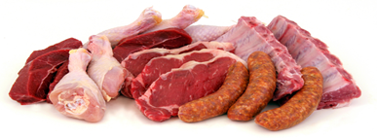
MEAT: Fe, Zn, B₁₂
HEALTH CLAIM/RELATIONSHIP:
Iron: cognitive function, contribution to normal energy-yielding metabolism, formation of red blood cells and haemoglobin, oxygen transport in the body, function of the immune systém, reduction of tiredness and fatigue, cell division*
Zinc: DNA synthesis and cell division, acid-base metabolism, contribution to normal carbohydrate metabolism, cognitive function, fertility and reproduction, contribution to normal macronutrient metabolism, maintenance of normal serum testosterone concentrations, vitamin A metabolism, contribution to normal protein synthesis, maintenance of bones, normal hair, normal nails and normal skin, fertility and reproduction, maintenance of vision, function of the immune system, protection of DNA, proteins and lipids from oxidative damage, DNA synthesis and cell division*
B₁₂: energy-yielding metabolism, contribution to neurological and psychological function, contribution to normal homocysteine metabolism, contribution to neurological and psychological function, red blood cell formation, function of the immune system, reduction of tiredness and fatigue, cell division*
A: metabolism of iron, maintenance of normal skin and mucous membranes, normal vision and normal function of the immune system, cell differentiation*
*The claim may be used only for food which is at least a source of iron as referred to in the claim SOURCE OF [NAME OF VITAMIN/S] AND/OR [NAME OF MINERAL/S] as listed in the Annex to Regulation (EC) No 1924/2006
Protein foods
Notes:
!!! vitamin A: beta-carotene serves as a precursor, deficiency is the leading cause of blindness in developing countries, it is highly toxic when consumed excess

Slide 61
Health claim: MEAT or FISH
Meat or fish contributes to the improvement of iron absorption when eaten with other foods containing iron*
= MEAT FACTOR EFFECT
*The claim may be used only for food which contains at least 50 g of meat or fish in a single quantified portion. In order to bear the claim information shall be given to the consumer that the beneficial effect is obtained by consuming 50 g of meat or fish together with food(s) containing non-haem iron.
Protein foods

Slide 62
PROCESSED MEAT x RED MEAT
Processed meat refers to meat that has been transformed through salting, curing, fermentation, smoking, or other processes to enhance flavour or improve preservation.
Red meat refers to all mammalian muscle meat, including, beef, veal, pork, lamb, mutton, horse, and goat.
Processed meat was classified as Group 1 - this classification is based on sufficient evidence from epidemiological studies that eating processed meat causes colorectal cancer. An analysis of data from 10 studies estimated that every 50 gram portion of processed meat eaten daily increases the risk of colorectal cancer by about 18%.
Red meat was classified as Group 2A, probably carcinogenic to humans. The cancer risk related to the consumption of red meat is more difficult to estimate because the evidence that red meat causes cancer is not as strong. However, if the association of red meat and colorectal cancer were proven to be causal, data from the same studies suggest that the risk of colorectal cancer could increase by 17% for every 100 gram portion of red meat eaten daily.
Protein foods

Slide 63
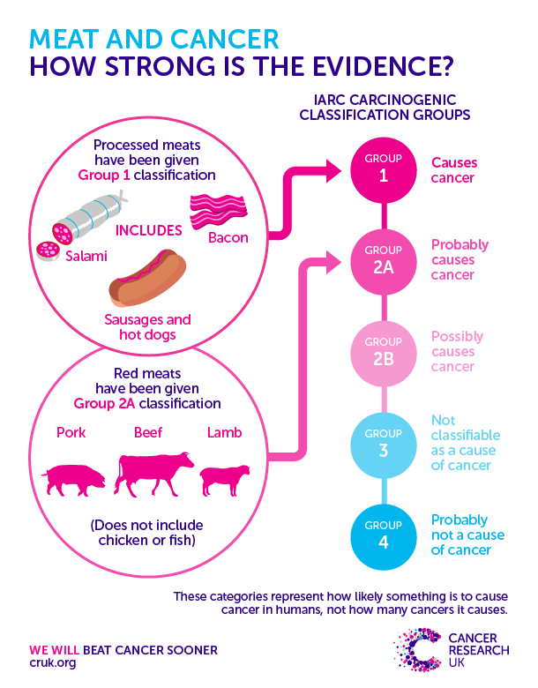
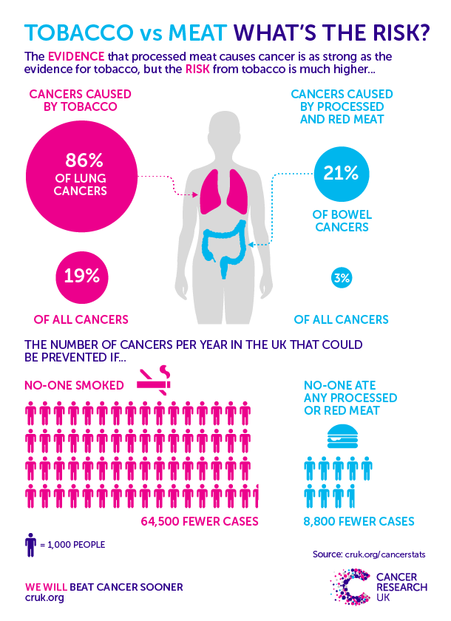

Slide 64
Cholesterol
Myth: „If you have high cholesterol, stop eating eggs“
only the cell membranes of animal tissue contain cholesterol
chicken liver (497 mg / 100 g), egg yolk (1281 mg / 100 g), butter (266 mg / 100 g), cream (109 mg / 100 g)
!!! Cholesterol is not a fat. It´s a sterol
it is a “fat-like” substance present in all body cells that is needed for many essential body processes
Importance:
component of cell membranes
it contributes to the digestion of fat and the skin’s production of vitamin D
…dietary determinants of blood cholesterol levels
are saturated fatty acids and trans fatty acids
Protein foods

Slide 65

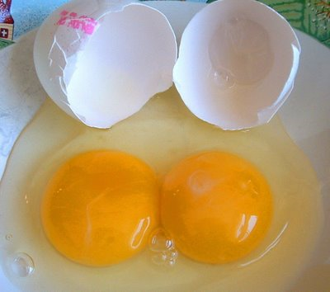
Cholesterol In Foods:
all animals make cholesterol > if you eat any animal product, including MEAT, POULTRY and FISH, you will be consuming some “extra” or unneeded cholesterol.
other foods high in cholesterol are:
  egg yolks
  liver / organ meats
  some shellfish
Protein foods

Slide 66



Nutrients in eggs
All essential nutrients
(except vitamin C ☺)
CHICKEN FEED
8,25 μg Se/100 g
40 mg EPA+DHA/100 g
Protein foods

Slide 67

Legumes, nuts and seeds: FIBRE
SOURCE OF FIBRE (nutrition claims)
= product contains at least 3 g of fibre per 100 g or at least 1,5 g of fibre per 100 kcal.
HIGH FIBRE (nutrition claims)
= product contains at least 6 g of fibre per 100 g or at least 3 g of fibre per 100 kcal
FIBRE
SOYBEANS - dried: 19,4 g/100 g - boiled: 7,9 g/100 g | ALMONDS: 12,2 g/100 g PISTACHIOS: 10,4 g/100 g HAZELNUTS: 8,7 g/100 g
LENTILS: - dried: 15 g/100 g - boiled: 5 g/100 g | POPPY SEEDS: 22,7 g/100 g SESAME SEEDS: 7,9 g/100 g PUPMKIN SEEDS: 3,9 g/100 g
SOAKING, GERMINATION, COOKING
- legumes are more digestible
Protein foods

Slide 68
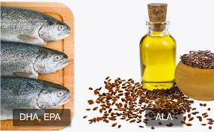
Legumes, nuts and seeds: ALA
ALA
= alpha-linolenic acid (omega 3)
flaxseed oil, canola oil, soyabean oil, walnuts, …
health claim: ALA contributes to the maintenance of normal blood cholesterol levels*
*The claim may be used only for food which is at least a source of ALA as referred to in the claim SOURCE OF OMEGA 3 FATTY ACIDS as listed in the Annex to Regulation (EC) No 1924/2006. Information shall be given to the consumer that the beneficial effect is obtained with a daily intake of 2 g of ALA.
ALA → EPA and DHA
!!! conversion efficiencies 10%
Protein foods

Slide 69
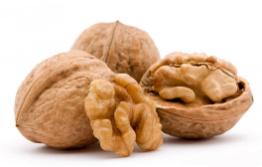
Health claim: WALNUTS
Walnuts contribute to the improvement
of the elasticity of blood vessels*
*The claim may be used only for food which provides a daily intake of 30 g of walnuts. In order to bear the claim, information shall be given to the consumer that the beneficial effect is obtained with a daily intake of 30 g of walnuts.
Protein foods

Slide 70
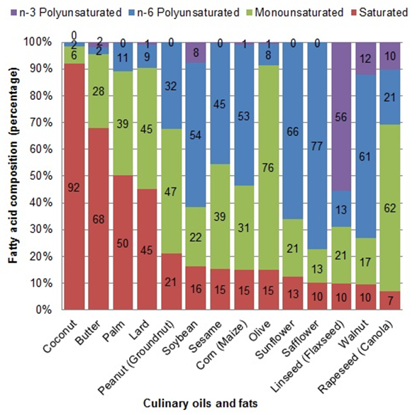
Notes:
http://www.eufic.org/article/en/artid/How_to_choose_your_culinary_oil/

Slide 71
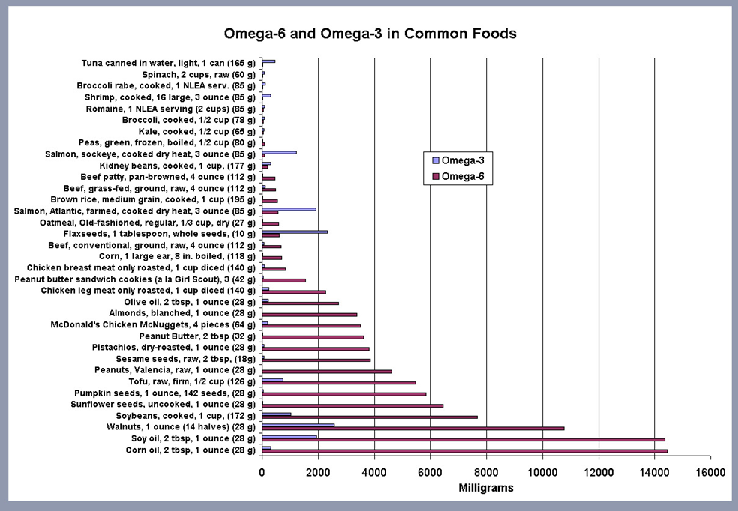
Notes:
https://cardiologydoc.wordpress.com/2012/05/15/good-fat-bad-fat-whats-going-on/

Slide 72
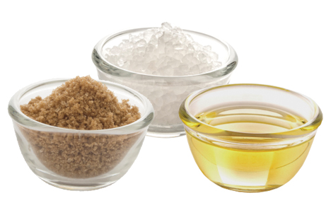
FAT, SALT AND SUGAR
Use moderation with their intake!

Slide 73
LIPID
Lipid = a compound that is insoluble in water, but soluble in an organic solvent (e.g. ether, benzene, acetone, chloroform)
“lipid” is synonymous with “fat”, but also includes phospholipids, sterols etc.
chemical structure: glycerol + fatty acids > triacylglycerols = triglycerides = TAGs
Contain carbon, oxygen, and hydrogen
Fat, salt and sugar

Slide 74
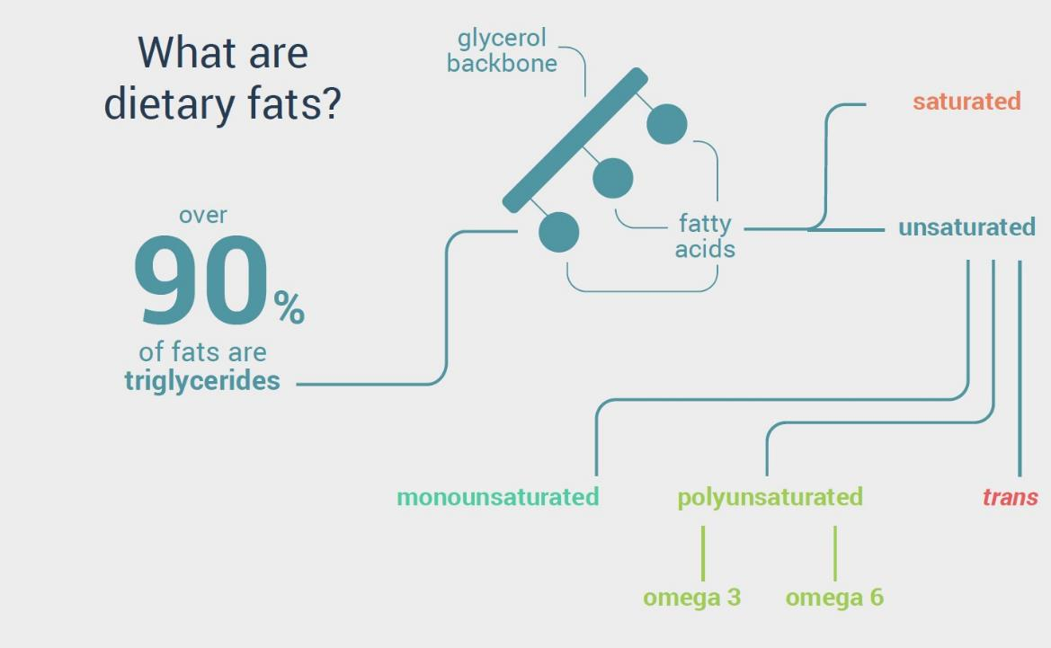

Slide 75
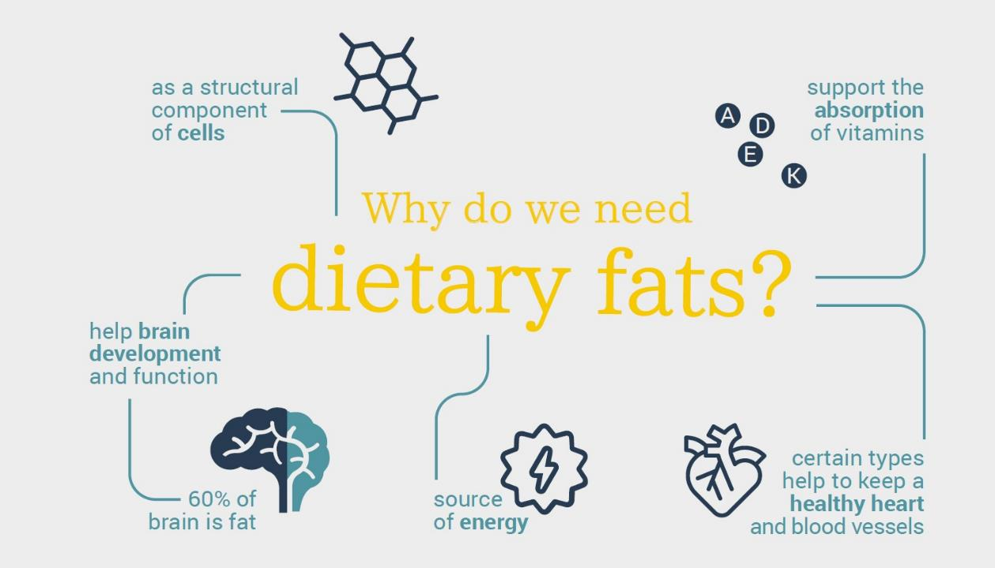

Slide 76
Functions of Fat
supplies Energy Fats provide 9 kcal per gram/37 kJ per gram
carries Vitamins A, D, E and K through the body
provides a reserve store of energy
promotes healthy skin
secures normal cell growth
acts like a "cushion" and heat regulator to protect your heart, liver and other vital organs
used to manufacture major sex hormones
key to the structure of cell membranes
components of hormones and precursors for prostaglandin synthesis
it helps you feel full longer
adds flavor to food
Fat, salt and sugar

Slide 77
In 2.000 kcal…
It is recommended that the maximum number of grams of fat a person should have in a day is 60-70 grams.
No more than 30 % (adults 20-35 %) of a person’s total calories should come from fat sources.
Fat, salt and sugar

Slide 78


Slide 79
Fatty acid nomenclature
nomenclature reflects location of double bonds
there are also used common names (e.g., oleic, stearic, palmitic)
linoleic is also known as 18:2 n-6
this means the FA is 18 carbons in length, has 2 double bonds, the first of which is on the 6th carbon
arachidonic = 20:4 n-6
Fat, salt and sugar

Slide 80
Difference in double-bond location
The location of the first double bond in unsaturated fatty acids differ the omega-3 fatty acid and omega-6 fatty acid
Omega-3 fatty acid
  First double bond is between the third and fourth carbon from the omega end
  Example: Alpha-linolenic acid
    One of the two essential fatty acids
Fat, salt and sugar

Slide 81
Difference in double-bond location
Omega-6 fatty acid
  First double bond is between the sixth and seventh carbon from the omega end
  Example: Linoleic acid
    One of the two essential fatty acids
Fat, salt and sugar

Slide 82
Types of fatty acids
  organic acid units that make up fat
  there are three types:
      Saturated FA - SFA (SAFA)
      Monounsaturated FA - MUFA
      Polyunsaturated FA - PUFA
recommended ratio: 1 SFA : 1,4 MUFA : 0,6 PUFA
Fat, salt and sugar

Slide 83

The Omega fatty acids
Fat, salt and sugar

Slide 84

Sources of fatty acids
Saturated fatty acids sources: butter, beef fat, lard, meat, milk and dairy products, coconut, palm and palm kernel oils
Recommended amount: 20 g
Monounsaturated fatty acids sources: olive canola oil, nuts - pistachios, almonds, hazelnuts, cashews, as well as peanuts, avocados
Recommended amount: 28 g
Polyunsaturated fatty acids sources: walnuts, soybeans, flax, sunflower, sesame oils, salmon, mackerel, herring (ie. especially oily fish and seafood)
Recommended amount: 12 g
Fat, salt and sugar

Slide 85


SFA
butter, beef fat, lard, meat, milk and dairy products, coconut, palm and palm kernel oil
recommended amount: 20 g
Fat, salt and sugar

Slide 86


MUFA
olives, olive oil, rapeseed oil (canola oil), nuts (pistachios, almonds, hazelnuts, cashews, also peanuts), avocados
recommended amount: 28 g
Fat, salt and sugar

Slide 87






PUFA
walnuts, soybeans, flaxseed, sunflower, sesame, canola oils, salmon, mackerel, herring (ie. especially oily fish and seafood)
Fat, salt and sugar

Slide 88


Slide 89
Hydrogenation of unsaturated FA
= conversion of PUFA to MUFA & SFA
purposes:
  production of solid fats (shortening) from liquid oils
  production of more chemically stable fats (resist oxidation, rancidity)
the process in which missing hydrogen atoms are added to an unsaturated fat to make it firmer
Fat, salt and sugar

Slide 90
Trans-unsaturated fatty acids
A large number of TFA isomers of MUFA and PUFA, including positional isomers of individual fatty acids, occurs in foods. These TFA originate from several sources:
bacterial transformation of unsaturated fatty acids in the rumen of ruminant animals.
industrial hydrogenation used to produce semi-liquid and solid fats that can be used for the production of foods such as margarine, shortenings and biscuits
deodorisation (a necessary step in refining) of unsaturated vegetable oils (or occasionally fish oils) high in polyunsaturated fatty acids
heating and frying of oils at too high temperatures (> 220 °C). These modifications are time-dependent with about 5 % of isomerisation of n-3 18:3 after 2 hours and 25 % after 12 hours of heating.
Fat, salt and sugar

Slide 91

Hydrogenation
forms a new type of fatty acid called trans-fatty acid
  (“man-made” fat)
trans-fatty acids have many of the same properties as SATURATED fats
Fat, salt and sugar

Slide 92
Trans-unsaturated fatty acids (TFAs)
Trans fatty acids are produced by partial hydrogenation of liquid plant oils
Trans fatty acids occur naturally in animal products such as meat and dairy products
Trans fatty acids are formed during heating of cooking oils
Fat, salt and sugar

Slide 93
Down with TFAs -1 %
TFAs have been associated with a detrimental effect on plasma lipids, with raised levels of LDLs, and lowered high-density lipoproteins (HDLs)
Because of this , food manufacturers have in recents years worked to lower levels of TFAs in foods, and some labelling regulations require that any TFAs are declared.
Trans fatty acids intake should be as low as possible within the context of
a nutritionally adequate diet.
The available evidence is insufficient to establish whether there is
a difference between ruminant and industrial trans fatty acids consumed in equivalent amounts on the risk of coronary heart disease.
Fat, salt and sugar

Slide 94

Sterols
Sterols are not fat!
More complex than phospholipids or triacylglycerols
  Four connected rings of carbon and hydrogen
Do not provide energy
Cholesterol is the best known sterol
  Found in every cell
Fat, salt and sugar

Slide 95
Phytosterols – major plant sterols
phytosterols are derived from plants
beta-sitosterol is obtained from nuts, cereals, fats and oils
plant stanol and sterol esters have been marketed in recent years to help in cholesterol lowering, as they compete with cholesterol for absorption and promote the increases loss of cholesterol in faeces
Fat, salt and sugar

Slide 96
Phytosterols
Chemical structure of cholesterol, sitosterol (plant sterol), and sitostanol (plant stanol). Both plant sterols and plant stanols differ from cholesterol only in the side chain attached to the sterol ring. Plant stanols are saturated plant sterols without a double bond in the sterol ring. Due to their saturation status, plant stanols are less effectively absorbed. Esterified plant sterols and plant stanols are supplemented in ‘nutraceuticals’ to reduce serum cholesterol levels
Fat, salt and sugar

Slide 97
Plant sterols/stanols – HEALTH CLAIMS
following wording reflects the scientific evidence: “Plant sterols/stanols help to maintain normal blood cholesterol levels”.
Plant sterols improve blood cholesterol levels
Daily phytosterols intake helps achieve acceptable LDL-cholesterol levels
In order to bear the claim, a food should provide at least 0.8 g per day of plant sterols/stanols in one or more servings. These amounts can be reasonably achieved in the context of a balanced diet. The target population is adults.
Food products containing plant sterols and/or plant stanols may not be nutritionally appropriate for pregnant and breastfeeding women, and for children under the age of five years.
Fat, salt and sugar

Slide 98
What is cholesterol?
Cholesterol is NOT a fat.
a “fat-like” substance present in all body cells that is needed for many essential body processes
contributes to the digestion of fat and the skin’s production of vitamin D
adults manufacture all the cholesterol they need, mostly in the liver
all animals also have the ability to manufacture cholesterol
Fat, salt and sugar

Slide 99
LDLs and HDLs
certain amount of cholesterol circulates in the blood
it does not float through the bloodstream on its own, but in chemical “packages” called lipoproteins
there are two major kinds of lipoproteins:
  LDLs (Low-Density Lipoproteins)
  HDLs (High-Density Lipoproteins)
Fat, salt and sugar

Slide 100
Low-Density Lipoproteins
take cholesterol from the liver to wherever it is needed in the body
if too much LDL cholesterol is circulating, the excess amounts of cholesterol can build up in artery walls
this buildup increases the risk of heart disease or stroke
thus, LDL cholesterol has come to be known as “bad cholesterol”
Fat, salt and sugar

Slide 101

High-Density Lipoproteins
picks up excess cholesterol and takes it back to the liver, keeping it from causing harm
Thus, HDL cholesterol has come to be known as “good cholesterol.”
Fat, salt and sugar

Slide 102
Important!
For most people, the amounts and types of fats eaten have a greater effect on blood cholesterol than does the cholesterol itself.
The fats found in food, such as butter, chicken fat, or corn oil, are made up of different combinations of fatty acids.
Fat, salt and sugar

Slide 103


Slide 104
Saturated fatty acids
raise LDLs - lauric, myristic and palmitic acid raise blood total and LDL cholesterol concentrations
raise HDLs - lauric acid strongly increases blood HDL cholesterol
Fat, salt and sugar

Slide 105
Monounsaturated fatty acids
appear to lower LDL (“bad”) cholesterol and help raise levels of HDL (“good”) cholesterol
Fat, salt and sugar

Slide 106
Polyunsaturated Fatty Acids
n-6 PUFA lower blood total and LDL cholesterol concentrations
effects of alpha-linolenic acid on the blood lipoprotein profile are comparable to those of linoleic
EPA and DHA lower blood triacylglycerol concentrations
Fat, salt and sugar

Slide 107
Lipoprotein profile
The most favourable lipoprotein profile to lower atherosclerotic risk is achieved when a mixture of SFA and TFA is replaced by a mixture of oleic acid, linoleic acid and n-3 LCPUFA. These effects are dose-dependent. The various SFA may also differ in their effects on the blood lipoprotein profile. In particular, the effects of stearic acid may be less disadvantageous than those of myristic and palmitic acids. However the available data are insufficient to set different DRVs for different SFA.
Fat, salt and sugar

Slide 108
Effect on blood cholesterol
all fats include all 3 kinds of fatty acids, but in varying amounts
each type of fat has a different effect on cholesterol levels
decreasing the intake of SFA and TFA, and increasing the intake of fish oil, lower cardiovascular risk
Fat, salt and sugar

Slide 109


Slide 110
Essential fatty acids
Alfa-Linolenic Acid (ALA)
Linoleic Acid (LA)
“essential” because the body cannot manufacture them
have to be supplied by food a person eats
both polyunsaturated fatty acids
found in the natural oils of plants and fish
body needs them for its basic functions, including production of various hormones
Fat, salt and sugar

Slide 111

Interconversion between fatty acids
desaturation and elongation
Fat, salt and sugar

Slide 112
Essential fatty acids, eicosanoids, and cell membrane
linoleic acid can be elongated and converted to arachidonic acid
alpha-linolenic acid
  converts to eicosapentaenoic acid (EPA)
    EPA elongates to docosahexaenoic acid (DHA)
  needed for healthy cell membranes
  intake of 250 mg per day of EPA plus DHA (1 to 2 fatty fish meals per week) appears to be sufficient for primary prevention (cardiovascular) in healthy subjects.
Fat, salt and sugar

Slide 113
Essential Fatty Acids, Eicosanoids, and Cell Membrane
EPA and arachidonic acid are used to manufacture eicosanoids
eicosanoids are hormonelike substances
  prostaglandins, thromboxanes, and leukotrienes
  regulate the immune system, blood clotting, inflammation, and blood pressure
Fat, salt and sugar

Slide 114
Eicosanoid functions: role in heart disease
regulate
  smooth muscle contractions
    blood pressure
      Omega-3 eicosanoids tend to lower BP
      Omega-6 tend to increase BP
  blood clotting
      Omega-3 eicosanoids tend to inhibit blood clotting
      Omega-6 tend to increase blood clotting
  inflammatory response
      Omega-3 PUFA may reduce inflammatory response
Fat, salt and sugar

Slide 115


Slide 116


Slide 117
Lowering fat and cholesterol in the diet
exercise!
replace saturated fats with unsaturated fats in the diet
choose lean cuts of meat
steam, boil or bake foods instead of cooking them in oil or fat
many more!!
Fat, salt and sugar

Slide 118
Use moderation with fat intake
  read food labels
  use olive oil, canola oil for cooking
  avoid margarine with trans fatty acids
  choose lean meat, fish, poultry
  eat fewer cold cuts, less bacon, sausages, hot dogs, organ meats
  use substitutes for higher-fat products
Fat, salt and sugar

Slide 119
Salt vs. Sodium
Salt is sodium chloride (NaCl)
Sodium is an element which occurs naturally and is used by the body
1 g of sodium = 2,5 g of salt
Fat, salt and sugar

Slide 120

Salt: a history
The word salt comes from the word ‘salarium’ in latin (salary)
This is because roman soldiers used to be partly paid in salt
Fat, salt and sugar

Slide 121

Salt: a history
Salt was once needed as a preservative to make food last longer – we call this increasing “shelf life”
Fat, salt and sugar
Notes:
A very small amount of salt is needed by the body, but this is only 0.25g.
Salt can help food to last longer and can also add flavour to foods
Fridges, freezers and cans all help to make food last longer so salts role in this has reduced a lot
BUT… it is still used too much by food companies.

Slide 122


Salt: a history
We now have fridges, freezers and cans to make food last a long time
Fat, salt and sugar
I
Notes:
A very small amount of salt is needed by the body, but this is only 0.25g.
Salt can help food to last longer and can also add flavour to foods
Fridges, freezers and cans all help to make food last longer so salts role in this has reduced a lot
BUT… it is still used too much by food companies.

Slide 123

Salt: a history
But there are much nicer and healthier sources of flavours such as herbs and spices…
Fat, salt and sugar
Notes:
A very small amount of salt is needed by the body, but this is only 0.25g.
Salt can help food to last longer and can also add flavour to foods
Fridges, freezers and cans all help to make food last longer so salts role in this has reduced a lot
BUT… it is still used too much by food companies.

Slide 124

Where is the sodium?
Fact: Most of the foods we eat contain too much sodium.
Fat, salt and sugar
Notes:
Speaker’s Notes:
Fact: Most of the foods we eat contain too much sodium.
Over 75% of the sodium we eat comes from processed foods such as cheese, deli meats, pizza, sauces, and soups.
Breads, breakfast cereals and bakery products also contain sodium even though they may not taste salty.
Processed foods:
Most of the sodium we eat comes from processed foods, not the salt shaker.
Sodium is added to processed foods such as frozen meals, pizza, sauces, deli meat, and crackers for flavour, texture, and as a preservative.
Naturally occurring:
There is a small amount of sodium found naturally in vegetables, fruits, meat and meat alternatives, and milk and milk alternatives.
Added during cooking or at the table:
11% of sodium Canadians consume comes from condiments added during cooking or at the table. These include ingredients such as:
Table salt
Sea salt
Ketchup
Pickles
Teriyaki sauce
Soy sauce

Slide 125
Where is the salt?
around 75 % of our salt intake comes from processed foods,
e.g. bread, breakfast cereals and ready meals.
it is important to know how much salt the food product provides. You can check the salt content on the food label before you buy, to help you make a good choice.
many commercially-made food products have been reformulated to reduce their salt content
Fat, salt and sugar

Slide 126


At home
tips for vegetables and fruit
  try fresh vegetables and fruit for snack instead of packaged snacks
  rinse canned vegetables to wash away the sodium
  flavour food with herbs and spices instead of salt, celery salt, garlic salt or onion salt
  try unsalted margarine or unsalted butter
Fat, salt and sugar
Notes:
Speaker’s Notes:
Eating the recommended number of servings of vegetables and fruit each day will contribute to an overall diet lower in sodium.
When preparing vegetables and fruit at home:
Try fresh vegetables and fruit for snack instead of packaged snacks. Fresh vegetables and fruit are naturally low in sodium, plus they are high in vitamins and fibre. Keep sliced veggies in the crisper for a quick and easy snack.
Rinse canned vegetables to wash away the sodium. Pour the can into a strainer or colander and rinse under cold running water.
Flavour food with herbs and spices instead of salt, celery salt, garlic salt or onion salt. Fresh and dried herbs and spices add tons of flavour to food – there is often no need for salt!
When preparing grains at home:
Cook pasta in unsalted water. Let the sauce, meat or alternative, and vegetables be the flavour star!
Cook rice, barley and quinoa in water or “no salt added” broth instead of salty broth. Add flavour with lemon, garlic, herbs and spices instead of salt.
Try unsalted margarine or unsalted butter. It’s a simple swap, and with all the other flavours in a sandwich your taste buds won’t miss the extra sodium.
Suggested Activity: Ask the participants to think about the strategies and tips they use to reach their recommended number of Food Guide Servings for Vegetables and Fruit. Do they eat a vegetable and fruit at each meal and snack? Do they add extra vegetables to their favourite soups and casseroles? What are their favourite ways to prepare tasty vegetable dishes without using salt or sauces high in sodium?
Suggested Activity: Ask the participants to think about the ways in which they limit the amount of sodium added to their favourite grains and grain products. For example, do they spice up noodles and rice with fresh herbs or curry instead of higher sodium sauces? Have they experimented with different grains such as quinoa or bulgar which are naturally low in sodium?

Slide 127

Why Sodium Reduction?
hypertension
osteoporosis
stomach cancer
obesity
Fat, salt and sugar
Notes:
That’s’ why the American Heart Association is working with the food industry and encouraging them to voluntarily reduce the sodium in foods.
This slide shows an example of the impact that could be achieved by reducing sodium in the food supply. According to modeling commissioned by the AHA and presented at its June 2013 Sodium Conference, if the food industry voluntarily reduced sodium by 50% in the top 50 foods that contribute to Americans’ sodium intakes, and then reduced sodium in other foods by 10%, it could result in 80% of the population reaching intermediate sodium goals (2,300 mg sodium/day) and 30% achieving ideal sodium intake (1,500 mg sodium/day).
To help the food industry ‘get the message’ about sodium, we encourage everyone to look for the lower sodium options and choose those whenever possible. The more we purchase them, the more incentive the food industry will have to offer more of them.

Slide 128
Iodine and salt
IDD is the world's leading cause of preventable mental retardation and impaired psychomotoric development in young children.
in its most extreme form, iodine deficiency causes cretinism
it also significantly raises the risks of stillbirth and miscarriage for pregnant women
Fat, salt and sugar

Slide 129
Differences in Na between Countries
USA - 6-piece Chicken Nuggets
600 mg sodium
(280 calories)
United Kingdom - 6-piece Chicken Nuggets
280 mg sodium
(260 calories)
= 320 mg less sodium
Fat, salt and sugar

Slide 130
SUGARS = mono- and disaccharides
The proposed labelling reference intake for (total) sugars (90 g) corresponds to 18 E% for a 8400 kJ (2000 kcal) diet. The proposed value is at the lower end of the range of average intakes of total sugars in adults in EU countries (about 17 - 26 E%). Total sugars include both indigenous (sugars naturally present in foods such as fruit, vegetables, cereals and lactose in milk products) and added sugars. There are generally no recommended intakes for total sugars.
Some authorities have recommended upper limits of intake of added sugars (generally 10 E%) for individuals in the general population, while others recommend that intake of added sugars, or certain foods containing added sugars, be limited but do not recommend an upper limit.
Fat, salt and sugar

Slide 131
Sugar
It has been estimated that indigenous sugars provided by recommended daily intakes of fruits, vegetables, cereals and dairy products would amount to about 45 g in adults.
Assuming that the remaining 45 g of sugars (up to the 90 g proposed for the labelling reference intake) are added sugars, this would correspond to 9 E% for a 8400 kJ or 2000 kcal diet.
Fat, salt and sugar

Slide 132

Sugar
Intrinsic sugars
  from intact fruits & vegetables
Added sugars
  the term “added sugars”or “extrinsic” sugars” refers to sucrose, fructose, glucose, starch hydrolysates (glucose syrup, high-fructose syrup) and other isolated sugar preparations used as such or added during food & beverages preparation and manufacturing.
Free sugars
  added sugars + concentrated sugars (i.e. from honey, syrups, and juices)
Fat, salt and sugar

Slide 133
Sugar - European legislation
Sugar alcohols (polyols) such as sorbitol, xylitol, mannitol, and lactitol, are usually not included in the term “sugars”.
Fat, salt and sugar

Slide 134
Sugar
Why is sugar added to foods?
  flavour enhancement
  provide texture and colour
  permits fermentation
  adds bulk
  acts as a preservative
  balance acidity
Fat, salt and sugar

Slide 135
Empty Calories?
 | Honey | Coke | Apricots
Size of 100 kcal portion | 1.5 tbsp | 1 cup | 6
Carbohydrate (g) | 26 | 26 | 24
Protein (g) | trace | 0 | 2
Calcium (mg) | 2 | 6 | 30
Vitamin A (mg) | 0 | 0 | 554
Vitamin C (mg) | trace | 0 | 22
Fat, salt and sugar

Slide 136
Nutritive & Artificial Sweeteners
Nutritive sweeteners
imparts sweetness and provides energy
includes natural sweeteners, refined sweeteners, and sugar alcohols
Refined sweeteners
composed of simple sugars extracted from other foods
Non-nutritive (artificial) sweeteners
impart sweetness but provide a negligible amount of energy
Fat, salt and sugar

Slide 137


Nutritive & Artificial Sweeteners
Fat, salt and sugar

Slide 138

Sugar recommendations
DRI:
  < 10% of average daily energy intake should be from sugars
Tips for limiting sugar intake:
  use food labels to determine amount of sugar in products
  use ingredient lists to identify multiple sugar sources and added sugars
  use less added sugar
  limit soft drinks, juice, sugary cereals, candy
  choose fresh or frozen fruits
Fat, salt and sugar

Slide 139

WATER

Slide 140

Water balance
IN
  fluids: 1 400 ml
  food: 700 ml
  metabolism: 200 ml
OUT
  urine: 1 400 ml
  feces: 100 ml
  perspiration: 100 ml
  insensible loss (skin, respiration): 700 ml
metabolism
food
liquids
Water

Slide 141
How much water?
30–35 ml/day/kg BW
average man of 70 kg
= 2,1–2,5 l
(total gain from food and drinks)
Water

Slide 142
Content of water in food
Water

Slide 143

Use nutrition information on food labels to help you make healthier food choices.
Notes:
This is an additional slide to provide information about other topics.
Whether it’s the Nutrition Facts, the ingredient list or the nutrition or health claims on the label, you can use the information to compare products and make healthy choices for you and your family. Eating well and being active are steps towards better health and a healthy body weight.
For more information, visit Health Canada’s Web site:
www.healthcanada.gc.ca/nutritionlabelling

