Slide 1

Pathology of the endocrine system.
Markéta Hermanová
Masaryk University, Medical Faculty

Slide 2
Pituitary gland
Thyroid
Parathyroid
Adrenal gland
Endocrine pancreas

Slide 3
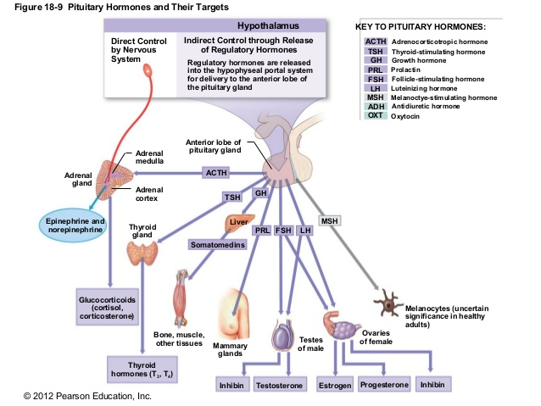
Posterior lobe of pituitary gland

Slide 4
Pathological basis of endocrine signs and symptoms
Sign or symptom | Pathological basis
Hormone excess (hyperfunction) | Endocrine gland hyperplasia cause by increased trophic stimulus to secretion Functioning neoplasm of endocrine gland
Hormone deficiency (hypofunction) | Endocrine gland atrophy due to loss of trophic stimulus to secretion Destruction of endocrine gland by inflammation, ischamia or non-functioing tumor
Diffuse enlargement of gland | Inflammatory cell infiltration Hyperplasia

Slide 5
Pituitary
Adenohypophysis
Hypofunction/partial or panhypopituitarism
Due to destruction by tumor or compression, Rathke's cleft cyst; due to hypothalamic reasons
Due to inflammation (autoimmune); due to genetic abnormalities of hormone synthesis
Due to ischaemic necrosis, radiation damage or surgical ablation
Leads to secondary hypofunction of adenohypophyseal dependent endocrine glands
(atrophy of gonads, hypothyreosis, hypocorticalism,…)
Hyperfunction/hyperpituitarism
in adenomas, carcinomas, hyperplasias, due to hypothalamic reasons

Slide 6
Adenomas of the adenohypophysis
Adenoma type | Clinical picture
Prolactinoma | Commonest type, produces galactorrhoea and menstrual disturbances
GH-secreting | Produces gigantism in children and acromegaly in adults
ACTH-secreting | Produces Cushing syndrome
Others | Exceptionally rare (TSH-, FSH-, LH- secreting)
 | Plurihormonal
 | Hormonally non-functioning
Association with MEN-1 syndrome!

Slide 7
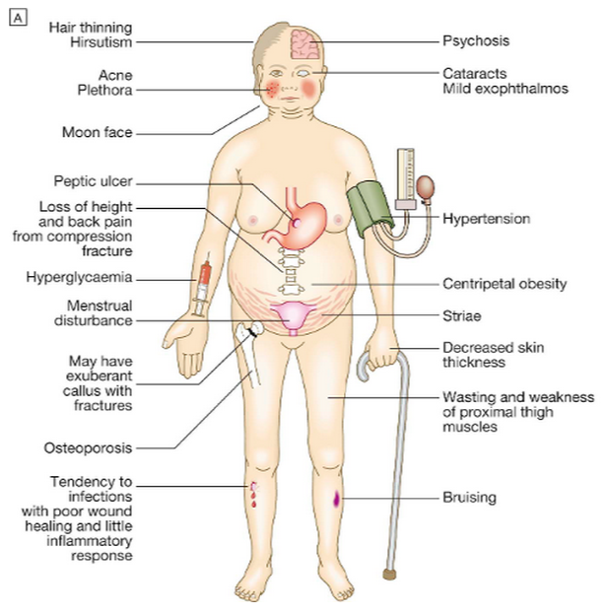
Cushing syndrome

Slide 8
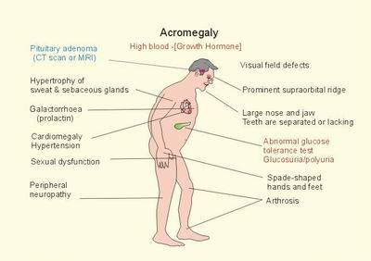

Slide 9
Neurohypophysis
Antidiuretic hormone (ADH)
ADH deficiency – diabetes insipidus (DI)
Due to hypothalamus damage (trauma, tumor, inflammation.. due to hypothalamic reasons)
Polyuria, polydipsia
In peripheral forms of DI the renal tubules insensitive to ADH
Excess ADH
Usually due to ectopic production by tumors (neuroendocrine carcinomas of the lung)
Oxytocin

Slide 10
Hypothalamic suprasellar tumors
Gliomas
Craniopharyngeoma
usually benign, malignisation rare; from the Rathke´s cleft epithelial rests
children (5-15 years; endocrinopathies) + 2nd peak in 6th decase
solid, cystic or multilocular

Slide 11
Adrenals
Medulla
Production of catecholamins (adrenalin, noradrenalin)
Tumors:
Pheochromocytoma
symptoms due to excess catecholamine secretion (secondary hypertension with ↑risk of cerebral bleeding), sweating)
Adrenal or extraadrenal, uni or bilateral, assoc. with MEN 2A and 2B (10 %)
10 % with malignant biological behavior
Neuroblastoma
(tumor of children, malignant)
Ganglioneuroblastoma, ganglioneuroma

Slide 12
Adrenals
Cortex
Production of glucocorticoids,mineralocorticoids, sex steroids
Hyperfunction:
Cushing syndrome
(excess secretion of ACTH, tumors of adrenals, treatment by steroids
Conn´s syndrome
(overproduction of mineralocorticoids: retention of water, hypertension, muscular weakness, arrhythmias)
Hypofunction
Addison´s disease - primary adrenal insufficiency and hypocortisolism
Caused by autoimmune adrenalitis, tbc, necrosis of adrenals in sepsis, destruction by tumors,…
Weight loss, lethargy, hypotension, pigmentation, hyponatraemia

Slide 13
Thyroid
Hyperthyroidism
Syndrome due to excess T3 and T4
Very rarely due to excess TSH
Caused by Graves-Basedow disease/thyreoiditis, in which the thyroid stimulating autoantibodies are produced
Rarely due to functioning adenoma or toxic nodular goiter
Hypothyroidism (myxoedema)
Syndrome due to insufficient circulating T3 and T4
If congenital , causes cretenism
Commonest cause is Hashimoto´s thyreoiditis (=autoimmune thyreoiditis)

Slide 14
Causes of thyreotoxicosis
Primary associated with hyperthyreoidism
Diffuse toxic hyperplasia (m. Graves-Basedow)
Hyperfunctional (toxic) nodulat goiter
Hyperfunctional (toxic) adenoma
Hyperfunctional thyreoidal carcinoma
Iodine induced hyperthyreoidismus
Neonatal thyreotoxicosis (of mothers with m. G-B)
Secondary associated with hypertyreoidismem
TSH producing pituitary adenoma
TRH overproduction
Without association with hyperthyreoidism
Subacute granulomatous thyreoiditis
Chronic lymphocytic thyreoiditis
Struma ovarii (mature ovarial teratoma)

Slide 15
Hypothyreoidismus:
A) congenital - cretenismus
(endemic (in iodine defficiency); sporadic (due to enzymatic defect)
B) aquiered – myxoedema
Clinical signs of cretenism:
Impaired physical growth and mental development, hypomimic face, tongue protrusion, umbilical hernia
Clinical signs of myxoedema
Accumulation of mucosubstances in corium (and viscerally)
Hypercholesteroĺaemia, accelerated AS
Dry cold skin, gruff voice, muscle weakness, prone to hypotermia, dry hair, brittle nails, oligo –amenorea, obesity, psychic disorders - depression,….
Coma with hypothermia, circulaton failure
Causes
Primary
Developmental (dysgenesis: mutation in genes for TSH-receptor, TTF)
Genetically caused resistence to thyreoidal hormones
Surgical ablation, radiation
Autoimmunne thyreoiditis
Iodine deficiency
Congenital biosynthetical defect (dyshormonogenetic goiter)
Drugs – thyreostatic
Secundary and tertiary (hypothalamic anf hypophyseal reasons)

Slide 16
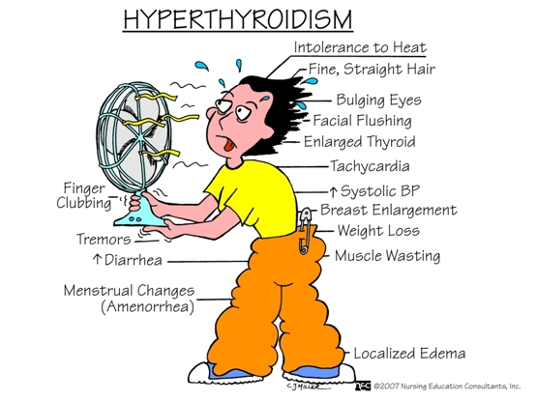

Slide 17
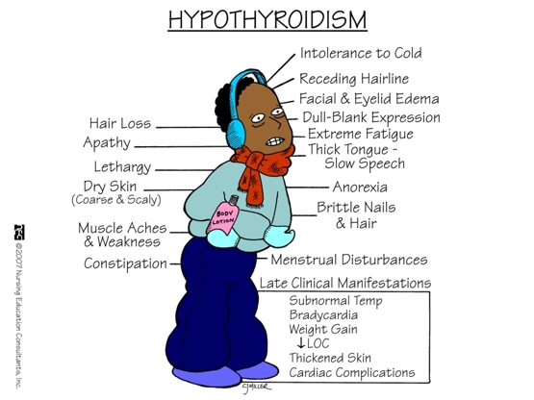

Slide 18
M. Graves-Basedow
(diffuse parenchymatous toxic (hyperfunctional) goitre)
F˃M, 2nd to 4th decade, genetically predisposed
Autoimmune disease: stimulating autoantibodies against TSH receptor
Hyperthyreoidism+infiltrative ophtalmopathy-exophthalmos (T cells, oedema, GAGs, adipocytes) +(pretibial myxoedema)
Diffuse hypertrophy and hyperplasia
„too many follicular cells and too little colloid“
Surgical removal or radioiodine ablation

Slide 19
Thyroiditis
Chronic autoimmune lymphocytic thyroiditis (Hashimoto´s)
F:M = 10:1
Genetic predisposition
CD8+ cytotoxic T cells mediated cell death; cytokines mediated cell death
Autoantibodies against TSH receptor, thyreoglobulin, peroxidase – antibody-dependent cell-mediated cytotoxicity (ADCC)
Enlarged thyroid, lymphoplasmocytic infiltrate, lymphatic follicles, oncocytic transformation of thyreocytes, fibrotisation
Often assoc. with other autoimmune diseases
Increased risk of malignant lymphoma (MALToma) and carcinom of the thyroid

Slide 20
Thyroiditis
Subacute granulomatous thyroiditis (de Quervainova)
F:M = 3-5:1
virus-induced host tisuue damage? cytotoxic T lymphocytes
Painfully enlarged thyroid, fever, fairly abrupt onset
Focal disruptions nad necroses of follicules, granulocytic and granulomatous reactions, fibrotisation)
Chronic sclerosing thyroiditis (Riedl´s)
Fibrotising inflammation involving thyroid and also surrounding tissues and organs (stenosis of trachea, paresis of n. recurrens, hypothyroidism)
Systemic connective tissue disease (IgG4 assoc.?), fibrotising Hashimoto´s thyroiditis?, idiopathic fibrosis?
Subacute lymphocytic thyroiditis (often post partum thyroiditis)

Slide 21
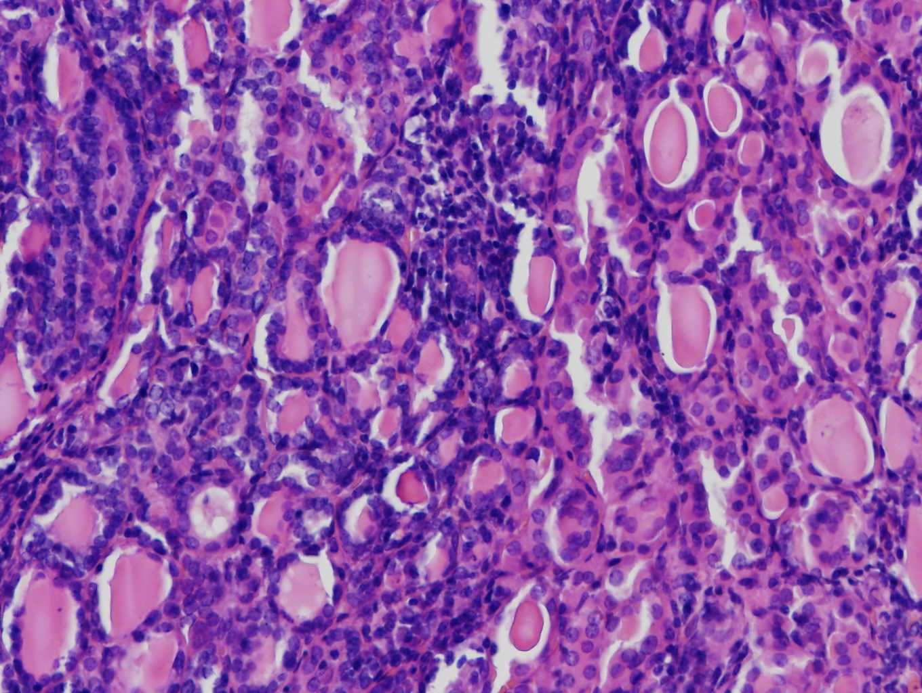
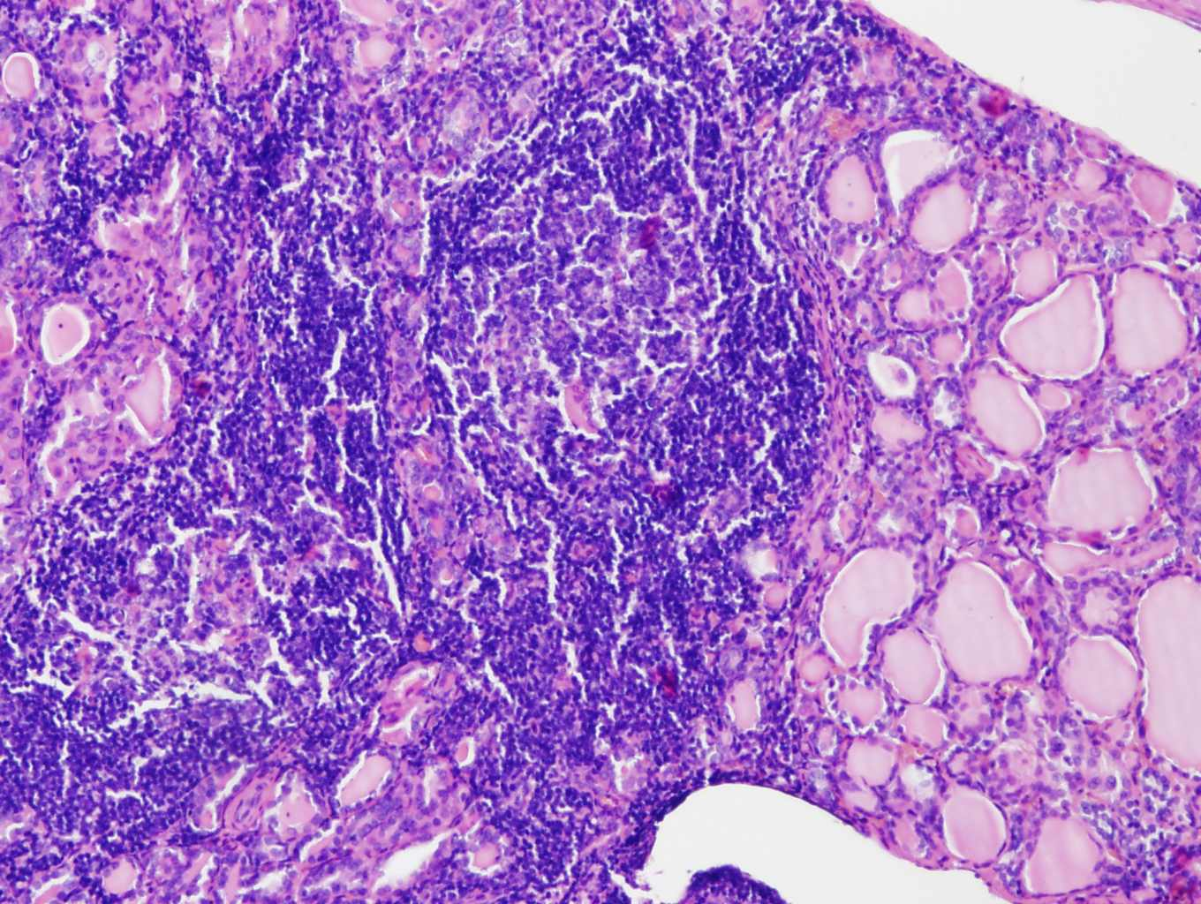
Chronic autoimmune lymphocytic thyroiditis
(Hashimoto´s thyroiditis)

Slide 22
Sclerosing lesions associated with IgG4
Autoimmune pancreatitia
Sclerosing cholangitis
Lymphoplasmocytic sclerosing cholecystitis
Sclerosing sialoadenitis
Idiopathic retroperitoneal fibrosis (M. Ormond)
Inflammatory pseudotumor of the liver, lung, pituitary gland
Tubulointerstitial nephritis assoc. with IgG4
Interstitial pneumonia assoc. With IgG4
Sclerosing prostatitis
Sclerosing thyreoiditis
M>F; immunosuppressive therapy response (steroids)
Imitation of neoplastic lesions
Sclerosing lesions with lymphoplasmocytic infiltrates, irregular fibrotisation, obliterative phlebitis, IgG4+ plasma cells.
Increased risk of malignant lymphoma

Slide 23
Goitre
(enlargement of the whole gland)
Parenchymatous goitre vs colloid goitre
Diffuse vs nodular goitre
Hypofunctional vs hyperfunctional vs eufunctional
Aetiology
Iodine deficiency, due to endemic goitre or food faddism
Rare inherited enzyme defects in T3 and T4 synthesis
Drugs that induce hypothyroidism

Slide 24
Thyroid tumors
Benign
Follicular adenoma
Malignant
Carcinoma
Lymphoma
(lymphoma (usually non-Hodgkin´s lymphomas of B-cell type, variable prognosis)

Slide 25
Carcinoma of the thyroid
Type | Proportion of all cases (%) | Typical age range | Mode of spread | Prognosis
Papillary | 60-70 | Children, young adults | Lymphatic, to lymph nodes | Excellent
Follicular | 20-25 | Young-middle age | Haematogenous, to bones | Good
Anaplastic | 10-15 | Elderly | Aggressive local extension | Very poor
Medullary | 5-10 | Usually elderly, also familial case (MEN sy) | Local, lymphatic, haematogenous | Variable, more aggressive in familial cases

Slide 26
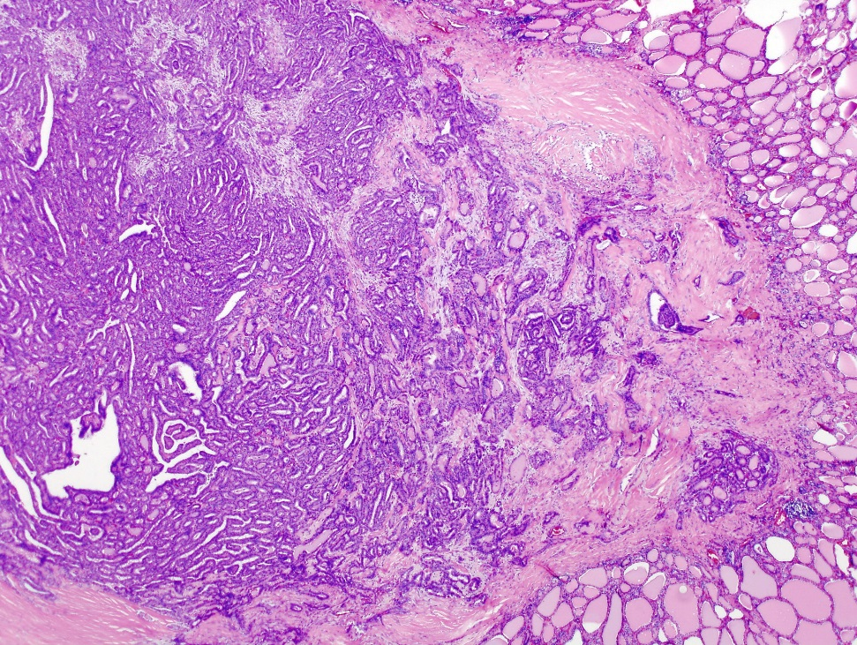
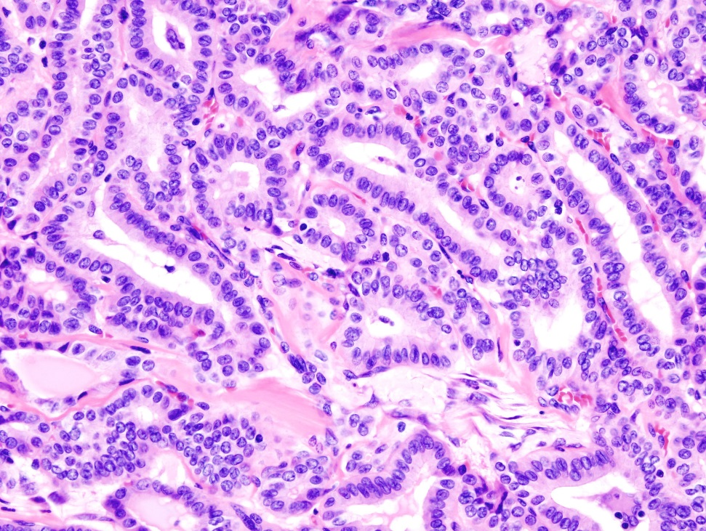
Papillary carcinoma of the thyroid

Slide 27
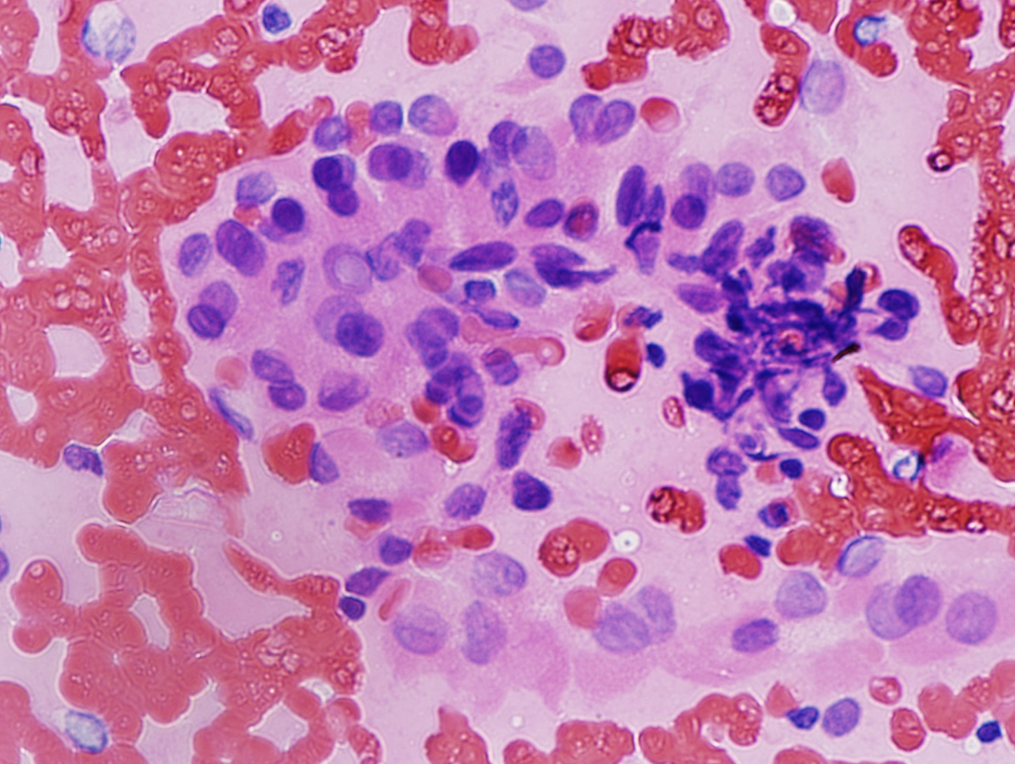
Papillary carcinoma of the thyroid
FNAB

Slide 28
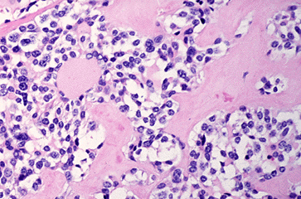
Medullary carcinoma of the thyroid
Amyloid deposits

Slide 29
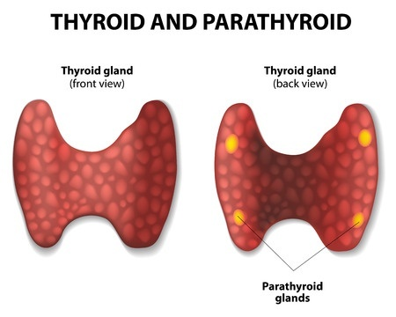

Slide 30
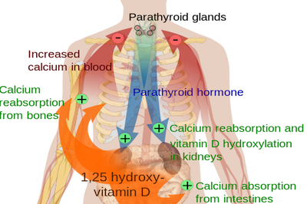
Parathyroid

Slide 31
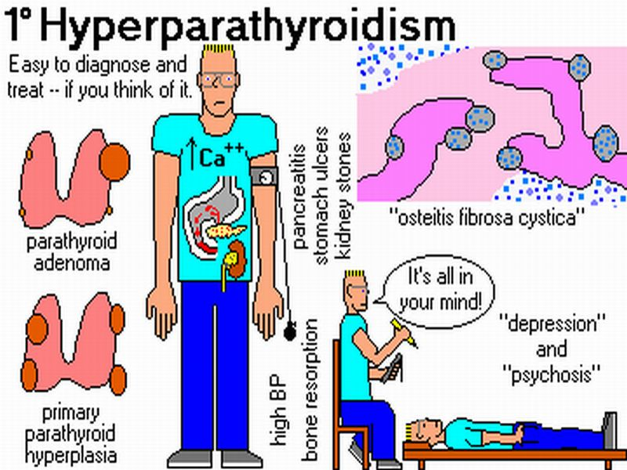
Primary
Secondary hyperparathyreoidsm: a physiological response
to hypocalcaemia (e.g. in malabsorption, renal failure)
MEN 1, MEN 2

Slide 32
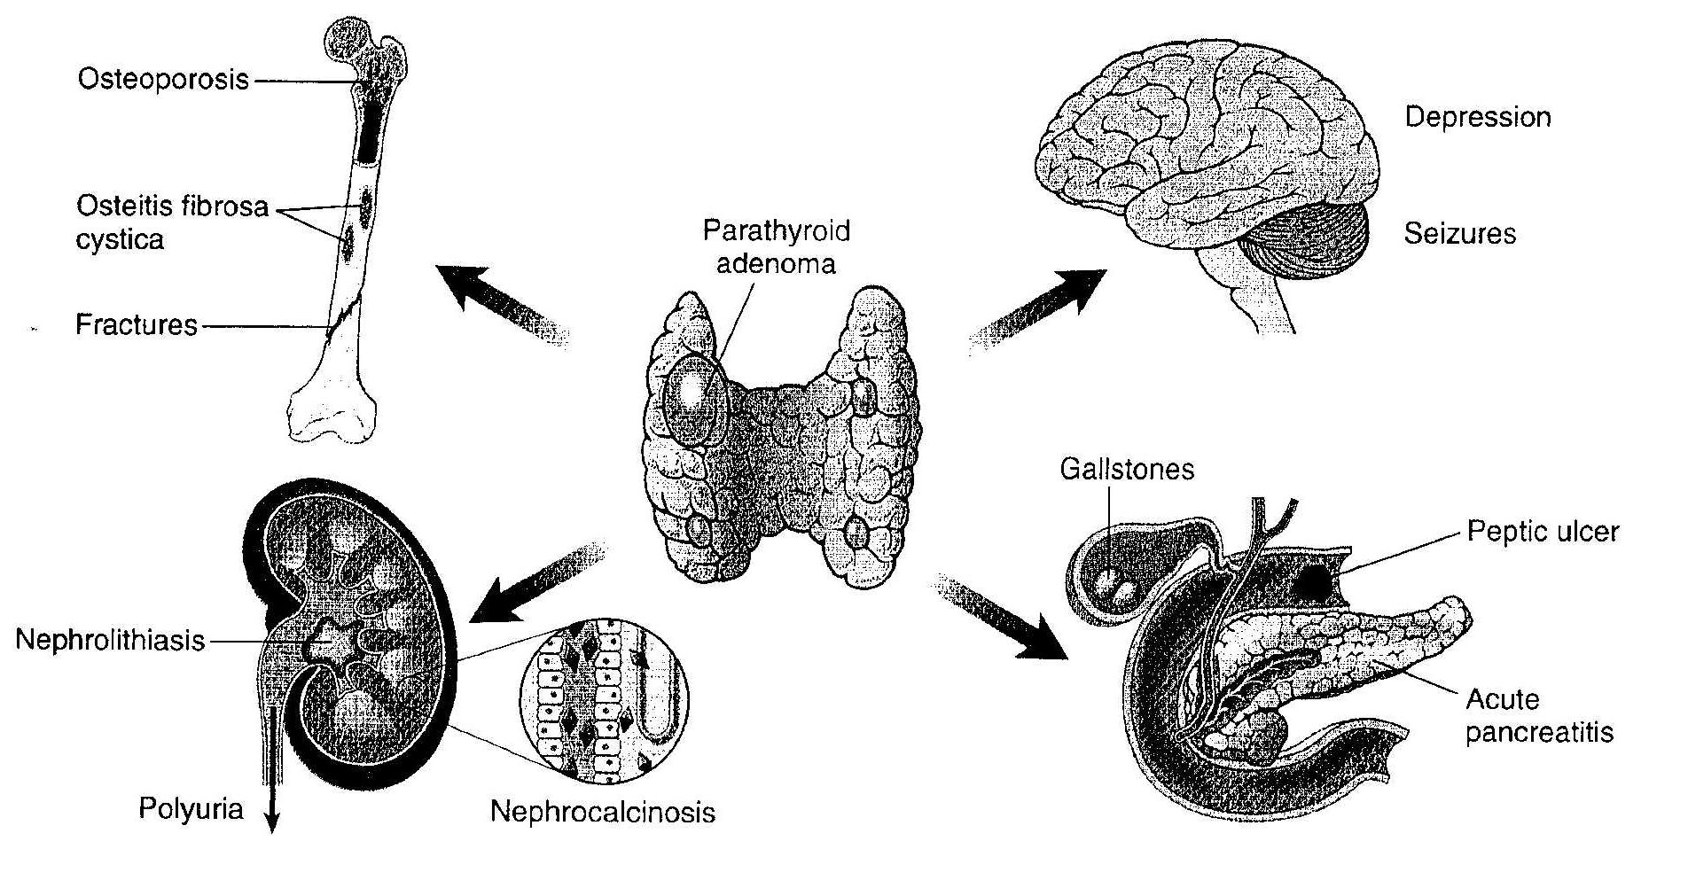
Clinical signs of hyperparathyreoidismu

Slide 33
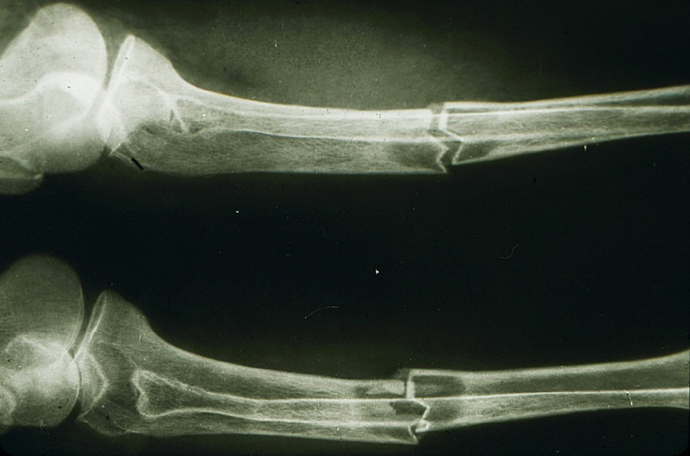
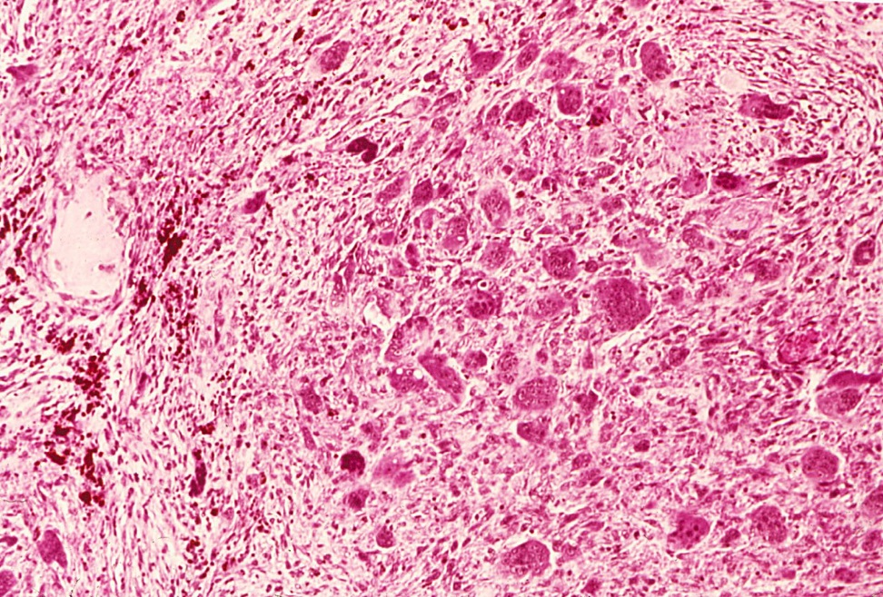
Pathological fracture and brown pseudotumor

Slide 34
Hypoparathyreoidism
Causes hypocalcaemia
Tetany (spasm of the skeletal muscle)
Convulsions
Paraesthesiae
Psychiatric disturbances
Rarely cataracts and brittle nails
Caused by:
Removal of or damage of the glands during thyreoidectomy
Idiopathic, autoimmune (also as a part of polyendocrine syndrome)
Congenital hypoplasia or aplasia (Di George syndroma)
Congenital deficiencies
Pseudohypothyreoidism:
Insensitivity of peripheral tissues to PTH
Usually genetically caused
Other causes of hypocalcaemia: chronic renal failure, vitamin D deficiency,
excess loss during lactation

Slide 35
Endocrine pancreas: islet cell tumors – neuroendocrine neoplasias
Less common than pancreatic adenocarcinoma (1-2 % of pancreatic tumors)
Present with endocrine effects and can be malignant:
Insulinoma: hypoglycaemia due to hypersecretion of insulin
Glucagonoma: secondary diabetes and skin rash
Gastrinoma: hypersecretion of gastric acid due to gastrin action resulting in severe peptic ulcerations
….others (somatostatinoma, VIPoma, serotoninoma, with ectopic hormonal production (ACTH, calcitonin)
Non-functional
Microadenoma (˂0,5 cm)
Islet cell tumor and gastrinomas may occur as a part of inherited MEN (multiple endocrine neoplasia) syndrome.

Slide 36
Neuroendocrine neoplasias – tumors of the endocrine pancreas
Neuroendocrine tumor (NET)
Non-functional pancreatic NET (NET G1, G2)
NET G1
NET G2
NET G3 (from WHO 2019)
Neuroendocrine carcinoma (NEC)
Large cell type NEC
Small cell type NEC

Slide 37
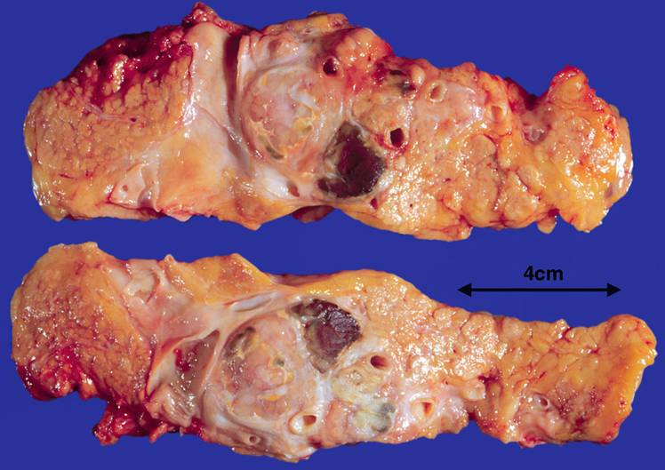
Neuroendocrine neoplasia of the pancreas.

Slide 38
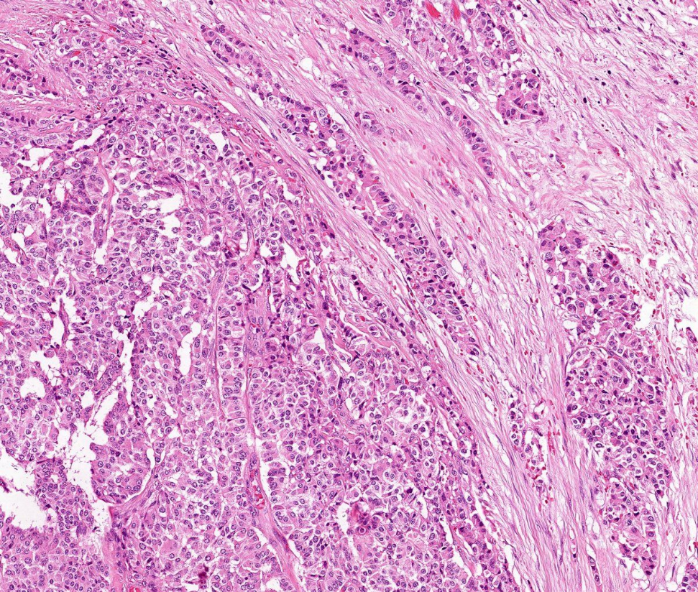
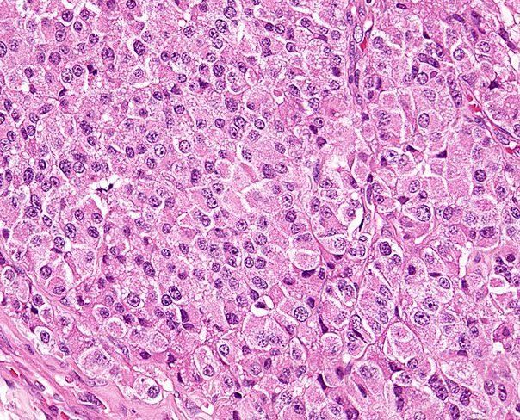
Neuroendocrine neoplasia of the pancreas.

Slide 39
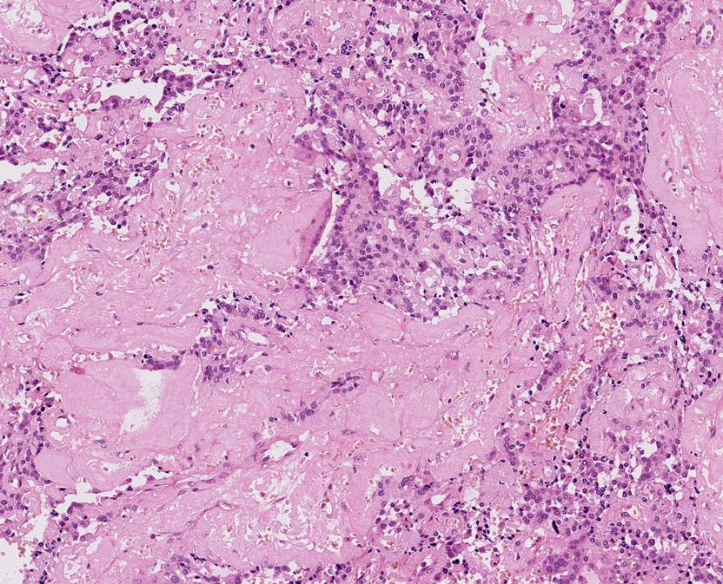
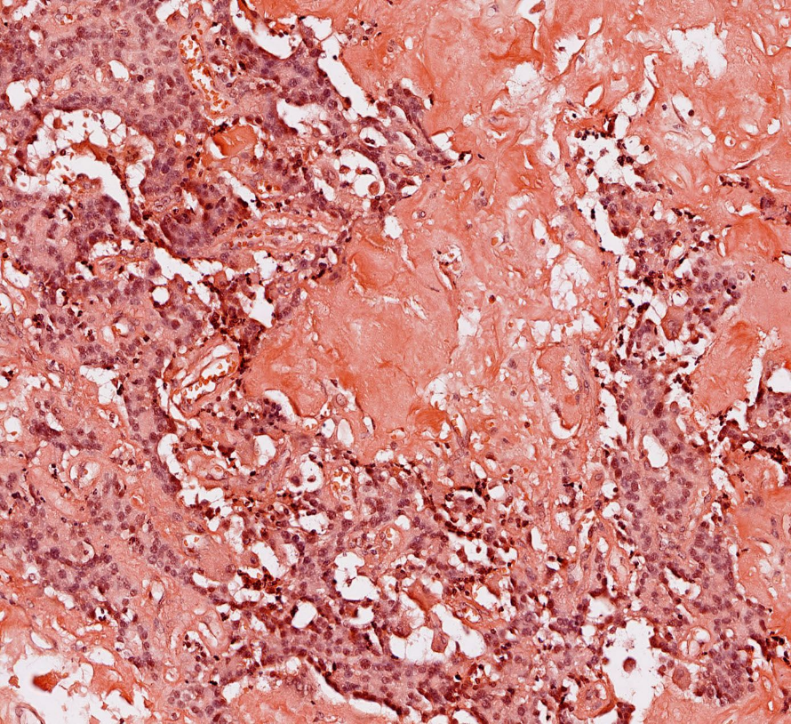
Amyloid deposits in insulinoma

Slide 40
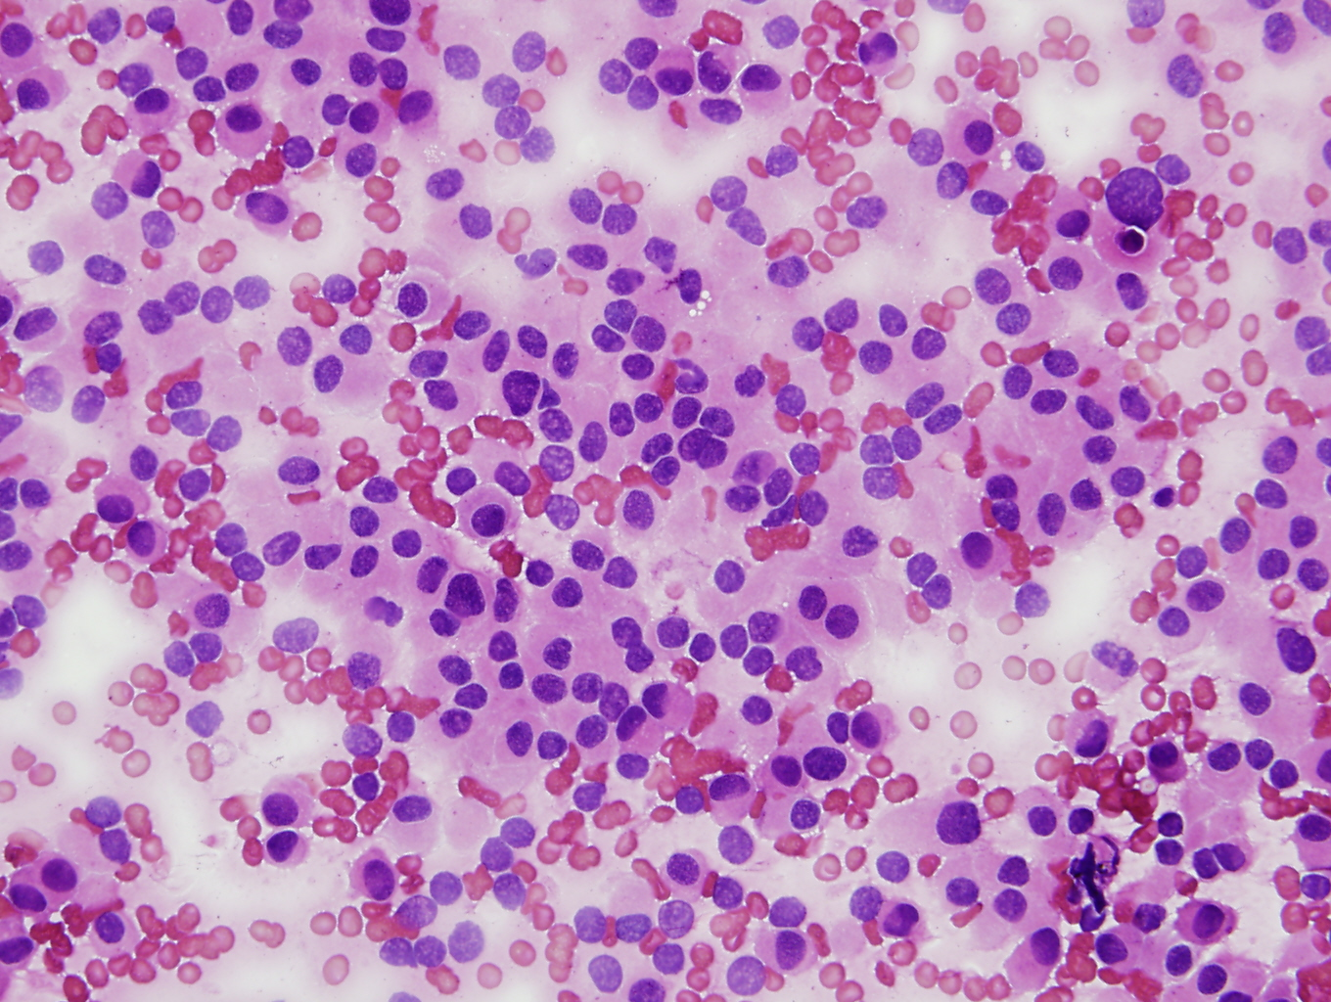
FNAB cytology of neuroendocrine neoplasia of the pancreas.

Slide 41
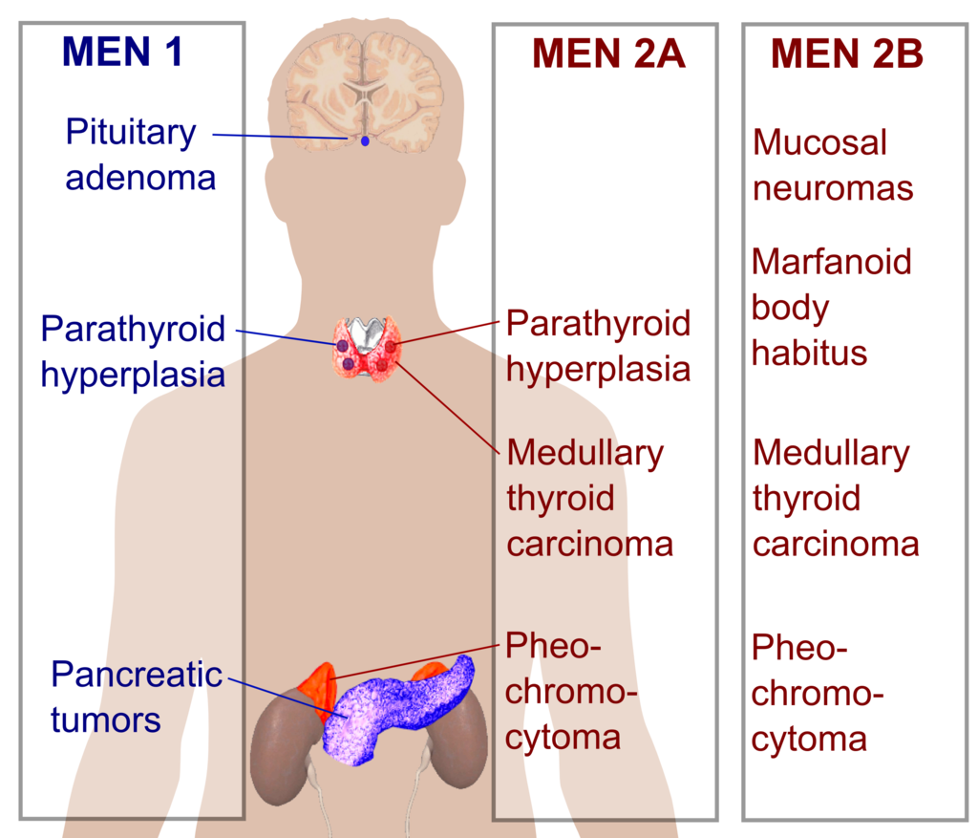
Multiple endocrine neoplasia (MEN) syndromes

Slide 42
Diabetes mellitus
(group of metabolic disorders sharing the common sign– hyperglycemia)
Type 1
Immune mediated destruction of B cells
Autoimunne IDDM in genetically predisposed patients + environmental factors (viruses)
Type 2
Insulin rezistent, with relative or absolute insulin deficiency
Genetics; obesity, life style
Genetically caused defects of B cells functions
„maturity-onset diabetes of the young“ (mutations in different genes)
„mitochondrial diabetes“ (mutations in mtDNA; oxidative phosphorylation failures)
Genetically caused defects in insulin function
- Insulin gene, insulin receptor gene mutations, defects of proinsulin conversion
Disorders of exocrine pancreas
Chronic pancreatitis
Pancreatectomy
Pancreatic neoplasia
Cystic fibrosis
Haemochromatosis

Slide 43
Diabetes mellitus
(group of metabolic disorders sharing the common sign– hyperglycemia)
Endokrinopathies
Acromegaly
Cushing syndroma
Hyperthyreoidismus
Glucagonoma, feochromocytoma
Infections
CMV
Coxackie virus B
Drugs
- Glucocorticoids, hormones of thyroid, alpha interferon, proteases inhibitors, thiazids, phenytoin, …
Genetic syndromas assoc. with DM
Down syndroma
Klienefelter syndroma
Turner syndroma
Gestational DM

Slide 44
Differences between types of diabetes mellitus (DM: abnormal metabolic state characterised by glucose intolerance due to inadequate insulin action)
Features | Type 1 (ketosis-prone, juvenile onset, insulin-dependent) | Type 2 (not ketosis-prone, maturity onset, non-insulin-dependent)
Age of onset | Usually ˂20y | Usually ˂40y
Proportion of all cases | ˂10 % | ˃90%
Type of onset | Abrupt (acute or subacute) | Gradual
Etiological factors | Possible viral/autoimmune, resulting in destruction of islet cells | Obesity associated insulin resistence
HLA asocciation | Yes (=genetic predisposition in DM) | No
Insulin antibodies | Yes | No
Body weight at onset | Normal or thin, obesity uncommon | Majority are obese (80%)
Endogenous insulin production | Decreased (little or none) | Variable (above or below normal)
Ketoacidosis | May occur | Rare
Treatment | Insulin, diet, exercise | Diet, oral hypoglycemic agents, exercise, insulin, and weight control

Slide 45
Risk factors for type 1 and type 2 diabetes mellitus
Type 1 DM risk factors
Type 1 DM in a first-degree relative (sibling or parents)
Type 2 DM risk factors
Positive family history
Ethnic origin (black, native americans, hispanic, asian american, pacific islanders)
Obesity
Increasing age
Habitual physical inactivity, sedentary lifestyle
History of gestational DM
Other clinical conditions assoc. with insulin resistence (e.g. polycystic ovary syndrome)
History of vasular diseases
Previously identified impaired fasting glucose or impaired glucose tolerance
Hypertension
HDL cholesterol level ˂35mg/dL and/or triglyceride level ≥250mg/dL
Cigarette smoking

Slide 46
Cardinal clinical signs of DM at diagnosis
Polyuria
Polydipsia
Polyphagia, excessive hunger (in type 1)
Weight loss (in type 1)
Recurrent blured vision
Ketonuria (in type 1)
Weakness, fatigue, dizziness
Often asymptomatic (type 2)

Slide 47
Complications of diabetes
Situation | Complication
Large blood vessels | Accelerated arteriosclerosis leading to: Myocardial infarction Cerebrovascular diseases Ischaemic limbs Responsible for 80 % of adult diabetic death
Small blood vessels | Endothelial cells and basal lamina damage. Retinopathy (major cause of blindness), nephropathy
Peripheral nerve | Diabetic neuropathy (v.s. due to disease of small vessels supplying the nerves)
Neutrophils | Susceptibility to infection
Pregnancy | Pre-eclamptic toxaemia Large babies Neonatal hypoglycamia
Skin | Gangrene of extremities Soft tissue lesions (Granuloma annulare, necrobiosis lipoidica)

Slide 48
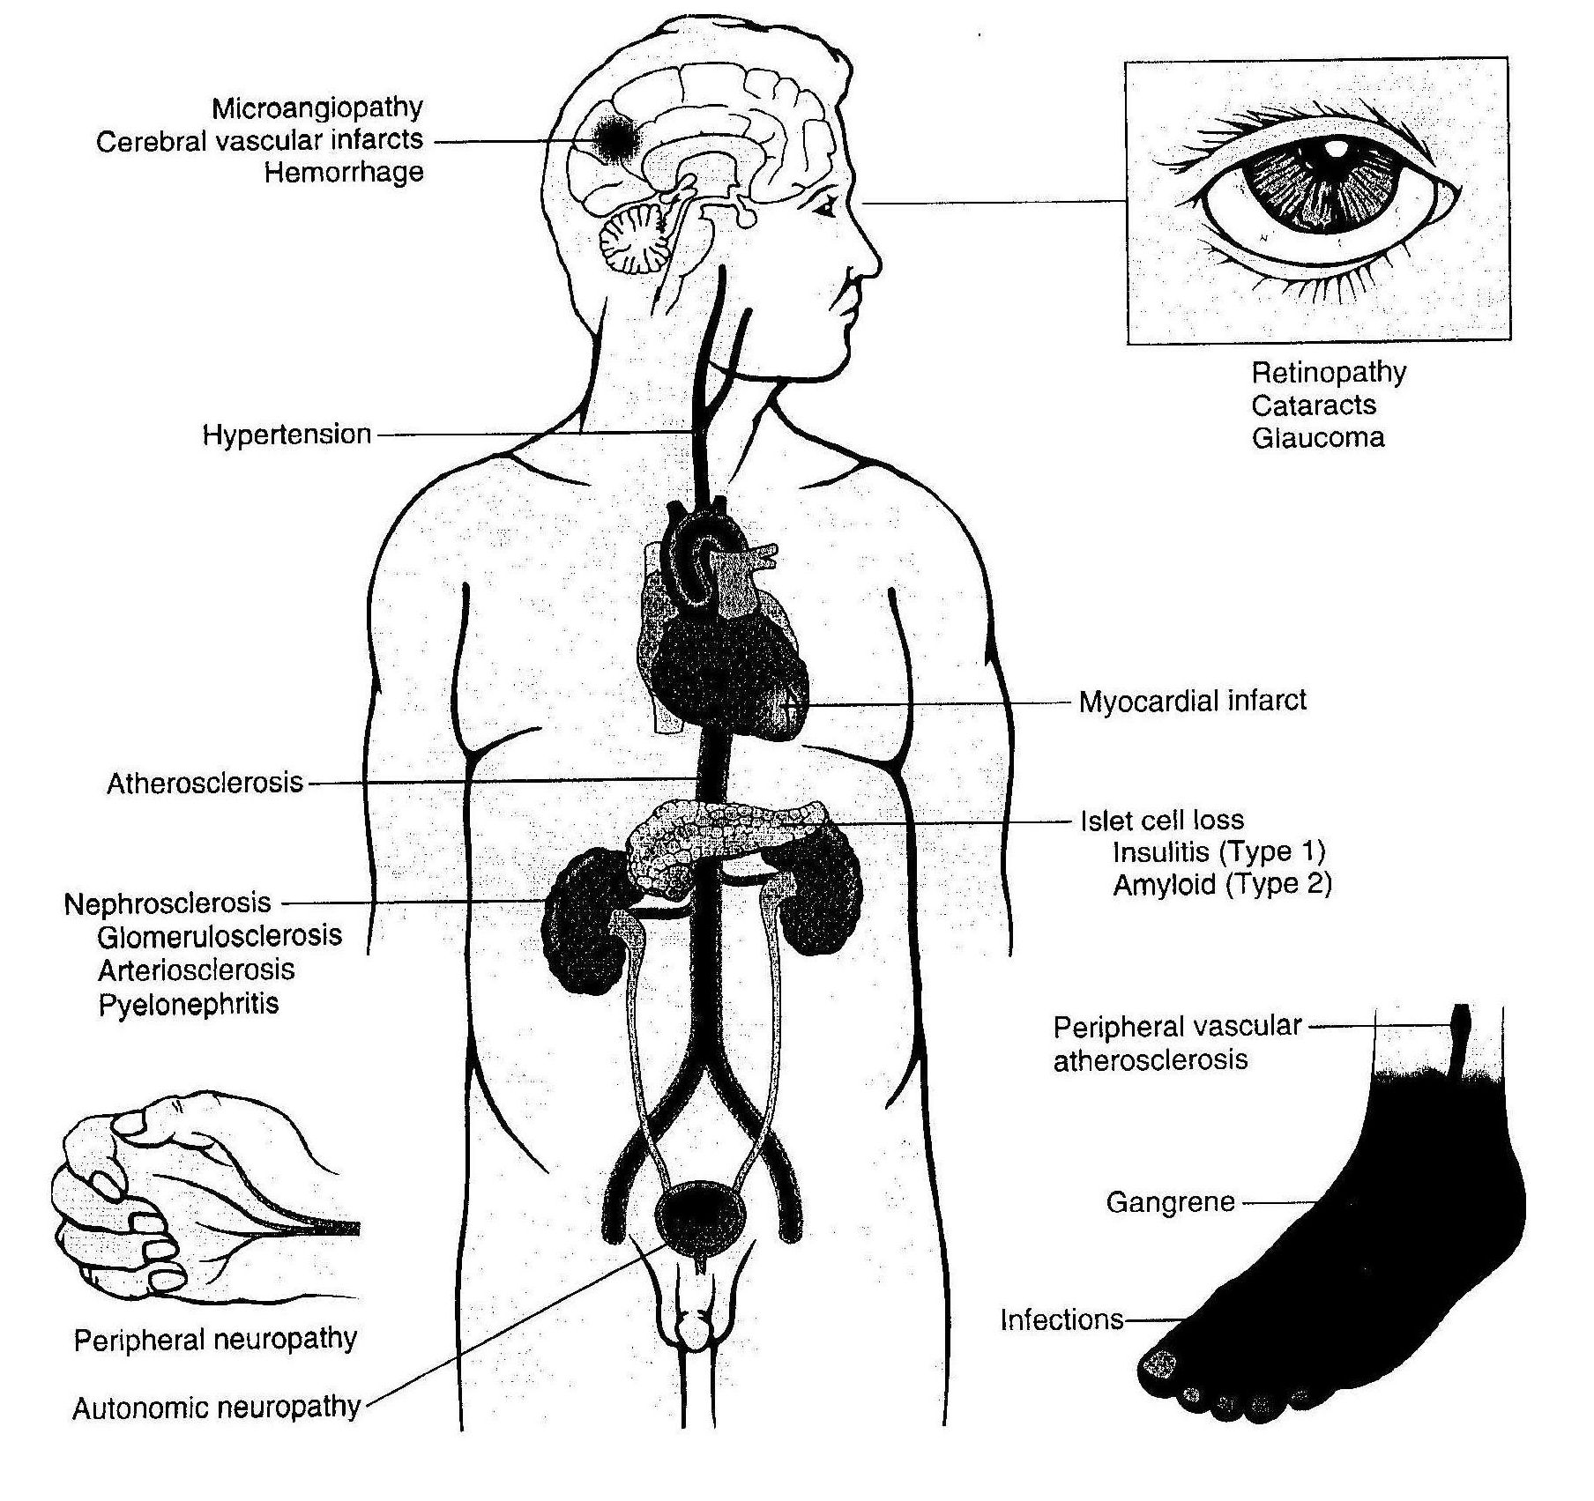
Complications of diabetes.

Slide 49
Thank you for your attention…

