Slide 1

Statistical methods in biology and medicine II

Slide 2
Repetition
descriptive statistics
  data presentation
statistical induction
  conclusions about populations are based on samples
statistical inference
  hypotheses testing
  multiple comparison

Slide 3

Repetition - kinds of data
Continuous (always quantitative) – the parameter can theoretically be of any value in a given interval (e.g. glucose concentration: 0-∞; ejection fraction: 0-100%)
  Ratio vs. interval data – only differences, but not ratios of two values can be determined (e.g. IQ score)
Categorical (usually qualitative) – the parameter can only be of some specified values (e.g. blood group: 0, A, B, AB; sex: male, female; a disease is present/absent)
  Ordinal data – are categorical, but quantitative (they can be ordered – e.g. heart failure classification NYHA I-IV)
  Count data – can be ordered and form a linearly increasing row (e.g. number of children in a family: 0,1,2…) - they are often treated as continuous data
  Binary data – only two possibilities (patients / healthy controls)

Slide 4
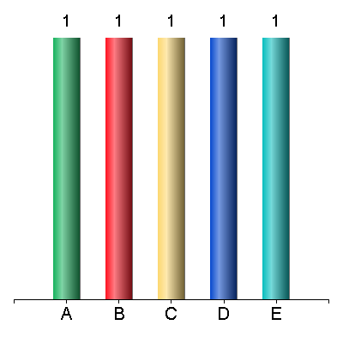
The level of education (basic, high school, university) is an example of...
Ordinal variable
Interval variable
Binary variable
Continuous variable
Qualitative variable

Slide 5
Repetition - formulation of statistical hypotheses
Research hypothesis (e.g. drug A has better effect than drug B, blood pressure decreases during the treatment, there is a correlation between sex and body height etc…) – can be formulated both for an experiment or for an observation
Testing of research hypothesis uses a proof by contradiction
For statistical hypothesis testing, a null hypothesis H₀ must be defined (e.g. between two groups, there is no difference in means, there is no difference in variances, there is no correlation between two parameters, a parameter does not change in time…resp. any observed difference is only due to a chance)
During the testing of null hypothesis, we try to refute it (or, more exactly, to show that it is highly improbable)
If the null hypothesis, is not true, then its negation must be true – alternative hypothesis H_{A} (there is a difference, there is a correlation…)
The result of hypothesis testing can thus be:
      A) non-refutal of the null hypothesis (at certain level of statistical significance α)
      B) refutal of the null hypothesis favouring the alternative hypothesis

Slide 6
Repetitions - errors in hypothesis testing
Type I error rate (α) – also significance level
α must be defined before the statistical testing – 0.05 is usual in biomedicine (i.e. when H₀ is refuted, there is 95% certainty, that it is really false and the observed difference/correlation is real)
1-β – also power of a test
Statistical significance p – probability that the observed result was obtained under the assumption that H₀ is true
When p < α, we refute the null hypothesis at a given significance level and the alternative hypothesis is valid
We say that the difference (effect) is statistically significant (that, of course, does not mean that it has to be significant practically)
 | Real nature of the null hypothesis
Statistical decision | H₀ true | H₀ false
H₀ refuted | type I error (α) | correct (1-β)
H₀ confirmed | correct (1-α) | type II error (β)

Slide 7

Statistical tests
For different statistical hypotheses, different tests are used
The selection of the right test depends on:
    the number of compared groups
    the character of the data (categorical vs. continuous)
    the distribution of the data
    mutual dependence of the data

Slide 8
Power of a test...
Express its practical (not statistical) significance
Increases with increasing variability of the data
Express the ability of a test to correctly refute the null hypothesis
Is expressed by a letter p
Is a probability that the alternative hypothesis is true in a case when the null hypothesis is refuted

Slide 9
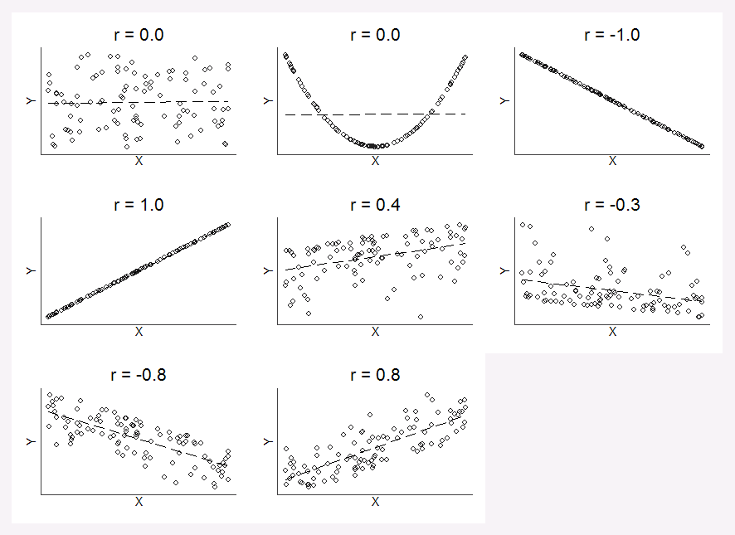
Correlation of two continuous parameters
Mutual dependence of two parameters - correlation
Expressed by correlation coefficient (r)
r generally express the size of the effect
r can achieve values in the interval from -1 to 1, where 0 corresponds to no correlation, 1 corresponds to 100% positive correlation (when one factor increases, the other does the same) and -1 corresponds to total negative correlation
Besides r, the corresponding p-value can be determined (H₀ – the variables are independent)
Correlation of a categorical vs. continuous variable – see the „tests for continuous data“ (categorical variable define the groups that are compared by the tests)

Slide 10
Examples of correlation coefficients
Pearson coefficient (parametric) – measures linear correlation between variables
  The main assumption is approximately normal distribution of the data
Spearman coefficient (non-parametric) – measures the rank correlation of the variables
None of the coefficients can reveal e.g. U-shaped dependence

Slide 11
Parametric vs. non-parametric tests for continuous data
Parametric
Non-parametric
Use the values
Have higher power, but only when their assumptions are met (esp. normal distribution of the data in each sample)
If the distribution is not normal, we can try to transform (normalize) them
Use ranks of values
Power is generally lower (but the difference is small in big samples)
They are more „robust“ – their use is not that dependent on data distribution
The normality can be tested by normality tests (e.g. Kolmogorov-Smirnov, Shapiro-Wilks – they compare the real distribution with the normal distribution) and „by eye“ evaluation of whether the histograms correspond to Gaussian curve (in small samples, the normal probability plot is a better choice)

Slide 12
Tests for continuous data - paired vs. unpaired tests
Paired (matched samples)
Unpaired (unmatched samples)
Used when to each value from sample A, we can match one value from sample B that differs only by its membership in the sample (e.g. comparing salaries in two hospitals: director A – director B; head physician A – head physician B… up to charwoman A – charwoman B)
Most often, this design is used to assess the change in time (e.g. patients‘ weight now vs. after 5 years: patient XY – and other patients – is the same person now as well as after 5 years and differs only by the time difference)
They assess differences between the samples (or their ranks)
Used in independent samples (they can differ in size)
They compare the actual values of the variable between the samples (or their ranks)
It is necessary to decide between the paired or unpaired design before the start of the study (pairing is technically challenging, but paired tests have higher power)

Slide 13
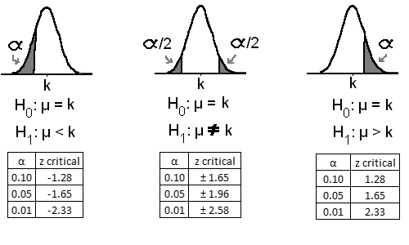
One-tailed vs. two-tailed tests
One-tailed
Two-tailed
H₀ is asymmetric: e.g. drug A is not better than drug B – but we are not interested whether it is or is not worse
They have higher power
H₀ is symmetric: there is no difference between drug A and drug B (i.e. A is neither better nor worse than B)
They can reveal the differences in both ways
They are usually more suitable – we don‘t know the result a priori, and we are interested in both possible effects

Slide 14
Tests for continuous data, 2 samples – examples
Test | Parametric | Non-parametric
Paired | Paired (dependent) t-test | Wilcoxon paired test Sign test
Unpaired | Unpaired (independent) t-test | Mann-Whitney U-test * Kolmogorov-Smirnov test
* has almost the same power as unpaired t-test, but it has an assumption of similar variability in both samples (as well as t-test)

Slide 15
Advanced statistics
Multiple samples comparison (ANOVA)
Contingency tables (Fisher`s exact test, χ²-test)
Survival analysis
Cluster analysis

Slide 16
Tests for continuous data, more than 2 samples – examples
Test | Parametric | Non-parametric
Paired | Repeated measures ANOVA (Analysis Of VAriance) – RMANOVA | Friedman test („ANOVA“)
Unpaired | One-way ANOVA (and its variants) | Kruskal-Wallis test („ANOVA“)
When ANOVA rejects H₀, it is necessary to find out which specific samples differ from each other – post hoc tests

Slide 17
Choose the best test
In a clinical trial, patients take either a new drug to treat epilepsy or a placebo. The study is randomized (the study group is randomly drawn). Only patients, which have at least one and at most ten seizures in three months are included. The study evaluates a number of seizures during the first year of treatment
Paired t-test
Unpaired t-test
Mann-Whitney U-test
Sign test
Repeated measures ANOVA

Slide 18
ANOVA
Analysis of variance
  tests null hypothesis about more than two samples
  requirements: Normal distribution, equal standard deviations
  requires further analyses to find out which sample is different

Slide 19
Nonparametric „ANOVA“
Kruskal-Wallis test (unpaired)
Friedman test (paired)

Slide 20
Multiple comparisons problem
When we perform more tests at once, the probability that some of them will give a statistically significant result only due to chance (i.e. type I error – H₀ is wrongly refuted) – increases (e.g. during post hoc tests following ANOVA
For example, when performing 10 tests at α = 0.05, the probability that none of them will give a significant result (given that H₀ is true in all of them) equals (1-α)¹⁰ =60%, i.e. in 40% the H₀ is wrongly rejected.
That is why the multiple comparisons corrections are applied (Bonferroni, Benjamini-Hochberg…) to further decrease α (and thus make the criteria for refuting H₀ stricter).
Bonferroni correction: initial α is divided by the number of tests (or, alternatively, all p-values are multiplied by the number of tests with α left unchanged)
  very “conservative“.

Slide 21
Contingency tables
The association beween two categorical variables can be expressed in a contingency table (n x m, see below an example for 2x2 table
Počet z Cislo | Skupina
Genotyp ADRB1 | control | TTC | Celkový součet
CC | 15 | 15 | 30
CG | 12 | 10 | 22
GG |  | 1 | 1
Celkový součet | 27 | 26 | 53

Slide 22
Tests for categorical data
From the contingency table, its probability under the assumption that H₀ is valid (i.e. the p-value) can be determined, as well as the effect size – e.g. the association between a mutation and a disease (expressed as RR – relative risk; OR – odds ratio)
Sometimes, a reduction of larger tables into 2x2 table is advantageous [this is especially suitable in ordinal data – e.g. heart failure staging NYHA I-IV can be transformed into binary data as mild failure (NYHA I+II) and severe failure (NYHA III+IV)]
For binary variables, paired design can be used (typically presence/absence of the disease in time)

Slide 23
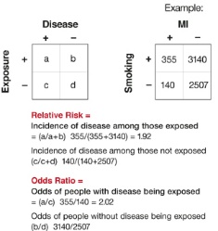
Relative risk and odds ratio in 2x2 tables
probabilities vs. odds
RR is suitable for prospective studies, while the design is not important in OR
If the dependent (modelled) variable is the same (e.g. disease in the table), values of RR (a/(a+b)) and OR (a/b) are similar in when the occurrence is low
RR is more intuitive, OR is more universal, commonly used in e.g. logistic regression
www.mdedge.com

Slide 24
Tests for categorical data - examples
Test | 2 x 2 contingency table | More categories/measurements ‡
Paired | McNemar test | Cochran Q test (Binary data, more measurements) Sign test (ordinal data, two measurements
Unpaired | Chi-square (χ²) test* Fisher exact test | Chi-square (χ²) test* Cochran-Armitage test (table 3x2, ordinal data)
‡ when H₀ is rejected, a serie of tests for 2 x 2 tables with appropriate multiple testing correction must follow
* under the assumption of certain minimal counts in each cell of the table (cca n ≥ 5)

Slide 25
Example
The study aimed to investigate an association between the blood group in AB0 system (A, B, AB and 0) and the presence of acute complications of the blood transfusion. How many fields does the respective contingency table have?
Ranking | Response | Votes
Correct Answer
1
2
3
4
Others

Slide 26
Example
In the previous case, χ² test yielded p < 0.05 and a series of post hoc tests for 2x2 tables „each with each“ followed. One of the tests showed higher number of complications in the patients with AB group compared to the A group, p = 0.05 (5 %). How will the p-value change when Bonferroni correction is applied (p, not α-value is corrected here)? The result should be in percents (a natural number), eventually rounded to percents.
Ranking | Response | Votes
Correct Answer
1
2
3
4
Others

Slide 27
Regression models
„Regression towards the mean“ (Galton) – but methods already by Friedrich Gauss
The goal is to estimate a value of modelled variable (dependent variable = regressand) using other known parameters (factors = regressors – categorical or continuous variables)
The contribution of individual factors may be assessed separately (univariable models) or together in mutual interaction (multivariable models)
Assumption: factors are independent
Most often:
  Linear regression (dependent variable is continuous)
  Logistic regression (dependent variable is binary)
  Cox regression (dependent variable is survival – survival time and endpoint)

Slide 28
Contribution of factors
Linear regression – regression coefficient β (standardized, unstandardized) and 95% confidence interval (CI) – i.e. estimation, where the coefficient really is with 95% likelihood
  Unlike in correlation, it is important which variable is independent and which one dependent
  When the regressor is categorical, the regression model equals ANOVA in fact
Logistic regression – OR and 95% CI
Cox regression – hazard ratio (HR) and 95% CI
When β ± 95% CI includes 0, the contribution of the factor is not significant (under 0, the value of outcome is decreased, over 0 it is increased)
In OR and HR, the same is true when 95% CI include 1 (under 1, the probability of an outcome is decreased, over 1 it is increased)
95% CI can thus replace the p-value
When the independent variable is categorical, one category has to be set as the reference one and regression coefficients / OR / HR are attributed to each other category
When the independent variable is continuous, β / OR / HR corresponds to 1 unit (e.g. 1 year of age – assumes linear effect, otherwise it is better to categorize)

Slide 29
Choose the right statement
In a cross-sectional study comprising 700 hospitalized patients aged between 80 – 90 years, 40 % had signs of cognitive dysfunction. Association with candidate risk factors (age, hypertension, diabetes) was assessed using univariable logistic regression. The presence of cognitive dysfunction was subsequently associated to: age (OR = 1.20; 95 % CI = 1.12 – 1.40 per each subsequent year), hypertension (OR 1.40; 95 % CI 1.20 – 1.78), and diabetes as well (OR 2.80; 95 % CI 2.00 – 6.40).
Factor of age is not statistically significant with respect to cognitive dysfunction
The probability of cognitive dysfunction is twice higher in diabetics than in hypertonics
Age, diabetes and hypertension are mutually independent risk factors
P-value is < 0.05 in all cases
There is causal relationship between the factors and cognitive dysfunction

Slide 30
What to do with the ordinal data?
Tests for categorical data, ANOVA (but: we ignore the order)
Nomnparametric tests (when there are many categories)
Dichotomization and tests for binary data (often in medicine)
Special tests – Cochran-Armitage (typically genetics), sign test

Slide 31
Survival analysis
probability of the given event (death) decreases with decreasing number of study group members „survivors“
censored data
  still alive at the end of the study (event did not occur)
  lost from the study
  died for another cause
Kaplan-Meier graphs
Log rank test

Slide 32
Kaplan-Meier survival curve

Slide 33
Tests for survival
log-rank test
Gehan-Wilcoxon test

Slide 34
Choose the right answer...
Four patients enrolled to the study investigating the re-occurrence of myocardial infarction (endpoint). In following years, subsequent events took place consecutively: one patients moved to Argentina and was thus lost from follow-up, one suffered the infarction and next month he died during a car accident, further one died of lung cancer and the last one lived until the end of the study in full health. The last point of Kaplan-Meier curve is at the value of:
66.6%
50%
33.3%
25%
0%

Slide 35
Cluster analysis
multidimensional analysis
measure of distance
amalgamation algorithm
data normalization
k means clustering
hierarchical tree (dendrogram)

Slide 36
Choose the right answer...
A lonely island is visited by anthropologists, who discover human skulls of unknown origin there. They use the cluster analysis to assign them to some of the human populations nearby. Besides the genetic markers, they also measure the cranial index (in percents, mean = 85, SD = 10), facial index in percents, mean = 80, SD = 5) and the braincase volume (in cm³, mean = 1500, SD = 200). What happens if the data are not standardized before the analysis:
Nothing, standardization is used for better visualization of the data.
The braincase volume will not be relevant for the analysis.
Cluster analysis will not be technically possible.
The assignment to a cluster will depend mainly on the braincase volume.
The mutual correlation of cranial and facial index will increase.

