Slide 1


Acute heart failure
;
Martin Radvan
Notes:
1

Slide 2
What we will talk about?
Patophysiology
Clinical signs
Diagnosis
Therapy

Slide 3
Definition
Acute heart failure (AHF) is generally defined as the rapid development or change of symptoms and signs of heart failure that requires urgent medical attentionis
No new mediaction for last 30 years

Slide 4
Definition
Symptoms related to pulmonary congestion due to elevated left ventricle filling pressures with or without low cardiac output

Slide 5
Definition
De novo x acute decompensation of chronic heart failure
Cardiogenic shock

Slide 6
Epidemiology
No1 reason for hospitalisation in people older than 65 years
65-75% known HF before hospitalisation
25-55% preserved ejection fraction (HFpEF)

Slide 7
Diagnosis
Anamnesis
Clinical signs
Examination: perfusion and volume status
ECG
Echocardiography
Labs
X-ray, CT, coronarography, etc.

Slide 8
Signs and symptoms
noisy syndrome, rapid developement
elevated jugular venous pressure
pulmonary edema
+S3 (gallop)
pulmonary crackles
peripheral oedema
orthopnoe

Slide 9
Signs and symptoms
Noisy syndrome, rapid developement
elevated jugular venous pressure
Pulmonary edema
+S3 (gallop)
pulmonary crackles
oedema
orthopnoe

Slide 10
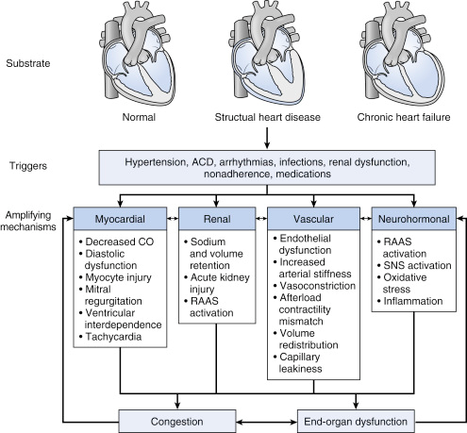

Slide 11
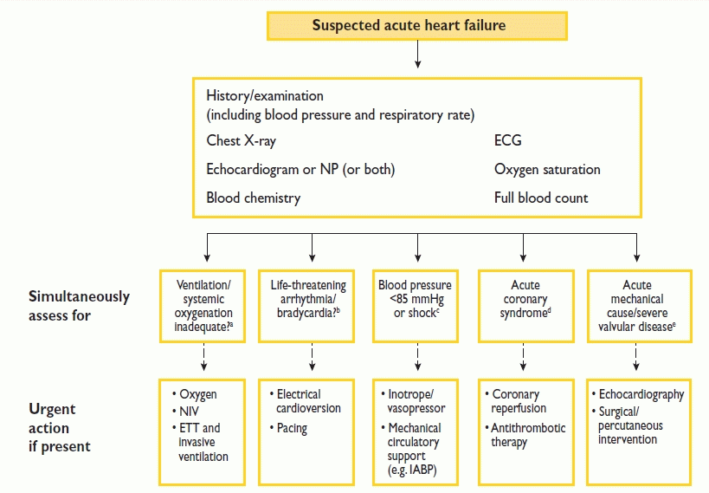

Slide 17
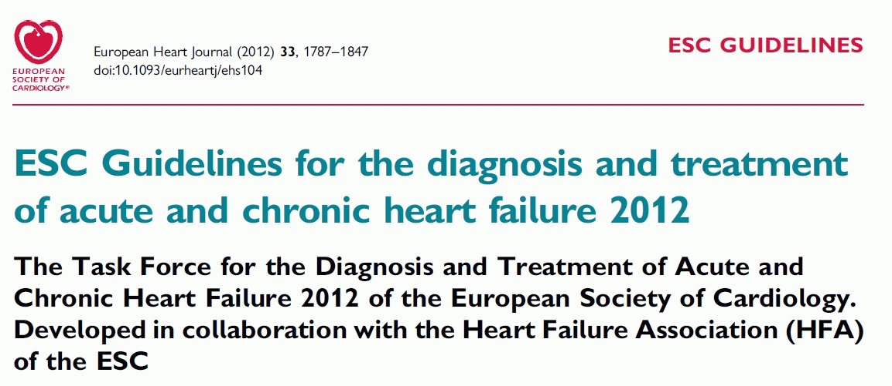

Slide 18
Pathopysiology
Dry-warm
Dry-cold
Wet –warm
Wet-cold

Slide 19
Pathopysiology
Dry-warm
Well perfused, normovolemic
Dry-cold
Hypoperfused, hypovolemic
Wet –warm
Congestion, well perfused
Wet-cold
Congested, hypoperfused

Slide 20
Pathopysiology
Dry-warm
Well perfused, normovolemic
Dry-cold
Hypoperfused, hypovolemic
Wet –warm
Congestion, well perfused
Wet-cold
Congested, hypoperfused

Slide 21
Pathopysiology
Dry-warm
Well perfused, normovolemic
Dry-cold
Hypoperfused, hypovolemic
Wet –warm
Congestion, well perfused
Wet-cold
Congested, hypoperfused

Slide 22
Pathopysiology
Dry-warm
Well perfused, normovolemic
Dry-cold
Hypoperfused, hypovolemic
Water challenge, inotropes
Wet –warm
Congestion, well perfused
Duiretics, vasodilatators
Wet-cold
Congested, hypoperfused
Inotropes, MCS

Slide 23
Pathopysiology – Forrester classification (PCWP, CI)
Dry-warm
Well perfused, normovolemic
Dry-cold
Hypoperfused, hypovolemic
Water challenge, inotropes
Wet –warm
Congestion, well perfused
Duiretics, vasodilatators
90-95%
Wet-cold
Congested, hypoperfused
Inotropes, MCS
5-10%

Slide 24
PCWP, CI
PCWP
Invasive vs. non-invasive measurment
Pressure in left atrium
Volume status
Cardiac index
Invasive vs. Non-invasive measurment
2,2L/min/m²
Cardiac output
Degree of perfusion

Slide 25
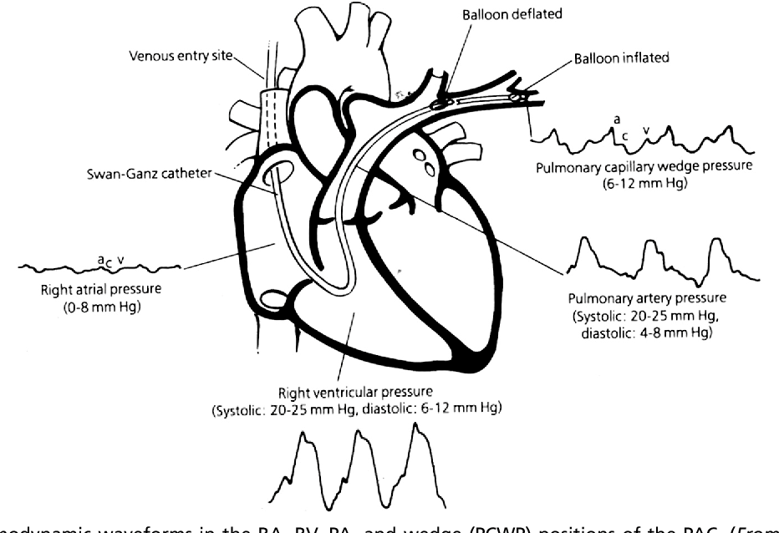
PCWP, CI
PCWP
Invasive vs. non-invasive measurment
Pressure in left atrium
Volume status
Cardiac index
Invasive vs. noninvasive measurment
2,2L/min/m²
Cardiac output
Degree of perfusion

Slide 26
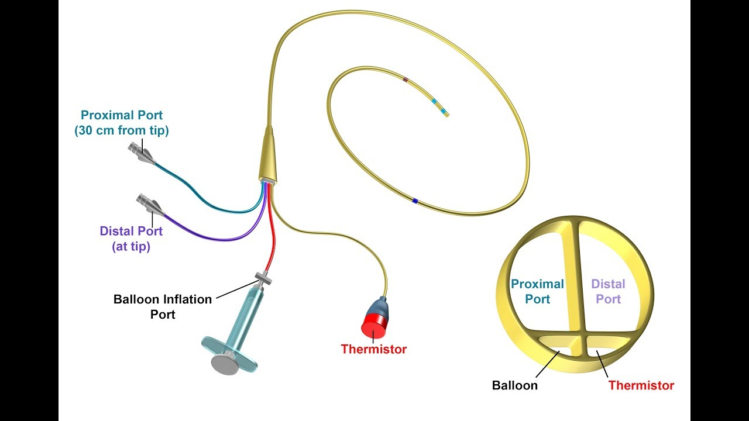
PCWP, CI
PCWP
Invasive vs. non-invasive measurment
Pressure in left atrium
Volume status
Cardiac index
Invasive vs. noninvasive measurment
2,2L/min/m²
Cardiac output
Degree of perfusion

Slide 27
PCWP, CI
PCWP
Invasive vs. non-invasive measurment
Pressure in left atrium
Volume status
Cardiac index
Invasive vs. non-invasive measurment
2,2L/min/m²
Cardiac output
Degree of perfusion

Slide 28
Labs
ECG – rarely normal
X-ray: congestion, normal heart size
Echocardiography – heart, lungs
BNP, NT-proBNP, troponin

Slide 29
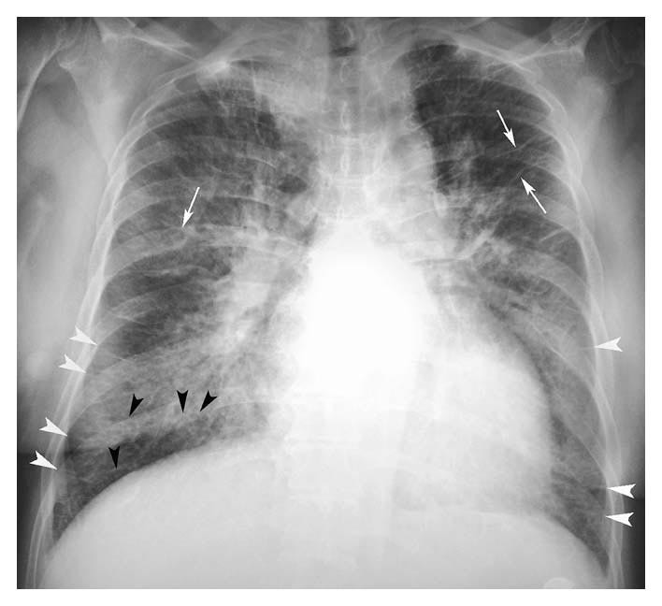
Labs
ECG
X-ray: congestion, normal heart size
BNP, NT-proBNP, troponin

Slide 30
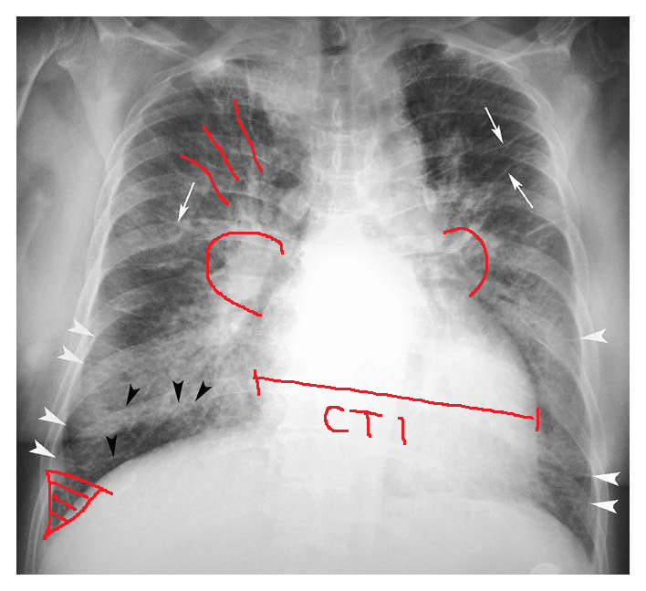
Labs
ECG
X-ray: congestion, normal heart size
BNP, NT-proBNP, troponin

Slide 31
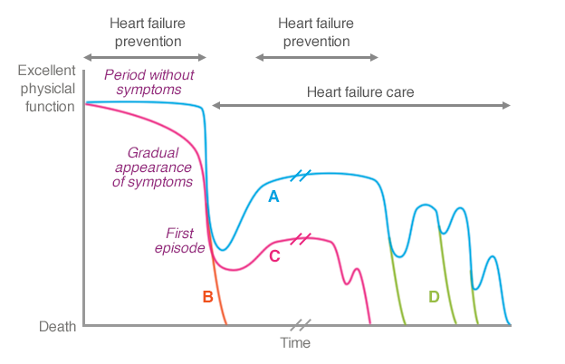
Clinical course

Slide 32
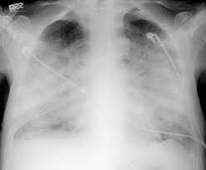
Pulmonary aedema

Slide 33
Therapy of pulmonary aedema?

Slide 34
Therapy of pulmonary aedema
Oxygen
Morphin
Vasodilatation (blood presure control)
Furosemide
Therapy of the cause

Slide 35
Classifications

Slide 36
Cardiogenic shock
Acute HF in naive patients
Myocardial injury
Arrythmia
Valvular disease
Obstructive shock
Tamponade
…

Slide 37
Diagnosis

Slide 38
Pharmacotherapy of cardiogenic shock
Inotropes: noradrenalin, dobutamin, adrenalin, milrinon, levosimendan
Ultrafiltration
Furosemide
Therapy of the cause

Slide 39
MCS
Intra-aortic balloon counterpulsation
LVAD
Total artificial heart
ECMO
Impella
Bridge to recovery/decision/transplantation
Destinantion therapy

Slide 40
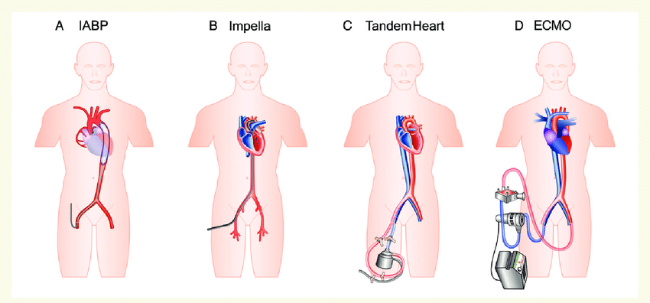
MCS
Intraaortic balloon contrapulsation
LVAD
Total artificial heart
ECMO
Impella
Bridge to recovery/decision/transplantation
Destinantion therapy

Slide 41
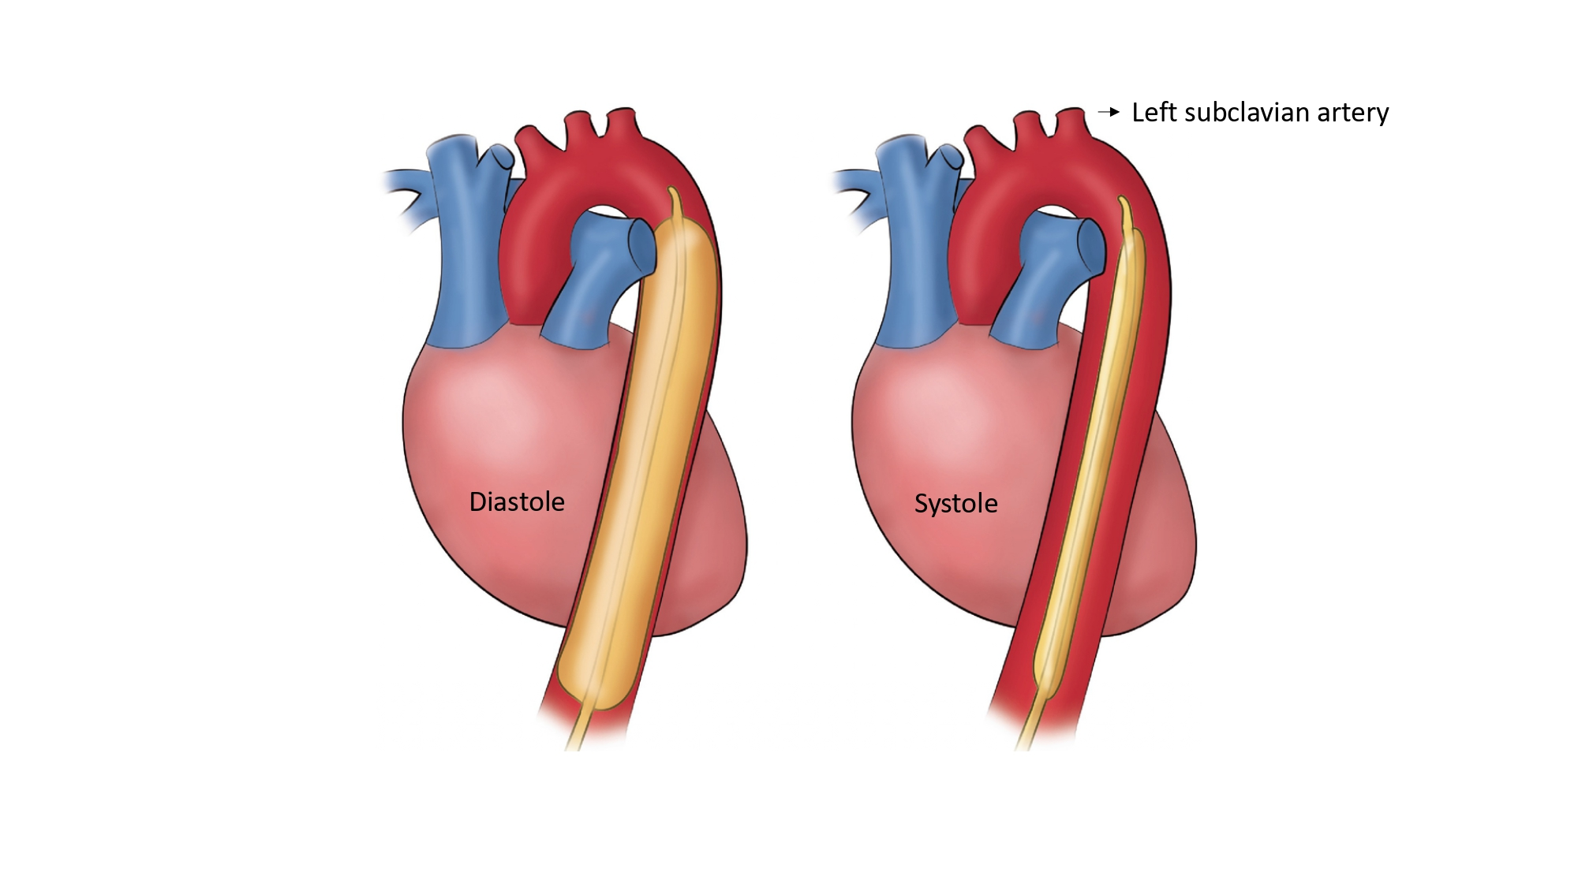
IABC

Slide 42
ECMO

Slide 43
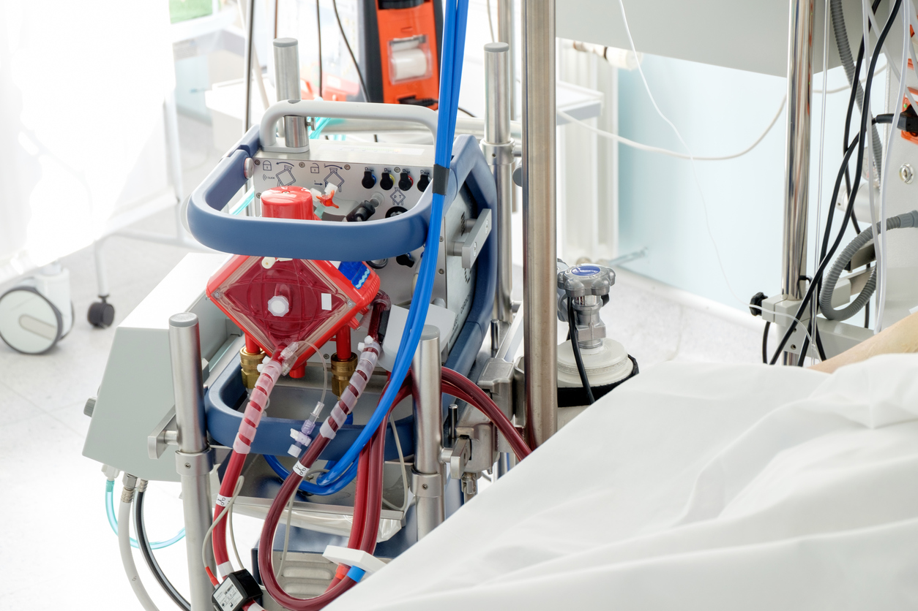
ECMO

Slide 44
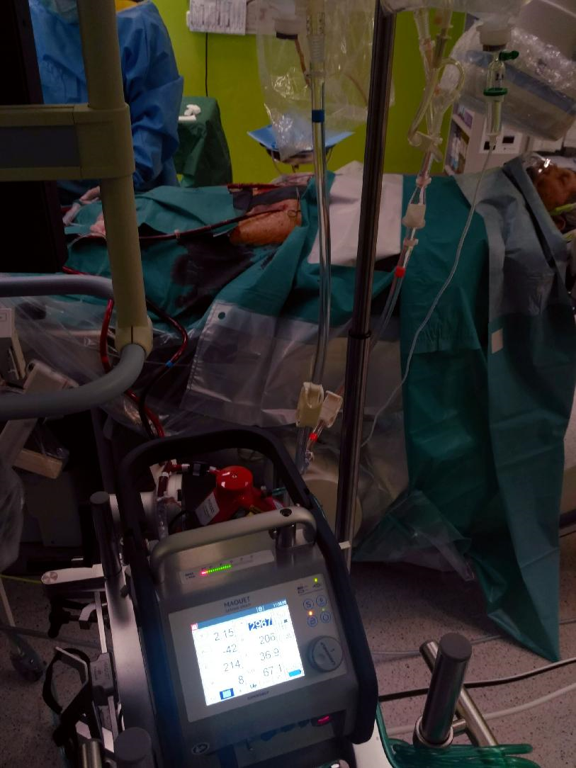
ECMO

Slide 45
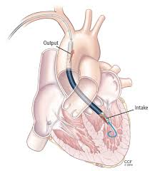
Impella

Slide 46
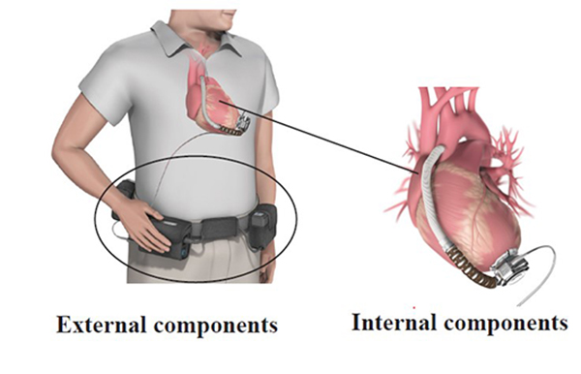
LVAD

Slide 47
Transplantation
Age?
Life expectancy (except heart)
Spiroergometry VO₂max
Imunosupression
Rejection, infection
Vasculopathy of the graft

Slide 48
Conclusions
Acute HF in naive patients
Acute decompensation of chronic HF
Fluid and perfusion status
Cause of HF/decompensation
Early goal directed echocardiography
Early therapy
Early recognition of therapy failure

Slide 49
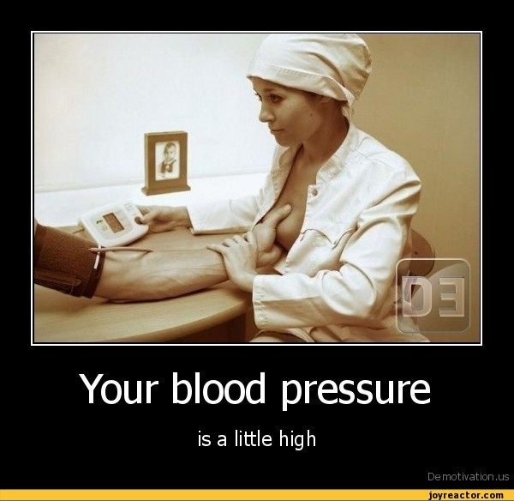
Thanks for the attention

