Slide 1
PHARMACOKINETICS
Notes for Students
This study material is exclusively for students of general medicine and stomatology in Pharmacology I course. It contains only basic notes of discussed topics, which should be completed with more details and actual information during practical courses to make a complete material for test or exam studies. Which means that without your own notes from the lesson this presentation IS NOT SUFFICIENT for proper preparation for neither tests in practicals nor the final exam.

Slide 2
Basic principles of pharmacokinetics
Pharmacokinetics is aimed on this processes: absorption
distribution
biotransformation
excretion of drugs
and their relation to pharmacologic (therapeutic or toxic) effects

Slide 3
Pharmacokinetics
absorption A
distribution D
metabolism M
excretion E
processes of ADME
invasion
“ADME“
elimination

Slide 4
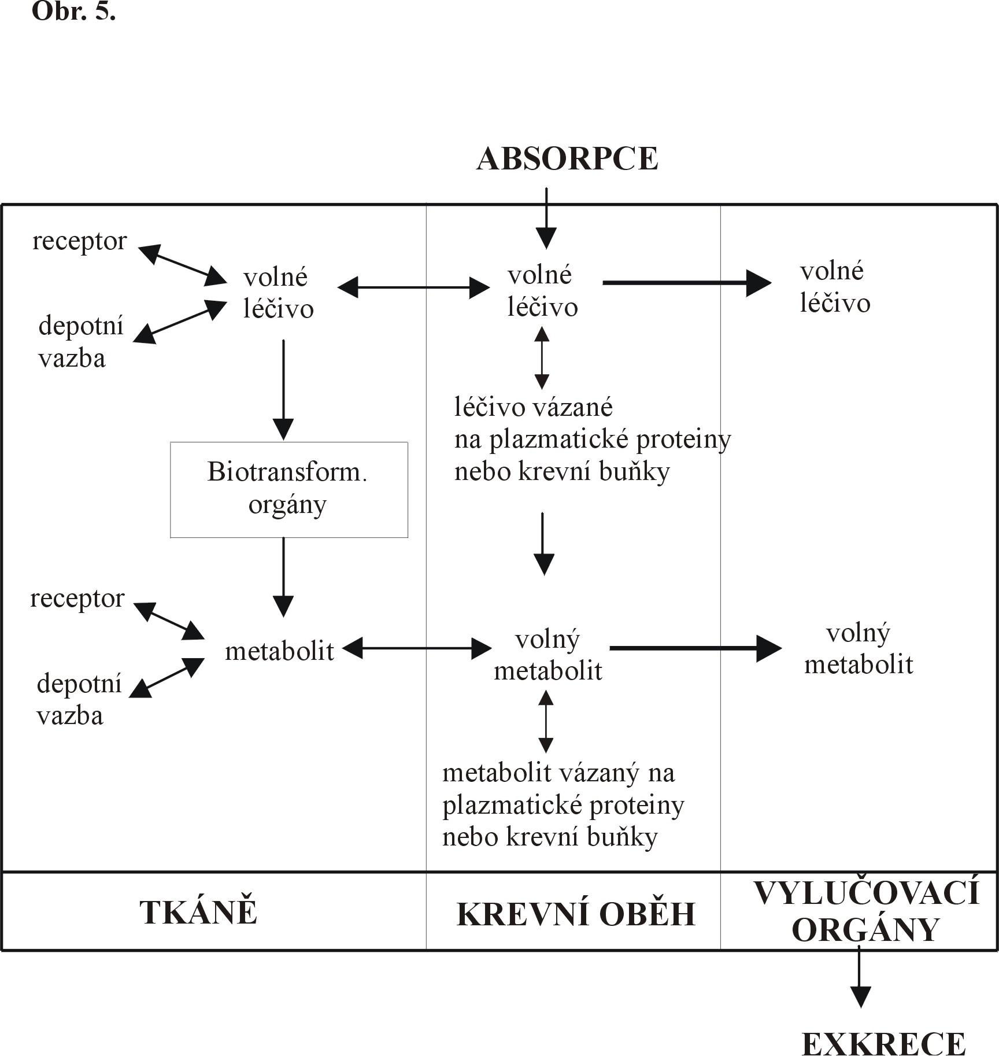
Administration of drug
Absorption
receptor
free
drug
free
drug
free
drug
depot
binding
drug bound to proteins or blood cells
Biotransformation
organs
receptor
metabolite
free
metabolite
free
metabolite
depot
binding
metabolite
bound to protein
or blood cell
TISSUES
BLOOD CIRCULATION
ORGANS OF
EXCRETION
EXCRETION

Slide 5
General rules for drug movement
Physical-chemical characteristic of drug
  lipophilic vs hydrophilic, size, charge, pKa, solubility
Drug transmission through biological barriers
  lipophilic - pasive diffusion
  hydrophilic- pore transmission
  active transport
  vesicular transport – pinocytosis, phagocytosis
Drug binding
  plasmatic proteins
  blood cells
  tissue binding
  receptor binding
Tissue perfusion
    brain, heart, liver and kidney
    adipose tissue
http://icp.org.nz/icp_t11.html

Slide 6
Absorption – routes of administration
penetration of dissolved drug from the site of administration to blood (systemic circulation) – necessary for general effect– systemic effect
Local effect:
  on skin, mucosas or ventricles
  absorption is undesirable – possible AE
  ie. local corticoids, local anesthetics
Speed and extent of absorption are described by P-kinetic parameters:
C _{max} max. concentration of drug in plasma after single dose
T _{max} time, when drug reach c_{max} (speed)
F bioavailability (extent)

Slide 7
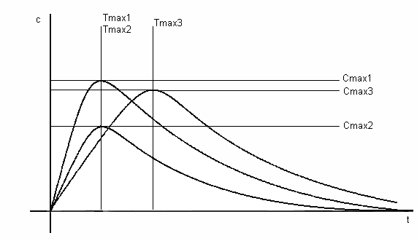
Concentration of drug
Time

Slide 8
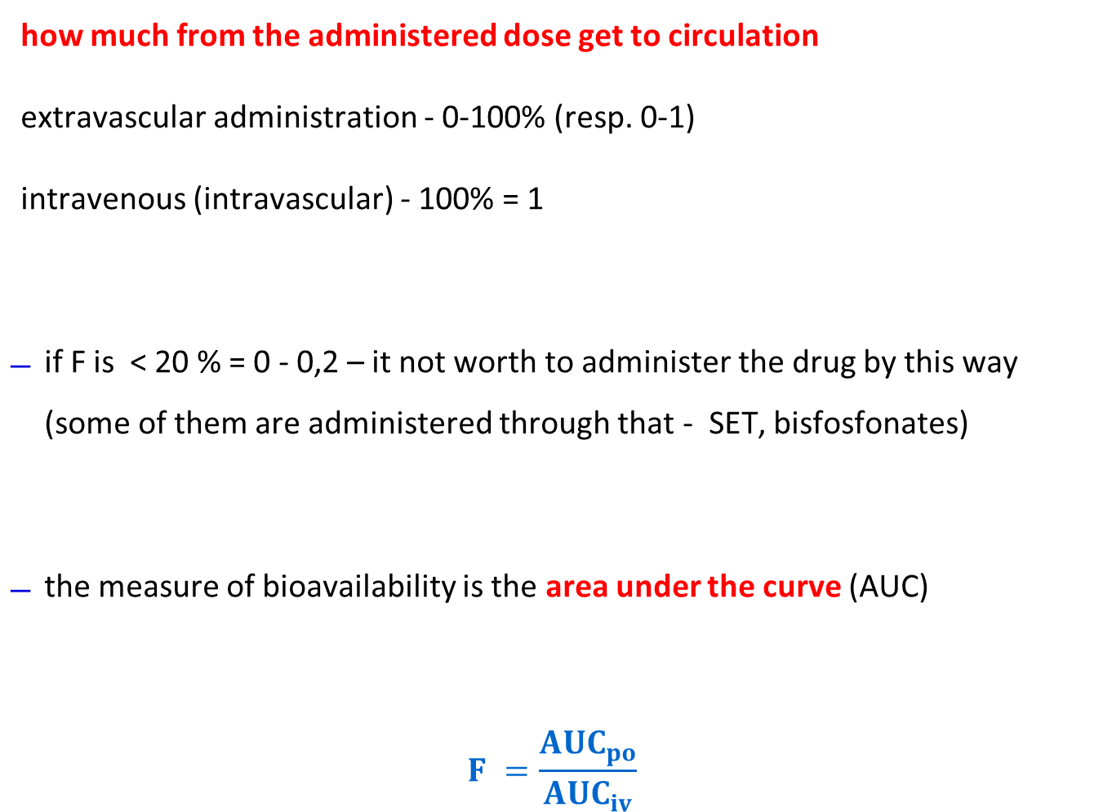
Bioavailability- F
how much from the administered dose get to circulation
extravascular administration - 0-100% (resp. 0-1)
intravenous (intravascular) - 100% = 1
if F is < 20 % = 0 - 0,2 – it not worth to administer the drug by this way (some of them are administered through that - SET, bisfosfonates)
the measure of bioavailability is the area under the curve (AUC)
$$F =\frac{{AUC}_{po}}{{AUC}_{iv}}$$
http://icp.org.nz/icp_t6.html

Slide 9
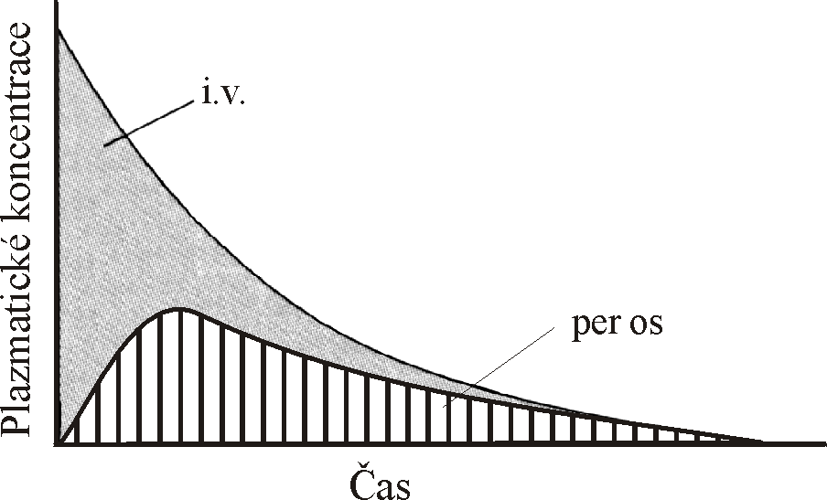
AUC – area under the curve
Time

Slide 10
Bioavailability- F
Absolute bioavailability
  comparing the AUC of administered drug in the test dosage form and the AUC after i.v. drug administration
  Relative bioavailability
  assess the expected biological equivalence of two preparations of a drug
  if the relative bioavailability = 1 (100%) → tested preparation is bioequivalent to the reference

Slide 11
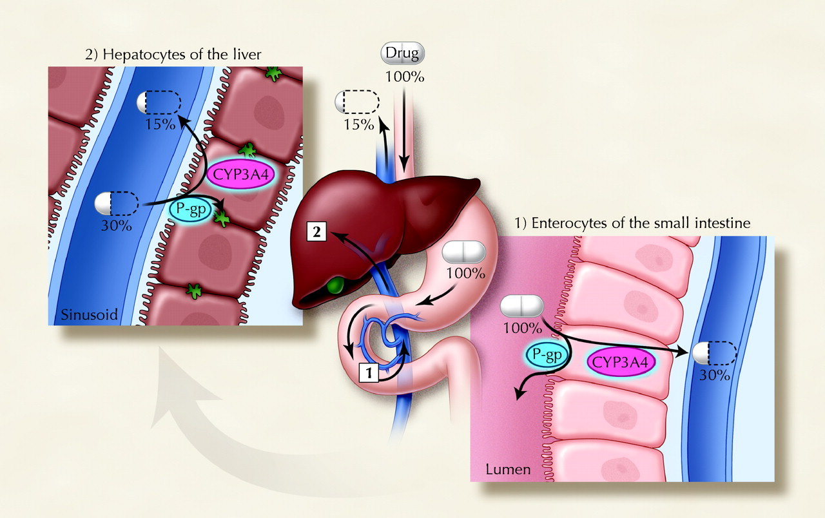
David G. Bailey, and George K. Dresser CMAJ 2004;170:1531-1532

Slide 12
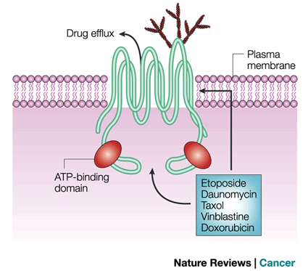
P-glycoprotein
  transmembrane pump encoded by MDR1, ABCB1
  drug efflux pump for xenobiotics
  multidrug resistence to chemotherapeutics

Slide 13
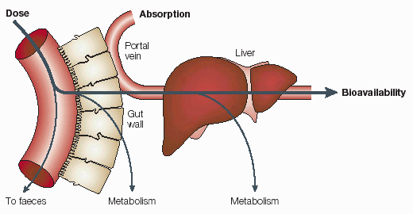
Presystemic elimination
First pass effect
http://icp.org.nz/icp_t6.html?htmlCond=1

Slide 14
Other factors influencing drug absorption
gender, weight, plasmatic volume, speed of gastric discharging
age - pH, bile, enzymes
pathophysiological defect – diseases of liver, inflammation ...
body constitution (BW/LBM)
diet
- acceleration/ decceleration
- chemical incompatibilities
- GIT functionality

Slide 15
c
i.v.
i.m.
p.o.
s.c.
T [min]

Slide 16
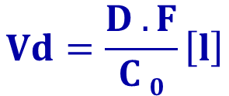
Distribution
Penetration of drug from blood to tissues, dynamic proces where we are interested in:
speed of distribution- depends on:
bindings
membrane penetration
organ perfusion
status- distribution balance, free fractions of drug are equal in blood and tissue
Volume of distributionV_{d}
hypothetic, theoretical volume
rate between amount of drug in organism and plastmatic concentration
$$Vd=\frac{D . F}{C 0}\left[l\right]$$
http://icp.org.nz/icp_t3.html?htmlCond=0

Slide 17
The apparent volume of distribution, Vd, is defined as the volume that would contain the total body content of the drug at a concentration equal to that present in the plasma

Slide 18
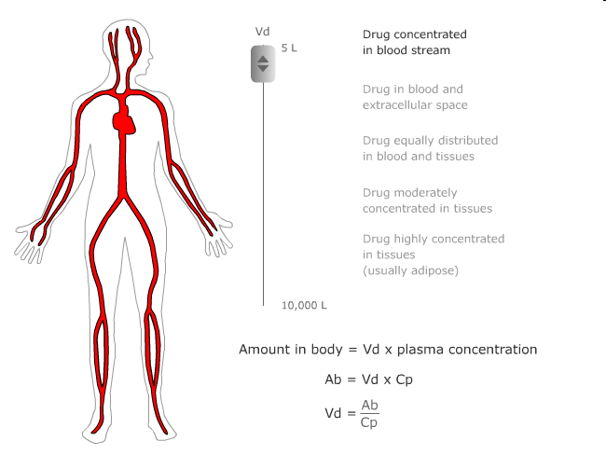

Slide 19
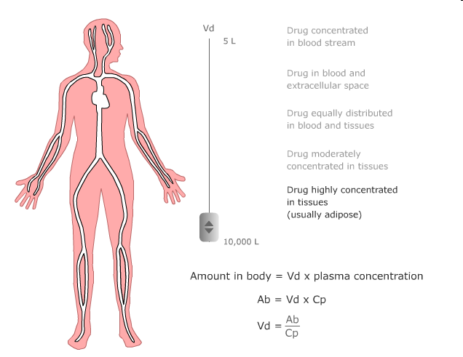

Slide 20
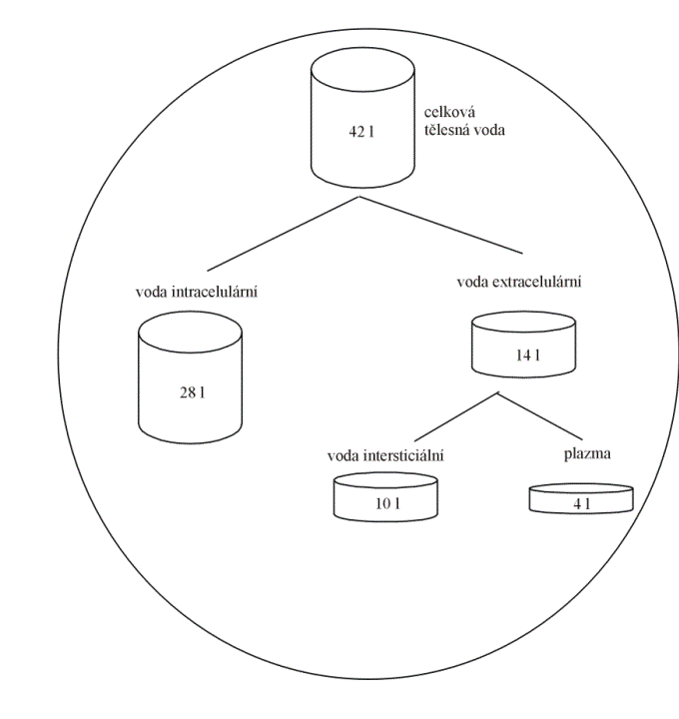
Vd = hypothetical volume,
Final value of Vd can be even 50000 liters (antimalarial drugs). What does this value tell us:
We can assess distribution of the drug in the body.

Slide 21
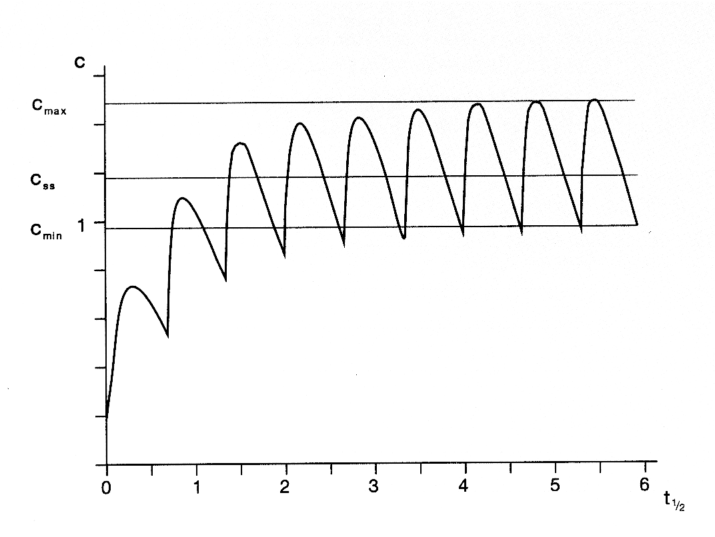
Distribution
Distribution volume - use:
Calculation of initial dose:
  D = Vd . c_{T}

Slide 22
Distribution
Estimate the amount of drug in the body
  M = Vd . C
Assessment of the effect of hemodialysis and hemoperfusion
  drugs with higher Vd can not be eliminate from the body by these technics

Slide 23
Elimination of drugs
First-order elimination
  Elimination speed is influenced by plasmatic concentration
  Linear kinetics
Zero-order elimination
  Elimination speed is not influenced by plasmatic concentration
  Non-linear kinetics

Slide 24
Biotransformation - metabolism
Predominantly in liver, but also in other organs and parts of body
Enzymatic processes
bioactivation (prodrug)
tamoxifen – endoxifen
cyclophosphamide – phosphoramide
biodegradation

Slide 25
Biotransformation - metabolism
Phase:
  oxidation, hydrolysis → drug is still partly lipophilic
  cytochromes P450, dehydrogenases
Phase:
  conjugation → molecules becomes hydrophilic
Metabolites
- effective („more/less“)
- inneffective
- toxic

Slide 26
CYP 450

Slide 27
CYP 1A2
CYP 3A4
ostatní
CYP 2C9
2%
3%
CYP 2D6
10%
CYP 2C9
CYP 1A2
others
CYP 3A4
CYP 2D6
55%
30%

Slide 28
Inducers of CYP450
dexametazon
fenobarbital
rifampicine
fenytoin
St. John´s worth (Hypericum perforatum)
Maidenhair Tree (Ginkgo biloba)

Slide 29
Inhibitors of CYP450
antidepressants (fluoxetin, fluvoxamin, paroxetin)
chinin, chinidin
chloramphenicol, erytromycine
ketokonazol, itrakonazol
grapefruit juice

Slide 30
Excretion
kidneys
bile
lungs
Saliva, skin, hair, milk…

Slide 31
Excretion by kidney
MW < 60.000 D (MW of albumin = 68.000 D)
glomerular filtration
tubular secretion
  organic acids
    furosemide
    thiazide diuretics
    penicilins
    glukuronids
  organic bases
    morfin
tubular reabsorption
    diazepam
alkalization
  natrium hydrogencarbonate
acidification
  ammonium chloride

Slide 32
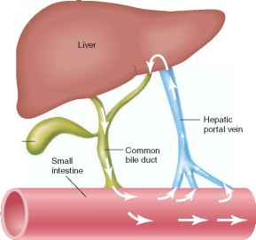
Excretion by liver
Substances permeate through 2 membranes of hepatocytes – basolateral and apical (canalicular)
Metabolites are excreted primary by pasive diffusion, further by active transport (glucuronides, bile acids, penicillins, tetracyclines, etc.)
Metabolites can be deconjugated by bacterial enzymes in intestine → release of lipophilic molecule → re-absorption
= ENTEROHEPATIC CIRCULATION

Slide 33
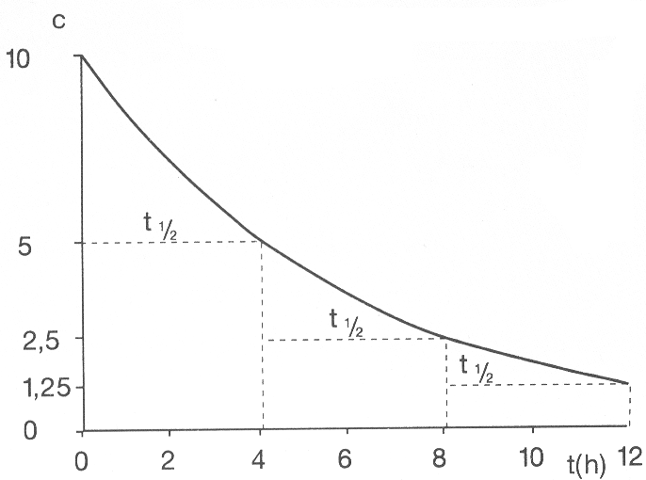

Slide 34
Pharmacokinetic parameters
Mathematic description of pharmacokinetic processes and its use in drug dosage

Slide 35

The guide for evaluation of pharmacokinetics in clinical practise is plasma concentration/time curve – problems with measuring in vivo

Slide 36
In accordance with concentration-time curves we determine pharmacokinetic parameters – model values, which provides us to describe P-kinetic processes
There are three possible manners of drug administration with regards to concentration-time curves:
single dose
continuous administration
repeated dose

Slide 37
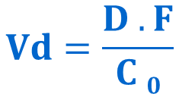
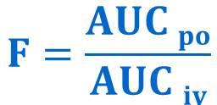
Single dose
Invasion phase
C _{max}
T _{max}
Bioavailability - F
Volume of distribution - Vd
$$F=\frac{AUC po}{AUC iv}$$
$$Vd=\frac{D . F}{C 0}$$

Slide 38
Relationship of plasmatic conc. on time
C [mg/ml]
Cmax_{ter}
THERAPEUTICAL RANGE
Cmin_{ter}
lag time
Tmax
T [min]
INVASION ELIMINATION

Slide 39

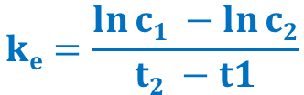
Single dose
Elimination phase
Drug is eliminated from the organism with speed determined by:
Elimination rate constant:
Biological halftime – drug is totally eliminated after 4-5 halftimes
Clearance
= volume of plasma, which is fully cleaned from drug at time unit[l . h⁻¹]
$$ke=\frac{\ln{c1 −\ln{c2}}}{t2 −t1}$$
$$t_{1/2}=\frac{\ln{2}}{ke}=\frac{0,7}{ke}$$
${Cl}_{TOT}$ $=\frac{D}{AUC}=ke . Vd={Cl}_{REN}+{Cl}_{HEP} +{Cl}_{PUL }…$

Slide 40
Compartment models

Slide 41
Compartment models– block schema
1- compartment model
D
i.v. intake
A (GIT)
D
k_{a}
Vd
Vd
k_{e}
k_{e}

Slide 42
Compartment models– block schema
2- compartment model
i.v. intake
D
k₁₂
Vd₁
Vd₂
central compartment
k₂₁
peripheral compartment
k₁₀

Slide 43
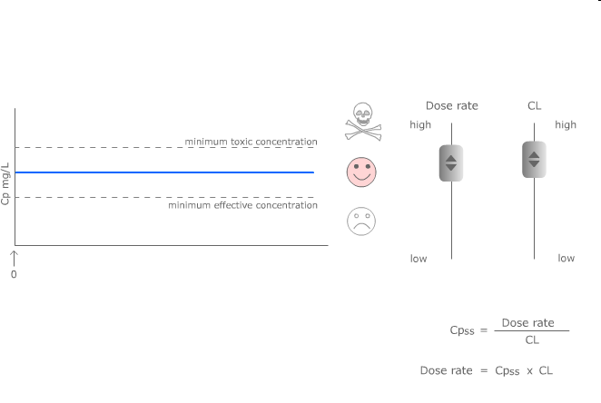
Continuous and repeated administration of drugs

Slide 44
Continuous administration
Intravenous (e.g. by infusio pump), transdermal (TTS), implant → administration of drug with constant speed (mg/min)
If duration of infusion is long enought, concentrations are increasing until the speed of elimination and inflow are the same – plato state is reached (concentration of plato is expressed as Css)

Slide 45
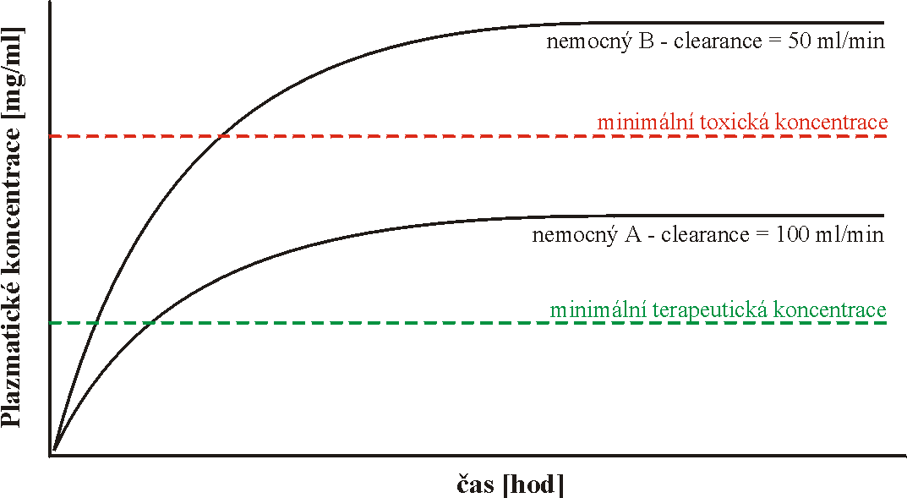
Continuous administration
patient B – clearence = 50ml/min
minimal toxic concentration
Plasmatic concentration
patient A – clearence = 100ml/min
minimal therapeutic concentration
Time

Slide 46
Continuous administration
In plato:
Drug is binded to all binding sites, which can be occupied (distribution is finished)
constant infusion speed supplements amount, which is eliminated from organism in same
speed of inflow [mg/min] = speed of elimination [mg/min]

Slide 47
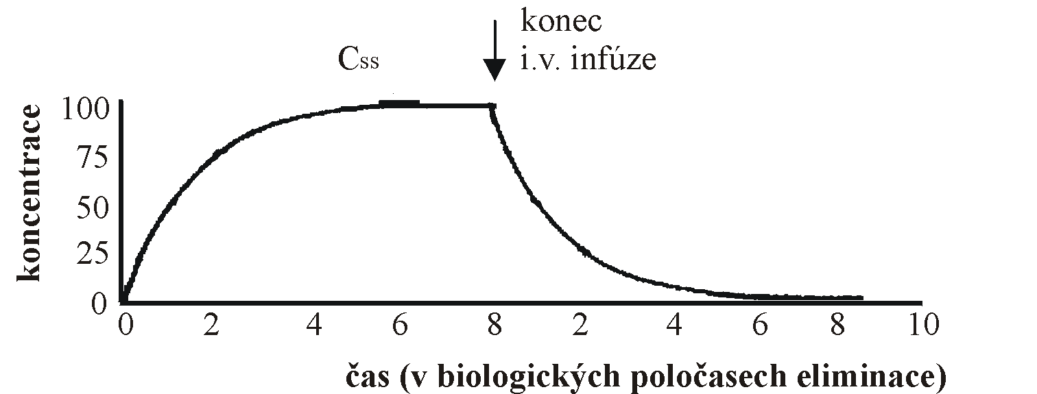
Continuous administration
End of i.v. infusion
Time (in biological halftimes)

Slide 48
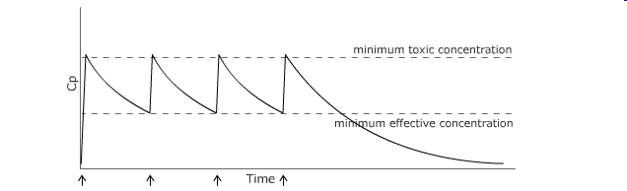
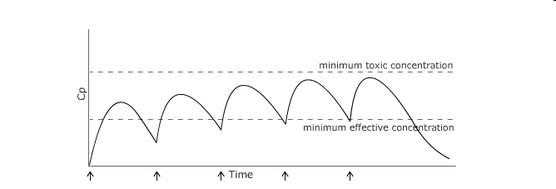
Repeated administration
intra- (repeated intravascular injection) or extravascular (i.e. per os)

Slide 49
Repeated administration
If doses are administered so close that first of them is not fully eliminated, cumulation starts or plato is reached
Instead of css, css_{plato} is described and it is an average concentration from all concentrations meaured during one dosage interval

Slide 50
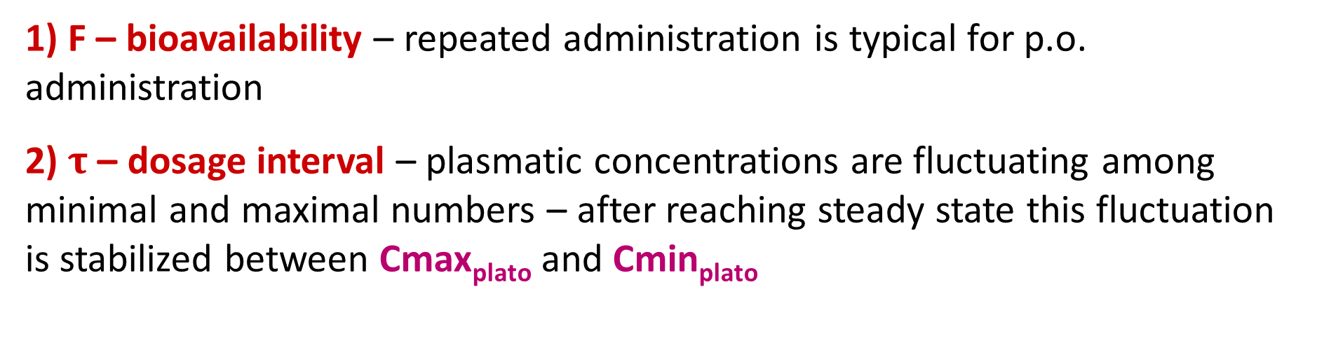
Repeated administration
1) F – bioavailability – repeated administration is typical for p.o. administration
2) $τ$ – dosage interval – plasmatic concentrations are fluctuating among minimal and maximal numbers – after reaching steady state this fluctuation is stabilized between Cmax_{plato} and Cmin_{plato}
$$\frac{D . F}{τ}=Cl . css plato$$

Slide 51



Basic pharmacokinetic parameters (+computations)
c_{max} = maximal plasmatic concentration
t_{max} = time when c_{max} is reached
k_{e} = elimination rate constant
t_{1/2} = biological halftime
V_{d} = volume of distribution
Cl = clearence
AUC = area under the curve
$ke=\frac{\ln{c1 −\ln{c2}}}{t2 −t1}$ $\left[h^{−1}\right]$
$$t_{1/2}=\frac{\ln{2}}{ke}=\frac{0,7}{ke} \left[h\right]$$
$$Vd=\frac{D . F}{C 0}= \frac{F.D}{AUC . ke} \left[l\right]$$
${Cl}_{TOT}$ $=\frac{D}{AUC}=ke . Vd={Cl}_{REN}+{Cl}_{HEP} +{Cl}_{PUL }…\left[l.h^{−1}\right]$
$AUC$ $=\frac{D}{Cl}=\frac{co}{k_{e}}=\frac{D}{k_{e} . Vd} \left[mg . l^{−1 }. h\right]$

