Slide 1
Principles of plastic surgery

Slide 2
Plastic surgery techniques
Spontaneous wound healing
Direct surgical wound closure
Skin grafts, other types of graft materials
Flaps
Free tissue transfer
Tissue expansion
Ablative techniques
Other reconstructive problems
Aesthetic or plastic cosmetic surgery

Slide 3
Classification of WOUNDS
Wound may be defined as a defect or break in the skin that results from physical, mechanical or thermal damage.
Healing is complete when the skin surface has reformed and the skin has regained most of its tensile strenght.

Slide 4
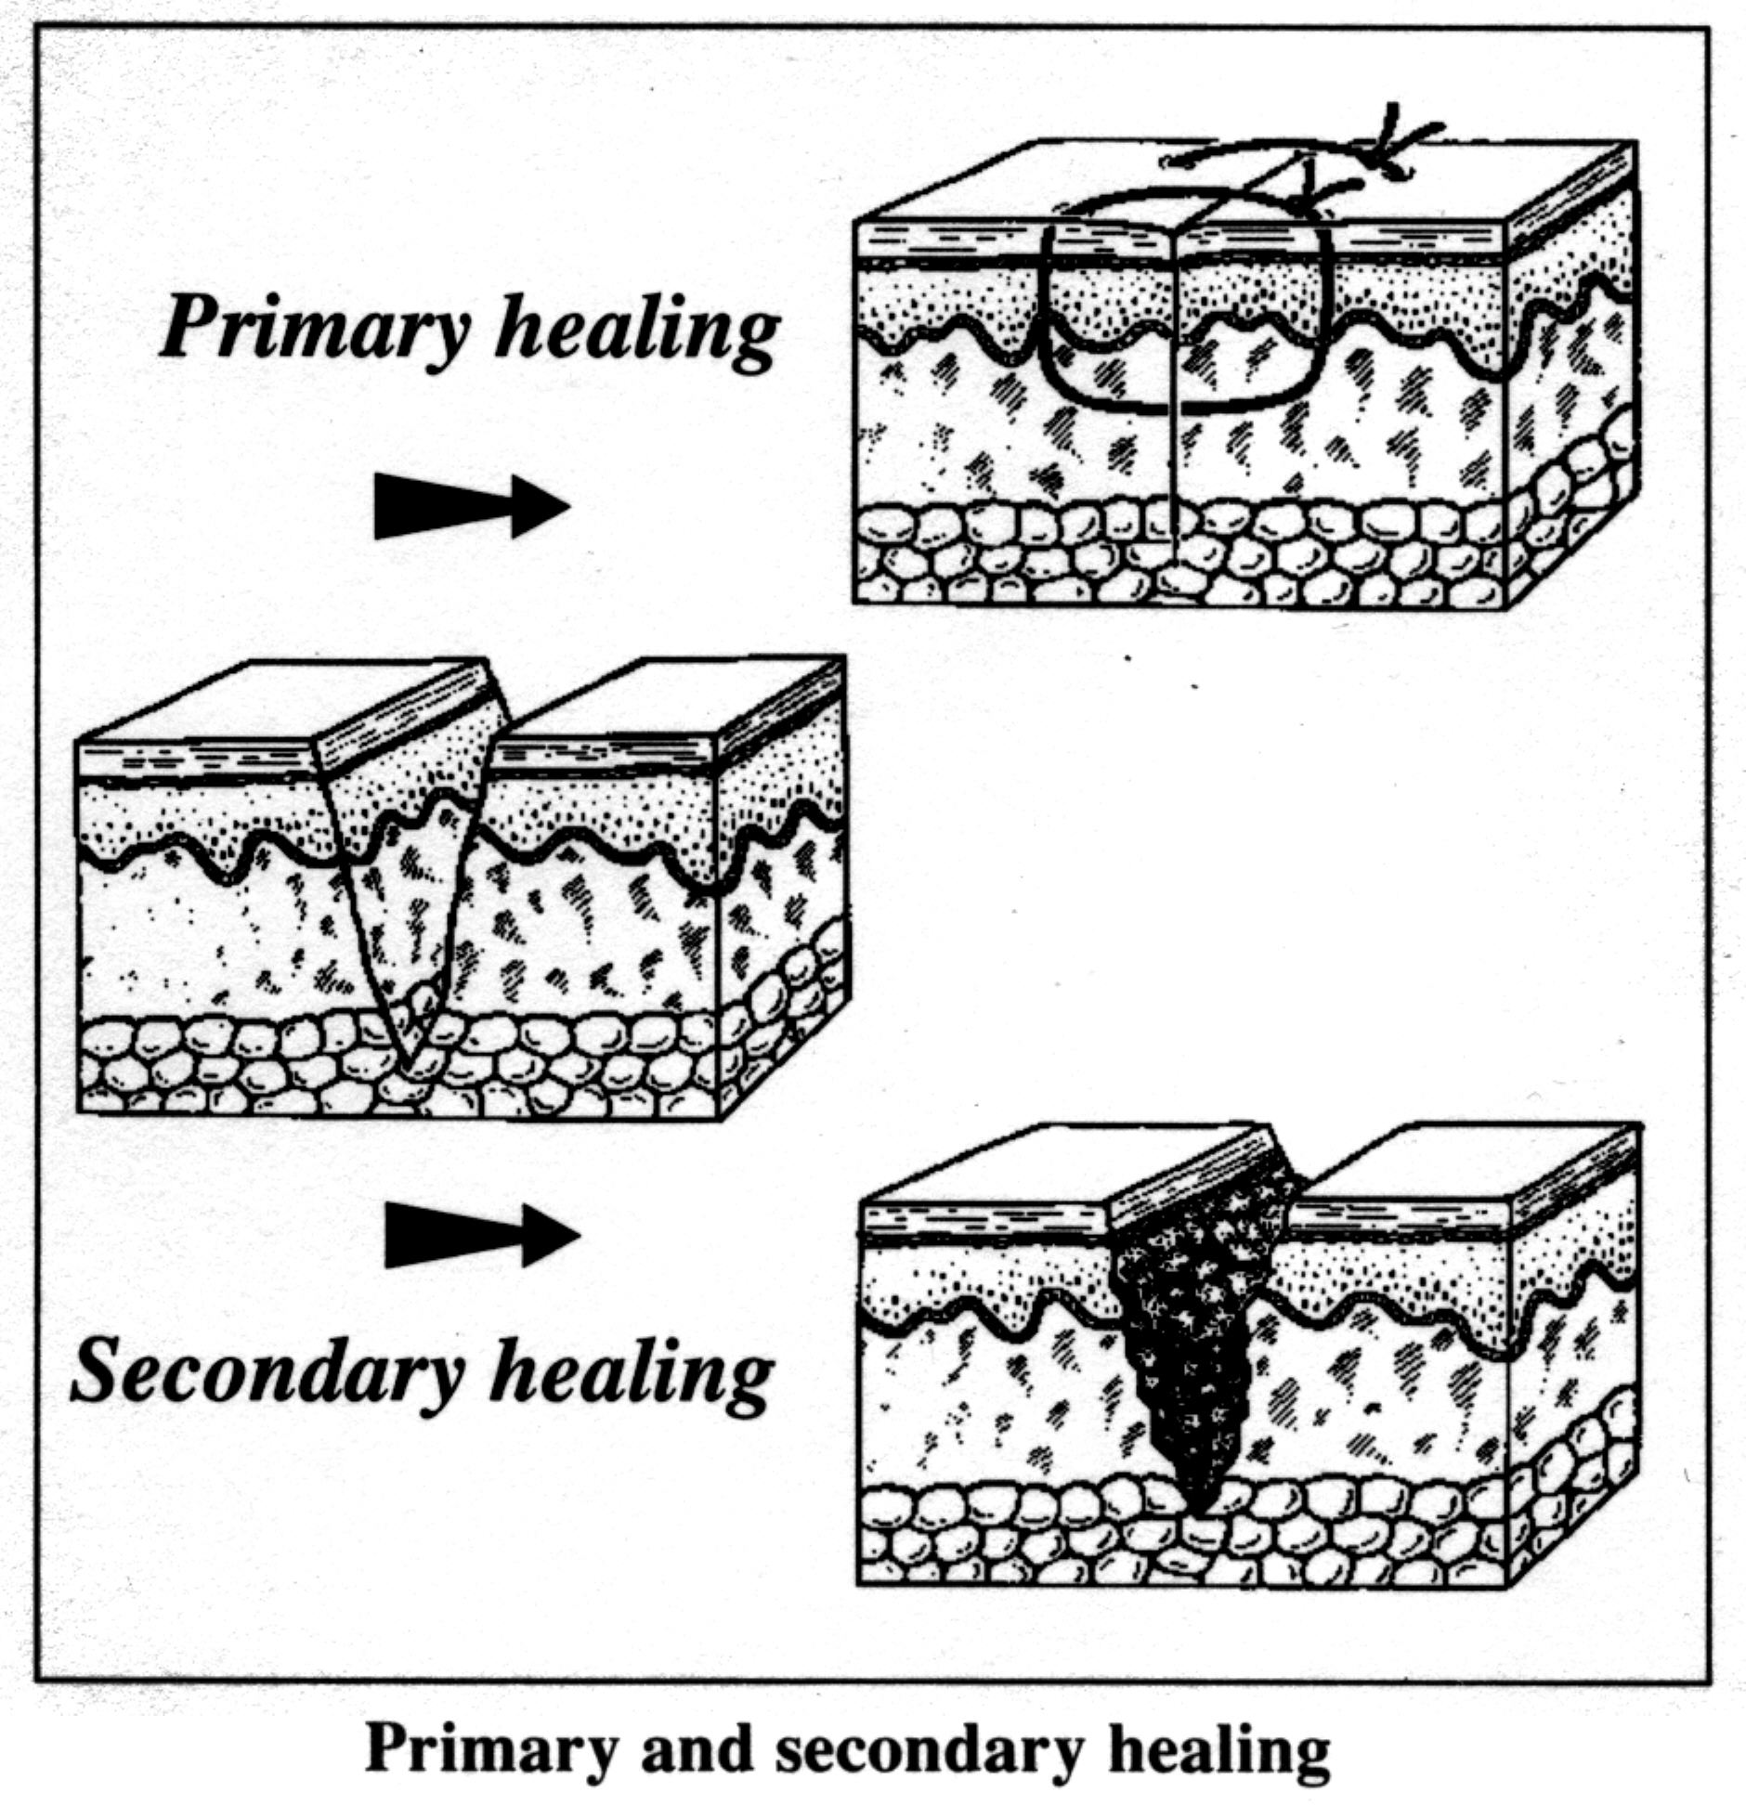

Slide 5
Healing time and chronicity
Primary intention – Minor tissue loss, wound edges can be apposed minimising the necessary repair
Secondary intention – Larger tissue losses, contraction occures and eventually the wound re-epithelialises. This healing by secondary intention requires considerable time

Slide 6

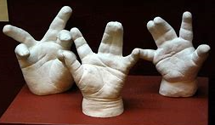
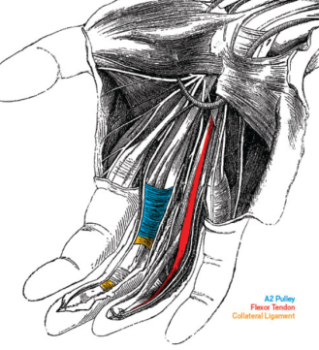
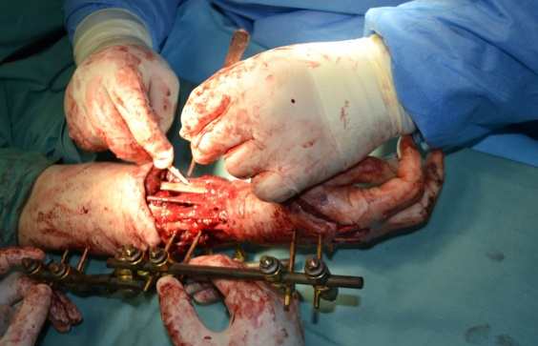
Types of problem involning the plastic surgeon
Aetiology defect | Example
Congenital abnormity | Cleft lip and palate Congenital hand abnormalies
Trauma | Lover limb soft tissue loss Hand injury Pressure sore – decubitus ulcer
Burns | Extensive skin loss
Neoplasma | Skin cancer Intraoral cancerexcision and recontruction Brest reconstruction following mastectomy
Degenerative process | Rheumatoid hand deformities

Slide 7
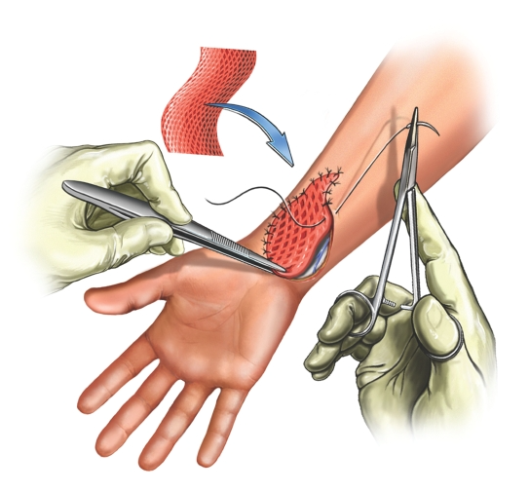
Skin Graft
Skin grafting is a surgical procedure that involves removing skin from one area of the body and moving it, or transplanting it, to a different area of the body

Slide 8
Why are skin grafts done
Common reasons for a skin graft include:
skin infections
deep burns
large, open wounds
Bed sores or other ulcers on the skin that haven’t healed well
skin cancer surgery
Notes:
Skin grafting is a surgical procedure that involves removing skin from one area of the body and moving it, or transplanting it, to a different area of the body.
Skin grafts are performed in a hospital. Most skin grafts are done using general anesthesia, which means you’ll be asleep throughout the procedure and won’t feel any pain

Slide 9
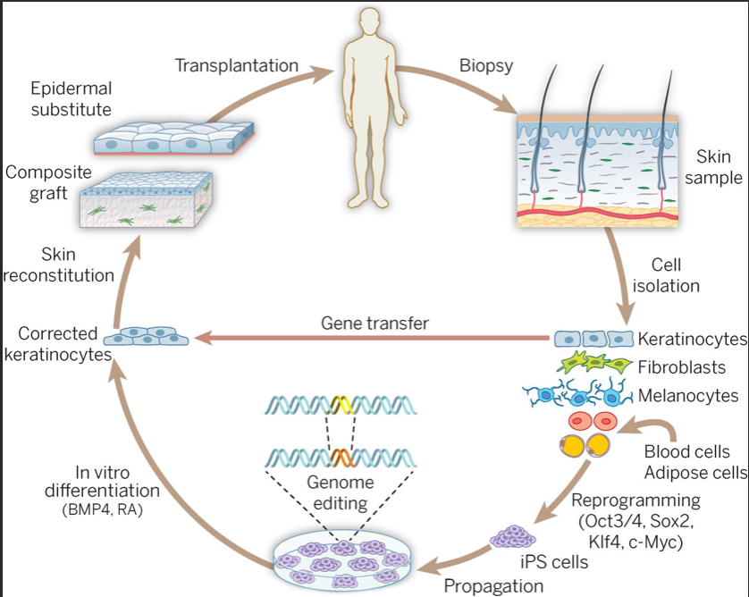
Advances in skin grafting and treatment of cutaneous wounds
Bryan K. Sun,

Slide 10
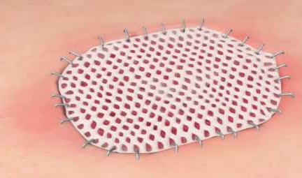
Types of skin grafts
There are two basic types of skin grafts: split-thickness and full-thickness grafts.
A split-thickness graft involves removing the top layer of the skin — the epidermis — as well as a portion of the deeper layer of the skin, called the dermis.
    Split-thickness skin grafts are usually harvested from the front or outer thigh, abdomen, buttocks, or back. Split-thickness grafts are used to cover large areas. These grafts tend to be fragile and typically have a shiny or smooth appearance.

Slide 11
Types of skin grafts
A full-thickness graft involves removing all of the epidermis and dermis from the donor site.
  These are usually taken from the abdomen, groin, forearm, or area above the clavicle (collarbone).
  They tend to be smaller pieces of skin, as the donor site from where it’s harvested is usually pulled together and closed in a straight-line incision with stitches or staples.
Full-thickness grafts are generally used for small wounds on highly visible parts of the body, such as the face.
Unlike split-thickness grafts, full-thickness grafts blend in well with the skin around them and tend to have a better cosmetic outcome.

Slide 12
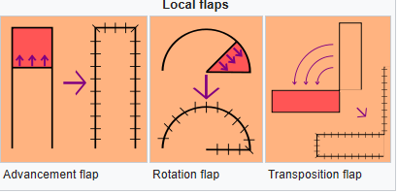
Flap
Flap surgery is a technique in plastic and Reconstructive surgery where any type of tissue is lifted from a donor site and moved to a recipient site with an intact blood supply. This is distinct from a graft, which does not have an intact blood supply and therefore relies on growth of new blood vessels.
Local flaps
Regional flaps
Distant flaps

Slide 13
Flap classifications by tissue type
Cutaneous flaps contain the full thickness of the skin and superficial fascia and are used to fill small defects.
Fasciocutaneous flaps add subcutaneous tissue and deep fascia, resulting in a more robust blood supply and ability to fill a larger defect.
Musculocutaneous flaps further add a layer of muscle to provide bulk that can fill a deeper defect.
Muscle flaps can provide bulk or functional muscle.
Bone flaps are used to replace bone, such as in jaw reconstruction.

Slide 14
Flap classifications by Vascular
Classification based on blood supply to the flap:
Axial flaps are supplied by a named artery and vein. This allows for a larger area to be freed from surrounding and underlying tissue, leaving only a small pedicle containing the vessels.
  Reverse-flow flaps are a type of axial flap in which the supply artery is cut on one end and blood is supplied by backwards flow from the other direction.
Random flaps are simpler and have no named blood supply.
Pedicled flaps remain attached to the donor site via a pedicle that contains the blood supply.

Slide 15
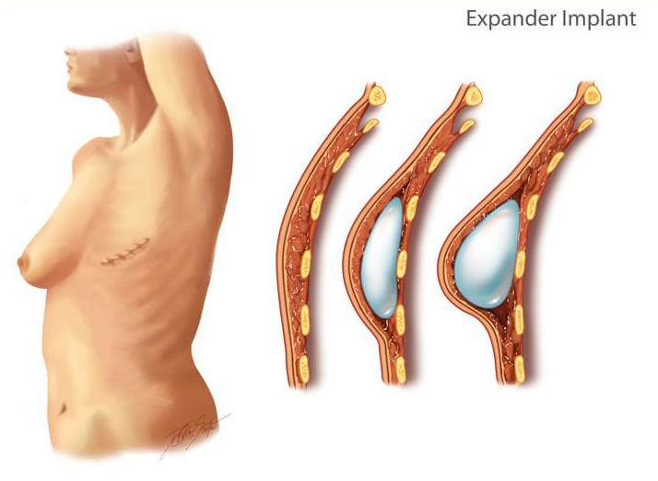
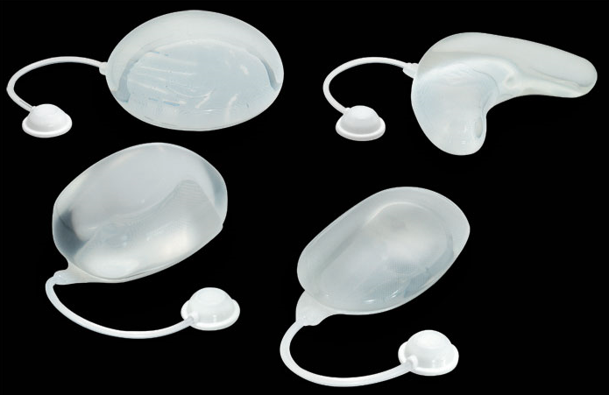
Tissue expansion
Skin expansion is a common surgical procedure to grow extra skin through controlled mechanical overstretch. It creates skin that matches the color, texture, and thickness of the surrounding tissue, while minimizing scars and risk of rejection

Slide 16
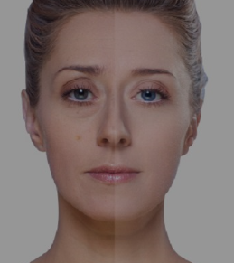
Ablative Techniques
These techniques involve creating a uniform wounding of the top layer of the skin, which when heals, grows back uniform and firmer.
There are two very common Ablative Techniques, which are used by the majority of the plastic surgeons
  CO2 Laser – this has been used for a long time for treatment of issues like scars, wrinkles, warts etc.
  Erbium Laser – this is a comparatively newer procedure used for treatment of deep lines, wrinkles on not just the face, but also on the neck, hands and feet.

Slide 17
Aesthetic or plastic cosmetic surgery
In cosmetic surgery there is no obvious surgical pathology
Face
Facelift, Eyalid surgery, Nose surgery, Era surgery
Breast
Breast augmentation, Breast lift, Breast reduction
Body
Tummy tuck, Liposuction
Male cosmetic surgery
Male breast surgery
Non surgical treatment
Botulinium treatment, Facial fillers, Chemical peels

