Slide 1
Eating disorders
ZLA - spring 2020

Slide 2
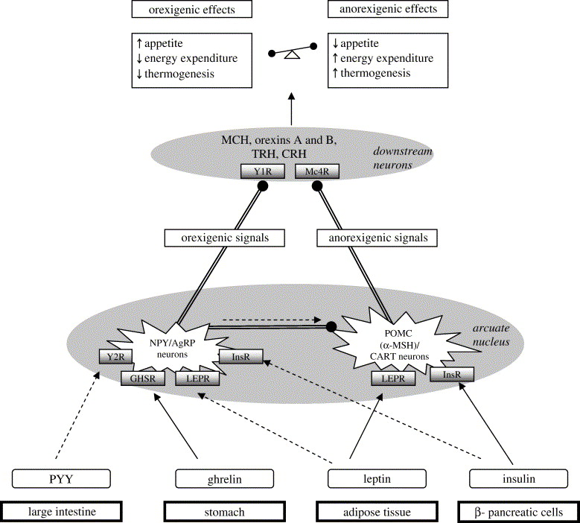
Energy homeostasis

Slide 3
History
Lipostatic hypothesis (Kennedy 1953) – adipose tissue products specific „lipostatic“ factor
Glukostatic hypothesis (Mayer and Thomas 1967) – changes in glycemia lead to stimulation /inhibition of food intake (brain and liver)
Combination of both hypotheses???

Slide 4
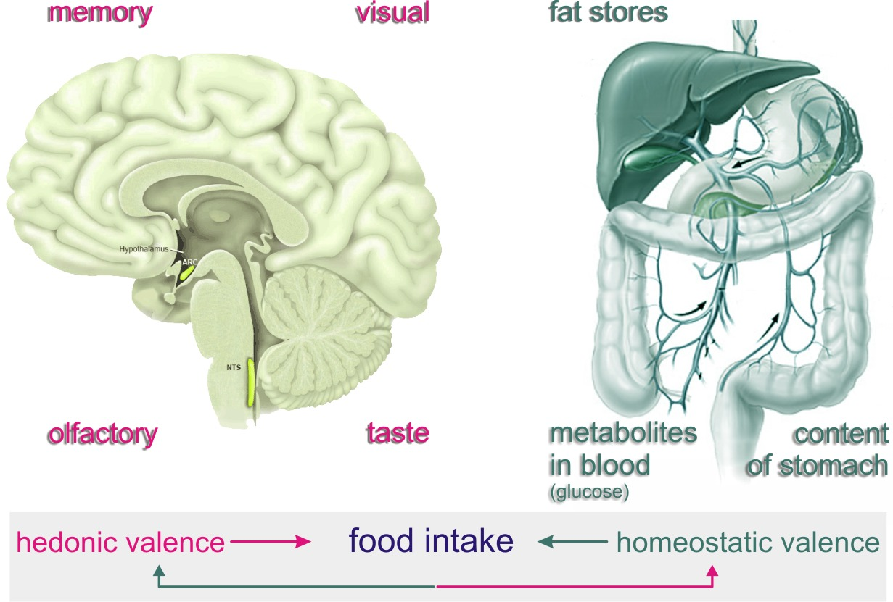
It is necessary to distinguish common homeostatic regulations of food intake and hedonic regulations

Slide 5
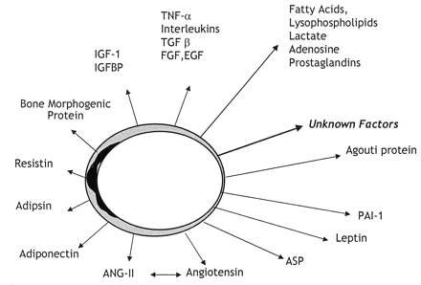
WAT produces adipokines
These factors are produced by adipocytes, but also by macrophages, fibroblasts, endothelial cells and other cells in adipose tissue
To date, a lot of adipose tissue-derived factors has been described. These factors with pleiotropic functions in many processes including regulation of energy metabolism, inflammation, food intake, insulin sensitivity etc. Markedly contribute to metabolic regulations and its pathologies.
They are usually:
1. Proinflammatory (TNF-α, IL-6, resistin)
2. Anti-inflammatory (adiponektin)
They are very important in metabolic regulations

Slide 6
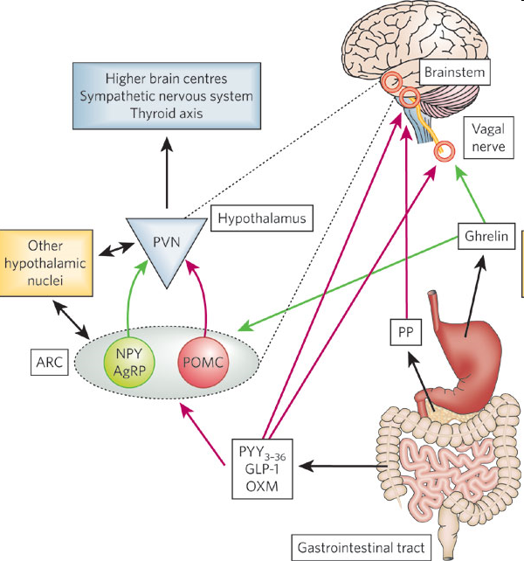
CENTRAL AND PERIPHERAL CIRCUITS IN REGULATION OF FOOD INTAKE
Gut hormones and the regulation of energy homeostasis
Kevin G. Murphy and Stephen R. Bloom
Nature 444, 854-859(14 December 2006)

Slide 7
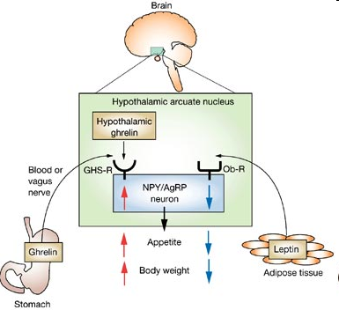
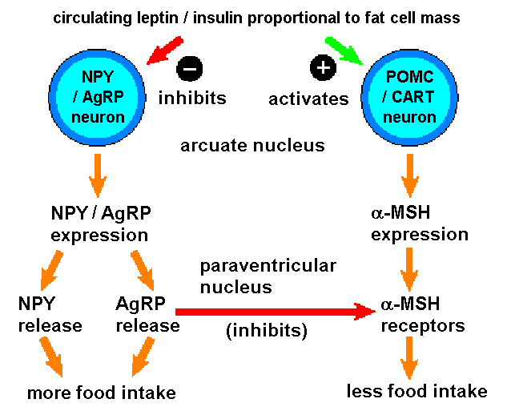
REGULATION OF FOOD INTAKE
Drug Insight: the functions of ghrelin and its potential as a multitherapeutic hormone
Masayasu Kojima and Kenji Kangawa
Nature Clinical Practice Endocrinology & Metabolism (2006) 2, 80-88

Slide 8
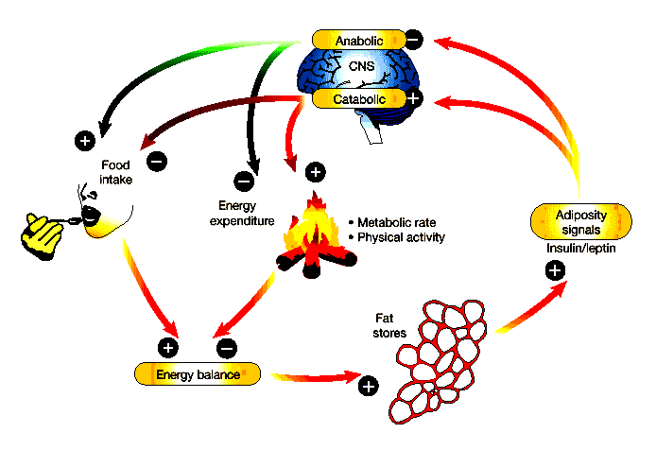

Slide 9
BASIC COMMUNICATION AMONG NEURONS
CRH
NPY
GHRELIN
POMC

Slide 10
OREXIGENIC- ANOREXIGENIX PATHWAYS
INHIBITS
ACTIVATES
BLOOD VESSEL
LEPTIN
INSULIN
NPY NEURON
AgRP NEURON
POMC NEURON
CART NEURON
α-MSH
NPY
AgRP
INHIBITS
α-MSH
RECEPTORS
MORE FOOD INTAKE
LESS FOOD INTAKE

Slide 11
Hypothalamus
PVN
PVN
PITUITARY GLAND
LHA
MCH
CART
DMN
DMN
LHA
CEREBRAL CORTEX
LIMBIC SYSTEM
THALAMUS
OLFACTORY
DYNORPHIN
OREXINS
VMN
VMN
RETINA
ARC
ARC
GLUCOCORTICOIDS
IL-6
INSULIN
LEPTIN/ ADIPONECTIN/ TNFα, IL-6
GHRELIN
ENDOCRINE GLANDS
MUSCLE
PANCREAS
ADIPOSE TISSUE
STOMACH/GUT

Slide 12
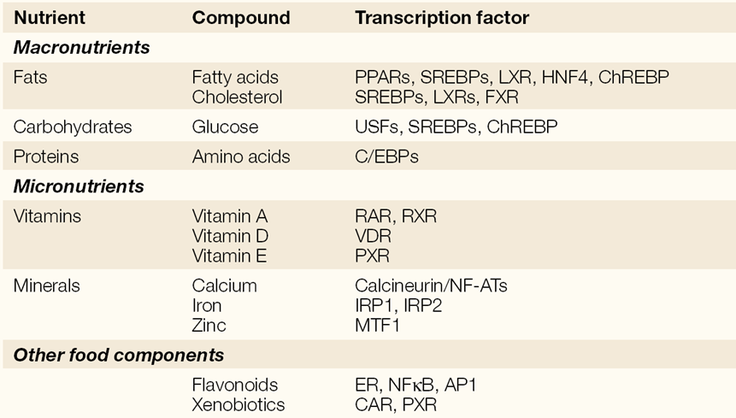
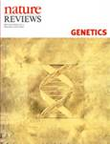
PATHWAYS OF TRANSCRIPTION FACTORS PARTICIPATING
IN NUTRITION BASED INTERACTIONS

Slide 13
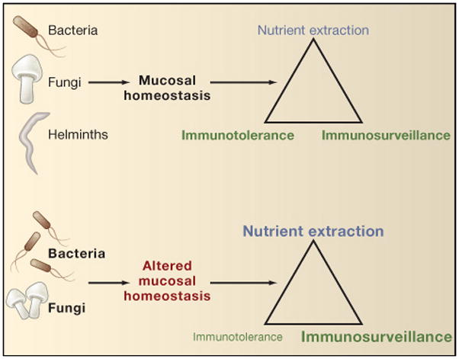
Immunosurveillance is a term used to describe the processes by which cells of the immune system look for and recognise foreign pathogens, such as bacteria and viruses, or pre-cancerous and cancerous cells in the body.
The loss of universal helminth infection as occurred in earlier human evolution may alter the numbers or types of bacterial and fungal commensals and thus affect normal mucosal tissue homeostasis. In susceptible or highly exposed individuals, such alterations might alter the balance between immunotolerance, immunosurveillance and nutrient extraction. This imbalance may contribute to the appearance of inflammatory systemic dysregulation at mucosal surfaces, resulting in increases in asthma and allergic diseases, particularly in the setting of environmental changes that have increased exposure to indoor allergens and pollutants, and even to increases in obesity, which can be a risk factor for severe asthma.

Slide 14
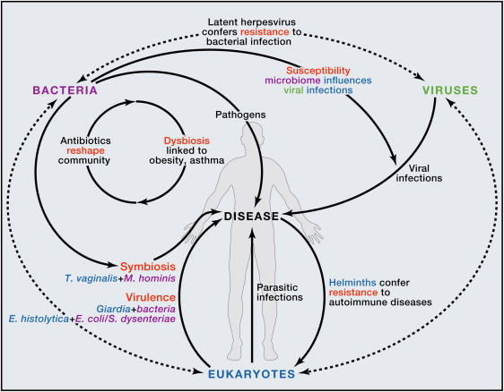
Cell 2012; 148: 1258–1270

Slide 15
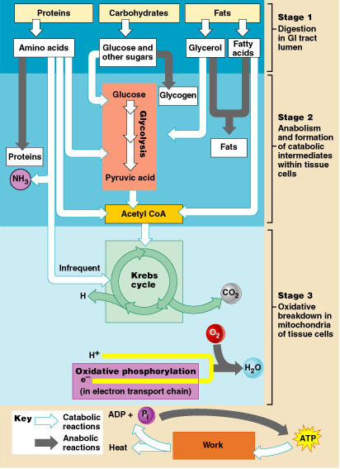
Stages of Metabolism
Figure 24.3

Slide 16
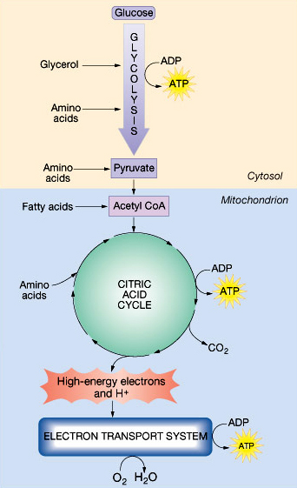
Metabolic pathways

Slide 17
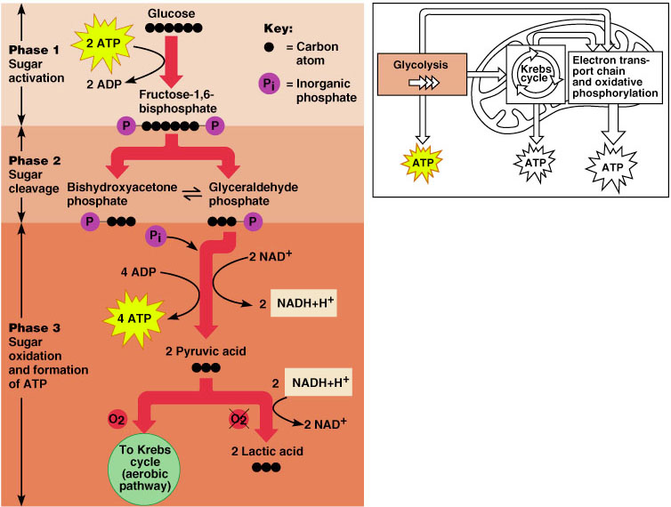
Glycolysis

Slide 18
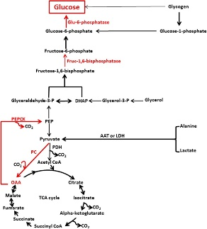
Gluconeogenesis
Major enzymes and substrates involved in the regulation of gluconeogenesis. Red arrows and text represent the major enzymes and pathways involved in the regulation of gluconeogenesis. Direct glucose release from glycogen via the debranching enzyme accounts for <10% of the total glucose made via gluconeogenesis.
AAT, alanine aminotransferase;
fruc-1,6-bisphosphatase, fructose-1,6-bisphosphatase;
glu-6-phosphatase, glucose-6-phosphatase;
glyceraldehyde-3-P, glyceraldehyde-3-phosphate;
glycerol-3-P, glycerol-3-phosphate; LDH, lactate dehydrogenase;
OAA, oxaloacetate;
PC, pyruvate carboxylase;
PDH, pyruvate dehydrogenase phosphoenolpyruvate carboxykinase (PEPCK)

Slide 19
RELATIONS TO GLUCOCORTICOIDS
THIRD
VENTRICLE
PVN/LHA
OREXIN
ARC
NPY
CRH
AgRP
NPY/AgRP
α-MSH
POMC
CRH
ACTH
LEPTIN
CORTISOL
ADIPOSE TISSUE
ADRENAL GLAND

Slide 20
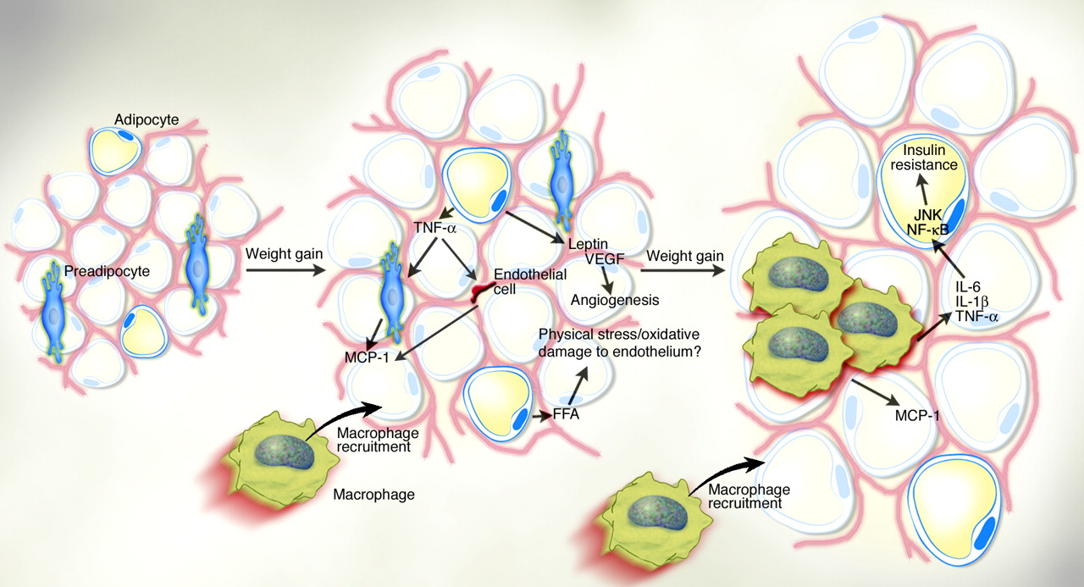
Obesity is associated with local inflammatory response in FAT
Notes:
Obesity is accompanied by local subclinical inflammatory response in adipose tissue that probably contributes to insulin resistance and the development of metabolic sysndrome

Slide 21
Vitamins soluble in lipids
Vitamins A, D and K directly modify state of the bone.
Their levels are dependent on composition of food (sufficient amount of fat is necessary for their absorption)
State of the bone is related fo functional state of insulin and leptin (insulin and leptin sensitivity and rezistance)

Slide 22
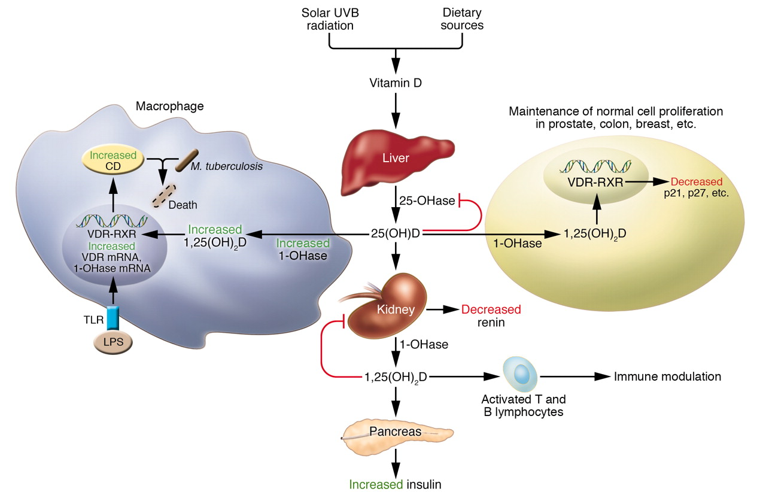

Holick, M. F. J. Clin. Invest. 2006;116:2062-2072
Copyright ©2006 American Society for Clinical Investigation

Slide 23
Regulation of gene expresssion by VDR

Slide 24
Vitamin K and bones
Vitamin K₂ is substantial cofactor for γ-carboxylase, enzyme which catalyses conversion of specific residuals of glutamic acid to Gla residuals
Vitamin K₂ is necessary for γ-carboxylation of proteins of bone matrix which contain Gla as MGP (= matrix Gla protein) a osteokalcin.
Uncompleted γ-carboxylation of osteocalcin and MGP during vitamin K decrease lead to osteoporosis and high risk of fractures. Vitamin K₂ stimulates synthesis of osteoblastic markers and bone deposition.
Vitamin K₂ decreases bone reabsorbtion by inhibition of osteclasts formation and by decrease of their resorbtion activity.
Vitamin K₂ treatment induces osteoclast apoptosis, but inhibits osteoblasts apoptosis which is leading to increased bone formation.
Vitamin K₂ supports osteocalcin expression ( increases its mRNA) which can be further modulated by 1, 25-(OH)₂ vitamin D_{3.}

Slide 25
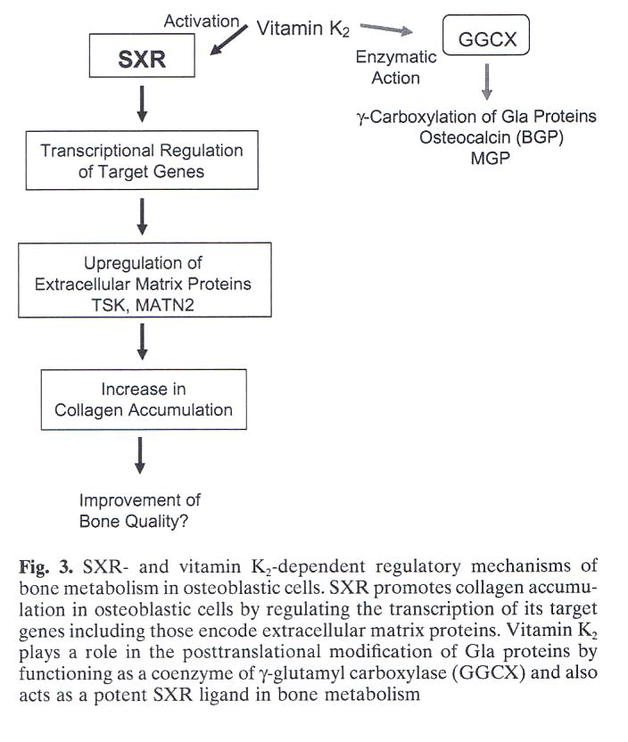
Vitamin K₂ is transcription regulator od specific bone genes, functioning using SXR which will lead to increase of osteoblastic markers expression.
SXR originally identifies as xenobiotic sensor…

Slide 26
Osteoporosis
is a skeletal disease characterised by low bone mass and microarchitectural deterioration with a resulting increase in bone fragility and hence susceptibility to fracture.
It is an important public health issue because of the potentially devastating results and high cumulative rate of fractures; in white populations, about 50% of women and 20% of men older than 50 years will have a fragility fracture in their remaining lifetime.

Slide 27
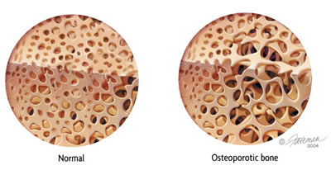
Osteoporosis

Slide 28
Osteoporosis
Oestrogen has a central role in normal physiological remodelling, and oestrogen deficiency after the menopause results in a remodelling imbalance with a substantial increase in bone turnover.
This imbalance leads to a progressive loss of trabecular bone, partly because of increased osteoclastogenesis.
Enhanced formation of functional osteoclasts seems to be the result of increased elaboration of osteoclastogenic proinflammatory cytokines such as interleukin-1 and tumour necrosis factor, which are negatively regulated by oestrogen.
A direct effect of oestrogen in accelerating osteoclast apoptosis has also been attributed to increased production of transforming growth factor β.

Slide 29
Osteoporosis - causes
Glucocorticoids excess
Estrogene deficiency
Vitamin K2 deficiency?

Slide 30
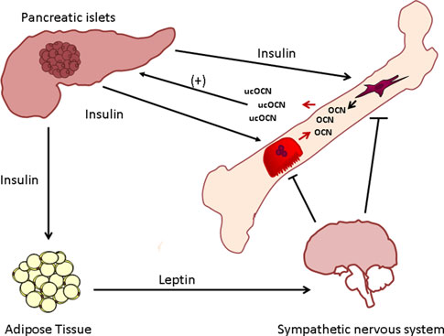
Cortisol generally antagonizes insulin …

Slide 31
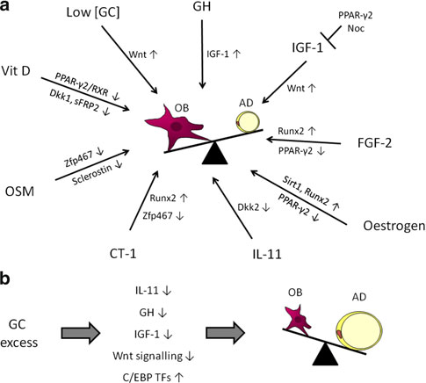
Equilibrium between osteoblastogenesis (OB) and adipogenesis
(AD)
Several endogenic factors support osteoblastogenesis against adipogenesis.
High levels of cortisol prefer adipogenesis to osteoblastogenesis
Low [GC] low (physiological) concentrations of glucocorticoids, GH- growth hormone, IGF-1 insulin-like
growth factor-1, FGF-2 fibroblast growth factor-2, IL-11 interleukin-
11, CT-1 cardiotrophin-1, OSM oncostatin M, OB osteoblast, AD-adipocyte

Slide 32
Common adverse effects of glucocorticoid therapy
There is substantial and accelerated decreases in bone mineral density (BMD) with oral glucocorticoid therapy, most pronounced in the first year, with trabecular bone more quickly affected than cortical bone.
Even after only 2 months of high-dose glucocorticoids, studies show markedly decreased BMD at the lumbar spine, femoral neck and whole body, with the greatest loss in the trabecular lumbar vertebrae.
In light of the high incidence of glucocorticoid-induced osteoporosis and associated fractures, screening and treatment rates for glucocorticoid-induced osteoporosis has come under substantial scrutiny.
Less than 50% of patients receiving long-term glucocorticoids have been evaluated for osteoporosis, and less than 25% have been treated. There is great variability among clinicians in both the awareness of glucocorticoid-induced osteoporosis and the importance of prevention and treatment as the standard of care.
The use of antiosteoporotic medication was observed to be most common among postmenopausal women, where it approached 50%.

Slide 33
Common adverse effects of glucocorticoid therapy- glucocorticoid-induced osteoporosis
Glucocorticoid-induced osteoporosis is the most common type of iatrogenic osteoporosis and a frequent cause of secondary osteoporosis.
An estimated 50% of patients taking glucocorticoids for longer than 6 months will develop secondary osteoporosis .
The absolute risk for glucocorticoid-induced osteoporosis is higher in patients aged 65 years or older given their baseline age-related fracture risk, although the relative risk of fracture related to glucocorticoid use may be even higher in patients under 65 .

Slide 34
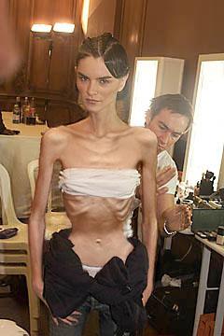

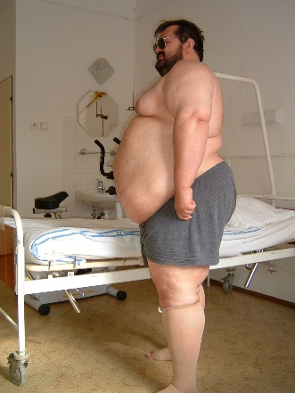
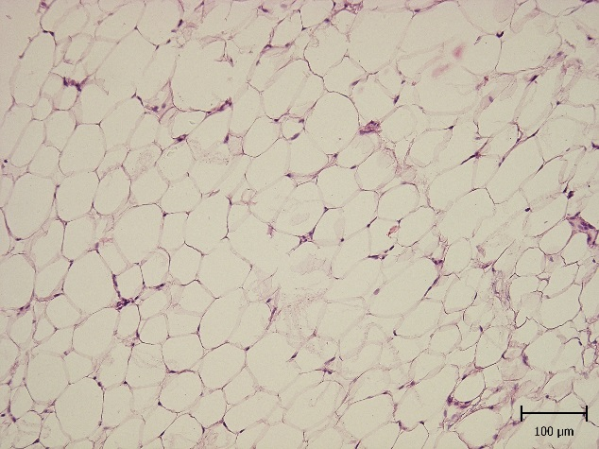
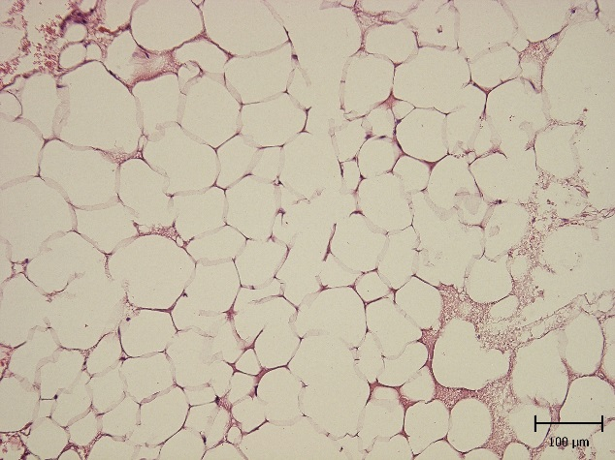
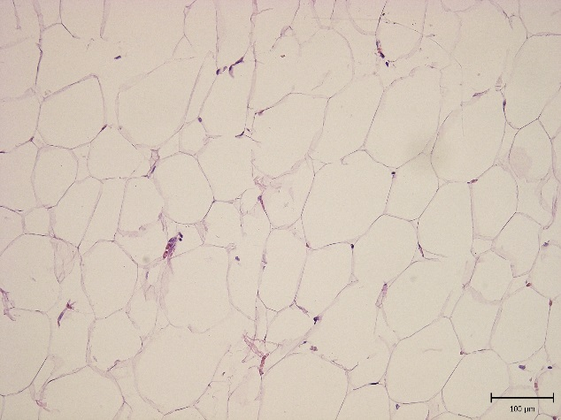
Size and endocrine profil of adipocytes is correlated with the whole adiposity
Malnutrition
(Anorexia nervosa)
Normal state (slight overweight))
Obesity
Notes:
The number of adipocytes remains widely stable during the life of the subject (there are some exceptions – morbidly obese???), whereas the size of adipocytes is widely variable. The size of adipocyte is probably the key to endocrine function of adipose tissue and its abnormalities. The second one is the infiltration of adipose tissue by immunocompetent cells which produce inflammatory factors.

Slide 35
Diagnostic criteria of obesity (BMI)
Weight (kg)
Height (m²)
BMI =
Classification BMI (kg/m²) metabolic rate
Normal body weight 18.5−24.9 average
Overweight 25−29.9 increased
Obesity I 30.0−34.9 middle
Obesity II 35.0−39.9 high
Obesity III ≥40.0 very high
WHO, 1998
Notes:
3
Xenical Slide Kit August 1998 Section 1
3
How we can classify that somebody is obese?
The most simple is to get its weight and height and calculate so called body mass index. Its value more than 30 means obesity and less than 18 is one of the diagnostic criterium for anorexia nervosa. Of course the other classification is to measure percent body fat by anthropometry, bioimpedancy etc., but it is more complicated.

Slide 36
waist size seems to be the best indicator of visceral obesity
Women
Men
cm
>88 cm = highly increase risk¹
>80 cm = higher risk¹
>102 cm = highly increased risk¹
>94 cm = higher risk¹
¹Lean MEJ, et al. Lancet;1998:351:853–6
Notes:
5
Xenical Slide Kit August 1998 Section 1
5
Waist circumference is a very useful indicator of visceral fat amount, this type of fat triggers the obesity-associated complications such as insulin resistance. We will be talking about this in detail in the next lecture

Slide 37
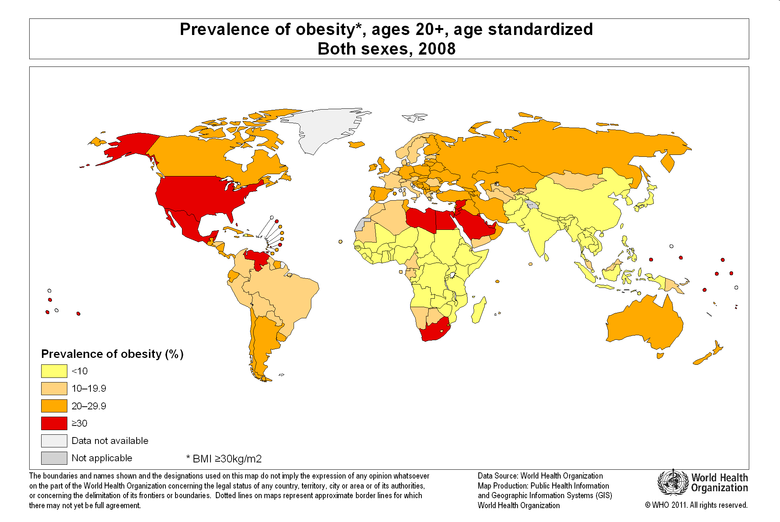
STANDARDISED PREVALENCE OF OBESITY 2008

Slide 38
OBESITY
Has obesity genetic background?

Slide 39
GENETICS OF OBESITY
Argumenst why yes:
  Family aggregation
  Twin studies (higher concordance of obesity incidence in MZ compared to DZ twins)
  Large family studies
HERITABILITy of OBESITY
Family studies 30-50%
Adoption studies 10-30%
Twin studies 50-90%

Slide 40
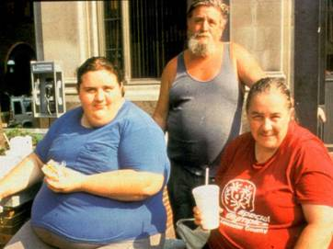
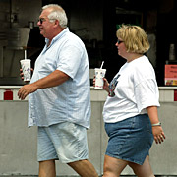
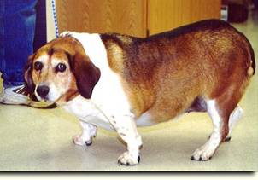
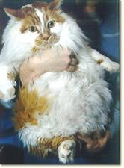

GENETICS OF OBESITY – ARGUMENTS WHY NOT
IS OBESITY DONE BY
CULTURAL EATING HABITS?

Slide 41

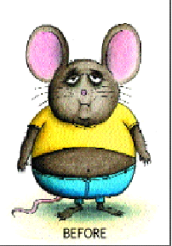
CLASSIFICATION OF OBESITY SYNDROMES
pleiotropic syndromes with obesity
„monogenic“ syndromes with obesity
polygenic (complex) syndromes

Slide 42
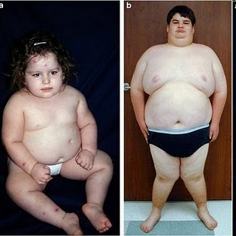
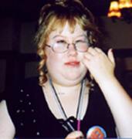
PLEIOTROPIC SYNDROMES WITH OBESITY
About 30 syndromes, in which obesity represents constant component

Slide 43
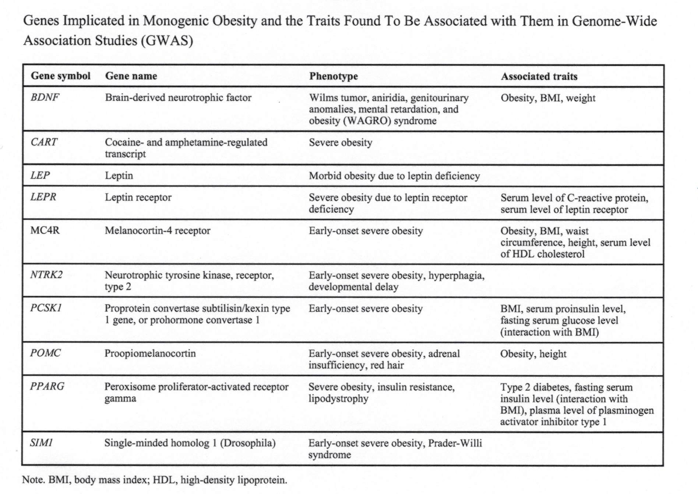
MONOGENIC SYNDROMES WITH OBESITY
N C Med J. 2013; 74(6):530-533

Slide 44
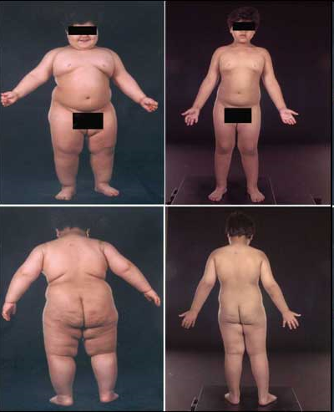
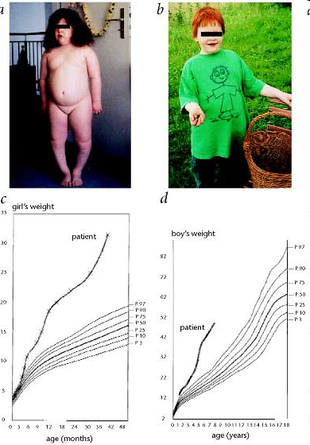
MONOGENIC OBESITY SYNDROMES
Congenital leptin defficiency
before and
after treatment
POMC mutation
(cave hair)
Prof.Stephen O'Rahilly, MD and I. Sadaf Farooqi, MD
Heiko Krude, Heike Biebermann, Werner Luck,
Rüdiger Horn, Georg Brabant & Annette Grüters

Slide 45
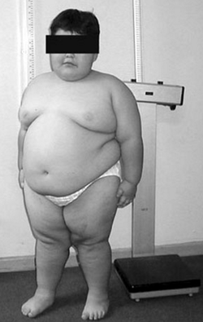
Sy Prader- Willi as a clinical example
Hypotonic children, mental retardation, small figure, behavioral complacations (hyperphagy as a result of incontrolled appetite – one of the most common causes of children obesity)
Loss of expression of paternally imprinted genes at15q11.2-q13 chromosome as a result of microdeletion in the region.

Slide 46
OBESITY AS A COMMON (COMPLEX) DISEASE
Susceptibility genes
QTL
(quantitative trait locus)
Genome wide scans
Metaanalysis of candidate
genes identified by
different methods
Association studies focused on
susceptibility (candidates)
genes for obesity

Slide 47
Future
BMC Med. 2017; 15: 50.
Published online 2017 Mar 7. doi: 10.1186/s12916-017-0800-1
PMCID: PMC5340003
Developmental pathways to adiposity begin before birth and are influenced by genotype, prenatal environment and epigenome
Xinyi Lin,^{#1} Ives Yubin Lim,^{#1,2} Yonghui Wu,¹ Ai Ling Teh,¹ Li Chen,¹ Izzuddin M. Aris,¹ Shu E. Soh,^{1,3} Mya Thway Tint,^{2,3} Julia L. MacIsaac,⁴ Alexander M. Morin,⁴ Fabian Yap,⁵ Kok Hian Tan,⁵ Seang Mei Saw,^{6,7,8} Michael S. Kobor,⁴ Michael J. Meaney,^{1,9} Keith M. Godfrey,¹⁰ Yap Seng Chong,^{1,2} Joanna D. Holbrook,¹ Yung Seng Lee,^{1,3,11} Peter D. Gluckman,^{1,12} Neerja Karnani,^{1,13} and on behalf of the GUSTO study group

Slide 48
Obesity as a complex disease
Genetic, epigenetic and prenatal environmental factors are linked to offspring size and adiposity at birth and in early childhood.
Individual prenatal environmental influences on birth weight was identified; some of these prenatal environment variables [maternal ppBMI, GWG („Gestational Weight Gain“) and glucose levels] continued to associate with offspring size and adiposity in early childhood.

Slide 49
Obesity as a complex disease
Genetic variation, as captured by PRS („Polygenic Risk Score“) , not only influenced birth weight, but also child size and adiposity up to 48 months of age, independent of birth weight.
The PRS was constructed using adiposity-linked genetic risk variants previously reported in an adult population. The association of adult adiposity risk score with size and adiposity in pediatric population indicates that the effects of genetic risk variants can be detected as early as birth.

Slide 50
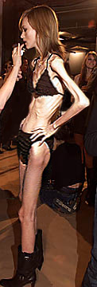
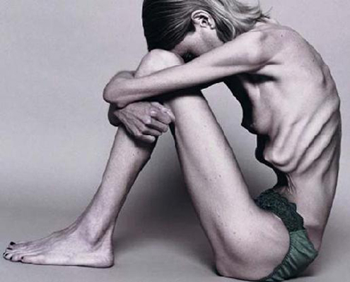

Anorexia nervosa (AN) and bulimia nervosa (BN)
are complex psychiatric disorders of great importance for public health policies, as they are associated with a high burden of morbidity and mortality due to their severe medical and psychological consequences. Etiopathogenesis of these eating disorders (EDs) continues to remain elusive, with the result that their treatment is often unsuccessful.
AN is a severe psychiatric disorder leading to life-threatening weight and fat loss. This illness could be characterized by irrational fear of becoming fat, abnormal eating behavior, hyperactivity, GIT complications and wide variety alterations of hormonal and metabolic systems.
The exact etiopathogenesis is unknown and the way of treatment remain limited.

Slide 51
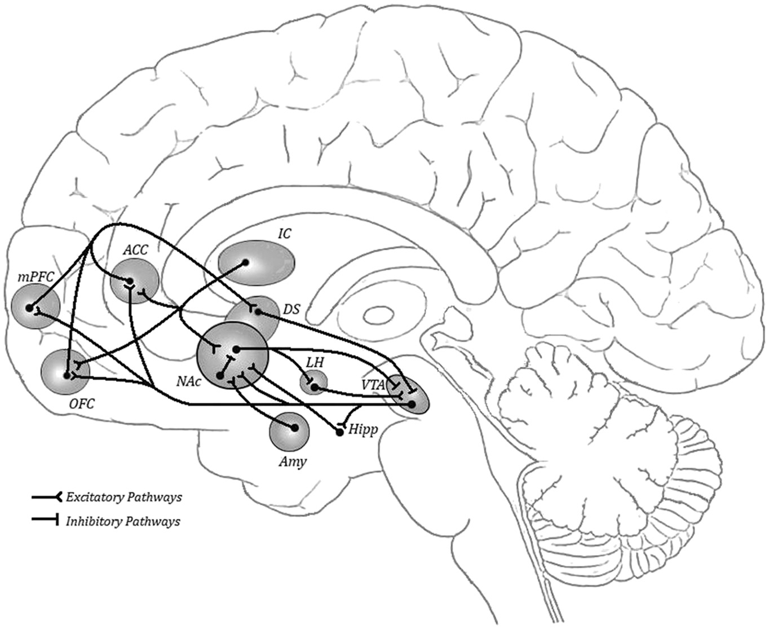
The brain reward system integrates basic and emotional stimuli, such as hunger, satiety, desire, pleasure and fear, with higher order cognitive processes aimed at modulating further actions or representation of the general experience. These high order processes involve anterior cingulate cortex (ACC), orbitofrontal cortex (OFC) and ventromedial prefrontal cortex (PFC), which are necessary for identification of rewarding stimuli, inhibition of emotional responses, and promote behavioral outcomes (Haber and Knutson, 2010; Wittman et al., 2010 ; Sripada et al., 2011). Overall, the PFC provides inhibitory influences on motivation and reward-directed behavior, integrating sensory inputs, memories, goals, and physiological states with the aim to provide an adequate performance (Miller and Cohen, 2001). ACC and dorsolateral prefrontal cortex (DLPFC) may also serve to monitor potential conflict situations induced by reward stimuli (Walton et al., 2003 ; Vogt et al., 2005). Therefore, they have a gating role in action selection following reward cues ( Goldstein and Volkow, 2011). Indeed, by a top-down effect, both OFC and ACC provide a negative feedback to mesolimbic areas regulating reward-seeking motivation (Goldstein and Volkow, 2011).
Schematic representation of brain reward circuits.
ACC anterior cingulated cortex; Amy amygdala; DS dorsal striatum; Hipp hippocampus; IC insular cortex; LH lateral hypothalamus; mPFC medial prefrontal cortex; NAc nucleus accumbens; OFC orbitofrontal cortex; VTA ventral tegmental area.

Slide 52
Anorexia nervosa (AN) and bulimia nervosa (BN)
Functional magnetic resonance imaging (fMRI) techniques have been employed to investigate the brain's processing of reward elicited by both food-related and non-food-related stimuli in AN and BN (O'Hara et al., 2015).
It has been shown that, compared to healthy controls, AN patients exhibit abnormal activation of different brain areas, including the parietal, the orbito-frontal, the dorso-lateral prefrontal, the anterior cingulate and the medial prefrontal cortex (Frank, 2015a ; Frank, 2015b) after exposure to visual food cues, especially for highly palatable foods.
Similarly, altered insula, striatum or orbitofrontal responses to sweet stimuli have been found in recovered or symptomatic AN and BN patients.
These findings suggest a dysregulation of brain mechanisms involved in the processing of food-related rewarding stimuli in the pathophysiology of EDs.

Slide 53
Pathophysiology of AN
An integral pathophysiological scenario that fits to the natural history of AN with the following steps an be porposed:
(1) enhanced vulnerability to stress (genetic, epigenetic, or environmental factors);
(2) major stressing events activating the stress-axis, increased intestinal permeability, and increased virulence of the microbiota;
(3) bacterial proteins (e.g., ClpB) challenge the immune response and due to molecular mimicry, cause increased production of Igs cross-reactive with neuropeptides (e.g., α-MSH);
(4) this results in altered food intake, anxiety, gastrointestinal discomfort and other consequences of altered central and peripheral melanocortin signaling;
(5) global malnutrition and some specific macro- and micro-nutrient deficiencies contribute to the perpetuation of gut barrier and immune dysfunction as well as behavioral symptoms.
Front Neurosci. 2016; 10: 256

Slide 54
Orexigenic neuropeptides
Orexigenic neuropeptides including ghrelin, orexins and 26RFa are up-regulated in AN and it is thought that this orexigenic profile reflects an adaptive mechanism of the organism to promote food intake and thus to counteract undernutrition. However, this adaptive mechanism is ineffective in increasing food consumption leading to the concept of a global resistance of AN patients to orexigenic signals.
We can speculate that a chronic increase of the activity of LHA orexigenic neurons expressing orexins, MCH, or 26RFa could reinforce dopamine-induced anxiety in the reward system of AN patients and thus the aversion to ingest food.
Front Neurosci. 2016; 10: 256

Slide 55
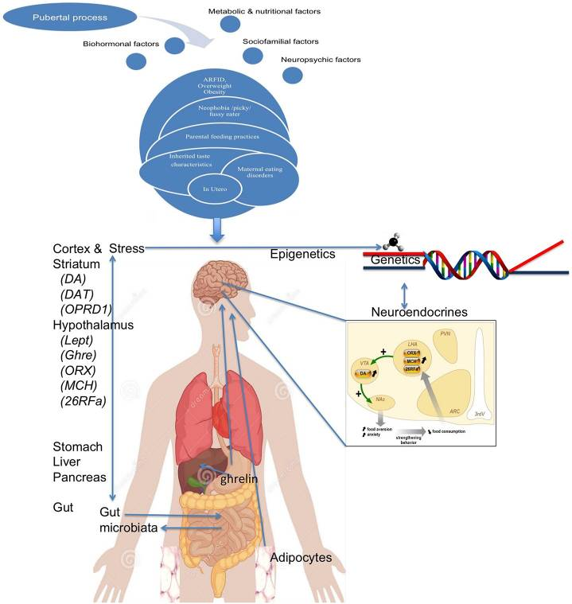
Front Neurosci. 2016; 10: 256

Slide 56
Loss od adipose tissue is supposed to be the main factor contributing to the body weight loss
 | Normal Weight (n = 50) | AN (n = 30)
Weight (kg) | 62.2 ± 1.54 | 45.8 ± 1.89*
Lean mass (kg) | 39.1 ± 0.76 | 37.8 ± 1.01
BMI (kg/m²) | 21.2 ± 0.42 | 15.7 ± 0.47*
Body fat content (%) | 24.3 ± 0.79 | 7.1 ± 0.88*
Total fat skinfold (mm) | 120.5 ± 12.17 | 42.1 ± 4.78*
Abdominal skinfold (mm) | 12.5 ± 2.13 | 4.8 ± 1.59*
Insulin (pmol/l) | 28.3 ± 4.53 | 14.2 ± 3.67*
Glucose (mmol/l) | 4.7 ± 0.08 | 4.1 ± 0.11
Menstruation | Yes - regular cycle | Secondary amenorrhea
Means ± SEM
Notes:
the loss of adipose tissue and the dysfunction of its function might be critical for endcorine and metabolic complications and weight relapses of AN patients.

Slide 57
GENETIC ASSOCIATIONS???
AN is 11x more frequent in relatives of probands compared to physiological population.
BN is 4-5x more frequent in relative women.
~15% risk of eating disorders in relatives of AN and BN vs. 4% risk in healthy population.
Strober et al. Am J Psychiatry 2000; 157:393

Slide 58
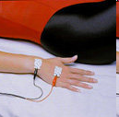
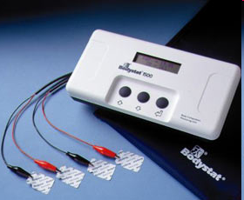
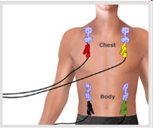
BODYSTAT

Slide 59

Děkuji vám za pozornost

