Slide 1
Obturter and post-resection replacement
MUDr.Bartáková Sonia, Ph.D
Stomatologická klinika LF MU, Brno
2020

Slide 2
Obturter
Prosthetic replacement removable or fixed that closes - wraps perforation mostly on a hard floor into the nasal cavity, or into Anthrum Highmori after removal of the tumor in the oral dutine
We make a obturter anchored with the aid of all the anchor elements that exist, even with the aid of implants, or we merely make a total replacement that is anchored by a protrusion into the hole to the hard floor.

Slide 3
Post-resection replacement
Is a replacement that closes the defect in the lower jaw after resection of part of the mandibula due to tumor or injury.
We make a post-resection replacement anchored with the aid of all the anchor elements that exist, even with the aid of implants, or we merely make a total replacement that is lightened at the soft tissue site only and must not touch and transfer pressure at these points.

Slide 4
History and treatment plan I.O examination
Thorough examination of the patient intraorally:
monitoring of inflamed mucous membranes after
radiotherapy (if a mucosal-covered bone or not)
of fungal coatings reduced saliva content
of the mucous membrane resivity
of fluid flowing through the nose
of the sanitation
of the mouth bad fonation

Slide 5
History and treatment plan of RTG examination
Thorough examination of the patient X-rays:
Assessment of the quality of remaining teeth
Evaluation of the quality of the bone of the jaw fracture (simple, or multiple bone fractures with or without dyslogation)
Find of bone fragments,
broken alveols
broken Le Fort I, Le Fort II, Le Fort III
broken caput mandibulae
Find of broken teeth (crowns, roots, multiple fractures of teeth)
Find cysts
Find more tumour tissues
Find unknown bodies in cavities

Slide 6
History and Treatment Plan Biological Teeth Factor 1
Thorough examination of the remaining teeth:
biological factor
endo treatment
periapical cysts
root length to the clinical part of the tooth
how to apply them to the patient's life expectancy of the tooth
which pillar is involved -- one, two, multi-root tooth
how many pillars are side by side -- whether only solo or group
we assess the strength of the tooth group

Slide 7
History and Treatment Plan Biological Teeth Factor 2
Důkladné vyšetření zbylých zubů :
Na základě biologického faktoru uvažujeme o možnosti zhotovení:
Fixního můstku neseného pouze zuby
Fixního můstku neseného zuby a implantáty
Fixního můstku s attachmenty a hybridní snímatelnou náhradou
Fixního můsku se sponovými krajními korunkami a klasickou snímatelnou náhradou
Pouze snímatelnou náhradou s jednoduchými sponani pro zachování co nejdéle zbytkových zubů
Použití pouze radixů a třmenu a hybridní snímatelné náhrady

Slide 8
History and treatment plan for bone examination
Thorough bone examination:
Bone quality densities
Lower jaw
- the individual parts of the remaining bone during resection of the lower jaw must always be joined by a titanium splint and then covered with mucous
Upper jaw
- in the upper jaw we monitor the damage to the palate where it hits (only on the palate and antra Higmori small hole or large opening, or missing both the contin and soft palate whole, or missing the hard and soft palate all of the rind).

Slide 9
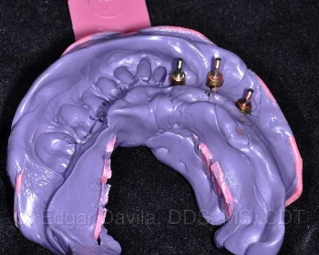
Impressions of lower reset jaw into silicone
For a fixed replacement that we will make, we take the highest quality print mass, mostly silicone into a perforated spoon as well as a hybrid replacement.
We can also print alginate on the classic removable partial and total replacement in the case of a nearby laboratory.

Slide 10
Upper jaw impressions with perforation on hard and soft palate
For a fixed replacement that we will make, we take the highest quality print mass, mostly silicone into a perforated tray as well as a hybrid replacement.
For a classic removable partial and total replacement, we can also make impression into alginate in the case of a nearby laboratory or into silicone, which is soft, otherwise there is a risk of damaging the patient -- breaking off a thin palate bone.
A perforated tray that must be specially prepared (extended as needed) or mostly lab.technique makes a perforated individual tray.
Introduce a swab into the cavity -- Antra Higmori rub slightly with vaselin
Nurse mixes hot water alginate quickly because the patient is not breathing throughout the printing process.
Disinfection is done with a routine, the swab is pasted into the print, and we remove it after impressioning.

Slide 11
Registration of interjaw relationships
Registration of interjaw relationships is done as is the case with classic partially or overall removable replacement
The emphasis is on modeling from the wax missing part of the vestibular - shaping the patient's face, filling in the missing facial defects with resin.

Slide 12
Design modelling of the construction of the prostheses
The technician emphasizes primarily the functionality of the removable replacement
For the retention of the replacement in the mouth so that the patient can eat
Foundations
Lighting several slices of wax, where the bone is not and only the mucous membrane is not supported by the bone aesthetics of the particularly frontal section and facial area

Slide 13
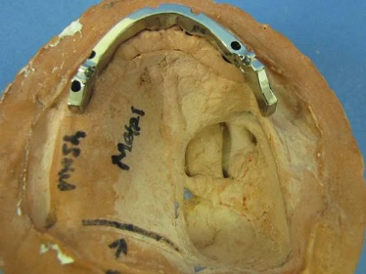
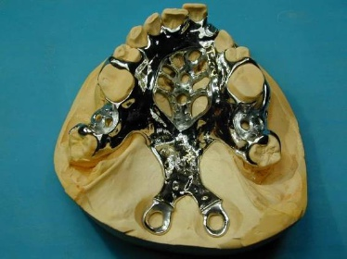
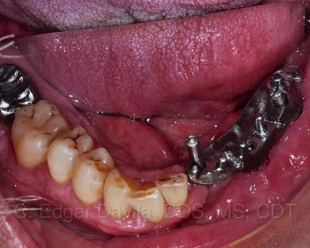
Testing of the construction of the prostheses

Slide 14
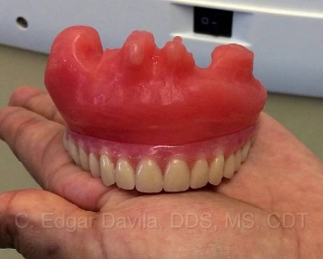
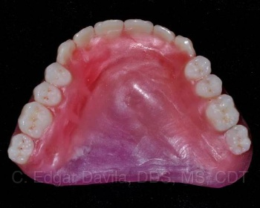
Testing of the partial denture at wax - articulation

Slide 15
Kyveting, materials
It can be used:
Hard materials:
Classically mixed methyl methacrylate
Injection methyl methacrylate
Polyamide
Soft materials:
Mollosil
Molloplast and Others

Slide 16
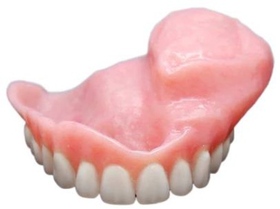
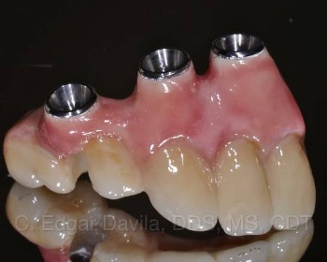
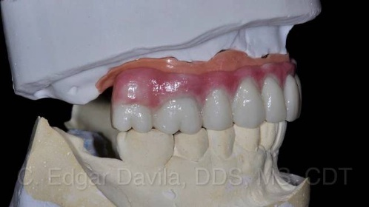
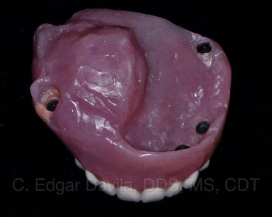
Surrendering the replacement and instructing the patient

Slide 17
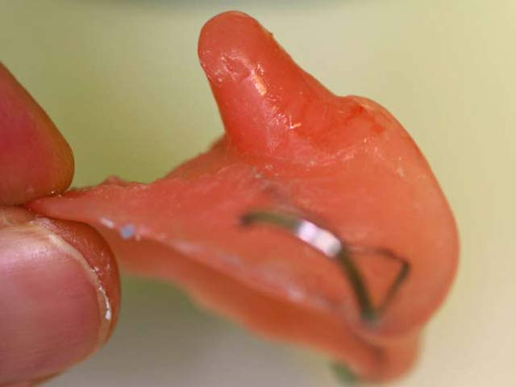
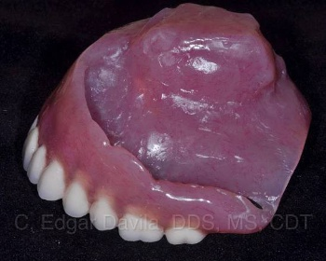
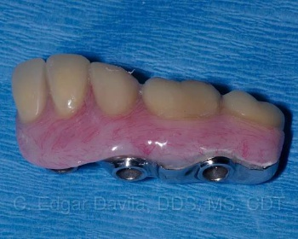

Slide 18

Thank you for your attention.

