Slide 1
Root canal shaping

Slide 2
Shaping techniques
Rotation – 45°
K – reamer
K- file

Slide 3
Shaping techniques
Rotace 45° pressure and pull motion
K – reamer
K- file
Risk of ledging
Zip, elbow effect
Via falsa

Slide 4
Shaping techniques
Filing
H- file
K – file
Risk of periapical infection infection
Risk of plug

Slide 5
Shaping techniques
Balanced force
K- flexofile
K – file (?)
90-180°
180 – 270°

Slide 6
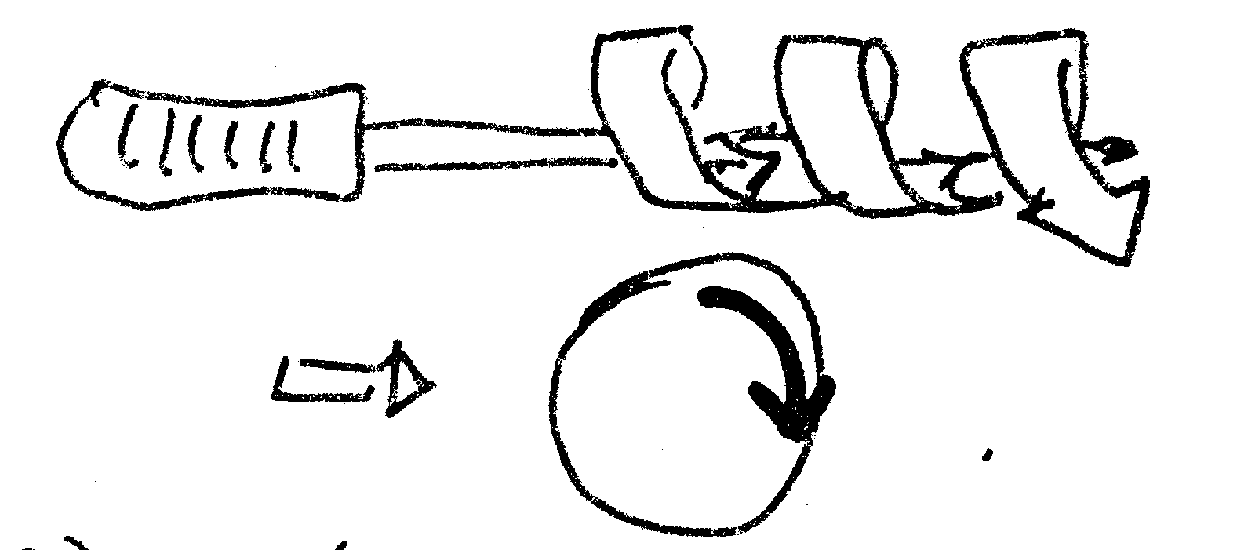
Reaming

Slide 7
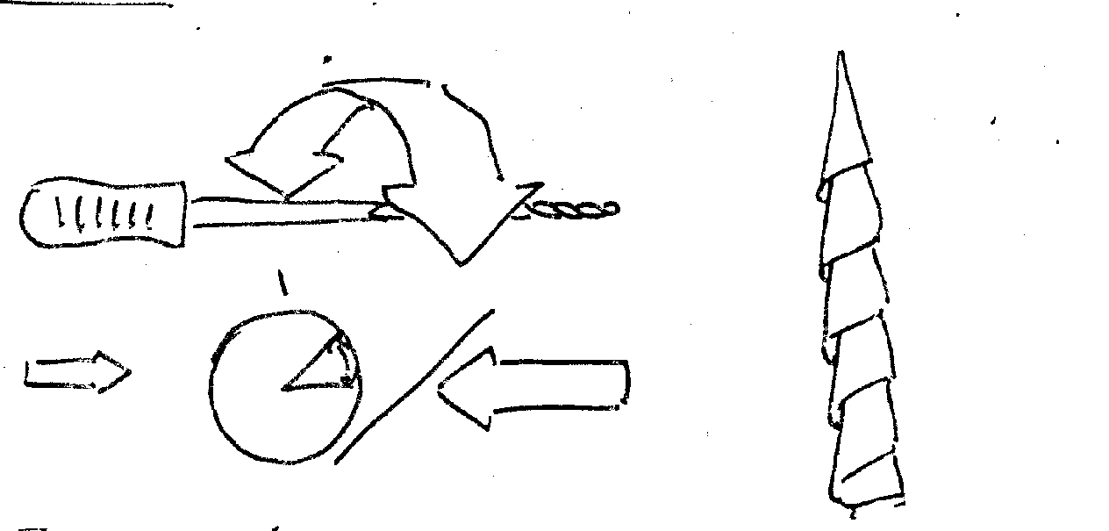
Filing

Slide 8
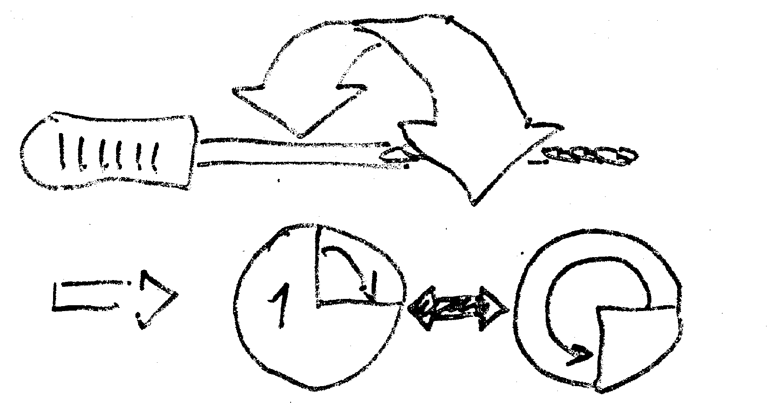
Balance forced technique

Slide 9
Methods of shaping
Rotation and filing combined
K - reamer
H- file

Slide 10
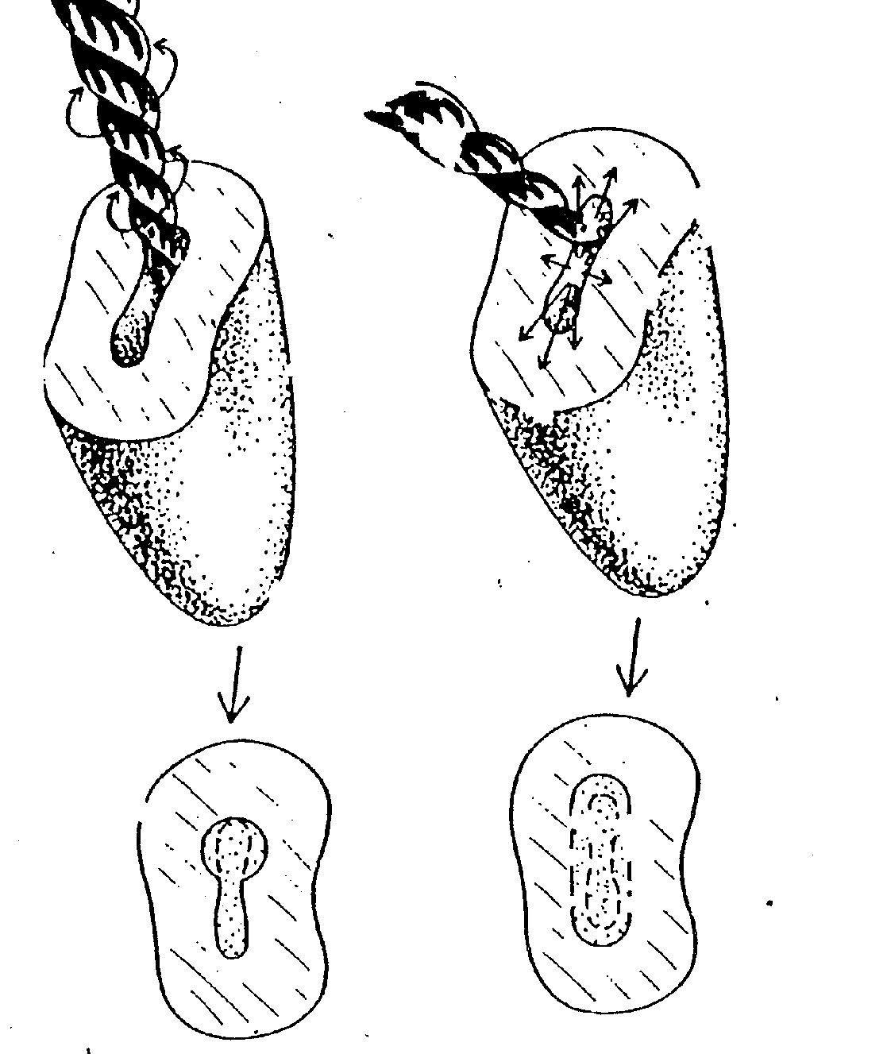
Methods of shaping
Circumferential filing
Rotation
Circumferential filing

Slide 11
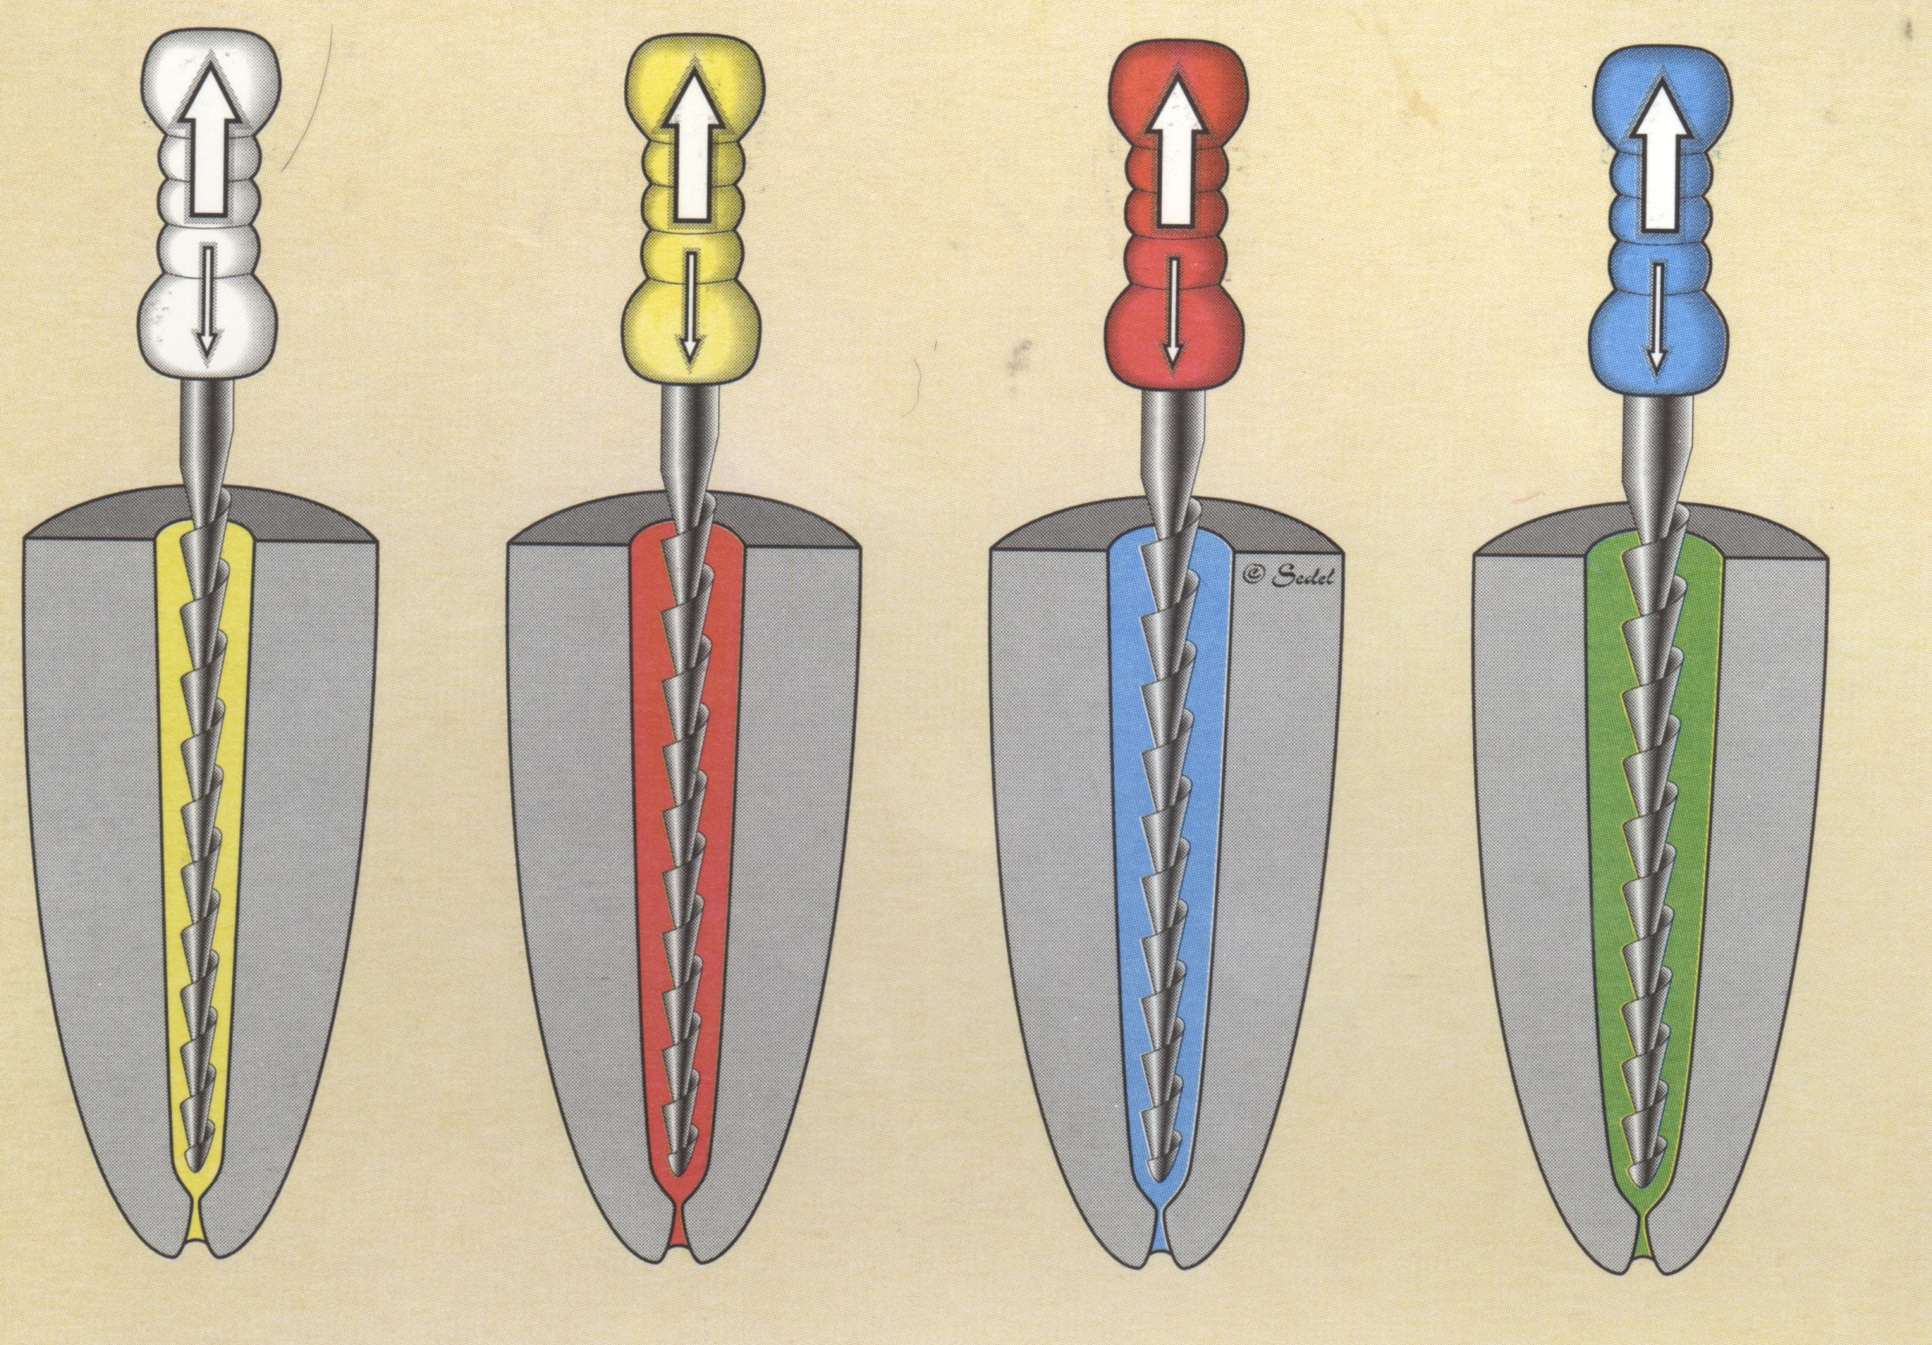
Dr. Sedlmayer

Slide 12
Methods of shaping
Combination of rotation and filing
Start with rotation
Finishing with filing
Suitable for straihgt root canals

Slide 13
Methods of shaping
Step back method
Increasing size with decreasing length.
Insertion of root canal instrument – WL
Next – 1 mm shorter
…

Slide 14
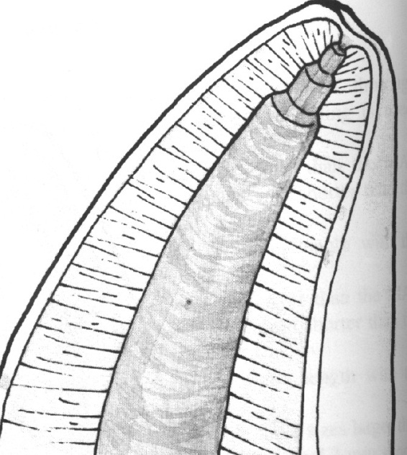
Taper
Final flaring with
the smallest instrument
H- File nebo K - Flexofile.

Slide 15
Method modified double flaerd
I. Opening of root canal
- Coronal third
II. Apical preparation
Cathetrization,measurement, shaping till ISO 30 – 35 balanced force. Master file – MAF (till WL)
III.Step back
Final flaring (MAF)

