Slide 1
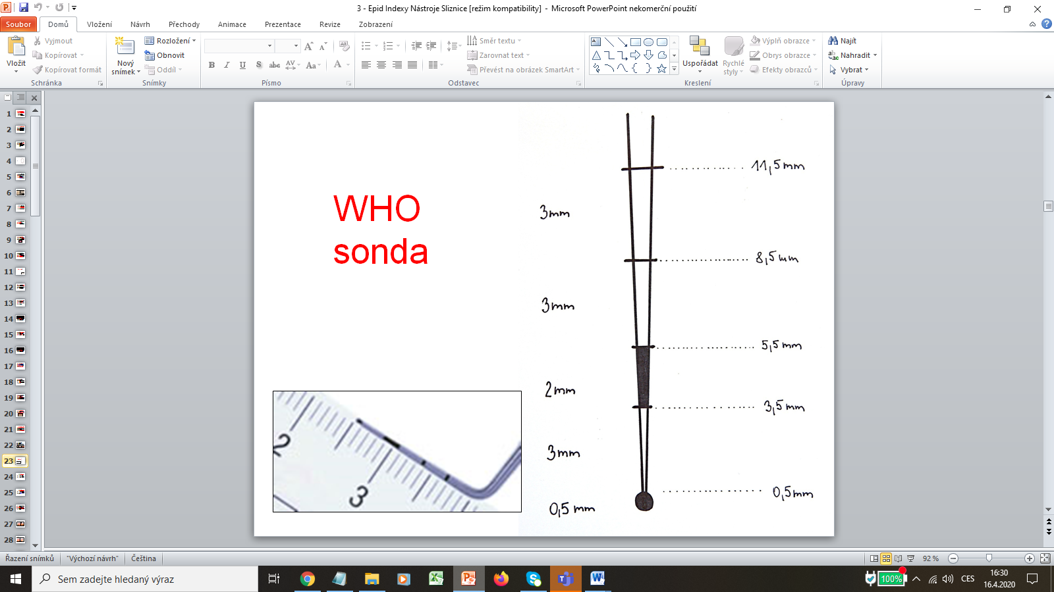
INDEXes TEST
MUDr. Hana Poskerová Ph.D.
Stomatologická klinika
FN u svaté Anny a LF MU v Brně

Slide 2
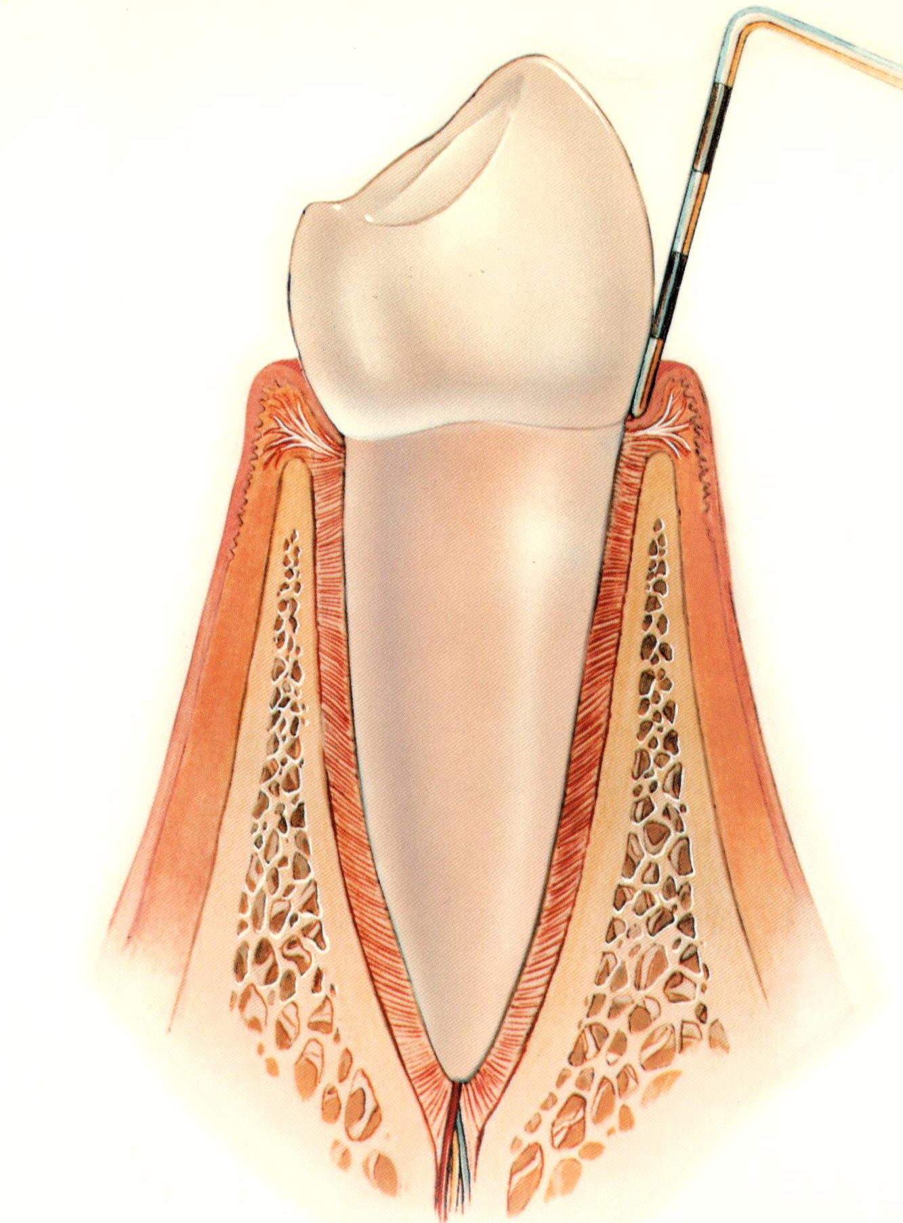
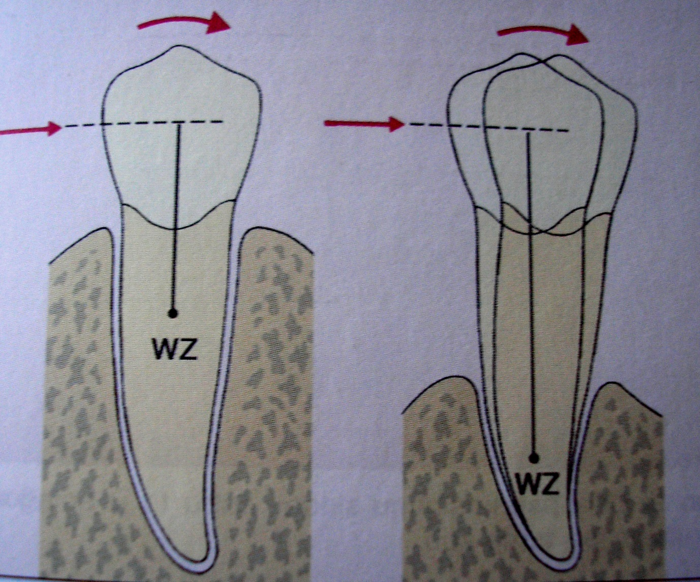
CPITN O
CPITN O

Slide 3
 | Bleeding | Calculus | Pocket probing depth (in mm) | CPITN
1 | - | - | 3 | 0
2 | - | - | 3,5 | 3
3 | - | + | 3 | 2
4 | - | + | 3,5 | 3
5 | + | + | 3 | 2
6 | + | + | 3,5 | 3
7 | - | - | 4 | 3
8 | + | + | 4 | 3
9 | + | - | 5,5 | 4
10 | - | + | 5,5 | 4
11 | - | - | 8 | 4
12 | + | + | 8 | 4

Slide 4
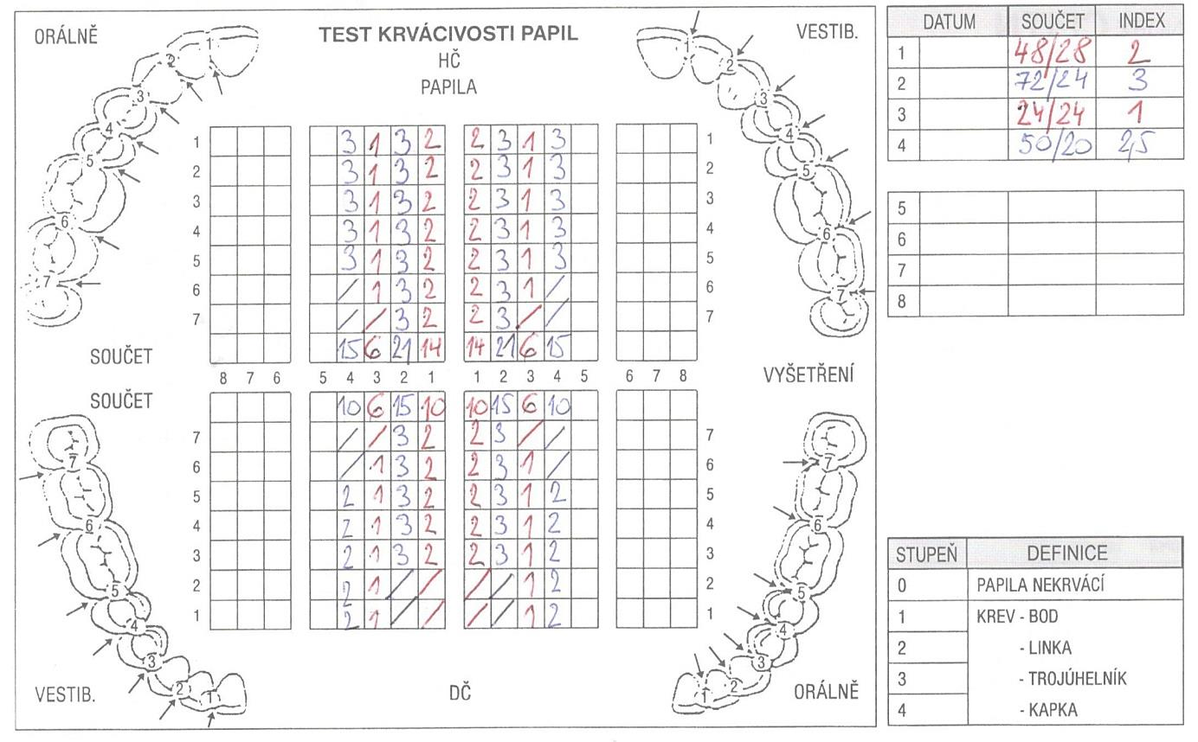

Slide 5
Determine the PBI value
Example: all distal papillas PBI 4, all teeth are present: PBI 112/28 index 4
1/ all distal papillas have PBI 2 | 3rd molares and all lower incisors are missing | 48/24 PBI 2
2/ all distal papillas have PBI 3 | all lower incisors are missing | 72/24 PBI 3
3/ all distal papillas have PBI 1 | 3rd and 2nd molares are missing | 24/24 PBI 1
4/ all upper distal papillas have PBI 3; all lower distal papillas have PBI 2 | all molares are missing | 50/20 PBI 2,5

Slide 6
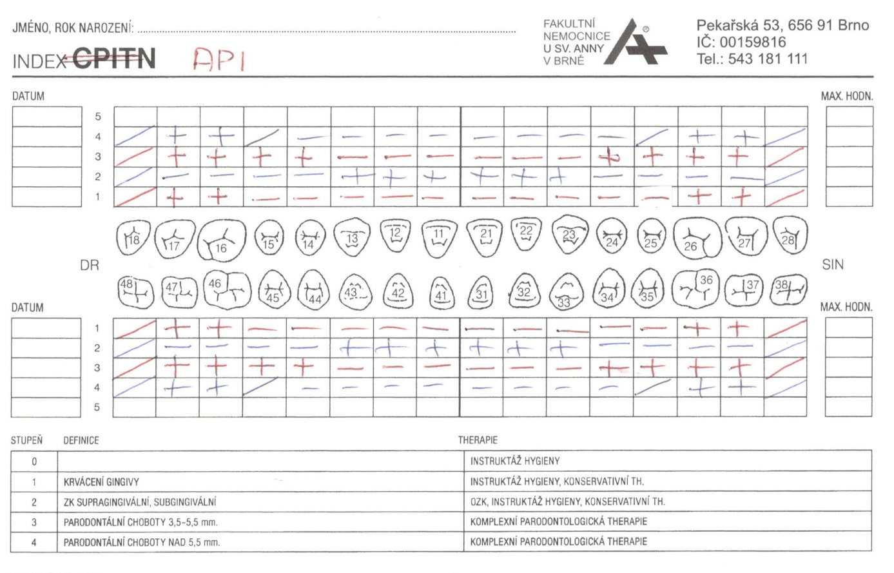

Slide 7
Determine the API value when all teeth are present API
API number of areas with plaque / number of evaluated areas × 100 (%)
1/ all aproximal areas at molars have a plaque, the others not | 8/28 API 28,5 %
2/ all distal aproximal areas at incisors and canines have a plaque, the others not | 12/28 API 42,8 %
3/ all distal aproximal areas at molars and premolars have a plaque, the others not | 16/28 API 57,1 %
4/ all distal aproximal areas at molars and premolars have a plaque, the others not. 3rd and 2nd molares and 1st premolars are missing | 8/20 API 40 %

