Slide 1
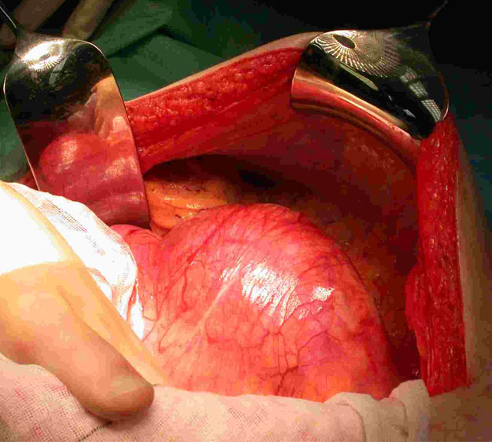
Vascular surgery
Dr.Lukáč Jakub
FN Brno –Trauma dept.

Slide 2
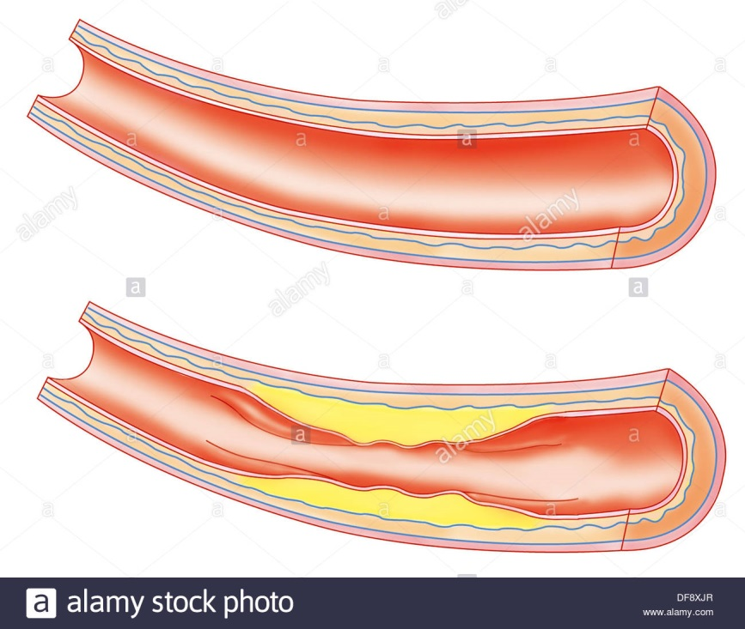
...little bit of history first
Studies on egyptian mummies revealed, that people more than 3500 yrs back suffer from atherosclerosis
Ebers Papyrus (2000 b.c.)-identified peripheral arterial aneurysms, and suggested forms of treatment , e.g. „treat it with a knife, and burn it with a fire, so it doesnt bleed so much“ LOL :D
Hippokrates (400 b.c.) – treated hemorrhoids by putting a red –hot iron in patients anus (first cautherization)
Antyllus (2 century a.d.)- invented a ligature system, in which he applied ligatures to arteries entering and leaving the aneurysm, then cutting the sac of aneurysm, and packing the cavity
Ambroise Paré (16th century) – starts using ligations, stops with boiling oil and cautherization

Slide 3
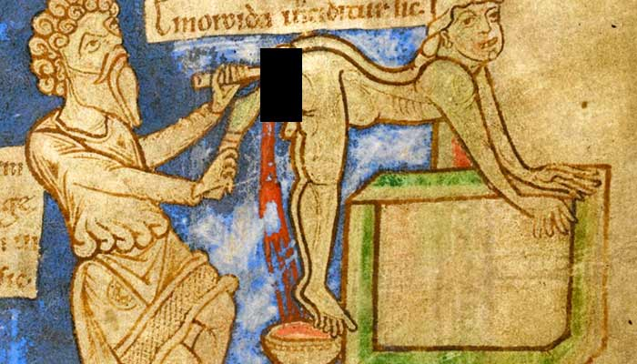
Dark ages treatment of hemorrhoids with hot iron
Please, kill me!

Slide 4
What is vascular surgery?
Vascular surgery is surgical subspecialty, which is dealing with diseases of vascular system, including lymphatic venous system.
Todays trend is to treat as much as possible conservatively, with medication, or using minimally – invasive procedures.
When need arises, open surgery of vascular reconstruction is done.
Vascular surgeon treats vascular problems,except for heart and brain vacular conditions.

Slide 5
What are the most common vascular diseases?
Abdominal aortic aneurysm
Aortic dissection
Atherosclerosis
Chronic venous insufficiency
Deep venous thrombosis
Peripheral arterial disease
Thoracic aortic aneurysm
Varicose veins
Haemorrhoids
Vascular trauma
Pulmonary embolism
Lymphedema
Carotid artery disease
and other....

Slide 6
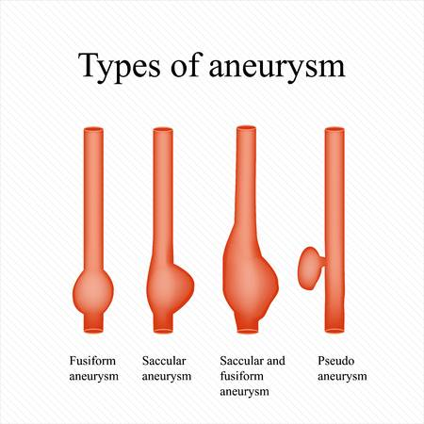
Aneurysms
Abnormal, localized weak spot on artery wall, that causes the wall to bulge outward, like a baloon.
Aneurysms may be divided due to localization, shape,
or mural structure.

Slide 7
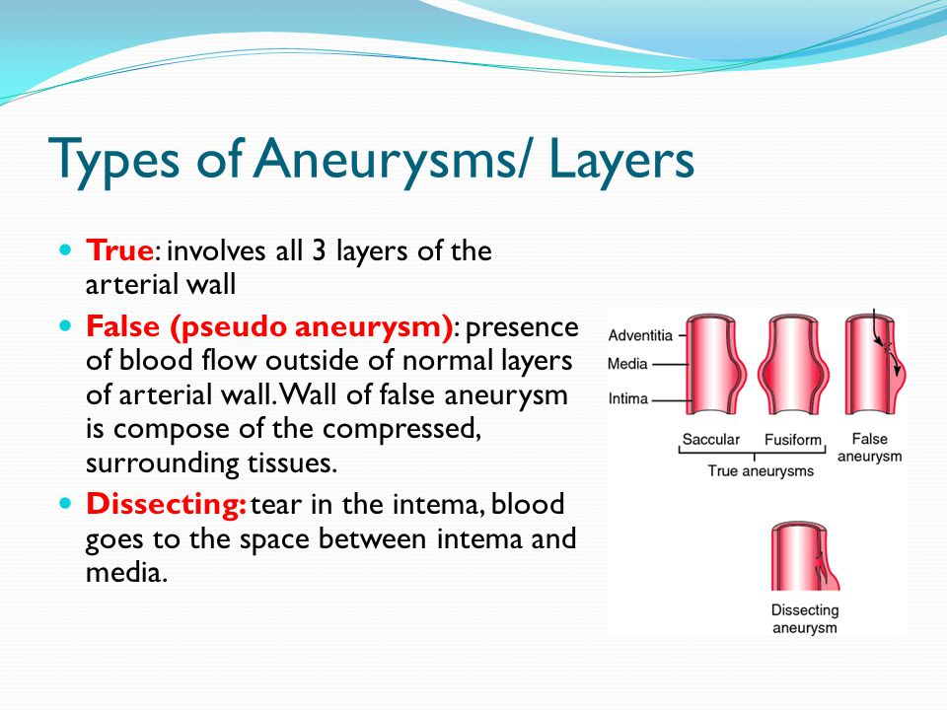

Slide 8
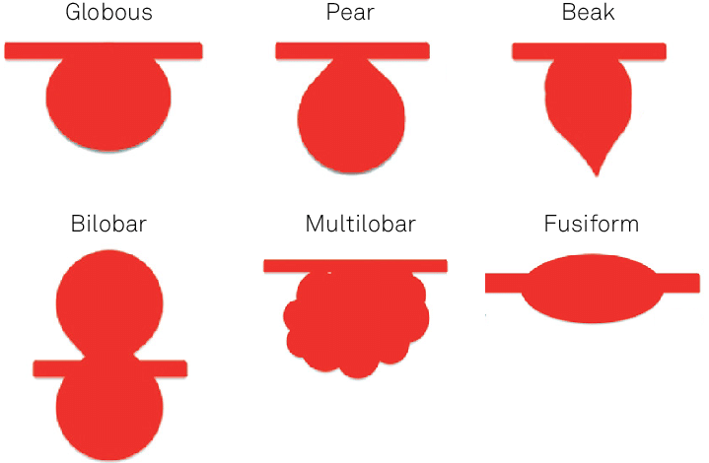
Shapes

Slide 9
Some statistics
-prevalence of AA in older than 65 yrs is 3-4 %
-prevalence in thoracic AA is 6 cases in 100 000 people
-males suffer more often than females
-in last 30.yrs, prevalence of aortic aneurysms has increased
-incidence is increased also

Slide 10
Signs and symptoms-thoracic aneurysm
-in many patients it is discovered incidentally
depending on the affected part of the aorta
Ascending thoracic aorta aneurysm:
-pain in neck, chest or back
-swelling of head, neck, extremities
-heart failure due to aortic valve regurgitation, distal embolism, rupture
Aortic arch and descending aorta aneurysm:
-wheezing,coughing, shortness of breath – trachea compression
-dysphagia, chest pain, hoarseness

Slide 11
other signs and symptoms....
Heart murmurs
Paraparesis/paraplegia
Substantial part of all aortal dilatations remains asymptomatic
Hemoptysis, hematemesis
Nausea
Constipation
Tachycardia, sweaty skin

Slide 12
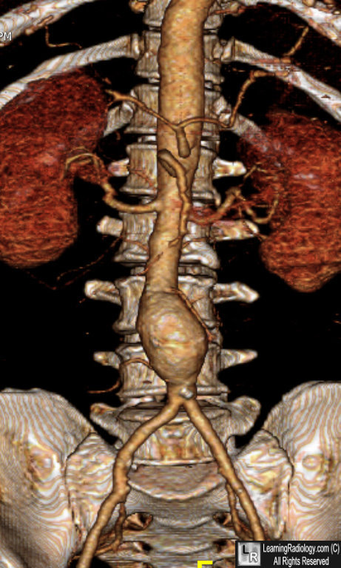
Abdominal aorta aneurysm
Enlargement of aorta below diaphragm
Dilatation over 3 cm is considered an aneurysm

Slide 13
Diagnostics
Anamnesis
Physical examination
Clinical presentation
Laboratory
ECG
Chest and abdominal Xray (according to urgency)
Ultrasound
CT scan (CT angiography)
MRI

Slide 14
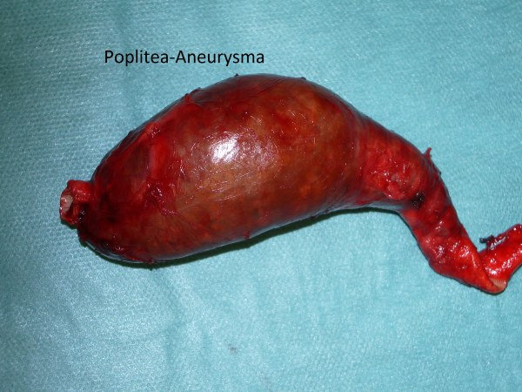
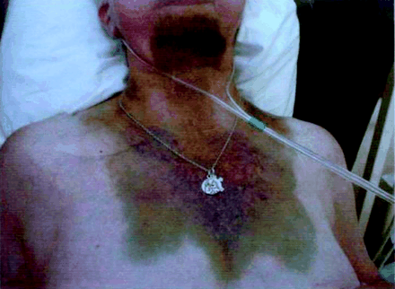
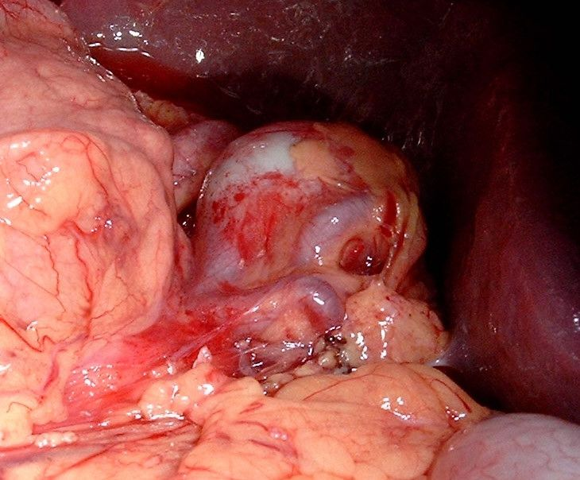
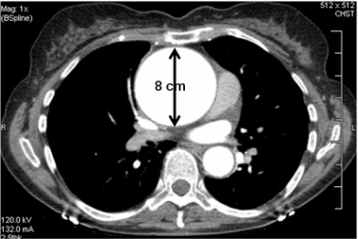

Slide 15
Conservative approach
In patients with high mortality risk
No improvement of life-expectancy
Less than 5,5 cm in diameter – observation
Growth less than 1 cm per year
Asymptomatic, „small“ aneurysms

Slide 16
Genetics
High predisposition in patients who suffer from some form of connective tissue disorder, e.g.
MARFAN SYNDROME
EHLER´S –DANLOS SYNDROME
RELAPSING POLYCHONDRITIS

Slide 17
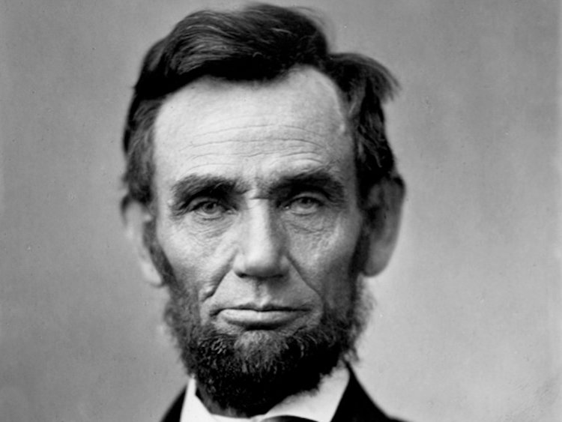
Characters of past
Marfans syndrome

Slide 18
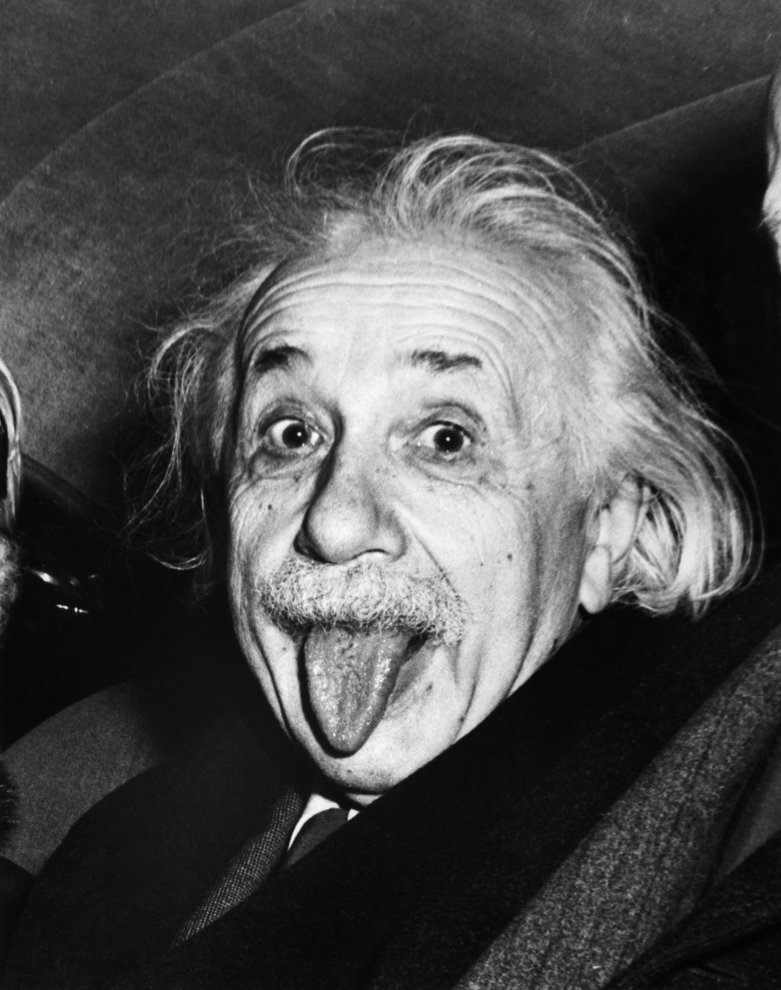
Characters of past
Diagnosed with abdominal aorta aneurysm
-treated by Nissen, who wrapped it in celophane
☺

Slide 19
Prophylaxis
STOP SMOKING!!! Damn it! –ESSENTIAL FACTOR
Control your blood pressure
Correct your diet – less fatty food
Consume less alcohol
Regular check-ups with control X ray
More movement

Slide 20
SURGERY
Open surgery – in younger patiens
- already ruptured
- symptomatic
- elective
Endovascular repair- older patients
(EVAR) - unfit for open surgery
- feasible for only some types
In general, there is no significant advantage when comparing open end EVAR technique

Slide 21
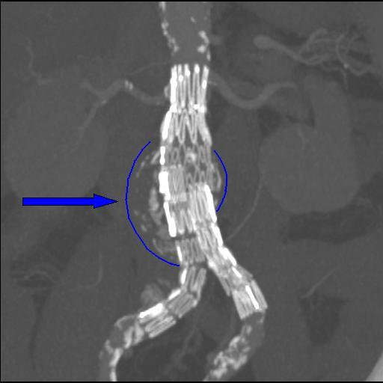

Slide 22
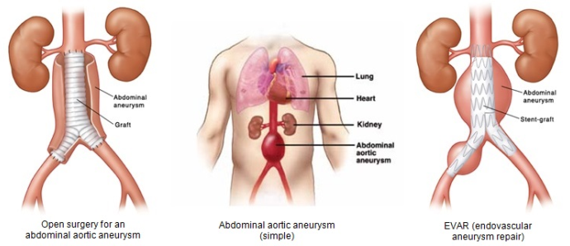

Slide 23
AORTIC DISSECTION
Injury of inner layer of aorta
Blood flows through deffect into medial layer of aortic wall, creating FALSE LUMEN
Difference :
Aortic aneurysms have TRUE LUMEN

Slide 24
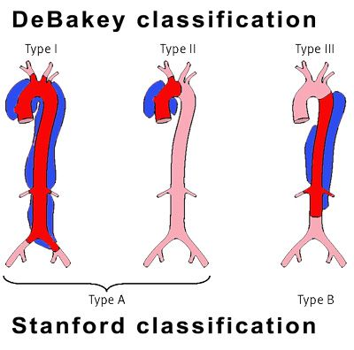
Classification

Slide 25
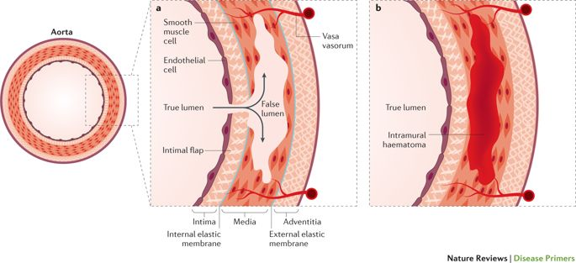

Slide 26
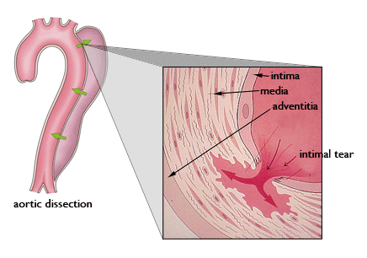

Slide 27
Causes
Atherosclerotic plaque rupture
In general similar/same as aneurysm
After trauma

Slide 28
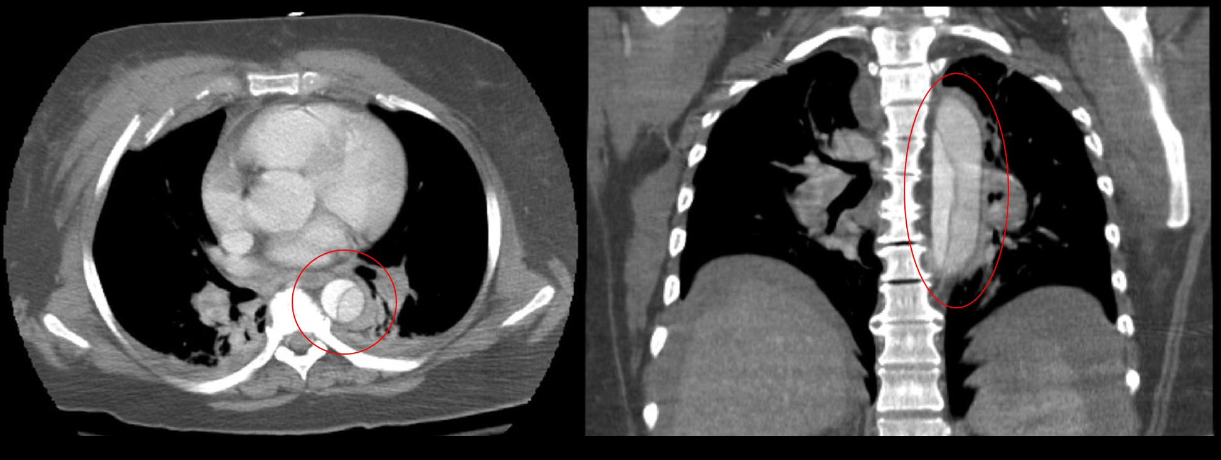
CT – crescent shape in axial plane
Identifiable layering

Slide 29
SURGERY
Especially in ascending aorta dissection – surgical approach

Slide 30
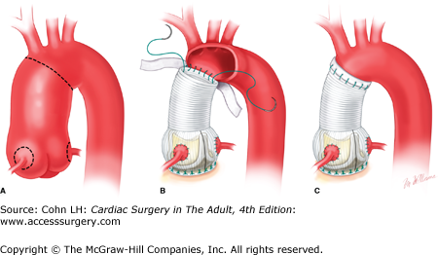
SURGERY
Bentall procedure – graft replacement of ascending aorta, aortic root, with re-implantation of coronary arteries

Slide 31
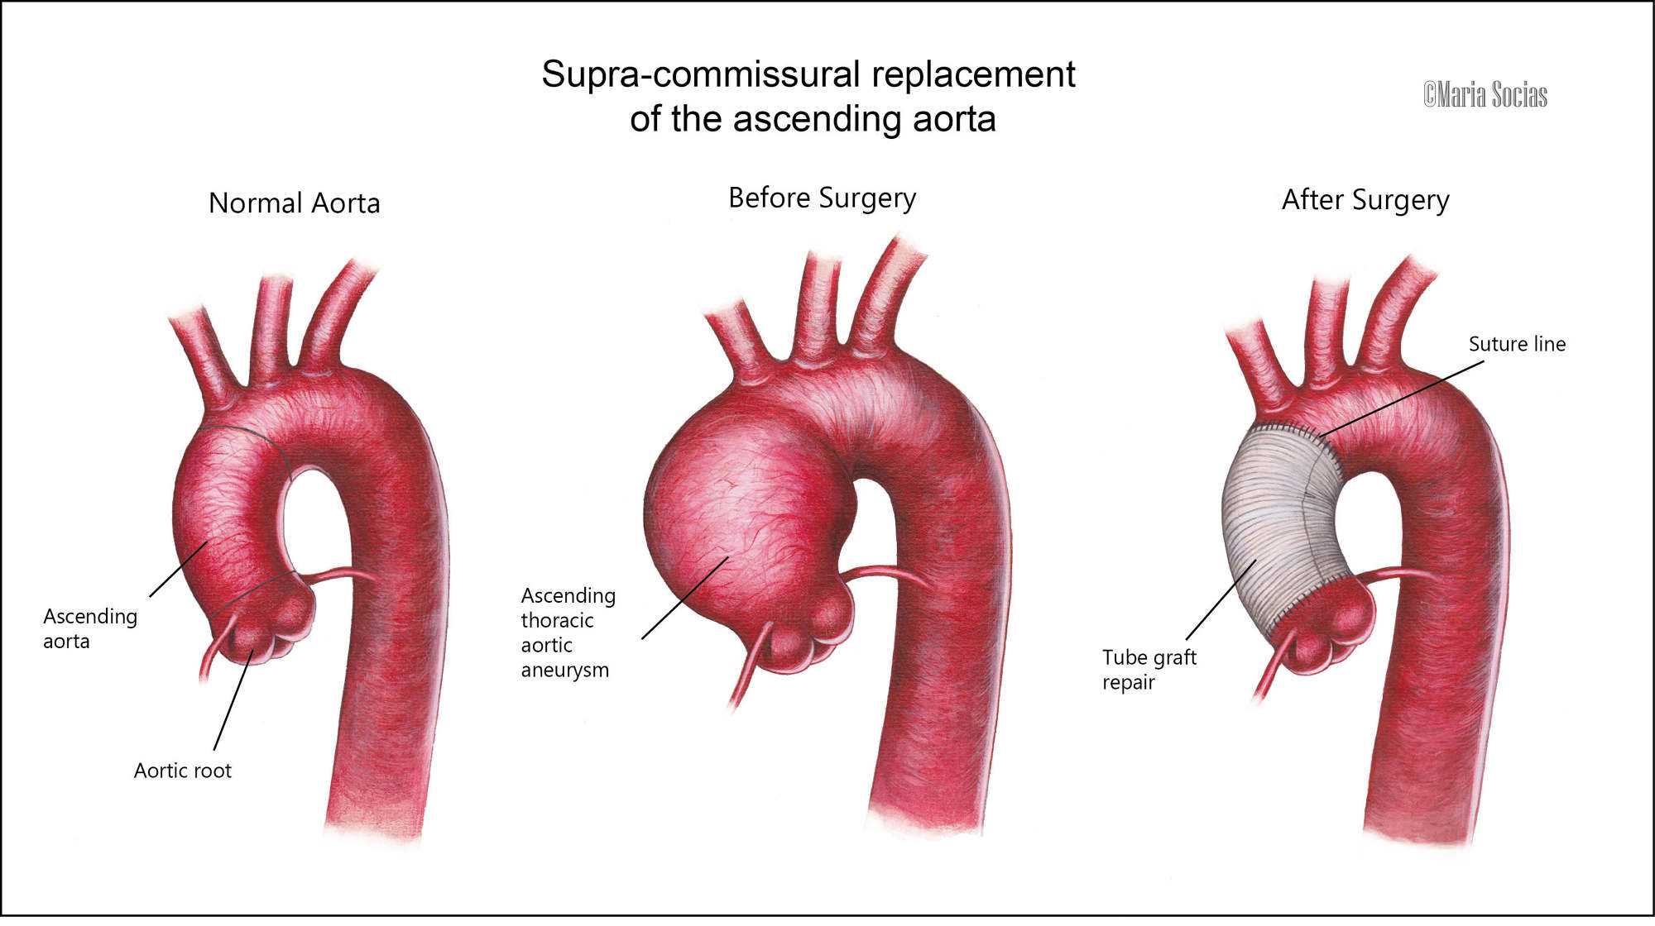
SURGERY
David procedure- valve sparing aortic root replacement

Slide 32
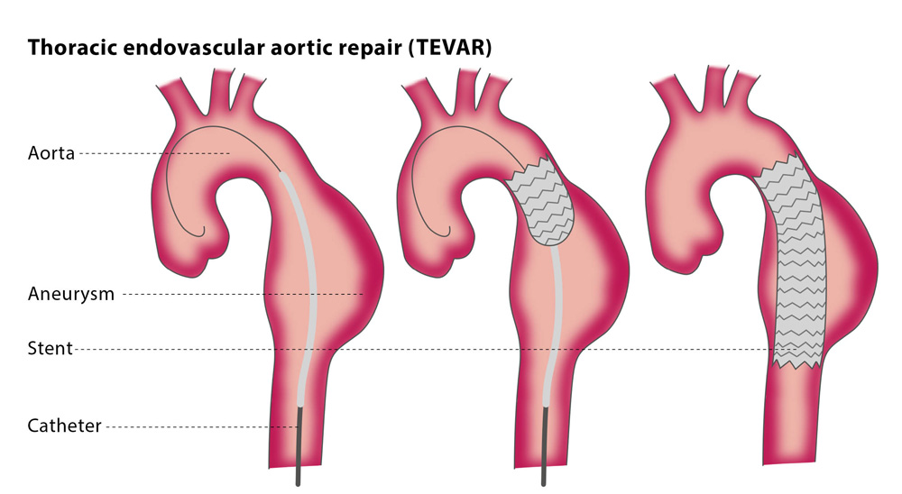
SURGERY
EVAR technique in descending aorta dissection

Slide 33
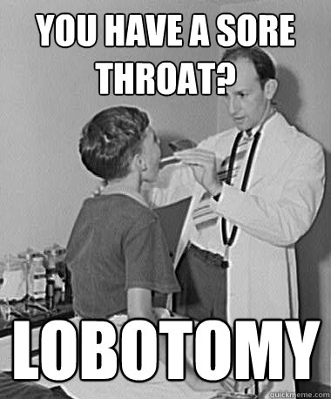
Short opportunity to take a breather ☺

Slide 34
Peripheral arterial disease (PAD)
Narrowing of the peripheral arterial system, usually due to atherosclerosis, worsened by other risk factors (diabetes, smoking, hyperlipidemia, artery spasms, hypertension etc...)

Slide 35
Clinical presentation
Cramping in feets, legs and calfs
Burning sensations
Numbness in feet and legs
Legs/feet cool to touch
Thick toenails
Worsened healing
CLAUDICATION!!!!
- pain during physical activity, walk

Slide 36
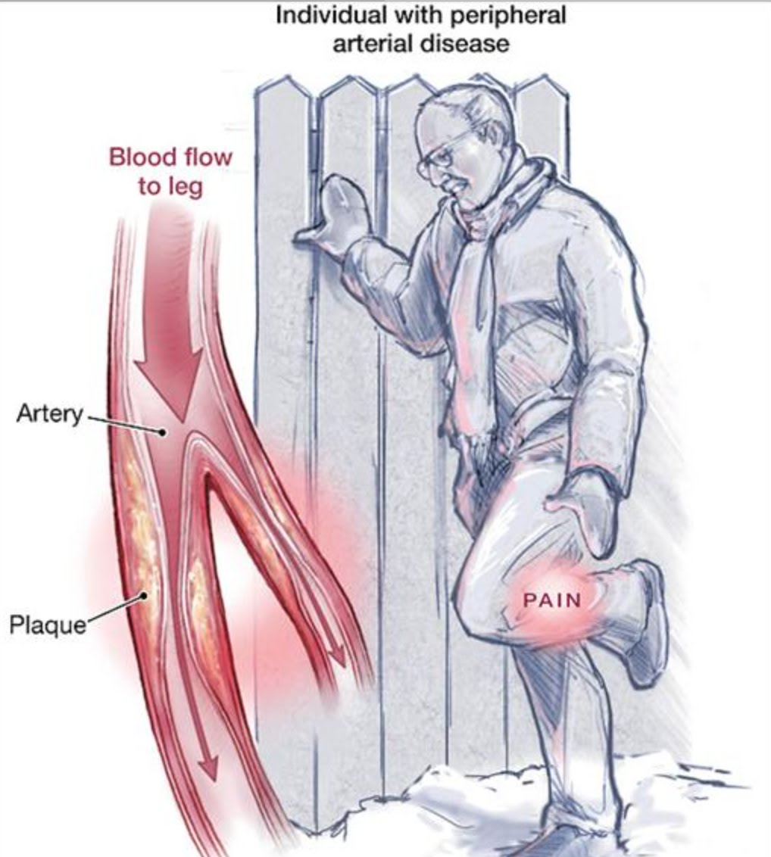
Patient suffers from pain during walk,and needs a rest. During inactivity, pain dissapear.

Slide 37
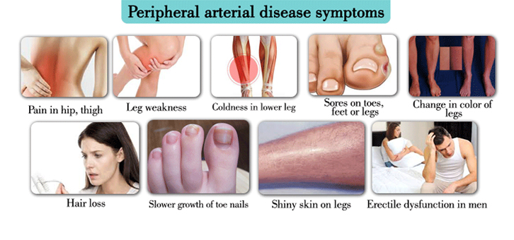

Slide 38
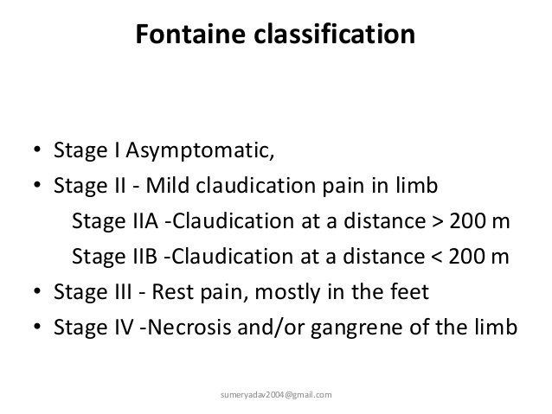
CLASSIFICATION

Slide 39
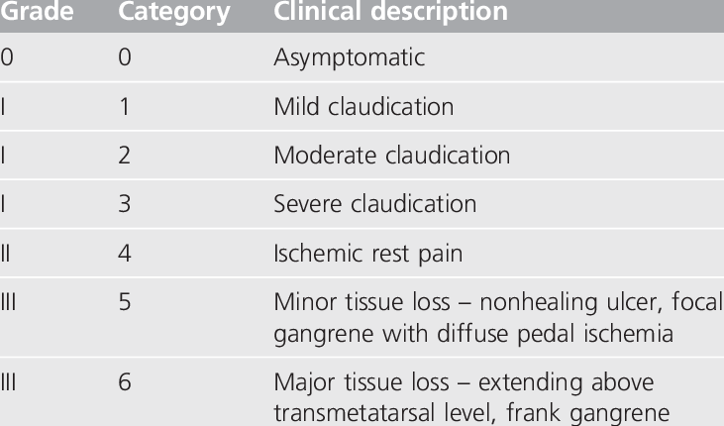
Rutherford classification

Slide 40
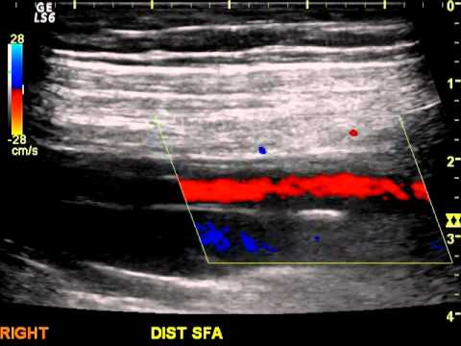
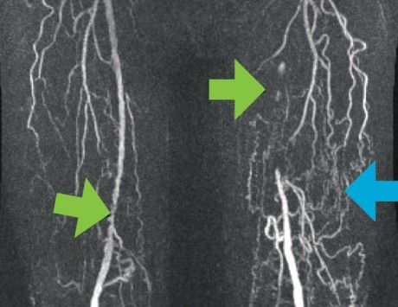
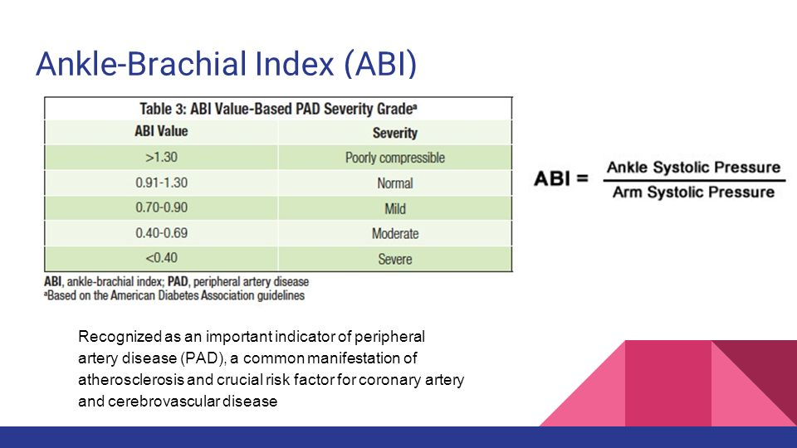
DIAGNOSIS
Doppler examination -
Angiography -
Ankle-brachial index -

Slide 41
TREATMENT
According to stage: mild to moderate
change of regimen –smoking, compensation of DM
Medication (Aspirin, statins, ACE inhib.)
Walk/exercise with gradual overload – helps to induce angiogenesis, which provides collateral arterial blood flow

Slide 42
SURGERY
PTA – Percutaneous Transluminal Angioplasty
-better for solitary lesions and narrowings, such as in femoral, popliteal or iliac artery
Atherectomy – atherosclerotic plaque removal from inside the artery-scraping
Vascular bypass – used to circumvent the diseased area – either using VSM, or PTFE (polytetrafluorethylene) or Gora-tex graft
Amputation – if gangrene develops
Thrombectomy, thrombolysis

Slide 43
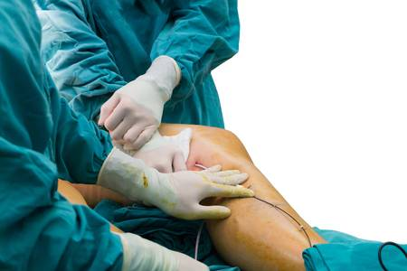
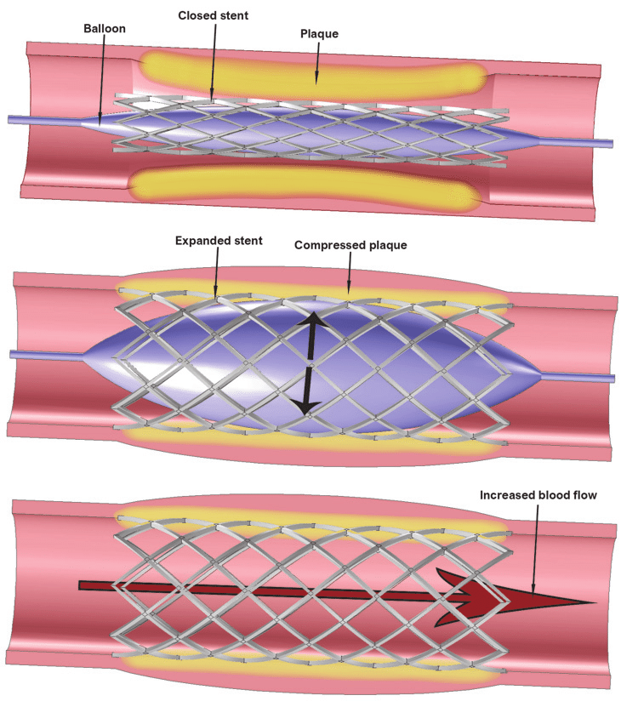
PTA

Slide 44
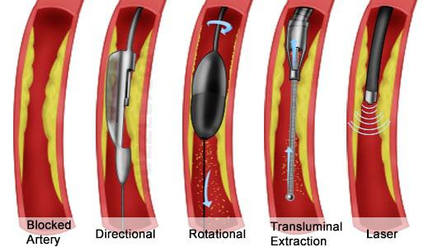
Atherectomy – „snow plow with suction“
Multiple devices – same effect

Slide 45
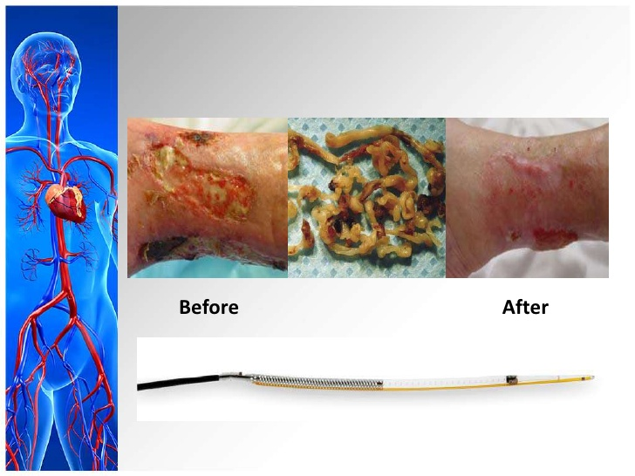
Successful recanalisation

Slide 46
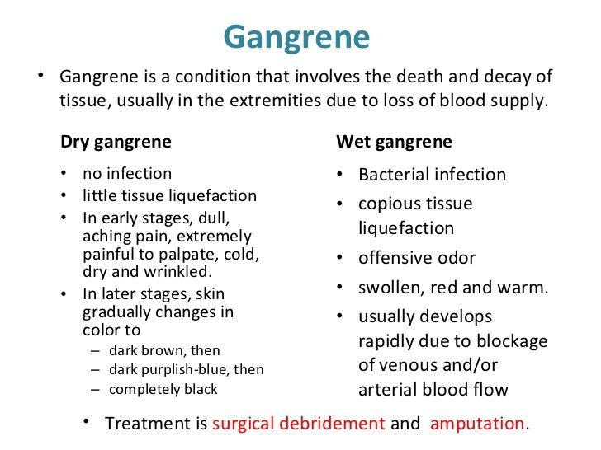
Amputation
-definite treatment of gangrene, and chronic ulcers, causing septic complications, especially in lower extremities

Slide 47
Transcutaneous oxygen measurement – TcPO2
Non- invasive, objective and realiable method which reflects the saturation of sking and soft-tissues with oxygen.
Helps to objectify ischemia, and to decide whether the extremity (defect) can be healed, or whether amputation should be performed

Slide 48
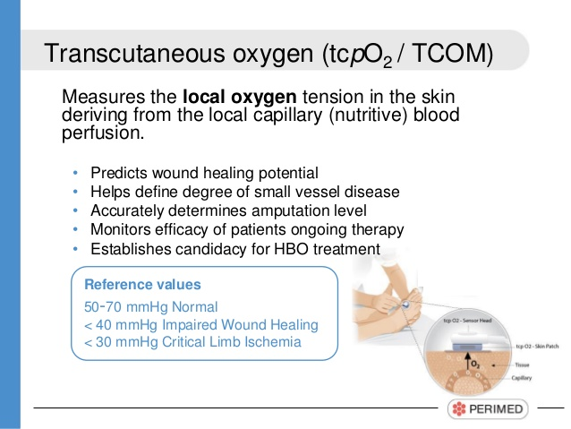

Slide 49
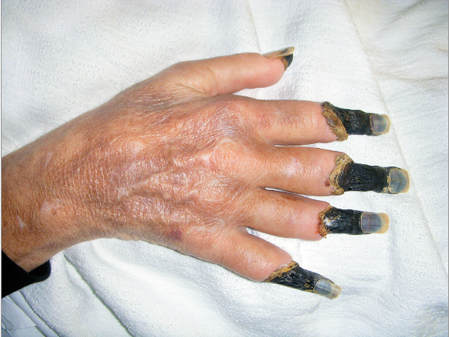

Slide 50
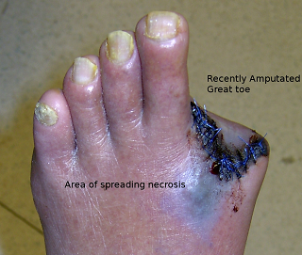

Slide 51
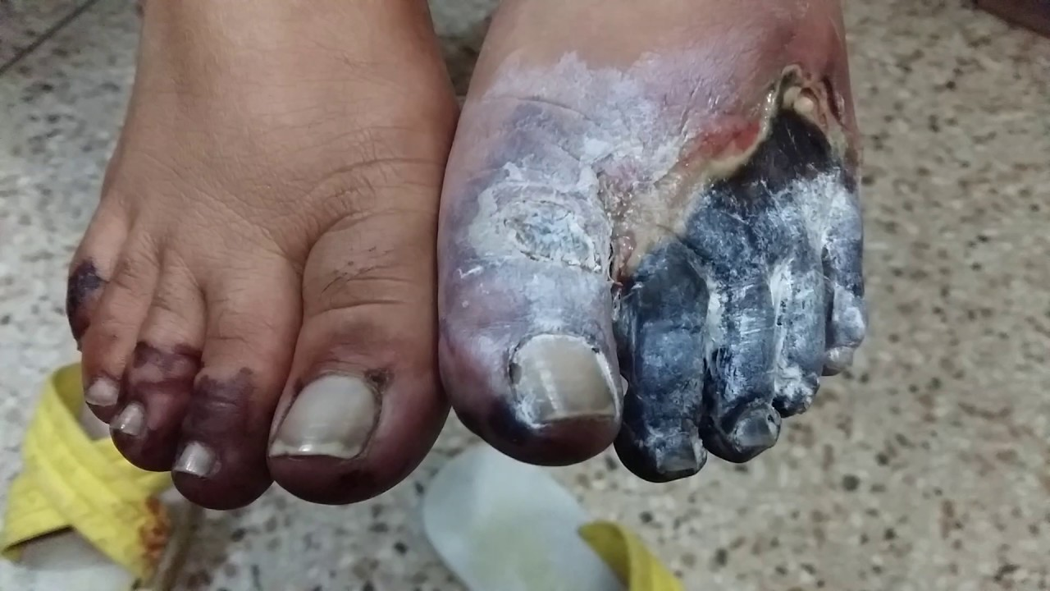

Slide 52
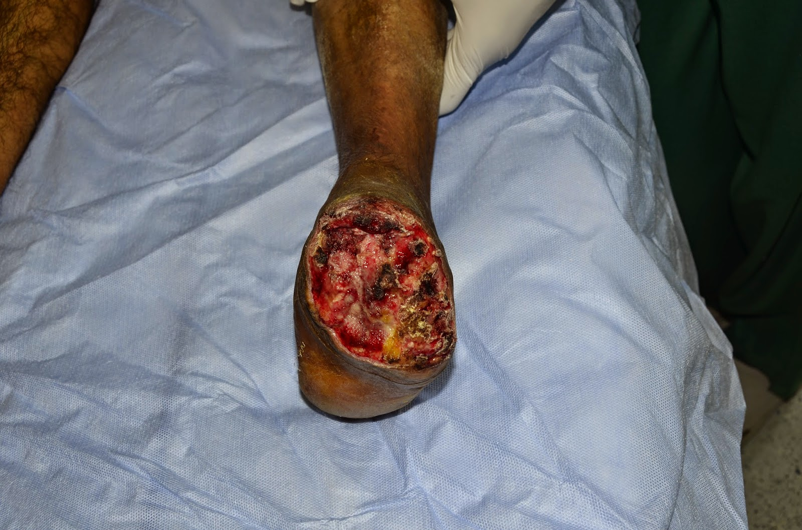

Slide 53
Vascular bypass – in PAD and in general
surgical procedure, allowing the redirection of blood flow from one place to another, using either prosthetic material grafts, allo-grafts or auto-grafts
there are many possible bypass locations, e.g.
fem-tib, ax-bifem, aorto-bifem, fem-fem
-mimicking physiological path anatomic
-creating new, unique pathways extra-anatomic

Slide 54
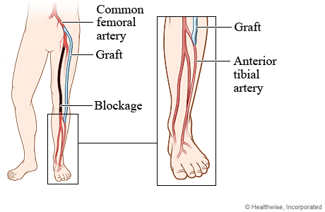
FEM- TIB – anatomic or no?

Slide 55
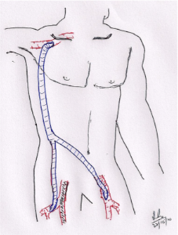
AX-BIFEM

Slide 56
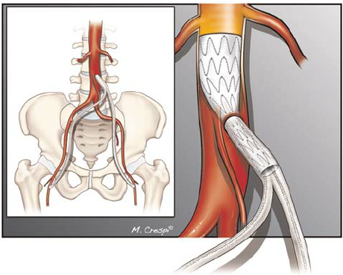
Aorto-bifem

Slide 57
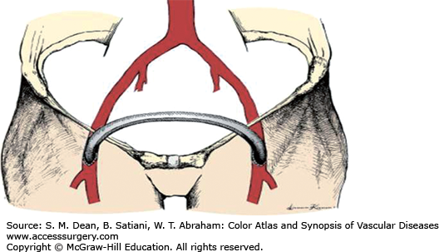
Fem-fem

Slide 58
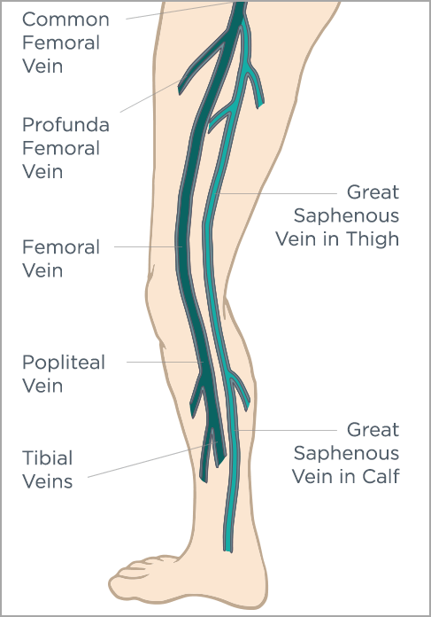
Great saphenous vein
                Ideal graft for bypass
                Spare part of our body

Slide 59
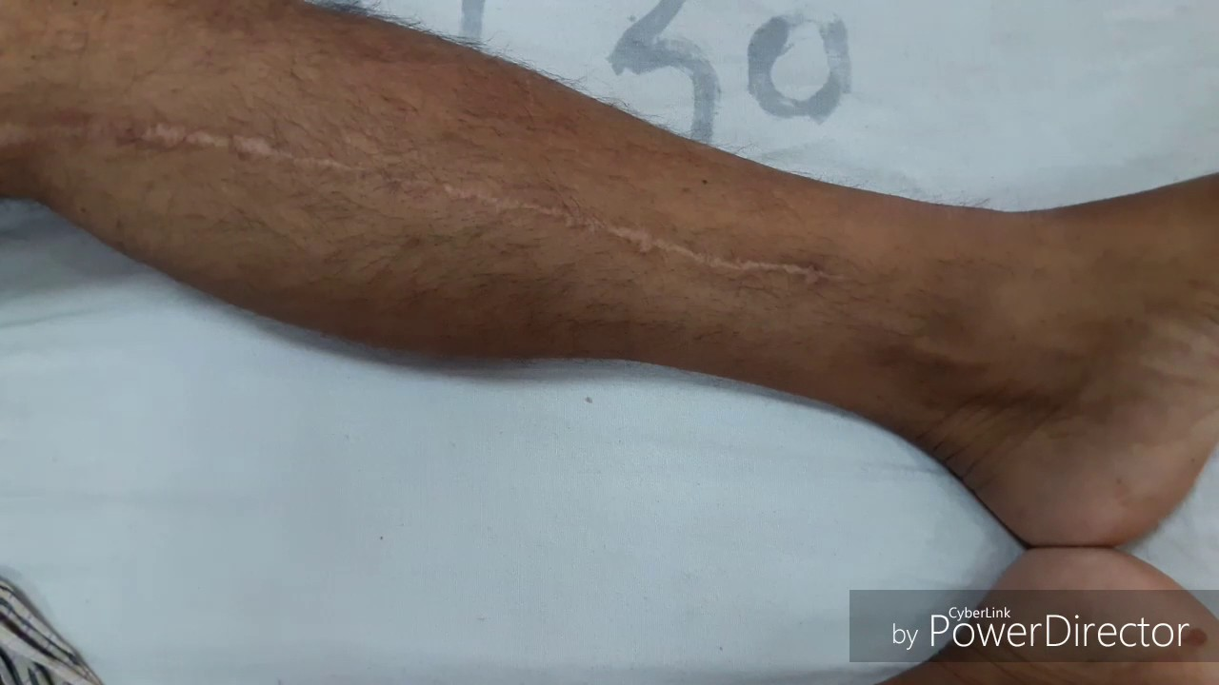

Slide 60
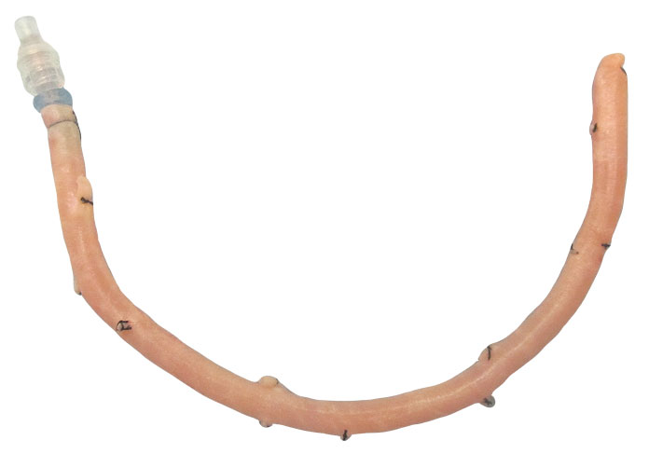
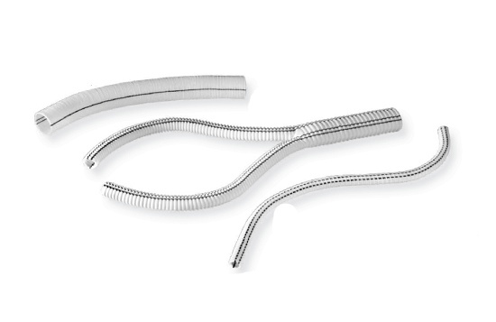
  Allo-graft from donor
  P PTFE ( polytetrafluorethylene)

Slide 61

Short break? No break? Coffee? Juice? Cigarette?

Slide 62
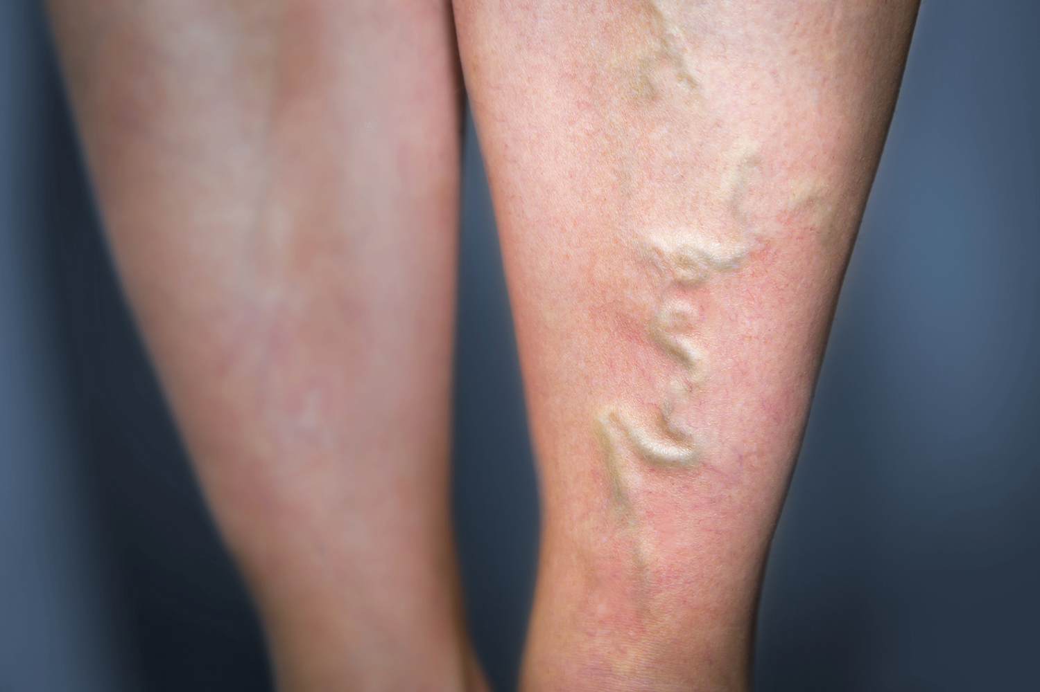
Chronic venous insufficiency - varicose veins
-pooling of blood in veins, straining vein walls
-cause can be found in venous reflux, due to inability of vein valves to work properly

Slide 63
Signs and symptoms:
- varices
swelling
hyperpigmentation
pruritus
ulceration
phlebitis

Slide 64
Chronic venous insufficiency
The reflux (incompetence) of vein valves can occur due to:
Phlebitis - infection of superficial veins, e.g. post-traumatic
Superficial vein thrombosis- this poses little to no danger of pulmonary embolism
Deep-venous thrombosis – blood clot formation in deep venous system, which can result in PE - chronic venous insufficiency is then considered as a part of postthrombotic syndrome
1.Thrombofilic state
2.Trauma VIRCHOW´S TRIADE
3.Imobility

Slide 65
DIAGNOSIS
Personal history
Clinical examination
Doppler – ultrasound of venous system
Rule out heart disease and hypervolemic state first!

Slide 66
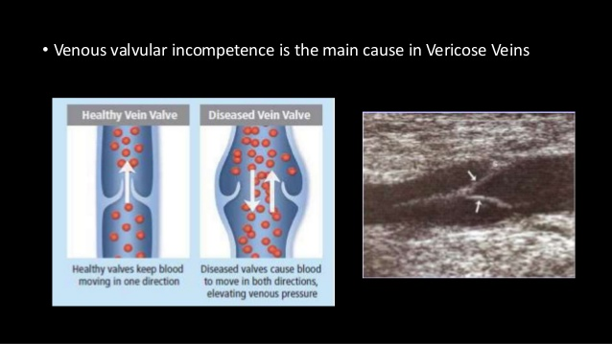

Slide 67


Slide 68

Conservative treatment
Effort to stabilize the condition, and prevent it from worsening
compression stockings
venoprotective medication-Detralex
blood pressure maintenance
elevation of lower extremities

Slide 69

Stockings effect

Slide 70
Surgical therapy
stripping
ligation
sclerotherapy
endovenous (intravascular) thermal ablation

Slide 71

Stripping

Slide 72

Ligature

Slide 73

Endovenous catether ablation

Slide 74

Sclerotherapy

Slide 75
Deep venous thrombosis – (DVT)
- condition in which blood clot forms in deep venous system of legs (rarely elsewhere)
untreated may pose a huge health risk
source of embolism to lungs, or in paradox embolism can cause stroke (venous thromboembolism- VTE)
many patients remain asymptomatic
more often in women

Slide 76

Deep venous thrombosis

Slide 77

Deep venous thrombosis

Slide 78
Signs
pain
tenderness
swelling/oedema
redness (erythema)
warmth
discoloration
may present also with:chest pain, trouble breathing, palpitation,chest dyscomfort, hemoptysis, tachycardia, tachypnoe, ....

Slide 79
Causes and risk factors:
Virchow´s triade –post surgery state
Smoking
Gravidity
Contraceptives
Older age
Medication
Genetic predisposition and disorders

Slide 80

Phlegmasia coerulea dolens
translated as „painful blue oedema“
form od DVT
caused by extensive block in outflow venous system
can present with sudden onset of severe pain, oedema, cyanosis
sometimes may be a first sign of malignant disease-need further examination
Treatment: cathether directed thrombolysis

Slide 81
Diagnosis of DVT
Clinical presentation, examination, risk factors, labs, doppler ultrasound, venography

Slide 82
Examination
Hommans sign – dorsiflexion of foot, eliciting pain – possibly dangerous
Pratt sign – calf squeeze elicite pain
positivity does not confirm the diagnosis
negative result does not rule out DVT

Slide 83

(Chris) Pratt sign
Squeeze my calf doctor ;)

Slide 84
Laboratory and Doppler - essential
D-dimer – fibrin degradation product – concentration gets higher, when blood clot decreases, thanks to fibrinolysis, which is physiological in body
Negative D-dimer concentration – 95% no DVT
Possitive D-dimer concenration – may sign DVT, or other pathological condition
Doppler + D-dimer – sets positive diagnosis

Slide 85
Therapy of DVT
Anticoagulation – LMWH, fondaparinux,UFH
Stockings, walking, check-ups
IVC filters
Thrombolysis – direct with catether or indirect- intravenous – using streptokinase, alteplaze, or urokinase (thrombolytics ensymes)
Mechanical thrombectomy – especially in acute, and symptomatic

Slide 86


LMWH – stops growth of blood cloth

Slide 87


Inferior vena cava filters

Slide 88

Catether thrombolysis

Slide 89

Mechanical thrombectomy

Slide 90

VASCULAR TRAUMA

Slide 91
Examination
Vascular trauma may be intracorporal or extracorporal (visible)
Check vital signs: Airway
Breathing
Circulation – signs of shock
Anamnesis

Slide 92

Pros- usually younger, healthy patients

Slide 93
Check for signs of arterial injury
Hard signs: pulsatile hemorrhage, significant blood loss, acute ischemia
volume resuscitation, tourniquet if possible, and acute repair
Soft signs: minor hemorrhage, small hematoma, associated injury

Slide 94
Aproach to arterial injury
Definitive or damage control therapy
Restore blood perfusion
Open vs endovascular treatment
Stable vs unstable patient

Slide 95

Surgery options

Slide 96

IN STABLE PATIENTS

Slide 97
Thoracic vascular injury
-take into consideration:
Clinical presentation
Visible penetration of chest wall
Hemodynamic stability/instability
X-ray, CT, CT-angio finding
Insert chest-tube if needed –chest decompression
Think over procedure in thoracic and abdominal trauma

Slide 98


Slide 99

Thoracic vascular injury

Slide 100

Chest tube insertion

Slide 101


Slide 102


Slide 103


Slide 104
Abdominal injury
Anamnesis
Clinical presentation
Examination- physical, laboratory
Special:
FAST –focused assessment with sonography for trauma
CT
CT-angio
Revision of abdominal cavity

Slide 105
Blunt trauma
stable patient, no deffance musculaire, no drop in laboratory – Hb,Ery, negative FAST
Observation

Slide 106
Penetrating abdominal injury
Open revision – ALWAYS!!!!

Slide 107

Peripheral vascular trauma

Slide 108
Periferal vascular injury
- open fractures, comminutive fractures, stab wounds, semiamputations, cut wounds, GSW, etc...

Slide 109
Examination?
What to do?

Slide 110

CASE REPORT ☺

Slide 111

Thank you for your attention!!!
Now, run home, save yourselves

