Slide 1
Vascular injury
Males 80% ( 20-40 y )
(1) Blunt : post M.V.A , fracture , dislocation
(2) Penetrating :
( stab wound , gunshot , fall , explosives )
(3) Iatrogenic ( angiography , cardiac cath, central line) 5-10% incidence
(4) Self induced ( drug abuse )

Slide 2
High Risk Areas for Peripheral Vascular injury
Upper limb :
1) Axilla
2) Deltopectoral groove
Lower limb :
1) Inguinal region
2) Popliteal fossa

Slide 3
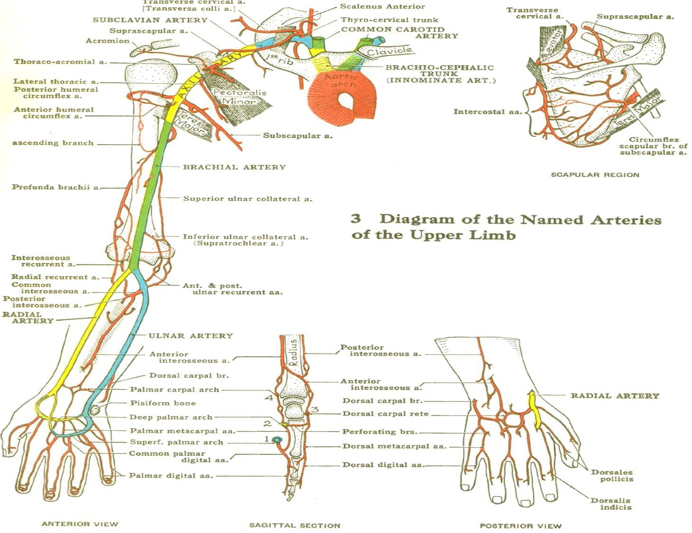

Slide 4
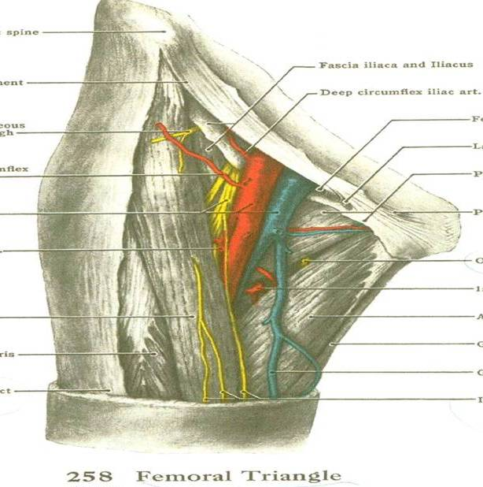
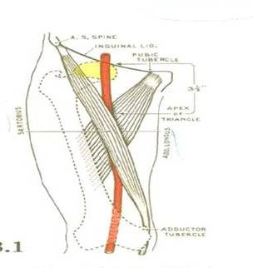
Femoral
Triangle

Slide 5
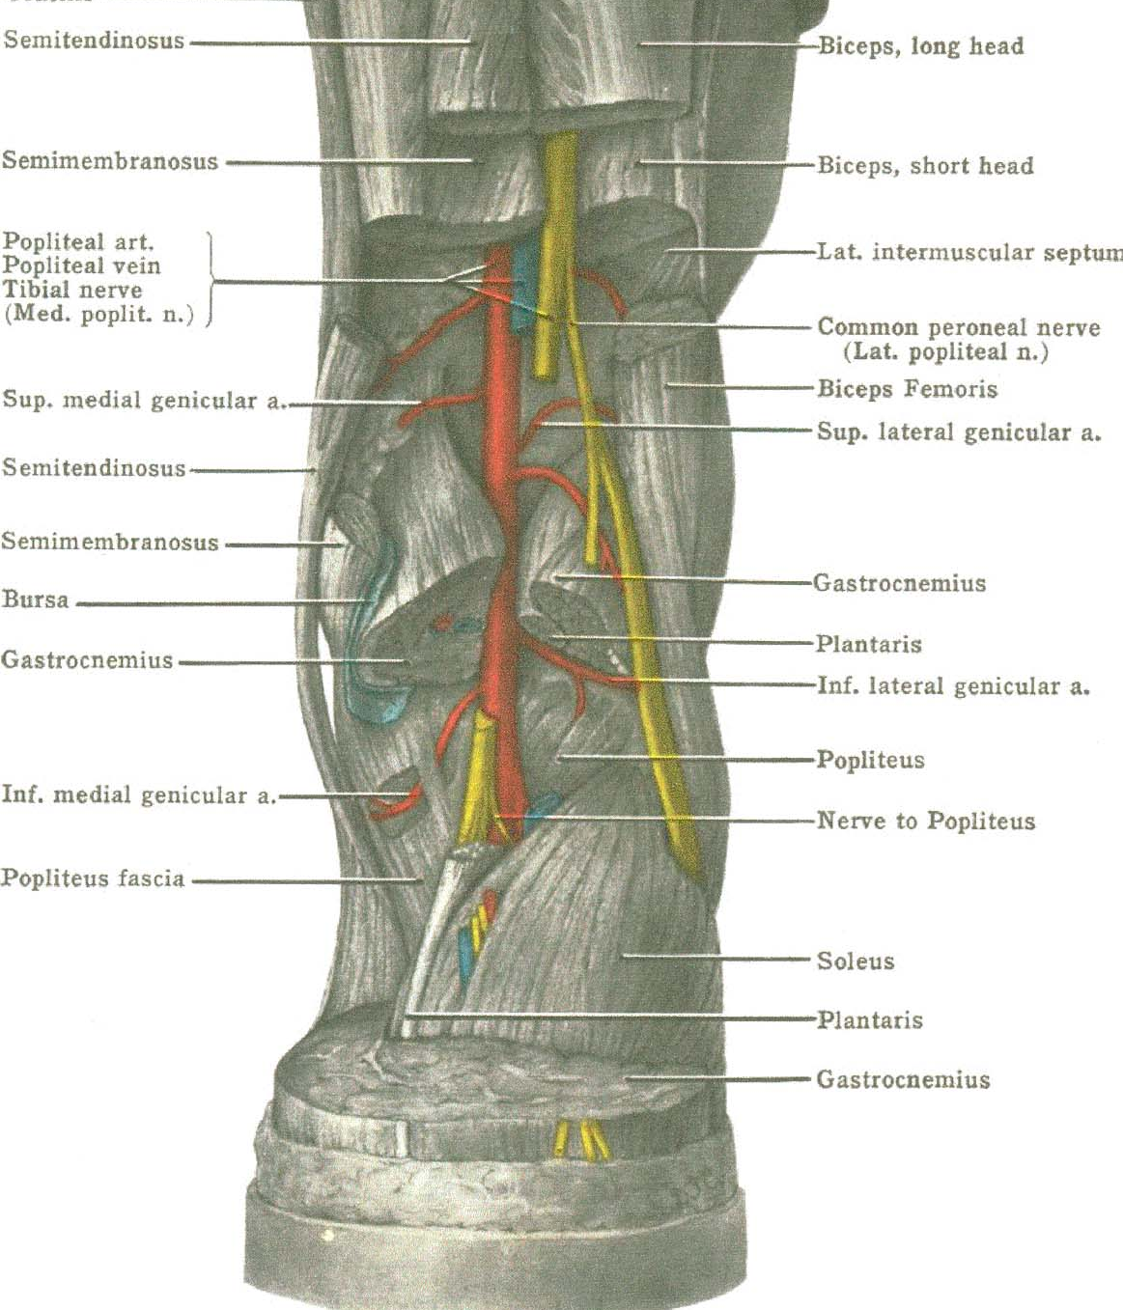
Step
Dissection
of
the
Popliteal
Fossa

Slide 6
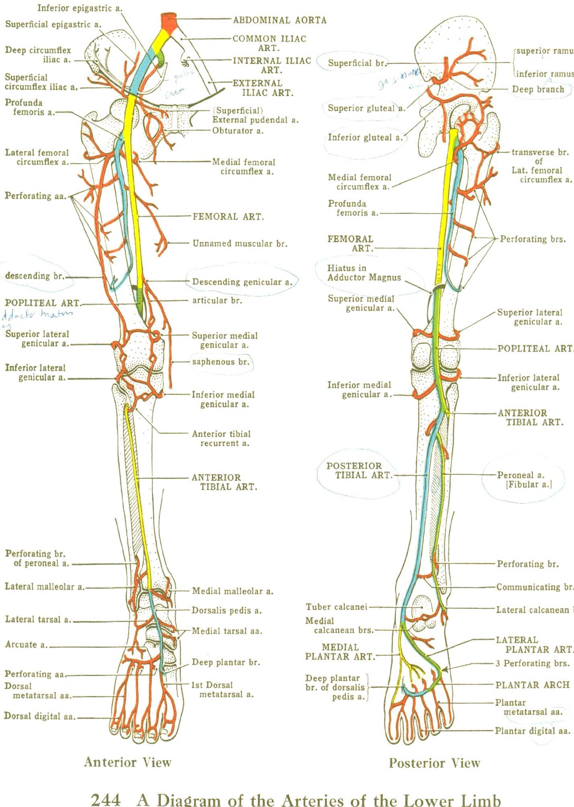

Slide 7
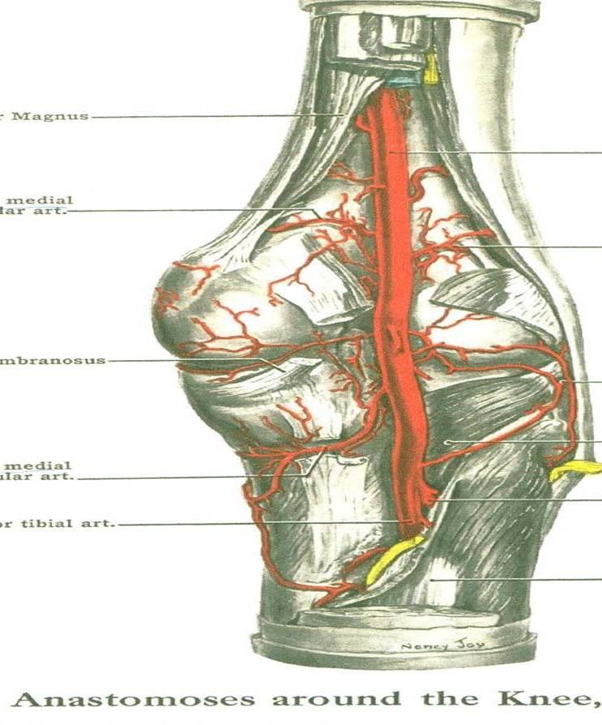
Anastomosis
around
the Knee

Slide 8
Physiology of Bleeding
( Haemostasis )
Vasoconstriction ,
platelet aggregation
Coagulation intrinsic , extrinsic
Hypotension

Slide 9
Vascular Pathology
Intimal injury
Thrombosis
Transection : Partial , or complete
Bleeding :
false aneurysm ( hematoma)
hemorrhage , exsanguination

Slide 10
History
Mechanism of trauma ( etiology )
Time interval
Prior vascular injury or D.V.T
Anticoagulation therapy
Specific vascular symptoms
Pulsatile mass , bleeding , ischemia

Slide 11
Examination
Vital signs
Vascular examination
Arterial pressure index
Ankle / brachial index
Allen index

Slide 12
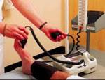

Slide 13
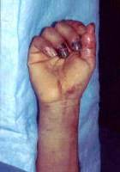
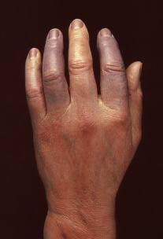

Slide 14
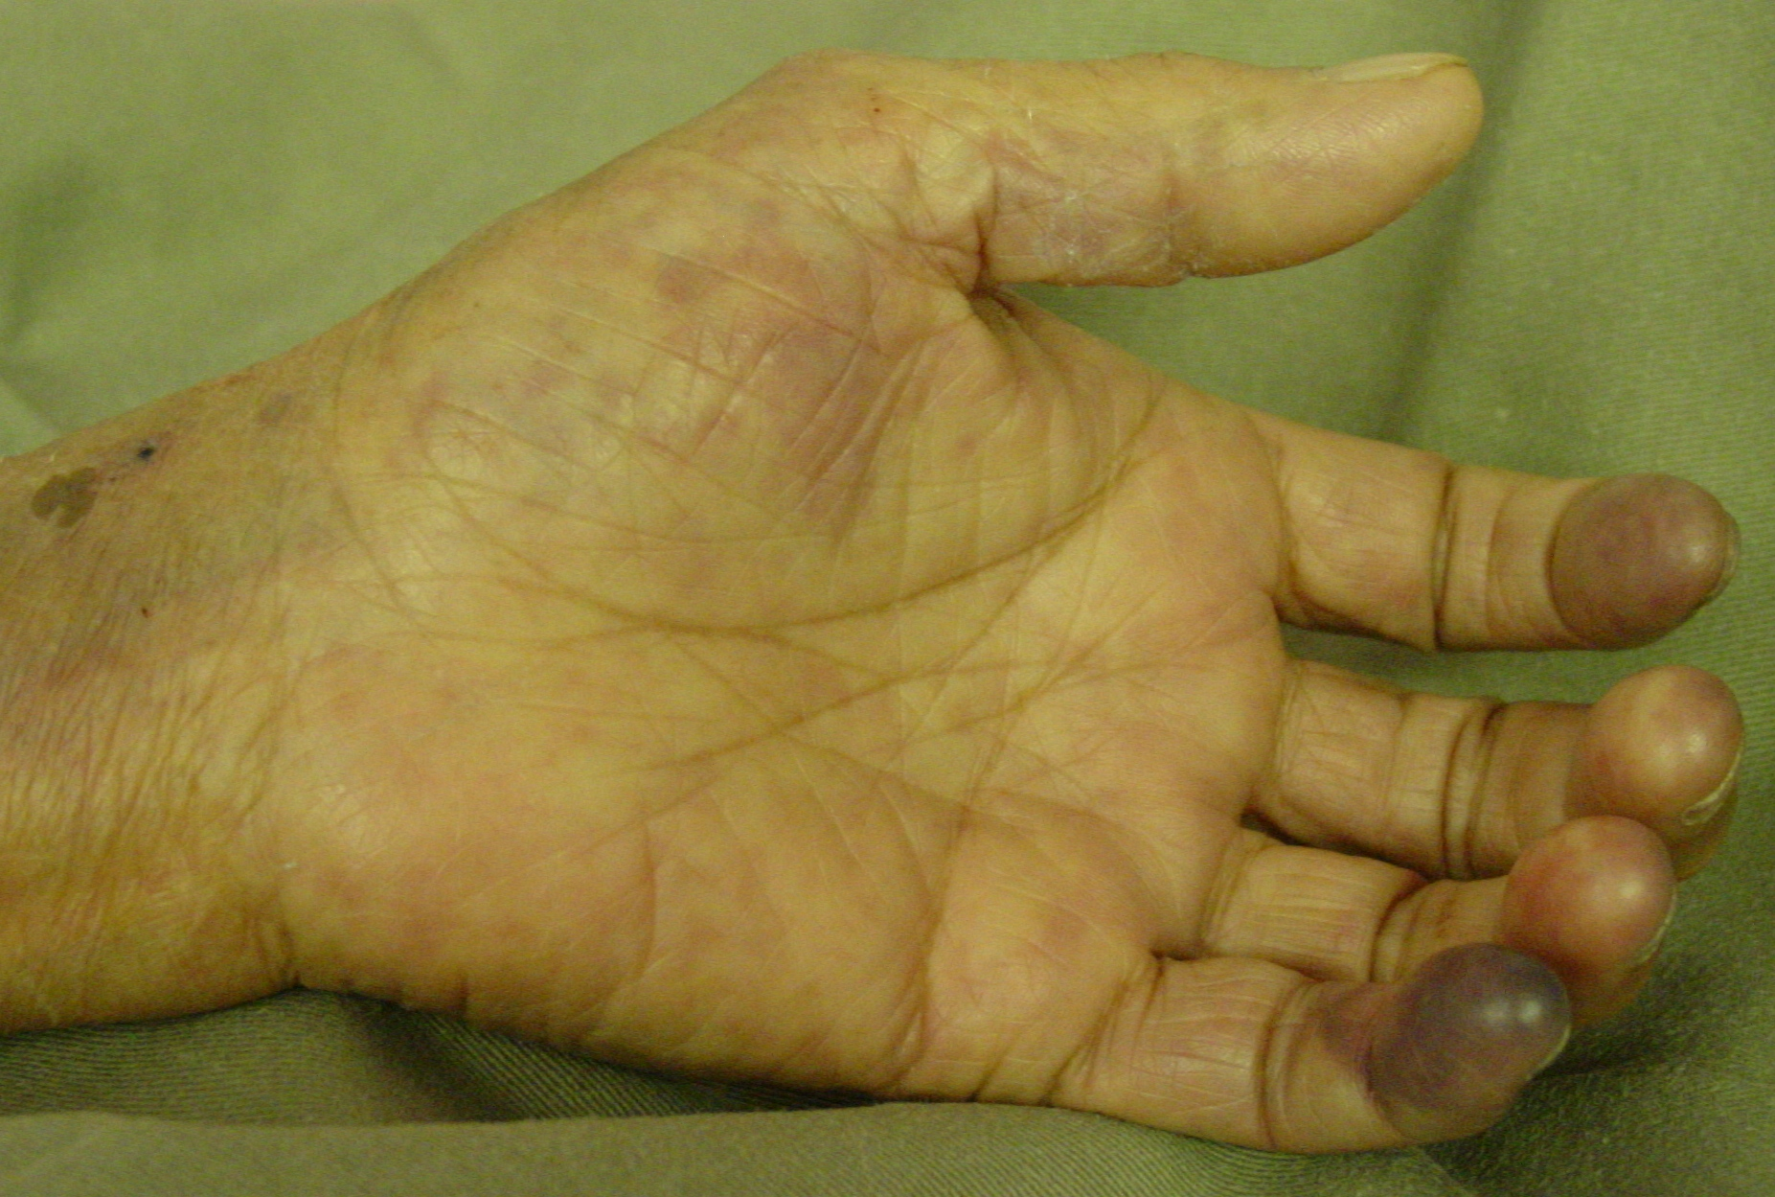

Slide 15
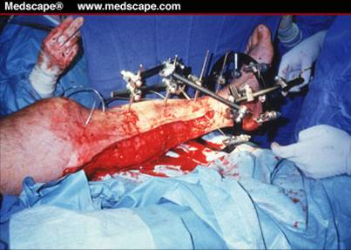

Slide 16
Diagnosis
Hard signs of vascular injury post trauma :
Pulsatile bleeding
Visible expanding hematoma
Distal ischemia (5 P’s)
Arterial thrill (( vibration ))
Bruit over artery
Distal normal pulses does not preclude vascular injury

Slide 17
Diagnosis
Soft signs of vascular injury post trauma :
Hypotension or shock
Neurologic deficit , fracture , dislocation
Stable, nonpulsatile or small hematoma
Proximity of the wound to major vascular structures

Slide 18
Investigation
Blood C.B.C , electrolytes B.U.N , creat. , P.T. , P.T.T
Duplex doppler ultrasound ( soft signs )
Multidetector helical CT (MDCT) angiography
Angiography ( hard signs )
* Renal toxicity avoid by rehydrat.+ alkaliniz. of urine
* Allergy
* Cost , time consuming , expertise
* iatrogenic tauma ( 0.6% )

Slide 19
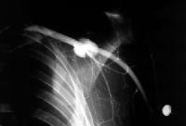
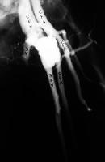

Slide 20
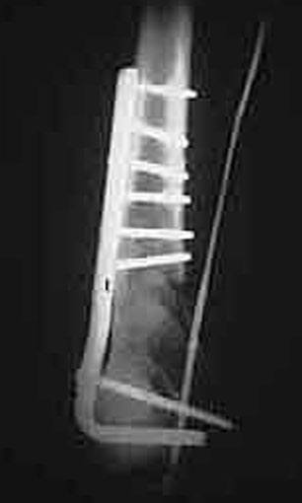
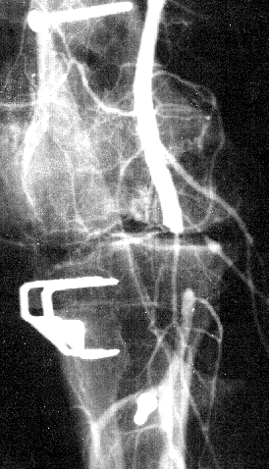

Slide 21
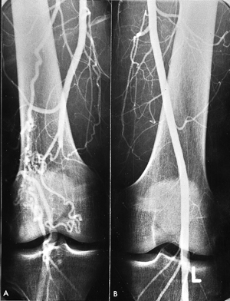

Slide 22
Management
General
Resuscitation
Reduce displaced fracture , dislocation
Stop hemorrhage :
- Direct pressure
- Avoid tournique except in exanguination
- Avoid clamps

Slide 23
Management
Specific
Surgical exploration
Indication
Hard signs of vascular injury,
Refractory hypotension,
Obvious limb ischemia

Slide 24
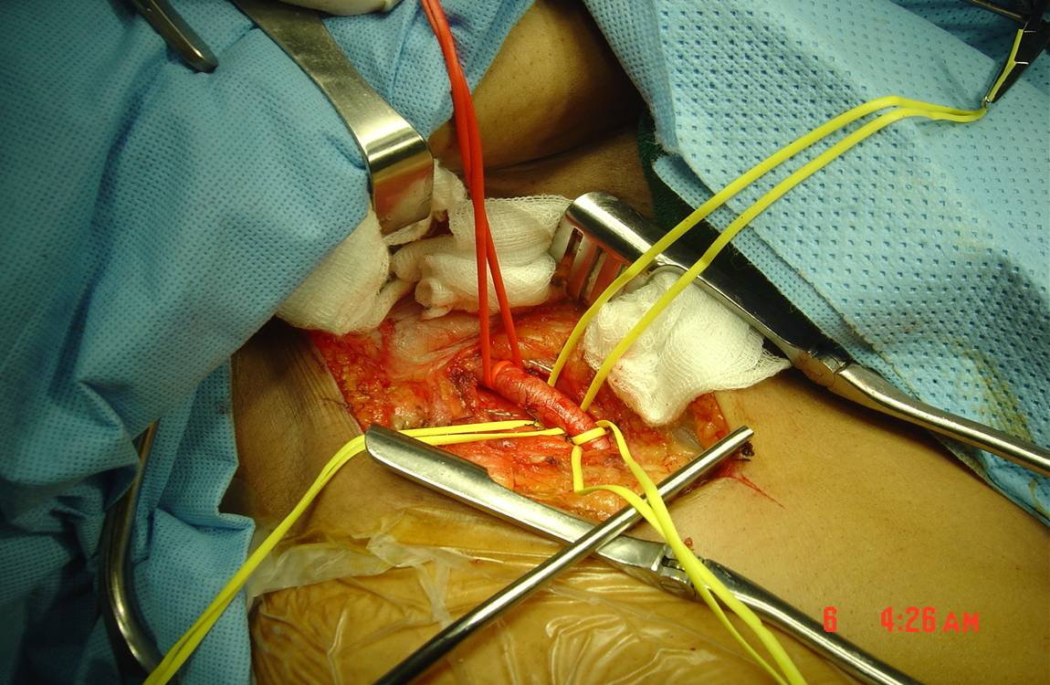

Slide 25
Vascular Repair
Arterial repair:
(1) direct arterial repair.
(2) arterial patch repair.
(3) interposition graft repair.
(4) bypass repair.
Venous repair whenever possible
avoid ligation.

Slide 26
Compartment syndrome
Swelling of muscles causing compression of nerves and blood vessels.
Pathophysiology
prolonged ischemia → tissue hypoxia → anaerobic metabolism → lactic acid accumulation →reperfusion→ vasodilatation→ transudation

Slide 27
Common causes of compartment syndrome
(1) Tibial or forearm fractures.
(2) Ischemic-reperfusion following injury.
(3) Haemorrhage .
(4) Vascular puncture.
(5) Intravenous drug injection,
(6) Casts.
(7) Prolonged limb compression
(8) Crush injuries
(9) Burns

Slide 28
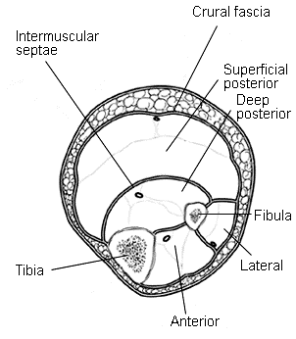
Four major
leg compartments
Anterior
Lateral
Superf. Poster.
Deep poster.
3
4
2
1

Slide 29
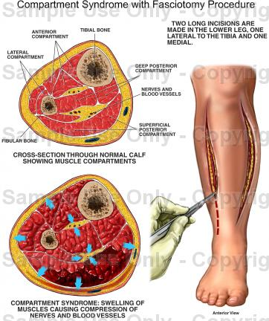

Slide 30
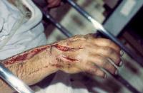

Slide 31
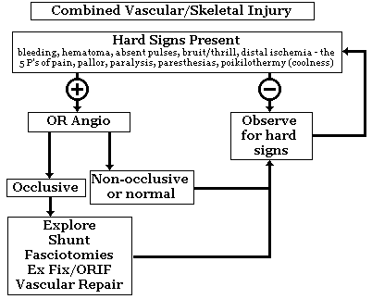

Slide 32
Morbidity
Limb loss
(1) When limb perfusion is compromised for more than 6 hours warm ischemia
(2) Extensive musculoskeletal damage.
(3) Open tibial fracture
(4) Compartment syndrome
Paralysis Post nerve injury
D.V.T post venous injury

Slide 33
Factors Predicting Risk of Amputation
The MESS score :
(1) Degree of skeletal/soft tissue injury .
(2) Limb ischemia .
(3) Shock .
(4) Patient age .
MESS = mangled extremity severity score .( Heflet et al ,1990)

Slide 34
Mortality
Rare except from :
(1) Exsanguination
(2) Necrotizing myofascial infection
(3) Rhabdomyolysis and Renal failure in untreated acute compartment syndrome

Slide 35
Any questions ?
Thank you

