Slide 1


Lecture 1 : NGS Overview
Modern Genomic Technologies (LF:DSMGT01 )
Vojta Bystry
vojtech.bystry@ceitec.muni.cz

Slide 2
Introduction to LF: DSMGT01
NGS data analysis for non-bioinformatics
  Focus on experiment planning and result interpretation
Introduction; NGS Overview
DNA resequencing
DNA resequencing
RNA-seq
RNA-seq
Chip-seq (CLIP-seq)
Everything else ☺ + colloquium
The plan is open to change - (based on your suggestions and wishes)

Slide 3
What is NGS?
Next generation sequencing
  New generation sequencing
  HTP = High throughput
  Massively parallel sequencing
Contrast to Sanger sequencing

Slide 4
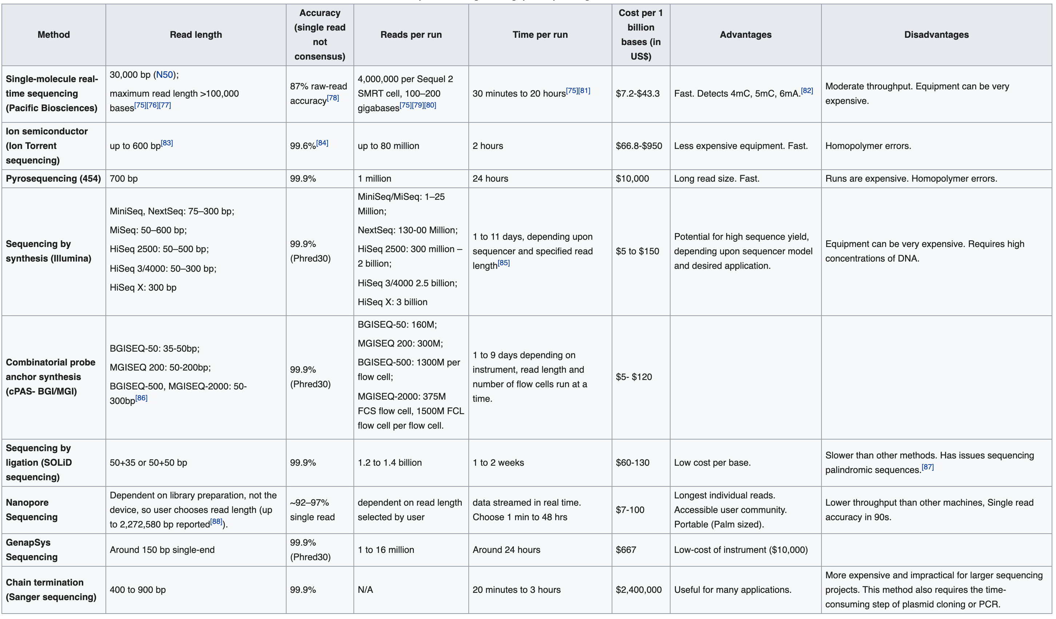
What is NGS?

Slide 5
What is NGS?

Slide 6
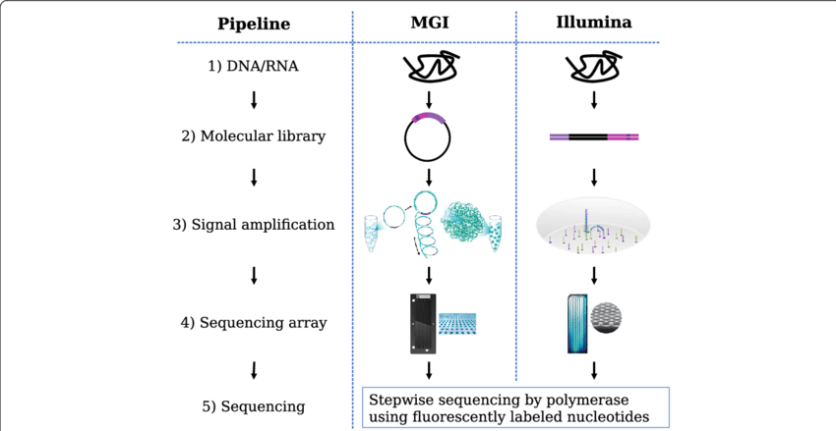
What is NGS?
Illumina – sequencing by synthesis
Oxford Nanopore – Nanopore sequencing
Pacific Bioscience - Single Molecule, Real-Time (SMRT)
Chinese are coming - BGI DNBSeq platforms

Slide 7
What is NGS?
Illumina – sequencing by synthesis
Oxford Nanopore – Nanopore sequencing
Pacific Bioscience - Single Molecule, Real-Time (SMRT)

Slide 8
Illumina – sequencing by synthesis
https://www.youtube.com/watch?v=fCd6B5HRaZ8

Slide 9
Raw data
10^5 – 10^10 reads
75 – 300Bp
Could be pair-end

Slide 10


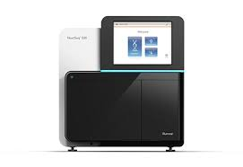

Basic workflow
Experimental
design
Library
preparation
Sequencing
Data analysis

Slide 11
Basic workflow
Experimental
design
Library
preparation
Sequencing
Data analysis
Why we sequence
What we sequence
How we sequence

Slide 12
Basic workflow
Experimental
design
Library
preparation
Sequencing
Data analysis
Why we sequence
What we sequence
How we sequence
Consultation regarding data analysis is highly advisable.

Slide 13

NGS library preparation
DNA
Select
some parts
RNA
Living material

Slide 14
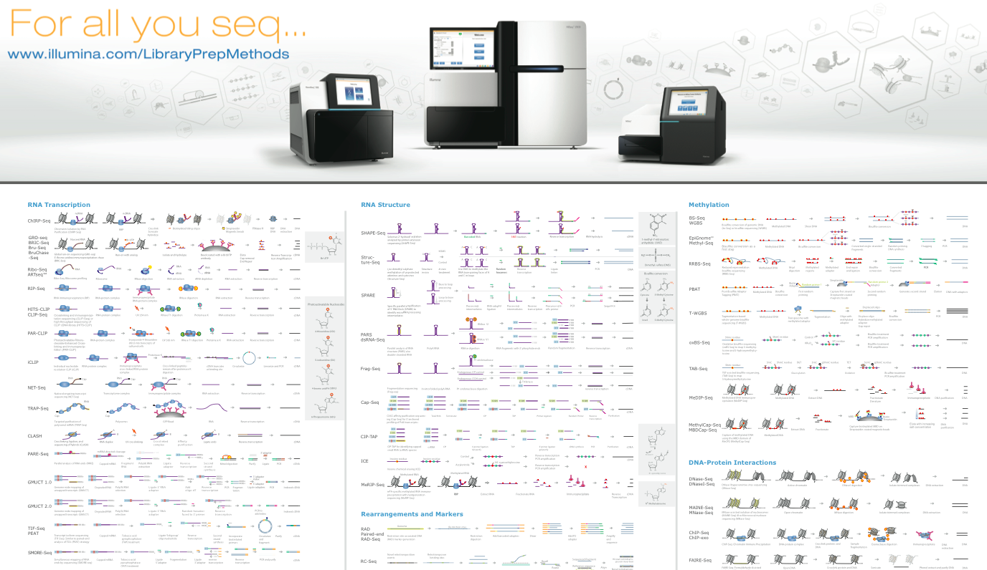
NGS library overview

Slide 15
NGS data analysis
Raw data
.fastq
Experiment design
de-multiplexing
QC
Not known
reference
Not ”classic” reference
Genome/Transcriptome Reference Mapping
.bam
Metagenomics
Reference assembly
Immunogenetic
VDJ-genes
CRISPR
sgRNA
QC
Methylation
Bisulfide-seq
Interaction
analysis
CHIP-seq
Expression analysis
RNAseq
Variant analysis
WES
…
15

Slide 16
NGS data analysis
Raw data
.fastq
Experiment design
de-multiplexing
QC
Not known
reference
Not ”classic” reference
Genome/Transcriptome Reference Mapping
.bam
Metagenomics
Reference assembly
Immunogenetic
VDJ-genes
CRISPR
sgRNA
QC
Methylation
Bisulfide-seq
Interaction
analysis
CHIP-seq
Expression analysis
RNAseq
Variant analysis
WES
…
16

Slide 17
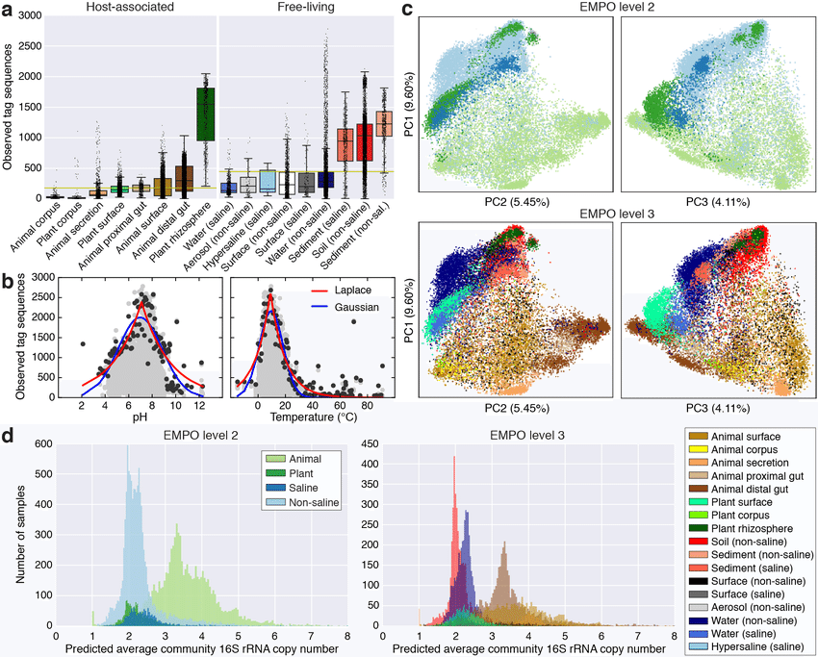
Metagenomics
Environmental statistics about populations
  alpha, beta, gamma diversity
  identify known bacterial species
  eventually functional profiling
    E.g. antimicrobial resistance genes
Sequencing techniques
  16S rRNA sequencing
  Shotgun metagenomic sequencing

Slide 18
Metagenomics – 16S rRNA vs. Shotgun
Factors | 16S rRNA sequencing | Shotgun Metagenomic Sequencing
Cost | ~$50 USD | Starting at ~$150 but price will depend on sequencing depth required
Sample preparation | Similar complexity to shotgun sequencing | Similar complexity to 16S rRNA sequencing
Functional profiling (profile microbial genes) | No (but ‘predicted’ functional profiling is possible) | Yes (but it only reveals information on functional potential)
Taxonomic resolution: Genus, species, strain? | Bacterial genus (sometimes species); dependent on region(s) targeted | Bacterial species (sometimes strains and single nucleotide variants, if sequencing is deep enough)
Taxonomic coverage | Bacteria and archaea | All taxa, including viruses
Bioinformatics requirements | Beginner to intermediate expertise | Intermediate to advanced expertise
Databases | Established, well-curated | Relatively new, still growing
Sensitivity to host DNA contamination | Low (but PCR success depends on the absence of inhibitors and the presence of a detectable microbiome) | High , varies with sample type (but this can be mitigated by calibrating the sequencing depth)
Bias | Medium to high (retrieved taxonomic composition is dependent on selected primers and targeted variable region) | Lower (while metagenomics is “untargeted”, experimental and analytical biases can be introduced at various stages)

Slide 19
Metagenomics – 16S rRNA vs. Shotgun
Study Examples
  Assessment of the bacterial microbiome of Amazonian soil
    16S rRNA sequencing may provide more taxonomic resolution
  Changes in microbiome composition and antimicrobial gene carriage following fecal transplant
    shotgun sequencing to assess both compositional and functional differences
  Daily fluctuations in gut microbiome following 2 week dietary fiber intervention
    shotgun sequencing to assess both compositional and functional differences

Slide 20
NGS data analysis
Raw data
.fastq
Experiment design
de-multiplexing
QC
Not known
reference
Not ”classic” reference
Genome/Transcriptome Reference Mapping
.bam
Metagenomics
Reference assembly
Immunogenetic
VDJ-genes
CRISPR
sgRNA
QC
Methylation
Bisulfide-seq
Interaction
analysis
CHIP-seq
Expression analysis
RNAseq
Variant analysis
WES
…
20

Slide 21
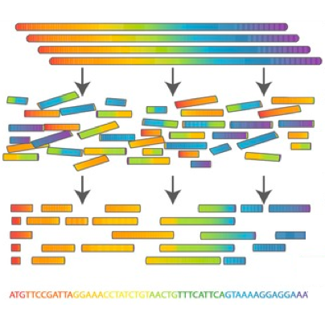
Reference Assembly

Slide 22
Reference Assembly

Slide 23
Reference Assembly
Genome – DNA – very hard and costly
Transcriptome – RNA
Multiple sequencing types highly beneficial
  Pair-end
  Long reads
  Mate-pairs
Similar reference helpful – assembly by homology

Slide 24
NGS data analysis
Raw data
.fastq
Experiment design
de-multiplexing
QC
Not known
reference
Not ”classic” reference
Genome/Transcriptome Reference Mapping
.bam
Metagenomics
Reference assembly
Immunogenetic
VDJ-genes
CRISPR
sgRNA
QC
Methylation
Bisulfide-seq
Interaction
analysis
CHIP-seq
Expression analysis
RNAseq
Variant analysis
WES
…
24

Slide 25
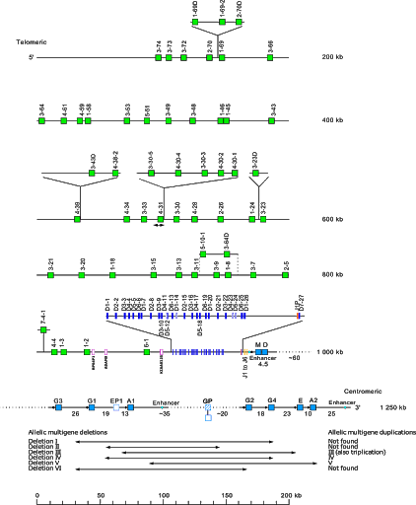
Immunogenetic
T-cell receptor , Immunoglobulin – (B-cell)
Gene rearrangement during cell maturation
  VDJ recombination

Slide 26
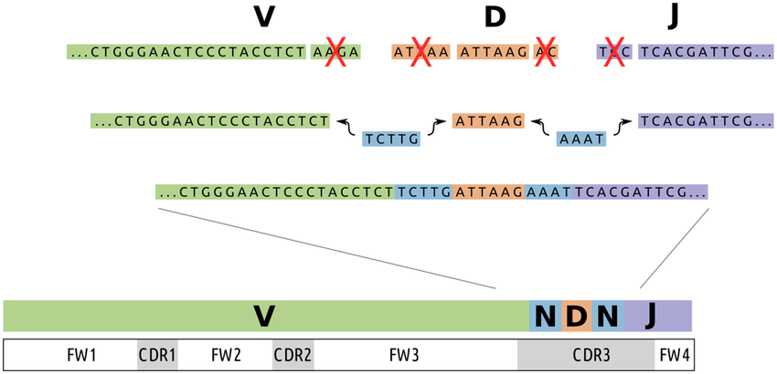
Immunogenetic
T-cell receptor , Immunoglobulin – (B-cell)
Gene rearrangement during cell maturation
  VDJ recombination

Slide 27
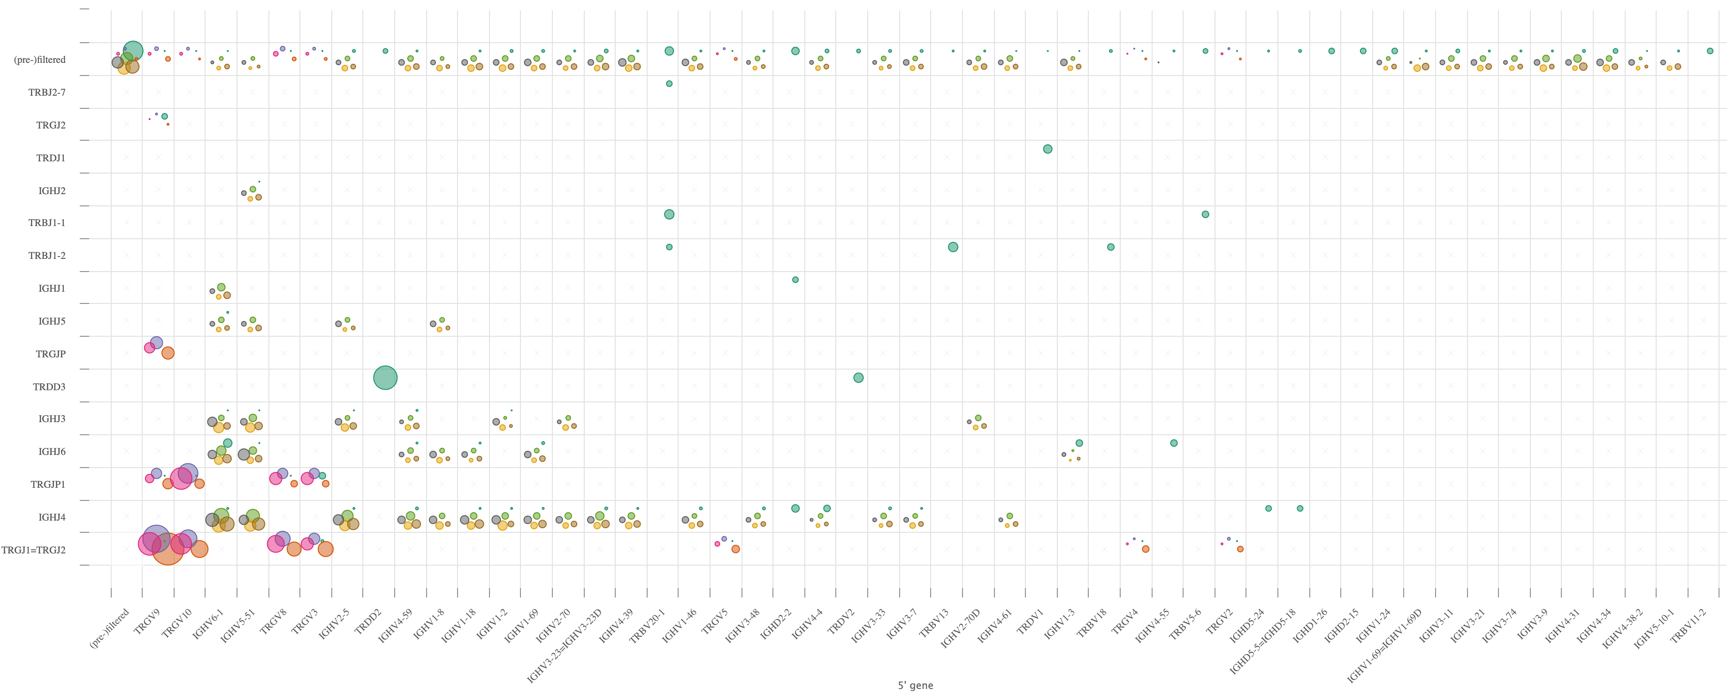
Immunogenetic
Different cell populations
  Clonal studies
  Repertoire usage
Main usage – blood malignancies (leukemias)

Slide 28
NGS data analysis
Raw data
.fastq
Experiment design
de-multiplexing
QC
Not known
reference
Not ”classic” reference
Genome/Transcriptome Reference Mapping
.bam
Metagenomics
Reference assembly
Immunogenetic
VDJ-genes
CRISPR
sgRNA
QC
Methylation
Bisulfide-seq
Interaction
analysis
CHIP-seq
Expression analysis
RNAseq
Variant analysis
WES
…
28

Slide 29
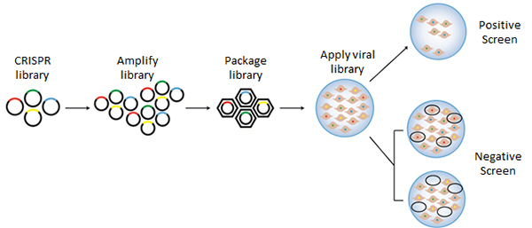
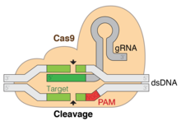
Genome-wide CRISPR-Cas9 knockout screens
Cas9 (CRISPR associated protein 9) is a protein which plays a vital role in the immunological defense of certain bacteria against DNA viruses
sgRNA libraries
  Each sgRNA knockout specific gene
  76,000 guide RNAs (sgRNAs) with four highly active guides per gene, targeting about 19,000 genes as well as non-targeting sgRNA controls
Lentivirus

Slide 30
Genome-wide CRISPR-Cas9 knockout screens
Screen selection + expansion/enrichment of surviving cells
NGS sequencing

Slide 31
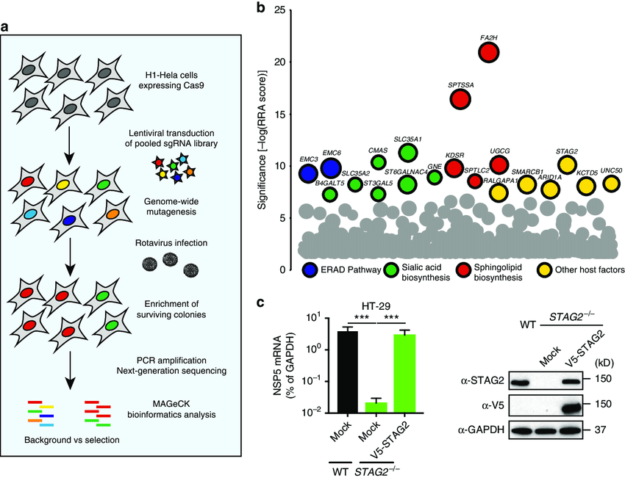
Genome-wide CRISPR-Cas9 knockout screens
NGS data analysis
  Counting cells with different genes KD
  Counting sgRNA fragments
  Compare conditions

Slide 32
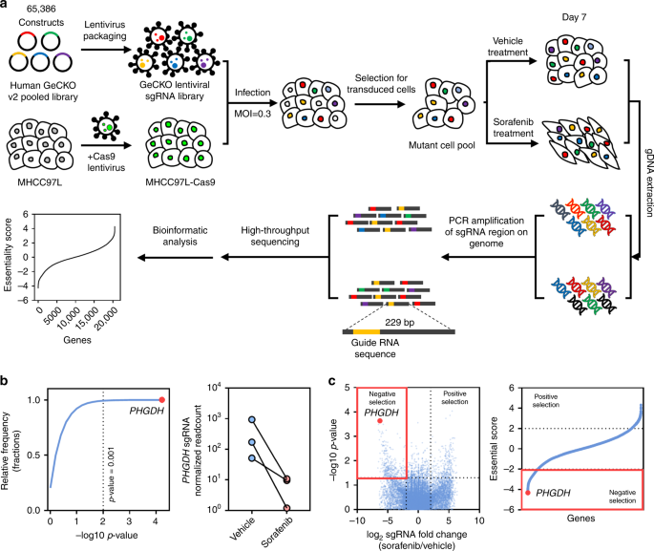
Genome-wide CRISPR-Cas9 knockout screens
Example study
Wei, L., Lee, D., Law, CT. et al. Genome-wide CRISPR/Cas9 library screening identified PHGDH as a critical driver for Sorafenib resistance in HCC.
Nat Commun 10, 4681 (2019). https://doi.org/10.1038/s41467-019-12606-7

Slide 33
NGS data analysis
de-multiplexing
Raw data
.fastq
Experiment design
QC
Not known
reference
Not ”classic” reference
Genome/Transcriptome Reference Mapping
.bam
Metagenomics
Reference assembly
Immunogenetic
VDJ-genes
CRISPR
sgRNA
QC
Methylation
Bisulfide-seq
Interaction
analysis
CHIP-seq
Expression analysis
RNAseq
Variant analysis
WES
…
33

Slide 34
De-multiplexing

Slide 35
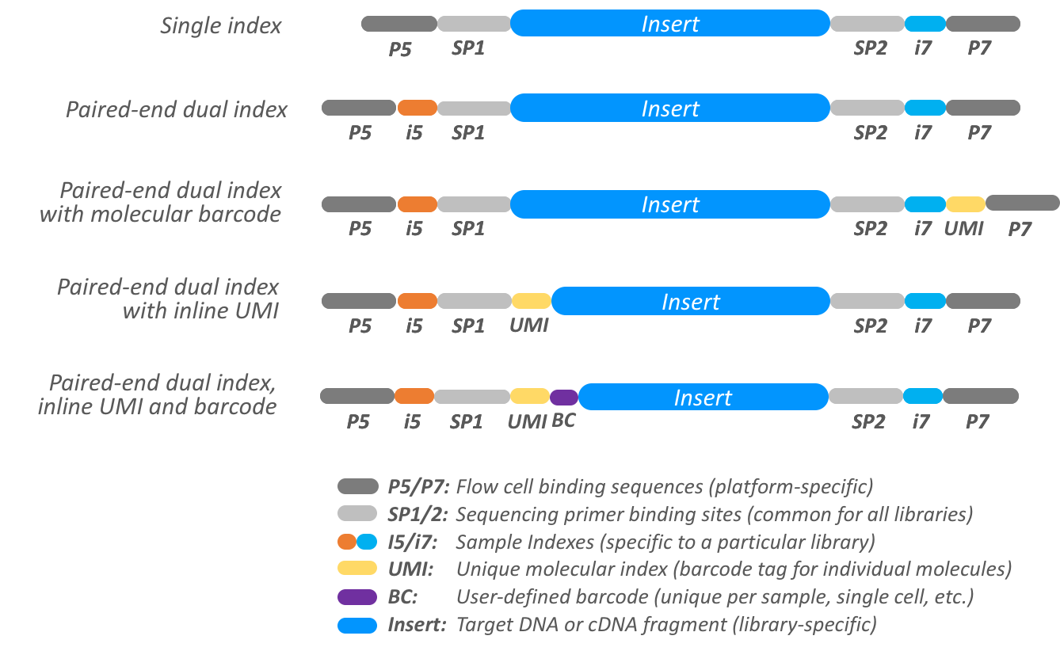
De-multiplexing
Bcl2fastq tool
  Needs sample sheet with indexes
  Number of barcode mismatches
    Check undetermined

Slide 36
Primary data – fastq file

Slide 37
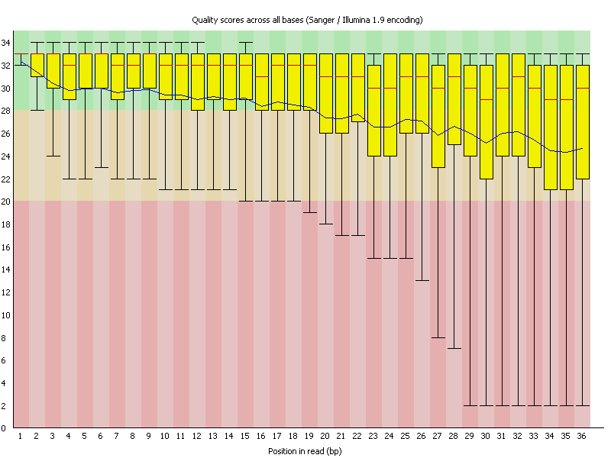
Fastq format - quality
Fastq - q stands for quality – coded phred score
CFFFFEFFGCEEGECFGGGGAFF87@E:++6C<++3:,8,33,,:,,,:,,:,,,
Quality | Error probability
5 | 31%
10 | 10%
20 | 1%
30 | 0.1%
Very good for early problem detection
Reasonable for trimming and read filtering
  RNA seq - above phred score 5

Slide 38
Fastq – quality control
Fastqc - tool

Slide 39
CEITEC
@CEITEC_Brno
Thank you for your attention!
Vojta Bystry
vojtech.bystry@ceitec.muni.cz
www.ceitec.eu

