Slide 1

Lecture 6 : Single Cell
RNA-seq analysis
Modern Genomic Technologies (LF:DSMGT01 )
Vojta Bystry
vojtech.bystry@ceitec.muni.cz

Slide 2
RNA-seq types
Bulk RNA-seq
SC-RNA-seq
Spatially resolved RNA-seq

Slide 3
Bulk RNA-seq vs. SC-RNA-seq
Bulk RNA-seq
  Several samples
  Difference in RNA levels between predetermined set of samples (conditions)
SC-RNA-seq
  Hundreds to thousand cells
  Distinguish (cluster) cells based on the difference in RNA levels

Slide 4
SC-RNA-seq primary analysis
In principle similar to the bulk RNA-seq
  Map to genomic reference, demultiplex and count reads per gene
For 10x Genomics tool from the company - Cell Ranger
Cell Ranger - report example

Slide 5
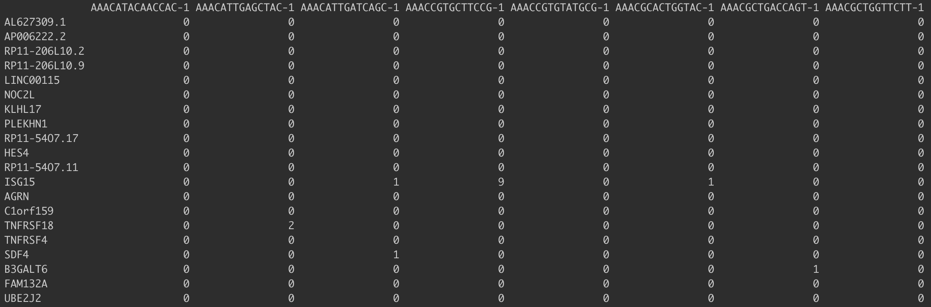
SC-RNA-seq primary analysis results
per gene (feature) per cell read count

Slide 6
Pre-processing workflow
Filtering of cells based on QC metrics
Detection and filtering of highly variable features
Data normalization and scaling

Slide 7
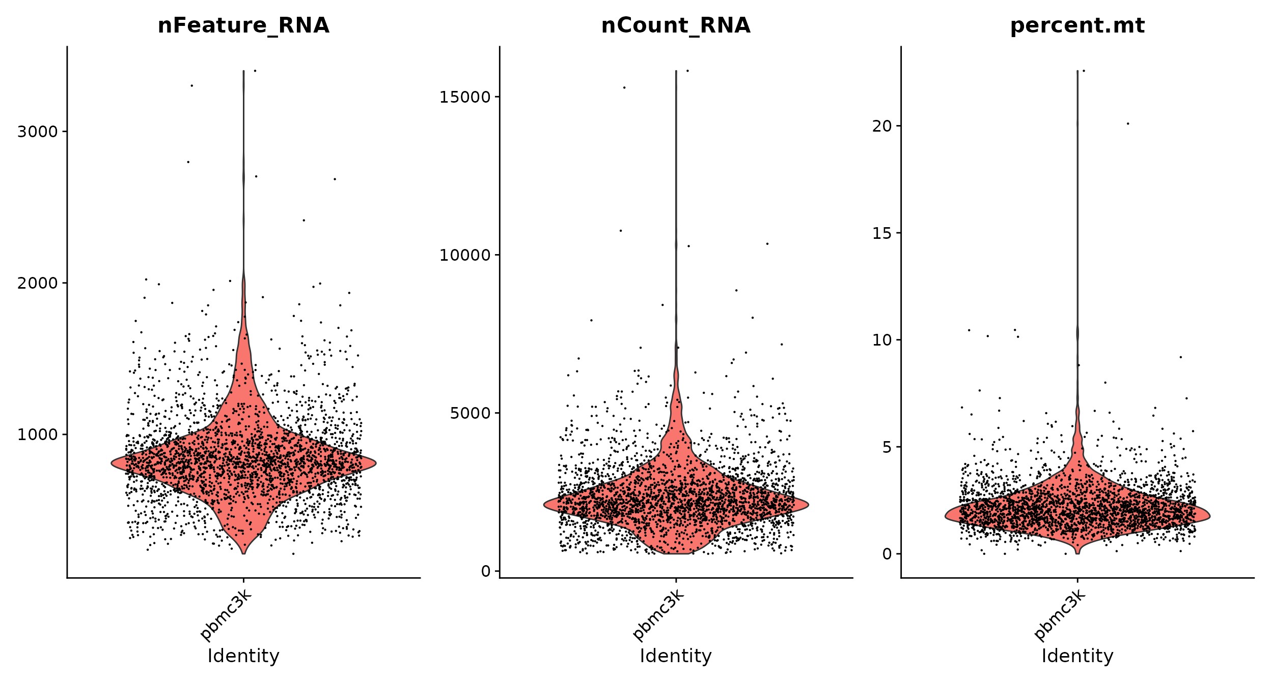
Filtering of cells QC
Number of genes
Number of reads
% of mitochondrial RNA
  Sign of dying cells
Example filtering:
  filter cells that have unique feature counts over 2,500 or less than 200
  filter cells that have >5% mitochondrial counts

Slide 8
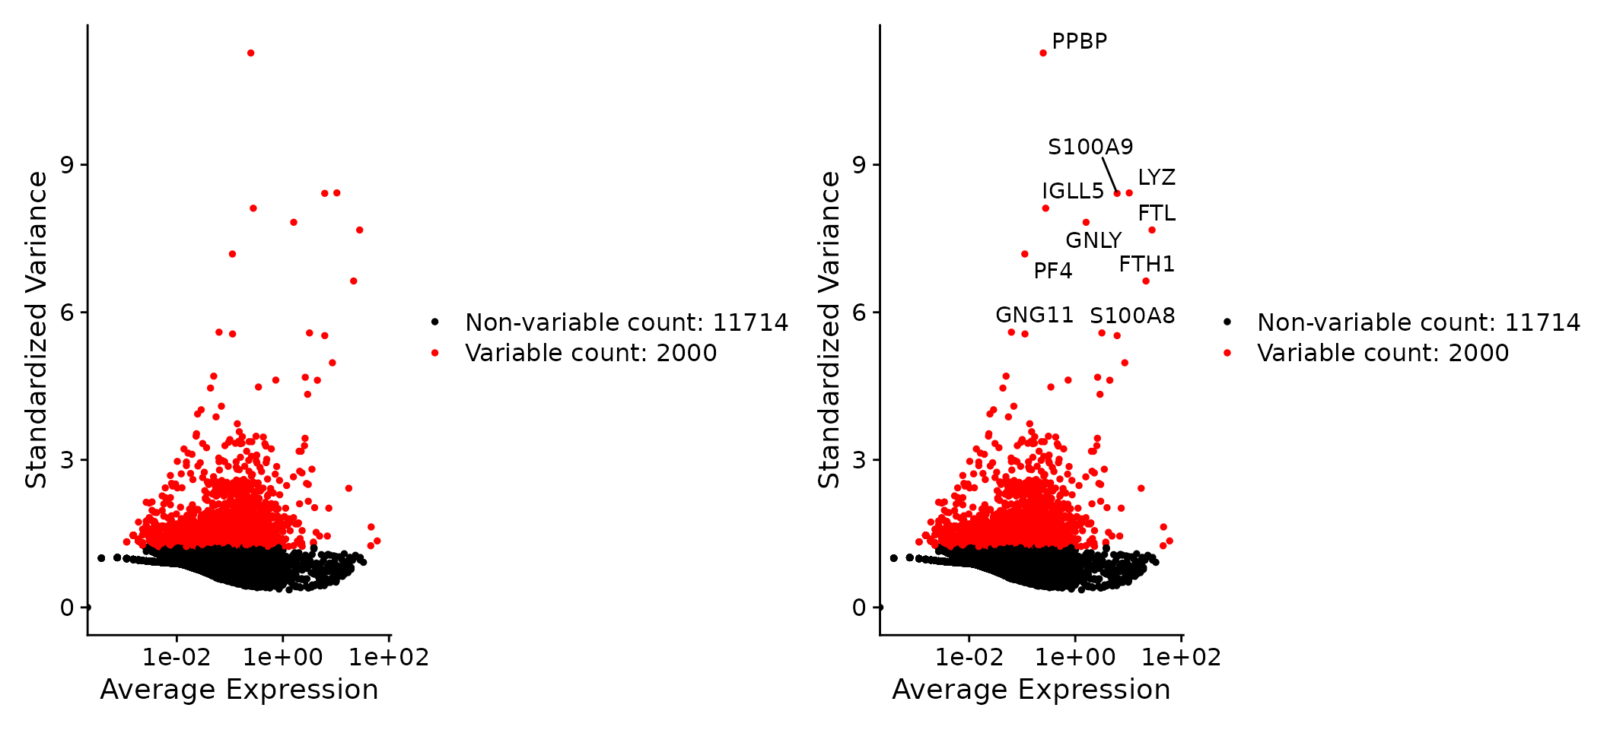
Identification of highly variable features

Slide 9
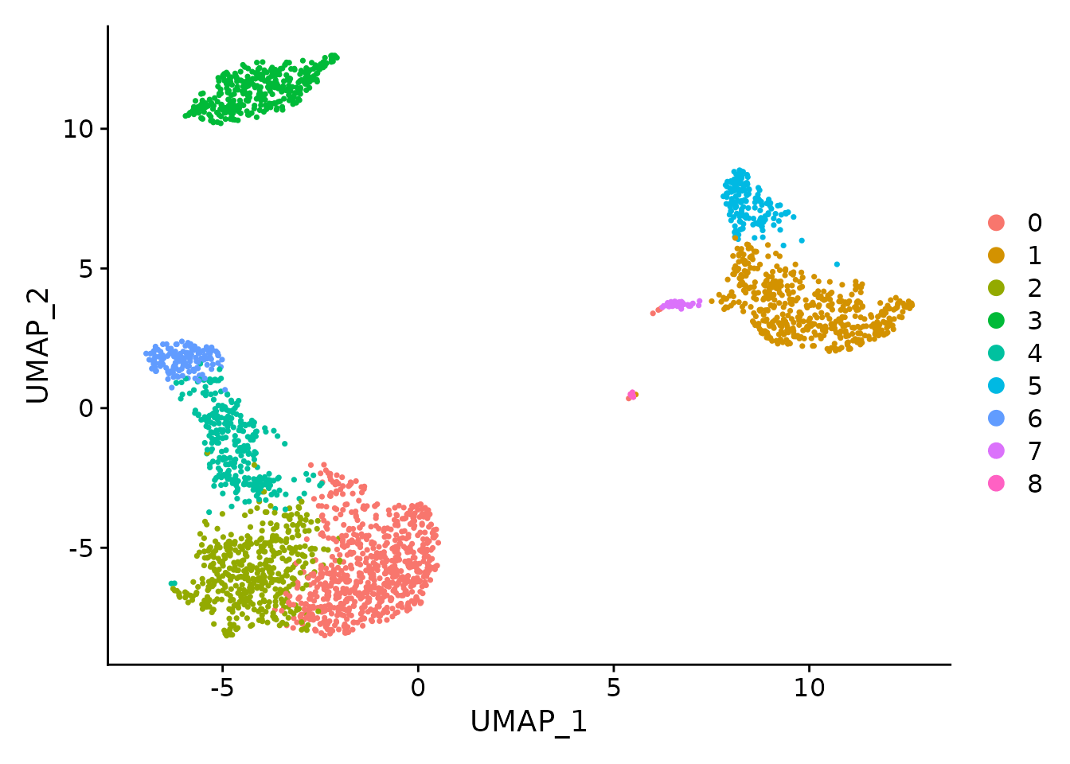
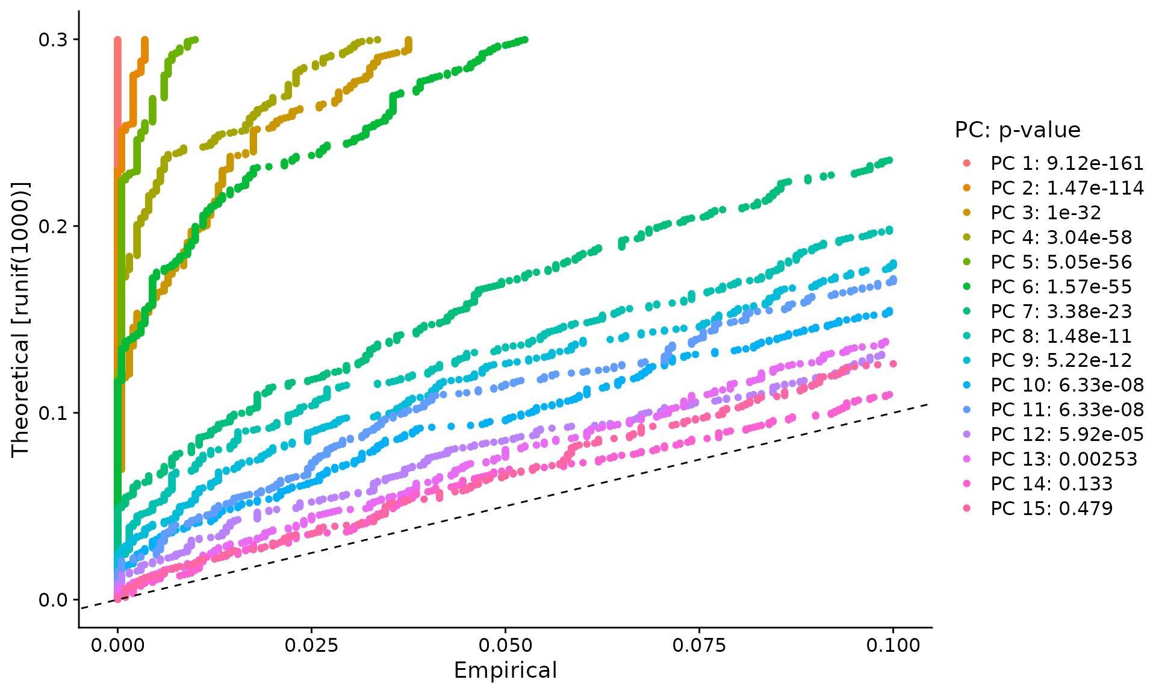
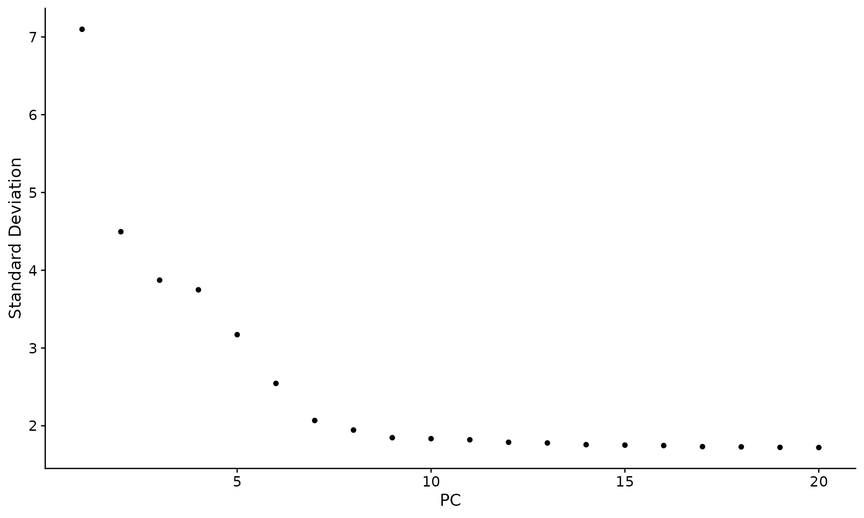
Determine the ‘dimensionality’ of the dataset
How many clusters (cell types) is in the experiment (we want to explore)
Analysis of PCA results
Better to choose higher value then smaller

Slide 10
Cluster the cells
graph-based algorithms
UMAP/tSNE visualization

Slide 11
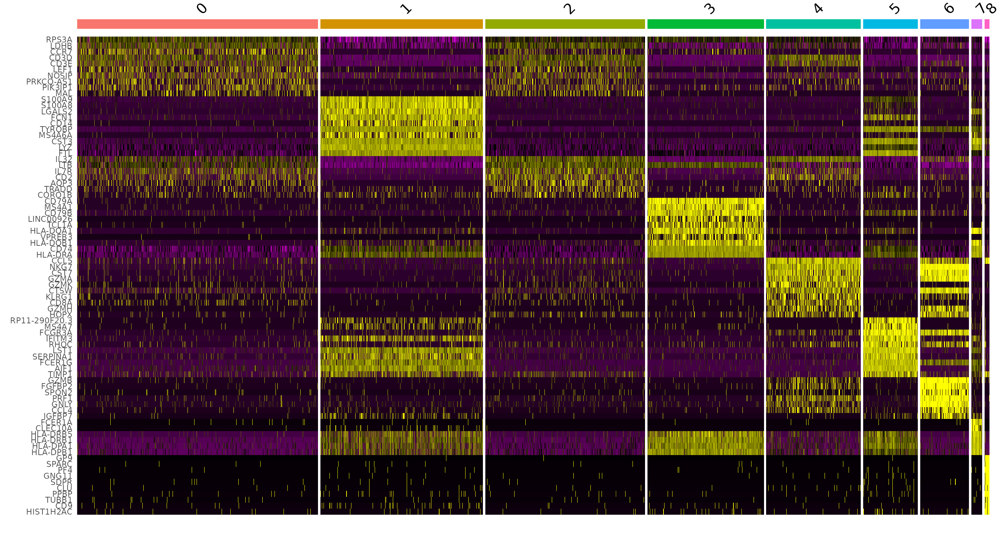
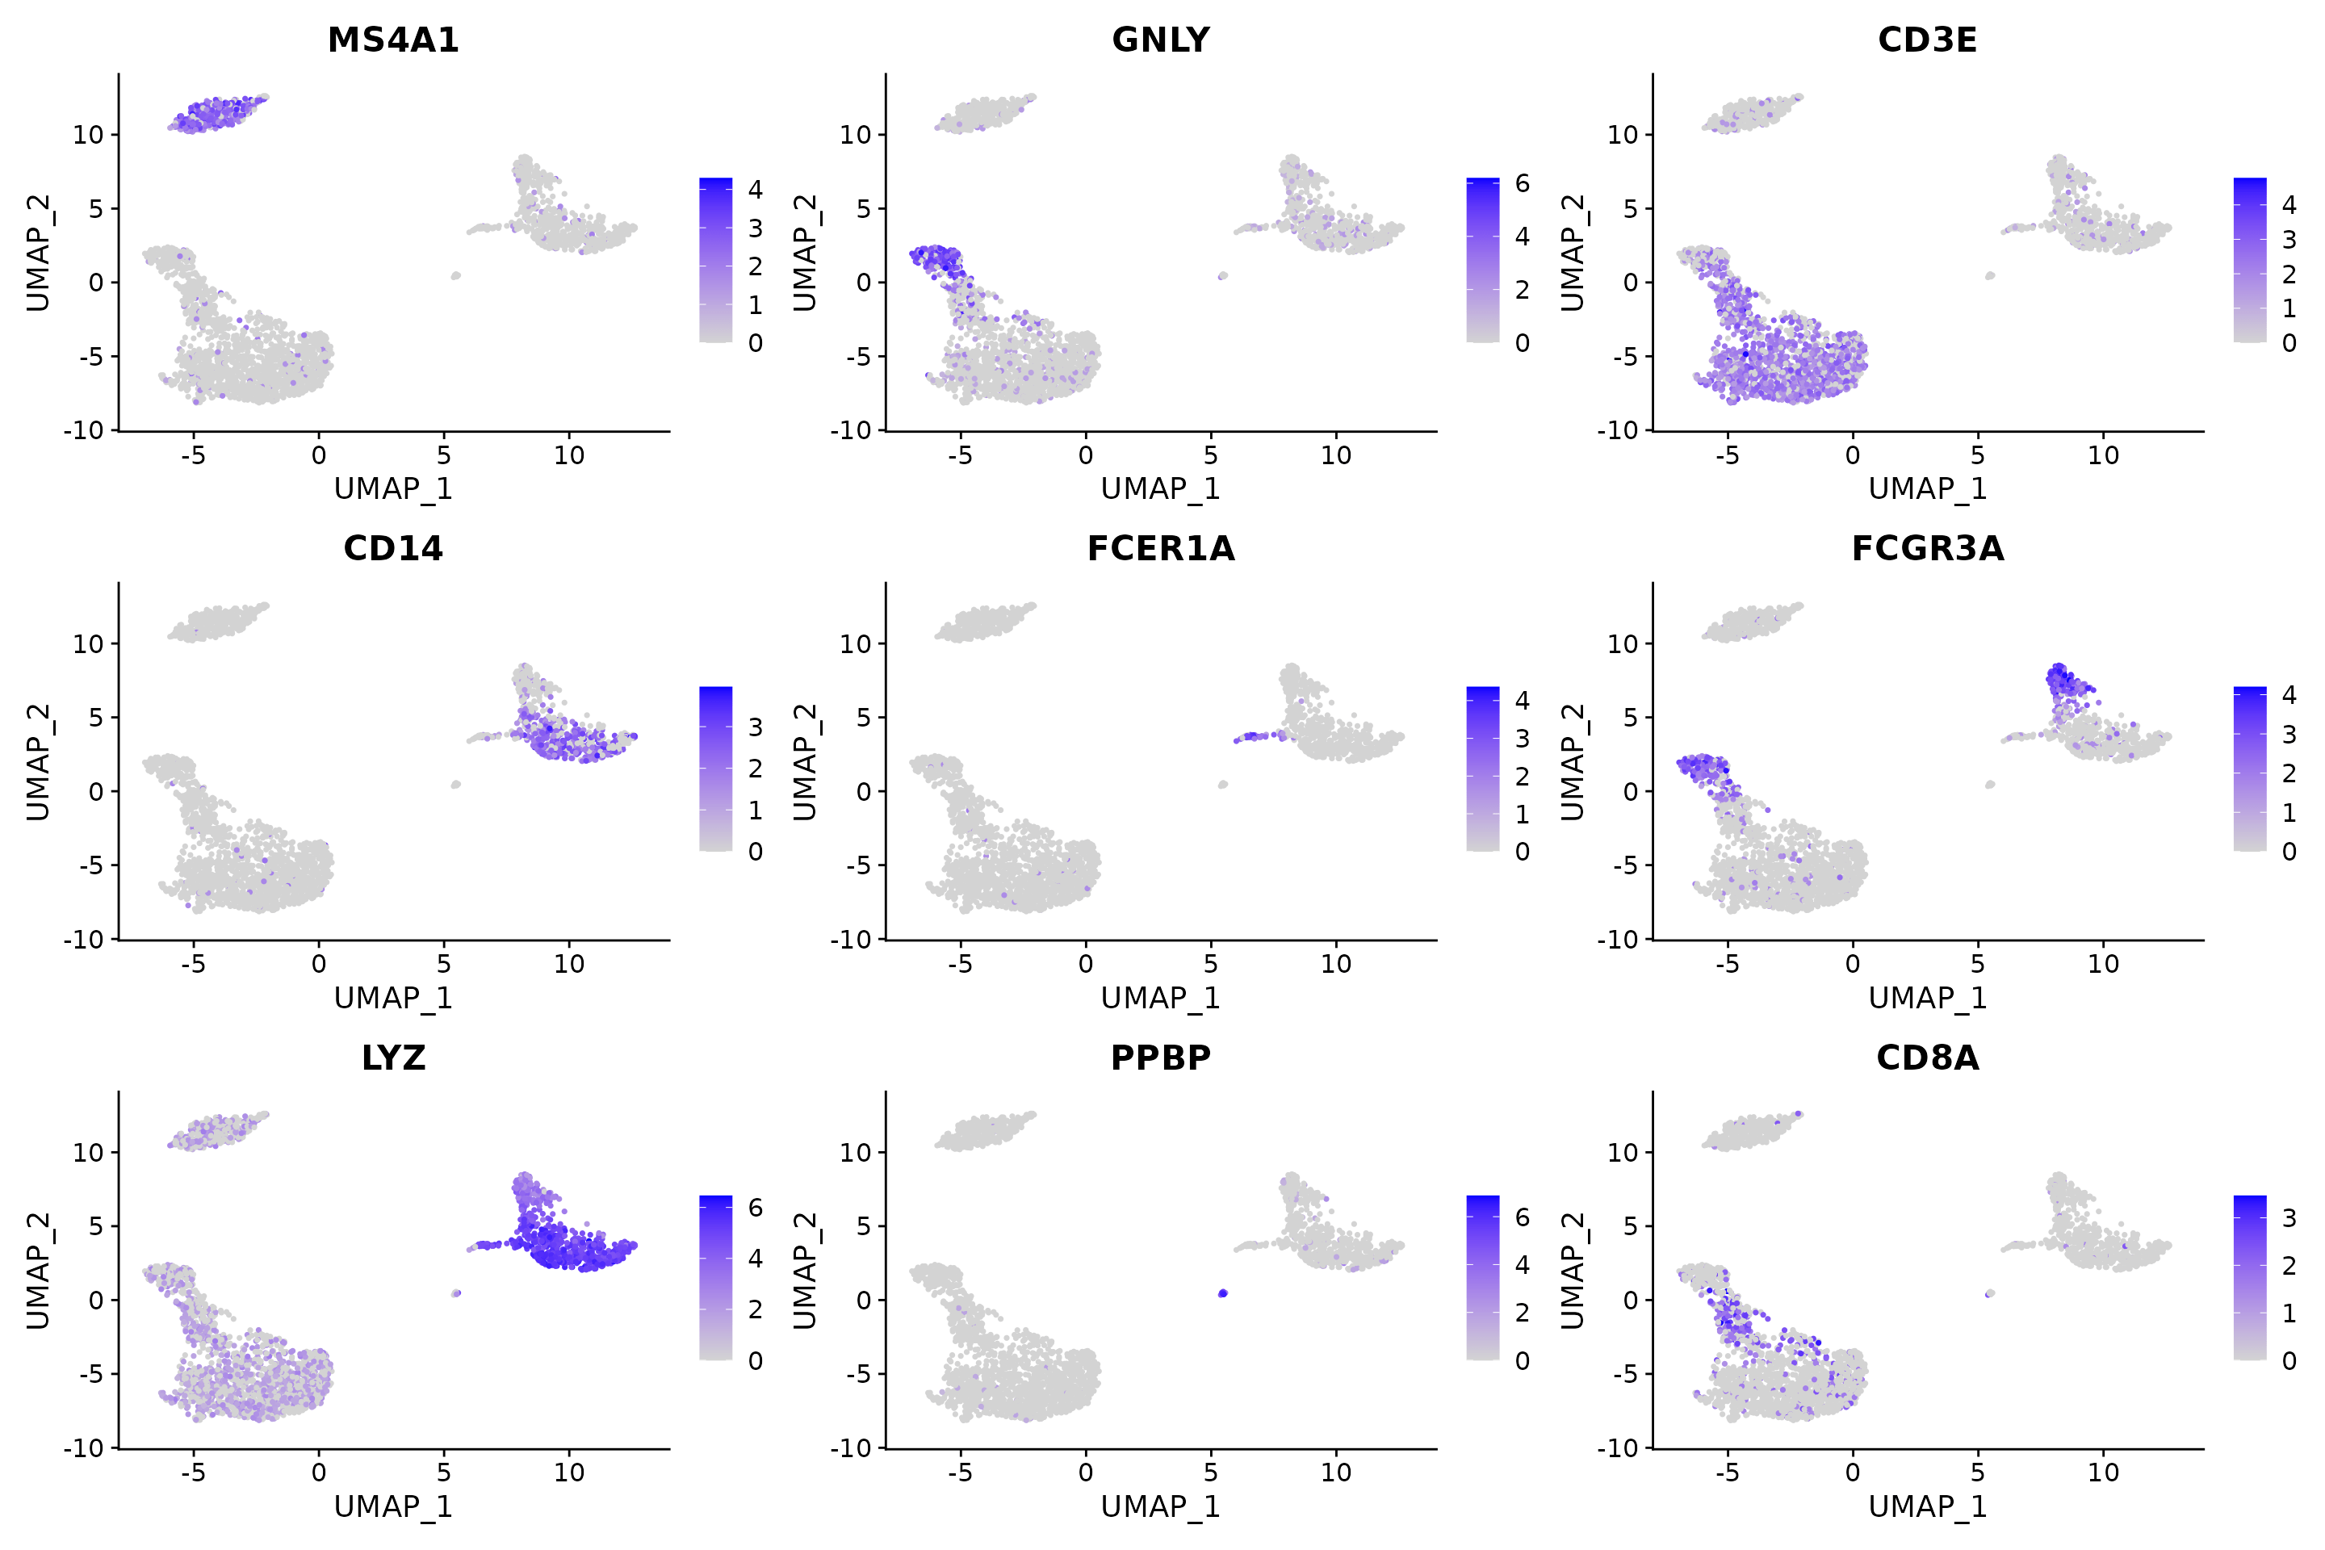
Analysing clusters
Finding differentially expressed features (cluster biomarkers)

Slide 12
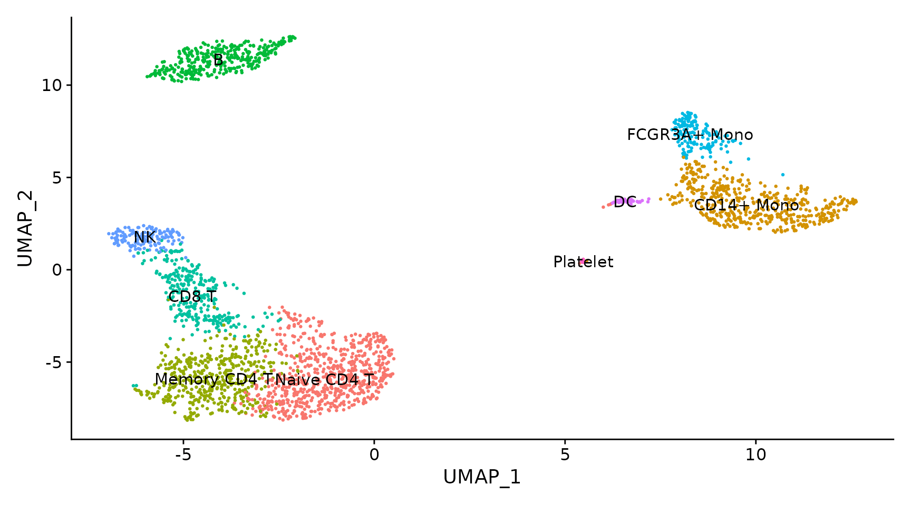
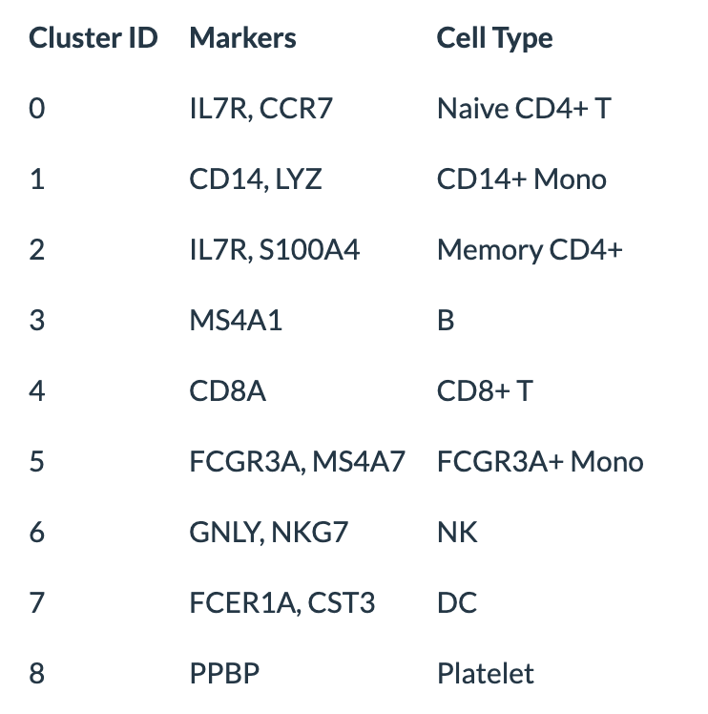
Assigning cell type identity to clusters

Slide 13
Advanced analysis
Cell state/development directions
  Pseudo-time
  Velocity

Slide 14
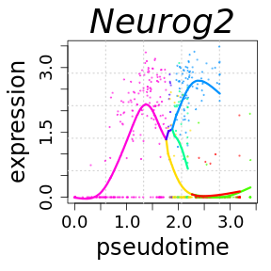
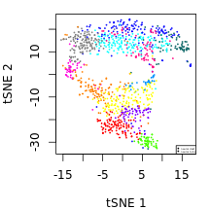
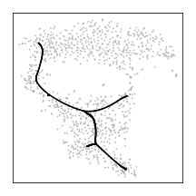
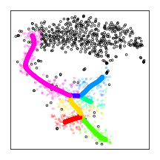
Pseudotime
does not provide information about directionality of dynamics

Slide 15
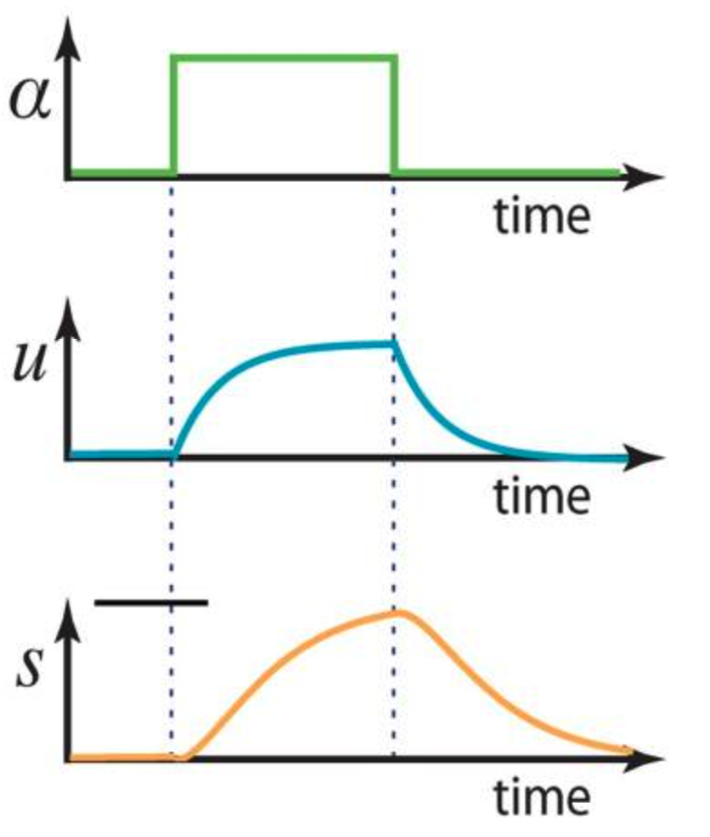
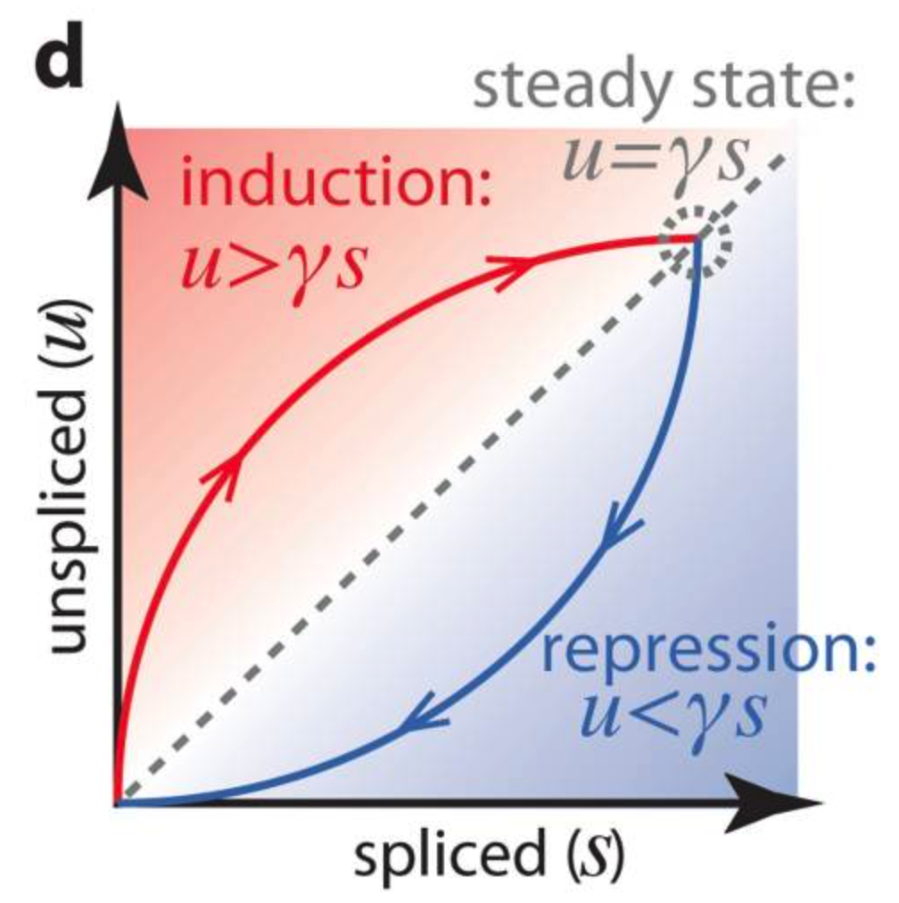
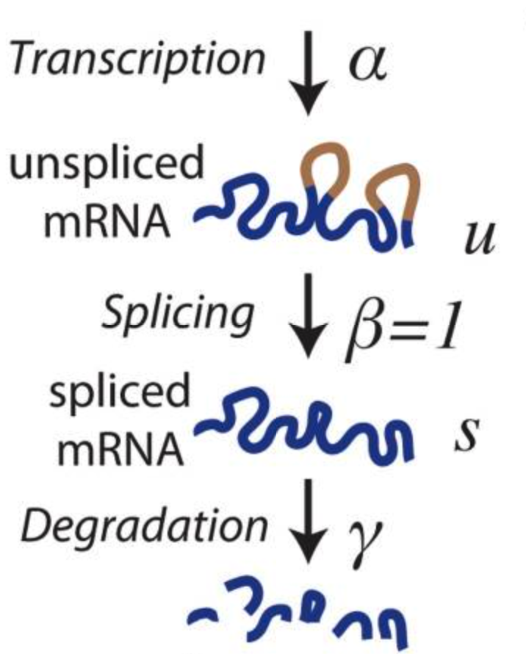
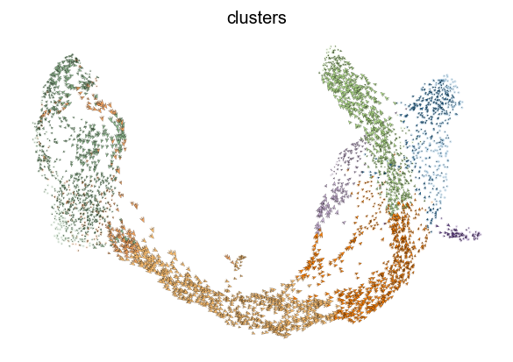
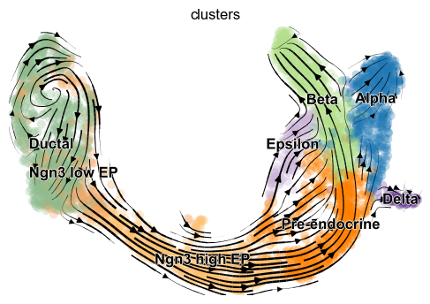
Velocity

Slide 16
CEITEC
@CEITEC_Brno
Thank you for your attention!
Vojta Bystry
vojtech.bystry@ceitec.muni.cz
www.ceitec.eu

