Slide 1
Prosthetics
Field, its essentials and use in practice
Department of Orthopedic Surgery – Faculty of Medicine – Masaryk University
Assistant professor Jan Kocanda

Slide 2
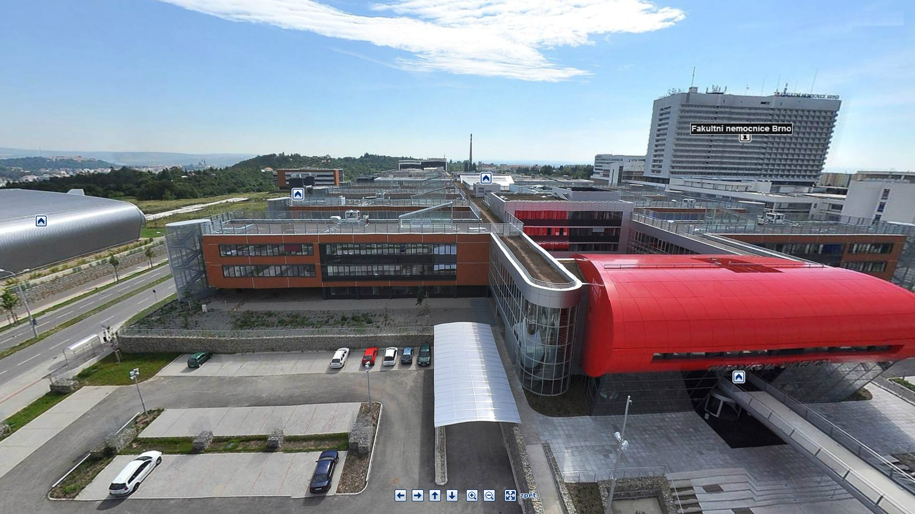

Slide 3
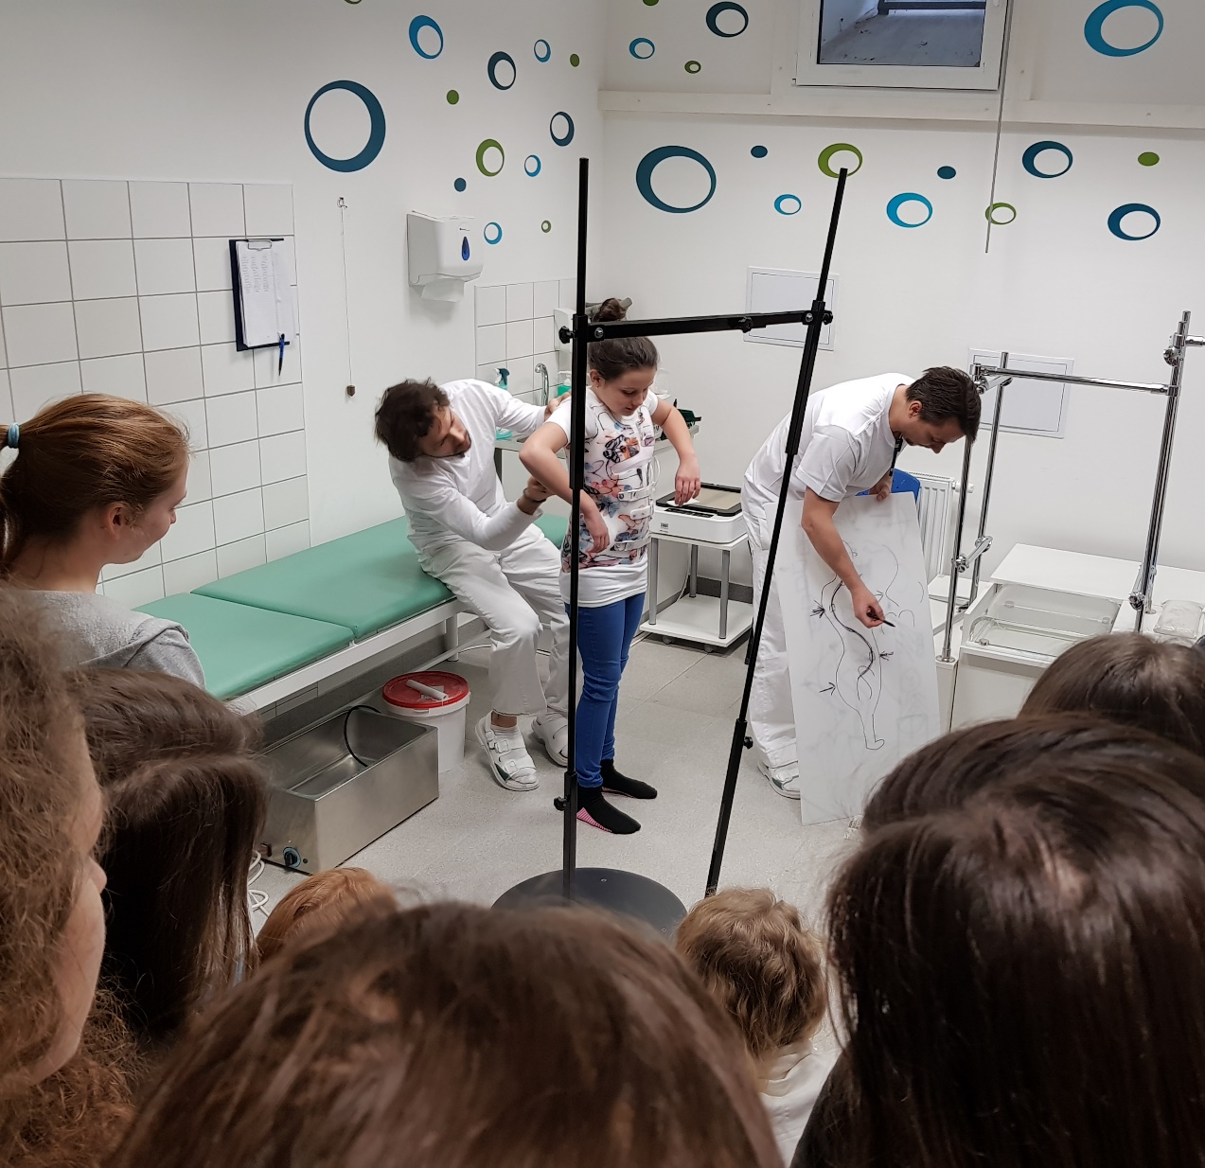
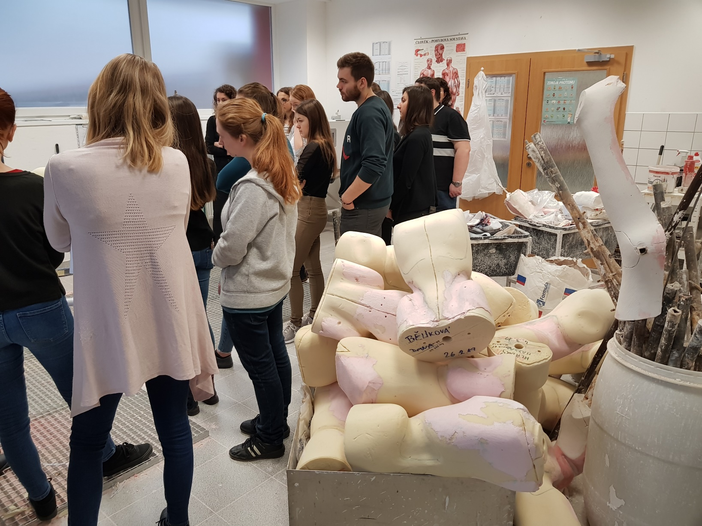

Slide 4
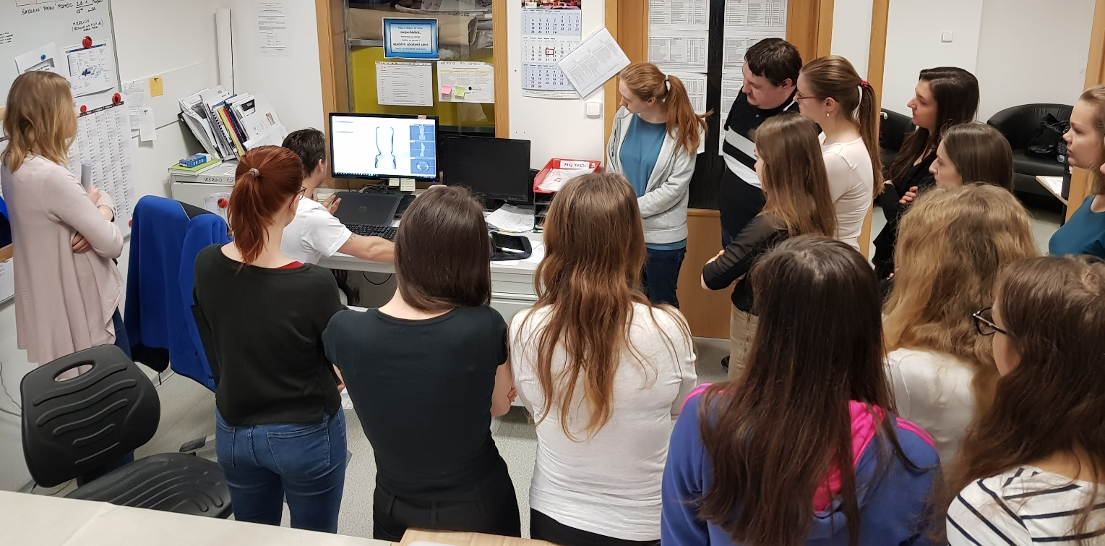
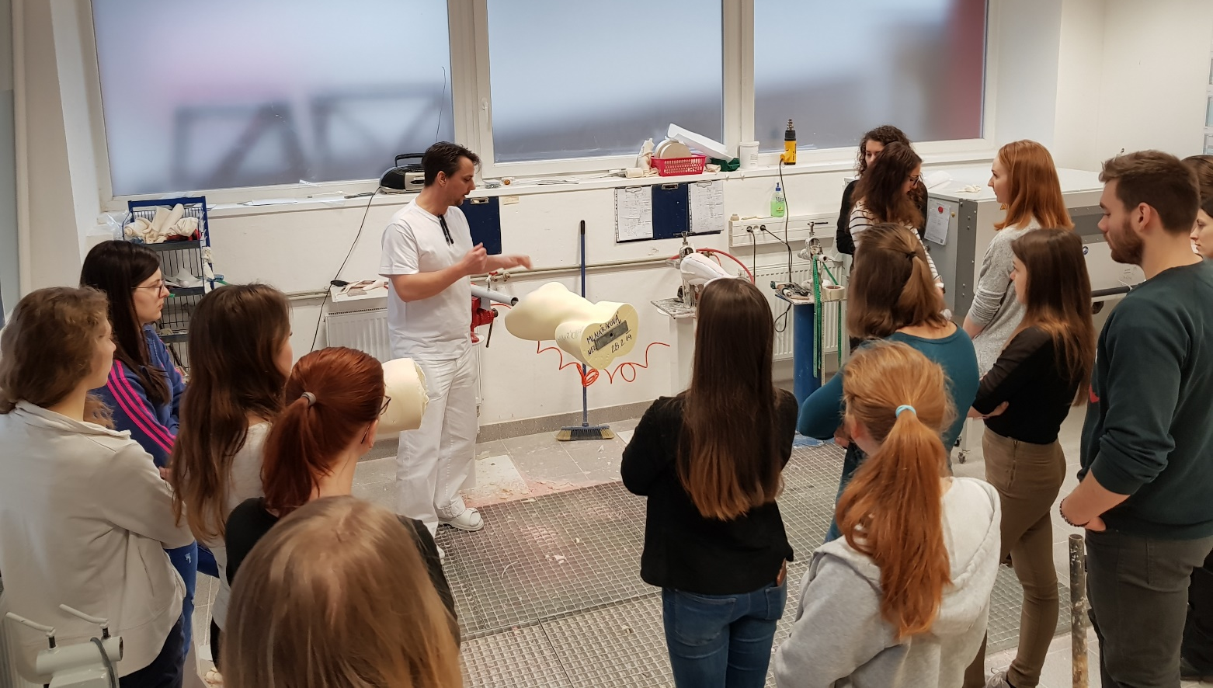

Slide 5
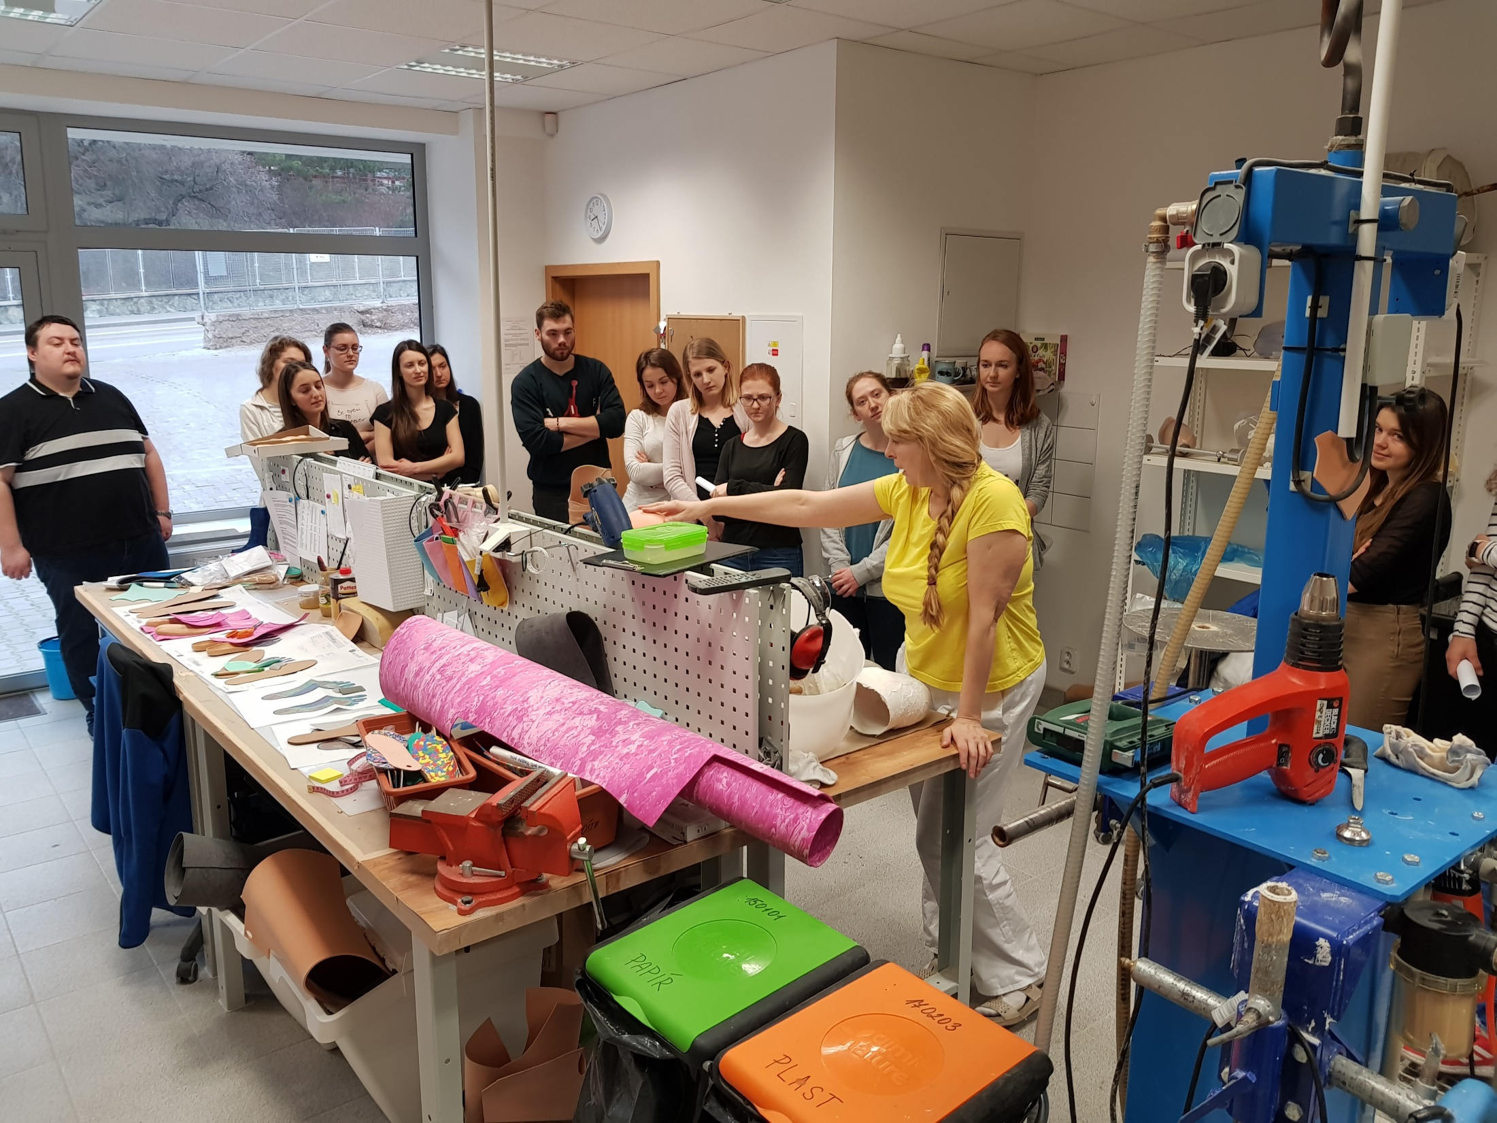
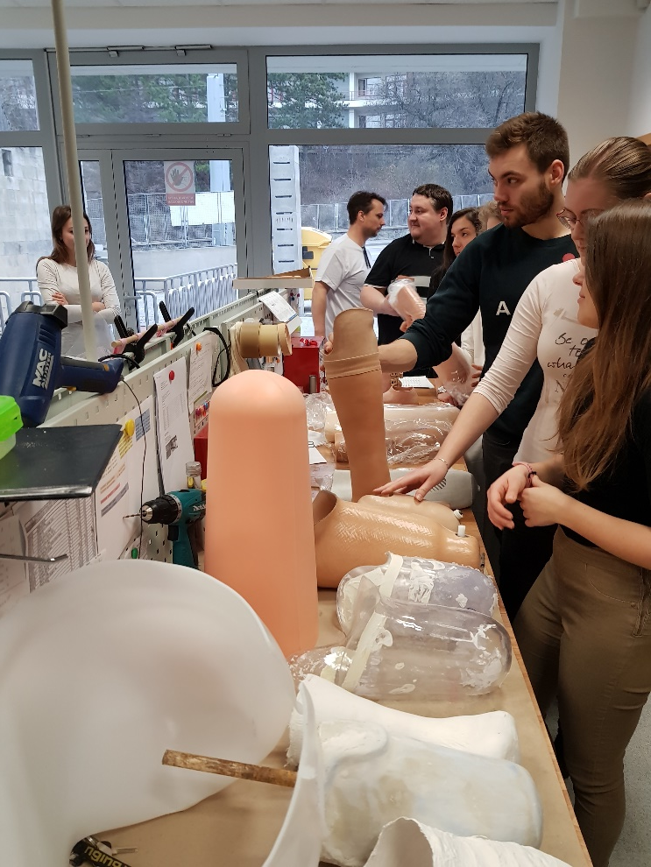

Slide 6
Acknowledgements to assoc prof Zdenek Rozkydal & assoc prof Ivan Muller for database

Slide 7
Orthopaedic Prosthetics
Medical and technical production
Distribution of rehabilitative care

Slide 8
Orthopaedic Prosthetics
Proteometry – gets data for the design, production and application
Prosthetics - the doctrine of replacement of lost parts of the body and function
Orthotics - the doctrine of replacement of the lost functions of the body
Epitetics - the doctrine of cosmetic covering of part of the body
Kalceotika - the doctrine of orthopedic footwear
Adjuvatics - the doctrine of operator aids

Slide 9
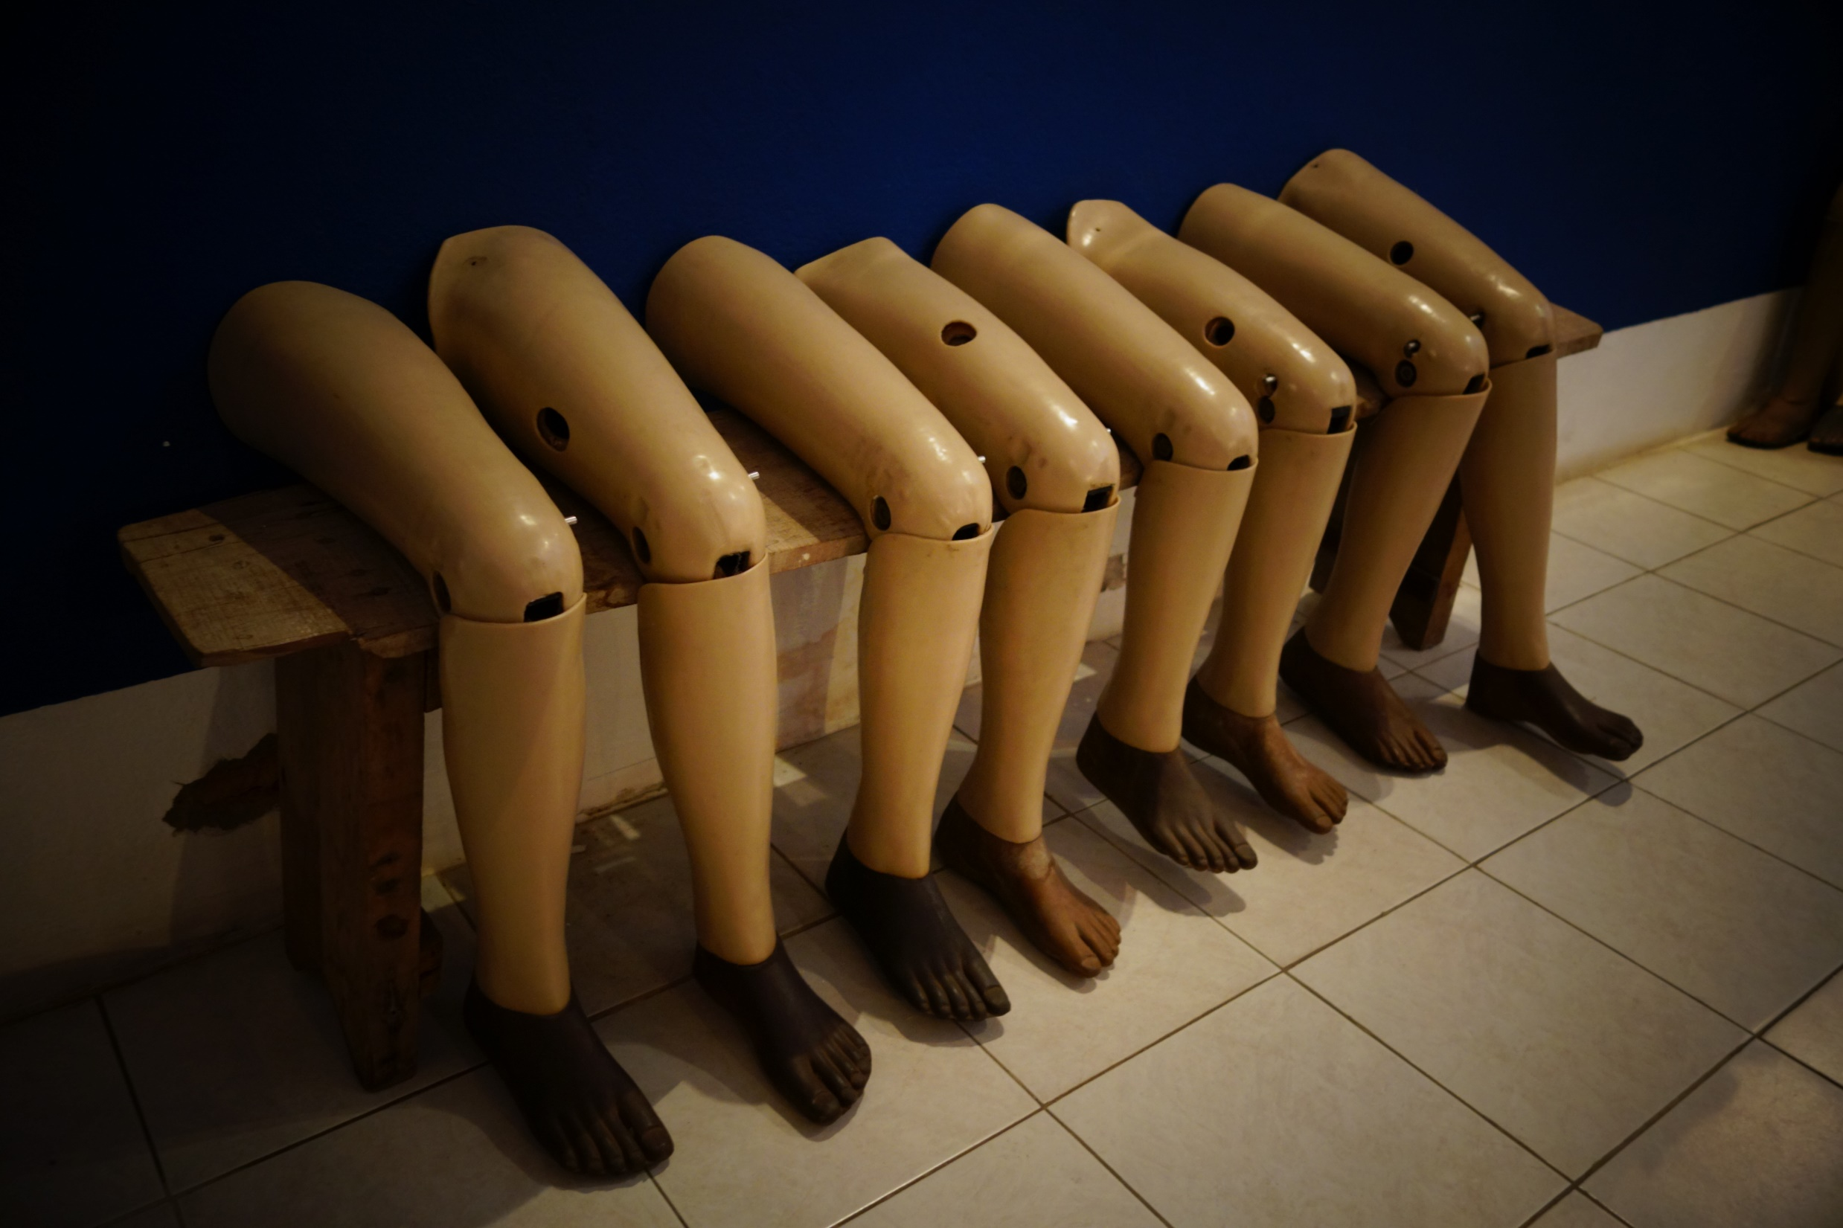
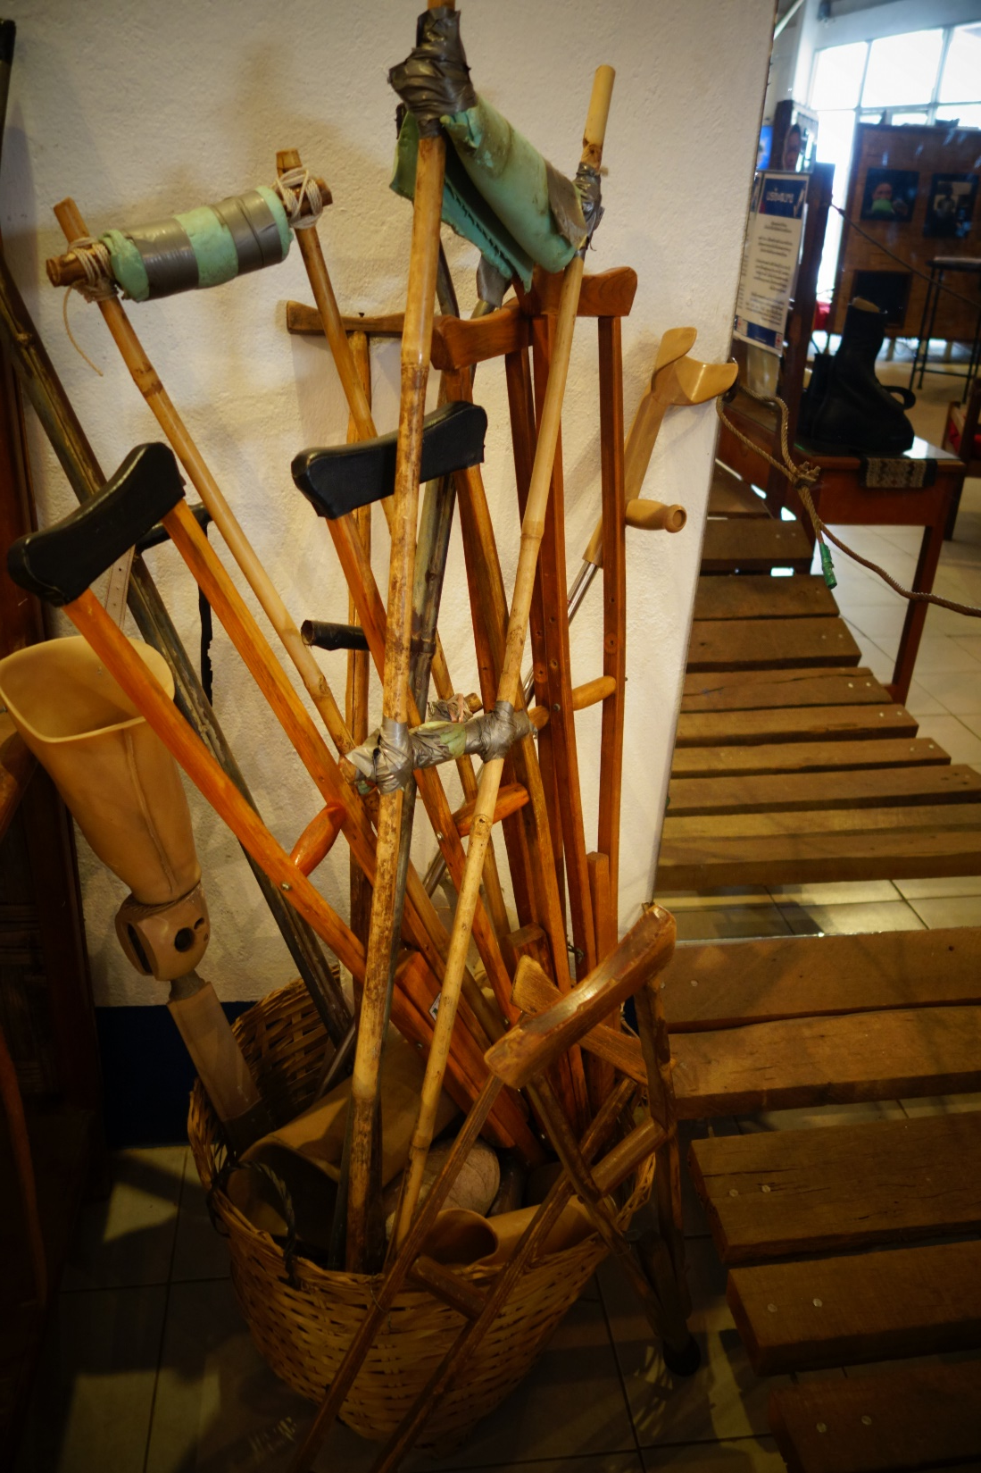
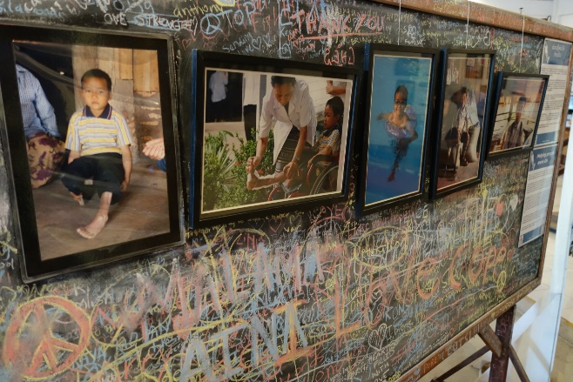
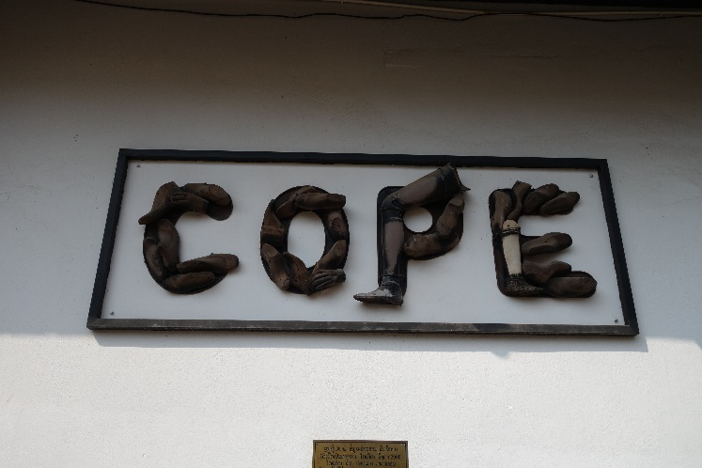
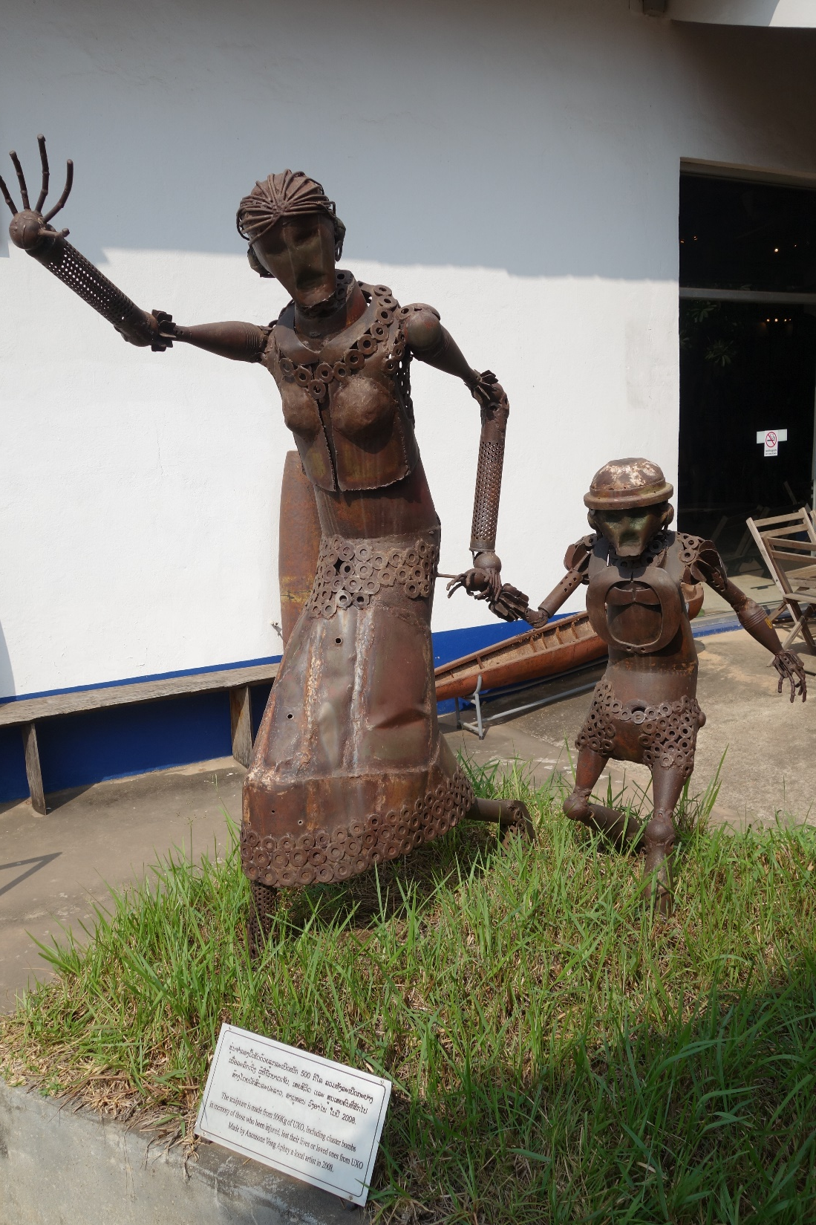
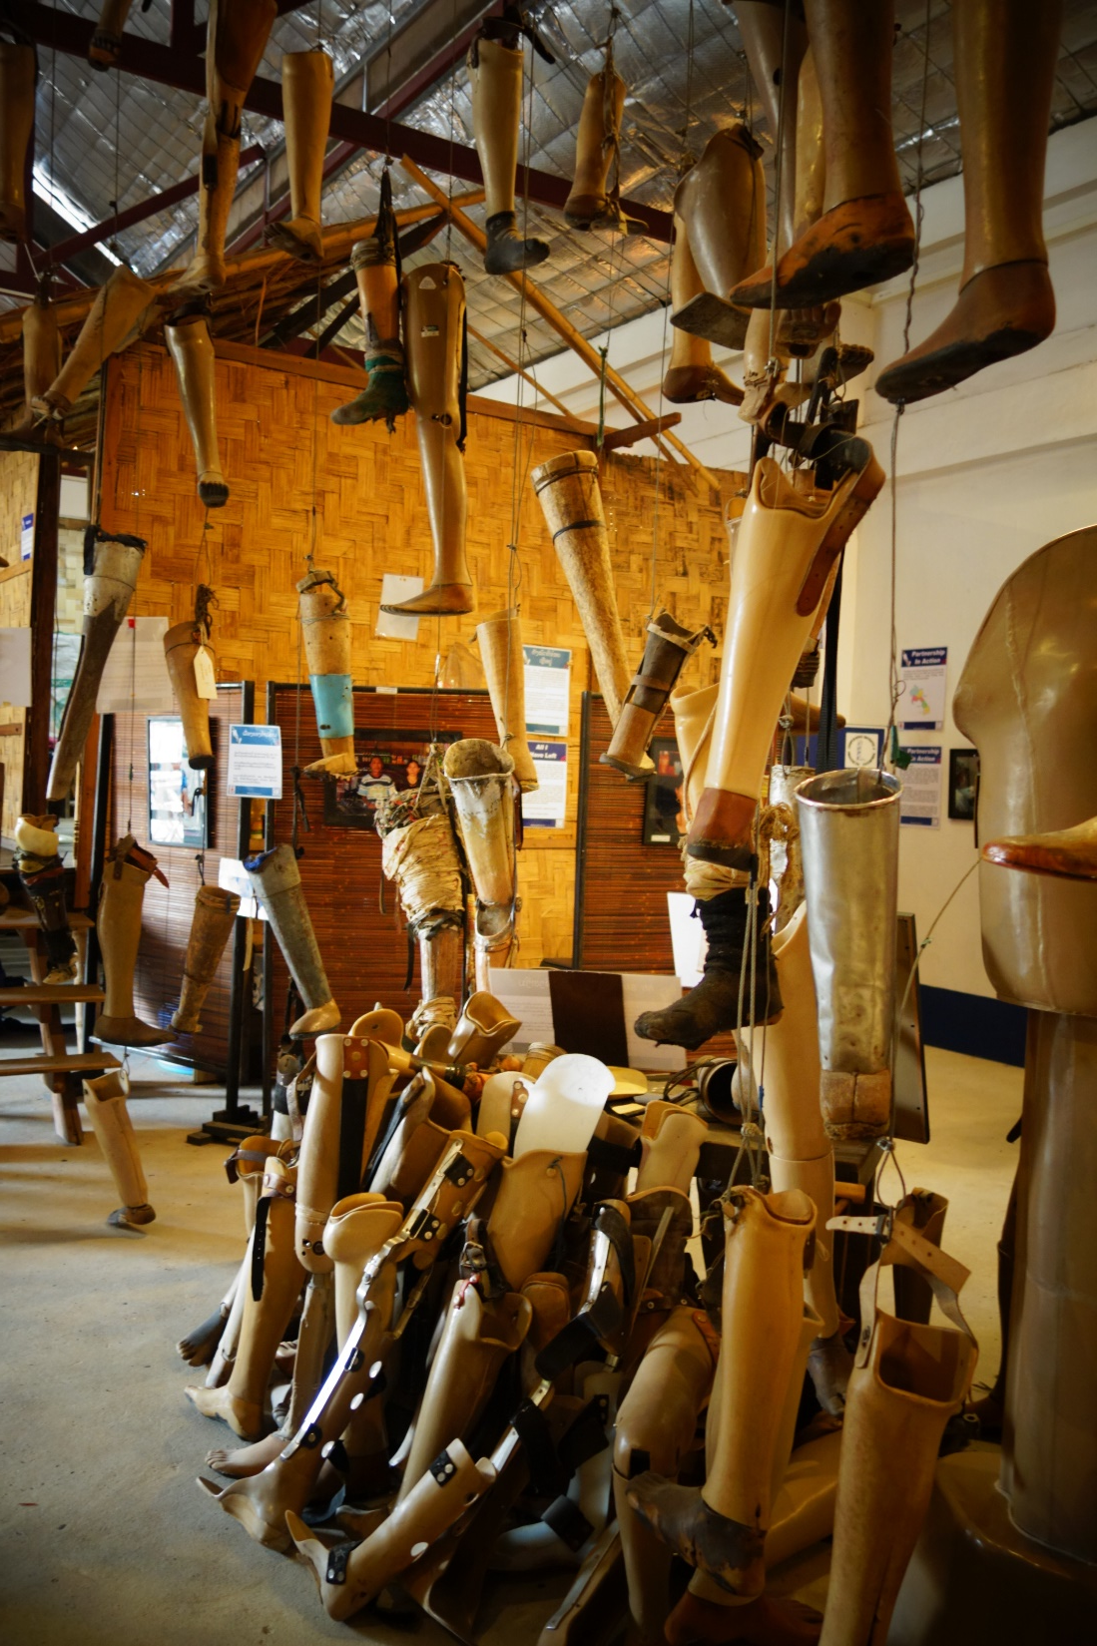
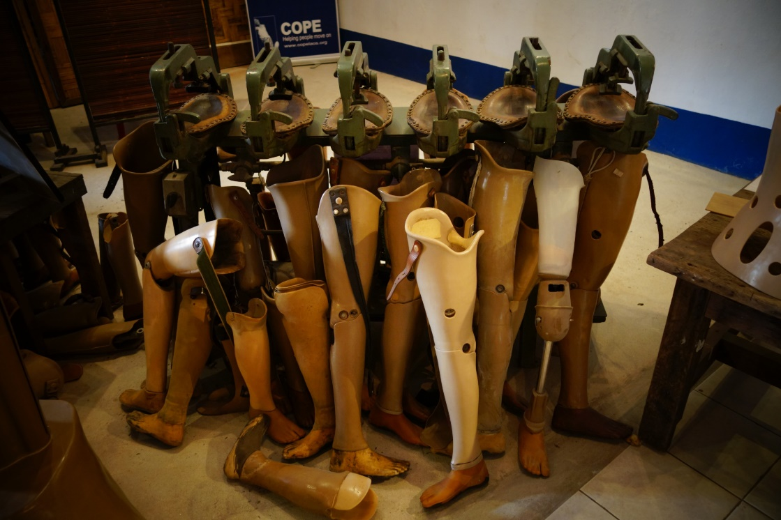
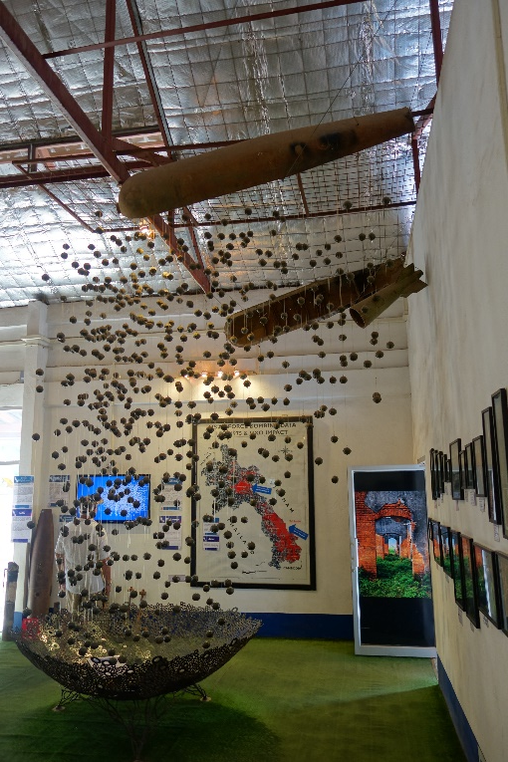
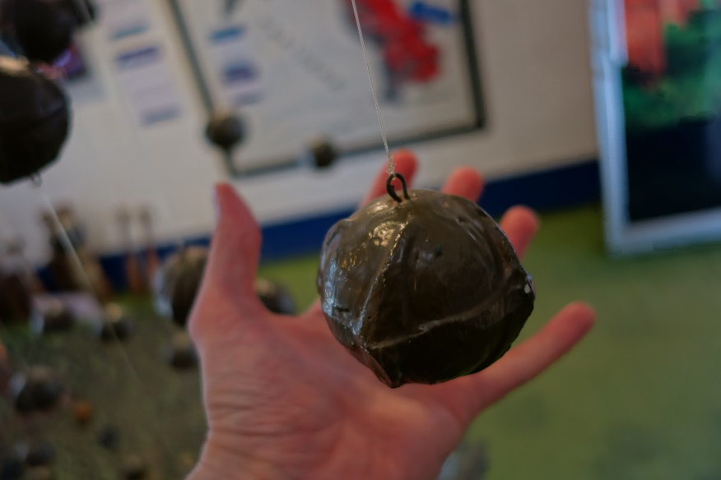
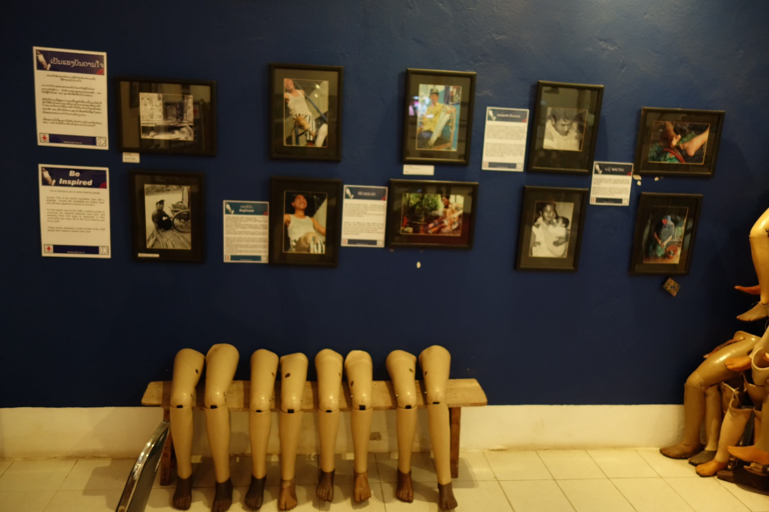
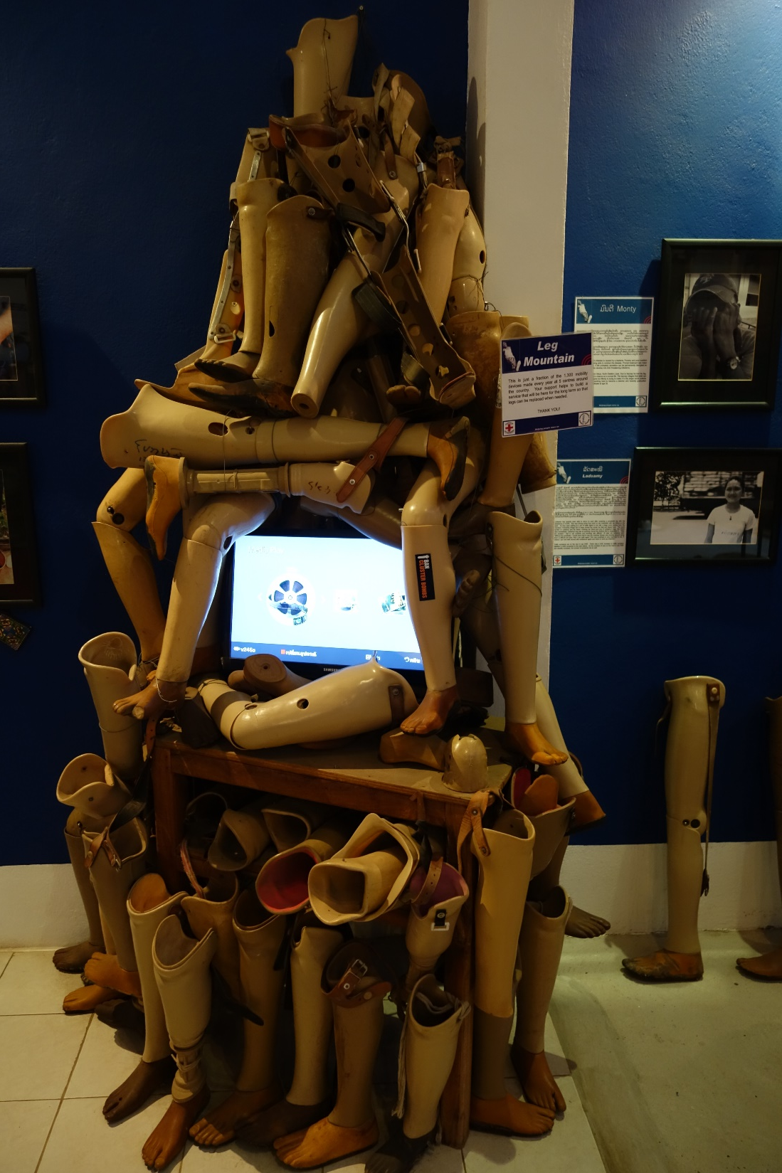
History
21st?

Slide 10
Proteometry
History with a focus on social and work history
Clinical examination
Kinesiological analyses (GROSS a spol. 2005).
Anthropometric examination
Kartezian planes:
  3D, frontal, sagittal, transversal
  orthopedic somatometry (base points, limb length, measuring sheets)

Slide 11
Protetika
doctrine on the replacement of lost body parts
Prothesis:
  Replacement: body parts and functions
  Requirements:
    statics, dynamics, controllability
    durability, aesthetics
  Construction:
    Stump bed
    Module (thigh, leg, leg, joint)
    Auxiliary parts: bandages, stools

Slide 12
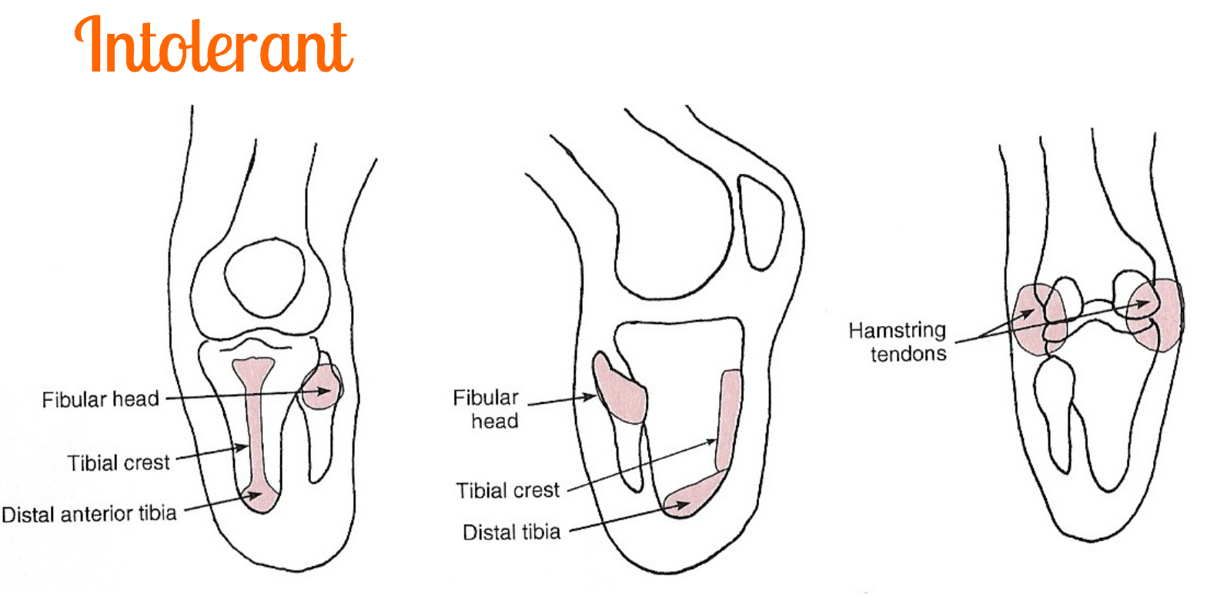
Protetika
Construction – stump bed

Slide 13
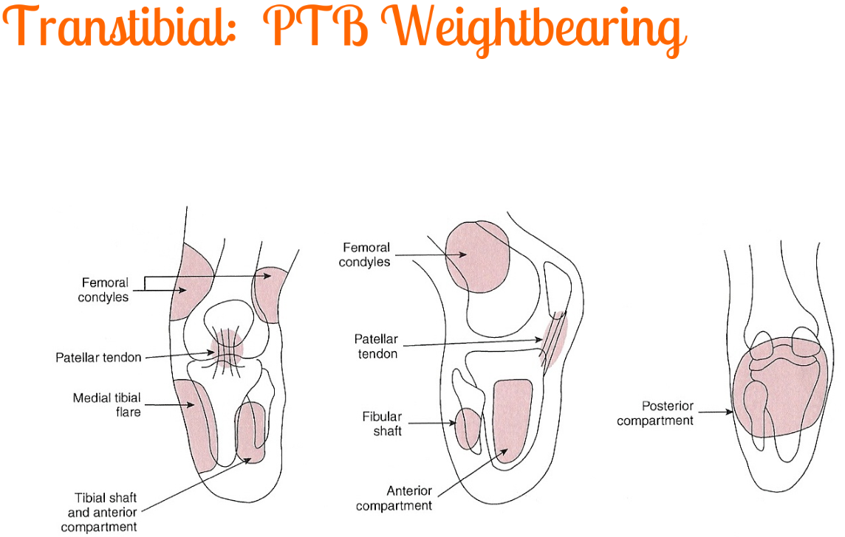
Protetika
Konstrukce – pahýlové lůžko

Slide 14
Protetika
Construction – stump bed

Slide 15
Protetika
Construction – stump bed

Slide 16
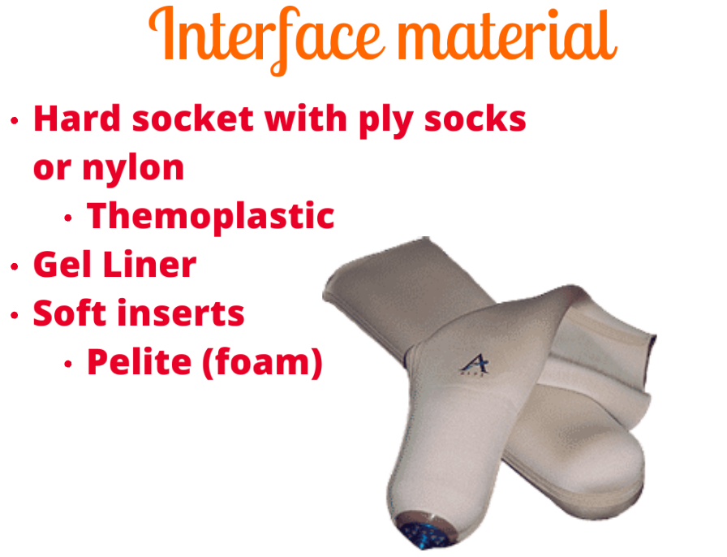
Protetika
Construction – stump bed

Slide 17
Protetika
Stump moulding – stump bed

Slide 18
Protetika
Production – stump bed – negative positives

Slide 19
Protetika
Production – stump bed – silicone/rubber, thermoplastic

Slide 20
Prosthetics
Production – stump bed – exarticulation in the hip

Slide 21
Prothetics
Production – stump bed – exartulation in the hip

Slide 22
Prosthetics
Production – stump bed – exarticulation in the hip

Slide 23
Prosthetics
Construction – module

Slide 24
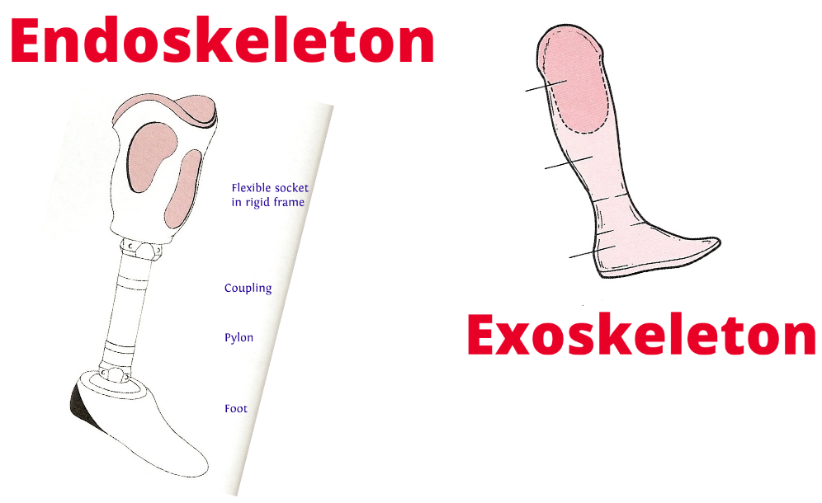
Prosthetics
Construction Module

Slide 25
Prosthetics
Rehabilitation
Training the seat
Proprioception
Work out
Coordination of movement
Walk
Stay in the inpatient department

Slide 26
Prosthetics
Prosthesis of the upper limb
Cosmetic
Cosmetic with mechanical hand
Bioelectric prosthesis

Slide 27
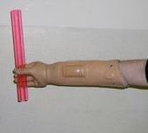
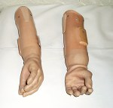
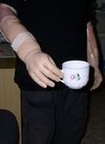
Prosthetics
Prostheses of the upper limb
Cosmetic
Cosmetic with mechanical hand
Bioelectric prosthesis

Slide 28
Orthosis
doctrine on the replacement of lost body functions
Weakened or lost function
Brace:
  serial or individual
  torso or limbs

Slide 29
Orthosis
doctrine on the replacement of lost body functions
Static:
  Solid without movement, relieve pain, stabilize the limb
Dynamic:
  Controlled movement, replace lost or weakened functions of muscles and joints

Slide 30
Orthosis
And parts of them
Splints
Joints
Calipers
Strokes
Pelotons
Auxiliary parts (sleeves)

Slide 31
Orthosis
doctrine on replacing lost body functions
  Brace:
  serial or individual
  torso or limb
  fixation (restrict movement)
  corrective (adjusting position)
  extension (straighten ing the limb)
  leveling (mechanicallength)
  support (reliever from load)
  for work
Dynamic
Static

Slide 32
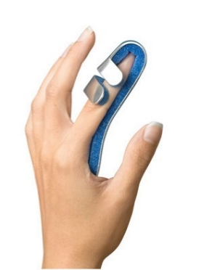
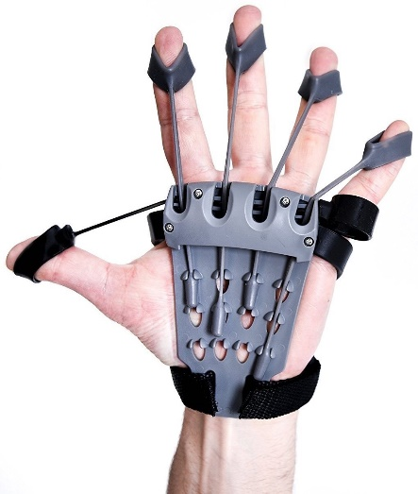
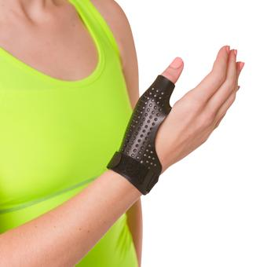
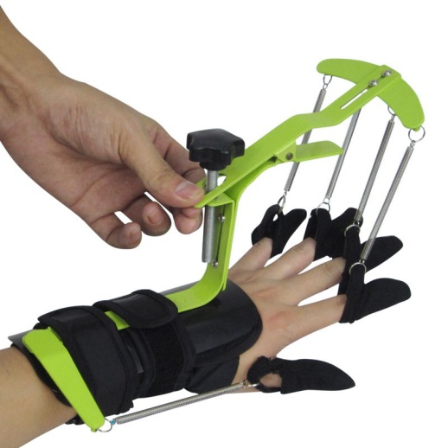
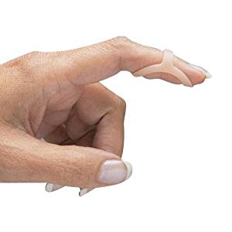
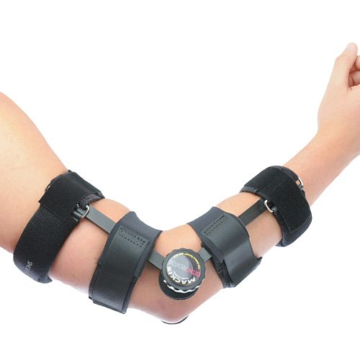
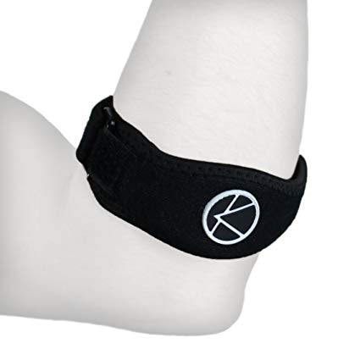
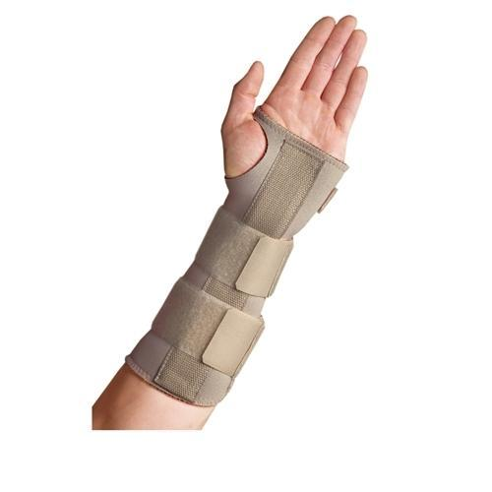
Orthosis
Upper limbs
Finger brace
  Dynamic: Flexible strokes
  Static
Wrist/forearm:
  Rigid
  Semirigid
Forearm:
  epicondylitis
  elbow

Slide 33
Orthosis
Upper limbs

Slide 34
Orthosis
Pain shoulder syndrome
Tendosynovitis capitis longi m. bicipitis brachii
Rupture of the tendon long head of the biceps
Bursitis subacromialis
Tendinitis m. supraspinati
Rupture of the rotator cuff
Impimgement shoulder syndrome
Frozen shoulder syndrome
Arthrosis art. glenohumeralis
Affective acromioclavicular joint
Inflammation
Tumors
Trauma
Pain transferred from another place
Postoperative treatment

Slide 35
Orthosis
Shoulder joint
  Orthopedic surgery:
  Arthroscopy:
    SLAP lesions
    Rotator cuff repair
    SA decompression
  Endoprosthesis:
    hemiarthroplasty
    Rev TSR
    TSR
  Traumatology:
    ORIF
    IM nail
  Brace:
  Arthroscopy:
    Desault 4 – 6 weeks
    Abduction orthosis
    Scarf hinge
  Endoprosthesis:
    No fixation/DO
    No fixation/DO
    No fixation /DO
  Traumatology:
    No fixation 90% ORIF performance
    Conservative Therapy: DO/AD
    Individual orthosis and splints
    Scarf hinge

Slide 36
Orthosis
Shoulder joint
Desault Orthosis
fixation for 4 – 6 weeks
a) active exercises of fingers, wrists
b) passive and later active elbow movement
b1) (arm in internal rotation!)
c) isometry of arm muscles in the orthosis
d) adjustment of the posture
Abduction splint/orthosis
fixation 4 – 6 weeks
a) active exercise of fingers, wrists
b) passive and later active elbow movement
c) modification of the posture

Slide 37
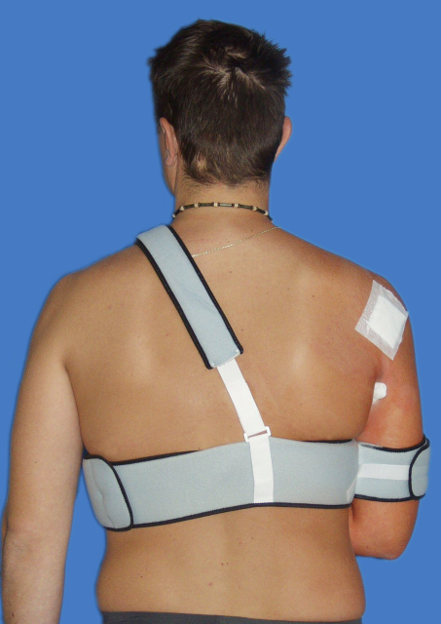
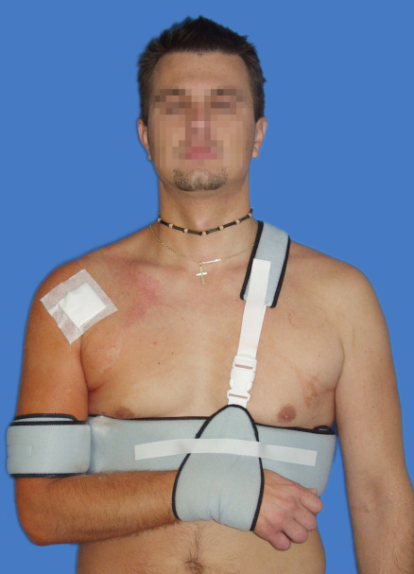
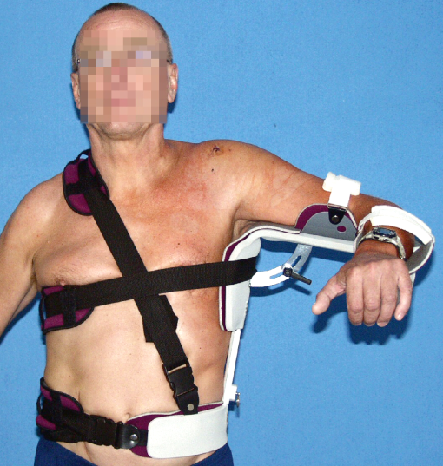
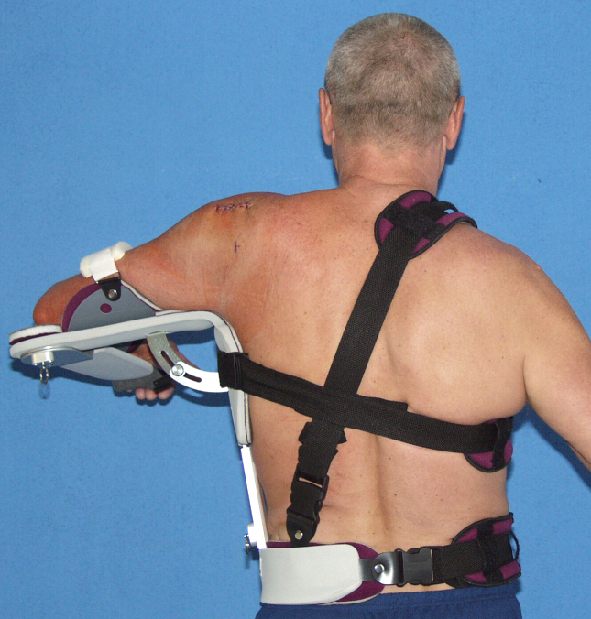
Orthosis
Shoulder joint
Desault Orthosis
Abduction splint/orthosis

Slide 38
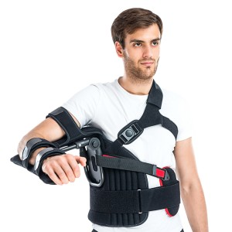
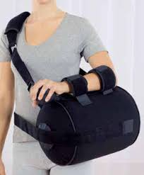
Orthosis
Shoulder joint
Desault Orthosis
Abduction splint/orthosis

Slide 39
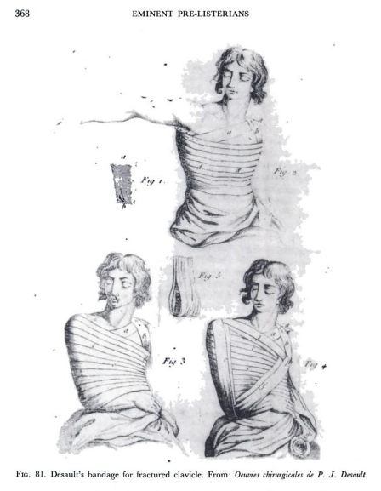
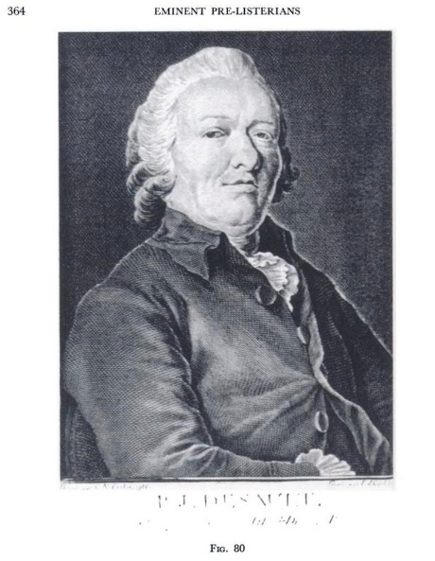
Orthosis
Pierre-Joseph Desault
Pierre-Joseph Desault
  6 Feb 1738 – 1 June 1795
  France
  Anatomy/surgeon

Slide 40
Orthotics
Lower limb

Slide 41

TLSO brace
Types and clinical use

Slide 43
Prosthetics
Prosthetics - doctrine on the replacement of lost parts of the body
Orthotics - doctrine on the replacement of lost body functions
Epithetics - doctrine on cosmetic cover of the body part
Kalceotika - doctrine of orthopedic shoes
Adjuvatics - doctrine of aids

Slide 44
Korzetoterapie
Stop/mitigate the progression of spinal deformity
Maintain steady position of the fuselage
NMS sometimes questionable and problematic

Slide 45
Differential diagnosis of pathologies
etiology: physical, chemical, biological and in particular genetic and multifactorial
Trauma
Radiotherapy
Postural
Laminectomy
Osteoporosis
Osteomalacia
Achondroplasia, Mucopolysaccharides
Oncology
Infectious causes
M Bechterev
M Scheuermann
PHYSICAL INFLUENCES
CHEMICAL INFLUENCES
BIOLOGICAL INFLUENCES
Injuries
Iatrogenic causes
Faulty posture
Muscle dysbalance
Hormone/Corticoid Therapy
Menopausa
Genetics
Combination of influences
Congenital kyphosis – disorders of segmentation and formation
Neuromuscular kyphosis
Degenerative changes

Slide 46
Conservative treatment of trauma
A) Rest
B) Collars:
  soft/molitan
  Philladephia

Slide 47
Conservative treatment of trauma
rest
C: Halo traction

Slide 48
Conservative treatment of trauma
Rest
Th fracture: Jewet's brace/TLSO
Th-L fracture: Jewet's brace, lumbar belt

Slide 49
Conservative treatment of trauma
Plaster TLSO: not adequate in traumatology these days

Slide 50
Conservative treatment of trauma

Slide 51
Corsetotherapy
Indications:
  Scoliosis: Congenital, Idiopathic, Neuromuscular, Degenerative
  Traumas: primarily, event. postoperative treatment
  Oncology: primarily, event. postoperative treatment
Degeneration: postoperative treatment
Objective: stabilization, correction

Slide 52
Principle of three-point fixation
Pelvic belt – neck circle – side pressure pellets
Primary forces:
  acts indirectly on the spine through surrounding structures
  axis: tensile – for deformity in the sense of stretching: pelvis – cervical pelotes
  sides: pressure – through the rib cage by pressure on the vertebra
Milwaukee Brace
Thorakolumbosacral orthosis (TLSO)
Two-part cervikothoracolumbusal orthosis (CTLSO).
Carlson and Payette (2017) braces supporting sed

Slide 53
Principle of three-point fixation
Milwaukee Brace (May & Lockard, 2011)

Slide 54
Principle of three-point fixation
Thorakolumbossacral orthosis (author unknown, 2018)

Slide 55
Principle of three-point fixation
Thoracosocal corset of synthetic material

Slide 56
Principle of three-point fixation
Sample sit-supporting orthosis supplemented with additional compensatory aids (Carlson &amp; Payette)

Slide 57
Morbus Scheuermann
Holger Werfel Scheuermann (1877-1960) - Dánsko - 1920 osteochondritis deformans juvenilis dorsi
Abnormal increase in lower thoracic kyphosis in puberty with rigidity and typical X-ray changes (ASCANI and co. 1985)
Disparity between growth hormone production and sex hormones with vertebral fragility (Bradford 1985)
The cause is not yet fully known
Genetics/Multifactorial

Slide 58
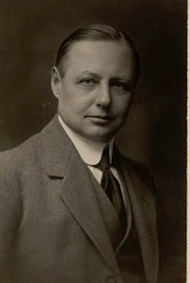
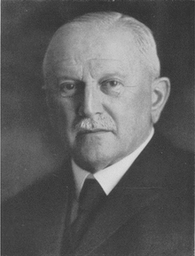
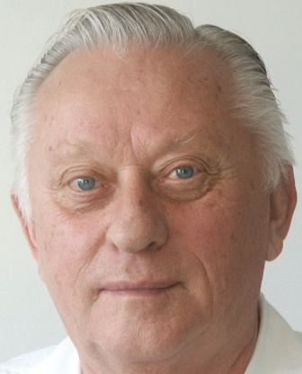
Epidemiology and Etiology
Morbus Scheuermann
Aseptic necrosis of the vertebrae (Scheuermann 1920)
Herniation of discs into vertebrae (C.G. Schmorl 2 May 1861 – 14 August 1932 1930)
Mechanical overload ("apprentice's back," Mau 1927, Keim 1975)
Hereditary talents (Sörensen 1964, prof. Vlach a spol. 1990 – 36%)
Hormonal influences (Ipolito 1981)
0.5 - 8 % of the population
More often boys (but 612, Ž:M 1,2:1; ORTK FN, odb.as.Filipovič 2001)
Age 12-18 years
Enchondral ossification disorder
More often lower thoracic spine

Slide 59
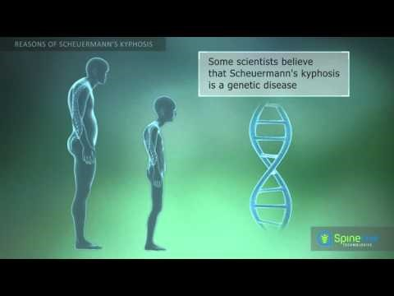
Epidemiologie a etiologie
Morbus Scheuermann youtube

Slide 60
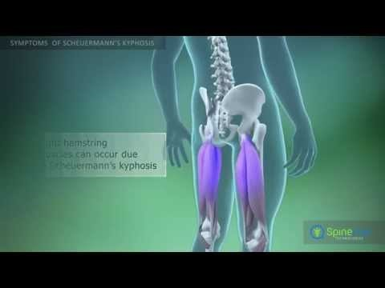
Epidemiologie a etiologie
Morbus Scheuermann youtube

Slide 61
Epidemiology and Etiology
Morbus Scheuermann in literature
„…autosomal genetic component of high penetrance and variable expressivity, with 74% heredity…“
Damborg F, Engell V, Andersen M, Kyvik KO, Thomsen K. Prevalence, concordance, and heritability of Scheuermann kyphosis based on a study of twins. J Bone Joint Surg Am. 2006;88(10):2133–2136
„….Its origin has been associated with avascular necrosis of the epiphyseal rings….“
Scheuermann HW. Kyphosis dorsalis juvenilis. Orthop Chir. 1921;41:305–317
„…juvenile osteoporosis…“
Gilsanz V, Gibbens DT, Carlson M, King J. Vertebral bone density in Scheuermann disease. J Bone Joint Surg Am. 1989;71(6):894–897
Lopez RA, Burke SW, Levine DB, Schneider R. Osteoporosis in Scheuermann's disease. Spine. 1988;13(10):1099–1103
„…shortening of the ischiotibial musculature…“
Lopez RA, Burke SW, Levine DB, Schneider R. Osteoporosis in Scheuermann's disease. Spine. 1988;13(10):1099–1103
„….mechanical factors that would trigger secondary remodelling responses, such as reduction of sternal size…“
Sorensen KH. Scheuermann's Juvenile Kyphosis: clinical appearances, radiography, aetiology and prognosis. Munksgaard; Copenhagen: 1964.
Ferguson AB., Jr The etiology of preadolescent kyphosis. J Bone Joint Surg Am. 1956;38(1):149–157

Slide 62
Clinical examination
Round back at the bottom t8-9 (48%)
Thoracic or lumbar spine pain (28%)
Rigidity of deformity
Scoliosis in 49%
Muscle dysbalance "texas attitude"
Reflective changes in soft tissues
Positive tests (Matthias, Frank, hyperextion)

Slide 63
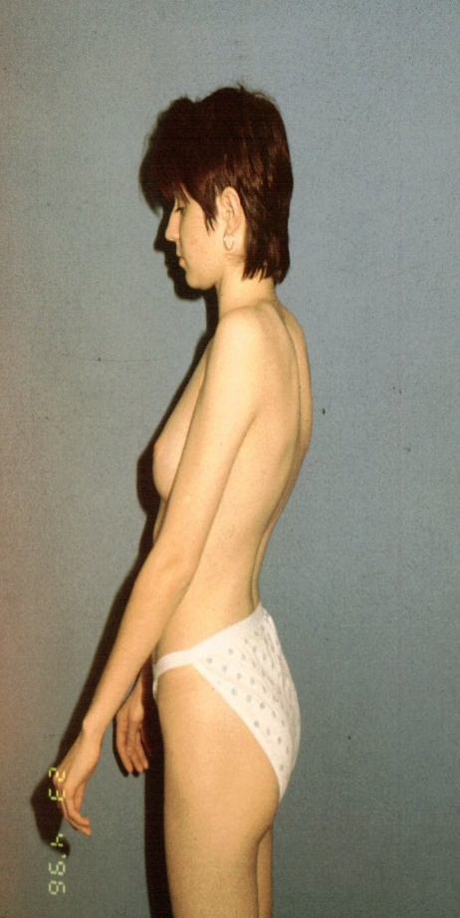
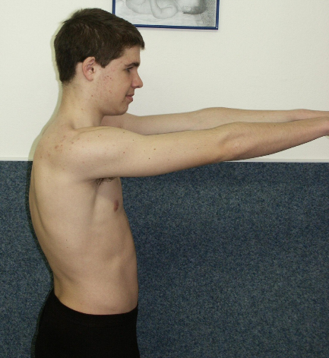
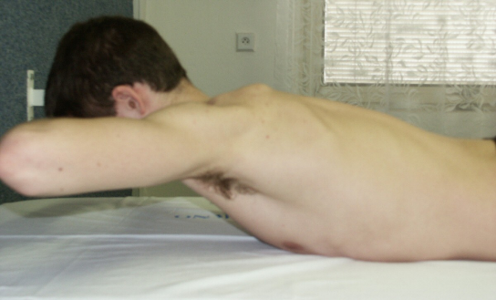
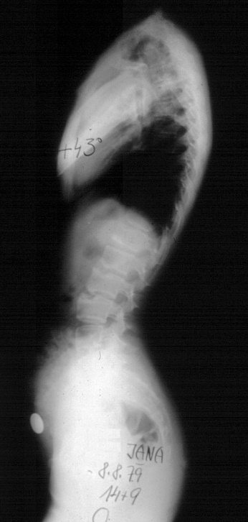

Clinical examination
Matthias
hyperextension
Franke

Slide 64


Clinical examination

Slide 65

Morphology
Histology, X-ray, CT, MRI
C lordosis, Th kyphosis, L lordosis
Th kyphosis: 20° - 40° (< 20° hypo; > 45° hyper)
Radiological criteria according to Bradford 1985:
Chest kyphosis above 40° according to Cobb
Vertebral wedges above 5° (43% in 3 vertebrae)
Unevenness of covering surfaces and disc narrowing
Stretching of vertebral bodies
Schmorl nodes (up to 42%)

Slide 66


Histology

Slide 67

Xrays
AP + side long formats
re-evaluation
We measure:
  Cobb angle T3/4 – T12
  reclination
  SVA
  PT, PI, SS

Slide 68



CT
CT - bone window
fresh Schmorl knot:
  character of osteolysis
  around the edge break
  In addition, STIR MRI
Differential diagnosis!

Slide 69


MRI
old Schmorl's knot:
  Consolidated
  Inactive
fresh Schmorl knot:
  Character of osteolysis
  around the edge break
on T2, better STIR MRI
Differential diagnosis!
T2
T1

Slide 70
Forms Morbus Scheuermann
Typical and atypical
Typical:
  Type I: Th spine only: upper type
  Type II: Th – L Gradient: Lower Type
  Affects the transition of Th and L of the spine
  "Lumbar type" Morbus Scheuermann
  fresh Schmorl's knot
Atypical:
  I. form (vertebrae changes without hyperkyphosis)
  II. form (typical clinic, no significant serious X-ray changes)
  III. form (lumbar localization)

Slide 71
Stages Morbus Scheuermann
early – deformities - consequences
Stage I early on set
  9-12 years, round loose back with pain, muscle changes
Stage II deformities
  13-16 years, stiffness, x-ray changes
Stage III of the consequences
  chronic back pain

Slide 72
Degrees Morbus Scheuermann
Montgomery 1981
Grade I – up to 45° kyphosis
Grade II - up to 55° kyphosis
Grade III - up to 65° kyphosis
Grade IV - 75° and up

Slide 73
Therapy
Conservative
Surgical
Exercising
orthosis and exercises
antigravity plaster corset followed by orthosis and LTV
"Lyon method" De Mauroy and Stagnar´s 1978
Indications:
  Absolute:
    neurological deficiency (extremely rare)
  Relative:
    Rigid deformity above 70°
    Pain
    Cosmetics
    Posterior spondylodesis
    SPO/PSO
Notes:
Scientific Exercise Approach to Scoliosis (SEAS)
SEAS je metodika rozvíjená především ve Spojených státech amerických.
Vychází z Lyonské metody (Francie). Její vývoj a průběžné změny jsou založeny na nejnovějších vědeckých poznatcích a medicíně založené na důkazech. Základním principem je aktivní auto-korekce ve třech rovinách. Přístup terapeutů k pacientům je tzv. kognitivně-behaviorální, což zahrnuje především práci s rodinou pacienta. Cílem je vstoupit do řetězce posturálně patologických funkcí, vytvořit „novou posturu“. Autoři zdůrazňují rozdíl mezi nastavením postury (s aktivací autochtonní muskulatury) a aktivní redukcí křivky (pomocí svalů na konvexní či konkávní straně). První způsob, který využívá SEAS, vyžaduje přestavbu 40 motorických programů v CNS. Druhý způsob pracuje na periferii, využívá jej například metoda Schrothové (Negrini et al., 2007).
Cílem využití SEAS v dospělosti je redukce posturálního kolapsu, zlepšení
posturální kontroly a stability páteře. V polohách aktivní auto-korekce pacient posiluje svaly trupu, trénuje rovnováhu, provádí dechová cvičení (Negrini et al., 2007). Autoři této metody uvádí vysokou úspěšnost: SEAS podle nich redukuje potřebu léčby korzetem, snižuje Cobbův úhel, zlepšuje rovnovážné reakce a koordinaci a napomáhá lepší funkci korzetu, pokud je nošen.
Účinnost metody vyplývá z výzkumu, který provedla společnost ISICO
(l'Istituto Scientifico Italiano Colonna Vertebrale) u dospělých pacientů s křivkami nad 30° podle Cobba. Počáteční průměrná progrese křivky 0,84° za rok se po pěti letech terapie snížila na 0,47° za rok. Během prvního roku se navíc objevilo výrazné snížení Cobbova úhlu, u pacientů se zlepšila stabilita. Tyto výsledky autoři připisují odstranění posturálního kolapsu (Negrini et al., 2007).

Slide 74

Conservative practices

Slide 75




Conservative practices
Exercise + corztotherapy
Physical treatment
Stop: competitive sport
Stop: heavy loads
NSAIDs, analgesics?
Myorelaxantia?
Modified Milwaukee Orthosis (Hudeček- Wernio – Nobility 2004)

Slide 76




Antigravity – plaster - corset

Slide 77
Rehabilitation and prosthetics
23h/16h night mode, „NO“ night mode, intense, daily exercise
Exercising
Physical treatment
Prohibition of competitive sport
Prohibition of heavy loads
NSAIDs, analgesics
Muscle relaxants
Anti-gravity brace

Slide 78
Rehabilitation and prosthetics
23h/16h night mode, „NO“ night mode, intense, daily exercise
Individual LTV + instruction
Individual + special techniques (Brunkow, Brügger, Klapp and others)
Group and Motivational (swimming, hippotherapy, dancing)

Slide 79

Rehabilitation and prosthetics
Brunkow

Slide 80


Rehabilitation and prosthetics
Brügger

Slide 81


Rehabilitation and prosthetics
Brügger

Slide 82


Rehabilitation and prosthetics
Klapp
Notes:
Klappovo lezení
Metoda podle německého ortopeda Rudolfa Klappa je založená na kvadrupední
lokomoci. Dnes se v terapii skolióz využívají spíše jednotlivé prvky. Její základy patří
do základního vzdělávání fyzioterapeutů (Pavlů, 2003). Podle Koláře se dnes do konceptu integrují také poznatky z vývojové kineziologie (Kolář, 2003).
Základní myšlenka říká, že při chůzi čtvernožců dochází k příznivým pohybům
páteře, a že u těchto zvířat se skolióza téměř nevyskytuje. Cvičí se lokomoce po
čtyřech končetinách, což vede k mobilizaci páteře v prostoru. Dále trénujeme svalovou sílu, koordinaci a vytrvalost. Původní indikací jsou idiopatické skoliózy, metodu s úspěchem použijeme i v terapii poruch držení těla. Kontraindikací je postižení končetin, které nedovoluje jejich zátěž (Pavlů, 2003).
Využívají se prvky zkřížené i mimochodní kvadrupední lokomoce. Pohyb musí
začínat v přesně individuálně nastavené atitudě, měl by být pomalý a plynulý. Dále se
využívá tlaku do končetin s jejich současnou mírnou zevní rotací a abdukcí
(centrované postavení kořenových kloubů). Důležitý je dechový stereotyp,
protahování a automobilizace páteře (Kolář, 2003).
Klappovo lezení bylo přizpůsobeno zejména dětským pacientům, napovídají
tomu i názvy jednotlivých cviků – zaječí skok, pavouček, plížení atd. Přesto se
domníváme, že jednotlivé prvky můžeme s výhodou zařadit i do terapie dospělých,
zejména v mladším středním věku, kdy je možné zvládnout posturálně náročné pozice.

Slide 83

Complications of conservative therapy
Patient and parents
CAST SYNDROME!!!
Care for antigravity corset (exanthema, decubitus)
Long-term treatment
Small cooperation in puberty
Little motivation
Lifestyle
Assessment problems:
improved with the abolition of compulsory military service
the most common cause of the "blue book"

Slide 84

Complications
CAST SYNDROME = ACUTE CONDITION = THERAPY IMMEDIATELY
SMAS= superior mesenteric artery syndrome (mesenteric artery syndrome)
dilation of the stomach with partial or complete obstruction of the duodenum
Conservative therapy: castings, plaster corsets, corsets:
in all patients with mesenteric artery syndrome
NSG (nasogastric decompression), pharmacological treatment: Metoclopramid i.v.
Positioning: left, knee-to-chest position or Goldthwaite maneuver
Enteral nutrition using a double lumen tube, soyurally guided distal to obstruction under fluororoscopic assistance
Surgical therapy:
Failure of conservative treatment = surgical intervention:
duodenojejunostomy or gastrojejunostomy to bypass obstruction or duodenal derotation altimeter
mobilization of duodenum by laparotomy or laparoscopy
duodenojejunostomiestomy rarely
Pathophysiology:
compression of the duodenum between the upper mesenteric artery forward and the aortic and spine at the back.
obstruction may occur within a few hours to days after surgery or casting or plaster corset or may not develop for several weeks.

Slide 85







Surgical theatment
Late, severe diagnosis
Posterior spondylodesis
Osteotomy: SPO/PSO
+ treatment in TLSO

Slide 86


Surgical therapy
Smith-Petersen osteotomies

Slide 87




Surgical therapy
Cantilever maneuver

Slide 88





Surgical therapy
Xrays Follow ups (16y + 2m)

Slide 89





Surgical therapy
XR FU (17y + 3m)

Slide 90
Faulty posture
Most common
It arises with muscle imbalance, lack of exercise and „sitting“ lifestyle.
Poor musculature of the back and abdominal.
Increased lumbar lordosis and thoracic kyphosis
Treatment:
  "Good lifestyle"
  Regular exercises of back and abdominal muscles
  Endurance
  Physiotherapist

Slide 91

Faulty posture
BMI a „bad posture“?
Zdroj: http://www.szu.cz/uploads/documents/chzp/odborne_zpravy/OZ_16/OZ_BMI_VDT.pdf
Výsledky studie „Zdraví dětí 2016“ Tělesná hmotnost a vadné držení těla

Slide 92

Faulty posture
Zdroj: http://www.szu.cz/uploads/documents/chzp/odborne_zpravy/OZ_16/OZ_BMI_VDT.pdf
Výsledky studie „Zdraví dětí 2016“ Tělesná hmotnost a vadné držení těla

Slide 93


Faulty posture
Zdroj: http://www.szu.cz/uploads/documents/chzp/odborne_zpravy/OZ_16/OZ_BMI_VDT.pdf
Výsledky studie „Zdraví dětí 2016“ Tělesná hmotnost a vadné držení těla

Slide 94
Evaluation morbus scheuermann
adolescent damage to the spine with lifelong consequences
requires 100% cooperation between patients and families
Conservative therapy: in combination treatment with orthosis and rehabilitation
Surgical therapy: Dpt of Orthopaedic Surgery UniHospital Brno

Slide 95
Evaluation morbus scheuermann
Exercise: affecting up to 5%
TLSO braces: up to 30% influence
Operation: today over 70%

Slide 96






Case report – JH 1997

Slide 97






Case report – JH 1997
06/2011
06/2011
04/2012
10/2012
03/2013
05/2013

Slide 98


Case report – JH 1997
05/2013
10/2013

Slide 99


Case report – AF 1999

Slide 100

Case report– AF 1999
11/2012
11/2012
01/2013
01/2013

Slide 101

Case report – AF 1999
11/2012
11/2012
01/2013
01/2013

Slide 102

CR – AF 1999
06/2013
01/2014

Slide 103




CR – RS 1999

Slide 104


CR – RS 1999

Slide 105




CR – RS 1999

Slide 106

CR – RS 1999

Slide 107
Epithetics
doctrine on cosmetic cover of the body part
Replacement of lost, undeveloped or atrophied body parts

Slide 108
Epithetics
3D
In the abode of paired organs, parts (ears, fingers, amputation of the foot)
Skenner: sensing – CAD - positives
Maxillacafacial epithesis (Bibb et al.)
Design Covers - SLS (Selective Laser Sintering)

Slide 109
Calceotics
orthopedic shoe doctrine
Specially adapted shoes

Slide 110
Calceotics
orthopedic shoe doctrine
Features of orthopedic shoes:
1. Relief
2. Correction of defective position
3. Immobilization

Slide 111
Calceotics
orthopedic shoe doctrine
Types of orthopedic footwear:
Medical shoes
Customized ready-made shoes
Orthopedic shoes
Diabetic shoes

Slide 112
Calceotics
orthopedic shoe doctrine
Part:

Slide 113
Calceotics
doctrine on orthopedic shoes
To make a copy:
1. Sew the upper according to the hoof
2. Drawing of the tensioning insole
3. Tensioning the upper through the insole
4. Sticking the upper to the insole
5. Making a frame circling the entire insole
6. Knob workmanship – reinforcement
7. Soiling
8. Sticking soles and heel: A-measures, B-sides, C-tuna, K-hoof

Slide 114
Calceotics
Shoe shapes
A- high boots
B-shoe
C- ankle shoe
D-half-shoe
E- „perka“
F- boots

Slide 115
Calceotics
Principles of children's shoes
1. The correct size. Front of the tip of at least 1 cm of free space
2. Shoes with wider forefoot
3. Flexible in the centre of the foot
4. A solid abbot that holds the heel well
5, Barefoot….

Slide 116
Calceotics
vložky
1. Insoles
2. Three-quarter
3. Heel heels
4. Hearts
1. Stiff
2. Soft
1. Active
2. Passive

Slide 117
Calceotics
Inserts
Shell inserts
Helfet heel insert

Slide 118

Calceotics
3D

Slide 119
Calceotics
Concealers, heel-heels
heels
concealers

Slide 120
Adjuvatics - aids
teaching on operator aids
Disabled persons and daily tasks
locomotive, hygiene and self-sufficiency, safety
practical and graphomotor activities
Sports

Slide 121
Adjuvatics
teaching of operator aids
Immobile patients, wheelchair users, seniors
Long-term bed treatment
After demanding orthopedic – surgical procedures

Slide 122
Adjuvatics
teaching of operator aids
positioning and fixing
for locomotion, its training and compensation
Hygiene
facilitating the performance of practical activities
for the implementation of leisure, work activities

Slide 123
Adjuvatics
positioning and fixing
position optimisation, verticalization of persons with impaired momentum
equipped with a controller to adjust the necessary height and slopes

Slide 124
Adjuvatics
positioning and fixing
Positioning wedges, tubes:
  Fixation lying on the back, side, abdomen
  Rotation of positions and 30min, prevention of dekubitus
Brace:
  Stabilization of posture, spine, chest and joints
Seats:
  Specially adapted, adjustable
  Safe seat, headrest

Slide 125
Adjuvatics
positioning and fixing
Positioning, verticalizing stands:
Fixation in the areas of the feet, calves, knees and thighs, pelvis, hips and hare
+ working stations
Sliding plate:
Makes it easy to move from trolley to bed or car

Slide 126
Adjuvatics
For locusming, practicing and compensating
Medical strollers:
For children of early age
Combination with duct wedges, backrests, tables ap
Rehabilitation carts:
according to the drive - mechanical x electric
according to the environment - interior x exterior
by age - for children, young people and adults
according to construction - fixed x folding
according to the purpose - standard x special (sports, hygienic, transport).

Slide 127
Adjuvatics
Rehabilitation trucks – mechanical: activating, mechanical, multi-blow, for hemiparetics, amelia, dysmels

Slide 128
Adjuvatics
Special sports carts: basketball, rugby, tennis, bencykl

Slide 129

Adjuvatics
For sports: handbike, monocross, monoski

Slide 130
Adjuvatics
Limb movement trainers, e.g. after operations
Motopeds:
Motoding:
Upper limbs
Lower limbs:
Knee and hip joint
Ankle joint

Slide 131
Adjuvatics
Limb movement trainers, e.g. after operations
Climbers: nana for children with cerebral palsy - diparetic form
Walkers: walking practice:
Four-point immobile/mobile
Two-wheeled: mobile
Three-wheeled....

Slide 132
Adjuvatics
Crutches: support function
four-point, French, children's elbow crutches,
armpit, walking sticks
height adjustable, folding outing sticks

Slide 133
Adjuvatics
Overcoming barriers
Stair platforms: oblique, vertical
„stairclimbers“
ramps

Slide 134
Adjuvatics
For hygiene
increase the user's potential in self-service and independence from the assistance of the other person
Jacks, bath/shower seats, toilet trolleys
Attachments, backrests, toilet handles

Slide 135
Adjuvatics
Usnadňující výkon praktických činností
fixing boards, plates
Cutlery, handles
Special knives
Feeders

Slide 136
Adjuvatics
IT
Trackball, mouse
Keyboard

Slide 137
Adjuvatics
IT

Slide 138


Adjuvatics
Smart NAV a 14 Control

Slide 139
Adjuvatics
Strollers, trolleys
Medical strollers:
For children of early age
Combination with abduction wedges, armrests, tables ap
Rehabilitation carts:
according to drive - mechanical x electric
according to the environment - interior x exterior
by age - for children, young people and adults
according to the design - fixed x folding
according to purpose - standard x special (sports, hygienic, transport).

Slide 140

Conclusion

Slide 141


Conclusion

Slide 142



Slide 143



Conclusion
21st century

Slide 144
Source
publikace LF MU, doc. Ivan Müller, CSc., doc. Z. Rozkydal, Internet
BENDOVÁ, P., JEŘÁBKOVÁ, K., RŮŢIČKOVÁ, V. Kompenzační pomůcky pro osoby se specifickými potřebami. Olomouc, 2006. ISBN 80-244-1436-8.
JONÁŠKOVÁ, V. Protetické pomůcky osob s poruchou mobility. In Renotiérová M., Ludíková, L. a kol. Speciální pedagogika. Olomouc: UP, 2006. ISBN 80-244-1475-9.
TŘASOŇOVÁ, Miroslava, LF MU 2005 PPT
http://www.oajl.cz, http:// www.ms-protetik.cz, http:// www.ergon.czm ,http:// www.altech-uh.cz, http:// www.ortoservis.cz, http:// www.zdravotniprodejna.cz
http:// www.medicco.cz, http:// www.meyra.cz, http:// www.dmapraha.cz, http:// www.petit-os.cz
Janíček, P.: Ortopedie. Lékařská fakulta MU v Brně, 2001 Spoluautoři: Dufek, P., Chaloupka, R., Krbec, M.,Poul, J.,Procházka, P., Rozkydal, Z.
Näder, E.M., Näder, H.G., Blomke, F: Otto- Bock Prothesen- Kompendium Prothesen für die untere Extermität. 2. Auflage, Schiele and Schön, 1993.
Otto Bock: Technische Information, 2.3.5. ISNY – Island- Schweden, New York, 1990.
Sosna, A., Vavřík, P., Krbec, M., Pokorný, D.: Základy ortopedie. Triton, 2001.
Fotografie z LAOS (soukromá databáze Jan Kocanda)

Slide 145
Source
1. Scheuermann HW. Kyphosis dorsalis juvenilis. Orthop Chir. 1921;41:305–317.
2. Sorensen KH. Scheuermann's Juvenile Kyphosis: clinical appearances, radiography, aetiology and prognosis. Munksgaard; Copenhagen: 1964.
3. Stoddasd A, Osborn JF. Scheuermann's disease or spinal osteochondrosis: its frequency and relationship with spondylosis. J Bone Joint Surg Br. 1979;61(1):56–58.
4. Taylor TC, Wenger DR, Stephen J, Gillespie R, Bobechko WP. Surgical management of thoracic kyphosis in adolescents. J Bone Joint Surg Am. 1979;61(4):496–503.
5. Ali RM, Green DW, Patel TC. Scheuermann's kyphosis. Curr Opin Pediatr. 1999;11(1):70–75.
6. Bradford DS. Juvenile kyphosis. In: Lonstein JE, Bradford DS, Winter RB, Ogilvie J, editors. Moe's textbook of scoliosis and other spinal deformities. 3rd ed. Saunders; Philadelphia: 1995. pp. 349–367.
7. Damborg F, Engell V, Andersen M, Kyvik KO, Thomsen K. Prevalence, concordance, and heritability of Scheuermann kyphosis based on a study of twins. J Bone Joint Surg Am. 2006;88(10):2133–2136
8. Gilsanz V, Gibbens DT, Carlson M, King J. Vertebral bone density in Scheuermann disease. J Bone Joint Surg Am. 1989;71(6):894–897
9. Lopez RA, Burke SW, Levine DB, Schneider R. Osteoporosis in Scheuermann's disease. Spine. 1988;13(10):1099–1103.
10. Lowe TG. Scheuermann disease. J Bone Joint Surg Am. 1990;72(6):940–945
11. Aufdermaur M. Juvenile kyphosis (Scheuermann's disease): radiography, histology, and pathogenesis. Clin Orthop Relat Res. 1981;(154):166–174.
12. Ferguson AB., Jr The etiology of preadolescent kyphosis. J Bone Joint Surg Am. 1956;38(1):149–157
13. Scoles PV, Latimer BM, Diglovanni BF, Vargo E, Bauza S, Jellema LM. Vertebral alterations in Scheuermann's kyphosis. Spine. 1991;16(5):509–515
14. Bradford DS, Moe JH, Montalvo FJ, Winter RB. Scheuermann's kyphosis. Results of surgical treatment by posterior spine arthrodesis in twenty-two patients. J Bone Joint Surg Am. 1975;57(4):439–448.
15. Murray PM, Weinstein SL, Spratt KF. The natural history and long-term follow-up of Scheuermann kyphosis. J Bone Joint Surg Am. 1993;75(2):236–248.
16. Tribus CB. Scheuermann's kyphosis in adolescents and adults: diagnosis and management. J Am Acad Orthop Surg. 1998;6(1):36–43.
17. Gill JB, Levin A, Burd T, Longley M. Corrective osteotomies in spine surgery. J Bone Joint Surg Am. 2008;90(11):2509–2520
18. Berven SH, Deviren V, Smith JA, Hu SA, Bradford DS. Management of fixed sagittal plane deformity: outcome of combined anterior and posterior surgery. Spine (Phila Pa 1976) 2003;28:1710–1716.
19. Bridwell KH. Decision making regarding Smith-Petersen vs. pedicle subtraction osteotomy vs. vertebral column resection for spinal deformity. Spine (Phila Pa 1976) 2006;31(19 Suppl):S171–S178
20. Lee SS, Lenke LG, Kuklo TR, Valenté L, Bridwell KH, Sides B, Blanke KM. Comparison of Scheuermann kyphosis correction by posterior-only thoracic pedicle screw fixation versus combined anterior/posterior fusion. Spine (Phila Pa 1976) 2006;31(20):2316–2321
21. Macedo RD, Fontes BPC, Cunha FM, Werlang PM. Sistema de parafusos pediculares no tratamento de deformidades vertebrais: Rev Bras Ortop. 2006;41(10):417–424.
22. Suk SI, Kim WJ, Lee SM, Kim JH, Chung ER. Thoracic pedicle screw fixation in spinal deformities: are they really safe? Spine (Phila Pa 1976) 2001;26(18):2049–2057.
23. Kim YJ, Lenke LG, Bridwell KH, Cho YS, Riew KD. Free hand pedicle screw placement in the thoracic spine: is it safe? Spine (Phila Pa 1976) 2004;29(3):333–342.
24. Bradford DS, Ahmed KB, Moe JH, Winter RB, Lonstein JE. The surgical management of patients with Scheuermann's disease: a review of twenty-four cases managed by combined anterior and posterior spine fusion. J Bone Joint Surg Am. 1980;62(5):705–712

Slide 146
Thank you for your attention.
E: kocanda@med.muni.cz
T: 00420 5 3223 3118
M: 00420 774 536 287
UČO: 31182

