Slide 1
Soft tissue trauma
Ligaments (bone to bone)
Tendons (muscle to bone)
Muscle
Fat, joint capsules, other connective tissue…

Slide 2
Common traumas
Sprain
Strain
Contusions
Tendonitis
Bursitis

Slide 3
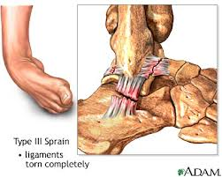
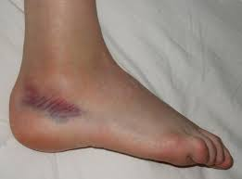
Sprains
Ankle, knee, wrists…
Stretch or complete or
partial tear of a ligament
Over extension
of joint

Slide 4
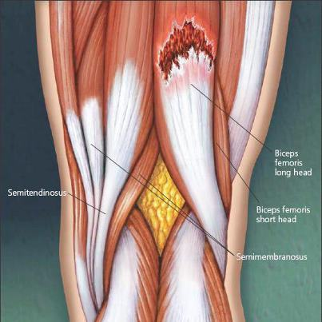
Strains
Equivalent injury of sprain, to a muscle or tendon.
Stretch or complete/partial
tear of a muscle or tendon

Slide 5
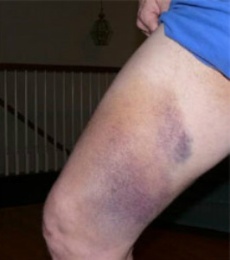
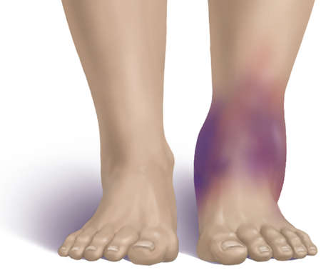
Contusions
Bruise caused by a blow to
muscle, tendon, or ligament.
Blood pools under the skin
leading to discoloration,
swelling and pain.

Slide 6
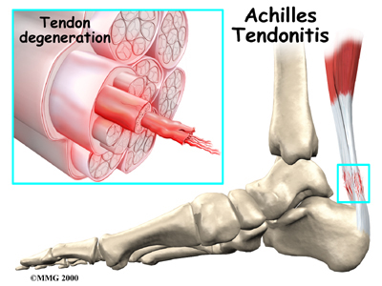
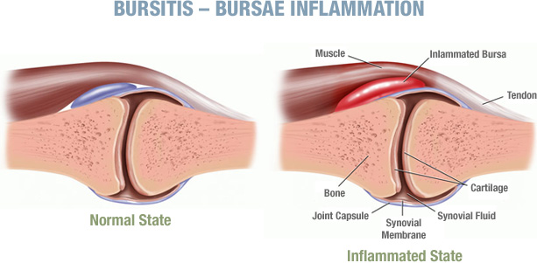
Tendonitis and bursitis
Inflammation
Caused by series of small
stresses (overuse) or injury

Slide 7
Management
Minimize pain, swelling, hemorrhage, inflammation and muscle spasm.
Protection and immobilization of the damaged tissue.
Preventing joint deformity, stiffness, muscle atrophy and tight adhesions.
Eventually controlled mobilization, simulation of activity stress and finally complete recovery.

Slide 8
Management
Immediately after the injury occurs one should apply the PRICE principle to minimize the local tissue damage, prevent further trauma and reduce inflammation.
PRICE stands for: Protection, Rest, Ice, Compression and Elevation

Slide 9
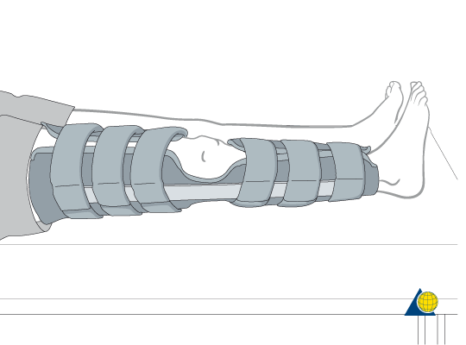
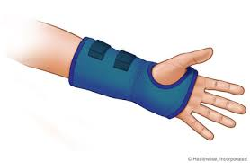
Protection: removing hazards away from the individual and preventing movement (often by splinting)
Rest: avoid activity causing discomfort, usually imobilizing injury area by splinting and casting and avoiding weight bearing by the use of crutches.

Slide 10
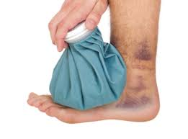
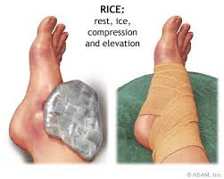
Ice: for the first 72 hours, controls swelling and minimizes pain and inflammation symptoms. Recommended for 15 minutes every 4 hours.
Compression: application of pressure over the injured area. Controls initial bleeding and reduces residual swelling. The bandage should be firm but not so tight as to cause pain.

Slide 11
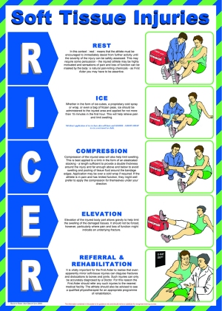
Elevation: also
minimizes bleeding,
swelling and
general inflammation.
Ideally above heart level.

Slide 12
If severe pain persists nerve conduction studies may also be used to localize nerve dysfunction, assess severity and help with prognosis. Electrodiagnosis also helps differentiate between myopathy and neuropathy.
Anti-inflammatory medication may also be used in combination with PRICE.

Slide 13
More severe soft tissue trauma may require surgical intervention:
Repair of torn tissues
Replacement or reconstruction
Reattachment and transposition

